Slide 1

JavaScript
The Language of the Browser

Slide 2
Goal
Not to teach someone who is new to programming but rather get someone up to date with JavaScript practices
Particularly modern features more recently added to JavaScript
Preparing a developer for use of JavaScript within modern frameworks

Slide 3
Creation of Javascript
Created at NetScape by Brendan Eich in 1995
At the time all web pages were static in the browser and JavaScript was created to add dynamic behaviour
Naming has been seen as marketing ploy as Java was a popular language at the time

Slide 4

Node JS
A JavaScript runtime created by Ryan Dahl in 2010
Represents “JavaScript Everywhere” paradigm
Unifies web development by allowing you to use JavaScript for server-side and client-side scripts
Vast amounts of libraries and packages available under NPM

Slide 5
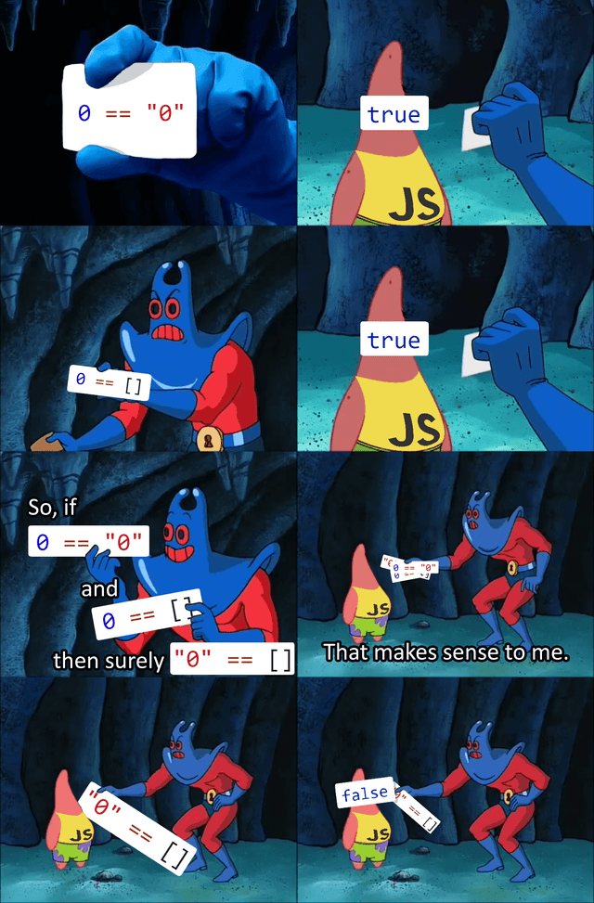
Type Coercion

