Slide 1

React
A JavaScript library for building user interfaces

Slide 2
Goal
Keeping in mind we have a range of experience with React, starting with basic to more complex concepts to try and fill in some gaps in knowledge and give our team a firmer foundation in React for our frontend work
Showcasing some helpful React libraries

Slide 3




Creation of React
Created by Jordan Walke at Facebook in 2011
Open-sourced in May 2013
Contributed to by over a thousand developers
Now used by Netflix, New York Times, Airbnb, Discord etc.

Slide 4
Topics
Create React App
Folders and files
Configuration
Components
onClick
useState
Conditional Rendering
Handling Input
Forms and Input
Data Fetching
Consuming an API
Displaying Fetched Data
React Query
React Router
Creating multiple pages
Dynamic Routing
React Context
Storing local state

Slide 5
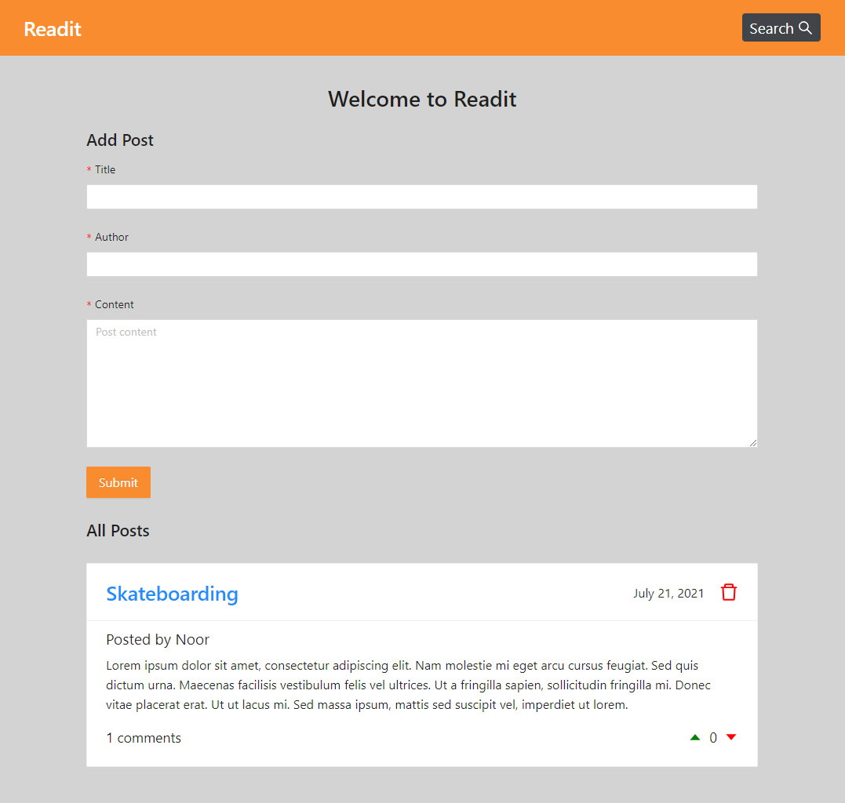
Home Page
Form to add a Post
List of all posts

Slide 6
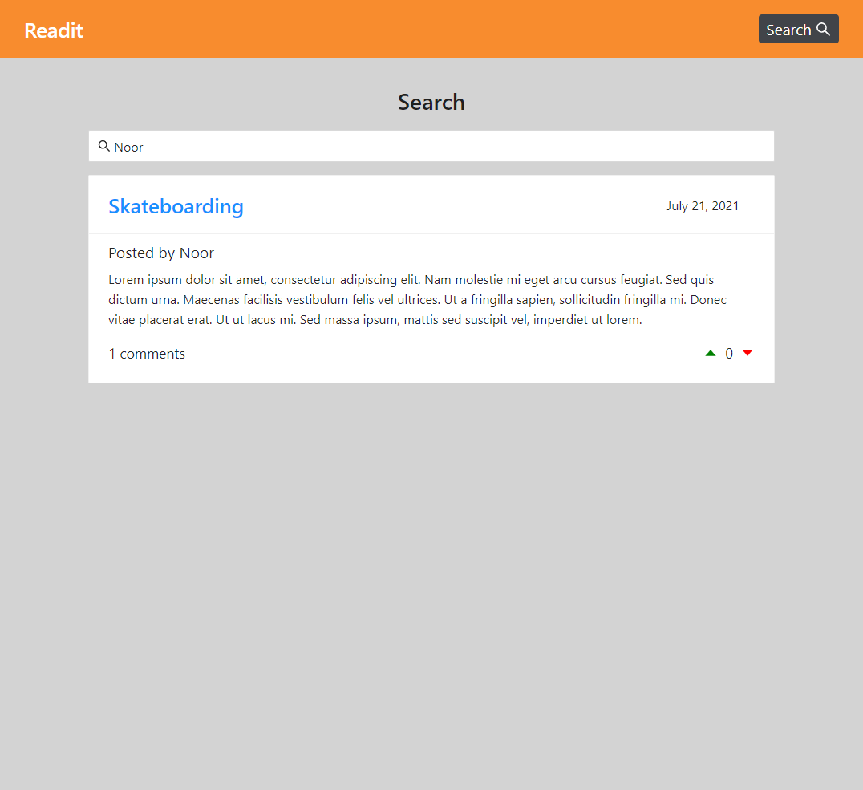
Search Page
Searches by keyword
Shows relevant posts

Slide 7
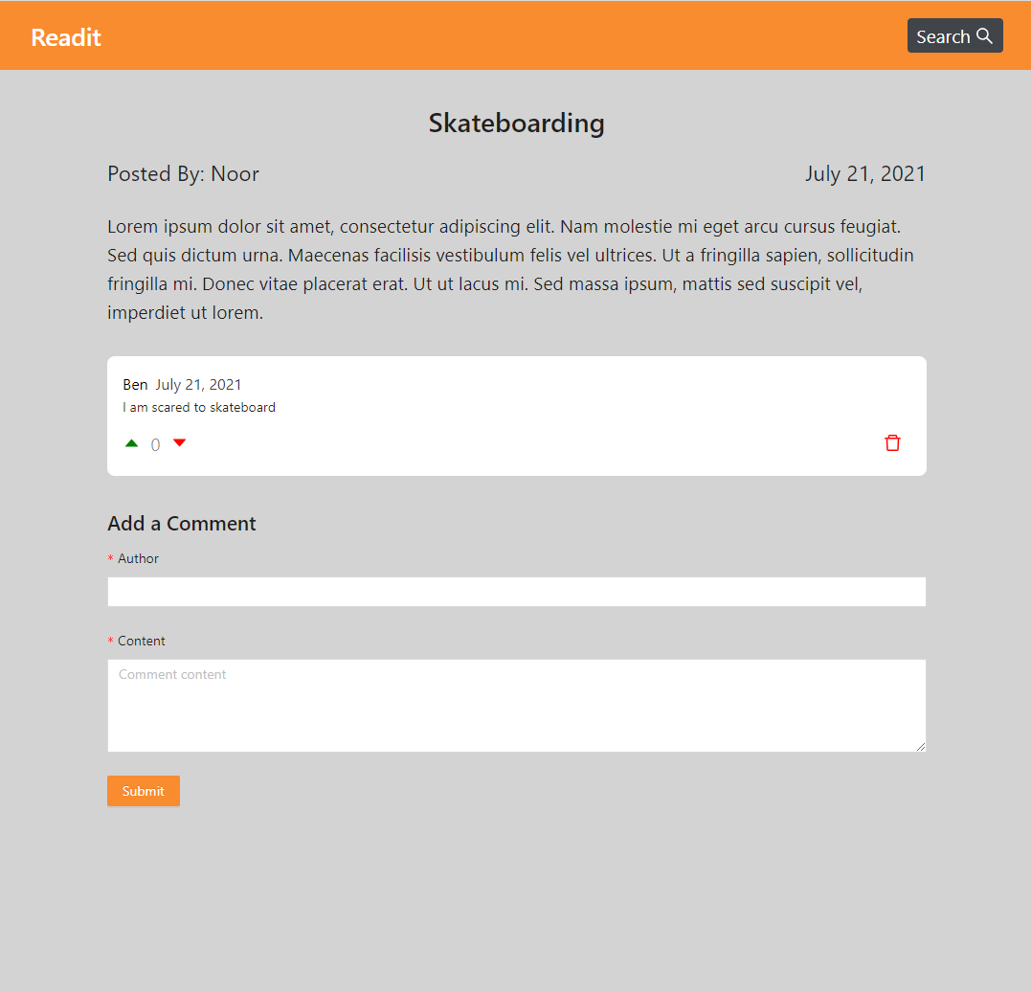
Post Page
Display details of post
Lists comments on post
Form to add a comment

