Slide 1
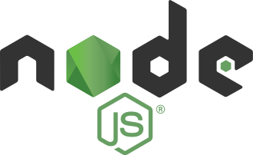
Node js
open-source, cross-platform, JavaScript runtime environment

Slide 2
Welcome to node
Node.js is an open-source, cross-platform, JavaScript runtime environment that runs on the V8 engine and executes JavaScript code outside a web browser.
Written by Ryan Dahl, initially released in 2009
Node.js lets developers use JavaScript to write command line tools and for server-side scripting—running scripts server-side to produce dynamic web page content before the page is sent to the user's web browser.

Slide 3
Rest api
(RESTful API) is an application programming interface (API) that conforms to the constraints of REST architectural style and allows for interaction with RESTful web services.
Representational state transfer
Created by computer scientist Roy Fielding.
an API is a mediator between the users/clients and the resources or web services they want to access (DB, data on server

Slide 4
Rest api cont.
REST is a set of architectural constraints, not a protocol or a standard.
When a client request is made via a RESTful API, it transfers a representation of the state of the resource to the requester or endpoint. This information, or representation, is delivered in one of several formats via HTTP: JSON (Javascript Object Notation), HTML, XLT, Python, PHP, or plain text.
Headers and parameters are also important in the HTTP methods of a RESTful API HTTP request, as they contain important identifier information as to the request's metadata, authorization, uniform resource identifier (URI), caching, cookies, and more.

Slide 5

MongoDb
MongoDB is a document-oriented NoSQL database used for high volume data storage. Instead of using tables and rows as in the traditional relational databases, MongoDB makes use of collections and documents. Documents consist of key-value pairs which are the basic unit of data in MongoDB.
Released in 2009
SQL databases are used to store structured data while NoSQL databases like MongoDB are used to save unstructured data. MongoDB is used to save unstructured data in JSON format. MongoDB does not support advanced analytics and joins like SQL databases support.

Slide 6

Mongoose
Mongoose is an Object Data Modeling (ODM) library for MongoDB and Node. js. It manages relationships between data, provides schema validation, and is used to translate between objects in code and the representation of those objects in MongoDB
A Mongoose model is a wrapper on the Mongoose schema. A Mongoose schema defines the structure of the document, default values, validators, etc., whereas a Mongoose model provides an interface to the database for creating, querying, updating, deleting records, etc.

Slide 7
CRUd operations
CRUD stands for Create, Read, Update, and Delete they are the four basic operations of persistent storage.
The acronym CRUD refers to the major operations which are implemented by databases. Each letter in the acronym can be mapped to a standard Structured Query Language (SQL) statement.
Create: Insert
Read: Select
Update: Update
Delete: Delete
The acronym CRUD also appears in discussion of RESTful APIs. Each letter in the acronym may be mapped to a Hypertext Transfer Protocol (HTTP) method:
Create: Post
Read: Get
Update: Put
Delete: Delete
In HTTP, the GET (read), PUT (create and update), and DELETE (delete) methods are CRUD operations as they have storage management semantics, because they let user agents directly manipulate the states of target resources.

Slide 8
Rest CRUD explained
Post: POST APIs are used to create new subordinate resources, (e.g., a row is subordinate to a database table.) In other words, POST methods are used to create a new resource into a collection of resources. If a resource is successfully created on the origin server, the response has a response code of 201 (Created) and contains an entity which describes the status of the request and refers to the new resource, and a Location header. Many times, the action performed by the POST method might not result in a resource that can be identified by a URI. In this case, either HTTP response code 200 (OK) or 204 (No Content) is the appropriate response status.
Example request URI
HTTP POST http://www.appdomain.com/users
Get: GET requests are used to retrieve resource representation/information only – and not to modify it in any way. As GET requests do not change the state of the resource, these are said to be safe methods. Additionally, GET APIs should be idempotent, which means that making multiple identical requests must produce the same result every time until another API (POST or PUT) has changed the state of the resource on the server. For any given HTTP GET API, if the resource is found on the server, then it must return HTTP response code 200 (OK) – along with the response body, which is usually either XML or JSON content. If the resource is NOT found on server, then it must return HTTP response code 404 (NOT FOUND). Similarly, if the GET request itself is not correctly formed then the server will return an HTTP response code 400 (BAD REQUEST).
Example request URIs
HTTP GET http://www.appdomain.com/users?size=20&page=5

Slide 9
Rest CRUD explained
PUT: PUT APIs are used to update existing resources (if resource does not exist, API may create a new resource or not). If a new resource has been created by the PUT API, the origin server returns an HTTP response code 201 (Created) response and if an existing resource is modified, either the 200 (OK) or 204 (No Content) response codes should be sent to indicate successful completion of the request.
Example request URIs
HTTP PUT http://www.appdomain.com/users/123
DELETE: DELETE APIs are used to delete resources (identified by the Request-URI). A successful DELETE response of the request SHOULD be an HTTP response code 200 (OK), 202 (Accepted) if the action has been queued, or 204 (No Content) if the action has been performed but the response does not include an entity. DELETE operations are idempotent. If you DELETE a resource, it’s removed from the collection of resources. Repeatedly calling DELETE API on that resource will not change the outcome – however, calling DELETE on a resource a second time will return a 404 (NOT FOUND) since it was already removed.
Example request URIs
HTTP DELETE http://www.appdomain.com/users/123

Slide 10
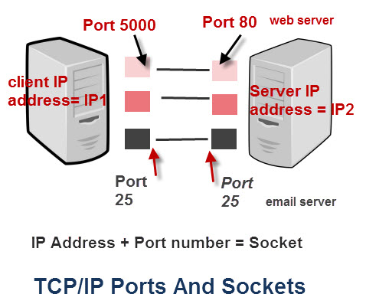
Ips and ports intro
On a TCP/IP network every device must have an IP address.
The IP address identifies the device (computer.)
An IP address alone is not sufficient for running network applications, as a computer can run multiple applications and/or services.
Just as the IP address identifies the computer, The network port identifies the application or service running on the computer.
The use of ports allow computers/devices to run multiple services/applications.

Slide 11
Well known ports
Port numbers 0-1023 These are allocated to server services by the Internet Assigned Numbers Authority (IANA).
Port 21: FTP (file transfer protocol)
Port 22: SSH (Secure Shell Service)
Port 23: telnet service
Port 25: Simple mail transfer protocol (SMTP)
Port 80: HyperText Transfer Protocol (HTTP)
Port 113: Authentication and Ident protocols (AUTH)
Port 115: Secure File Transfer Protocol (SFTP) services
Port 443: Secure Hypertext Transfer Protocol (HTTPS)
And many more (https://web.mit.edu/rhel-doc/4/RH-DOCS/rhel-sg-en-4/ch-ports.html)

