Slide 1

GIT
Distributed Version Control System

Slide 2
What is git
Git is an open-source project originally developed in 2005 by Linus Torvalds.
Git is an example of a DVCS (Distributed Version Control System). Rather than have only one single place for the full version history of the software.
In Git, every developer's working copy of the code is also a repository that can contain the full history of all changes.

Slide 3
Initialize repository
To create a repository, create a directory where your project will reside locally
In terminal (cmd/bash) go to that directory and enter the command git init.
git init:
Creates an empty Git repository - basically a .git directory with subdirectories for objects, refs/heads, refs/tags, and template files.
An initial Master branch without any commits will be created.

Slide 4
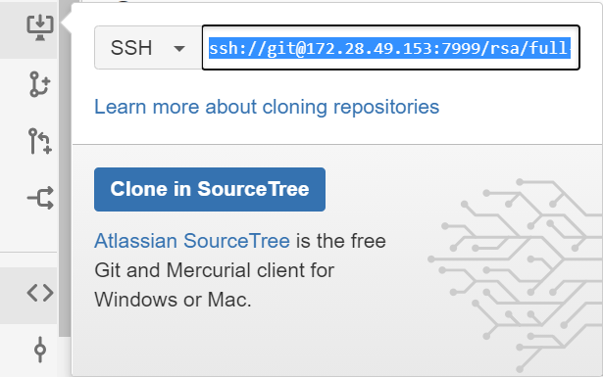
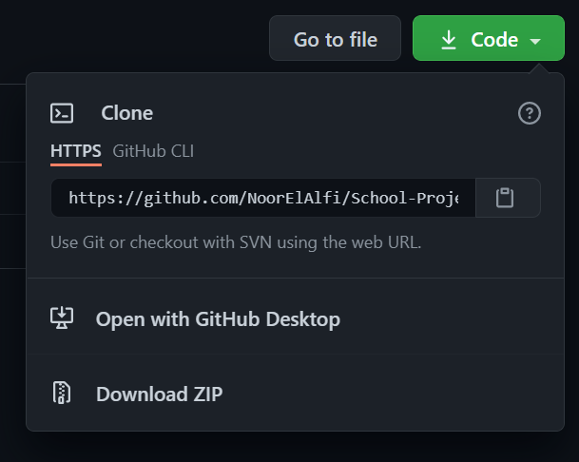
Clone repository
To clone an existing remote repository, you must have the ssh/http/https link. which can be found on the remote repository
In the local directory where the remote repository will reside. Using the terminal run the command git clone.
git clone “ssh/http/https link”

Slide 5
Git ignore
A gitignore file specifies intentionally untracked files that Git should ignore.
Each line in a gitignore file specifies a pattern. When deciding whether to ignore a path, Git normally checks gitignore patterns from multiple sources, with the following order of precedence, from highest to lowest

Slide 6
Pull repository
The git pull command is used to fetch and download content from a remote repository and immediately update the local repository to match that content.
Once the content is downloaded, git pull will enter a merge workflow. A new merge commit will be created, and HEAD updated to point at the new commit

Slide 7
Push Repository
The git push command is used to upload local repository content to a remote repository.
Pushing is how you transfer commits from your local repository to a remote repo.
Steps to push:
git add . : adds all new files and changes to remote repository
git commit -m “enter change message here”: saves your changes to the local repository along with a message that describes the change
git push origin “branch name”: Uploads local repository content to a remote repository. you transfer commits from your local repository to a remote repository.

Slide 8

Git branches
Branching is when you diverge from the main line of development and continue to do work without messing with that main line.
Useful commands
Git branch: shows all branches, and the current branch of the repository
Git checkout “branch name”: Changes current branch to inputted “branch name” branch
git checkout -b “new branch”: creates new branch with name inputted in command

Slide 9
Git branches
Different types of branching
Master: Codebase residing in the master branch considered production ready. When it is ready for a specific release, the latest commit will be given a release tag.
Feature branch : A feature branch is normally created off a develop branch. This feature branch can reside in your local machine throughout the entire development lifecycle of the feature.
Release branch: The release branch is typically created off the develop branch when it's close to being production ready. Only bug fixes and release related issues should be addressed on this branch. Having this branch will allow other team members to continue pushing new features to the develop branch without interrupting the release workflow.
Hotfix branch: When you need to add an important fix to your production codebase quickly, you can create a Hotfix branch off the master branch.
Develop branch: A develop branch should be always kept stable. This is important because new branches are created off this branch, and this branch could eventually go out live on production.

Slide 10
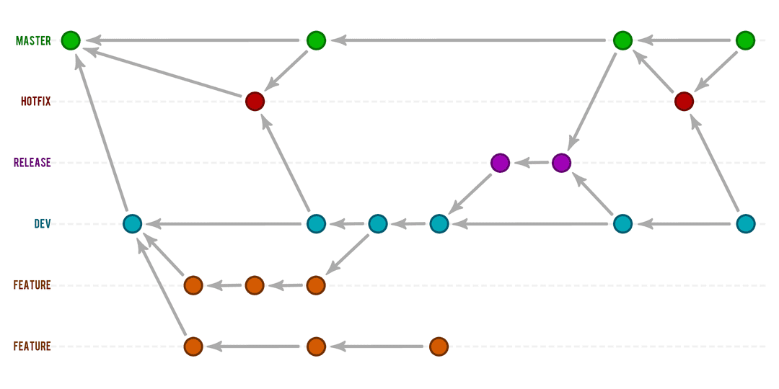

Slide 11
Git merging
Merging is Git's way of putting a forked history back together again. The git merge command lets you take the independent lines of development created by git branch and integrate them into a single branch.
Example flow:
git checkout -b new-feature main # Start a new feature
git add <file> # Edit some files
git commit -m "Start a feature“
git add <file> # Edit some files
git commit -m "Finish a feature“
git checkout main # Merge in the new-feature branch
git merge new-feature
git branch -d new-feature

Slide 12
