Slide 1
Summary of supplemental analyses
Proportion of cells tracked over N days, by condition
Not significantly different between condition (cell_multiday_analysis.ipynb)
Null distribution of cell-type categories
Many more rewarded cells than expected by chance, given definition of category (cell_multiday_analysis.ipynb)
ROC analysis with balanced datasets (roc_multirecording_balanced.Rmd [and helper.R])
92% overlap in responsiveness between balanced and unbalanced sets

Slide 2
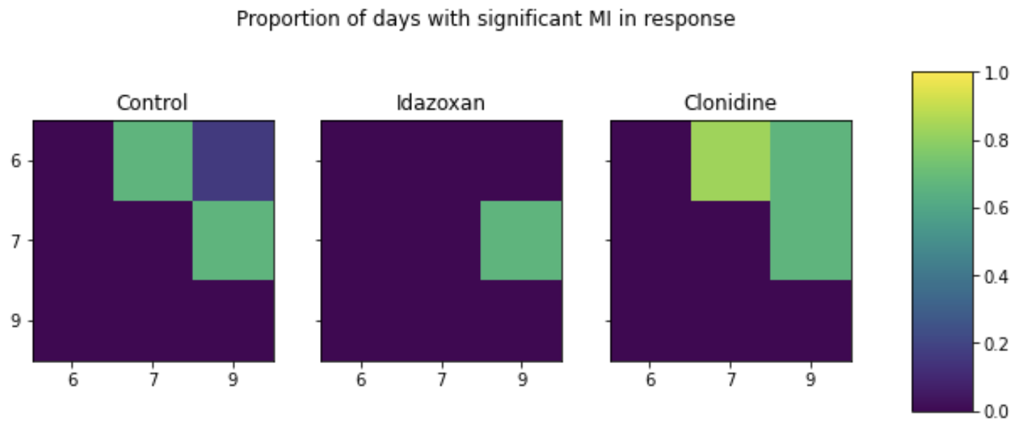
Mutual information with new labels
(mutual_information.ipynb)

Slide 3
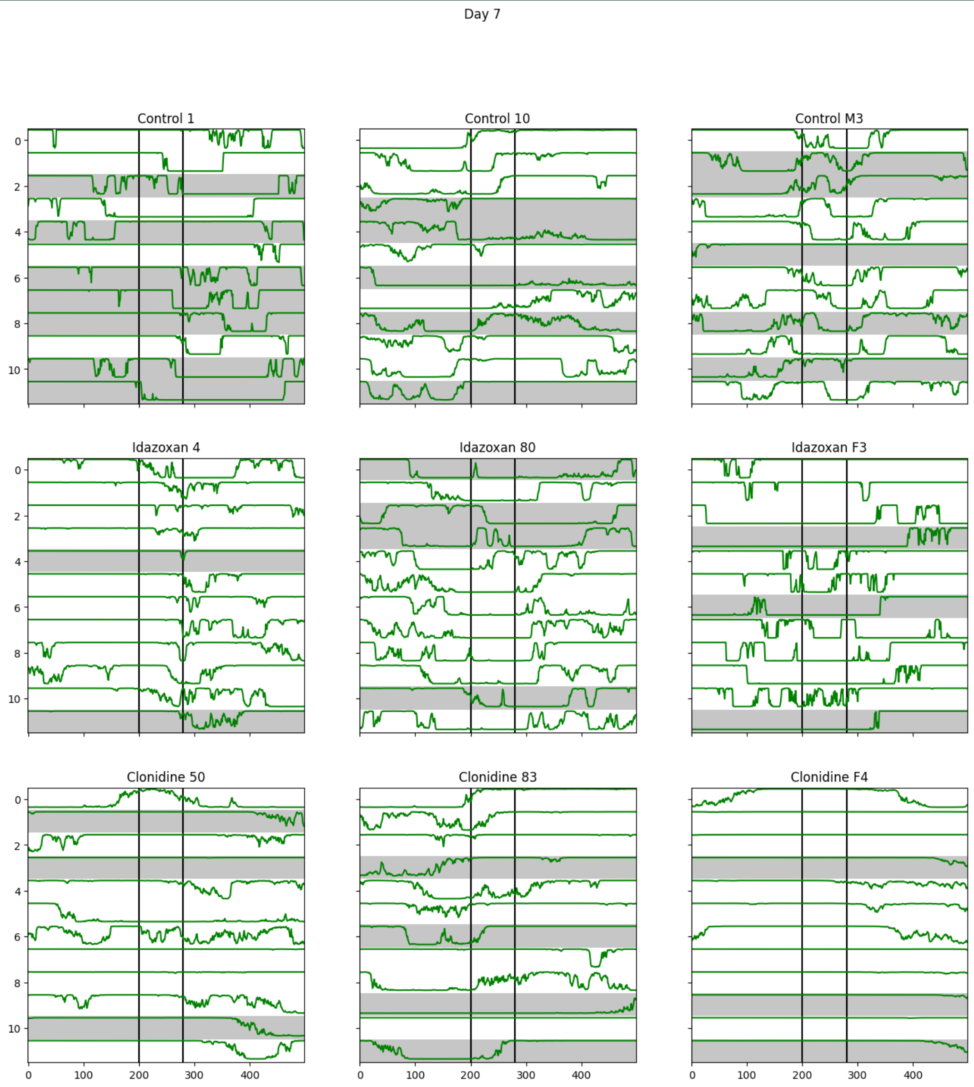
decoder.py
decoder_analysis_plots.ipynb

Slide 4
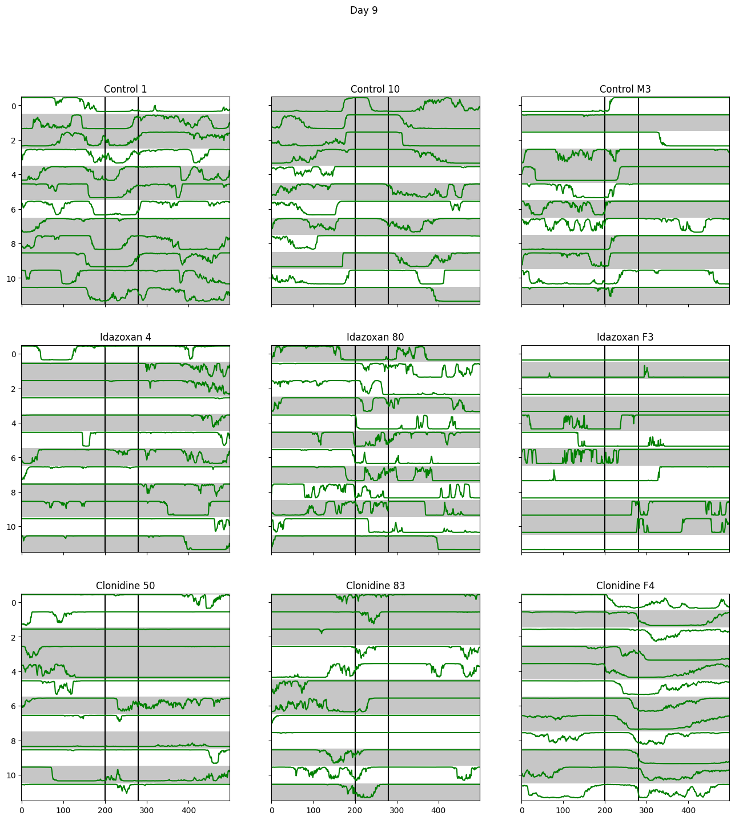
decoder.py
decoder_analysis_plots.ipynb

Slide 5
Switching between ‘confident’ periods
Day | Treatment | Median ‘Confident’ periods
7 | Control | 9
 | Clonidine | 6.5
 | Idazoxan | 13
9 | Control | 8
 | Clonidine | 6.5
 | Idazoxan | 9
decoder.py
decoder_analysis_plots.ipynb
 | Test | p-val
7 | Control v clonidine | 0.029
 | Control v Idazoxan | 0.045
 | Clonidine v Idazoxan | 0.0002
9 | Control v clonidine | 0.149
 | Control v Idazoxan | 0.503
 | Clonidine v Idazoxan | 0.038

Slide 6
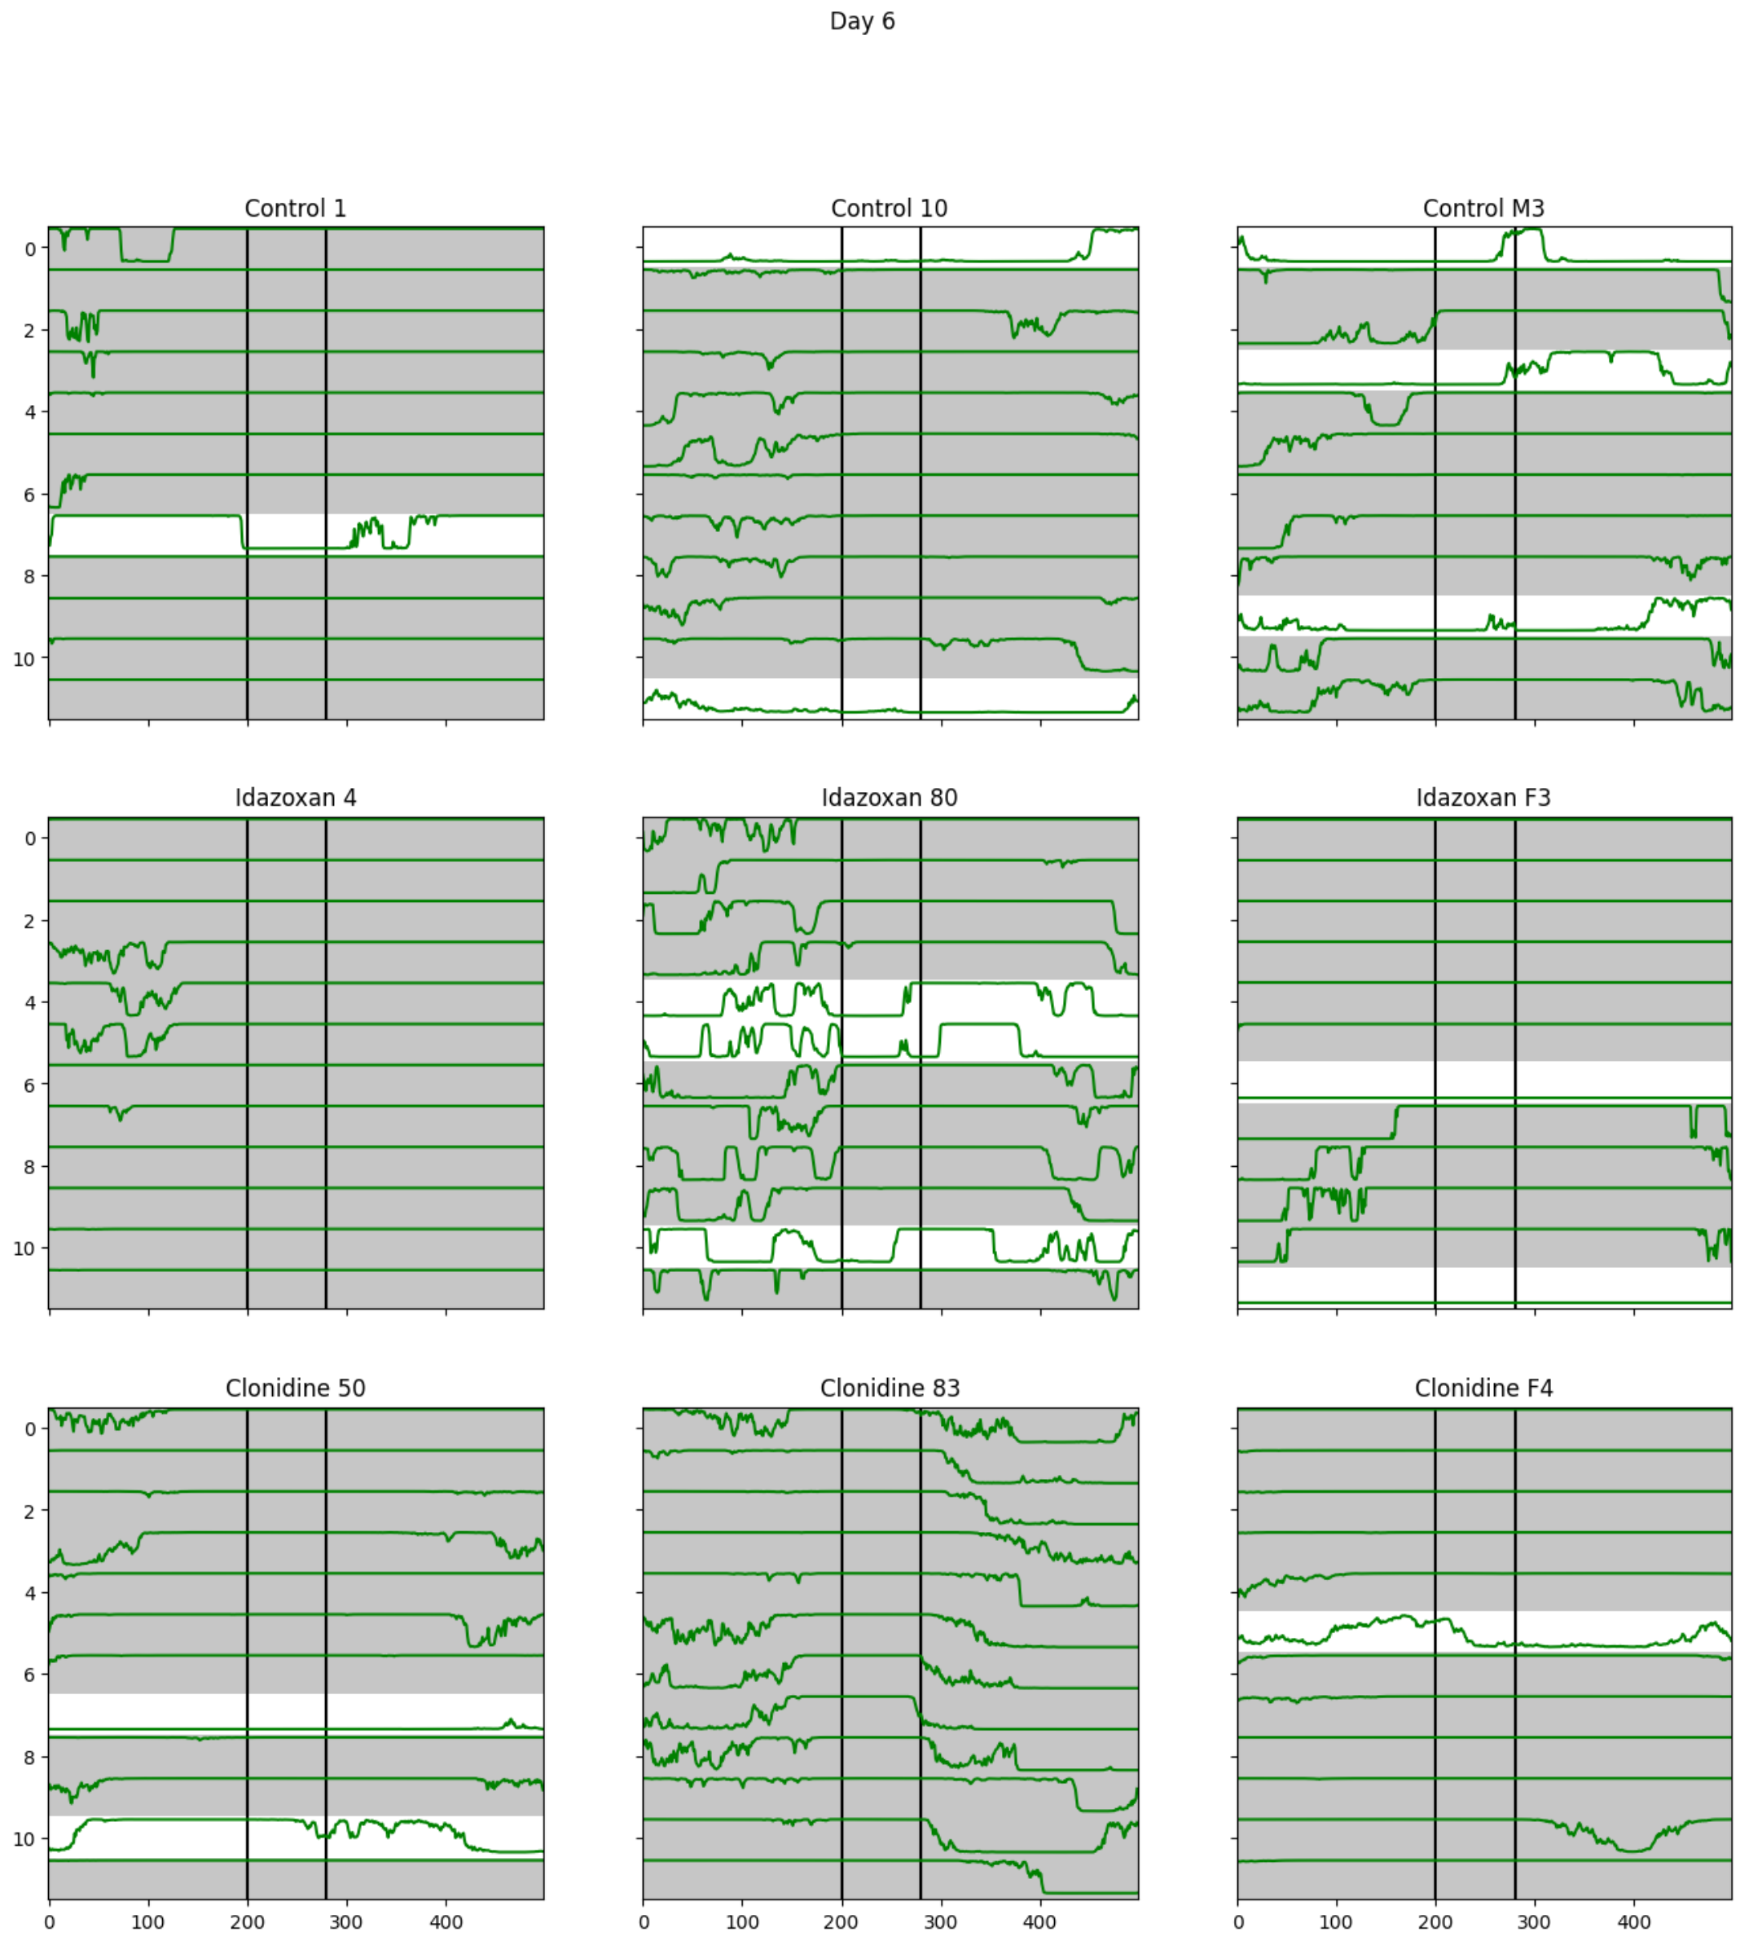
decoder.py
decoder_analysis_plots.ipynb

Slide 7
Switching between ‘confident’ periods
Day | Treatment | Median ‘Confident’ periods
6 | Control | 5.5
 | Clonidine | 3
 | Idazoxan | 3.5
decoder.py
decoder_analysis_plots.ipynb
 | Test | p-val
6 | Control v clonidine | 0.134
 | Control v Idazoxan | 0.182
 | Clonidine v Idazoxan | 0.502

Slide 8
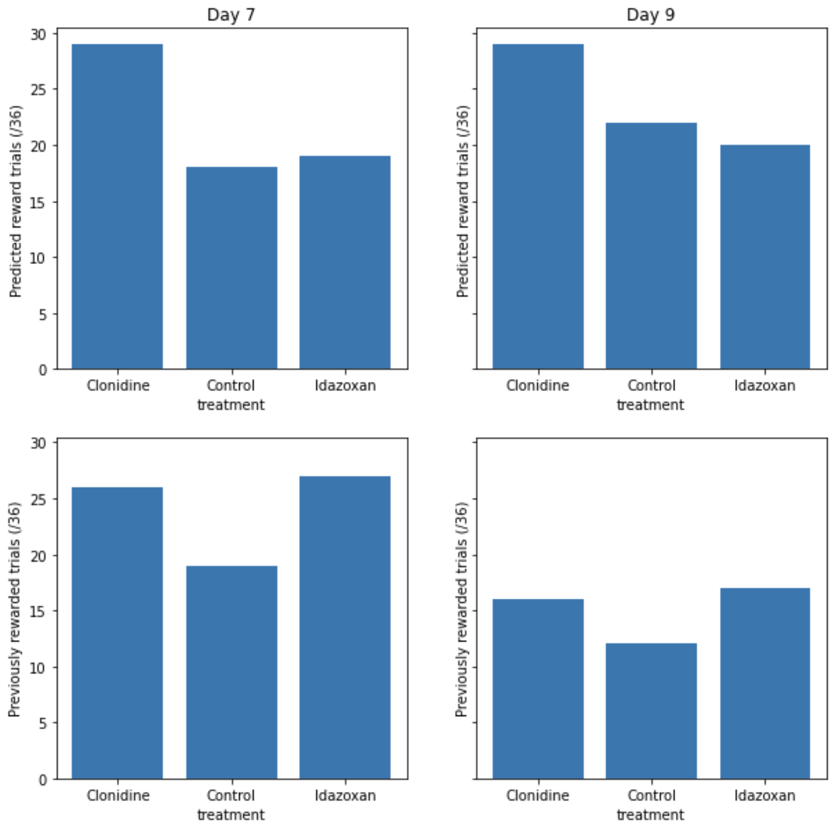
decoder.py
decoder_analysis_plots.ipynb

