Slide 1
A Study in Music Trends Among Four College Students

Slide 2
Big Questions
How Do Students Listen to Music?
What Does Weather do to Music Selection?
When Students Listen to Music?

Slide 3
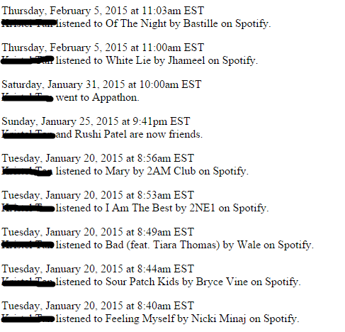
Data Collection Methods
Each participate submitted their Facebook Wall and music history then cleaned from it
Genre info was scrapped from AllMusic.com
Regional weather Data was collected from NOAA
Notes:
Is scrapped the official compsci term? Idk sounds unprofessional

Slide 4
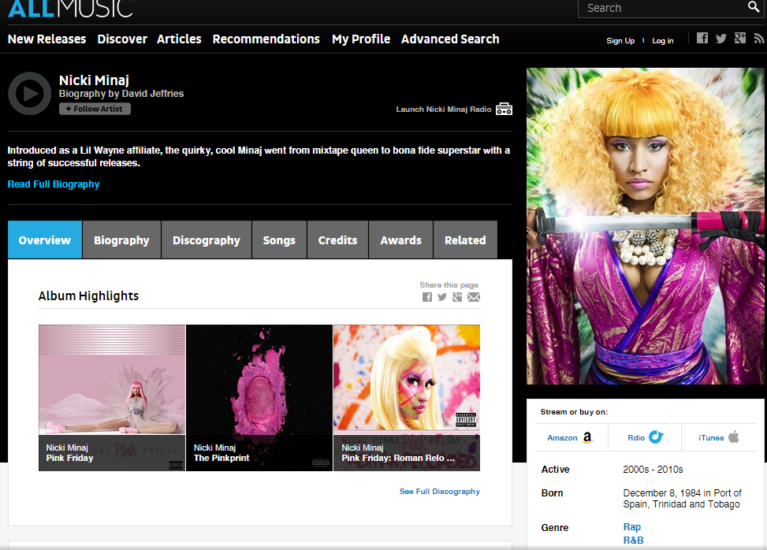
Notes:
Add “example”

Slide 5
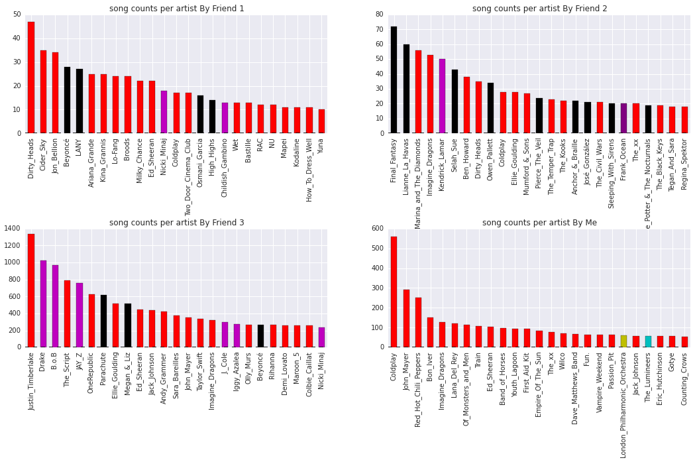
Top 25 Favorite Artists by Student
Notes:
TBH I don’t know what the point of this slide is – obvs favorite artist by person but it doesn’t really seem to tie into anything else? If you’re worried about running over time cut this out.
If you’re gonna keep it, give it a title and add some words

Slide 6
Graph Analysis
A network was created for the first week of January for three of the students (one did not have appropriate time interval)
Can reveal patterns in listening styles, like playlist listening, radio/discovery mode.
Notes:
This slide originally said “lessons learned” and said “we listen to a lot of pop rock” but that’s way too little info for one slide. instead, use this slide to intro your pretty graphs

Slide 7
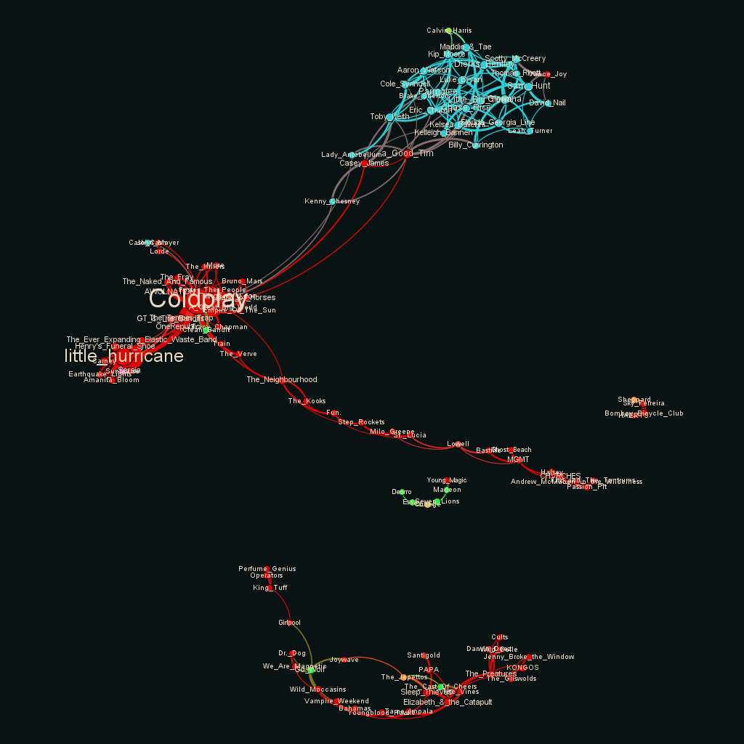
Nodes: Artists. Size indicates average weighted degree, or time spent listening to each artist.
Edges: Closeness in Listening. Thicker edges indicates songs listened together frequently
Key:
Red: Pop/Rock
Blue: Country
Green: Electronic
Orange: Jazz
Yellow: Classical
Pink: Rap
Seafoam: Religion
Purple: R&B
Notes:
Remember to describe: first week of january this year

Slide 8
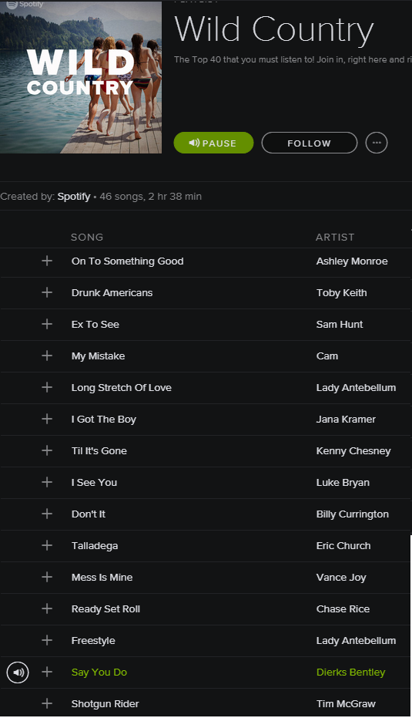
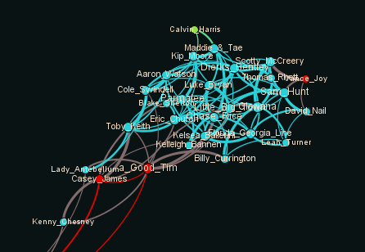
Colors:
Red: Pop/Rock
Blue: Country
Green: Electronic
Orange: Jazz
Yellow: Classical
Pink: Rap
Seafoam: Religion
Purple: R&B
Notes:
Spotify Playlists are SLOWER than user generated

Slide 9
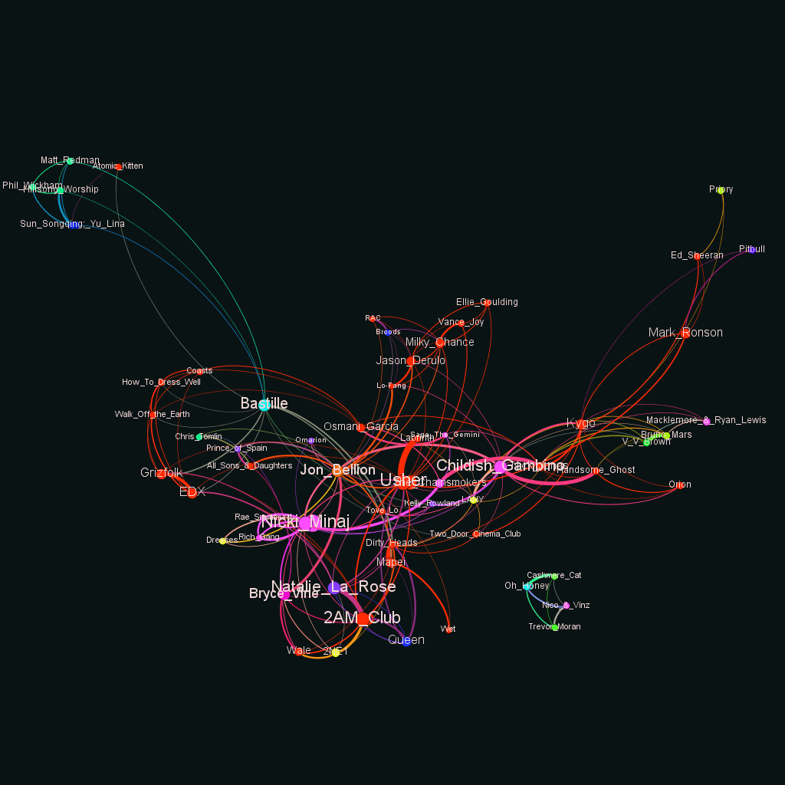
Nodes: Artists. Size indicates average weighted degree, or time spent listening to each artist.
Edges: Closeness in Listening. Thicker edges indicates songs listened together frequently
Key:
Red: Pop/Rock
Blue: Country
Green: Electronic
Orange: Jazz
Yellow: Classical
Pink: Rap
Seafoam: Religion
Purple: R&B
Notes:
‘entry’ points to the playlist

Slide 10
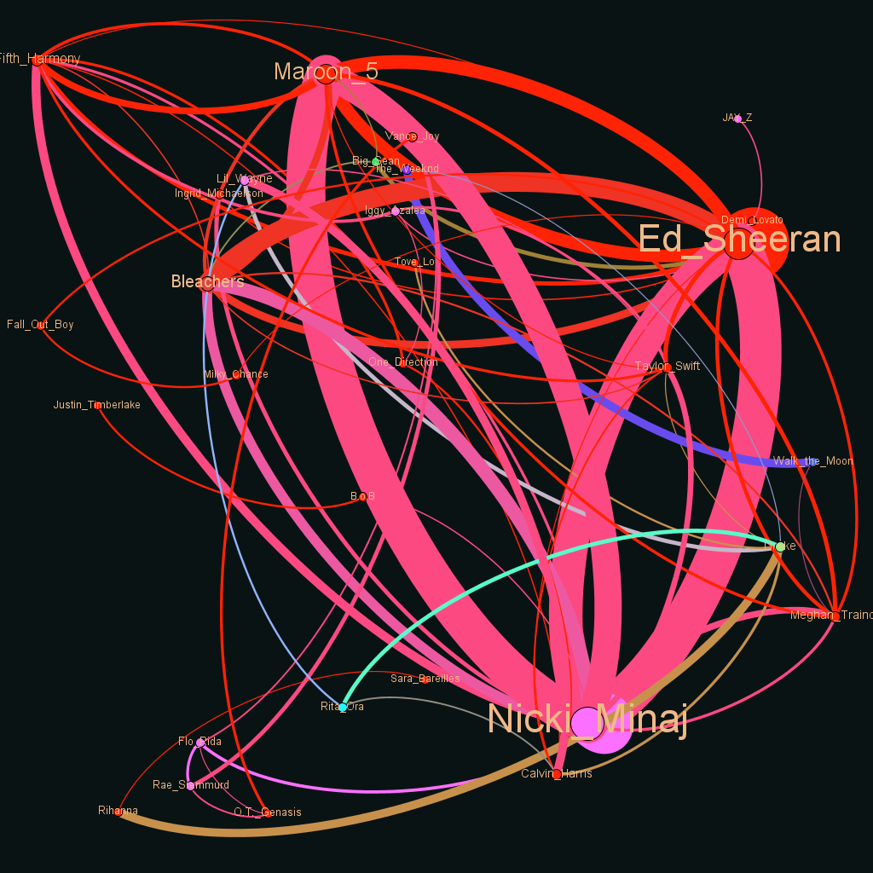
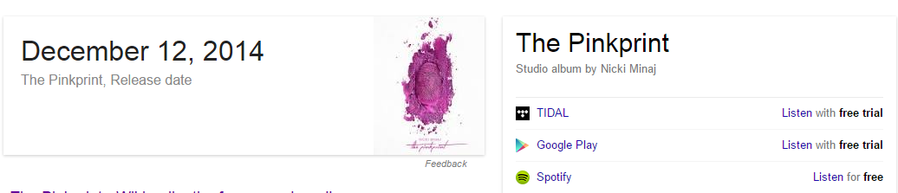
Nodes: Artists. Size indicates average weighted degree, or time spent listening to each artist.
Edges: Closeness in Listening. Thicker edges indicates songs listened together frequently
This is because Nicki Minaj release an album
Key:
Red: Pop/Rock
Blue: Country
Green: Electronic
Orange: Jazz
Yellow: Classical
Pink: Rap
Seafoam: Religion
Purple: R&B

Slide 11
Big Questions
How they Listen to Music
Through playlists (either Spotify generated like me or user generated like Student 1)
Through artist albums (Student 3 and maybe Student 1)
What Weather Does to Music Selection
When Students Listen to Music

Slide 12
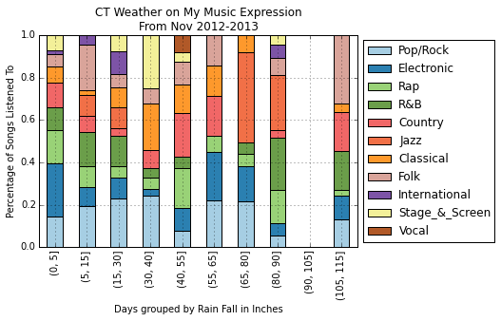
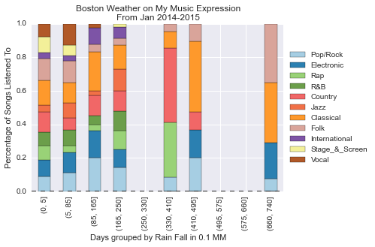
Effect of Weather on Music Selection
x-axis is binned days with rainfall in 0.1mm
y-axis is a bar chart of the ratios of listening to a genre based on the ratio of that genre to the rest of the dataset, per bin (think TF/IDF)
Notes:
Add the precursor graphs, percentage of percentage per day, it is the bar chart of the ratios , rainfall is in 10th of MM
IF I ONLY LISTEN TO CLASSICAL MUSIC WHEN IT IS RAINY THEN IT WILL SHOW IT. TF/IDF the genres (if the genre isn’t very frequent in the data set, but shows up a lot in a bin, it is important)

Slide 13
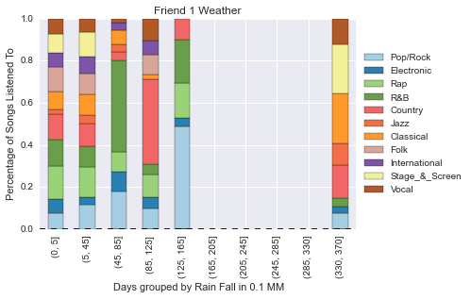
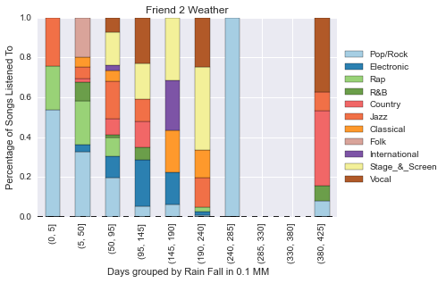
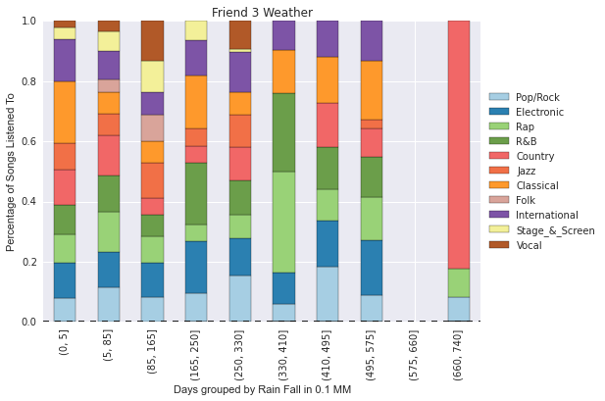
Effect of Weather on Music Selection
Notes:
Don’t show your data set again, it is distracting

Slide 14
Big Questions
How they Listen to Music
Through playlists (either Spotify generated like me or user generated like Student 1)
Through artist albums (Student 3 and maybe Student 1)
What Weather Does to Music Selection
Each student was more likely to listen to a specific genre than they normally would, on a rainy (or snowy) day
When Students Listen to Music

Slide 15
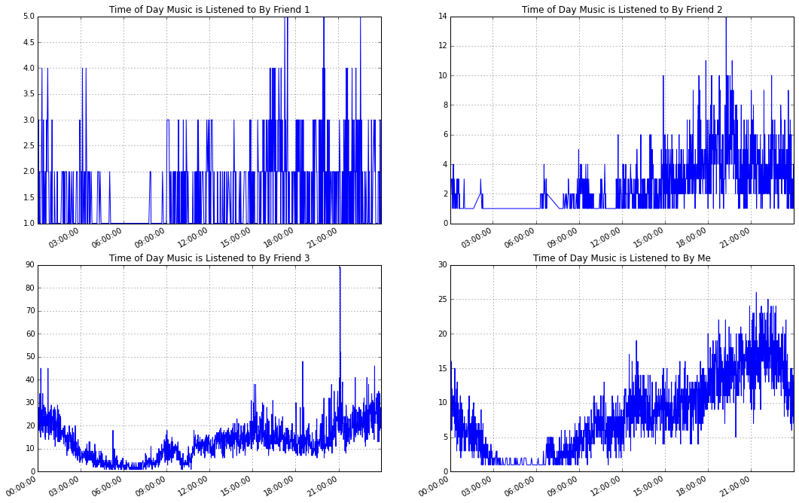
Individual Time Analysis
Trends show more listening during dinner time
Notes:
Look into seaborn and smooth it, also desribe how this is now the entire dataset again
Explain the different scales and why that leads to smoother data

Slide 16
Big Questions
How they Listen to Music
Through playlists (either Spotify generated like me or user generated like Student 1)
Through artist albums (Student 3 and maybe Student 1)
What Weather Does to Music Selection
Each student was more likely to listen to a specific genre than they normally would, on a rainy (or snowy) day
When Students Listen to Music
Students listen to music the most during ‘dinner time’, when they are not likely be in classes or at work

Slide 17
Future Directions
Introduce Moods/Styles into analysis
Introduce types of precipitation
Graph study of Artists collaboration
Scale to larger study, recruit more people
Facebook application / Pipeline

