Slide 1
Santa’s Little Helpers
Project Architecture
Josh Goldberg, John (Wiley) Hunt
Ken Krebs, Ben Leone, Panat Taranat

Slide 2
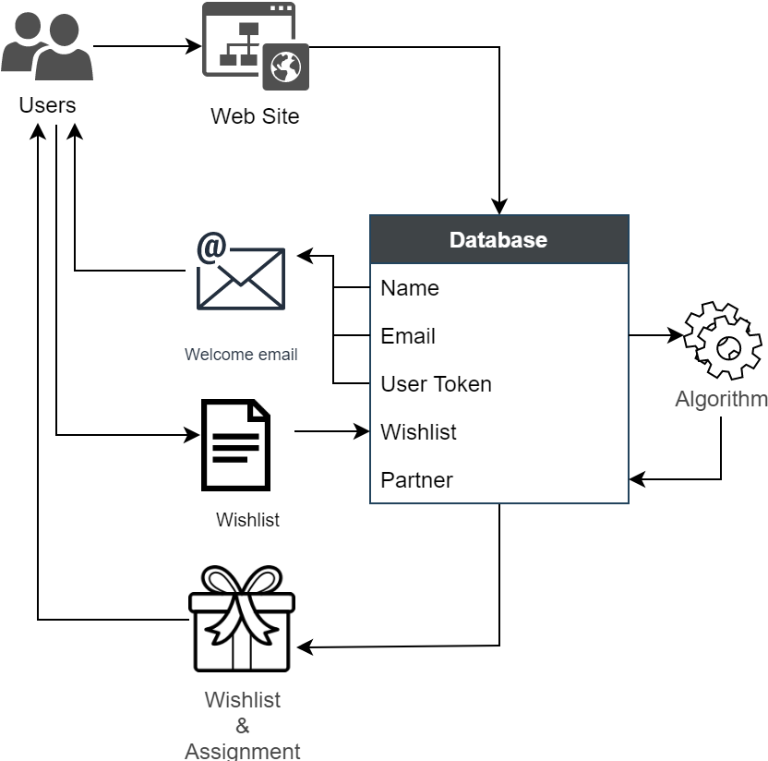
Architecture Overview

Slide 3
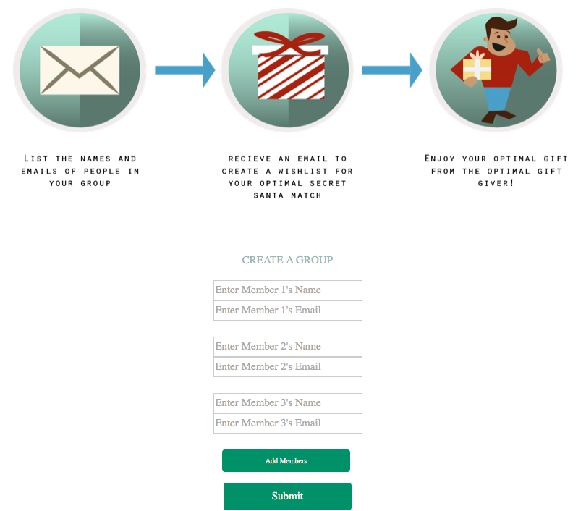
Landing Page
Requests user and list of users’ emails for creation of Secret Santa Group. ‘Submit’ sends the list of emails to the database.

Slide 4
Sorting algorithm matches each user to their assigned Secret Santa and stores the assignment in the database

Slide 5
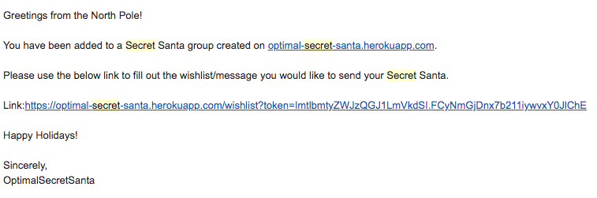
Email bot generates unique URL that routes the user to wishlist sign-in page. Uses asynchronous email sending to send emails to each user with unique link for wishlist input.

Slide 6
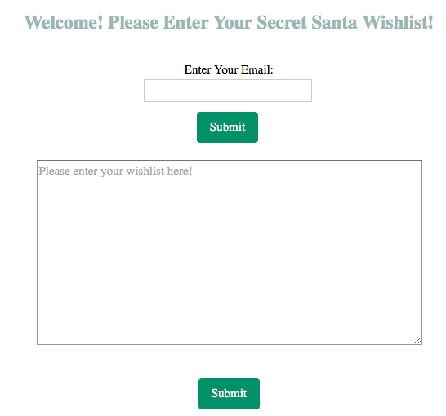
User follows the link to a different webpage to fill out wishlist which is sent to their Secret Santa upon submission.

Slide 7


Slide 8
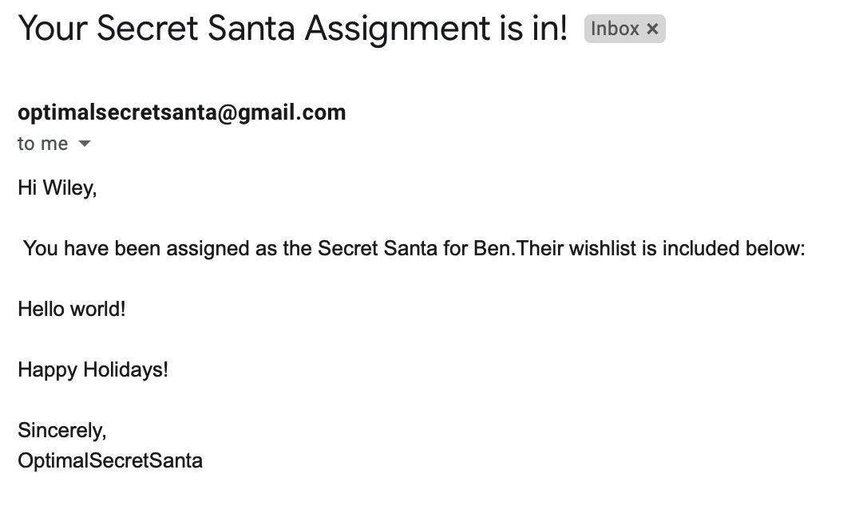
Email bot sends a user’s wishlist to their Secret Santa

Slide 9
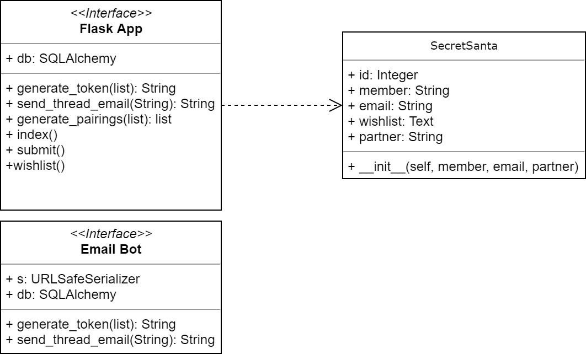
HML Diagrams

