Slide 1
Resonant FCML
Nathan Brooks

Slide 2

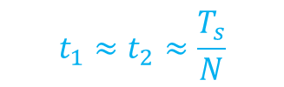
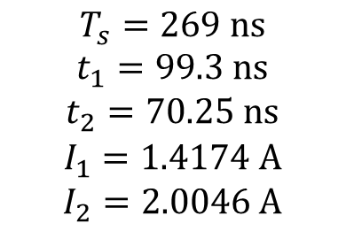

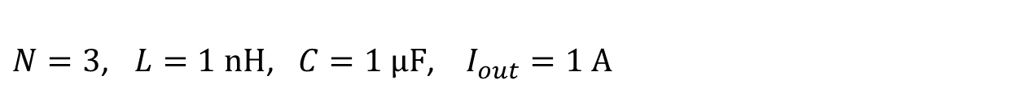

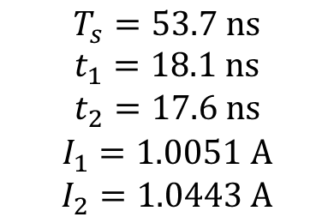
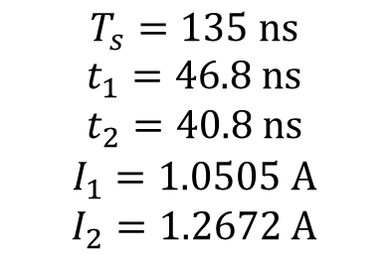

Resonant FCML Examples
$N=3$, $L=1 nH$, $C=1 μF$, $I_{out}=1 A$
$$T_{s}=269 ns$$
$$t_{1}=99.3 ns$$
$$t_{2}=70.25 ns$$
$$I_{1}=1.4174 A$$
$$I_{2}=2.0046 A$$
$$=T_{s,nom}$$
$$T_{s}=135 ns$$
$$t_{1}=46.8 ns$$
$$t_{2}=40.8 ns$$
$$I_{1}=1.0505 A$$
$$I_{2}=1.2672 A$$
$$T_{s}=53.7 ns$$
$$t_{1}=18.1 ns$$
$$t_{2}=17.6 ns$$
$$I_{1}=1.0051 A$$
$$I_{2}=1.0443 A$$
$$t_{1}≈t_{2}≈\frac{T_{s}}{N}$$
$$\sqrt{2}$$
$$\sqrt{2}$$
$$I_{1}≈I_{2}≈I_{out}$$

Slide 3


Below resonance
$$I_{out}=1$$
$$I_{out}=1$$

Slide 4





On-times vs Gamma
$$N=\frac{1}{3}$$
$$N=\frac{1}{6}$$
$$\frac{t_{2}}{t_{1}}{\left.​\right|}_{Γ=0}=1$$
$$\frac{t_{2}}{t_{1}}{\left.​\right|}_{Γ=1}=\sqrt{2}$$
$$\frac{t_{2}}{t_{1}}{\left.​\right|}_{Γ=2}=\sqrt{2}$$

Slide 5
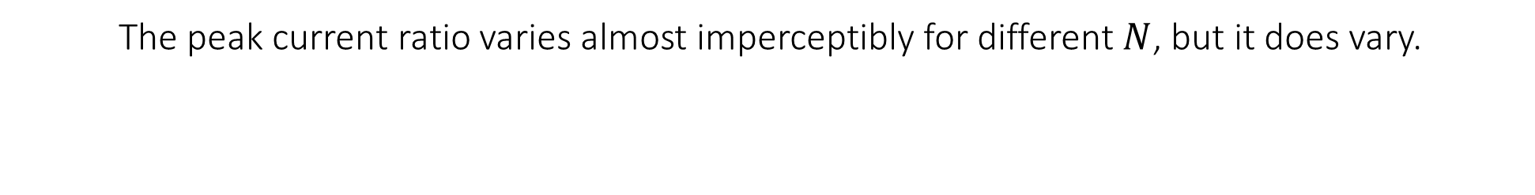
Gamma vs Peak Current Ratio
The peak current ratio varies almost imperceptibly for different $N$, but it does vary.

Slide 6

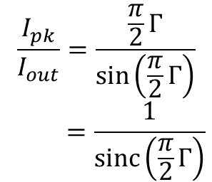
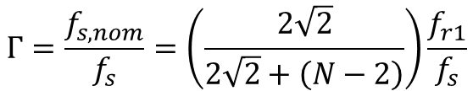



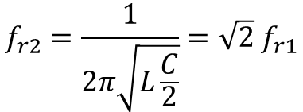
Gamma vs Peak Current Ratio
2:1 Doubler
N:1 FCML
$$f_{r1}=\frac{1}{2π\sqrt{LC}}$$
$$f_{r}=\frac{1}{2π\sqrt{LC}}$$
$$f_{r2}=\frac{1}{2π\sqrt{L\frac{C}{2}}}=\sqrt{2} f_{r1}$$
$$Γ=\frac{f_{s,nom}}{f_{s}}=\frac{f_{r}}{f_{s}}$$
$$Γ=\frac{f_{s,nom}}{f_{s}}=\left(\frac{2\sqrt{2}}{2\sqrt{2}+\left(N−2\right)}\right)\frac{f_{r1}}{f_{s}}$$
$$\frac{I_{pk}}{I_{out}}=\frac{\frac{π}{2}Γ}{\sin\left(\frac{π}{2}Γ\right)}$$
$$=\frac{1}{sinc\left(\frac{π}{2}Γ\right)}$$
$$\frac{I_{pk}}{I_{out}}=\frac{I_{2}}{I_{out}}= ?$$
(See later slide for estimated closed-form solution)

Slide 7






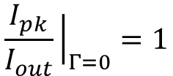

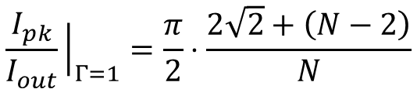
Gamma vs Peak Current Ratio over N
$$N=3$$
$$N=4$$
$$⋮$$
$$N=10$$
$$⋮$$
$N=∞$ and $N=2$
$$\frac{I_{pk}}{I_{out}}{\left.​\right|}_{Γ=1}=\frac{π}{2}⋅\frac{2\sqrt{2}+\left(N−2\right)}{N}$$
for $N>2$
$$\frac{I_{pk}}{I_{out}}{\left.​\right|}_{Γ=0}=1$$

Slide 8
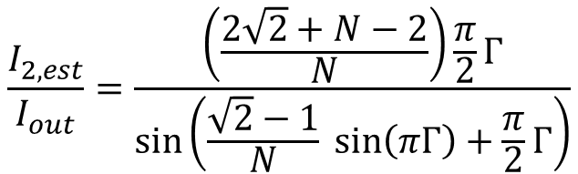
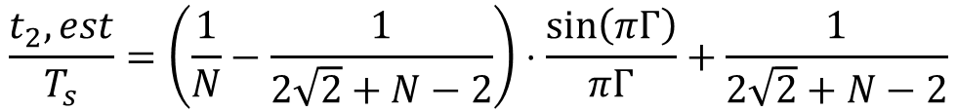
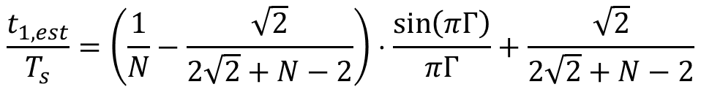
Approximate fit to $t_{1}$ and $t_{2}$
$$\frac{t_{1,est}}{T_{s}}=\left(\frac{1}{N}−\frac{\sqrt{2}}{2\sqrt{2}+N−2}\right)⋅\frac{\sin\left(πΓ\right)}{πΓ}+\frac{\sqrt{2}}{2\sqrt{2}+N−2}$$
$$\frac{I_{2,est}}{I_{out}}=\frac{\left(\frac{2\sqrt{2}+N−2}{N}\right)\frac{π}{2}Γ}{sin\left(\frac{\sqrt{2}−1}{N} sin\left(πΓ\right)+\frac{π}{2}Γ\right)}$$
$$\frac{t_{2},est}{T_{s}}=\left(\frac{1}{N}−\frac{1}{2\sqrt{2}+N−2}\right)⋅\frac{\sin\left(πΓ\right)}{πΓ}+\frac{1}{2\sqrt{2}+N−2}$$

