Slide 1
Outline
1D planar shock (without damping)

Slide 2
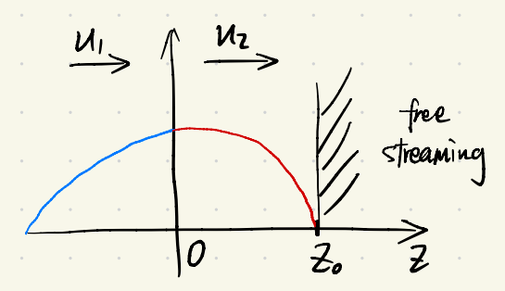
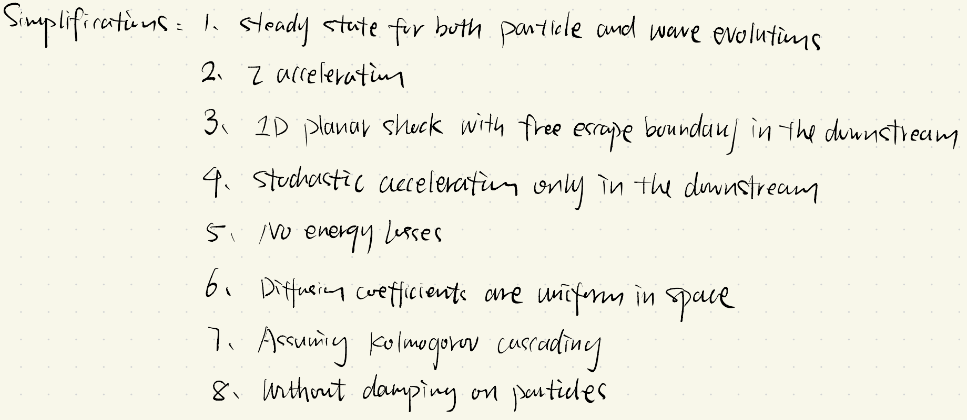
1D planar shock (without damping)

Slide 3
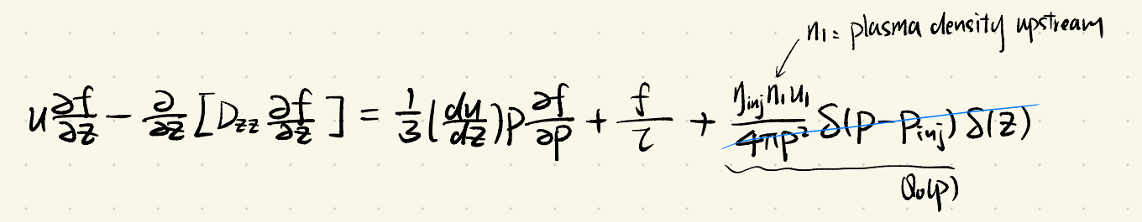
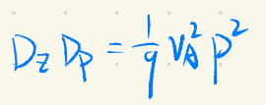
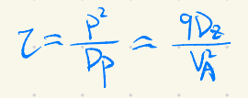
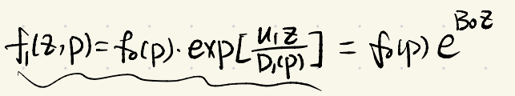
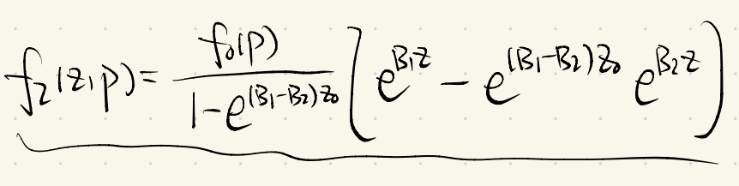
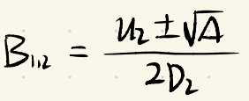

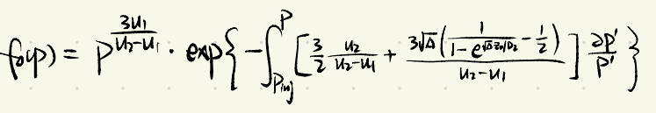
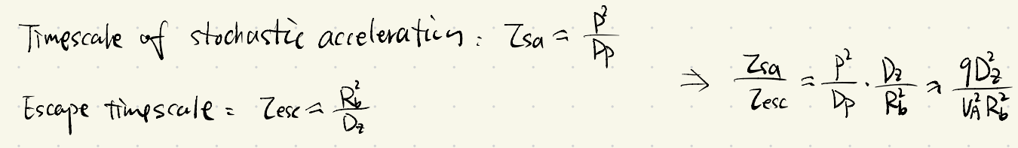
Transport equation
upstream:
downstream:
at the TS:
timescales:

Slide 4
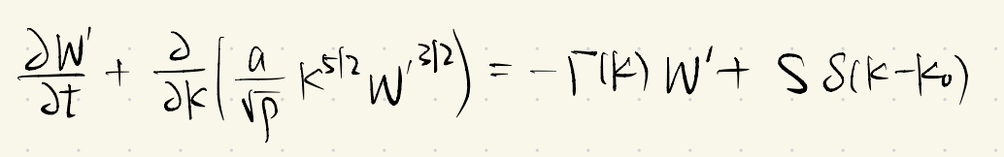
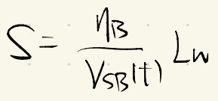
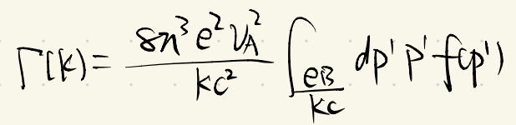
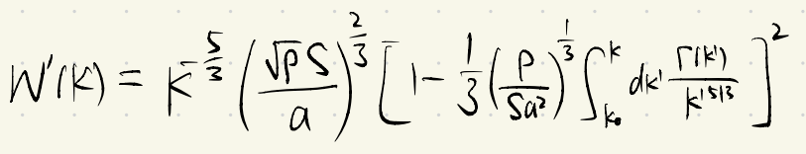
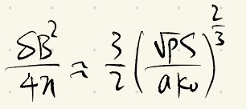
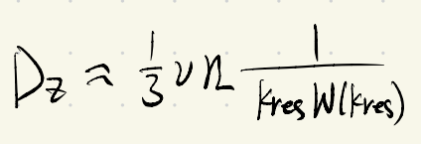
Wave evolution
injection term:
damping rate:
wave spectrum:
magnetic field:
spatial diffusion:

Slide 5
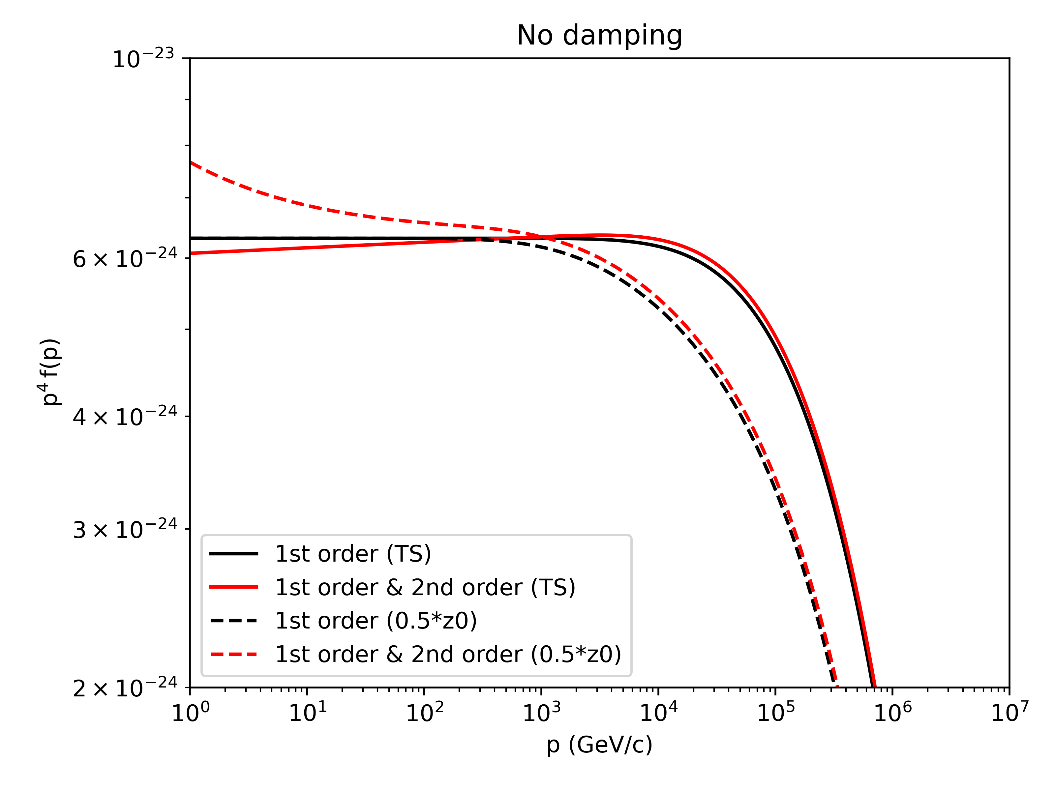
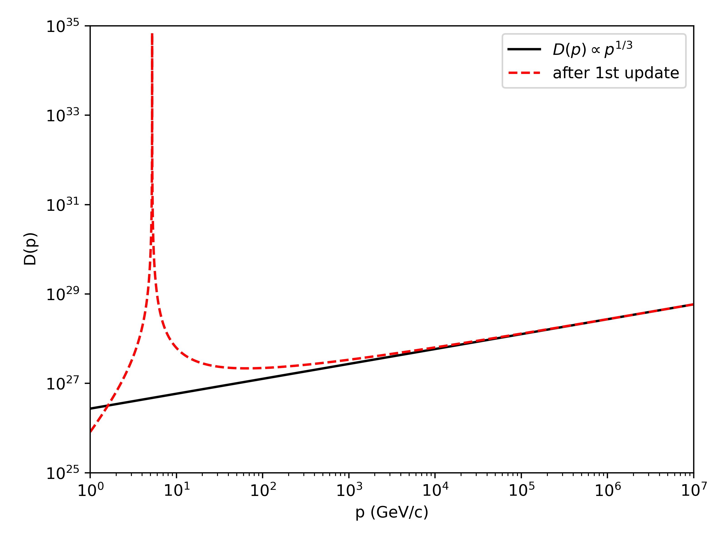
At the shock, spectrum is slightly harder; at larger distance, flux of lower energy particles increases.
2nd aceleration has little influence on Emax.

Slide 6
Possible algorithm (numerical)
solve wave equation without damping;
calculate spatial and momentum diffusion coefficients;
assuming initial f0(p), solve transport equations upstream and downstream numerically;
update f0(p);
update diffusion coefficients;
repeat 3-5 until convergence.

