Slide 1
DLCV Hw1 Report
R10942198 林仲偉

Slide 2
1-1
(3, 64, 64) up-sample to (3, 224, 224)
(3, 224, 224)
Draw the network architecture of method A or B
The network architecture of method B [Fig.1] consists of pre-trained Resnet50 and 1 layer MLP with input channel size = 1000.
2. Report accuracy of your model (A and B) on validation set.
Model A: 0.6376
Model B: 0.8928
Resnet50
Feature
extractor
(1000)
1-layer MLP
Classifier
(n_class = 50)
Fig.1. Network architecture of method B

Slide 3
1-1
Report your implementation details of model A.
Optimizer: Adam
Loss: CE loss
Cross validation: 5-fold cross validation ensembling
Learning rate: 5e-5
Learning rate scheduled: StepLR
Epoch: 50
4. Report your alternative model or method in B, and describe its difference from model A.
Optimizer: Adam
Loss: CE loss
Cross validation: 5-fold cross validation ensembling
Learning rate: 5e-5
Learning rate scheduled: StepLR
Epoch: 50
Difference: model architecture
Use pre-train Resnet50 instead of regular CNN: adding residual during forwarding.

Slide 4
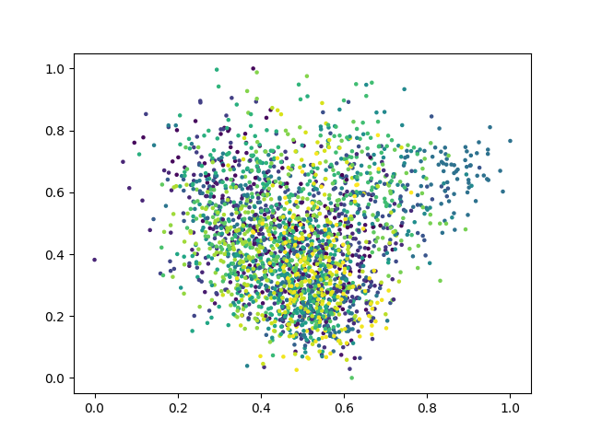
1-1
5. Visualize the learned visual representations of model A on the validation set by implementing PCA (Principal Component Analysis) on the output of the second last layer. Briefly explain your result of the PCA visualization.
Explanation:
The clustering result is not very good since PCA is a linear dimensionality reducing algorithm. Moreover, the performance of model A also influence the result of PCA.
Fig.2. PCA(n_component=2)

Slide 5
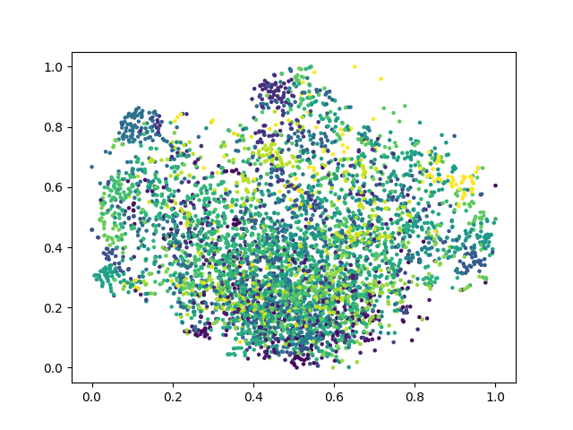
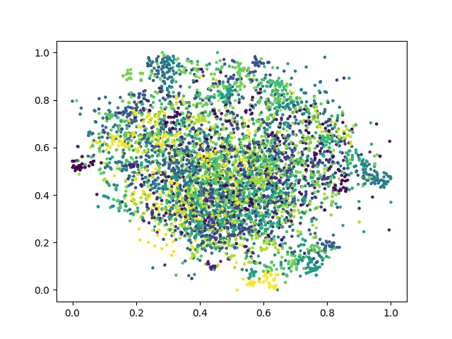
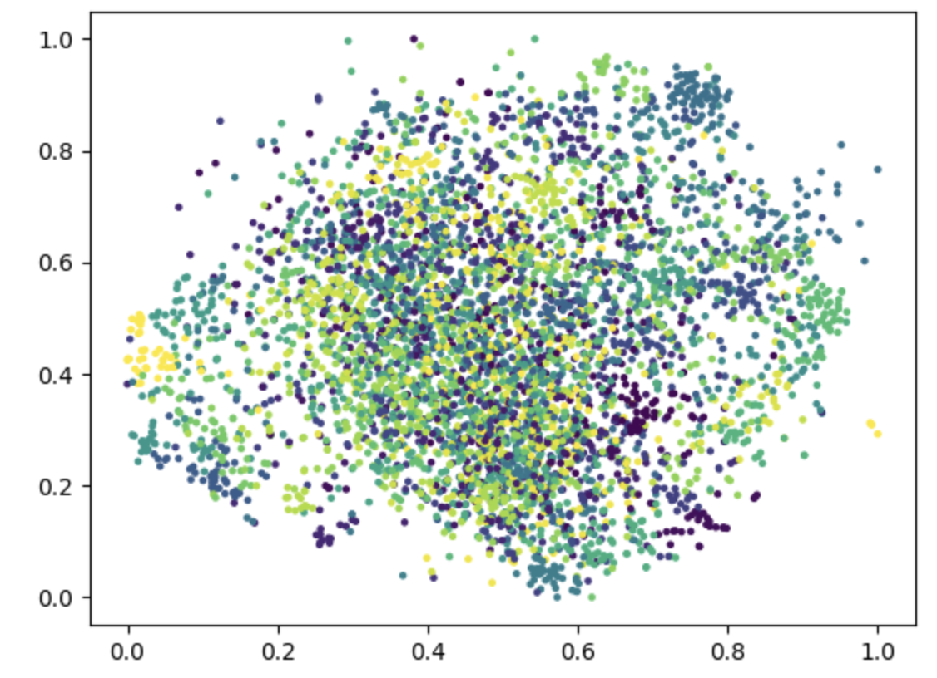
1-1
6. Visualize the learned visual representation of model A, again on the output of the second last layer, but using t-SNE (t-distributed Stochastic Neighbor Embedding) instead. Depict your visualization from three different epochs including the first one and the last one. Briefly explain the above results.
Fig.3(a). First-epoch t-SNE
Fig.3(b). 5-epoch t-SNE
Fig.3(c). Last-epoch t-SNE
Explanation:
The clustering result is slightly better as the number of epoch increases.
However, since model A doesn’t have good performance (in comparison to model B), the clustering result is not significantly greater than PCA.

Slide 6
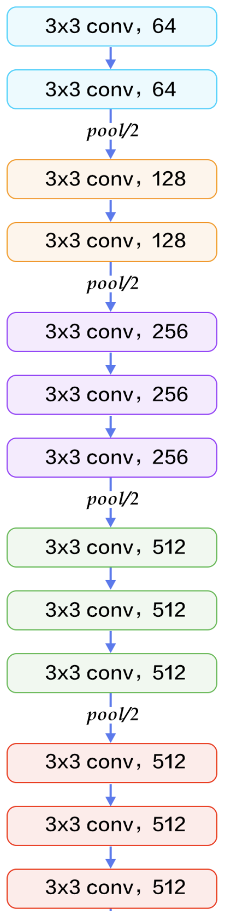
1-2
(3, H, W)
Draw the network architecture of your VGG16-FCN32s model (model A).
Ref: http://deanhan.com/2018/07/26/vgg16/
VGG16
Score function
2x2 conv, 4096
1x1 conv, 7
Up-sampling
64x64 TransposeConv, 7, stride=32
(n_class, H, W)
Fig.4(a). Network architecture of model A

Slide 7
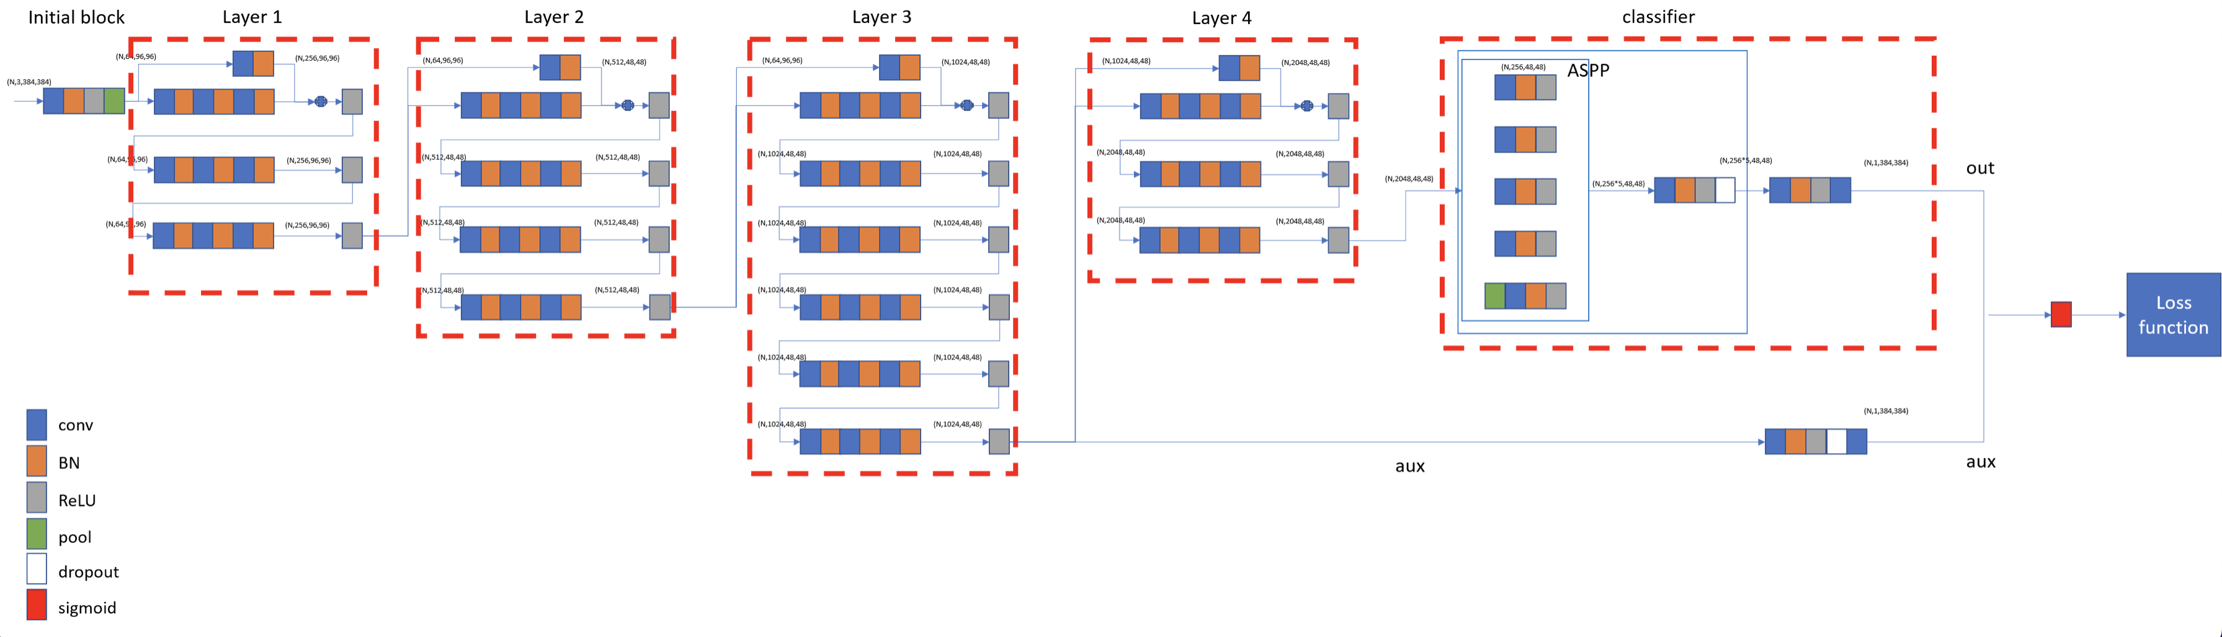
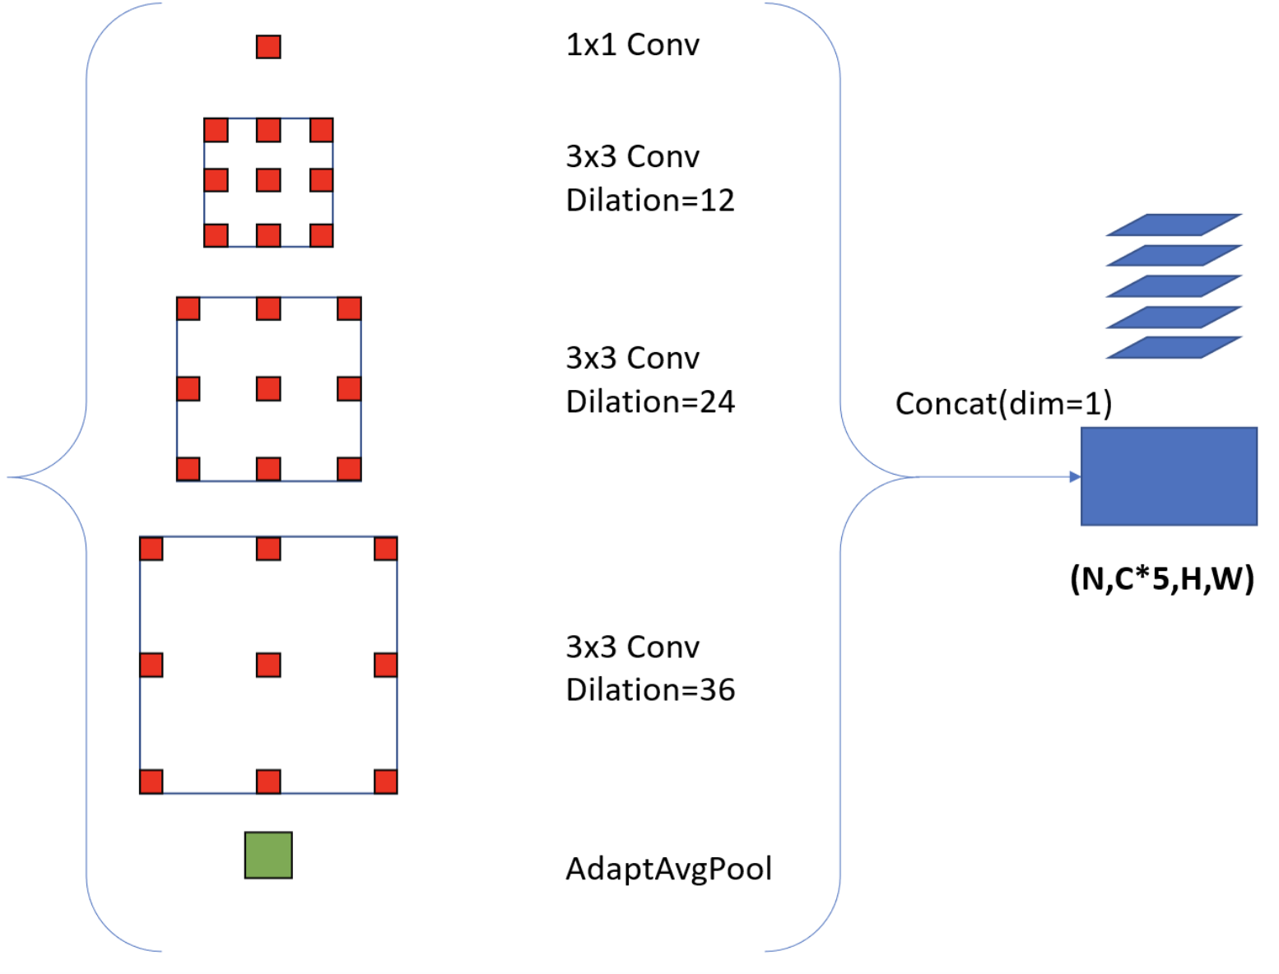
1-2
2. Draw the network architecture of the improved model (model B: Deeplabv3_resnet50) and explain it differs from your VGG16-FCN32s model.
ASPP
Deeplabv3_resnet50 多了一個 Atrous Spatial Pyramid Pooling
(ASPP) module, 由一系列dilated convolution組成，使其擁有更好的up sampling 結果。
Ref: https://blog.csdn.net/weixin_44816589/article/details/115266935

Slide 8
1-2
Report mIoUs of two models on the validation set.
Model A (VGG16+FCN32s): mIoU = 0.411476
Model B (DeepLabV3_Resnet50): mIoU= 0.747531

Slide 9
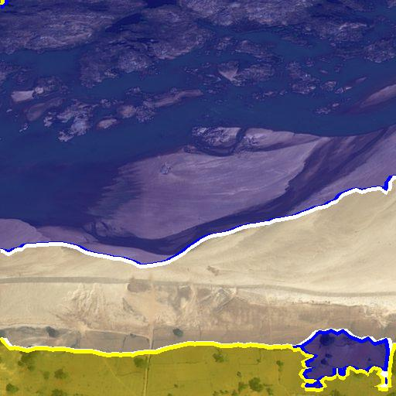
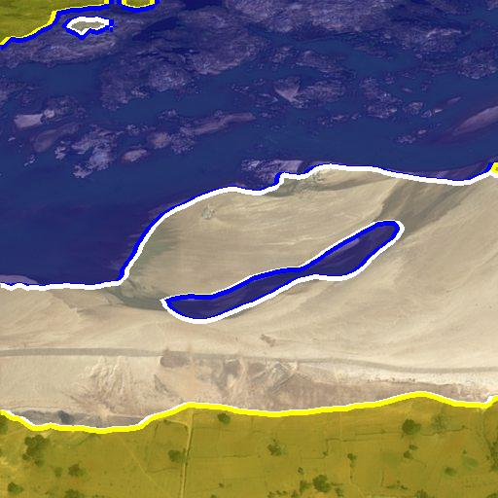
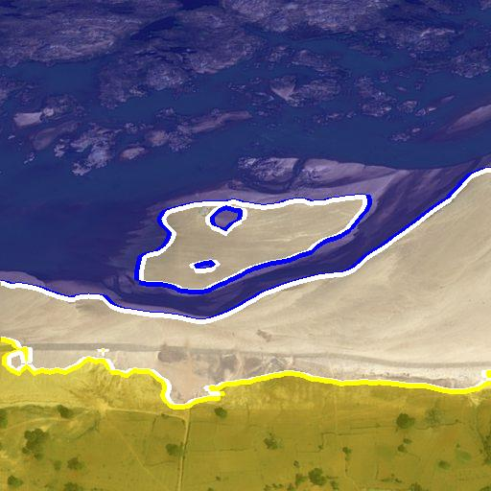
1-2
Show the predicted segmentation mask of “validation/0013_sat.jpg”, “validation/0062_sat.jpg”, “validation/0104_sat.jpg” during the early, middle, and the final stage during the training process of the improved model.
validation/0013_sat.jpg:
Early (epoch=0)
Middle (epoch=0)
final

Slide 10
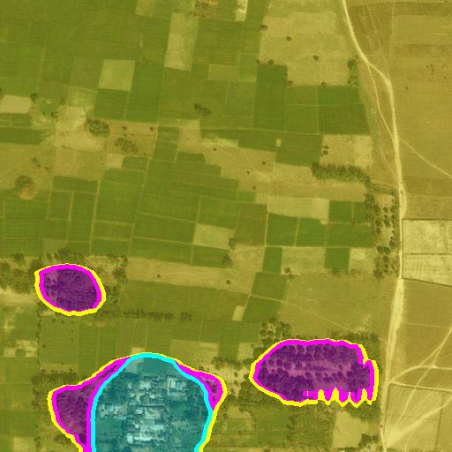
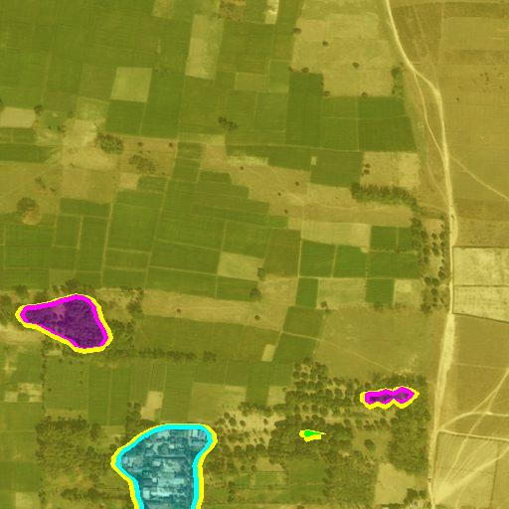
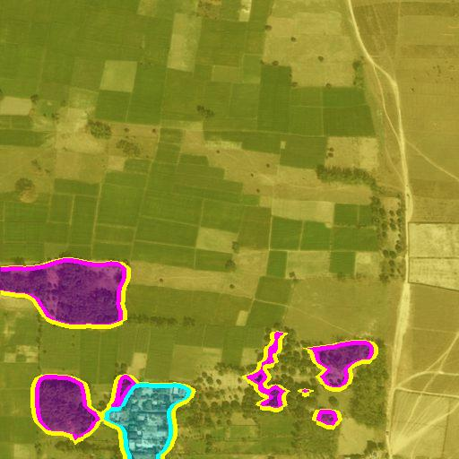
1-2
Show the predicted segmentation mask of “validation/0013_sat.jpg”, “validation/0062_sat.jpg”, “validation/0104_sat.jpg” during the early, middle, and the final stage during the training process of the improved model.
validation/0062_sat.jpg:
Early (epoch=0)
Middle (epoch=5)
final

Slide 11
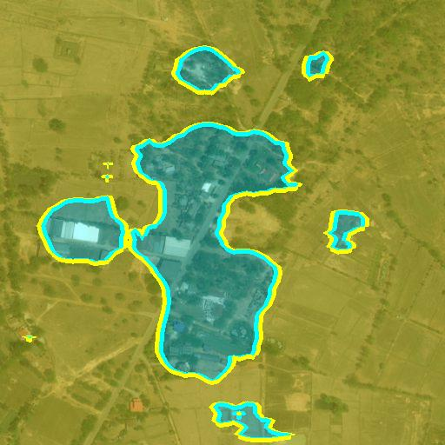
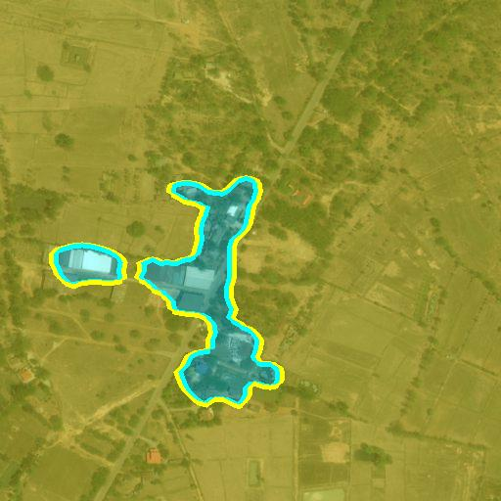
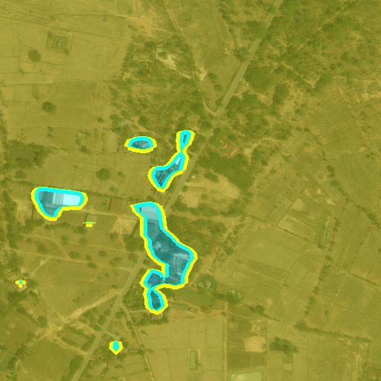
1-2
Show the predicted segmentation mask of “validation/0013_sat.jpg”, “validation/0062_sat.jpg”, “validation/0104_sat.jpg” during the early, middle, and the final stage during the training process of the improved model.
validation/0104_sat.jpg:
Early (epoch=0)
Middle (epoch=5)
final

