Slide 1
Fahr’s Disease
Benson Long

Slide 2
What is Fahr’s Disease?
Neurological disorder
Abnormal calcium deposits in the brain (basal ganglia)
Idiopathic Basal Ganglia Calcification (IBGC)
Notes:
Rare in that less than 20 cases have been recorded in the 20th century

Slide 3
Diagnostic Techniques
Computed Tomography
Magnetic Resonance Imaging
Plain skull radiograph
Notes:
Dentate nucleus
Globus pallidus
L Putamen
Basal Ganglia

Slide 4
Diagnostic Criteria
Bilateral calcification of basal ganglia
Progressive neurologic dysfunction
30 to 60 years of age
Free from mitochondrial, metabolic or other systemic diseases
Absence of infectious, toxic or traumatic cause
Autosomal dominant inheritance

Slide 5
Case Study #1
34 year old female
Numbness on tongue and arms, tremor, sleep loss, loss of consciousness
Decreased calcium and PTH levels and increased phosphorus levels
Bilateral symmetric calcifications in caudate and lentiform nuclei and thalamus
Notes:
Caudate nuclei, lenticular nuclei, thalamus

Slide 6
Case Study #2
25 year old female
Loss of memory, irritability, poor night time sleep and social isolation
Illiterate → depression
No muscular problems
Negative lab test results

Slide 7
Case Study #3
63 year old male
Difficulty in speech, slowness in movements, bradykinesia
No mood changes or seizures
No contributory family history
Normal lab tests results of calcium, phosphorous & PTH
Notes:
Cerebrum
Cerebellum
Basal Ganglia

Slide 8
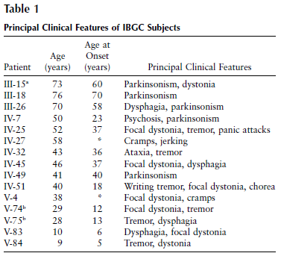
Genetics
14q locus (IBGC1)
Chromosome 8 (SLC20A2)
Notes:
IBGC1 link in 1 family but not found in others
Also Chromosome 2 but lack of data
All have symptoms and linkage to 14q region gene; point mutations within the region affect enzymes that cause symptoms like dystonia
Otherwise, more research has to be done within the genomic region to see what pathways this gene affects

Slide 9
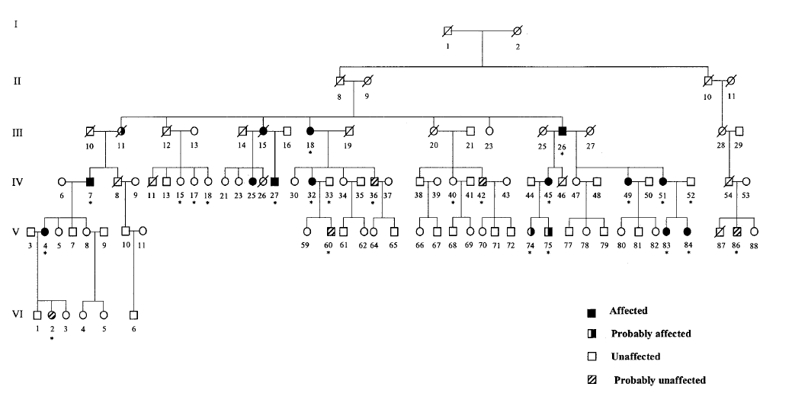
IBGC1
Notes:
Asterisks = DNA tested individuals
Shows autosomal dominant inheritance of Fahr’s disease
Not all family members shown
3 generations affected

Slide 10
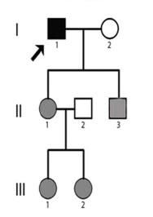
SLC20A2
Sodium-dependent phosphate transporter
Not regulated in the brain
Mutation in SLC20A2 → decrease in SLC20A2 mRNA expression → abnormal local Pi homeostasis → calcification of basal ganglia
SLC20A1 (co-expressed) → resistance to SLC20A2 mutations → calcifications in brain but not elsewhere
Notes:
Chinese family with 3 generations of affected individuals
SLC34 = type 2 sodium/phosphate co-transporters in kidneys and intestines (reabsorption)
Used by viruses for cell invasion
Familial only = limitation

Slide 11
Symptoms
Abnormal movements/EPS (55%)
Parkinsonism (57%)
Chorea (19%)
Tremor (8%)
Dystonia (8%)
Athetosis (5%)
Orofacial dyskinesia (3%)
Asymptomatic
Notes:
Symptomatic patients significantly greater amount of calcification compared to asymptomatic
Dementia
Chorea → involuntary, irregular movements of limbs
Dystonia → torsion spasms of limbs, trunk & neck
Athetosis → involuntary, slow, twisting movements of trunk & limbs
Orofacial dyskinesia → involuntary repetitive movements of mouth & face

Slide 12
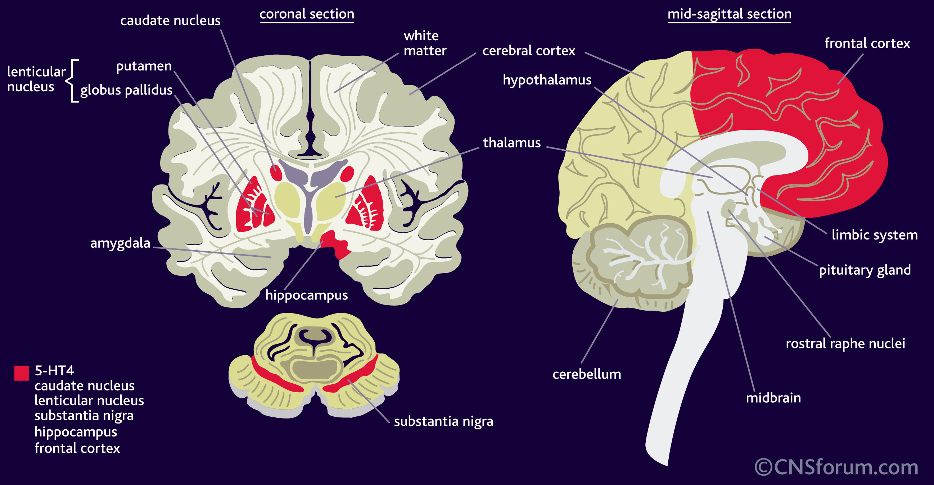
The Brain

Slide 13
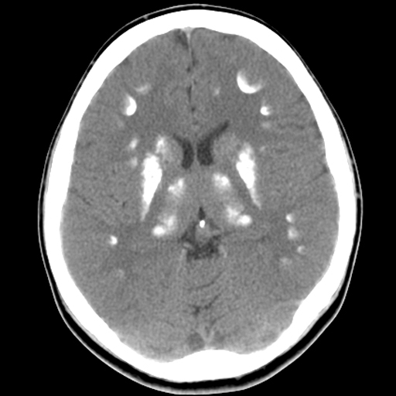
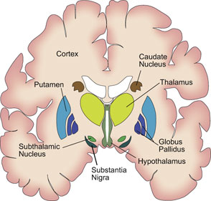
Basal Ganglia

Slide 14
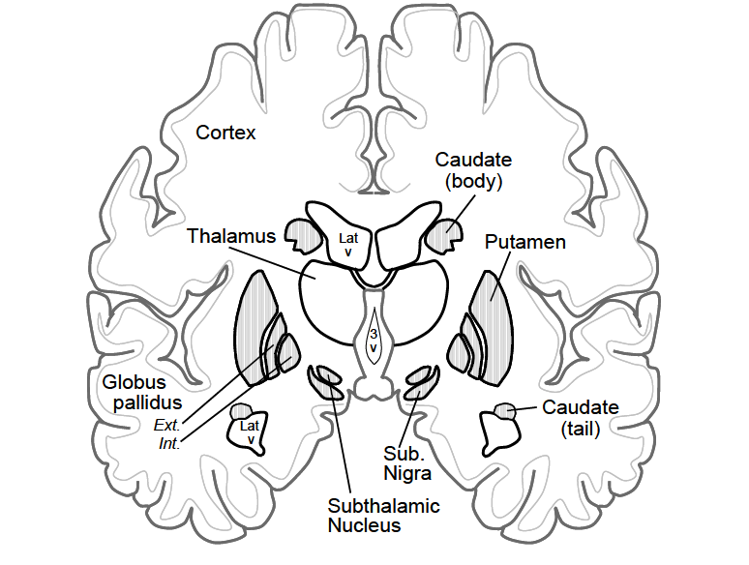
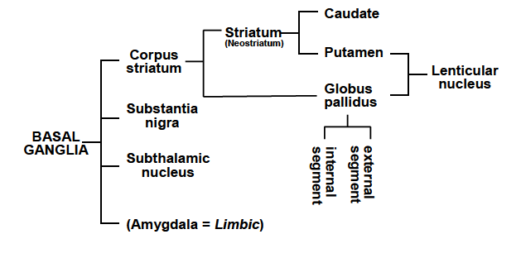
Basal Ganglia
Notes:
Caudate, putamen, globus pallidus & amygdala

Slide 15
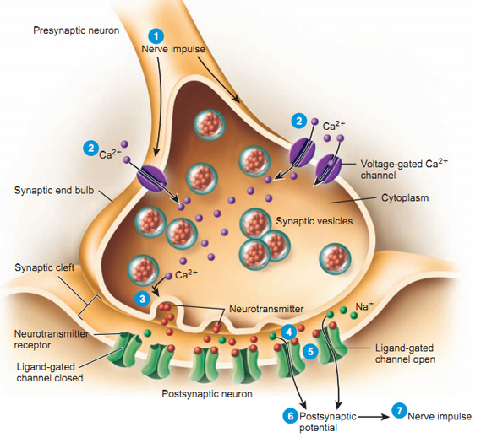

Slide 16
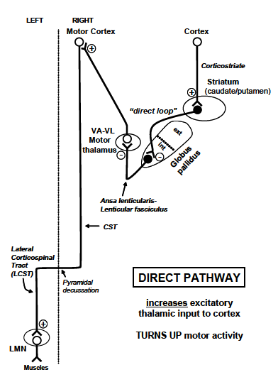
Direct Pathway
Glutamate (excitatory)
GABA (inhibitory)
Notes:
Striatal cells → GP int → inc excitatory drive from thalamus to cortex
Cortical projections → striatum → excitatory transmitter glutamate → activate → cortical projections excite striatal neurons → turn on striatal cell → uses inhibitor transmitter GABA → inhibits cell in GP int
Inc cortical signal → inc inhibition of GP int → less inhibition of motor thalamus (VA/VL) → VA/VL cells inc firing (disinhibition) → inc firing of motor cortex → inc activity in corticospinal tract and muscles
Gamma aminobutyric acid

Slide 17
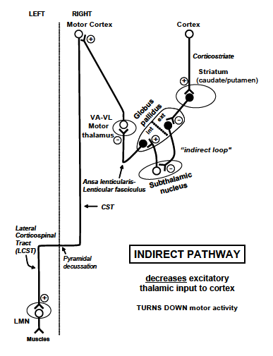
Indirect Pathway

Slide 18
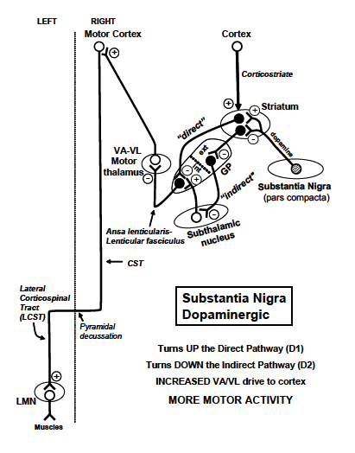
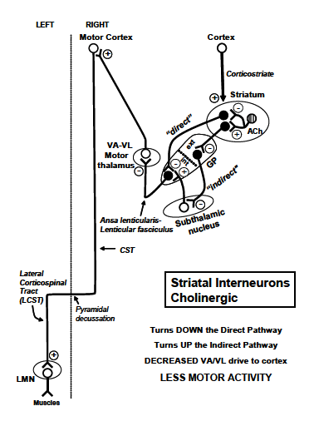
Dopamine & Acetylcholine

Slide 19
Dopamine & acetylcholine
ACh TURNS DOWN MOTOR ACTIVITY
ACh inhibits striatal cells in the direct loop
ACh excites striatal cells in the indirect loop
DA TURNS UP MOTOR ACTIVITY
DA excites striatal cells in the direct loop via D1 receptors
DA inhibits striatal cells in the indirect loop via D2 receptors

Slide 20
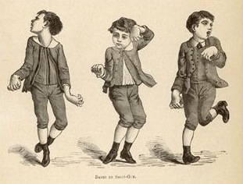
Hyperkinesia
Huntington’s chorea
Damaged subthalamic nucleus
Loss of Striatal-GP(ext) & ACh cells

Slide 21
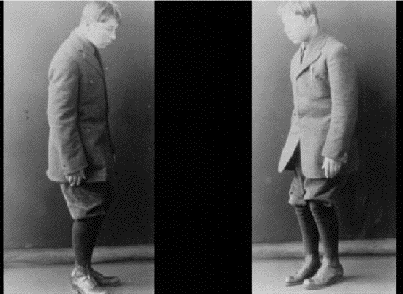
Hypokinesia
Parkinson’s disease
Loss of dopamine cells in substantia nigra
Ach interneurons still functional

Slide 22
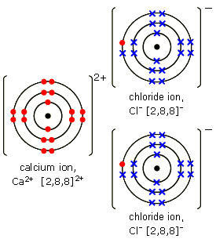
Calcium Functions
Skeleton structure
Muscle contraction (sliding filament)
Secondary messenger
Exocytosis of neurotransmitters
Blood clotting
Notes:
Too much Ca inhibits vitamin D
Hypercalcemia from PTH disease but also probably from Mg deficiency
Calcium homeostasis and other ion levels are normal so they can’t be the ones causing calcification
Chloride passively follows Ca, K & Na

Slide 23
Calcification
Excess calcium
Problem with calcium transporters
Calcium carbonate & calcium phosphate
Sign of tissue damage, cellular aging and impending cell death

Slide 24
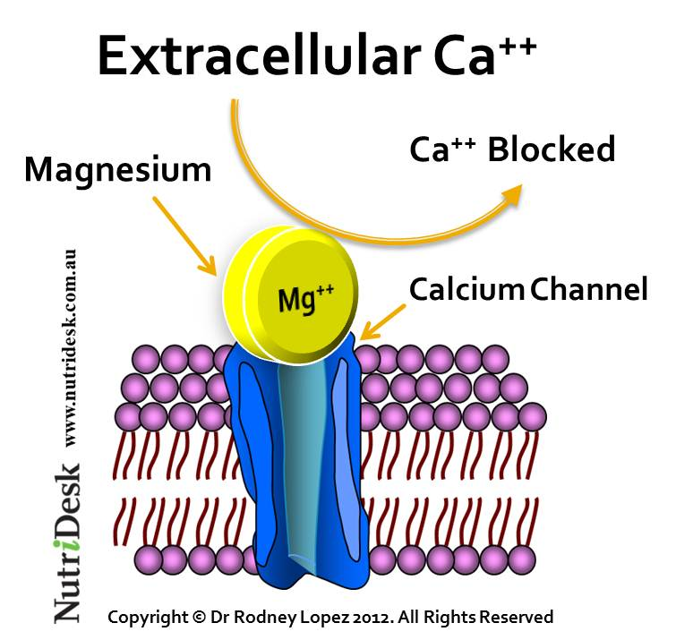
Magnesium
Affects ATP (mitochondria)
Calcium pump inhibition
Magnesium makes calcium more H₂O soluble (more soluble in urine)
Relaxes muscles
Activates thyrocalcitonin

Slide 25
Magnesium
Recommended 2:1 Ca²⁺ to Mg²⁺
Absorption of Mg greater than Ca²⁺ but similar
Caveman diet
Mg²⁺ is excreted with excess Ca²⁺ so excess Ca²⁺ excretion = lower Mg²⁺ levels
Mg²⁺ regulate influx of Ca²⁺ in postsynaptic Ca²⁺ channels from presynaptic neurons in brain

Slide 26
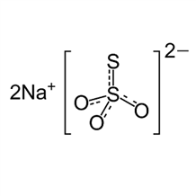
Sodium thiosulfate
Reacts with Ca²⁺ to form calcium thiosulfate = more soluble in urine → decalcification
Calcified deposits → pH decreased → Ca buffer system form blood, bones & tissues → Oxygen lvls fall in acidic conditions

Slide 27
Treatments
Early diagnosis
Measure electrolyte levels (Ca²⁺, Pi & Mg²⁺) and PTH
Examine CSF for infections and viruses
Test SLC20A2 gene
Notes:
Poor response to levodopa (Parkinson’s)

Slide 28
The Future
Research on the causes of bilateral calcification
Development of effective medical treatments

Slide 29
Conclusion
No specific etiologic cause
Symptoms may be confused with other conditions
Lack of effective treatment
Future research is being done

Slide 30
Citations
Amin, O. (2012). Fahr's Disease and Frontal Lobe-Like Cognitive Dysfunction. Journal of Mood Disorders, 2(3): 119-122. doi: 10.5455/jmood.20120608073057
Reeves, A. G. & Swenson, R. S. Chapter 26 – Disorders of basal ganglia function. Retrieved from https://www.dartmouth.edu/~dons/part_3/chapter_26.html
Basal Ganglia (PDF document). Retrieved from http://www.neuroanatomy.wisc.edu/coursebook/motor2.pdf
Sun, M. Yang, S. Juan, C. & Lin, S. (2010). Symmetrical Brain Calcifications. The American Journal of Medicine, 123(2): 131-133. doi: 10.1016/j.amjmed.2009.12.002

Slide 31
Citations
Geschwind, D. H., Loginov, M. & Stern, J. M. (1999). Identification of a Locus on Chromosome 14q for Idiopathic Basal Ganglia Calcification (Fahr Disease). American Journal of Human Genetics, 65: 764-772.
Paraskevas, G. P., Vlachos, G. S., Vassilopoulou, S., Anagnostou, E., Spengos, K. & Zis, V. (2012). Hypoglycemia-induced hemichorea in a patient with Fahr’s syndrome. Neurological Sciences, 33: 1397-1399. doi: 10.1007/s10072-012-1096-8
Zhang, Y., Guo, X. & Wu, A. (2013). Association between a Novel Mutation in SLC20A2 and Familial Idiopathic Basal Ganglia Calcification. Plos One, 8(2): e57060. doi: 10.1371/journal.pone.0057060
Saleem, S., Aslam, H. M., Anwar, M., Anwar, S., Saleem, M., Saleem, A. & Rehmani, M. A. K. (2013). Fahr’s syndrome: literature review of current evidence. Orphanet Journal of Rare Diseases, 8: 156. doi: 10.1186/1750-1172-8-156

Slide 32
Citations
Asokan, A. G., D'souza, S., Jeganathan, J., & Pai, S. (2013). Fahr's Syndrome - An Interesting Case Presentation. Journal of Clinical and Diagnostic Research, 7(3): 532-533. doi:10.7860/JCDR/2013/4946.2814
Arslan, E. D., Yilmaz, F., Koca, S., Uyanik, B., Sonmez, M., & Kavalci, C. (2013). Fahr's Disease and Its Relationship with Hypoparathyroidism: Case Report. Journal of Academic Emergency Medicine, 4: 95-97. doi: 10.5505/jaemcr.2013.59354
Sircus, M. (2009, December 8). Calcification and Its Treatment with Magnesium and Sodium Thiosulfate. DrSircus.com. Retrieved from http://drsircus.com/medicine/magnesium/calcification-and-its-treatment-with-magnesium-and-sodium-thiosulfate
NINDS Fahr's Syndrome Information Page. (2007, February 13). National Institute of Neurological Disorders and Stroke. Retrieved from http://www.ninds.nih.gov/disorders/fahrs/fahrs.htm
Fahr’s syndrome. Wikipedia: The Free Encyclopedia. Retrieved from http://en.wikipedia.org/wiki/Fahr's_syndrome
Goel, A. & Ho, M. et al. Fahr disease. Radiopaedia.org. Retrieved from http://radiopaedia.org/articles/fahr-disease

