Slide 1
Bayesian Network Tool

Slide 2
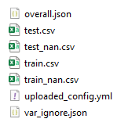
Links
Output of Preprocessing API
Tool : Bayesian Network Analysis Tool
Some documentation of the tool - SMARC/BBN_Capability at dev (hp.com) -> Readme section (might be outdated, but the BBN concepts are accurate)
Preprocessing API: FastAPI - Swagger UI
Bayes Server software: Bayes Server, Overview | Bayes Server

Slide 3
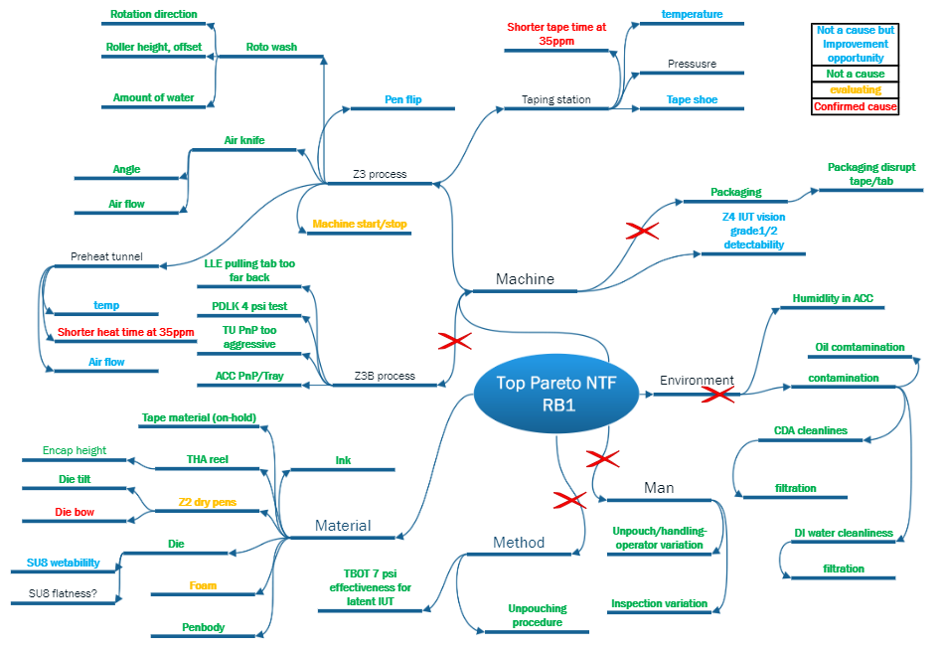
Typical Root Cause Analysis in Manufacturing
A few hours to days depending on the issue.
Difficult to understand the interdependencies between variables.
Done differently by different engineers over time
Notes:
First, I will go through the pain points in RCA in manufacturing.
So What happens during RCA in manufacturing is that .
when something breaks down or an issue occur, the engineers will draw out this diagram here,
It lists down several sources of failure from Machine Material Method and Man.
For each source, it further breaks down into the related factors and parameters that may lead to the issue.
The engineers would then look each source or factor individually to determine if it could be a root cause.
This is extremely time-consuming, and eats away the engineer’s time to do other tasks like equipment maintenance, and hence reduces their productivity.
Even if it does help to narrow down to the cause of the problem, it does not help the engineers to understand the relationships among the factors,
Every time a particular issue happens, perhaps due to different factor each time, the technique used for root cause analysis may be different each time because a different
Engineer may on the job.
Because of this, some knowledge gained from the previous time when it failed does not get transferred to current analysis, and it is almost the same as
Starting afresh each time it fails.
The RCA lacks consistency which is not very ideal and productive for engineers.
-----------------------------------------------
So by having a concrete Root Cause Analysis plan or technique, when something happens or breaks down in the manufacturing line, the engineers can identify a list of potential causes quickly and eliminate the issue without wasting time.
In the long run, it can save costs and improve productivity.
there is a faster response time to the issue, which helps to stop the issue from happening promptly.
Lastly, it helps to optimize and improve processes, so that the issue will not happen ever again.
Lacks consistency and easy repeatability in case of recurring issues. Adhoc basis
Also, engineers usually conduct RCA after a problem has occurred,
there are limited insights on how to prevent the problem from happening in the first place.

Slide 4

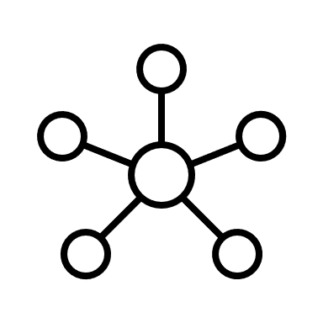

Need a solution for RCA which can…
Identify potential root causes quickly.
Easy to visualize and understand the impact of multiple variables.
Can be improved over time.
Bayesian Networks!
Notes:
An ideal RCA would be one that identify a set of potential root causes quickly.
And something that will help users to understand how all the variables interact and impact each other.
This allows engineers to have a better grasp of their processes and how to handle them if anything happens.
To manage the knowledge gained each time we do a RCA, it will great to have something that can be continuous improved and updated,
This will help to make the diagnosis richer each time, and more reliable since we always adding on to that.
And here comes Bayesian networks which can accomplish all of the above
---------------------
and it even has some predictive element which would help to prevent the problem from happening beforehand.
Engineers can utilize queried data to obtain list of potential root causes within an hour. Setting: Troubleshoot, Problem -> Solution, Analyze using BBN can help us do …
In
When the network is trained and validated well, it could be used to predict events,
such as predicting whether the outputs are going to fail or if the machine is producing at the optimal level.

Slide 5
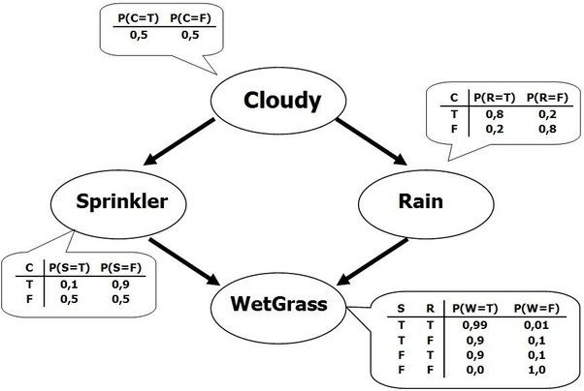


What are Bayesian Networks?
Bayesian networks are acyclic, probabilistic graphical models.
It aims represent relationships among variables, using conditional probabilities.
“The probability of A occurring in the event of B.”
Joint probability distribution can be defined:
$$P\left(X_{1},…, X_{n}\right)=\prod_{i=1}^{n}{P\left(X_{i}\right|Parents_X_{i})}$$
P(Wet Grass, Sprinkler, Rain, Cloudy) =
P( Cloudy) P(Sprinkler| Cloudy)
P(Rain | Cloudy) P(WetGrass | Sprinkler, Rain)
Notes:
Next, I will giving a brief walk through of Bayesian networks and what actually represents.
The graph on the left shows a mini Bayesian network that shows the interaction among the variable Cloudy, Sprinkler, Rain and WetGrass.
Each variable is connected to another via directed edges, which indicates some dependency among the 2 variables.
All the variables here are discrete, which means that they have their own categorical states of T or F.
Because of this property, each variable can easily have its own probability distribution defined, as seen from these tables at the side.
You can also notice that each variable has its probability distribution defined based on its parent.
For eg, sprinkler’s prob is based on Cloudy, for each State of Cloudy, there is a set of probabilities that adds up to 1 for Sprinkler.
In short, Bayesian networks are acyclic, probabilistic graphical models.
By Acyclic, it means that there are no full cycles in the network.
The relationships among variables are represented using conditional probabilities and this is the main building block of the network.
Conditional probabilities refer to the probability of an event given that we know something else has happened.
It allows us to easily calculate and predict events based on a set of assumptions.
The network's joint distribution can then be expressed as a product of all the conditional probabilities of each variable, conditioned on its parents.
---------------------
Such as, this arrow --> which points from Cloudy to Sprinkler; which means that Sprinkler is dependent on Cloudy
In graph theory,
Cloudy is a parent of Sprinkler, Sprinkler is a child of Cloudy.
Probabilistic meaning that the entire network is built on probabilities,
Graphical meaning that each node is the network is a variable, and all the variables are connected by edges.
Next, All variables are conditionally independent of its non-descendants given its parents.
Non-descendants refers to not being a child node.
What this means is that if we know that it is currently cloudy, then we don’t need to know what is likelihood of rain to
Predict Sprinkler. We simply look at this row here, to know what is the probability. Sprinker and Rain are essentially independent of each other.
This mini network here can then be defined as a product of conditional probabilities given its
parents.

Slide 6


Bayesian Network - Manufacturing
Machine 1
Example:
Machine 3
Defective
Machine 2
Satisfactory
Satisfactory
Machine 1
Machine 2
Machine 3
Product
Each machine has a set of sensor measurements → Discretized into states
Product
Diagnostic
Under what machine conditions will there be a high likelihood of failure?
Potential Bayesian network structure
What is the most likely cause of the Defective products?
Notes:
To explain Bayesian network in a manufacturing context,
let's assume that there are 3 machines in the manufacturing line
which produces a product with either satisfactory or defective quality.
As each variable in the network has to have a defined probability distribution, it will be best to work with discrete variables, in order to represent the probabilities accurately.
Therefore, discretization will be applied to continuous variables. If a variable has a range of 0 to 1, it is split into perhaps 3 intervals, each intervals is then a state.
The graph on the right shows a possible network structure of the manufacturing line.
The machines may not be related to each other in a sequential manner, as in the actual process.
The structure is constructed based on the historical data using network-building algorithms.
As mentioned before, Bayesian networks can be used for Diagnosis.
In diagnosis, it can applied if for example
There is a high number of defects, and the engineer would want to know under what conditions does that happen,
Or what machine settings can be adjusted so that the defects can be lowered.
We can also find out what is the most likely cause of the defects,
These questions can be answered using probabilities obtained from network with the appropriate analysis and techniques.
-------------------------------
For Prediction, we may be interested in knowing beforehand if the final product is going to be of good quality
If it is predicted to have defective quality, what process settings can the engineers use to increase the yield
It can also predict what is the machine that will probably breakdown if certain recipes are used.

Slide 7

RCA using Bayesian Network - Technique
Objective 1: Find key variables related to the target variable
State 1
State 2
State 3
Step 1
Mutual information (MI) measures the mutual dependence between the target and predictor variables.
For each machine, calculate the MI value between target and predictor variables.
MI = 0 → Both variables are independent of each other.
Higher the MI value, higher dependency between target and predictor variables.
Find variables that are the ‘most relevant’ to target variable.
Variable 1
State 1
State 2
State 3
State 1
State 2
State 3
Variable 4
Variable 3
State 1
State 2
State 3
Variable 2
Variable 5
State 1
State 2
State 3
Product
Defective
Satisfactory
Potential Bayesian network structure
Notes:
For RCA in Bayesian networks,
It would mean that we want to know what are the set of variables as well as its states which would lead to the highest likelihood of the target variable
Firstly, we will need to identify the variables with the strongest relationship with the target variable.
The metric used here is Mutual information, which can be easily found using probabilities.
It measures the mutual dependence between the target and predictor variable.
This is similar to the correlation metric except that correlation measures linear dependency
Whereas this is more general, and it explains how much information about the target variable is gained if we know the predictor variable.
a value of 0 indicates independence and the higher the value, the higher the dependency between the target and predictor.
Ideally, we would want the variables with the highest MI values.
---------------------------------------------------
To find machines and its states which would lead to the highest probability of Defective products.
Mention variable can be Man, machine method etc. (5M)
As we are using discrete variables only, each machine in the network here has 3 states.
Since we are using probabilities, this problem essentially translate to isolating the.
It is found using the marginal and joint probabilities of both variables, which can be easily found using the network.

Slide 8
RCA using Bayesian Network - Technique
Objective 2: Find key states that are related to the target variable
Step 2:
Assume Variable 1 from Step 1.
Intuition:
1
2
Probability
P(Machine 1 given Product = Defective)
P(Machine 1)
In a typical situation, where nothing is known
Positive; >0
Negative; <0
2
Variable 1
State 1
State 2
State 3
Probability
Possible Root Cause
Less likely Root cause
If we know there is a defective product
1
Variable 1
State 1
State 2
State 3
Notes:
After finding the variables with the strongest relationship, we need to nail down which of its states has the strongest
Correlation with the target.
Assuming that we found variable 1 from the previous step.
The graph here shows the probability distribution of Variable 1.
This is true for any situation where we have no prior knowledge at all,
What this means it that if we simply want to know which state of variable 1 occurs the most number of times on average, it will be state 2.
Suppose now that we see that some defects are passing from the manufacturing line, and there are no other information present,
except that it has defective products.
So then, we can insert this knowledge by using conditional probability.
This probability will be the probability of variable if we know that there are some defects.
So we can see that there is a obvious spike in State 1 comparing to the graph above and state 2 decreased significantly in probability.
This tells us that oh State 1 is the most likely state for Variable 1 when there is a defective product, and not so much for State 2.
This concept can be expressed by taking the difference between the probabilities from these 2 scenarios, and a positive difference would indicate a likely root cause, while negative difference will mean it is less likely to happen.
Therefore, combining this with the previous step, we will have a list of variables and its probable states, that are highly related to the target variable.
engineers could do a deep-dive into these variables to see if there exist any correlation to the issue, so this gives them something to starts with and focus on when the situation arises.

Slide 9


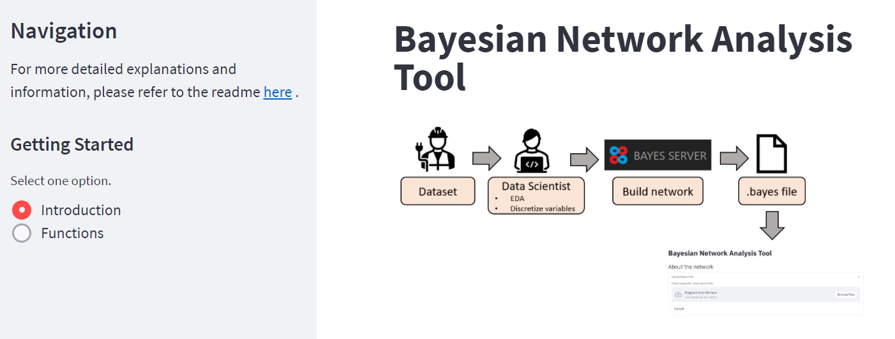





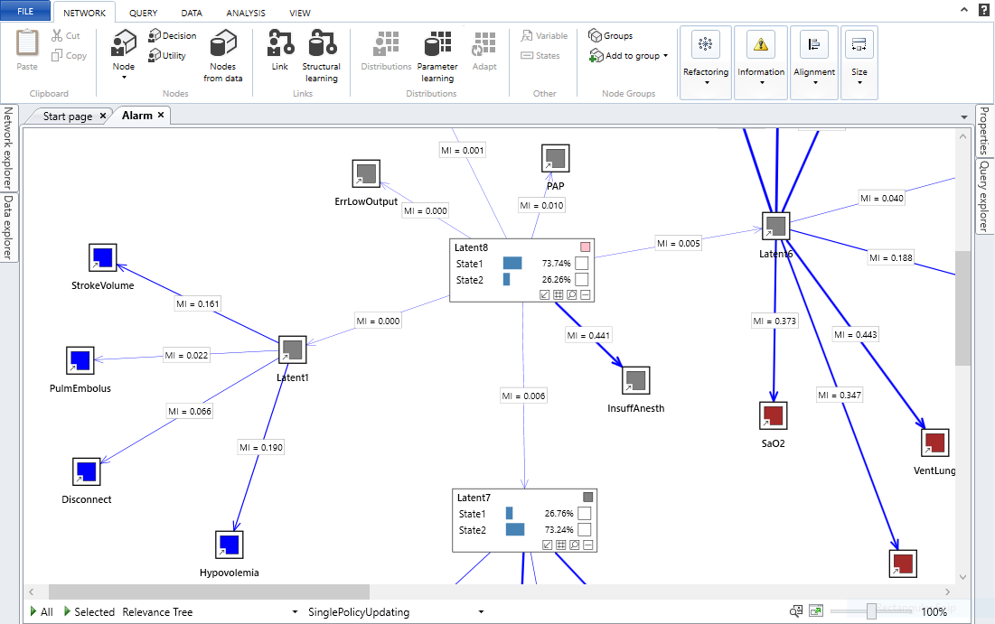
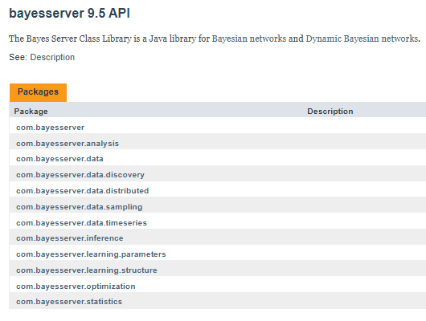
Implementation – Building Bayesian Network Analysis tool
Bayes Server software
Build a user interface
Specialises in building Bayesian networks for analysis
Integrate Bayes Server functions with Python
User interface
Code
Notes:
To introduce and implement Bayesian networks for engineers derive insights, we are using a licensed software called Bayes Server.
This software specialises in building Bayesian networks for industry use cases, it includes many functions for analysis and predictions.
The software consists of a user interface and a code base. The code base contains all the functions found in the software.
As the software may be confusing and complex to use, we decided to build a simplied and user-friendly platform using the code base.
We integrated the codes into a Python environment and repackaged it into API endpoints.
This allows us to easily call and combine Bayes Server functions according to our needs.
The user-interface is built using streamlit and it calls the API endpoints to return the output results.
The tool is then hosted on our team's server and available for use as long as you are connected to HP’s network/
This approach allows many users to enjoy the functionality of Bayes Server without having to download the entire software.

Slide 10
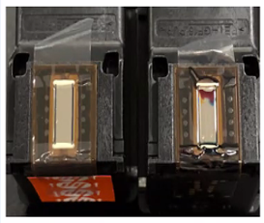
Use Case: Ink Under Tape (IUT)
Some ink cartridges faced Ink Under Tape (IUT) issues.
High IUT failures (25.81%) in May and June 2021 for Pluto Plus.
Normal pen Ink Under Tape
Demo
Notes:
Next I will be presenting a use case in manufacturing where we applied bayesian network to troubleshoot an ink under tape issue.
Ink under tape is as the term suggests, you see here in the picture on the right, there is some ink leakage happening under the transparent tape.
This issue happened to some ink cartridges in the hestia and pluto plus products mid last year.
There was a high percentage of this failure and it resulted in these cartridges being scrapped.
There could be several sources of factors coming from Man method machine or material from the process that could cause IUT failure.
That’s why it is very useful to build a network to combines all these factors together, to identify the potential causes.
Next I will be giving a demo of the tool based on this use case.
--------------------------------------
Pen = cartridge
Black portion is where the ink leaks out
(die)
Circle portion → connected to printhead
Historical data (engineer finds it useful; parameters identified – to be validated)
Mainly zone 1
After June 2021, the issue is not happening as often now; now it is reduced
It is happening in the staging process
- Staging -> keep it aside for a few to see if there’s anything happening to the product
Sample some pens
At the
- latent

Slide 11




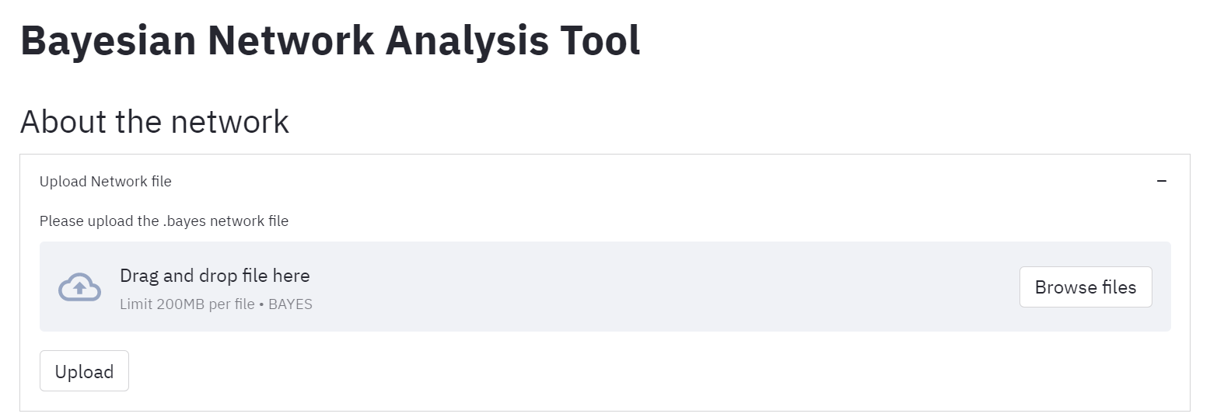

Implementation – User workflow
upload
return
Pass to
Dataset
Preprocess site
Train + Test datasets
Network training site
Network file
Preprocessing pipeline
Remove outliers
Discretize continuous variables using K-Means Clustering
Network training
Network trained and validated by Data Scientist and engineers.
Retraining to update network’s parameters available.
11
Notes:
The causes identified are still being investigated by the engineers, ( so far they have been using the tool, and they find it quite useful)
This slide here shows the current user workflow of the tool.
First the engineers will pass the data to us to run through the data preprocessing pipeline./
The pipeline, helps to remove the outliers and discretize the continuous variables into categorical states, returning a train and test sets for us to construct the network using bayes server.
The network can be saved in a file and pass to engineers. Engineers can simply upload the file on the tool and use the functions available.
---------------------------------------------------------------------
Optimal number of clusters obtained using silhouette score.

Slide 12
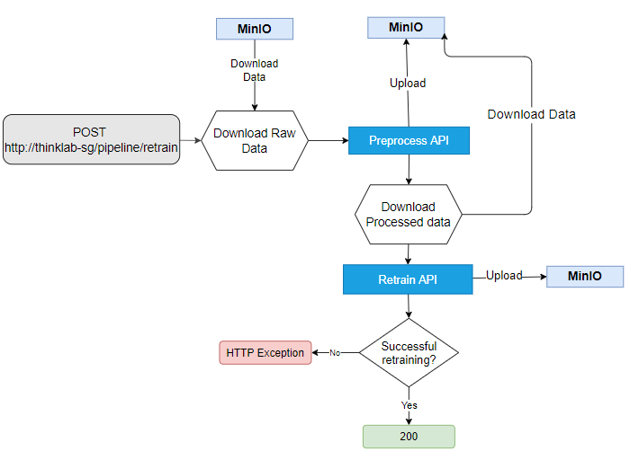


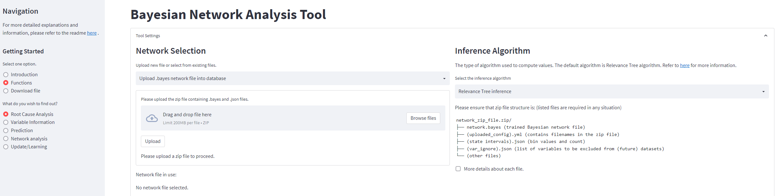
Pipeline Implementation
In a fixed time interval,
Process
Process
Process
Measurements collected
Data Aggregator
Source:
Notes:
Next, I will be sharing what the retrain pipeline does and how it is applied to engineers.
This pipeline can be triggered to run periodically, maybe once a month, to collect all the measurements data or sensors.
This is pulled and run by the data pipeline or data aggregator which will clean and combine the data from different data sources, into a single CSV file.
This csv file will be used to retrain the network.
Engineers and data scientists can also use this aggregated data for their own analysis, saving the time spent on pulling data from different places.
The data file is uploaded onto a cloud storage, we are currently using minio to store the files for this pipeline.
The moment it is uploaded, it will call this API located at this address, and this whole workflow is started on our team’s server.
It will download the data file from minio, run its preprocessing steps required for Bayesian networks and feed it to the retraining function.
The updated network file is uploaded to MinIO, and the file is accessed via the Bayesian Network Analysis Tool.

