Slide 1
WHOLE SCHOOL ASSEMBLY • BLACK BRITISH HISTORY
BEYOND THE SINGLE STORY
Deep Roots of Black British History: Roman York to the Modern Era
CORE ENQUIRY & ASSEMBLY MESSAGE
Black British history did not begin with the Windrush generation in 1948—it stretches back nearly two thousand years through the Roman Empire, Tudor royal courts, and the founding of modern Britain.
PUPIL 1
PUPIL 2
PUPIL 3
PUPIL 4
Roman York (350 AD)
Tudor Courts (1511)
Civil Rights (1931)
Windrush Era (1948)
Notes:
========================================================
SPEAKER: PUPIL 1
========================================================
[STAGE DIRECTIONS / CUES]
Advance to Slide 2 when introducing Roman York and the Ivory Bangle Lady.
[SCRIPT]
"Good morning, everyone.
When people talk about Black British history, many assume it begins in 1948 with the arrival of the Empire Windrush.
We often think of it as a relatively modern story. But history tells a very different tale. Black people have lived, worked, and shaped life on this island for nearly two thousand years."

Slide 2
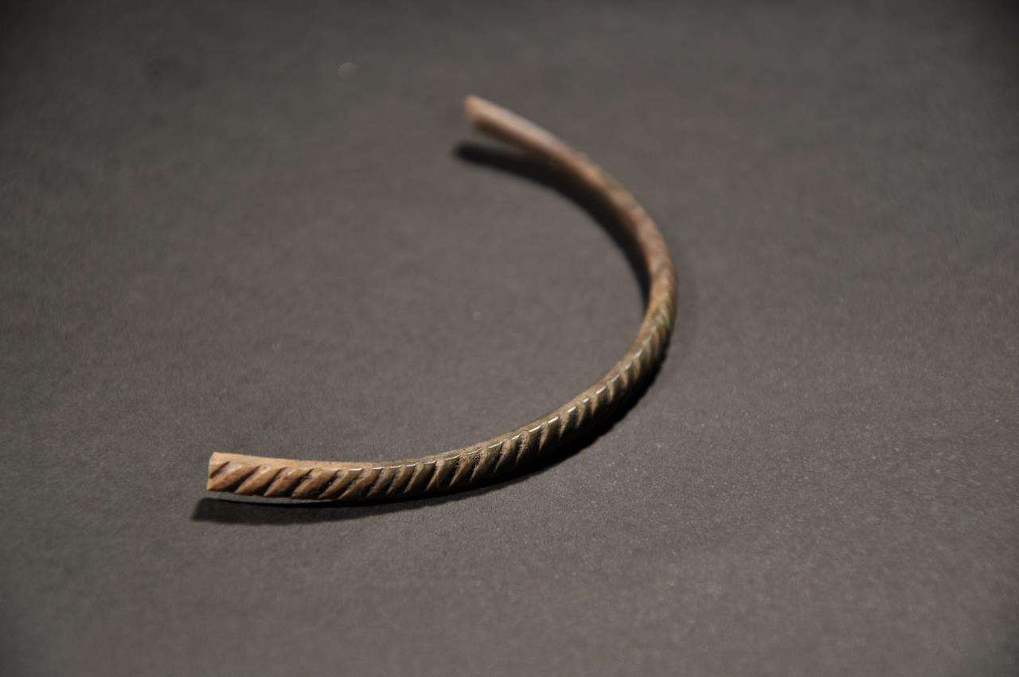
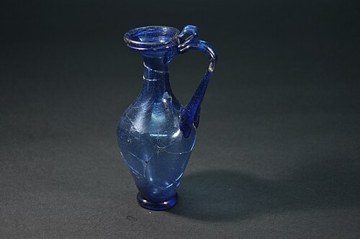
ACT I: ROMAN BRITAIN • 4th CENTURY YORK (EBORACUM)
Delivered by: Pupil 1
The Ivory Bangle Lady: High Status in Roman Britain
THE DISCOVERY (YORK, 1901)
In 1901, archaeologists in York excavated a stone sarcophagus dating to c. 350 AD containing the skeleton of a wealthy high-status woman.
EXPENSIVE GRAVE GOODS
Buried with luxury goods: an armlet carved from elephant ivory, jet bracelets, fine glass perfume bottles, beads, and a Christian bone mount.
York Museums Trust: Elephant ivory armlet with rope pattern (c. 350 AD)
FORENSIC & ISOTOPE ANALYSIS
Modern facial reconstruction and chemical isotope analysis of her teeth prove she grew up in a warmer climate and was of North African descent.
HISTORICAL SIGNIFICANCE:
"She was not enslaved or an outsider; she was a member of Roman Britain’s wealthy elite. Britain was multicultural long before it was even called Great Britain."
Roman blue glass perfume flask recovered from the York sarcophagus
Notes:
========================================================
SPEAKER: PUPIL 1
========================================================
[STAGE DIRECTIONS / CUES]
Hand handover to Pupil 2. Advance to Slide 3: John Blanke.
[SCRIPT]
"Our first story takes us all the way back to the 4th century, to Roman Britain—in the city of York.
In 1901, archaeologists uncovered a stone sarcophagus containing the skeleton of a woman. Along with her remains were expensive bracelets made of jet and elephant ivory, glass perfume bottles, and fine jewellery.
Forensic analysis revealed she was of North African descent, and she lived in York around the year 350 AD. She became known as the Ivory Bangle Lady.
She wasn’t an enslaved person or an outsider; she was a wealthy, high-status member of Roman British society. Her presence proves that Britain was multicultural long before it was even called Great Britain."

Slide 3
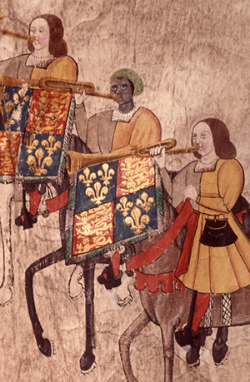
ACT II: TUDOR ENGLAND • THE ROYAL COURT OF HENRY VII & HENRY VIII
Delivered by: Pupil 2
John Blanke: Royal Musician at the Heart of the Tudor Court
REGULAR ROYAL TRUMPETER
John Blanke served as a retained court musician to both King Henry VII and King Henry VIII, performing at major state coronations and royal ceremonies.
WESTMINSTER TOURNAMENT ROLL (1511)
Illustrated twice on the 60-foot illuminated royal vellum roll celebrating the birth of Henry VIII’s son, riding on horseback in royal Tudor livery.
THE SUCCESSFUL PAY PETITION
Court warrants preserve his handwritten petition directly to King Henry VIII requesting a pay rise to eight pence a day—which the King signed and approved.
HISTORICAL SIGNIFICANCE:
"John Blanke was not an onlooker—he was a respected, skilled professional at the very centre of Tudor royal ceremony and spectacle."
College of Arms: John Blanke on the 1511 Westminster Tournament Roll
Notes:
========================================================
SPEAKER: PUPIL 2
========================================================
[STAGE DIRECTIONS / CUES]
Handover to Pupil 3. Advance to Slide 4: Dr. Harold Moody.
[SCRIPT]
"Move forward a thousand years to Tudor England, and we find another remarkable figure: John Blanke.
John Blanke was a gifted musician who served as a regular trumpeter in the royal courts of both King Henry VII and King Henry VIII.
We don't just know about him from written records—we can actually see him. In 1511, Henry VIII held a massive tournament to celebrate the birth of a royal son. An illuminated 60-foot scroll called the Westminster Tournament Roll was created to document the occasion.
Twice on that scroll, John Blanke is painted riding a horse, wearing royal Tudor livery and playing his trumpet alongside the other royal musicians.
Court records also show something fascinating about his character: he wrote a petition directly to King Henry VIII asking for a pay rise—and the King approved it.
John Blanke was a respected professional at the very centre of royal court ceremony."

Slide 4
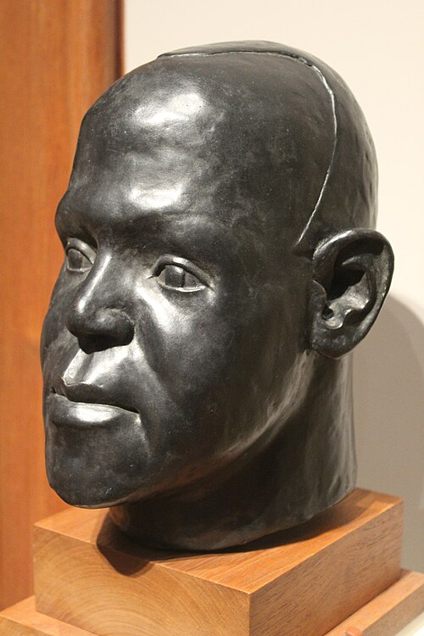
ACT III: EARLY 20th CENTURY • MEDICAL PIONEER & CIVIL RIGHTS LEADER
Delivered by: Pupil 3
Dr. Harold Moody: Fighting for Healthcare & Equality
ACADEMIC EXCELLENCE & BARRIERS (1904)
Born in Jamaica, arrived in London in 1904 to study medicine at King’s College London. Graduated top of his class, yet hospital posts were denied due to racial prejudice.
COMMUNITY DOCTOR IN PECKHAM (1913)
Refusing to give up, opened his own surgery in Peckham in 1913. Became beloved across south London for treating impoverished working-class families free of charge.
THE LEAGUE OF COLOURED PEOPLES (1931)
Founded Britain’s first major civil rights organization in 1931. Campaigned relentlessly against racist housing bans and employment discrimination in military and civil services.
HISTORICAL SIGNIFICANCE:
"Dr. Moody campaigned tirelessly for decades, successfully overturning racial colour bars and laying the direct groundwork for Britain’s modern race relations laws."
National Portrait Gallery: Dr Harold Moody (1882–1947) by Ronald Moody
Notes:
========================================================
SPEAKER: PUPIL 3
========================================================
[STAGE DIRECTIONS / CUES]
Handover to Pupil 4. Advance to Slide 5: The Windrush Generation.
[SCRIPT]
"Fast-forward to London in the early 20th century, and meet Dr. Harold Moody.
Born in Jamaica, Harold arrived in Britain in 1904 to study medicine at King’s College London. He graduated top of his class and won numerous medical prizes.
Yet, when he applied for doctor roles in London hospitals, he was repeatedly turned down simply because of the colour of his skin.
Instead of giving up, Dr. Moody opened his own private GP surgery in Peckham, South London, in 1913. He became beloved by the local community because he treated poor families for free when they couldn't afford medicine.
In 1931, seeing how Black people in Britain faced unfair barriers in finding jobs and renting homes, he founded the League of Coloured Peoples.
Dr. Moody campaigned tirelessly for decades, successfully challenging discriminatory housing policies and racist employment bans. He laid the direct groundwork for Britain’s modern race relations laws."

Slide 5
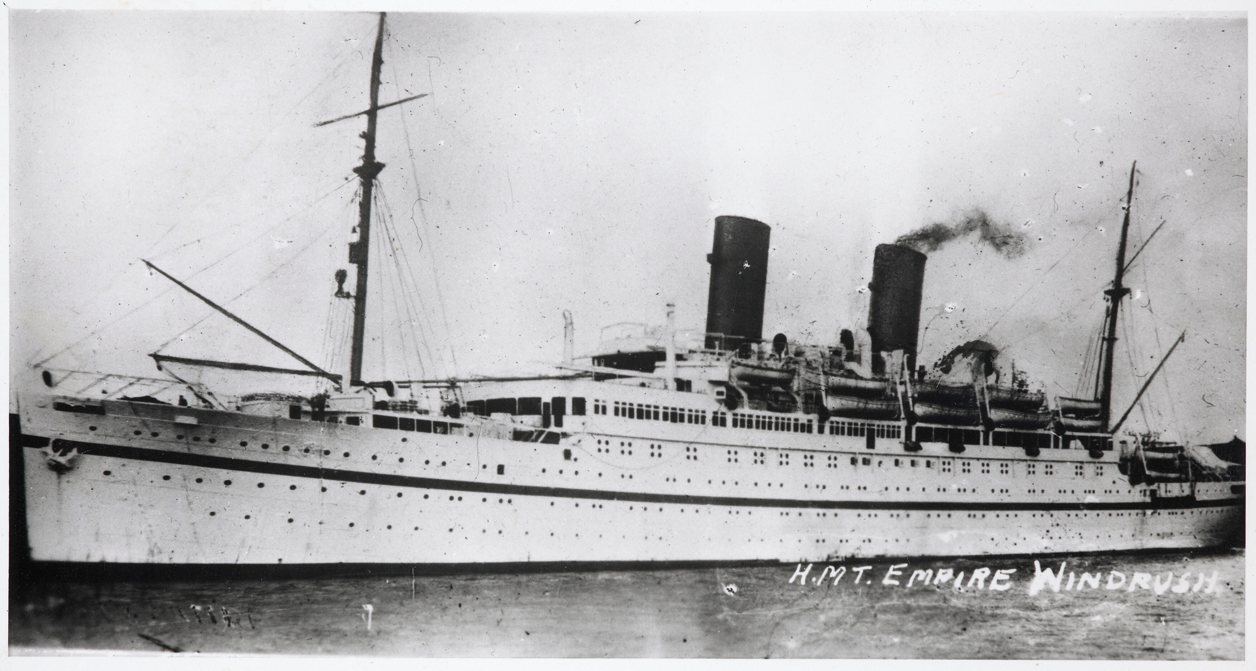
ACT IV: POST-WAR BRITAIN • REBUILDING THE NATION (1948 ONWARDS)
Delivered by: Pupil 4
The Empire Windrush: Rebuilding Britain & Creating the NHS
THE CALL TO REBUILD (JUNE 1948)
Facing severe post-war labour shortages and bomb devastation, the British government invited Commonwealth citizens to help rebuild industry, transport, and cities.
BACKBONE OF THE NEW NHS
Arriving in the exact month the National Health Service was founded (July 1948), Caribbean men and women became the vital nurses, doctors, and staff powering our hospitals.
VIBRANT CULTURAL TRANSFORMATION
Enriched British music, literature, art, and food, giving rise to celebrated global cultural institutions such as London’s Notting Hill Carnival.
Imperial War Museum: HMT Empire Windrush arriving at Tilbury Docks, 22 June 1948
HISTORICAL SIGNIFICANCE:
"They became the engine room of modern Britain. Their resilience and contribution shaped the public services and cultural life we all depend on every single day."
Notes:
========================================================
SPEAKER: PUPIL 4
========================================================
[STAGE DIRECTIONS / CUES]
Handover to all 4 pupils for shared conclusion. Advance to Slide 6: Reflection.
[SCRIPT]
"That brings us to 1948 and the Empire Windrush.
After the Second World War, Britain was devastated by bombing and facing a massive shortage of workers to rebuild towns, run transport systems, and staff hospitals.
The British government invited citizens from across the Commonwealth to come and help rebuild the country. Hundreds of Caribbean men, women, and families answered that call.
They became the engine room of modern Britain. They drove the buses, laid the railway tracks, and became the backbone of our newly founded National Health Service.
They also enriched British music, literature, food, and culture, turning events like the Notting Hill Carnival into celebrations known across the world.
Their resilience and contribution shaped the public services we all depend on every single day."

Slide 6
CONCLUSION & WHOLE SCHOOL REFLECTION
"How Deep Do Our Shared Roots Go?"
PUPIL 1
BELONGING & CONTINUITY
PUPIL 2
SHARED FOUNDATIONS
"History is not just about isolated dates; it is about belonging. Black history is not a separate topic tucked away for one month of the year—it is part of the deep, continuous story of Britain itself."
"As we head into our day, let's remember that Britain's story has always been built by people from diverse backgrounds working, creating, and standing together."
PUPIL 3
MOMENT OF PAUSE
PUPIL 4
CLOSING THE ASSEMBLY
"Take ten seconds of quiet now to reflect on how learning our full, shared history helps us build a stronger community today."
"Thank you for your attention. Have a great day, everyone."
⏱️ WHOLE SCHOOL SILENCE: 10 SECONDS OF QUIET REFLECTION
Reflecting on 2,000 years of shared history and building a stronger school community together.
Notes:
========================================================
SHARED CONCLUSION (ALL 4 PUPILS)
========================================================
PUPIL 1:
"So why does this matter?
Because history is not just about isolated dates; it is about belonging.
From the Roman streets of York to the Tudor royal court, and from a community doctor’s surgery in South London to the arrival of the Windrush—Black history is not a separate topic tucked away for one month of the year.
It is part of the deep, continuous story of Britain itself."
PUPIL 2:
"As we head into our day, let's remember that Britain’s story has always been built by people from diverse backgrounds working, creating, and standing together."
PUPIL 3:
"Take ten seconds of quiet now to reflect on how learning our full, shared history helps us build a stronger community today."
[PAUSE: 10 SECONDS OF SILENCE]
PUPIL 4:
"Thank you for your attention. Have a great day, everyone."

