Slide 1
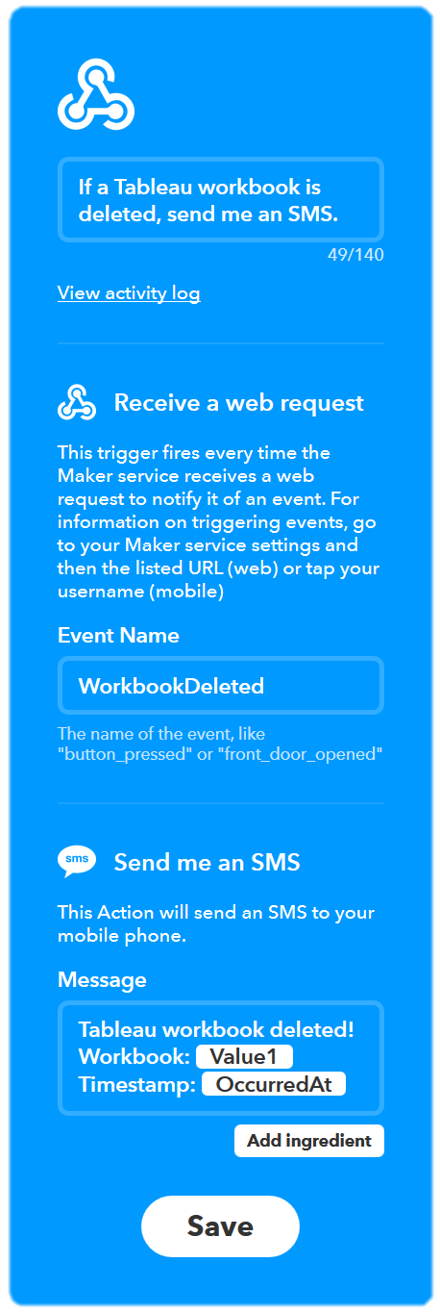
Configuring IFTTT for incoming webhooks to SMS
Webhook Name
Use this to describe your applet. This can be set to anything you want.
Event Name
Set this to the type of event that is coming in from Tableau. This is called “event-type” in the JSON body.
SMS Message
The message that will be sent out via SMS. Mixture of text and variables. Variables can be: EventName, Value1, Value2, Value3, and OccurredAt. The ValueN variables are passed in the JSON body in the incoming webhook.

