Slide 1
HAWQ MPP SQL for HDFS of Hadoop 基于Hadoop原生HDFS的大规模并行SQL

Slide 2
HAWQ Is The…
Enterprise platform that provides the fewest barriers, lowest risk, most cost effective and fastest way to enter in to big data analytics on HDFS of Hadoop
Notes:
Field Engineers delivering this presentation to customers are presumed to have experience working with HD/HAWQ or have attended HD/HAWQ immersion training.

Slide 3

HAWQ 简述
SQL Engine
CPU
Multi-User Platform
ANSI SQL 2003/2011 Support
Mem
Cost-Based Query Optimization
Resource Queues
Disk
Robust Query Optimizer
Users
Concurrency
Complex Data Management
Data Encryption
Sub-Partitioning
Role-Based Security
Distributions
Partitioning
Accessibility
Storage Options
ODBC/JDBC Driver L3,4
Greenplum database re-platformed on Hadoop/HDFS
Polymorphic Storage
txt
Parallel Loading/Unloading
Avro
Row/Columnar Storage
HDFS Native Formats
Seq
Built-in Compression
Extendable…
HBase
HDFS Native Formats
Hive
MapReduce Integration

Slide 4
HAWQ的优点…
支持Apache Hadoop原生HDFS的SQL大规模并行引擎（MPP SQL）
GPFX External Tables 接口，使用SQL透明访问Hadoop上各类数据
HDFS, HBase, Hive，Parquet格式等等
还支持SQL透明访问NFS，HTTP其他格式的数据（可自定义）
Performance and Scalability
Parallel Everything
Dynamic Pipelining
High Speed Interconnect（基于UDP）
HDFS access with C++ libhdfs3
Co-Located Joins & Data Locality
Partition Elimination（支持静态动态表分区）
Higher Cluster Utilization
Concurrency Control（资源作业优先级调度）

Slide 5
HAWQ 及Hadoop软件栈
HAWQ– MPP SQL
ANSI SQL + Analytics
Resource Management & Workflow
Xtension Framework
Catalog Services
Query Optimizer
Dynamic Pipelining
Yarn
HDFS
Zookeeper
Data Loader
Flume
Apache
HAWQ Added Value
Notes:
Start with basic HD and then comment about the addition of a true SQL interface

Slide 6



HAWQ 与 Hadoop HDFS
HAWQ
Master
Master
Segment
Segment
Segment
Segment
…
Segment
Data
Data
Data
Data
…
Data
Name
Name

Slide 7
HAWQ 与 Hadoop HDFS数据访问流
Master host
HAWQ Interconnect
Segment host
Segment host
Segment
Segment
Segment
Segment
Segment
Segment
Segment
Segment
Segment host
Segment host
Segment
Segment
Segment
Segment
Read/Write
B
Datanode
Datanode
replication
Datanode
Datanode
Rack1
Meta Ops
Rack2
Namenode
HDFS

Slide 8

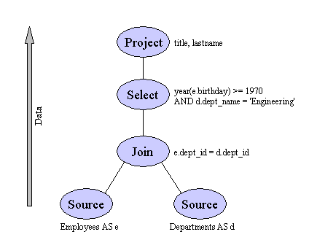

HAWQ 对比 Greenplum DB 基本架构
SQL 大规模并行处理
SQL MPP (Massively Parallel Processing) 无共享架构 Shared-Nothing Architecture
SQL
MapReduce
Master 节点
生成查询计划并派发
汇总执行结果
...
...
Network
Interconnect
Segment 节点
执行查询计划及数据存储管理
...
...
外部数据源
并行装载或导出
数据库存储层
Sharding+Replica

Slide 9
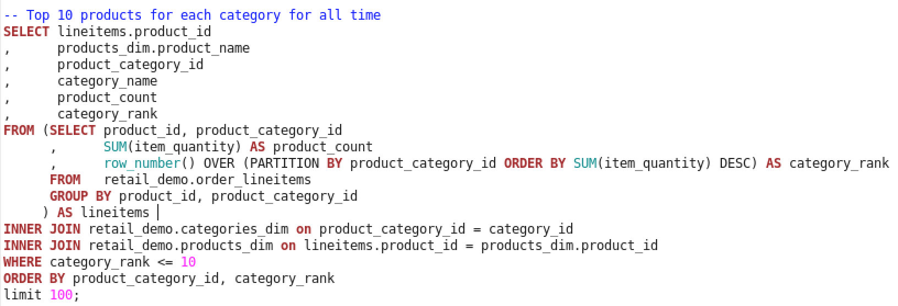
运行SQL，支持SQL2008及OLAP选项

Slide 10


HAWQ（SQL MPP）机制-1
Clients
SELECT beer, price
FROM Bars b, Sells s
WHERE b.name = s.bar
AND b.city = ‘San Francisco’
HAWQ Master Host
Query Parser
JDBC/ODBC
Query Optimizer
SQL Console
HDFS Namenode
HAWQ Segment Host
HAWQ Segment Host
HAWQ Segment Host
Query Executor
Query Executor
Query Executor
. . .
HDFS Datanode
HDFS Datanode
HDFS Datanode

Slide 11
HAWQ（SQL MPP）机制-2
Optimization Context
Clients
Parse Tree
HAWQ Master Host
Metadata
Query Parser
JDBC/ODBC
Query Optimizer
Cost Model
SQL Console
HDFS Namenode
Resources
HAWQ Segment Host
HAWQ Segment Host
HAWQ Segment Host
Query Executor
Query Executor
Query Executor
. . .
HDFS Datanode
HDFS Datanode
HDFS Datanode

Slide 12
HAWQ（SQL MPP）机制-3
Execution Plan
Shuffle
Clients
HAWQ Master Host
Query Parser
JDBC/ODBC
Query Optimizer
SQL Console
HDFS Namenode
Reduce
HAWQ Segment Host
HAWQ Segment Host
HAWQ Segment Host
Query Executor
Query Executor
Query Executor
. . .
Map
HDFS Datanode
HDFS Datanode
HDFS Datanode

Slide 13
HAWQ（SQL MPP）机制-4
Clients
HAWQ Master Host
Query Parser
JDBC/ODBC
Query Optimizer
SQL Console
HDFS Namenode
HAWQ Segment Host
HAWQ Segment Host
HAWQ Segment Host
Query Executor
Query Executor
Query Executor
. . .
HDFS Datanode
HDFS Datanode
HDFS Datanode

Slide 14
HAWQ（SQL MPP）机制-5
Clients
HAWQ Master Host
Query Parser
JDBC/ODBC
Query Optimizer
SQL Console
HDFS Namenode
HAWQ Segment Host
HAWQ Segment Host
HAWQ Segment Host
Query Executor
Query Executor
Query Executor
. . .
Dynamic Pipelining™
HDFS Datanode
HDFS Datanode
HDFS Datanode

Slide 15
HAWQ（SQL MPP）机制-6
Clients
HAWQ Master Host
Query Parser
JDBC/ODBC
Query Optimizer
SQL Console
HDFS Namenode
HAWQ Segment Host
HAWQ Segment Host
HAWQ Segment Host
Query Executor
Query Executor
Query Executor
. . .
HDFS Datanode
HDFS Datanode
HDFS Datanode

Slide 16

数据分布方式(Data Distribution)
Data can be distributed based on a column or a composite of columns
Tables distributed similarly are co-located
Distribution scheme modifiable thru alter table
Advantages:
Co-located joins
No data movement on joins or aggregates
Improved performance on complex queries
Query engine optimization
Table A
DN1
DN2
DN3
X=1
X=2
X=3
X=4
X=5
Y=1
Y=2
Y=3
Table B
SELECT X FROM A,B WHERE A.X = B.Y
SELECT SUM(X) FROM A GROUP BY A.X

Slide 17

数据互联框架(Xtension Framework)
An advanced version of Greenplum DB external tables
Enables combining HAWQ data and Hadoop data in single query
Supports connectors for HDFS, Hbase and Hive
Provides extensible framework API to enable custom connector development for other data sources
Xtension Framework
HDFS
HBase
Hive
Notes:
HDFS
Delimited Text
Sequence File
GPDB Writable Format
Protocol Buffer
Avro
Hbase
Predicate Pushdown
Hive
RCFile
Text File
Sequence File

Slide 18










数据导入导出(Loading/Unloading Data)
gpload, gpfdist, External Tables
PXF {Native Hadoop Files}
Spring XD
Flat Files, CSV, Delimited, …
HDFS Flat Files, CSV, Delimited, …
Java Development Framework
Existing RDBMS Systems
Hive
Web Tables, JSON, XML, HTML, …
HBase {w. predicate push-down}
Executing Scripts, …
Avro, RCFile, SeqFile
Open extendable API
Traditional Tools
Available on Github: Accumulo, JSON,…
Postgres insert, copy, …
DataLoader
File Farms
ODBC + JDBC drivers
Streaming || Batch Mode
Pivotal Data Dispatch {PDD}
Flume, … integration
Integration with ETL tools…
Throttling, Compression, … features
HAWQ 里数据导入导出仍是全并行

Slide 19



HAWQ External Tables
gpload, gpfdist, External Tables
Flat Files, CSV, Delimited, …
Existing RDBMS Systems
Web Tables, JSON, XML, HTML, …
Executing Scripts, …

Slide 20




HAWQ and Hadoop Native File Formats
PXF {Pivotal eXtention Framework}
HDFS Flat Files, CSV, Delimited, …
Hive
HBase {predicate push-down}
Avro, RCFile, SeqFile
Open extendable API
Available on Github: Accumulo, JSON,…
Read/Write

Slide 21


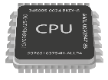


更强大的资源管理器,兼容YARN
HAWQ
HAWQ Queries
Resource Queue 1
Memory Consumption %
HAWQ (%)
Resource Queue 2
HIGH
Resource Queue …
MED
CPU Utilization
LOW
divide system memory for resource queue
YARN - MAPREDUCE
MapReduce
Pig
Hive
MAPRED (%)
# of Disk Operations
M
M
M
R
R
YARN NODEMANAGER
Memory Consumption %
HDFS DATANODE
OPERATING SYSTEM
Notes:
Describe the last slide visually
Explain that the user has ability to distribute how resources are divided between mapreduce, hawq, and other processes (not available with HAWQ or imapla)
Also explain that even within the context of hawq resources can be divided amongst the resource queues
Also explain that hawq resources assign memory, cpu, cost (disk fetches) where YARN at the moment only supports memory

Slide 22
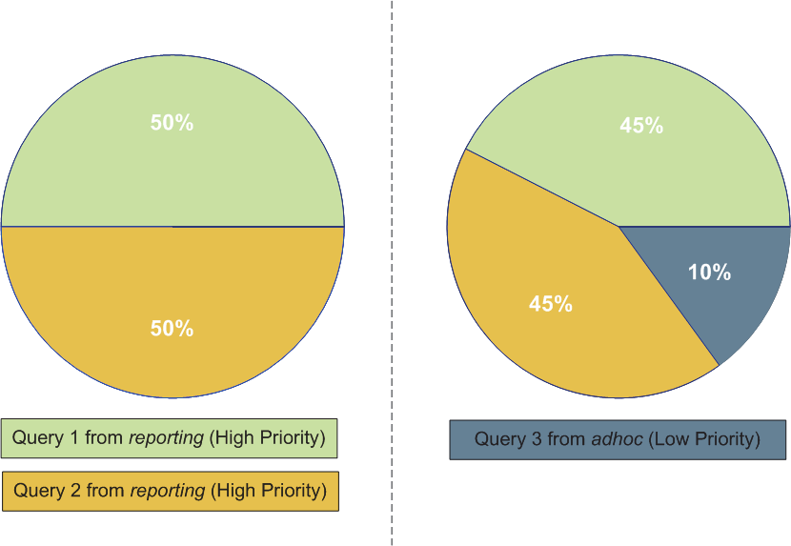
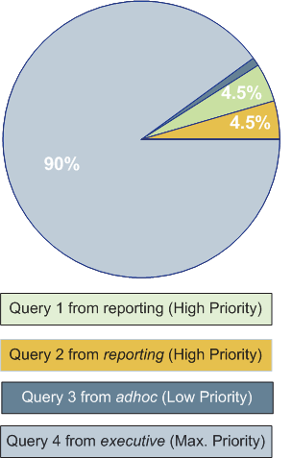
运行时资源可控 (Dynamic Resources Allocation)
Notes:
Dynamic resource allocation
Think there’s only 2 queries both with high priority then they split resources 50/50
Another query comes in with low priority and it shifts the resources to 45/45/10
Then another query comes in with max priority and based on the settings of the queue it’ll utilize the maximum allowed resources. The final allocation is 90/4.5/4.5/1

Slide 23
SQL for Hadoop功能对比
Feature | Hive | Impala | HAWQ
Work with HDFS native file formats | ✓ | ✓ | ✓
Polymorphic Storage | ✓ | ✓ | ✓
Advance SQL (ANSI SQL2008 & OLAP support) | ✖ | ✖ | ✓
Partitions and compression | ✓ | ✓ | ✓
Data Locality | ✓ | ✓ | ✓
Distributions, Join, Aggregate Locality | ✖ | ✖ | ✓
Join Optimization | ✖ | ✖ | ✓
Spill to disk (query must fit in memory) | ✓ | ✖ | ✓
Fault tolerance during large query execution | ✓ | ✖ | ✖
Granular Security and authentication | ✖ | ✓ | ✓
Extendable (Serdes) | ✓ | ✖ | ✓
Resource Management | ✖ | ✖ | ✓
Open-source code | ✓ | ✓ | ✓
Notes:
todo

Slide 24


HAWQ 性能对比-1
User intelligence | 4.2 | 37
Sales analysis | 8.7 | 596
Click analysis | 2.0 | 50
Data exploration | 2.7 | 55
BI drill down | 2.8 | 59
9X
69X
25X
20X
21X
Notes:
What would take you an hour with Impala would take you 1 minute with Hawq
We are talking orders of magnitude in terms of performance
In addition there’s a level of complexity that only Hawq can handle
And remember, this is just basic SQL, where Hawq’s advanced capabilities, like query optimization and dynamic pipelining, are not fully utilized

Slide 25

HAW性能对比-2
User intelligence | 4.2 | 198
Sales analysis | 8.7 | 161
Click analysis | 2.0 | 415
Data exploration | 2.7 | 1,285
BI drill down | 2.8 | 1,815
47X
19X
208X
476X
648X
Notes:
What would take you 24 hours with Hive you can do in 3 minutes

Slide 26
部分应用案例

Slide 27

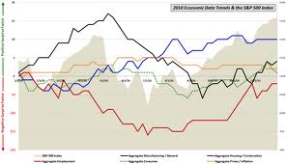

某企业解决方案
运维人员
管控人员
业务人员
管理人员
决策人员
数据
科学家
用户访问层
流程调度层
历史查
询应用
大数据分析应用
实时
分析应用
管理分析应用
沙盘
演练应用
数据应用层
历史归档数据区
大数据区
实时数据区
管理分析应用数据区
沙盘演
练数据区
结构化数据区
库存实时
变化数据
客户管理
财务管理
绩效管理
供应链管理
……
大数据存储区
数据存储计算层
数据管控层
主题数据区
社交媒体
用户评价
用户订单
实时数据
经营体
产品大类
用户
……
汇总区
访问日志
移动互联
音频视频
……
……
用户主题
营销主题
产品主题
……
明细区
数据交换层
非结构化数据交换
结构化数据交换
各数据区数据交换
数据
产生层
企业内外部半结构化、非结构化数据
xx商城
E-Hub系统
E-Store系统
SCRM系统
……系统

Slide 28







大数据分析应用：用户雷达
产品分析
经营实体分析
竞争对手分析
ODBC
ODBC
ODBC
Hadoop
HAWQ
用户雷达数据集市
用户雷达分析器
京东
淘宝
苏宁
国美
一淘
商城
官网
产品主数据
数据仓库

Slide 29




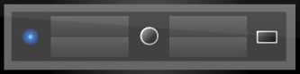
方案架构图
Gemfire
spring xd admin
gemfire xd locator
HAWQ master
spring xd container
gemfire xd server
HAWQ segment
spring xd container
gemfire xd server
HAWQ segment
ZooKeeper
HDFS

