Slide 1
Block 2 Project
Connect 4

Slide 2
Why I chose this game
Mostly because by the time I was officially assigned the project, this was the idea that I had put the most thought into. I knew how to start coding it and how I might represent the board.
I also had an idea for the algorithm to check for a win state.

Slide 3
My Plan
To implement the board as an array of vectors on the backend and a grid of labels/boxes on the front end. To have the button inputs change only the array and have the grid be based soley on the array.
The buttons need only be placed on the top, as you can only select the column that you wish to move in.
I will need a program to scan the array for winning board states.
Such a program can be made from one that checks a single row/column at a time and iterate over the array.
Then I will need to make a custom program specifically for diagonals (This will be a challenge).

Slide 4
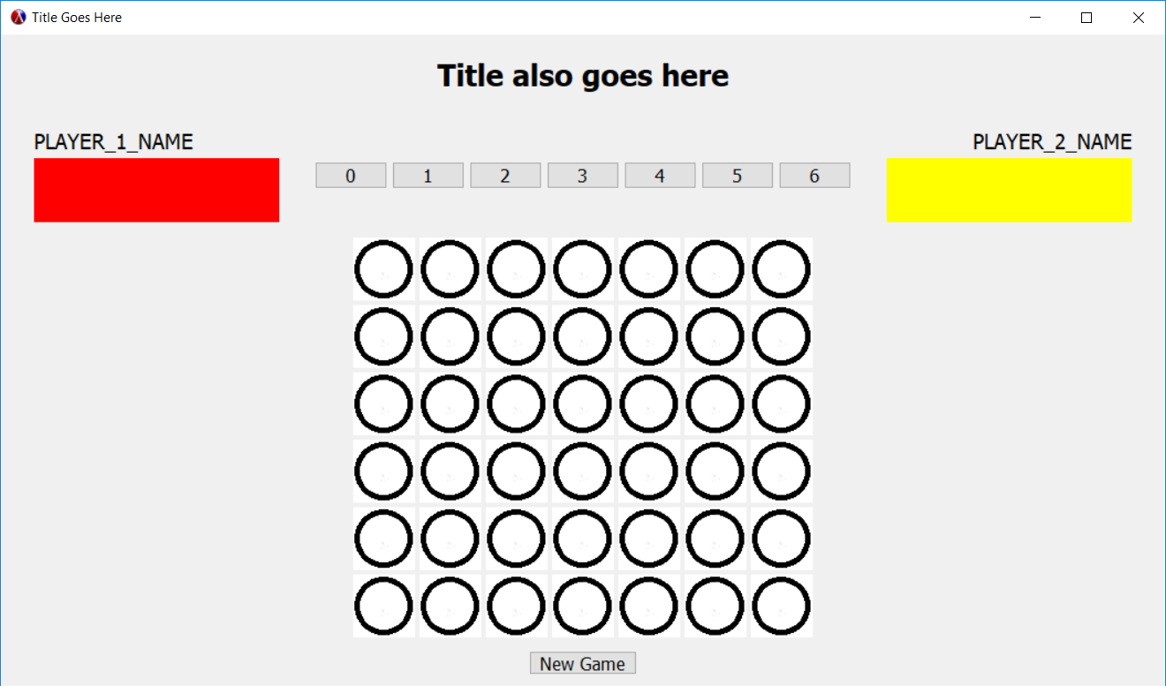
Prototype GUI

Slide 5
GUI Code
I would paste the code at this point here but:
a) it doesn’t want to paste in here
b) Its 360 lines long
The reason why I chose to code the GUI first is so that I don’t have to code up a temporary GUI to test the logic, then remove that and add in the final GUI without breaking anything.
Creating the GUI first also sets up a strong framework of variable names to base the logic code off of.

Slide 6
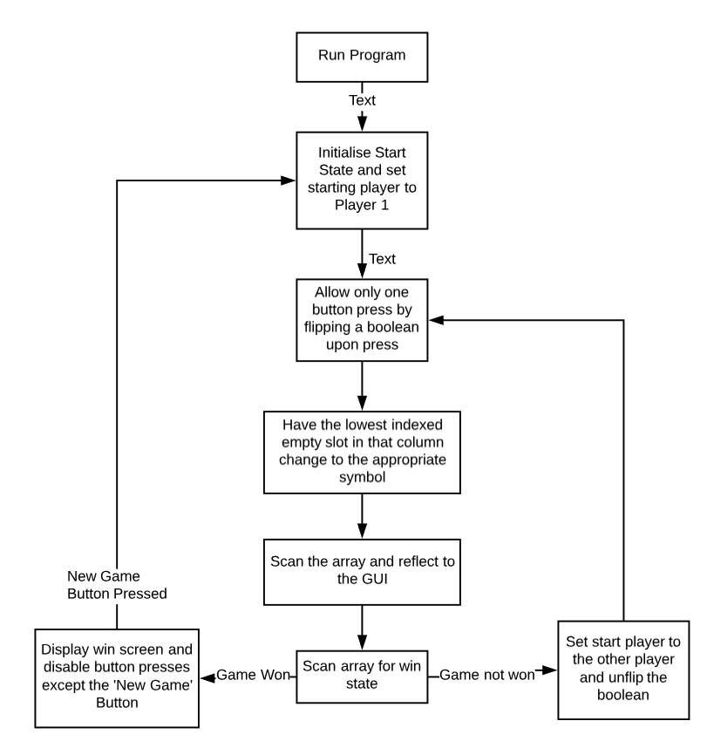
Logic Diagram

Slide 7
Logic Coding – 18/1
Today I added the array that will represent the board to the code and mocked up code that will:
  allow players to make only one move per turn
  look for the next suitable slot on the column selected
  put a correctly coloured piece there
  switch the tracker for player-turn to the other player.

Slide 8
Logic Coding – 20/1
Today I:
  Added the board to the main project file
  Added the place-piece function to the main project file and fixed it so it appeared to do the right task (i.e. did not test the function at this point)
  Wrote the place-piece-column-x functions
  Wrote the start-game function
  Wrote the array-reflect function
None of these are bound to buttons or tested for now as I wanted to save, backup and document today’s work before I lost all of the work for today.

Slide 10
Logic Coding - 21/1
Today I rewrote array-reflect and tested the array-reflect, place-piece, start-game and place-piece-column-x functions.
  array-reflect worked
  place-piece failed
  place-piece-column-x worked as far as calling place-piece
  start-game partly worked
I then worked on fixing the problems with place-piece and discovered that the code to set turn-done and turn-marker to their new values did not run.

Slide 11
Logic Coding - 22/1
Today I worked on fixing the problem I discovered yesterday.
With help from Franco I found out that I had misplaced some brackets as well as an unnecessary let construct.
I also learnt that turn-done was unneeded so I rewrote place-piece to not use turn-done.
Then I added a message% to tell the user(s) whose turn it is and change after a move is made.
Finally I fixed start-game to work properly by resetting the board. It is currently the callback of the New Game button which will be moved to the game won or game draw screen once that is made.

Slide 12
Logic Coding - 23/1
I didn’t do any coding today but I did show off the project to someone which allowed me to test for bugs.
I didn’t find any bugs.

Slide 13
Logic Coding - 24/1
Today I added lots of features to the project:
Firstly 3 dialog% windows that inform the players when a player has won (1 each) or if the board has been filled with no winner and therefore there is a draw.
Secondly 3 functionally identical New Game buttons (1 for each dialog% window) that reset the vector array and then send false to the show function of each dialog. This effectively auto closes the dialog window.
Thirdly a new horizontal-panel% was added below the game board along with 3 buttons added to the panel each triggering show on the new dialog%s to temporarily test functionality before I write in the full code to check for a game win or draw.
This panel will of course be commented out before the deadline.

Slide 14
Logic Coding – 24/1 Part 2
Next I began coding the multipart function that will check for a win or draw state and trigger the dialog%s I made earlier.
The super-function check-state will run the functions:
  check-win-h-red
  check-win-h-yellow
  check-win-v-red
  check-win-v-yellow
  check-win-d-red
  check-win-d-yellow
  check-draw
The h,v or d stands for horizontal, vertical or diagonal.

Slide 15
Logic Coding - 25/1
Today I got help from Julian to fix check-win-h-red and to simplify it into a more concise function.

Slide 16
Logic Coding - 26/1
Today I expanded on check-win-h-red, adding code to check for horizontal wins by yellow also.
Then I removed check-win-h-yellow and renamed check-win-h-red to check-win-h.
Next I adapted check-win-h to make check-win-v.
Finally I made check-draw at the end.

Slide 17
Logic Coding - 27/1
Today I wrote up the code to check for a win diagonally and tested it.

Slide 18
Logic Coding - 28/1
I added a instruction button and reset button on a new horizontal-panel%.
I added a new dialog% to show instructions and a string to hold instructions.
I set the callback of the reset button to restart the game.
I planned an idea for recording who won the game as well as the appropriate dialog% and button%.

Slide 19
Logic Coding – 30/1 and 31/1
I altered the player banner graphics to include text.
I removed the message%s for the original text.
I rearranged the GUI to make better use of space and deleted all unnecessary panel%s.

Slide 20
Logic Coding - 28/1
I fixed the alignment issue from the previous day where when the window was enlarged or made to be full screen the button-row did not move along with all other panels to the middle of the window and instead stayed aligned to the left side.
I’m not sure how this happened, but applying borders to all panels and removing them entirely again has fixed the problem.
Go figure. :)

Slide 21
Logic Coding – 30/1
Today I added proper comments to the code, fixed white space and proofread this powerpoint.

Slide 22
Feedback
The turn marker section is not very obvious.
I am not sure how to make it more obvious as it’s already in bold font.
The players tried to click on images (both board and banner).
This could be corrected by removing the button row and all buttons on it then replacing the message%s currently containing the images with button%s. I would then have to rewrite the whole game logic to accept buttons in array-reflect and write a new place-piece function to still only let pieces be placed in the lowest slot on each column no matter which button on that column is pressed.
I was also trying to emulate the physical act of placing your piece above the column you wanted to place the piece in and letting it go by placing the column buttons above the columns.
To fix this I will set the instructions to come up at the beginning so its more clear how to play the game (if the users bother to read it).

