Slide 1
Grand Challenges vs Actual Challenges Text mining small and big data for quantitative insights
Ian Kretzler
Joss Whittaker Ben Marwick
Department of Anthropology University of Washington

Slide 2
Motivation and methods

Slide 3
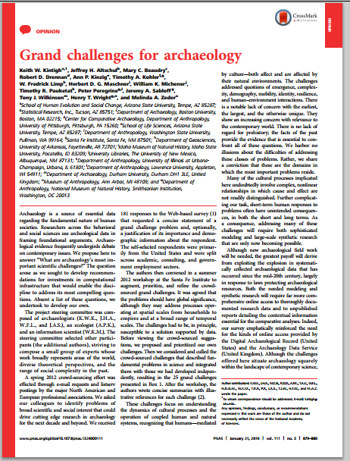
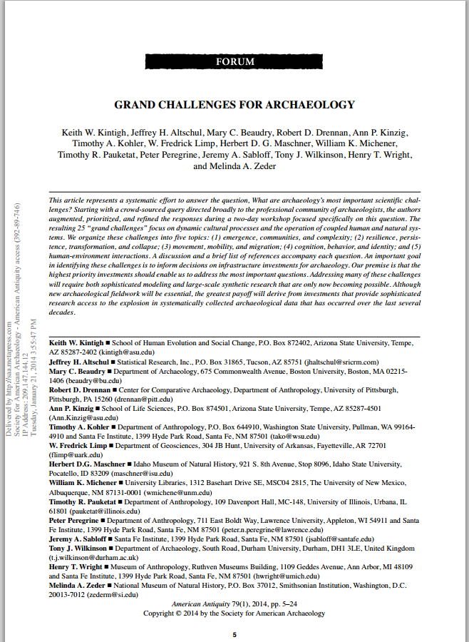
Bold claims about what’s important for archaeologists

Slide 4
A. Emergence, communities, and complexity
B. Resilience, persistence, transformation, and collapse
C. Movement, mobility, and migration
D. Cognition, behavior, and identity
E. Human–environment interactions

Slide 5
181 responses identifying 190 challenges
US (77%), Europe (12%)
Academic (45%), consulting (32%), gov (32%)
50 yrs or older (66%), 30–49 (32%), <30 (2%)
Male (62%), female (38%)

Slide 6
Reactions came online immediately, mostly negative

Slide 7
Representativeness of the sample
Small number of respondents
Demographic skew of respondents
Low diversity among the respondents
And of the authors of the survey
Some research areas over-represented (eg. environmental topics) and under-represented (eg. states, empires, and processes of domination).

Slide 8

Raw survey data openly available in an open repository… :)

Slide 9
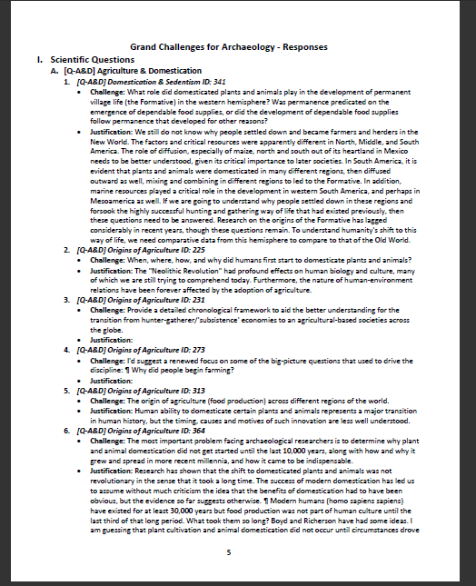
…in a PDF :(
…but the responses are tagged :)

Slide 10
Q1. What did archaeologists actually write in that survey?
Q2. Can we identify bias in the interpretation of the survey responses?
Q3. What do archaeologists actually write about in general?

Slide 11
Methods

Slide 12
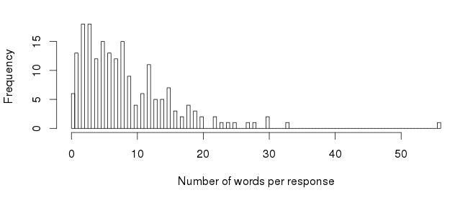
High freq. terms & association
K-means clustering
K-nearest neighbor classification
All data and code are freely available at https://github.com/benmarwick/SAA2015-Macroanalysis-Marwick_Kretzler_Whittaker

Slide 13
Results

Slide 14
Climate: responses, adaptive, document
Field: matter, widely, academia
Funding: citizen, image, value, government
History: humbleness, logic migration
Past: knowledge, solutions, wonderful

Slide 15
Population: prehistory, cause conflict
Sites: value, funding, crisis, decay
Social: flux, ecology, capacity
Timing: arrow, bow, dart

Slide 16
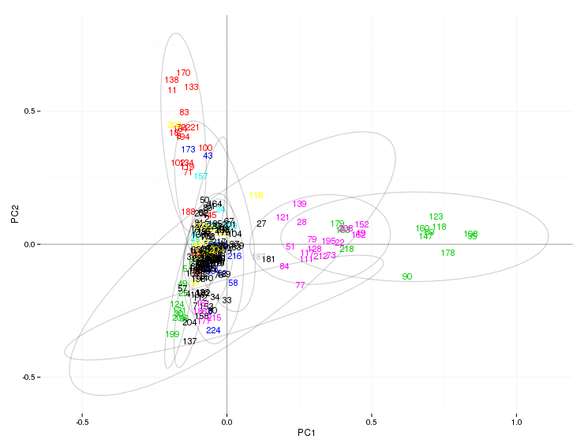
K-means clustering

Slide 17
Combining theory and practice There is a lot of theoretical discussions in but mostly it is an isolated branch of its own Archaeological practice
I'd suggest a renewed focus on some of the big‐picture questions that used to drive the discipline
How do we remain professionally and ethically to descendant groups the general public
The analysis of lithic assemblage variability
Refining existing dating techniques and developing new ones to assist of artifact poor regions and periods
Predict the effects of global climate in regions of the by determining how such has affected human society economy and history in the past

Slide 18
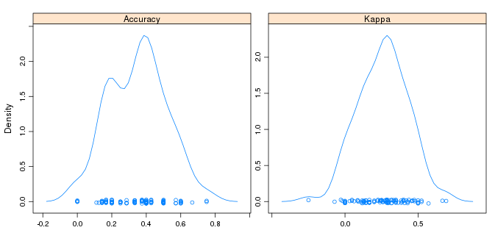
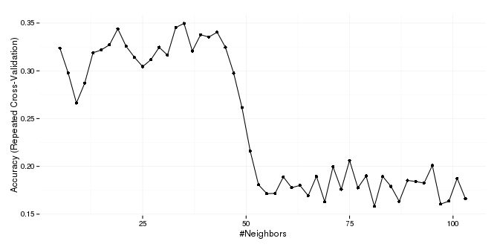
kNN classification

Slide 19
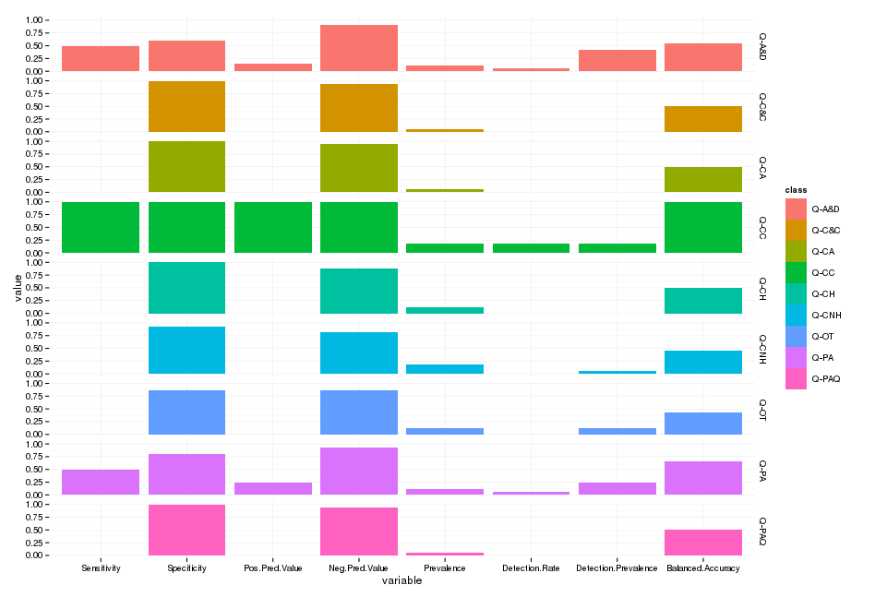

Slide 20

Agriculture and domestication
Climate change
Peopling of America

Slide 21
a single word, two words, sets of words over time
most frequent words by n-year ranges of documents (ie. top words in all documents published in 2-5-10 year ranges, whatever you like)
the top n words correlated with a word by n-year ranges of documents (ie. the top 20 words associated with the word 'pirate' in 5 year ranges)
various methods (k-means, PCA, affinity propagation) to detect clusters in a set of documents containing a word or set of words
topic models with the lda package for full R solution or the Java-based MALLET program
JSTORr
Motivated by Google Ngram Viewer
But especially for journals held by JSTOR

Slide 22


Why JSTOR?

Slide 23
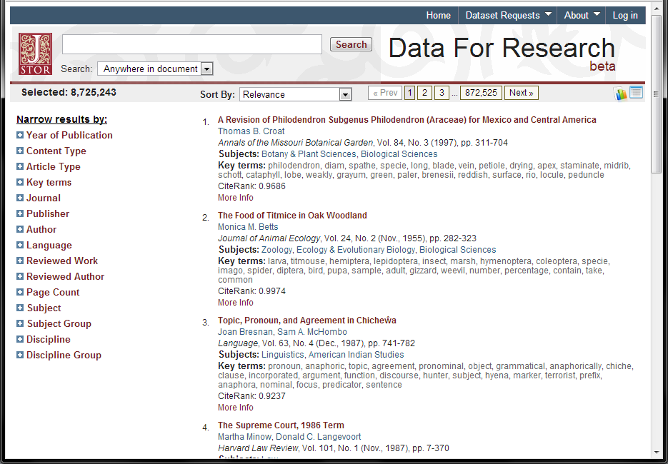
http://dfr.jstor.org/

Slide 24
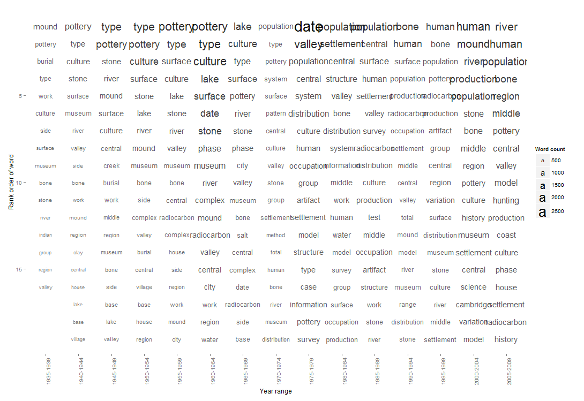
American Antiquity

Slide 25
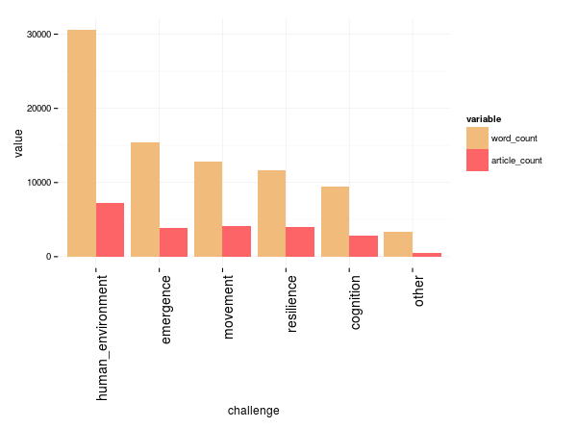

Slide 26
To conclude…
Quantitative analysis of the survey data suggests researcher bias in the ‘Grand Challenges’
Archaeologists find practical concerns highly challenging
Emphasis on climate change, agriculture/domestication & first peopling is supported

Slide 27


