Slide 1






Bright idea
article.qmd
text,
citations
code
article.docx
data.csv

Slide 2
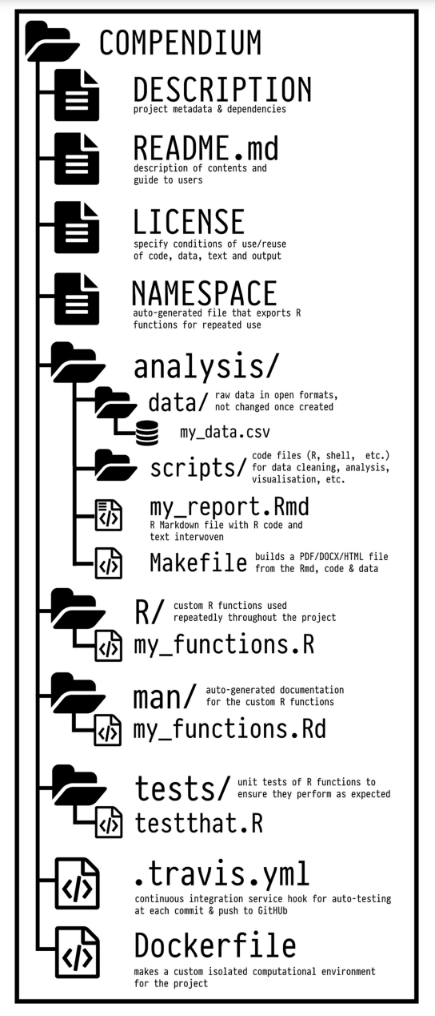
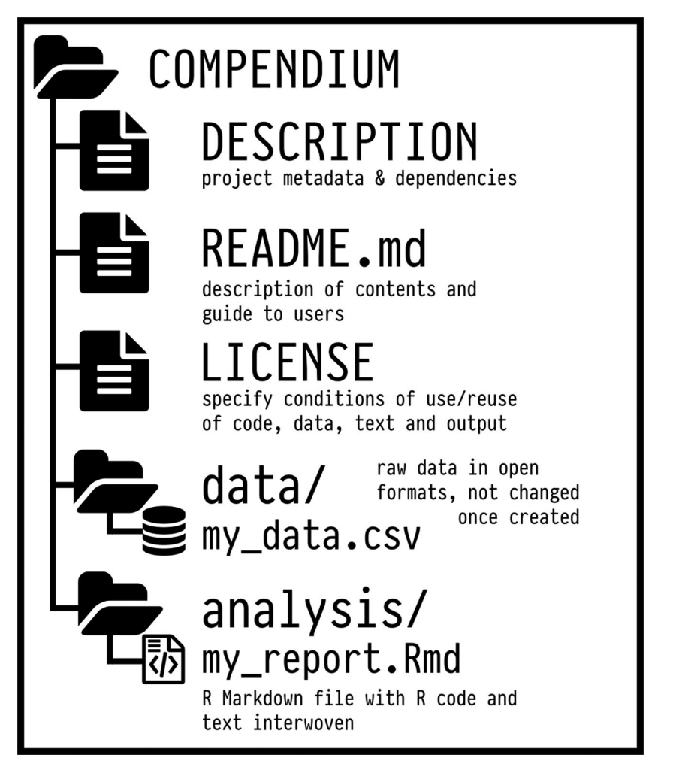
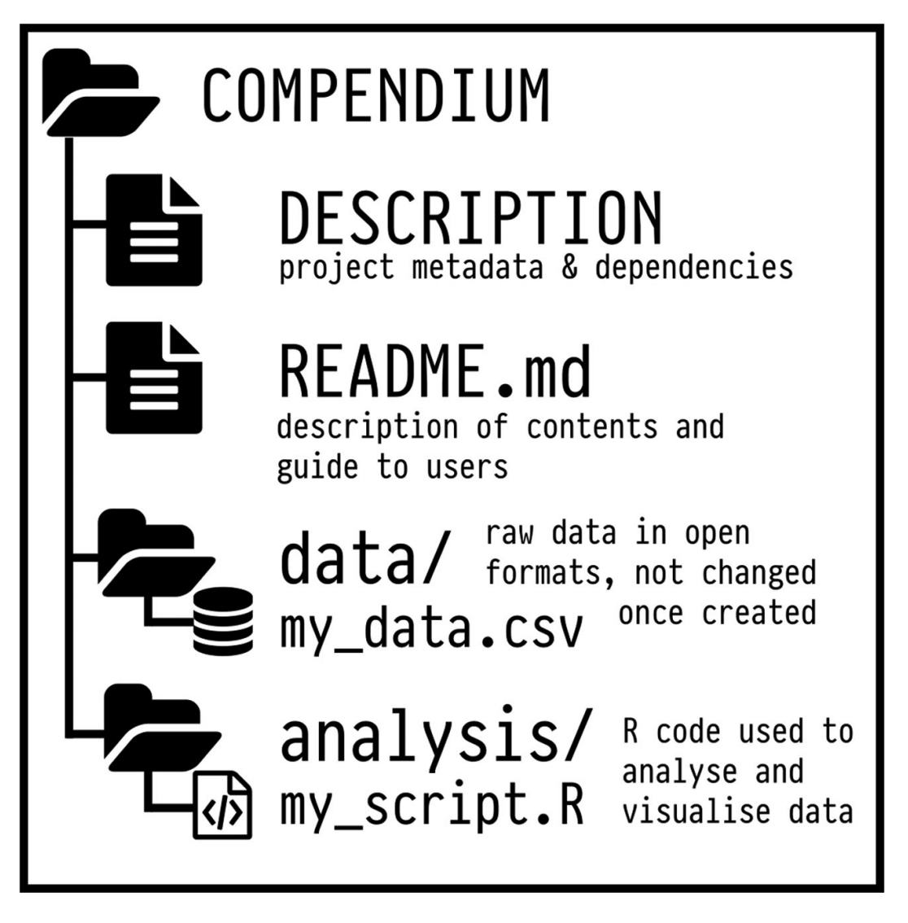
Ben Marwick, Carl Boettiger & Lincoln Mullen (2018) Packaging Data Analytical Work Reproducibly Using R (and Friends), The American Statistician, 72:1, 80-88, DOI: 10.1080/00031305.2017.1375986
An example of a small research compendium.
An example of a more complete use of the R package structure for a research compendium

