Slide 1
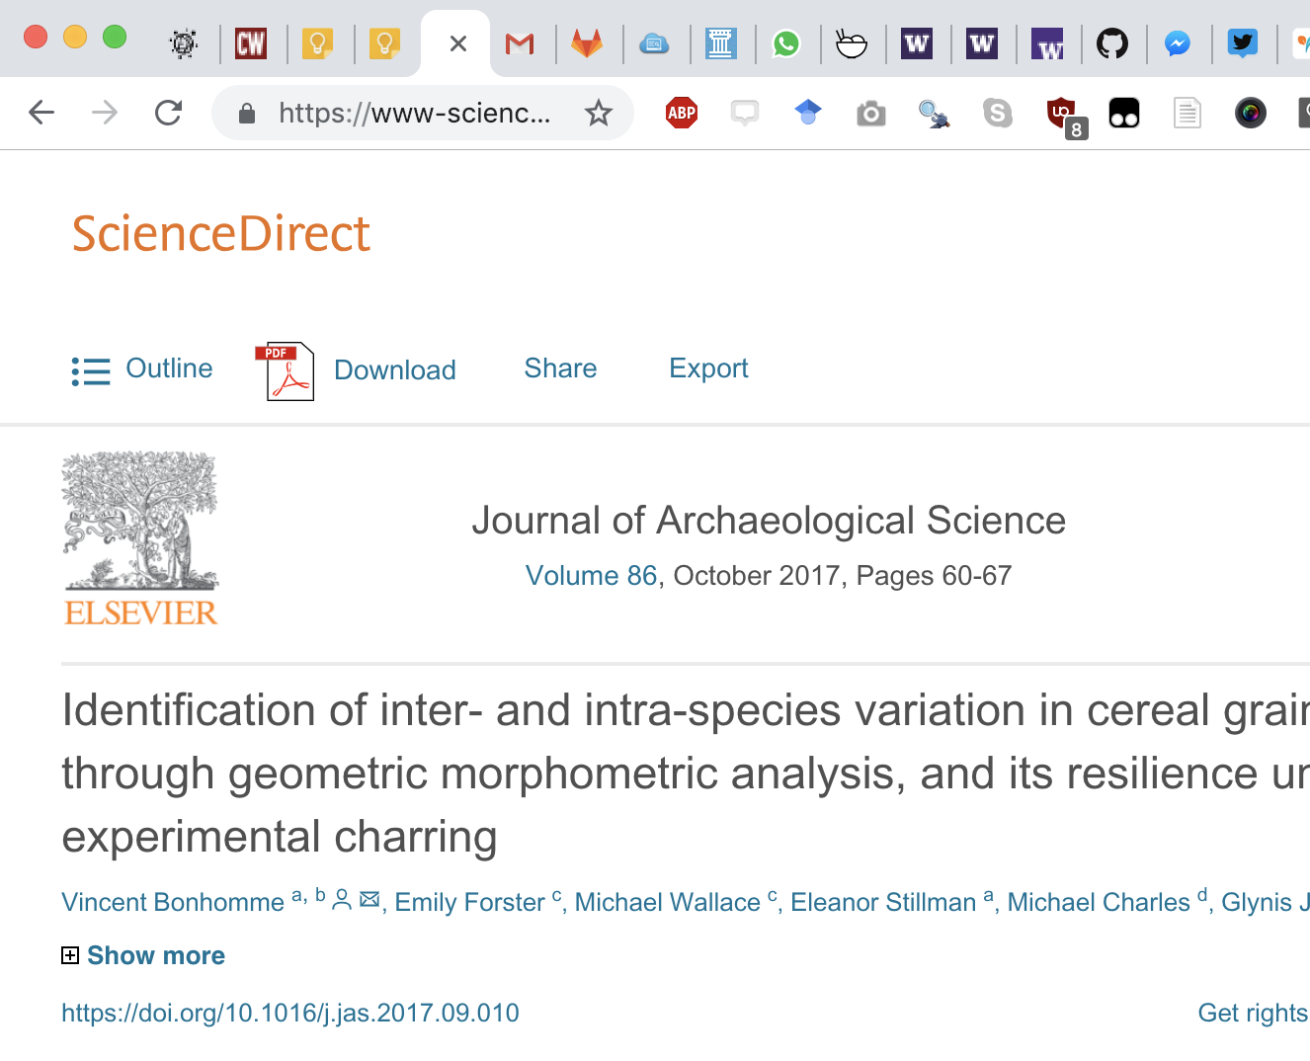
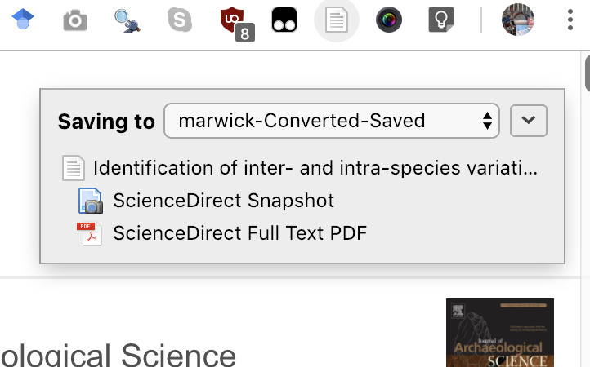
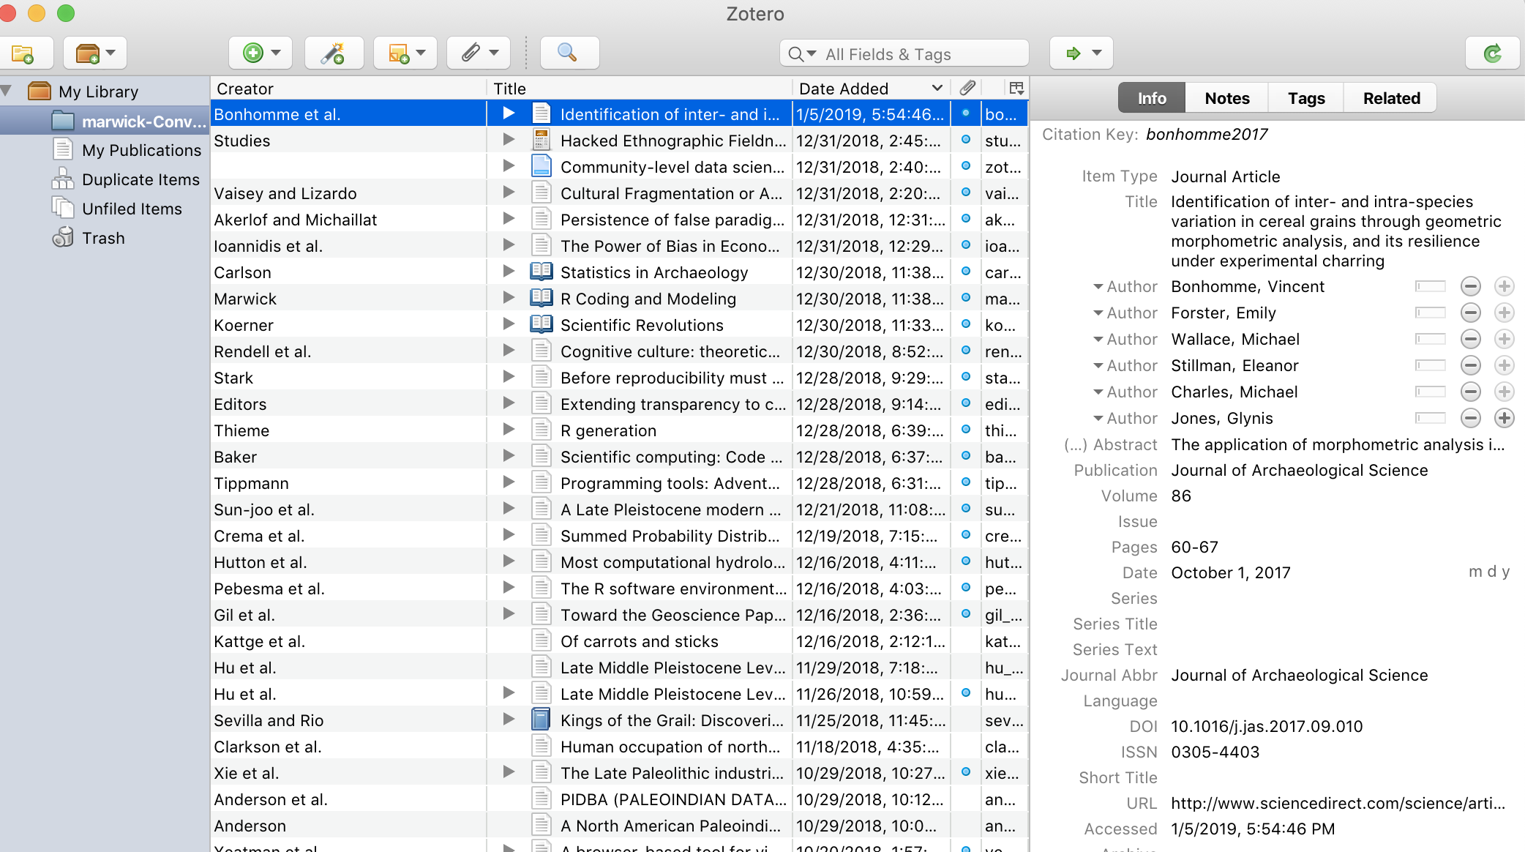
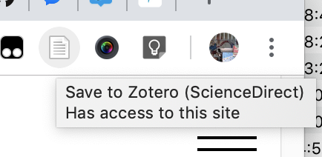
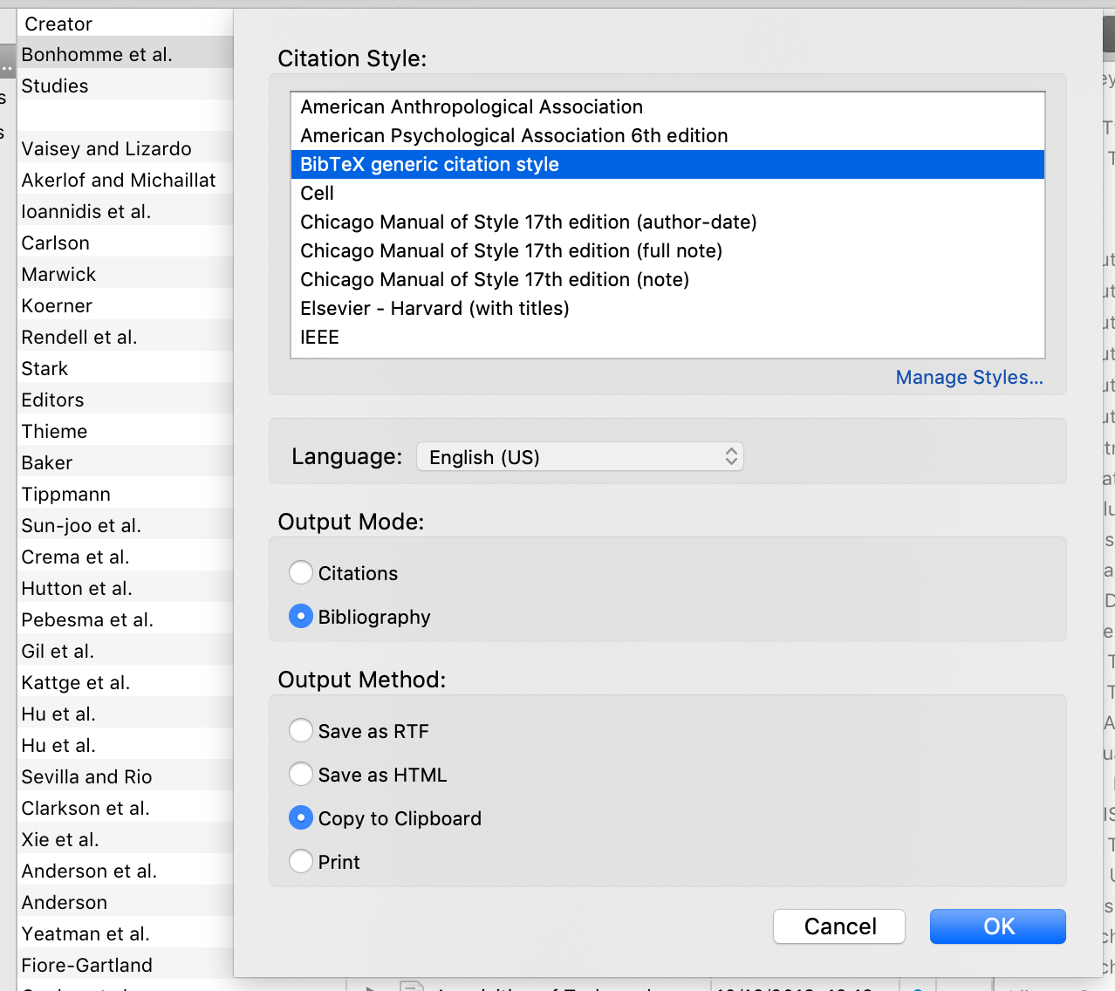
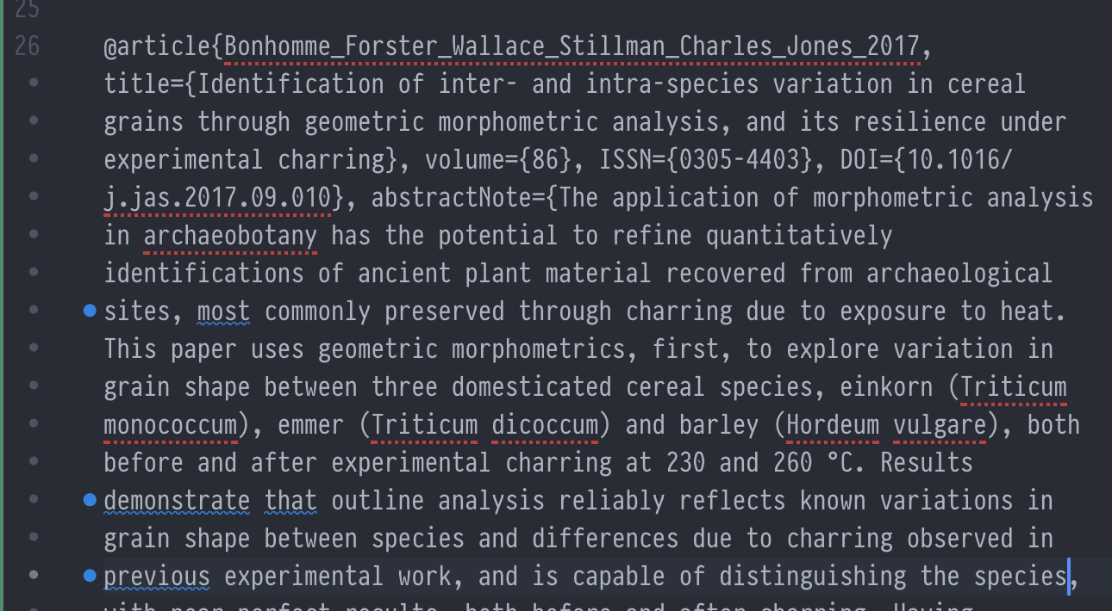
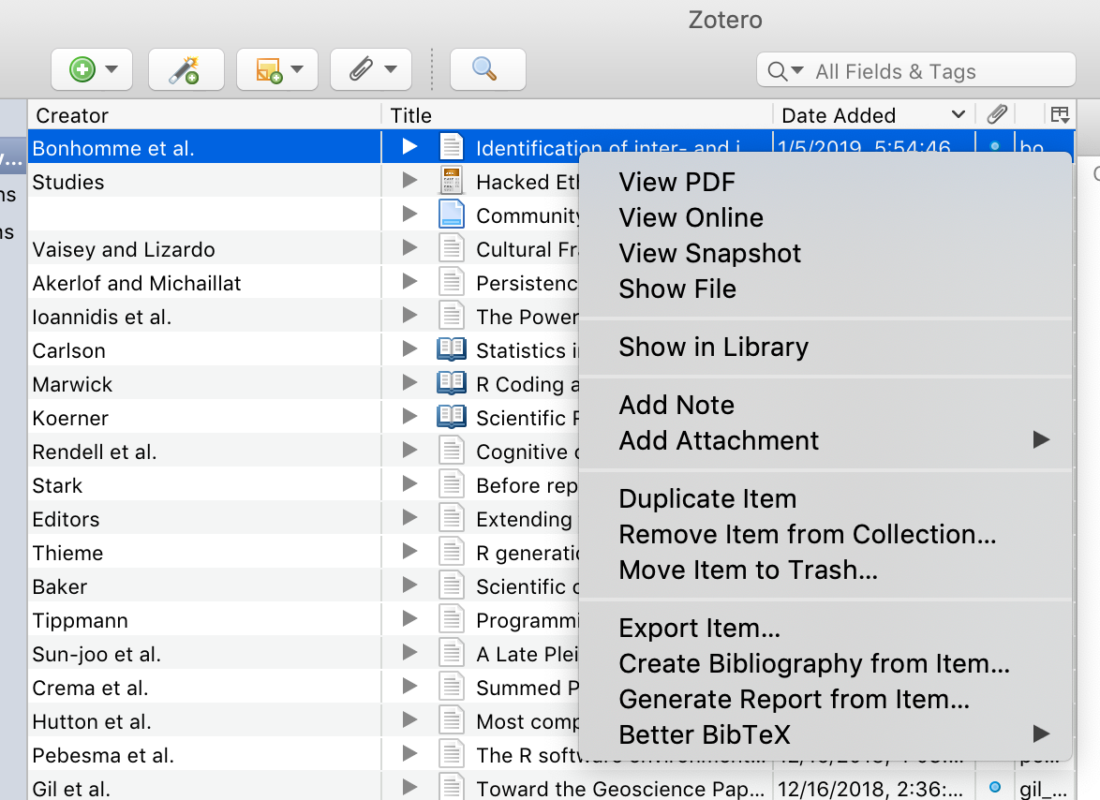
Start by reading an article online
Then Zotero will save the article citation and PDF to your computer
Click the toolbar button “Save to Zotero”
Now we can see the article in our Zotero
Choose ‘BibTeX generic style’, then ‘Bibliography’, then ‘Copy to Clipboard’, then click ‘OK’
Right-click on the item in Zotero, choose “Create Bibliography from Item…”
Paste the text into your .bib file, and save that file. Now you are ready to cite that item in your Rmd!
Don’t worry that the layout is not elegant with indentations, it will still work fine
If you don’t see ‘BibTeX generic…” then click “Manage Styles…” then click ‘Get Additional Styles…’ & then search & download

