Slide 1
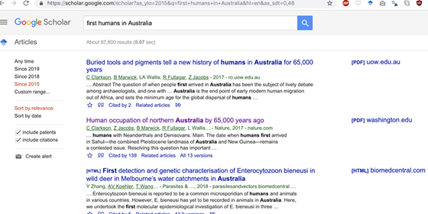
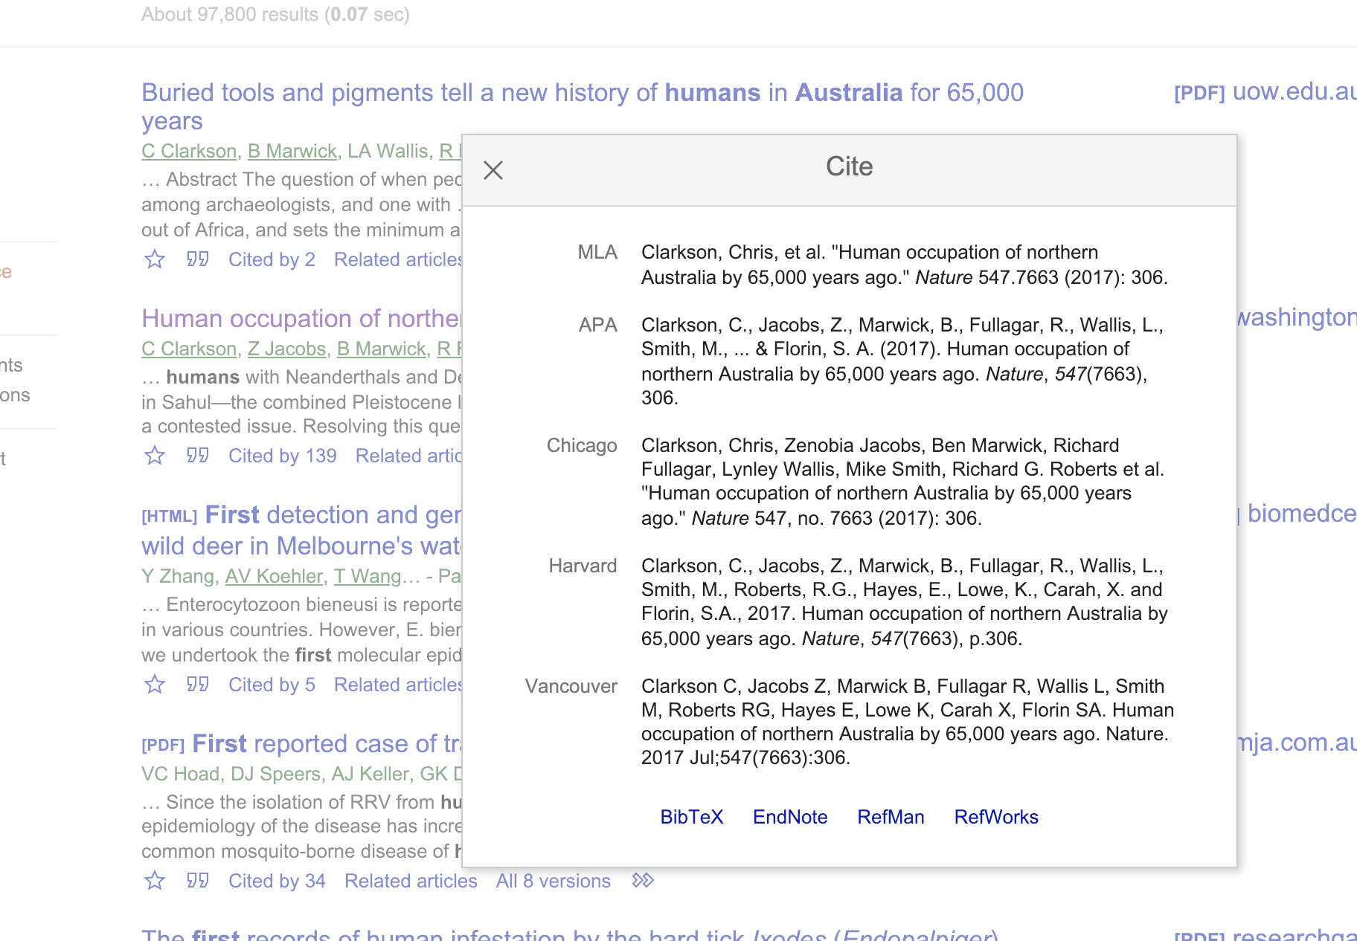
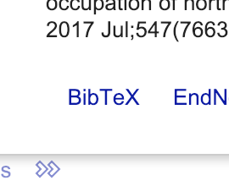

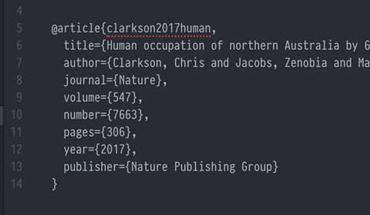
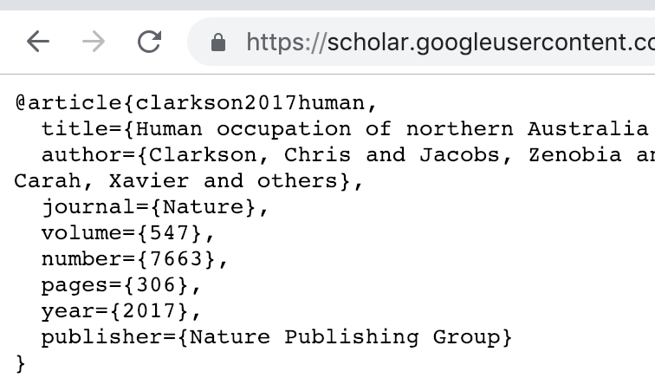
Start by searching on Google Scholar
A window of citation options will appear
Click the quote icon under the item you want to cite
Click on “BibTeX”
Paste the text into your .bib file, and save that file. Now you are ready to cite that item in your Rmd!
Select all text, copy to your clipboard (CTRL + c)

