Slide 1
The age-crime curve and the crime drop in (some of) Northern Europe
Dr. Ben Matthews

Slide 2
Background
In lots of places there’s less crime than there used to be - this is known as the international crime drop
Understandably people want to know why
Explanations for the crime drop are basically all inductive, using ‘data signatures’ to speculate possible causes
We can use change in the age distribution of crime to refine theories of the crime drop, some explanations for the crime drop fit better with period effects (implying a reasonably uniform effect across age?) (Kim et al. 2016)
Change in the age-crime curve is also interesting for developmental criminologists

Slide 3
Background
Some types of crime drop explanation to do with things like better security measures imply mostly period effects
One the other hand, there have been falls in other ‘risky behaviours’ (drinking, substance use, smoking, teenage pregnancy) for young people in particular, hypothesised as relating to more general aspects of youth culture/behaviour (Bell et al. 2023)
“The crime drop in Scotland is a youth crime drop” (Matthews and Minton, 2017)
Some evidence that this ‘youth crime drop’ differs in magnitude between countries (e.g. Matthews and Minton 2017; Farrell et al 2015; Sivertsson?), and in general there are questions about how ‘international’ the International crime drop is (Kotze 2019)
Let’s be more systematic!

Slide 4
Research Design
Aim: compare changing age-crime curves across Northern Europe
A lot of interesting register data analysis is in Northern Europe (because of data availability)
Want to know how far we can generalize findings from these countries to areas which don’t have this kind of data availability
Data from national statistical agencies (except for Scotland)
Problem: little data available at year-of-age level, no guarantee that the same age-groups are used in different countries
Solution: use Penalized Composite Link Model to construct smooth age-year-conviction surfaces

Slide 5
Data
Conviction numbers by age for Scotland, Norway, Finland and Denmark
Also available by sex (but not analysed separately here in interested of time)
Time periods covered:
Scotland: 1990-2018
Norway: 2002-2021
Finland: 1990-2021
Denmark: 1980-2021
No data (that I could find) for Sweden or the Netherlands!
Through some non-systematic Googling, there was data available for Switzerland, New Zealand and South Korea…

Slide 6
Data
Age bands used:
Scotland: single year of age (!) from age 12
Norway: 15-17; 18-20; 21-24; 25-29; 30-39; 40-49; 50-59; >=60
Finland: 15-17; 18-20; 21-24; 25-29; 30-39; 40-49; 50-59; 60-69; 70-79; >=80
Denmark: 15-24 single year of age; 25-29; 30-39; 40-49; 50-59; 60-69; 70-79; >=80

Slide 7
Analytical plan
How (qualitatively) similar is the change in the ACC between countries?
How much (qualitatively) does the ACC change within countries over time?
Precision? No
Vibes? Yes

Slide 8
Measures
Prevalence or incidence?
All crime types?
Yes. At least this is… less controversially comparable (at least after standardizing within country?)
All convictions?
In Norway I removed on the spot fines because that’s what SSB do

Slide 9
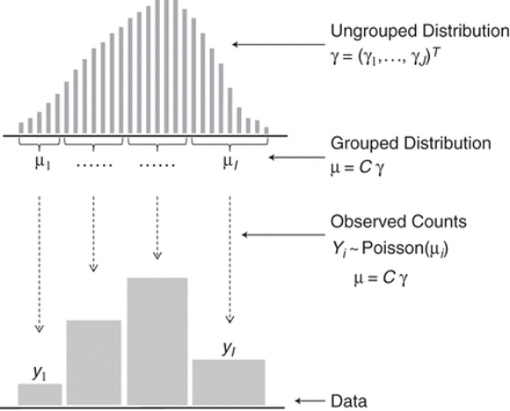
Methods
Convert aggregated counts of convictions and population estimates into single-year estimates of conviction rates
Used R implementation of Penalized Composite Link Model using library ungroup
Rizzi

Slide 10
Rizzi et al., Am J Epidemiol, Volume 182, Issue 2, 15 July 2015, Pages 138–147, https://doi.org/10.1093/aje/kwv020

Slide 11
Methods
Models convictions data and population data together to estimate a smooth surface of conviction rates
Means that you probably shouldn’t look for disruptions in the time series (policy shocks or what have you)
But you can look at overall trends

Slide 12
Modelling Assumptions
This is an unusual (for me at least) use of a statistical model! For prediction rather than inference
Model makes some assumptions:
“neighboring elements in γ do not differ drastically”
“This smoothness assumption is implemented in a roughness penalty on the coefficients β”
There is a penalty term λ and what the model does is pick the ‘best’ value of λ as determined by AIC
This means that - in the frequentist setting - the final results are ‘optimal’ but you might be concerned about propagating uncertainty in λ through your analysis (Bayes doesn’t have this problem, but has the problem of I don’t know how to fit this model)
You can get standard errors for your estimates/confidence intervals for the estimated conviction count/rate for each age in each year, but these seemed not to make much difference to the results from a quick look so I haven’t bothered here
This is because the age categories were coarse at older ages where there were also fewer convictions

Slide 13
Analysis
Look at the results visually on the Lexis surface (Minton) and as a bunch of line charts
Calculate relevant summary statistics (mode, median, mean, skew, kurtosis)
I did look into ways of quantifying how different each country’s age-crime surface was (things like 2D generalizations of Kolmogorov-Smirnov tests and that sort of thing), to quantify how ‘similar’ the age-crime surfaces are
Can frame this as either ‘how similar’ (continuous) or ‘are they statistically significantly different from each other’ (discrete)
Problem that the time series are different lengths (for methods like Kullback–Leibler divergence at least this is a problem)?
Methods do exist but seem opaque to me - so I haven’t bothered (yet)
[Describe lexis surfaces here and how to read them, describe the difference between surfaces approach]

Slide 14
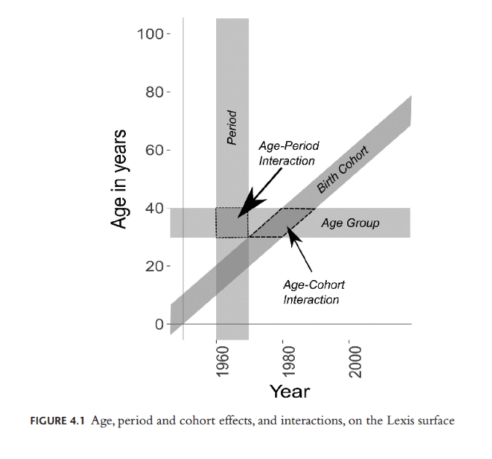
The lexis surface
Minton

Slide 15
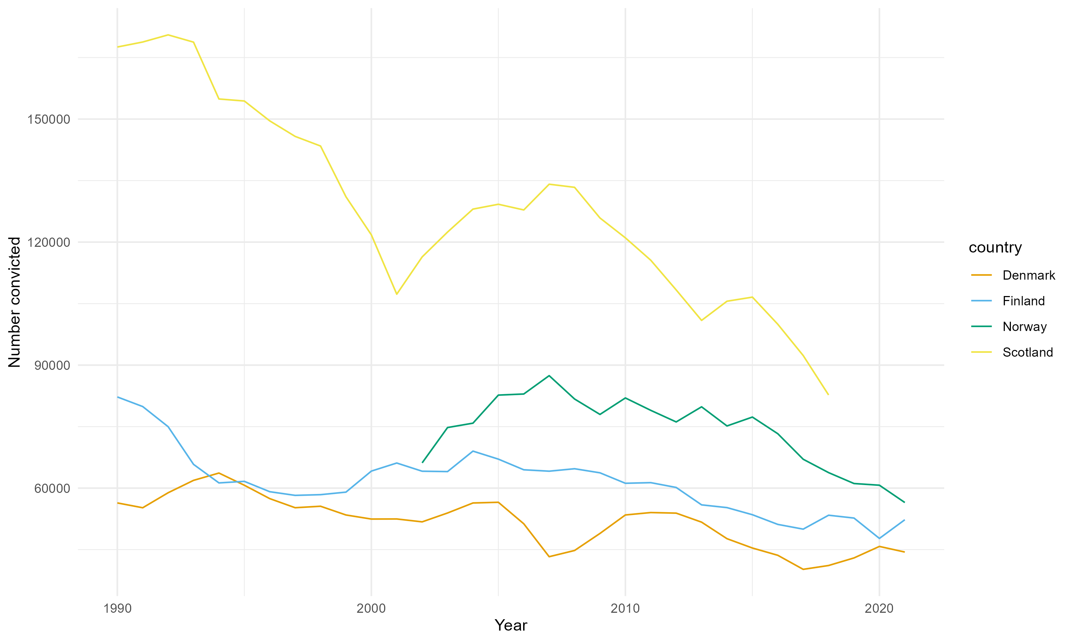
Results
trends

Slide 16
Comparing countries
Anim

Slide 17
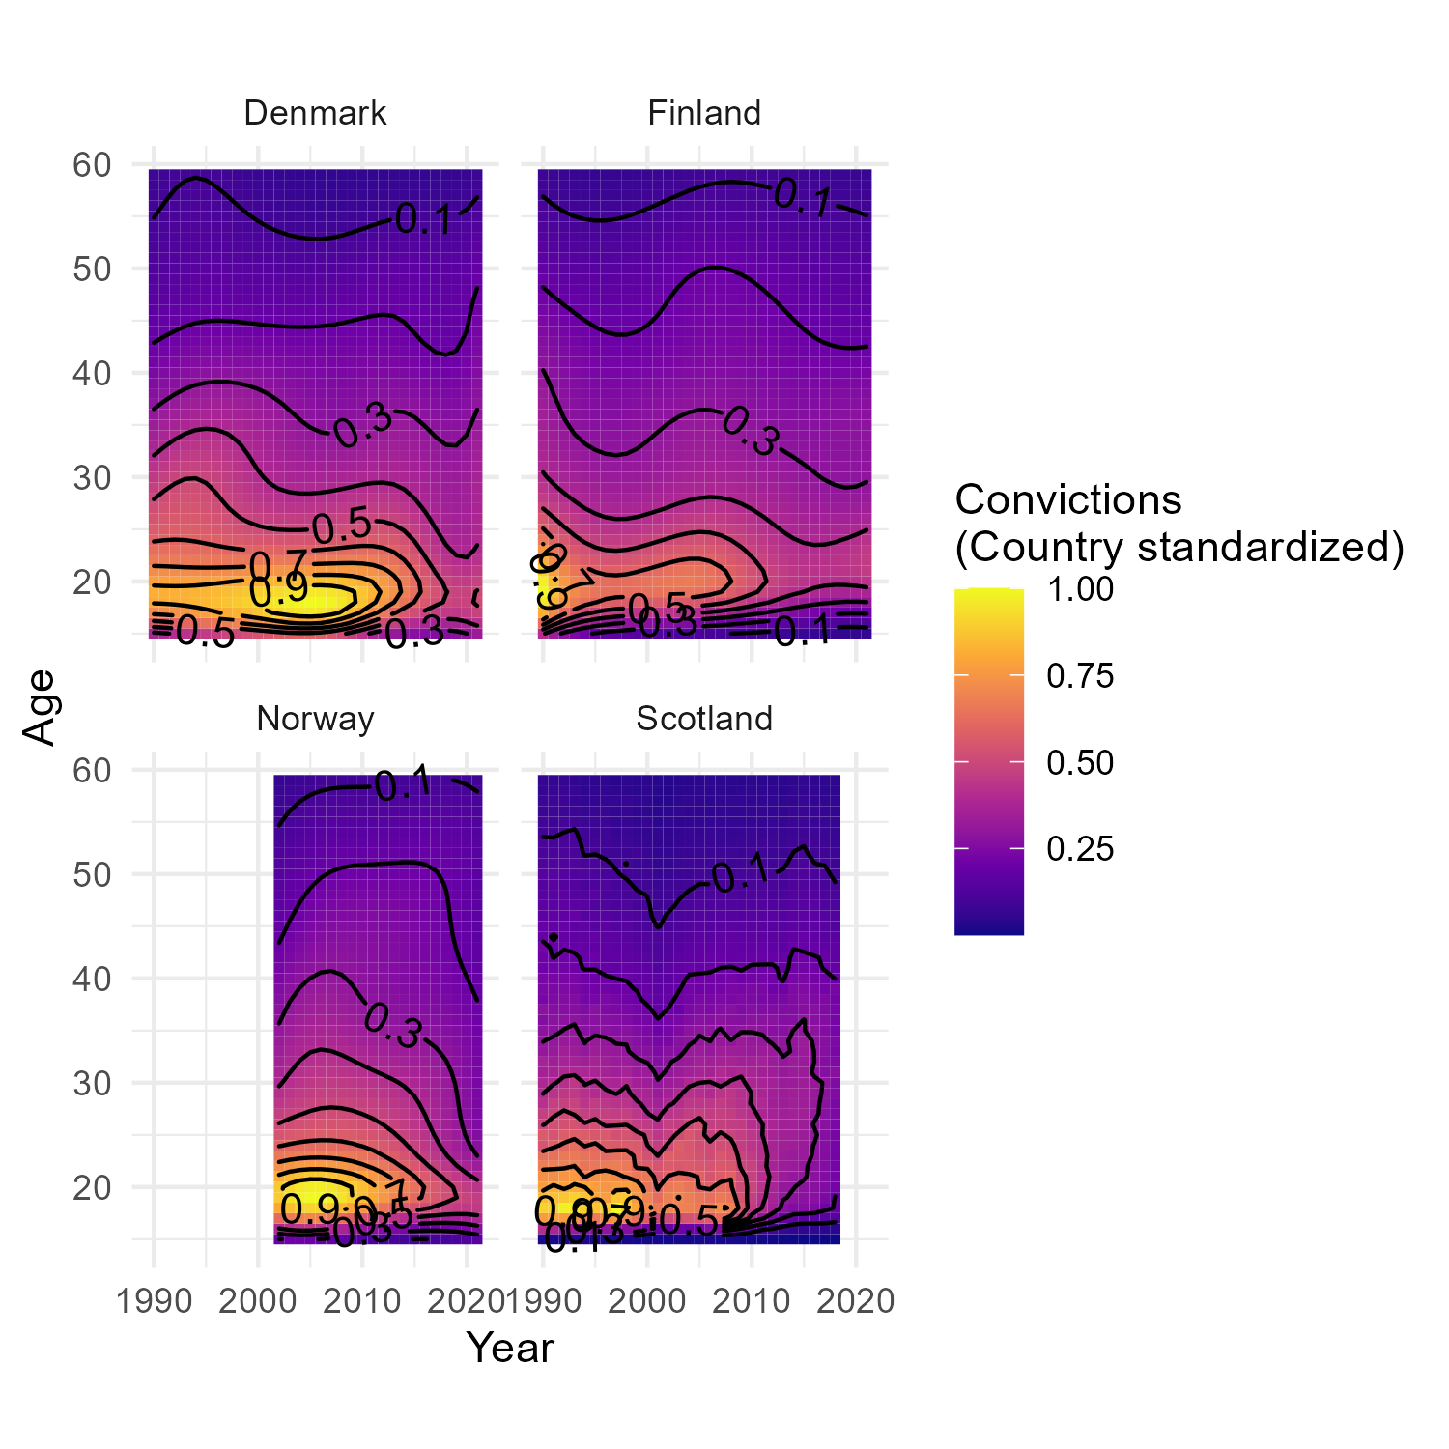
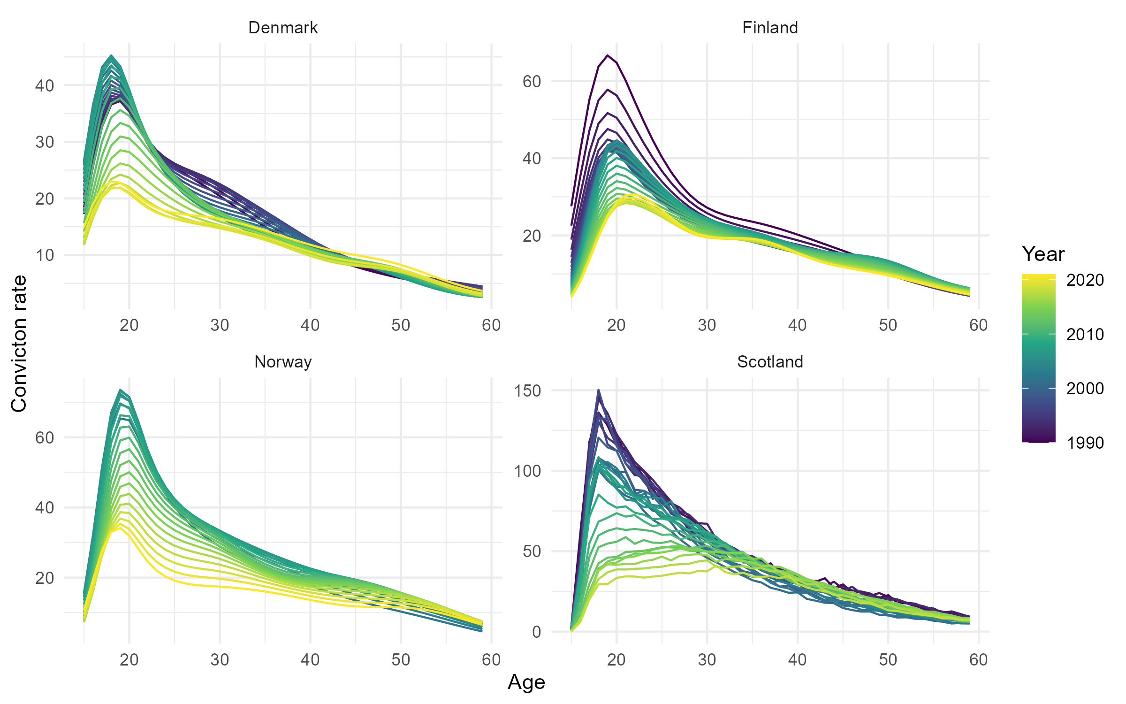
new page
Age-crime curves
Age-crime curves

Slide 18
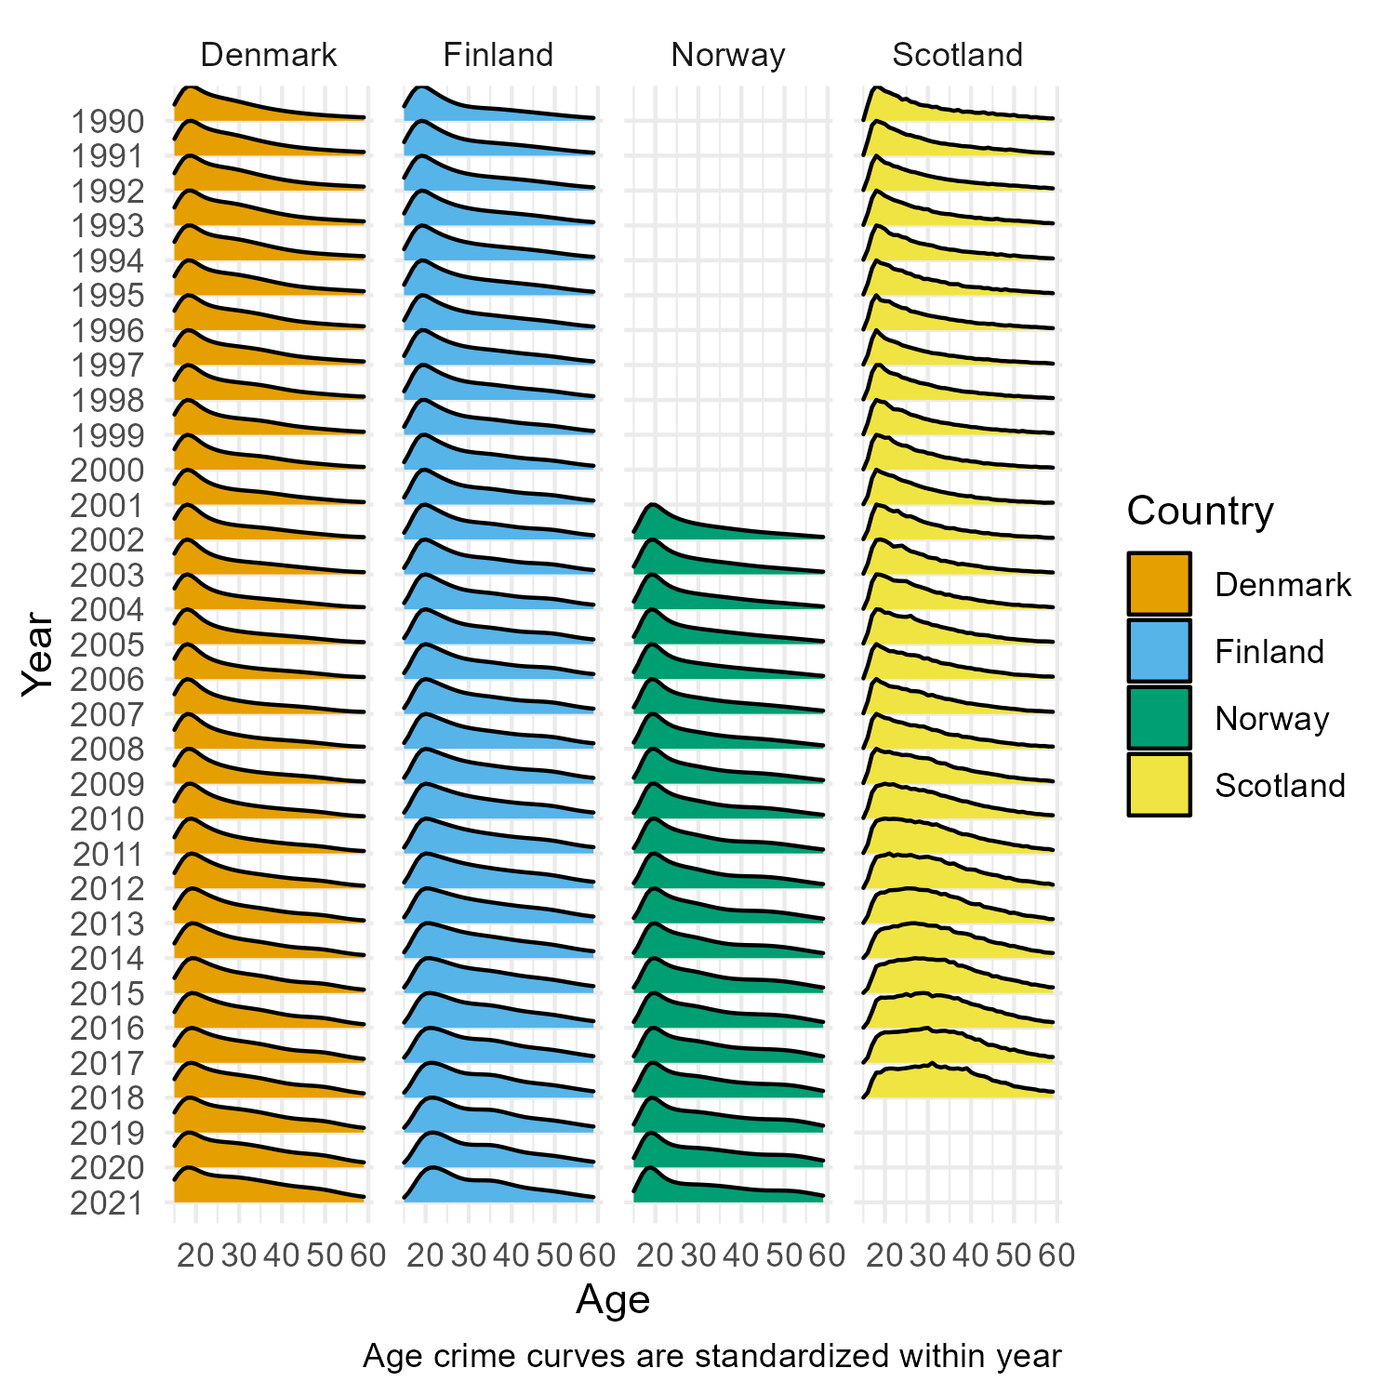
ridgeline
Age-crime curves ridgelines

Slide 19
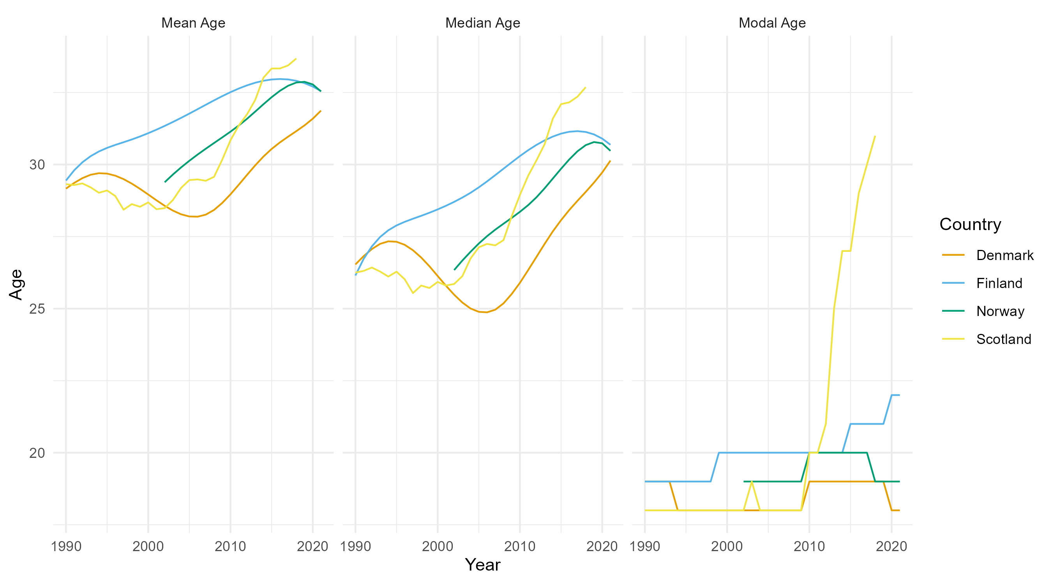
summary statistics
Summary statistics

Slide 20
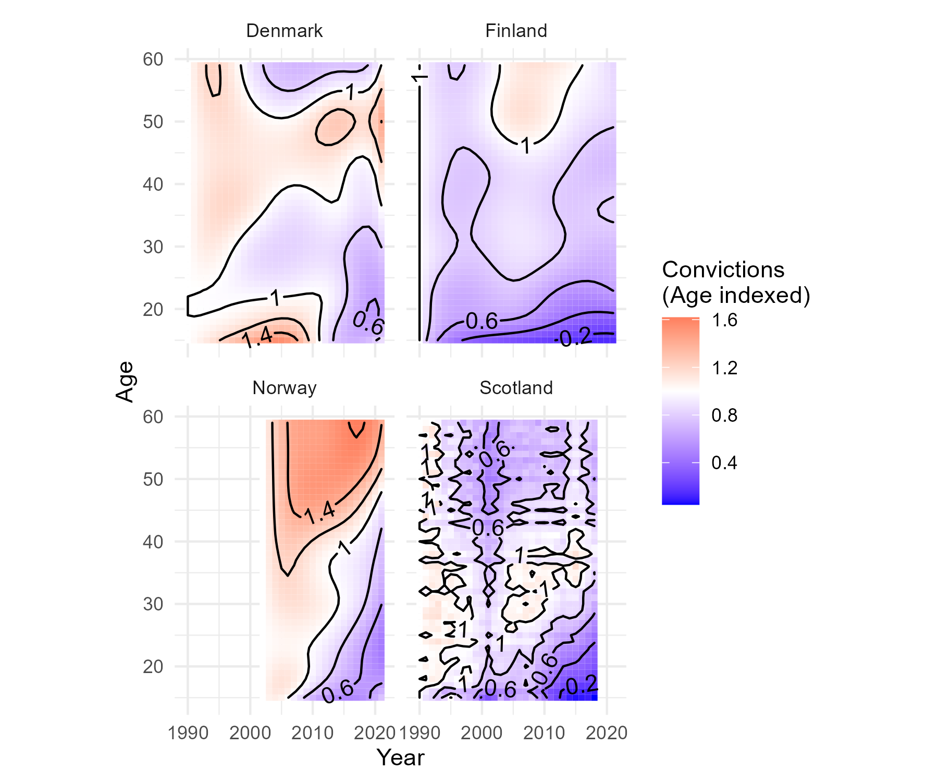
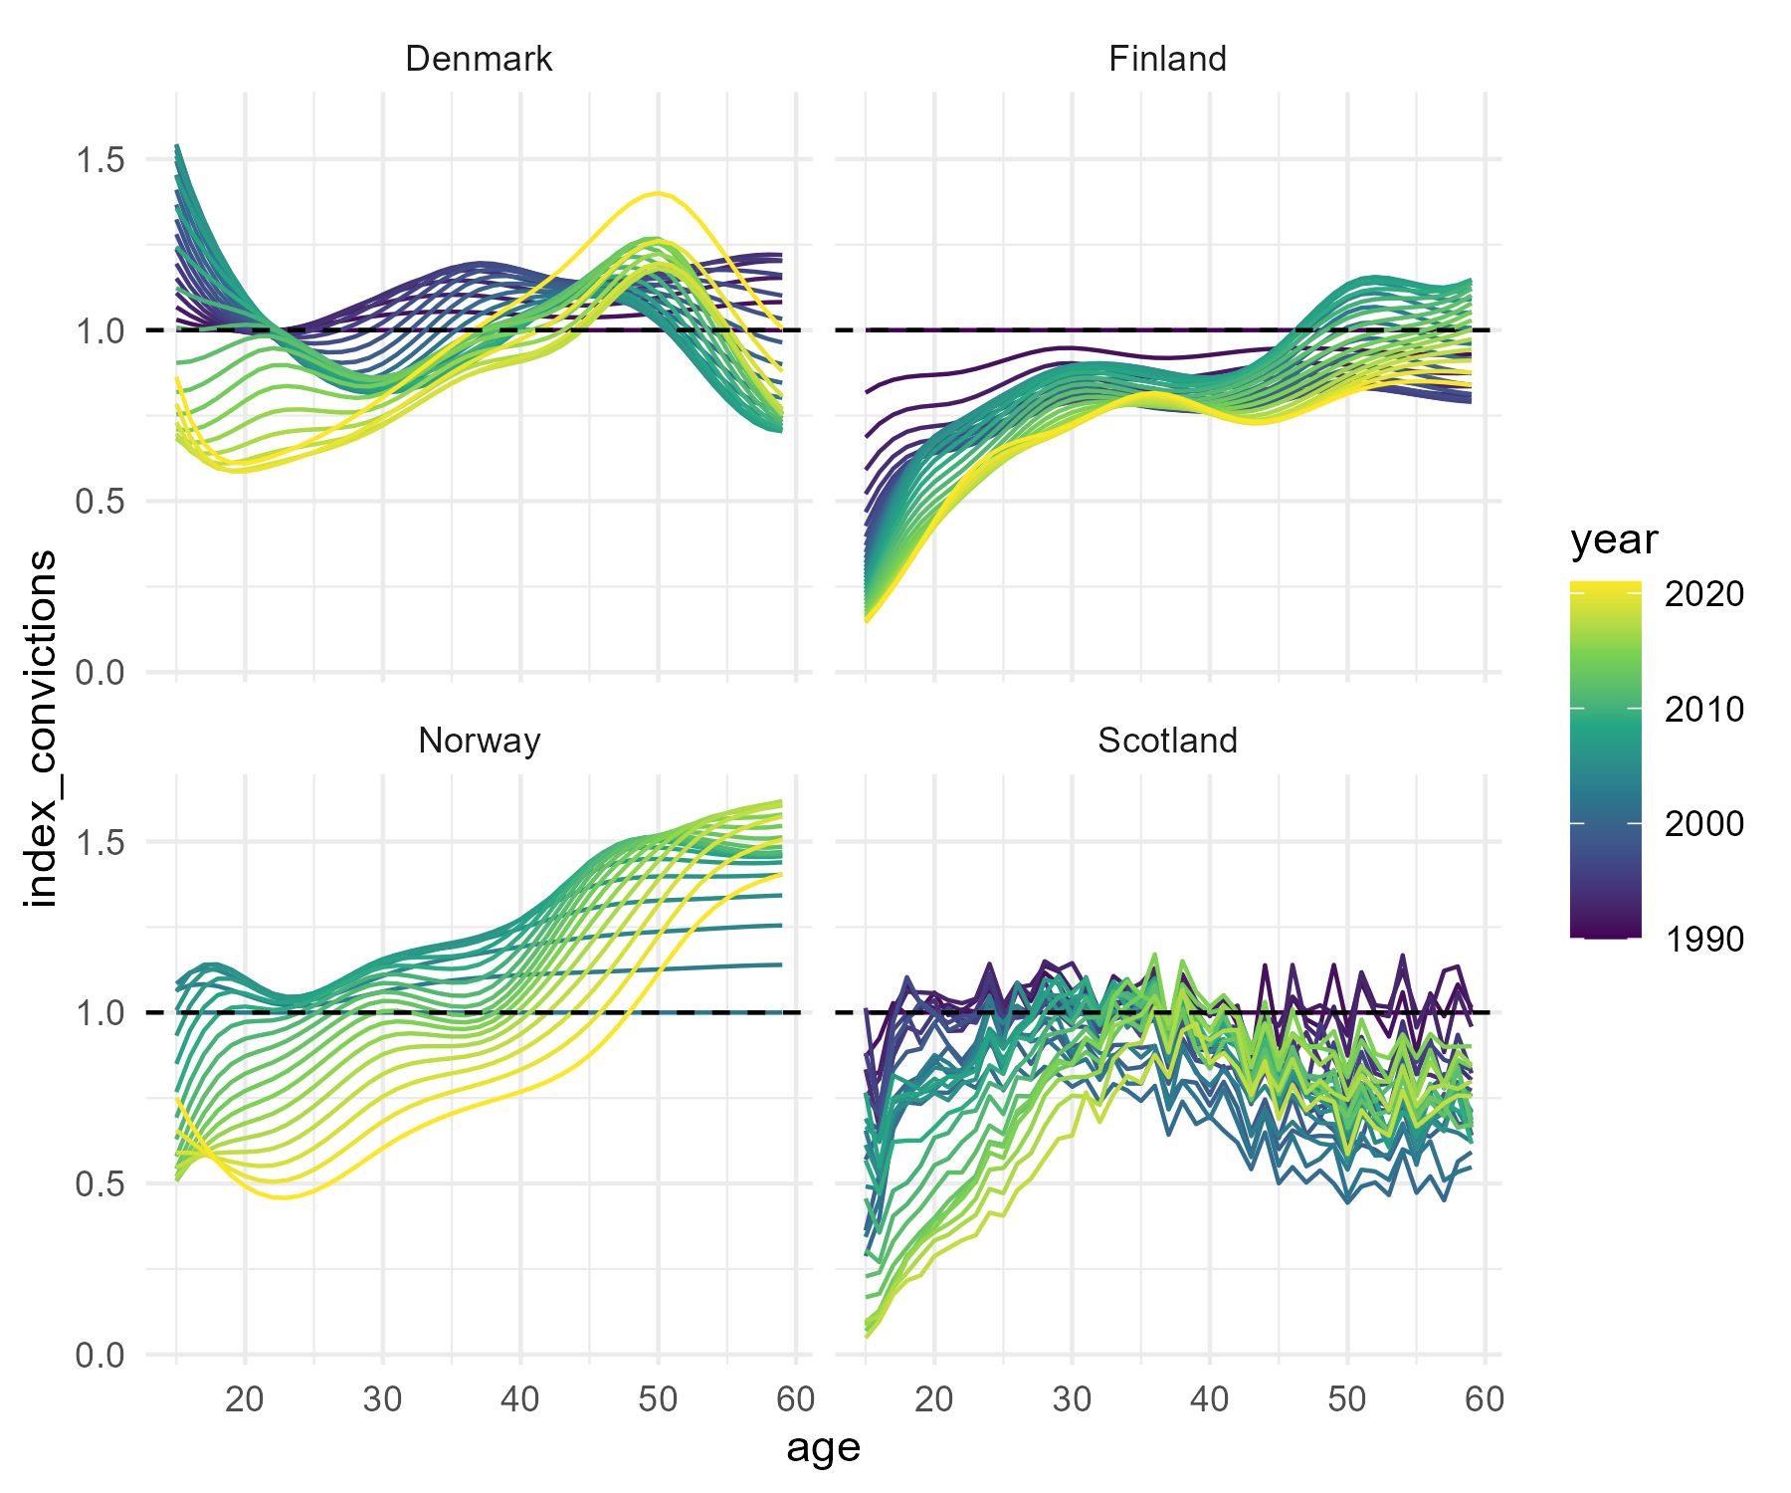
age index
(a) Acc age index lexis
(b) Acc age index facet

Slide 21
Conclusions
The crime drop is (mostly?) a youth crime drop
Timings of biggest falls in youth convictions (cohorts born around 1990ish) are pretty consistent?
Don’t see the same fall in for people at older ages
But only really see the increases in convictions 30s-40s in Scotland
So maybe you’re happy if you’re the ‘generation sensible’ people
Scotland does seem like an odd fit with these comparators

Slide 22
Conclusions
If you believe in the invariance these about the age-crime curve, you almost lose by winning - I’d say that three of the four countries showed pretty ‘classic’ age-crime curves throughout the period analysed, but one didn’t
This is implies that there are between country differences in how the age-crime curve has changed over time
But the whole point of the invariance thesis is that it’s invariance across time and place - so the fact that the change in the age-crime curve in Scotland seems very different than in Denmark, Finland and Norway is (I would argue) a bad thing for the invariance thesis
This initial analysis raises lots of questions about… crime types, other demographics (gender, ethnicity, income… etc) that could be answered by more bespoke data
Having done this analysis for (some of) Northern Europe, I think maybe an even more maximalist approach would be better - and can extend this comparison to anywhere that publishes data on age and conviction

