Slide 1


Stability and change in victimization inequality in Scotland, 2008/09-2019/20
Ben Matthews¹, Susan McVie² and Paul Norris²,
¹University of Stirling, ²University of Edinburgh
Eurocrim2023, Florence
8 September 2023

Slide 2
Background

Slide 3
Motivating question
Crime has fallen substantially over the last 30 years or so (van Dijk et al. 2012)
Victimization has fallen by almost 40% in Scotland between 2008/09 and 2017/18 (Scottish Government, 2019)
One of the big questions: has crime fallen for all groups in society equally (Hunter and Tseloni, 2016; McVie et al., 2020)?
Or put another way, how has victimization inequality changed over this period?

Slide 4
Measuring victimization inequality: ‘Dimensions’ of inequality?
Not just finances – we need to look across multiple dimensions (Hunter and Tseloni, 2016)
Literature is pretty fragmented, but important variables include age, gender, ethnicity, disability, area characteristics (deprivation and region), financial hardship and tenure (see variously Nilsson and Estrada, 2004; Hunter and Tseloni, 2016; Herranz de Rafael and Fernández-Prados, 2019; Ganpat et al., 2020; Grove et al., 2012; Rossetti et al., 2016)
No study has systematically looked at how overall victimization inequality has changed across these characteristics

Slide 5
Data and methods

Slide 6
Data and regression model specification
Data: combined Scottish Crime and Justice Survey sweeps from 2008/09-2019/20 (n = 90,713)
Outcome: number of victimizations of all crime types (0 = 83%, 1 = 11%, 2+ = 6%)
Predictors (reference category in italics)
Age (16-24, 25-44, 45-64, 65+; 14, 32, 33, 21% of sample respectively)
Gender (male/female; 48, 52%)
Ethnicity (white Scottish or British/white other/minority ethnic; 91, 5, 4%)
Disability (no/yes; 73, 27%)
Area deprivation/SIMD (15% most deprived/other; 15, 85%)
Urban/rural (82, 18%)
Financial hardship (a big problem or impossible to access £100 in an emergency/other; 8, 89, 2% missing)
Tenure (other/social renting; 79, 21, 1% missing)

Slide 7
Statistical model
We present a set of eight models of the number of victimization incidents experienced, modelled as a function of each predictor, survey year (as a linear trend) and the interaction between the predictor and survey year
And then a ‘full’ model with all predictors and their interactions with survey year
For illustration:
Model 1: victimization ~ age * survey year
Model 2: victimization ~ gender * survey year
…
Model 9: victimization ~ age * survey year + gender * survey year…

Slide 8
Measuring victimization inequality
We show results via predicted victimization rates from the different models, and the ratio of these predicted rates for comparison groups compared to reference groups
This measure is (reasonably…) easy to understand and it is easy to show both this ‘inequality’ measure and the estimated victimization rates themselves have changed, which gives necessary context to the inequality estimates (Spiegelhalter, 2017)
We also show which interaction terms were statistically significant (at the conventional p <0.05 level)

Slide 9
Data and regression model specification
Fit in R with the {survey} package using weighted-least squares and a quasipoisson link function to account for overdispersion
Responses modelled with individual-level weights
We used multiple imputation with chained equations (MICE) to impute missing data (we had ~ 2% missing data)
Confidence intervals calculated by simulation method similar to King et al. (2000)

Slide 10
Results

Slide 11
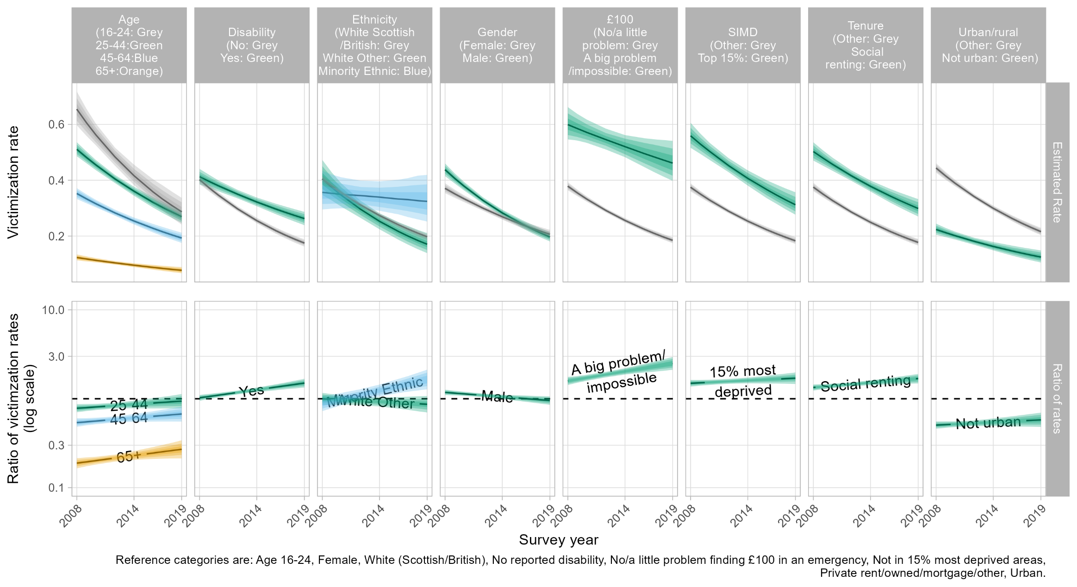
Changing victimization inequality (Models 1-8)

Slide 12
Changing victimization inequality (Models 1-8)

Slide 13
Changing victimization inequality (Models 1-8)
Parameter | Estimate
Survey year * Age: 25-44 | 0.017
Survey year * Age: 45-64 | 0.020
Survey year * Age: 65+ | 0.033*
Survey year * Gender: Male | -0.019**
Survey year * Disability: Yes | 0.034***
Survey year * Ethnicity: White Other | -0.013
Survey year * Ethnicity: Minority Ethnic | 0.057**
Survey year * SIMD: 15% most deprived | 0.012
Survey year * Tenure: Social renting | 0.021**
Survey year * £100: A big problem/impossible | 0.041***
Survey year * Urban/rural: Not urban | 0.012
*** = p < 0.001, ** = p < 0.01, * = p < 0.05. Figures are rounded to 3 d.p.

Slide 14
Changing victimization inequality (Models 9)
Parameter | Estimate
Survey year * Age: 25-44 | 0.014
Survey year * Age: 45-64 | 0.016
Survey year * Age: 65+ | 0.032*
Survey year * Gender: Male | -0.014
Survey year * Disability: Yes | 0.019*
Survey year * Ethnicity: White Other | -0.010
Survey year * Ethnicity: Minority Ethnic | 0.062***
Survey year * SIMD: 15% most deprived | 0.004
Survey year * Tenure: Social renting | 0.005
Survey year * £100: A big problem/impossible | 0.026*
Survey year * Urban/rural: Not urban | 0.019
*** = p < 0.001, ** = p < 0.01, * = p < 0.05. Figures are rounded to 3 d.p.

Slide 15
Discussion

Slide 16
What have we learned?
Victimization has pretty clearly fallen for every group we looked at – except for Minority Ethnic people where there’s a lot of uncertainty in our estimates and a flat overall (linear) trend
Has victimization inequality changed? Yes, a bit
Groups who have seen largest falls in victimization are most ‘advantaged’ in society: non-disabled, white Scottish/British, men, financially secure…
… except for young people, who actually saw the largest crime drop overall. That’s the same thing we see in Scottish convictions data (Matthews and Minton, 2018)

Slide 17
What have we learned?
The changes in victimization inequality from Models 1-8 compared to Model 9 were reasonably similar (although the trend for tenure was statistically significant in the unadjusted results but not in the adjusted ones)…
… albeit with generally smaller magnitudes for the unadjusted measures
High levels of uncertainty about the victimization trend for Minority Ethnic people in Scotland is severe limitation of current (Scottish) evidence base
This is compounded by the SCJS survey design (smaller sample sizes) lower response rates and, ironically, the crime drop itself (fewer victims in each sweep)

Slide 18

Thank you!
@benmatthewsed

Slide 19
References
Ganpat, Soenita M., Laura Garius, Andromachi Tseloni, and Nick Tilley. 2020. “Violence and the Crime Drop.” European Journal of Criminology, May, 1477370820913456. https://doi.org/10.1177/1477370820913456.
Gelman, Andrew, and Iain Pardoe. 2007. “Average Predictive Comparisons for Models with Nonlinearity, Interactions, and Variance Components.” Sociological Methodology 37 (1): 23–51. https://doi.org/10.1111/j.1467-9531.2007.00181.x.
Grove, Louise, Andromachi Tseloni, and Nick Tilley. 2012. “Crime, Inequality, and Change in England and Wales.” In The International Crime Drop: New Directions in Research, edited by Jan van Dijk, Andromachi Tseloni, and Graham Farrell, 182–99. Crime Prevention and Security Management. London: Palgrave Macmillan UK. https://doi.org/10.1057/9781137291462_8.
Herranz de Rafael, Gonzalo, and Juan Sebastián Fernández-Prados. 2019. “Victimization, Social Structure and Psychosocial Variables: The Case of Spain in 1999 and 2016.” Social Sciences 8 (3): 102. https://doi.org/10.3390/socsci8030102.
Hunter, James, and Andromachi Tseloni. 2016. “Equity, Justice and the Crime Drop: The Case of Burglary in England and Wales.” Crime Science 5 (1): 3. https://doi.org/10.1186/s40163-016-0051-z.
King, Gary, Michael Tomz, and Jason Wittenberg. 2000. “Making the Most of Statistical Analyses: Improving Interpretation and Presentation.” American Journal of Political Science 44: 341–55.
Matthews, Ben, and Jon Minton. 2018. “Rethinking One of Criminology’s ‘Brute Facts’: The Age-Crime Curve and the Crime Drop in Scotland.” European Journal of Criminology 15 (3): 296–320. https://doi.org/10.1177/1477370817731706.
McVie, Susan, Paul Norris, and Rebecca Pillinger. 2020. “Increasing Inequality in Experience of Victimization During the Crime Drop: Analysing Patterns of Victimization in Scotland from 1993 to 201415.” The British Journal of Criminology 60 (3): 782–802. https://doi.org/10.1093/bjc/azy044.
Nilsson, Anders, and Felipe Estrada. 2006. “The Inequality of Victimization: Trends in Exposure to Crime Among Rich and Poor.” European Journal of Criminology 3 (4): 387–412. https://doi.org/10.1177/1477370806067910.
Spiegelhalter, David. 2017. “Risk and Uncertainty Communication.” Annual Review of Statistics and Its Application 4 (1): 31–60. https://doi.org/10.1146/annurev-statistics-010814-020148.
Rossetti, Polly, Tamar Dinisman and Ania Moroz. 2016. An Easy Target? Risk factors affecting victimisation rates for violent crime and theft. Victim Support. https://www.victimsupport.org.uk/sites/default/files/VS%20Insight%20Report%20-%20An%20easy%20target.pdf
Van Dijk, Jan, and Andromachi Tseloni. 2012. Global Overview: International Trends in Victimization and Recorded Crime. In J. van Dijk, A. Tseloni, & G. Farrell (Eds.), The International Crime Drop (pp. 11–36). Basingstoke: Palgrave Macmillan. http://doi.org/10.1057/978113729142

Slide 20
Estimating victimization rates
Fit multiple regression model
Sample parameters
Distribution of victimization trends
Average predictive comparisons

Slide 21
Estimating victimization rates
Fit multiple regression model
Sample parameters
Distribution of victimization trends
Average predictive comparisons

Slide 22
Average predictive comparisons
Taking one predictor at a time, make a ‘counterfactual’ copy of each person in the pooled dataset where they have every possible level of that (categorical) predictor
Use the fitted regression model to make a predicted victimization rate for each counterfactual person (and the original data), keeping all other predictors at their observed values
For each level of the predictor of interest, take the average predicted victimization rate
For rationale, see Gelman and Pardoe (2007)

Slide 23
Average predictive comparisons
id | SIMD | age | urban/ rural | … | predict
01 | 0 | 16-24 | urban | … | 0.4
01 | 1 | 16-24 | urban | … | 0.6
02 | 0 | 25-44 | rural | … | 0.2
02 | 1 | 25-44 | rural | … | 0.4
… | … | … | … | … | …
id | SIMD | age | urban/ rural | …
01 | 1 | 16-24 | urban | …
02 | 0 | 25-44 | rural | …
… | … | … | … | …
SIMD | mean predict
0 | 0.5
1 | 0.3

Slide 24
Average predictive comparisons
id | SIMD | age | urban/ rural | … | predict
01 | 0 | 16-24 | urban | … | 0.4
01 | 1 | 16-24 | urban | … | 0.6
02 | 0 | 25-44 | rural | … | 0.2
02 | 1 | 25-44 | rural | … | 0.4
… | … | … | … | … | …
id | SIMD | age | urban/ rural | …
01 | 1 | 16-24 | urban | …
02 | 0 | 25-44 | rural | …
… | … | … | … | …
SIMD | mean predict
0 | 0.5
1 | 0.3

Slide 25
Average predictive comparisons
id | SIMD | age | urban/ rural | … | predict
01 | 0 | 16-24 | urban | … | 0.4
01 | 1 | 16-24 | urban | … | 0.6
02 | 0 | 25-44 | rural | … | 0.2
02 | 1 | 25-44 | rural | … | 0.4
… | … | … | … | … | …
id | SIMD | age | urban/ rural | …
01 | 1 | 16-24 | urban | …
02 | 0 | 25-44 | rural | …
… | … | … | … | …
SIMD | mean predict
0 | 0.5
1 | 0.3

Slide 26
Estimating victimization rates
Fit multiple regression model
Sample parameters
Distribution of victimization trends
Average predictive comparisons

