Slide 1
Criminal Careers and the Crime Drop in Scotland
Changing conviction patterns in the Scottish Offenders Index, 1989-2011
Ben Matthews and Susan McVie
University of Edinburgh
ESC Conference, Sarajevo, August 2018

Slide 2
Our argument
We can use change over time in criminal career parameters to understand the crime drop better
This probably requires the use of administrative data
Complex convictions trends in Scotland, varying by age, sex and period

Slide 3
Background
We want to understand individual-level change in crime over crime drop (Farrell et al 2015)
Criminal careers research shows that age and sex differences in conviction are crucial (Hirschi and Gottfredson 1983)
Therefore examine change in criminal career parameters over time (Kim et al. 2016)

Slide 4
Background
Conceptualize change in age-crime curve as an n = 1 study (Matthews and Minton 2018, Fernández-Molina and Gutiérrez 2018)
Criminal career parameter becomes the lens not the focus (Matthews and Minton 2018)
Contra assumption that change in the age-crime curve is meaningless (Hirschi and Gottfredson 1983:572)

Slide 5
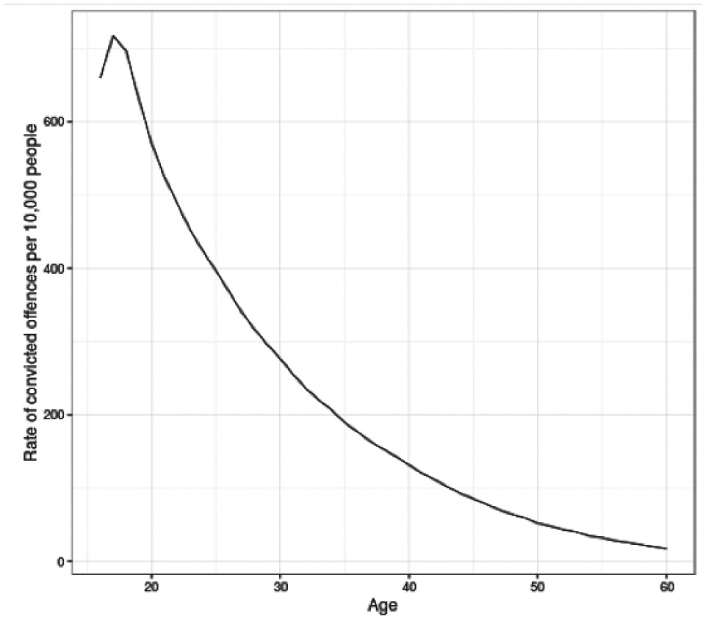
Background
Figure 1. Age-crime curve in the Scottish Offenders Index (1989-2011).
Source: Matthews and Minton (2018)

Slide 6
Background
Different explanations for the crime drop imply different patterns of cohort or period effects (Kim et al. 2016)
e.g. better security measures as period effects, young people’s social activities as cohort effects
But survey research offers only limited age ranges, and often only men (e.g. Berg et al. 2016)

Slide 7
Research design
The coverage of administrative data offers complement to survey data
Scottish Offenders Index (SOI)
(Almost) All sets of convictions proceedings in Scottish courts 1989-present (age 16+)
Allows multiple comparisons between and within ages and periods

Slide 8
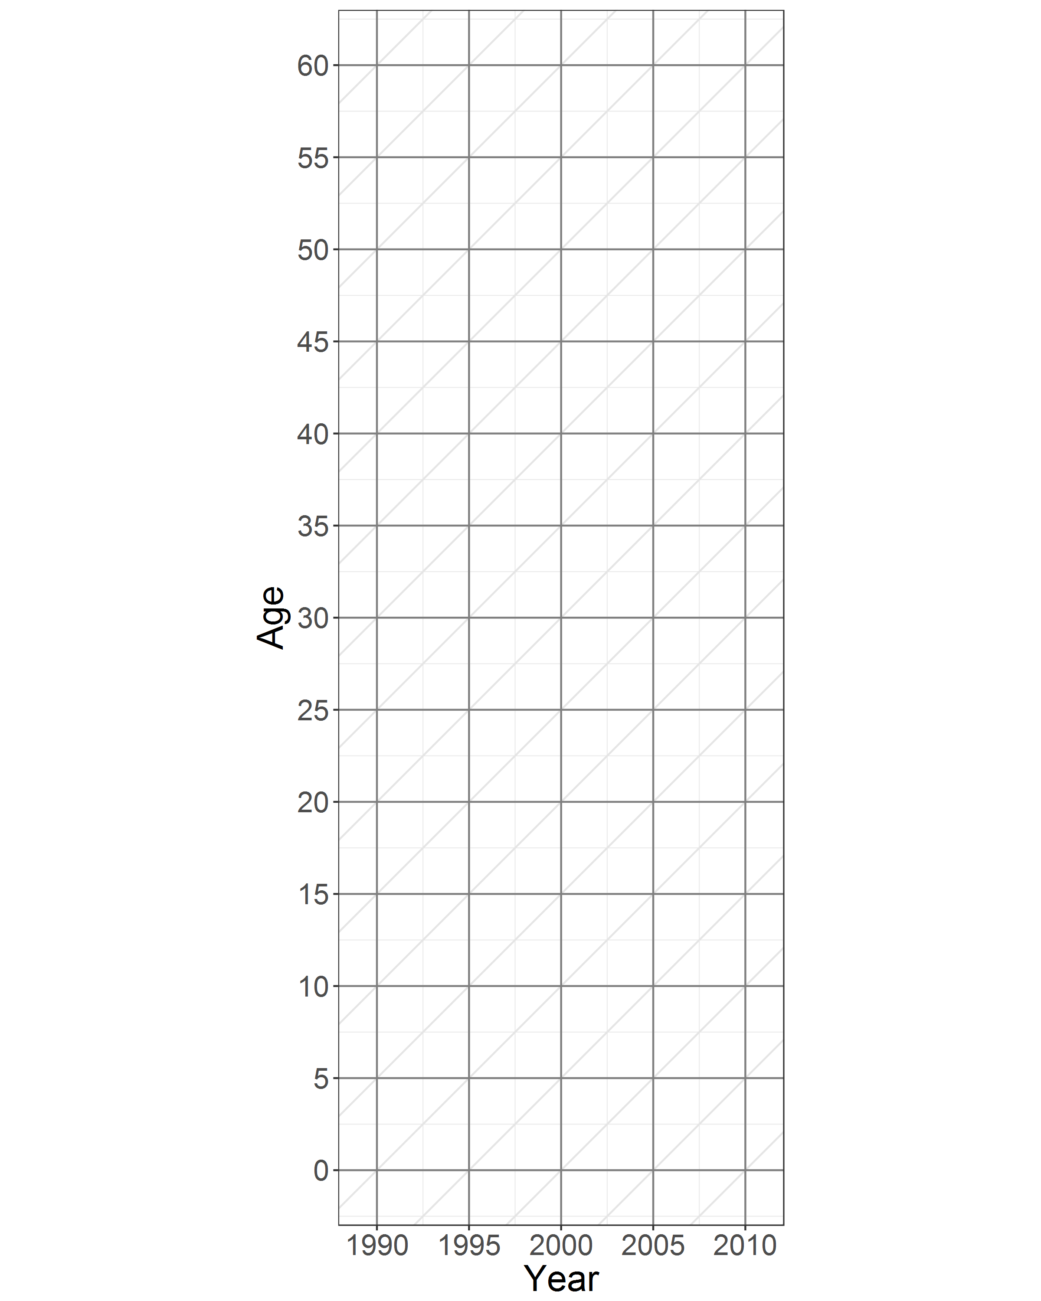
Research design
Figure 2. Comparing data coverage of SOI and cohorts used in Berg et al. (2016)

Slide 9
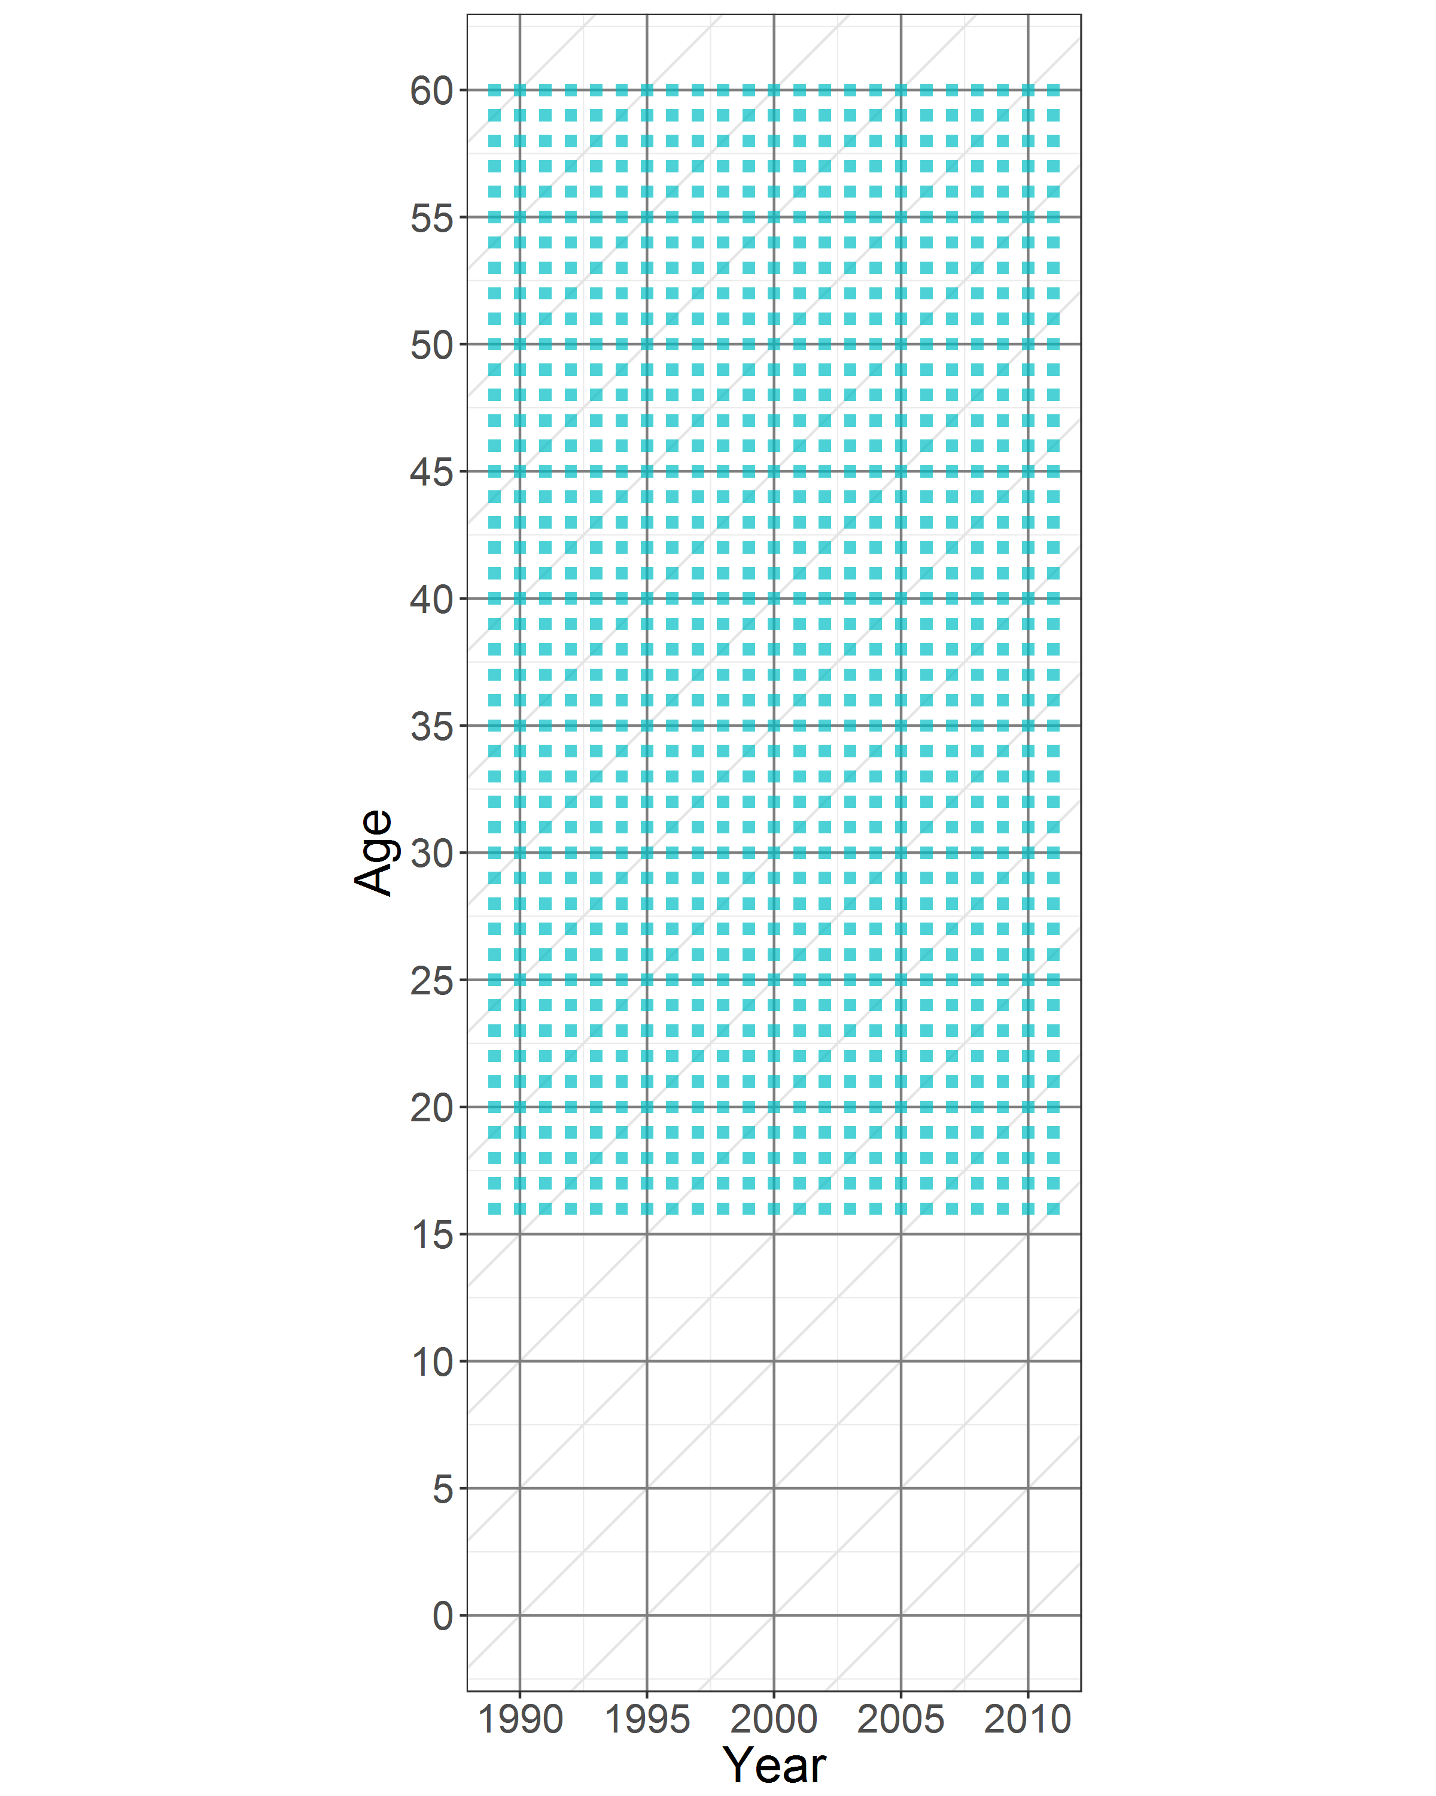
Research design
Figure 2. Comparing data coverage of SOI and cohorts used in Berg et al. (2016)

Slide 10

Research design
Figure 2. Comparing data coverage of SOI and cohorts used in Berg et al. (2016)

Slide 11
Methods
Level plot allows specific visualization of rates on lexis surface (Minton 2014)
But same principle of multiple age-period comparisons can be used for any parameter (including from models)

Slide 12
Methods
Visually inspect for period or cohort trends in conviction rates (Matthews and Minton 2018)
If change for all ages at the same time, assume a period effect (not cohort effect or age-limited period effect)

Slide 13
Results
Figure 3. Age-crime curves in SOI 1989-2011
Source: Matthews and Minton (2018)

Slide 14
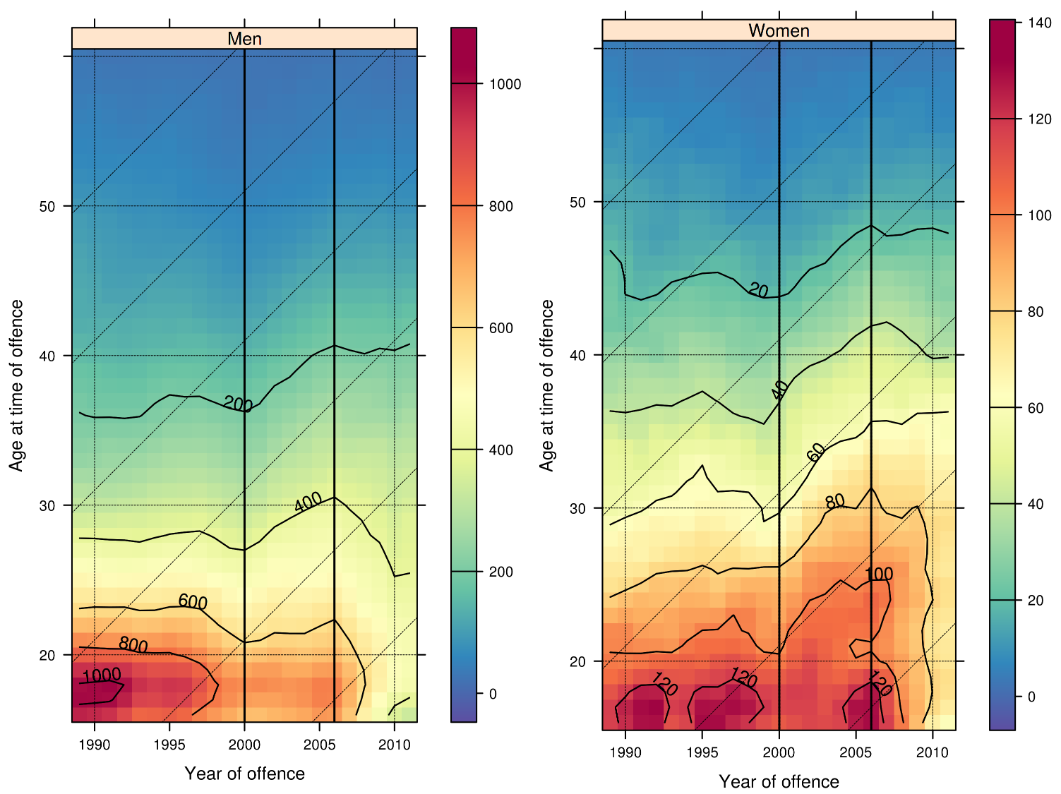
Results
Figure 4. Shaded contour plot of convicted offending for different ages in SOI, 1989-2011.
Source: Matthews and Minton (2018)

Slide 15
Results
Age at transition
between age-band
Figure 5. Proportion of people with convictions in consecutive age-bands, 1993-2007.
Source: Matthews (2016), SOI

Slide 16
Discussion
The crime drop is a youth crime drop…
… but shows different trends for men and women of different ages in different periods
Questions uniform explanations for crime drop which imply same mechanism for all people at the same time

Slide 17
Discussion
Administrative data can give breath, complementing depth of surveys
Visualization methods can be expanded to multiple countries (Minton et al. 2017)

Slide 18
Caveats
Inference is visual and logical not statistical
Requires a suitable data source (SOI, Scandinavian registers, …?)

Slide 19
Thank you!
ben.matthews@ed.ac.uk
@benmatthewsed
@U_Inequalities
@adrc_scotland
Data were provided by Scottish Government – many thanks to them for their help throughout this project.

Slide 20
References
Berg, Mark T., Eric Baumer, Richard Rosenfeld, and Rolf Loeber. 2016. “Dissecting the Prevalence and Incidence of Offending During the Crime Drop of the 1990s.” Journal of Quantitative Criminology 32 (3): 377–96. doi:10.1007/s10940-016-9289-6.
Farrell, Graham, Gloria Laycock, and Nick Tilley. 2015. “Debuts and Legacies: The Crime Drop and the Role of Adolescence-Limited and Persistent Offending.” Crime Science 4 (1). doi:10.1186/s40163-015-0028-3.
Fernández-Molina, Esther, and Raquel Bartolomé Gutiérrez. 2018. “Juvenile Crime Drop: What Is Happening with Youth in Spain and Why?” European Journal of Criminology, August, 147737081879238. doi:10.1177/1477370818792383.
Hirschi, Travis, and Michael Gottfredson. 1983. “Age and the Explanation of Crime.” American Journal of Sociology 89 (3): 552–84.
Kim, Jaeok, Shawn Bushway, and Hui-Shien Tsao. 2016. “Identifying Classes of Explanations for Crime Drop: Period and Cohort Effects for New York State.”Journal of Quantitative Criminology 32 (3): 357–75. doi:10.1007/s10940-015-9274-5.
Matthews, Ben. 2016. “Criminal Careers and the Crime Drop in Scotland, 1989-2011: An Exploration of Conviction Trends Across Age and Sex.” PhD thesis, University of Edinburgh.
Matthews, Ben, and Jon Minton. 2018. “Rethinking One of Criminology’s ‘Brute Facts’: The Age-crime Curve and the Crime Drop in Scotland.” European Journal of Criminology 15 (3): 296–320. doi:10.1177/1477370817731706.
Minton, Jon, Richard Shaw, Mark A Green, Laura Vanderbloemen, Frank Popham, and Gerry McCartney. 2017. “Visualising and Quantifying ‘Excess Deaths’ in Scotland Compared with the Rest of the UK and the Rest of Western Europe.” Journal of Epidemiology and Community Health 71 (5): 461–67. doi:10.1136/jech-2016-207379.

Slide 21
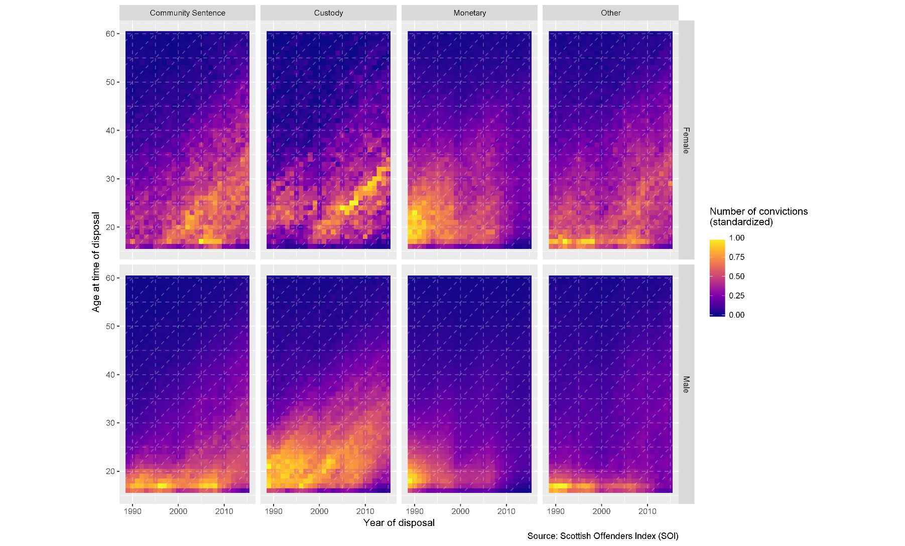
Results
Figure 6. Level plot of convicted offending for different ages in SOI, 1989-2015.

Slide 22
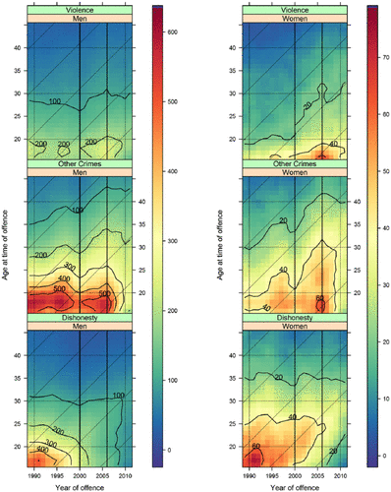
Results
Figure 7. Shaded contour plot of convicted offending for different ages in SOI by crime type, 1989-2011.
Source: Matthews and Minton (2018)

