Slide 1
The Scottish Offenders Index in comparative context: Challenges and opportunities
Ben Matthews, University of Edinburgh
Register-based Criminology Workshop, Stockholm University
August 2019

Slide 2
Overview

Slide 3
Overview
Background to the Scottish Offenders Index (SOI)
SOI in comparative context
Cohorts and cross-sections, Scotland and Sweden
Comparison to understand system effects?
Challenges in comparison (briefly)

Slide 4
Background to the Scottish Offenders Index

Slide 5
What is the SOI?
Used to calculate reconviction rates for Scottish Government annual statistical reports
CHS -> Criminal Proceedings -> SOI
Records linked through unique identifier (S-number)

Slide 6
Data coverage
(Almost) All convictions proceedings in Scottish courts 1989/01/01-present, ~1.6m records, ~600k people
Excludes convictions for motor vehicle offences, minor offences such as drunkenness and crimes against public justice
One record per proceeding (not per offence)
See SG’s documentation

Slide 7
What’s in the SOI
Date of birth
Sex
Date of offence # pre-2004 mostly month of offence
Date of disposal
Date of sentencing
Crime type # jd code, ~470
Disposal
Sentence length
Time in prison # estimated

Slide 8
What’s not in the SOI
Full records below the age of 16 (under 16s can be tried in adult courts, but most handled in separate youth justice system)
Any crimes other than the most serious per proceeding
Migration
Mortality
Any other covariate we’re interested in

Slide 9
Data access
Summary data available online
Individual-level data via Data Sharing Agreement with Scottish Government
… GDPR? Brexit?
Data linkage to Census in negotiation (since 2014…)

Slide 10
SOI in comparative context Possible avenues #1: Research design

Slide 11
Changing Criminal Careers
Sustained fall in crime and conviction in Scotland over last ~25 years, mostly because of lower youth conviction (Matthews and Minton 2018)
Broadly similar trends in Sweden - fall in conviction over last ~25 years, mostly young men (Sivertsson 2018, see also Andersen et al. 2016 for Denmark and van der Laan et al. 2016 for Netherlands) – but…

Slide 12
Scotland and Sweden
“The modal peak age for crime among both males and females [in Sweden] has shifted towards the lower end of the age spectrum” (Sivertsson 2018:24)
In Scotland the modal age of conviction increased! (Matthews and Minton 2018)
One explanation: Sivertsson used cohorts, we used cross-sections

Slide 13
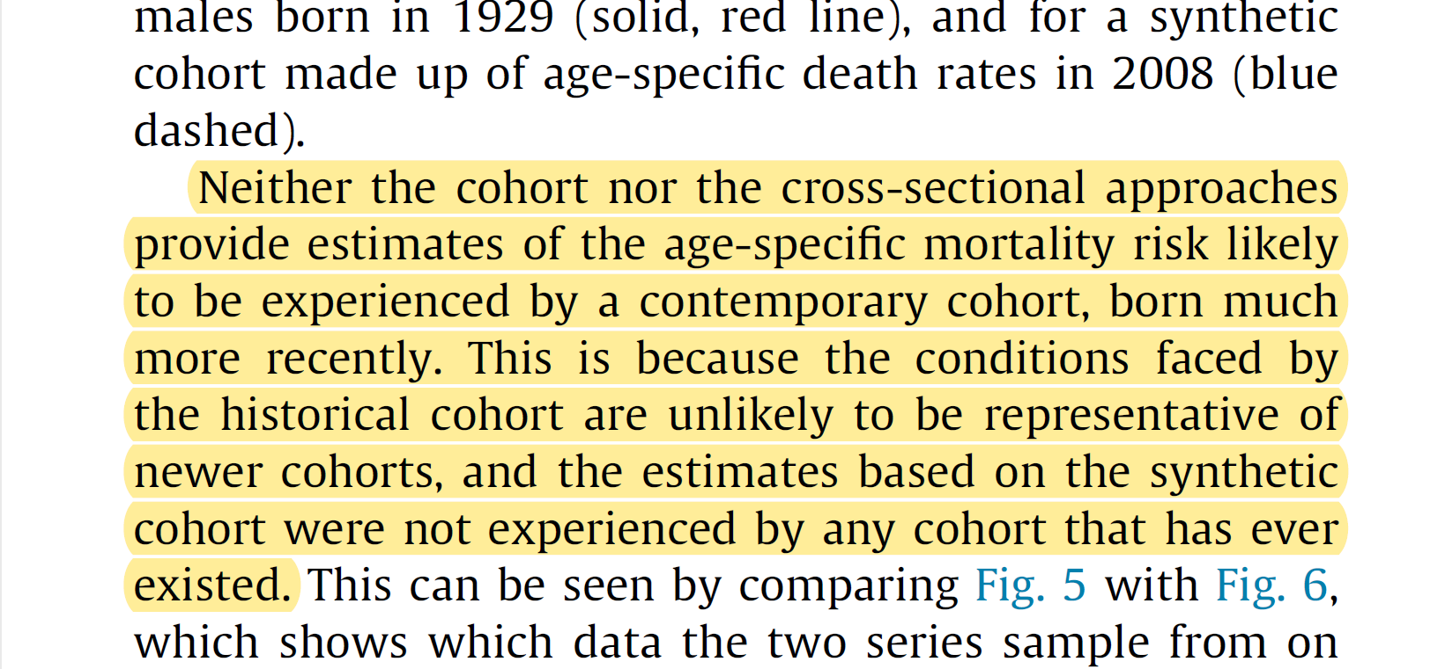
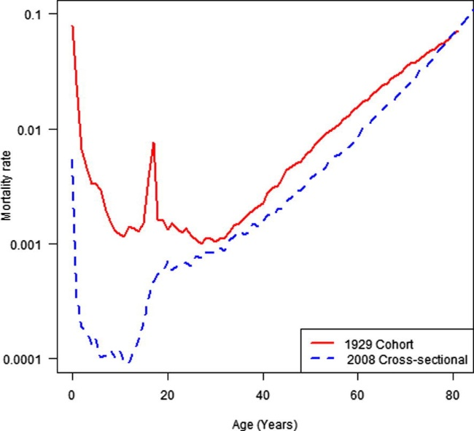
Cohorts or cross-sections?
Minton (2014), Real geographies and virtual landscapes: Exploring the influence on place and space on mortality Lexis surfaces using shaded contour maps, Spatial and Spatio-temporal Epidemiology (10:49-66)

Slide 14
Cohorts or cross-sections?
Focus depends on research question
… but we can sort of do both! Analyse on the lexis surface (Minton 2014, Matthews and Minton 2018)
Help (partially) disentangle Age-Period-Cohort trends (Minton 2018)
Different APC trends imply different causes for crime drop (Kim et al. 2016)

Slide 15
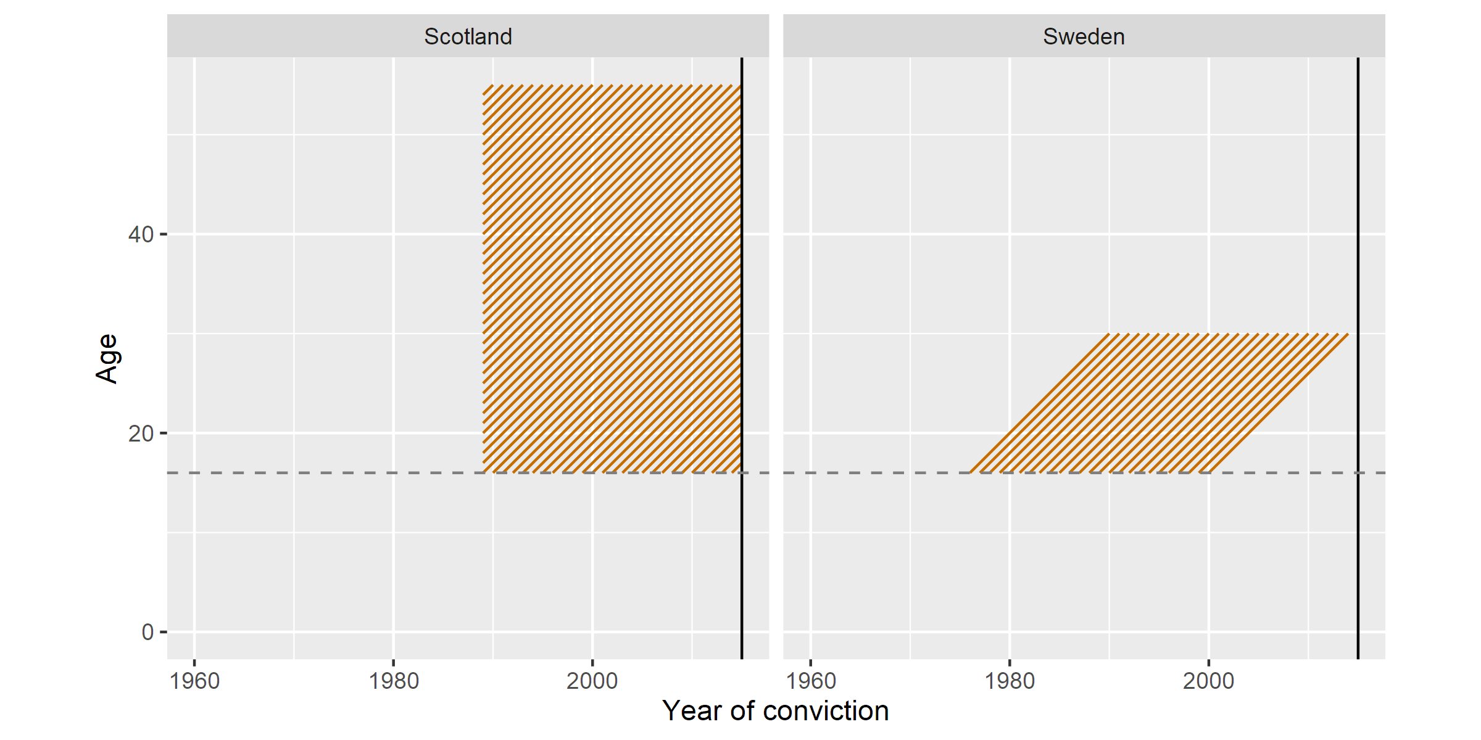
Data coverage: lexis grid

Slide 16
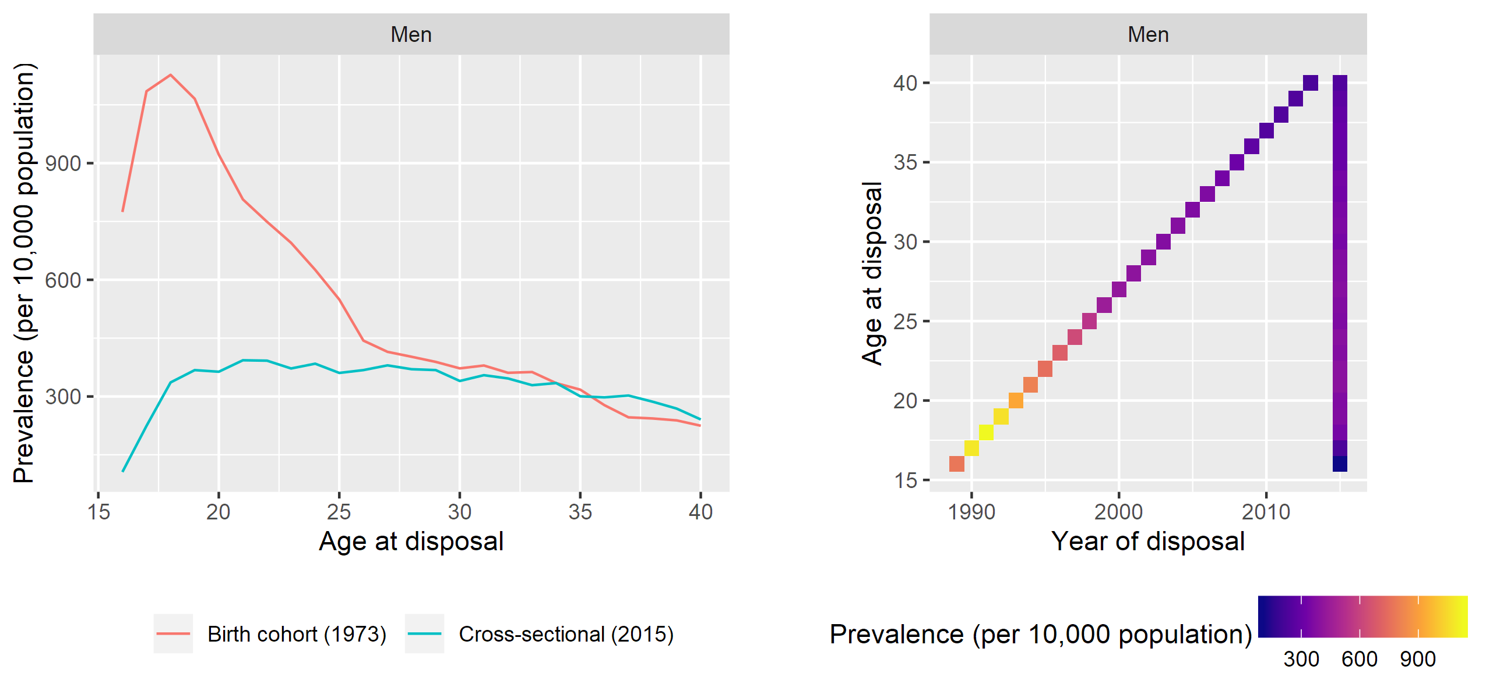
Line plots and the lexis grid
=

Slide 17
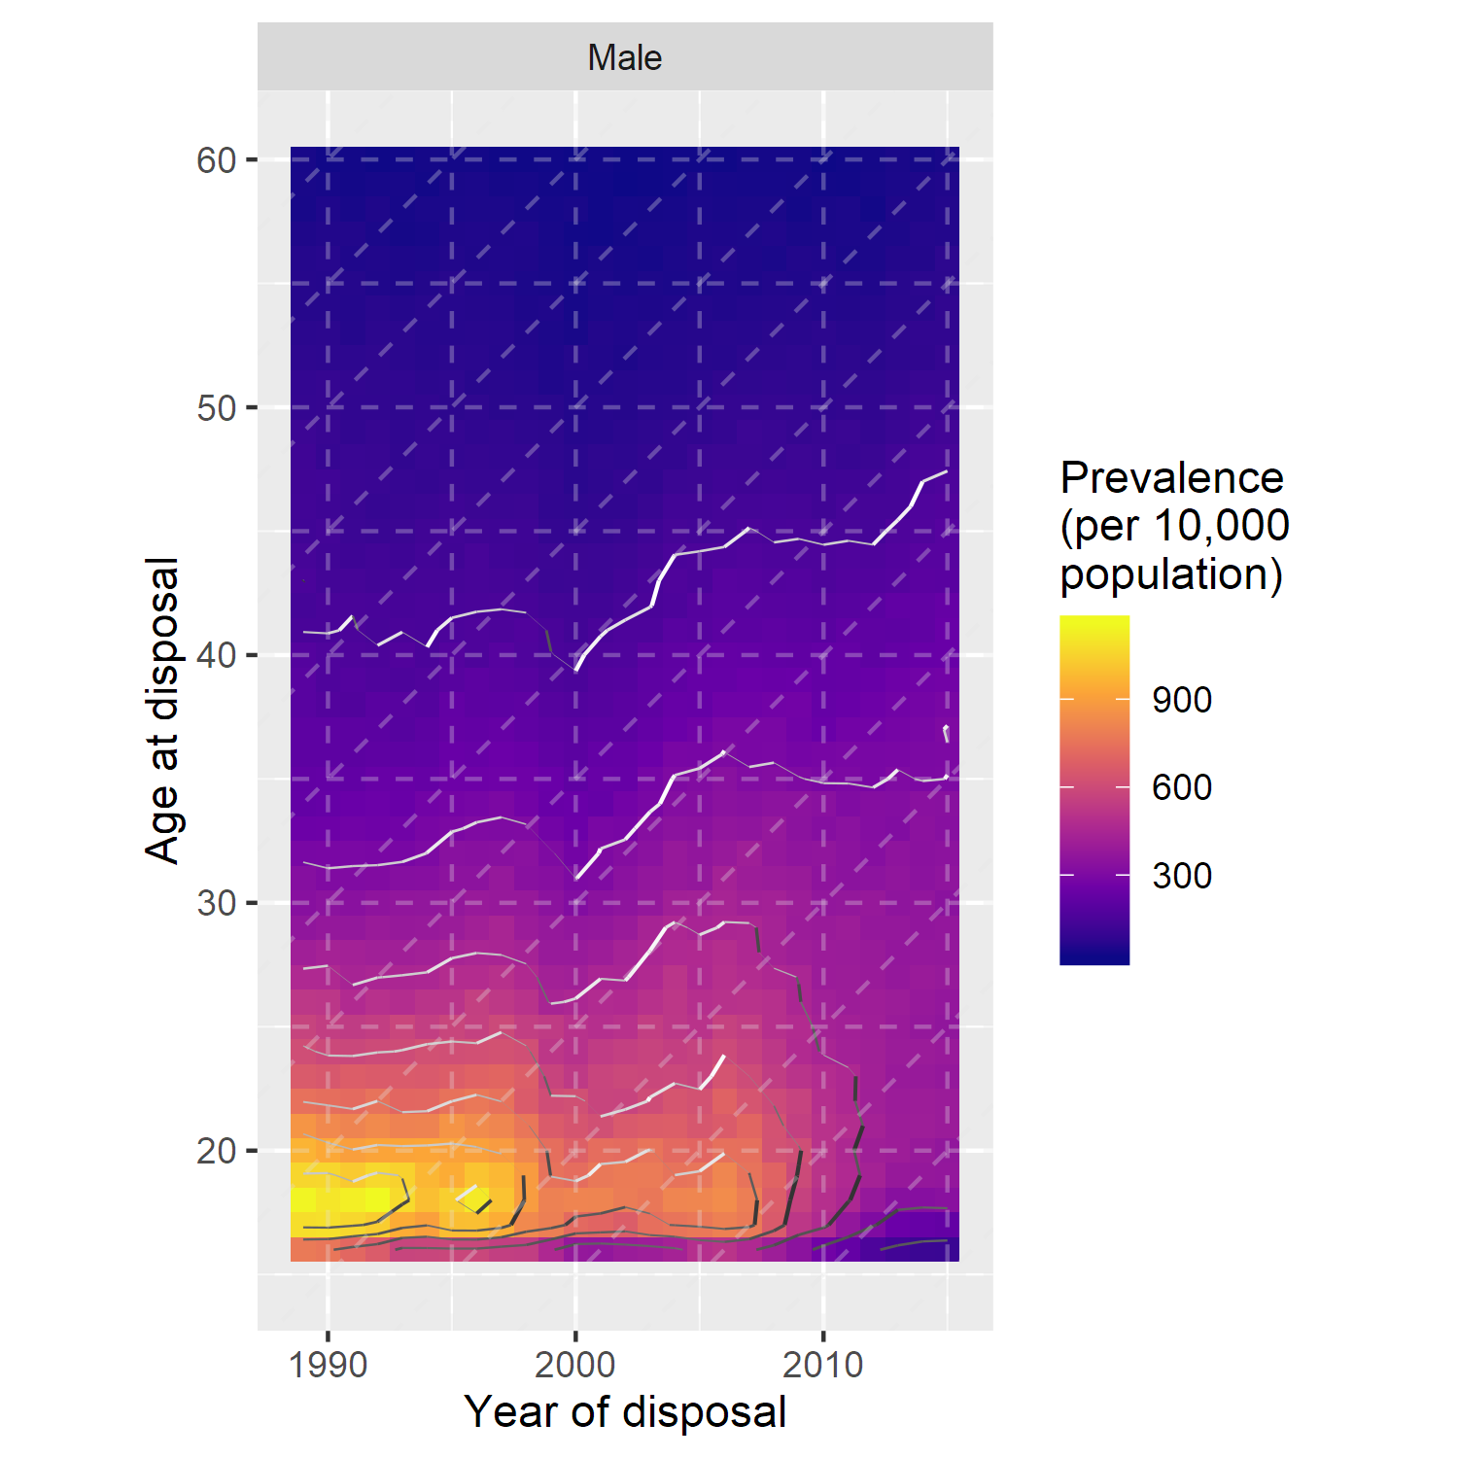
Convictions on the lexis grid

Slide 18
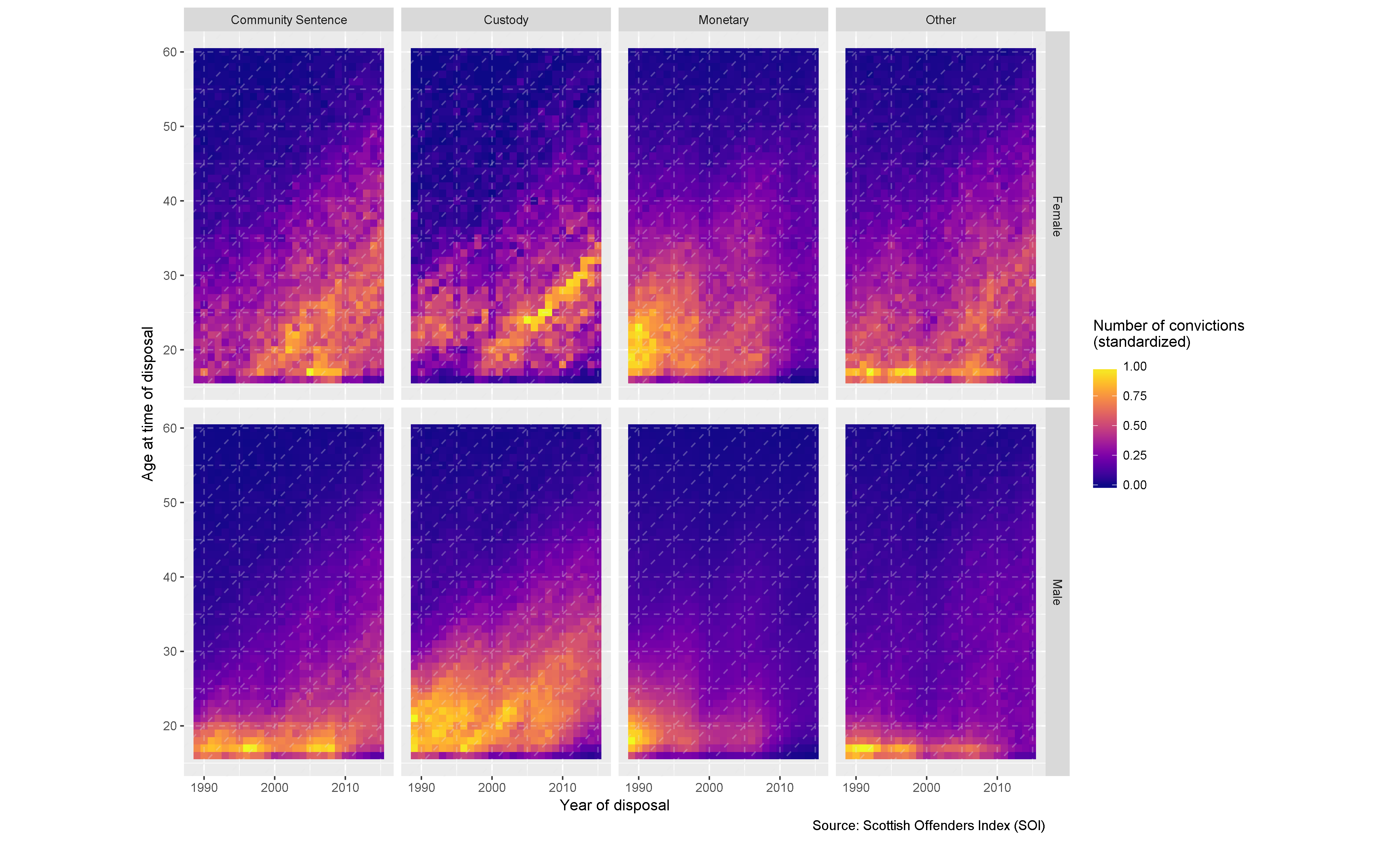
Convictions on the lexis grid

Slide 19
SOI in comparative context Possible avenues #2: System or behaviour?

Slide 20
System or behaviour?
Can we separate out system and behaviour effects in convictions data? Well, no.
But if trend looks to be period effects, matches with theoretical explanations, aligns with policy change then likely policy effect (Matthews 2016)
Cohort effects likely behavioural (Soothill et al. 2004)?
But really you need comparison

Slide 21
System or behaviour?
If trend looks to be period effects, matches with theoretical explanations, aligns with policy change, and is not present in other jurisdictions which did not have the same policy change, then likely policy effect
Can compare on Lexis plot, including multiple countries with pair-wise comparisons (Vaupel 1998, Minton 2018)

Slide 22
SOI in comparative context An example

Slide 23
WARNING! These data are crudely estimated and probably inaccurate

Slide 24
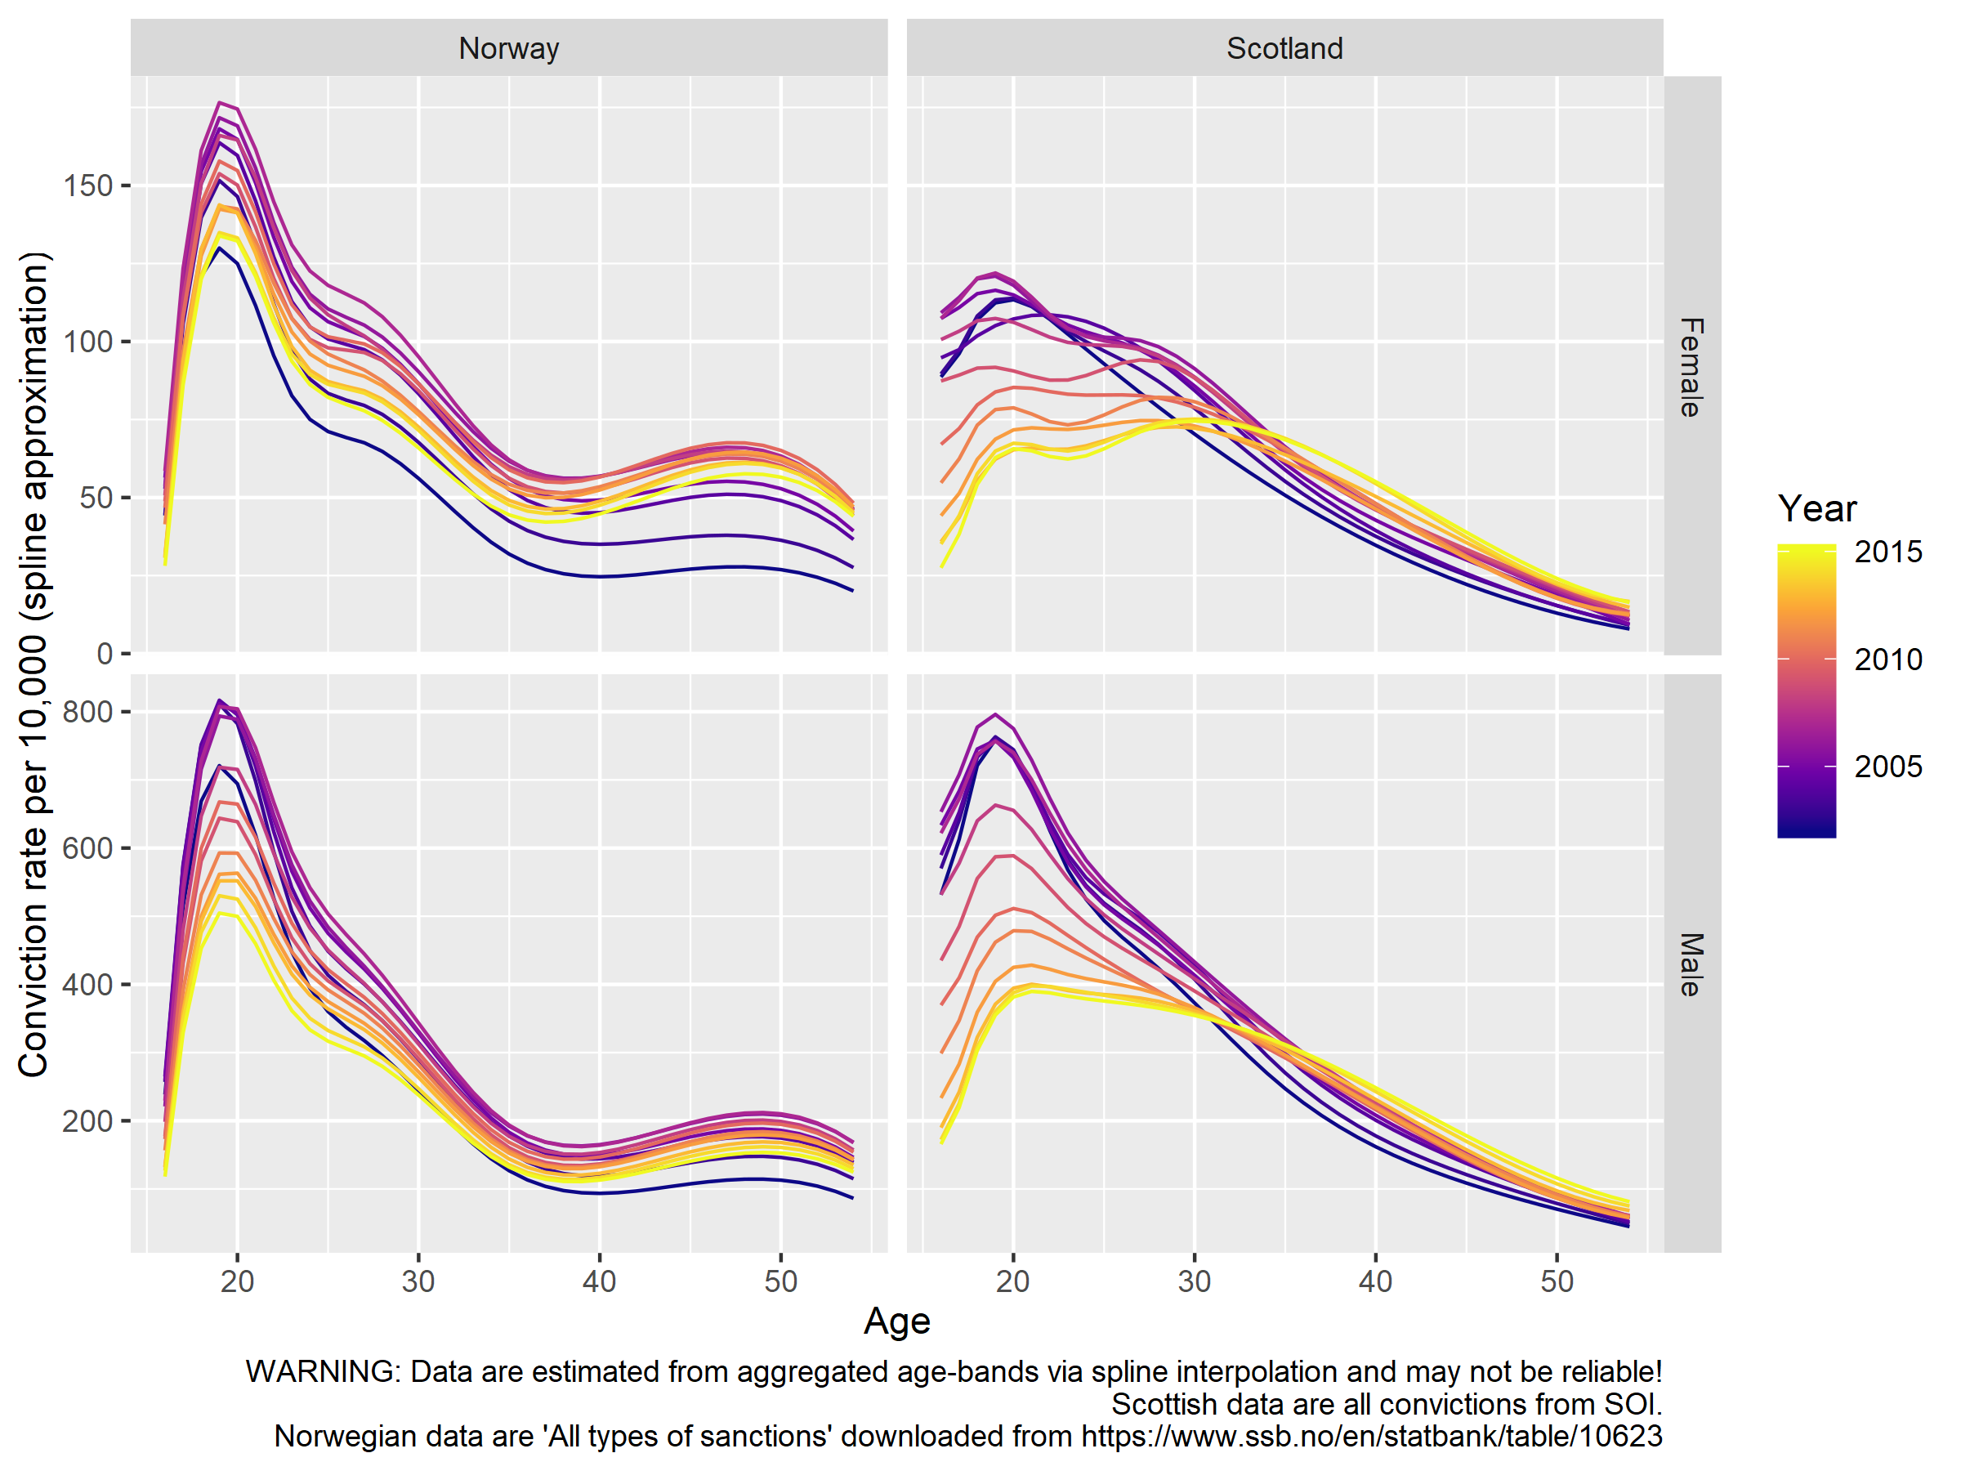

Slide 25
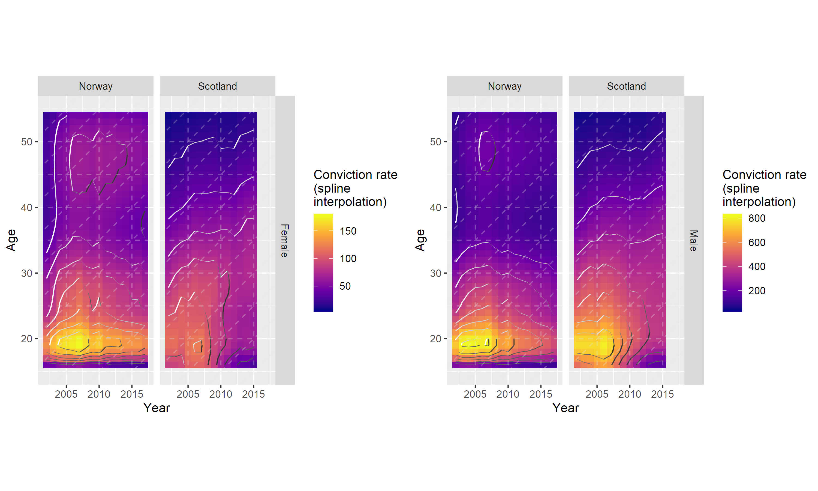

Slide 26
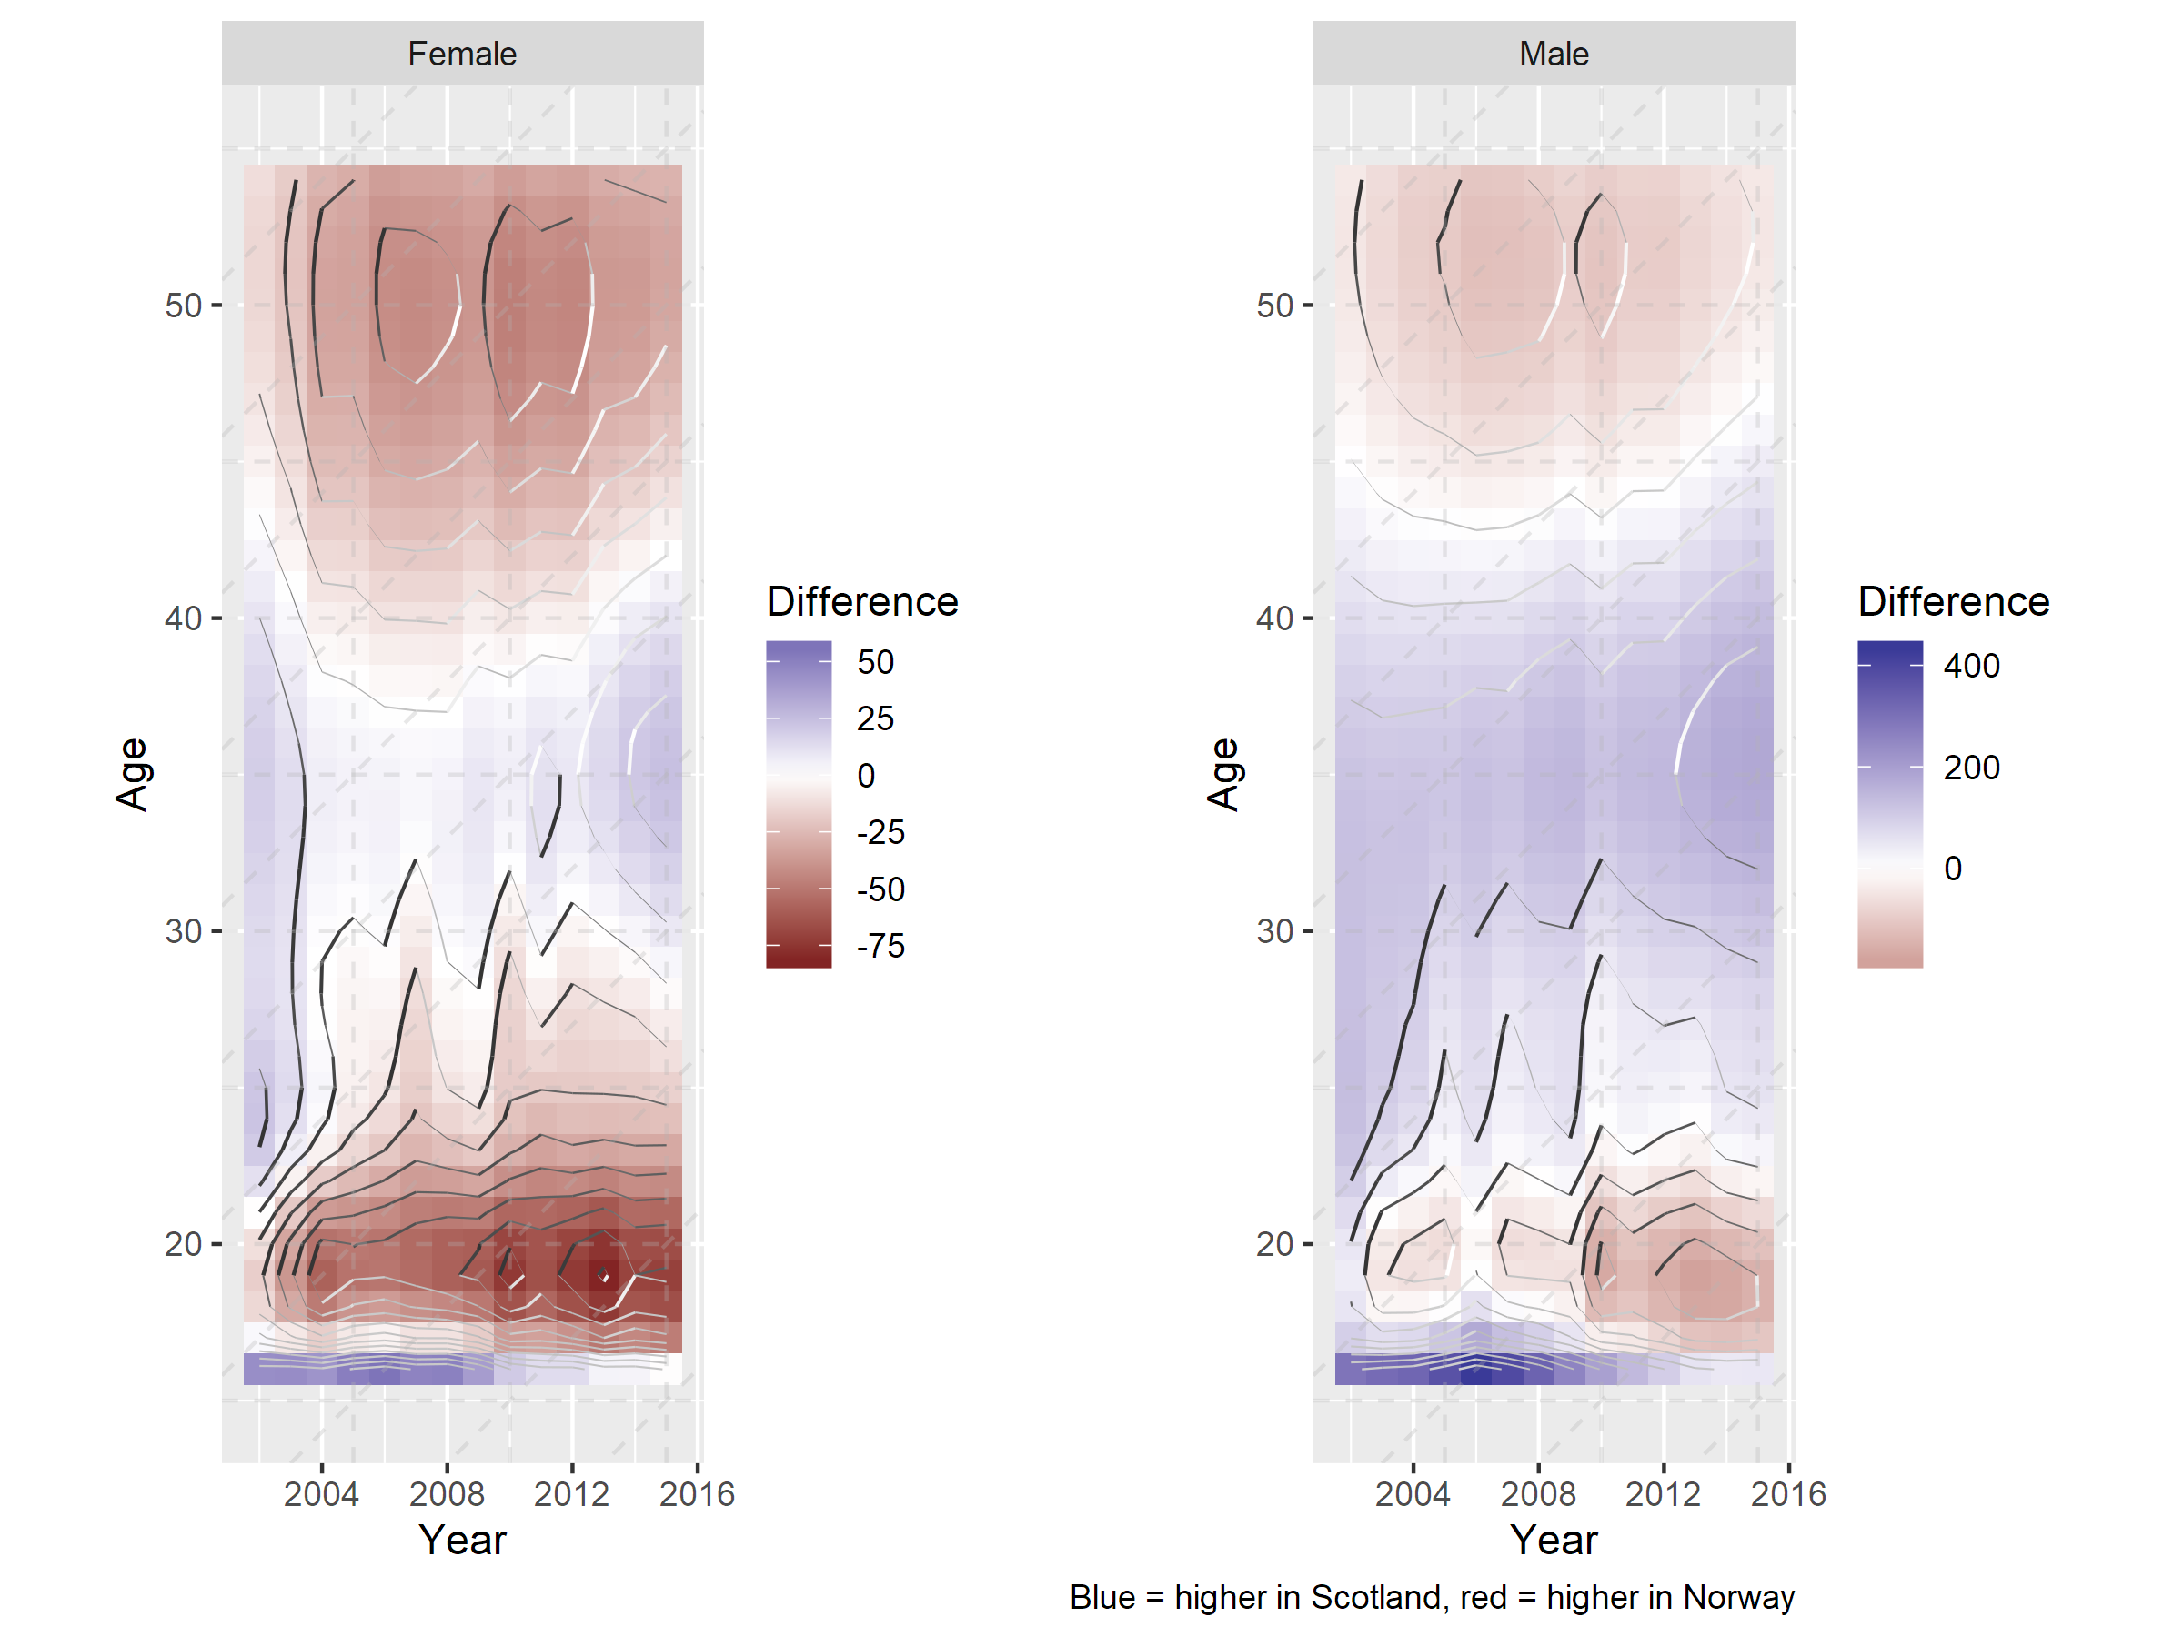

Slide 27
Challenges

Slide 28
Challenges
All the usual problems comparing between jurisdictions (Sartori 1991)
Data access :S

Slide 29
Thank you!
@benmatthewsed | ben.matthews@ed.ac.uk
-
Thanks to Scottish Government for providing SOI data and Amy Tilbrook, Suhail Iqbal and Dave Stobie at ADRC-Scotland for facilitating data access

