Slide 1


Two populations, two rates
Population 1
Population 2
-Rate = $\frac{3}{15}$ = 0.2
-Rate = $\frac{8}{15}$ = 0.53

Slide 2



Rates can be split into component parts
Population 1
Population 2
-Rate = $\frac{3}{15}$ = 0.2
-Rate = $\frac{8}{15}$ = 0.53
$\frac{5}{15}×\frac{3}{5}=\frac{3}{15}=0.2$
$\frac{10}{15}×\frac{8}{10}=\frac{8}{15}=0.53$
A
B
$×$ $=$
+
+
rate of green squares = proportion of squares x proportion of squares that are green

Slide 3
Two methods, two questions
Standardisation
What would Rate_{P2} be if… A was the same in P1 and P2?
B was the same in P1 and P2?
Decomposition
How much of Rate_{P2} – Rate_{P1} is because… A is different between P1 and P2?
B is different between P1 and P2?

Slide 4
Two methods, two questions
P1
P2
Rate = rate of green squares = AxB
A = proportion of squares
B = proportion of squares that are green
Standardisation
What would Rate_{P2} be if… A was the same in P1 and P2?
B was the same in P1 and P2?
Decomposition
How much of Rate_{P2} – Rate_{P1} is because… A is different between P1 and P2?
B is different between P1 and P2?

Slide 5
Need to be specific
Standardisation
What would Rate_{P2} be if… A was the same in P1 and P2?
A in P2 was the same as A in P1?
A in P2 was at the average of what it is in P1 and P2?

Slide 6
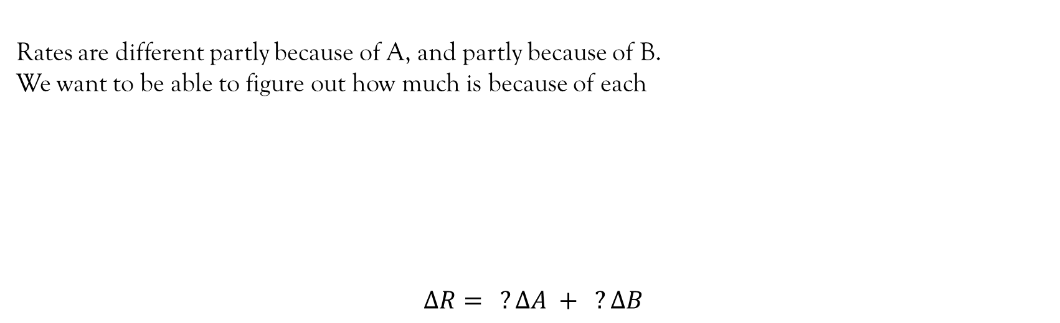
Decomposition
Rates are different partly because of A, and partly because of B.
We want to be able to figure out how much is because of each
$$∆R= ?∆A + ?∆B$$
Rate_{P1} = A_{P1} x B_{P1}
A-effect
B-effect
Rate_{P2} = A_{P2} x B_{P2}

Slide 7
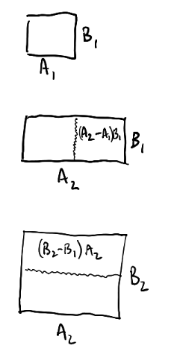


Decomposition – geometrically
Rate_{P1} = A_{P1} x B_{P1}
Rate_{P2} = A_{P2} x B_{P2}

Slide 8
Decomposition – one way to get ∆R
Rate_{P1} = A_{P1} x B_{P1}
Rate_{P2} = A_{P2} x B_{P2}

Slide 9
Decomposition – one way to get ∆R
Rate_{P1} = A_{P1} x B_{P1}
Rate_{P2} = A_{P2} x B_{P2}

Slide 10
Decomposition – another way to get ∆R
Rate_{P1} = A_{P1} x B_{P1}
Rate_{P2} = A_{P2} x B_{P2}

Slide 11
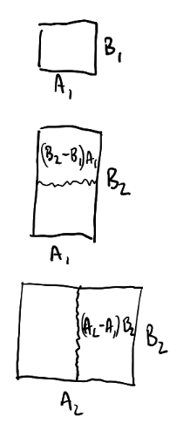
Decomposition – another way to get ∆R
Rate_{P1} = A_{P1} x B_{P1}
Rate_{P2} = A_{P2} x B_{P2}

Slide 12
Decomposition – another way to get ∆R
Rate_{P1} = A_{P1} x B_{P1}
Rate_{P2} = A_{P2} x B_{P2}

Slide 13
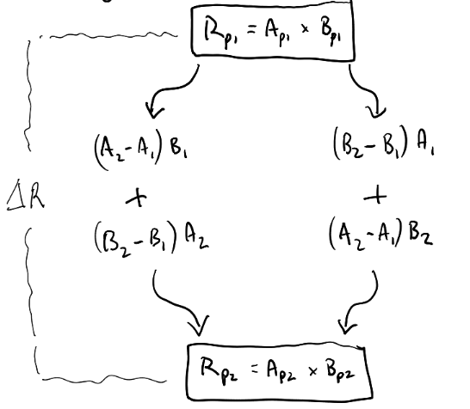
Decomposition – two ways to get ∆R, two sets of answers
Rate_{P1} = A_{P1} x B_{P1}
Two ways to get from Rp1 to Rp2
But the “effect of moving A1 -> A2”
is very different
Rate_{P2} = A_{P2} x B_{P2}

Slide 14
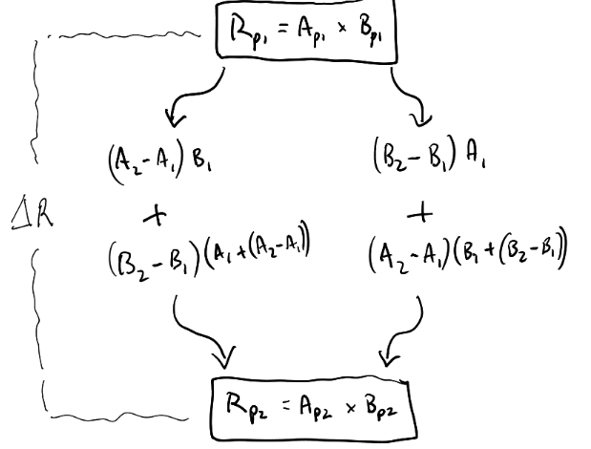
Decomposition – the interaction
Rate_{P1} = A_{P1} x B_{P1}
Substitute in A2 = A1 + (A2-A1)
Rate_{P2} = A_{P2} x B_{P2}

Slide 15
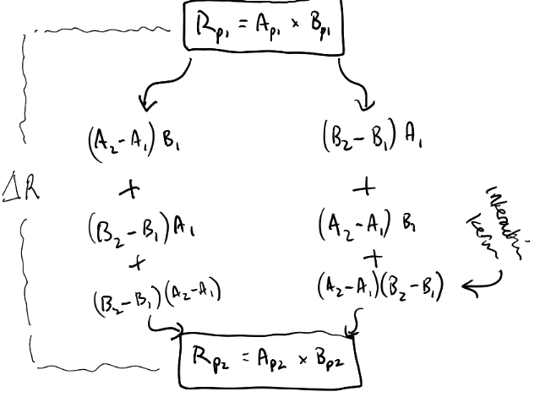
Decomposition – the interaction
Rate_{P1} = A_{P1} x B_{P1}
Interaction term
Rate_{P2} = A_{P2} x B_{P2}

Slide 16
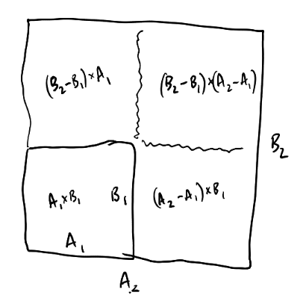
Decomposition – the interaction (geometrically)
Interaction term

Slide 17
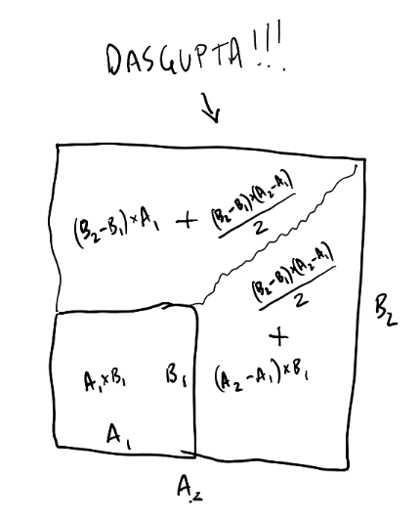

Decomposition – splitting the interaction

Slide 18
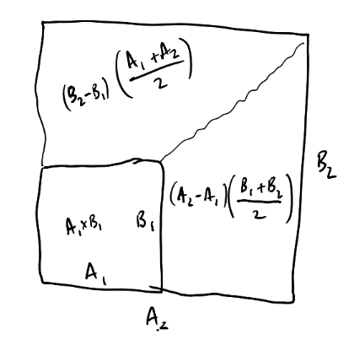
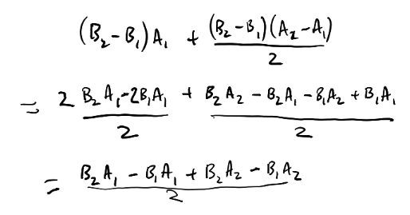
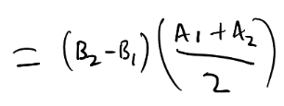
Decomposition – splitting the interaction
(just to show the simplification)

Slide 19




2 factor worked example
-Rate_{P1} = $\frac{3}{15}$ = 0.2
-Rate_{P2} = $\frac{8}{15}$ = 0.53
Population 1
Population 2
$\frac{5}{15}×\frac{3}{5}=\frac{3}{15}=0.2$
$\frac{10}{15}×\frac{8}{10}=\frac{8}{15}=0.53$

Slide 20

2 factor worked example
-Rate_{P1} = $\frac{3}{15}$ = 0.2
-Rate_{P2} = $\frac{8}{15}$ = 0.53
Population 1
Population 2
$\frac{5}{15}×\frac{3}{5}=\frac{3}{15}=0.2$
$\frac{10}{15}×\frac{8}{10}=\frac{8}{15}=0.53$
Standardisation
What would Rate_{P2} be if… A was the same in P1 and P2? - A in P2 was the same as A in P1? <<<
- A in P2 was at the average of what it is in P1 and P2?
$\frac{5}{15}×\frac{8}{10}=\frac{4}{15}=0.26$
A = proportion of squares
B = proportion of squares that are green

Slide 21
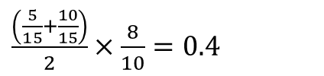
2 factor worked example
-Rate_{P1} = $\frac{3}{15}$ = 0.2
-Rate_{P2} = $\frac{8}{15}$ = 0.53
Population 1
Population 2
$\frac{5}{15}×\frac{3}{5}=\frac{3}{15}=0.2$
$\frac{10}{15}×\frac{8}{10}=\frac{8}{15}=0.53$
Standardisation
What would Rate_{P2} be if… A was the same in P1 and P2? - A in P2 was the same as A in P1?
- A in P2 was at the average of what it is in P1 and P2? <<<
$\frac{\left(\frac{5}{15}+\frac{10}{15}\right)}{2}×\frac{8}{10}=0.4$
A = proportion of squares
B = proportion of squares that are green

Slide 22
2 factor worked example
-Rate_{P1} = $\frac{3}{15}$ = 0.2
-Rate_{P2} = $\frac{8}{15}$ = 0.53
Population 1
Population 2
$\frac{5}{15}×\frac{3}{5}=\frac{3}{15}=0.2$
$\frac{10}{15}×\frac{8}{10}=\frac{8}{15}=0.53$
Decomposition
How much of Rate_{P2} – Rate_{P1} is because… A is different between P1 and P2? B is different between P1 and P2?
A = proportion of squares
B = proportion of squares that are green

Slide 23
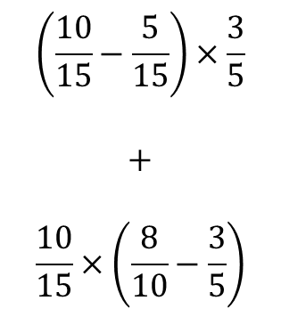


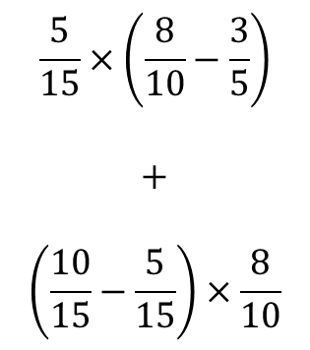
2 factor worked example
P1
$\frac{5}{15}×\frac{3}{5}=\frac{3}{15}=0.2$
$$\left(\frac{10}{15}−\frac{5}{15}\right)×\frac{3}{5}$$
$$+$$
$$\frac{10}{15}×\left(\frac{8}{10}−\frac{3}{5}\right)$$
$$\frac{5}{15}×\left(\frac{8}{10}−\frac{3}{5}\right)$$
$$+$$
$$\left(\frac{10}{15}−\frac{5}{15}\right)×\frac{8}{10}$$
P2
$\frac{10}{15}×\frac{8}{10}=\frac{8}{15}=0.53$

Slide 24
2 factor worked example
P1
$\frac{5}{15}×\frac{3}{5}=\frac{3}{15}=0.2$
A-effect
$$\left(\frac{10}{15}−\frac{5}{15}\right)×\frac{3}{5}$$
$$+$$
$$\frac{10}{15}×\left(\frac{8}{10}−\frac{3}{5}\right)$$
$$\frac{5}{15}×\left(\frac{8}{10}−\frac{3}{5}\right)$$
$$+$$
$$\left(\frac{10}{15}−\frac{5}{15}\right)×\frac{8}{10}$$
A-effect
P2
$\frac{10}{15}×\frac{8}{10}=\frac{8}{15}=0.53$

Slide 25
2 factor worked example
P1
$\frac{5}{15}×\frac{3}{5}=\frac{3}{15}=0.2$
A-effect
B-effect
$$\left(\frac{10}{15}−\frac{5}{15}\right)×\frac{3}{5}$$
$$+$$
$$\frac{10}{15}×\left(\frac{8}{10}−\frac{3}{5}\right)$$
$$\frac{5}{15}×\left(\frac{8}{10}−\frac{3}{5}\right)$$
$$+$$
$$\left(\frac{10}{15}−\frac{5}{15}\right)×\frac{8}{10}$$
B-effect
A-effect
P2
$\frac{10}{15}×\frac{8}{10}=\frac{8}{15}=0.53$

Slide 26



2 factor worked example
P1
$\frac{5}{15}×\frac{3}{5}=\frac{3}{15}=0.2$
A-effect
B-effect
$$0.2$$
$$+$$
$$0.1333$$
$$0.0667$$
$$+$$
$$0.2667$$
$$+0.33$$
B-effect
A-effect
P2
$\frac{10}{15}×\frac{8}{10}=\frac{8}{15}=0.53$

Slide 27

2 factor worked example
P1
$\frac{5}{15}×\frac{3}{5}=\frac{3}{15}=0.2$
A-effect
$$\left(\frac{10}{15}−\frac{5}{15}\right)×\frac{\frac{3}{5}+\frac{8}{10}}{2}$$
$$+$$
$$\frac{\frac{5}{15}+\frac{10}{15}}{2}×\left(\frac{8}{10}−\frac{3}{5}\right)$$
B-effect
P2
$\frac{10}{15}×\frac{8}{10}=\frac{8}{15}=0.53$

Slide 28

2 factor worked example
P1
$\frac{5}{15}×\frac{3}{5}=\frac{3}{15}=0.2$
A-effect
$$0.233$$
$$+$$
$$0.1$$
$$+0.33$$
B-effect
P2
$\frac{10}{15}×\frac{8}{10}=\frac{8}{15}=0.53$

Slide 29
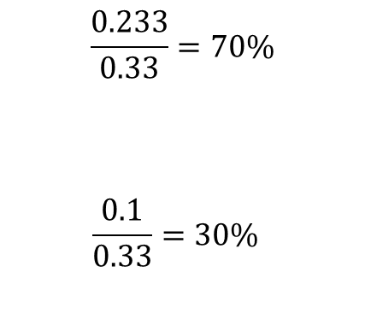
2 factor worked example
P1
$\frac{5}{15}×\frac{3}{5}=\frac{3}{15}=0.2$
A-effect
$$\frac{0.233}{0.33}=70\%$$
$$\frac{0.1}{0.33}=30\%$$
$$0.233$$
$$+$$
$$0.1$$
$$+0.33$$
B-effect
P2
$\frac{10}{15}×\frac{8}{10}=\frac{8}{15}=0.53$

Slide 30
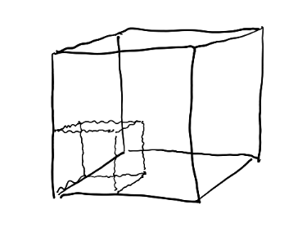
Decomposition – more dimensions…

Slide 31
Decomposition – more dimensions…, more interactions
We end up with pairwise interactions of A*B, A*C, B*C, and the three-way interaction A*B*C.
B2
B1
C1
C2
A1
A2

Slide 32



3 factor example
-Rate_{P1} = $\frac{3}{15}$ = 0.2
-Rate_{P2} = $\frac{8}{15}$ = 0.53
Population 1
Population 2
$\frac{11}{15}×\frac{4}{11}×\frac{3}{4}=0.2$
$\frac{13}{15}×\frac{10}{13}×\frac{8}{10}=0.53$
A B C
+
$× ×$ $=$
+ + +
+
+
rate of green squares = proportion of coloured shapes x proportion of coloured shapes that are squares x proportion of coloured squares that are green

Slide 33
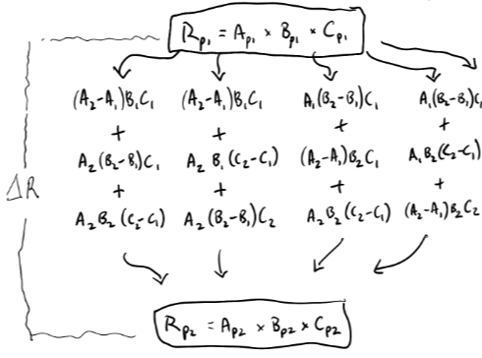
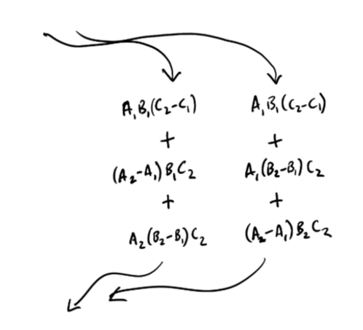
Decomposition – 6 ways to get ∆R, 6 sets of answers
Rate_{P1} = A_{P1} x B_{P1}
… …
… …
… …
Rate_{P2} = A_{P2} x B_{P2}

Slide 34
Decomposition – 6 ways to get ∆R, 6 sets of answers
Note that starting/ending combinations, e.g. B₁C₁ or B₂C₂ arise more frequently than mixed B₁C₂ or B₂C₁ …
Rate_{P1} = A_{P1} x B_{P1}
… …
… …
… …
Rate_{P2} = A_{P2} x B_{P2}

Slide 35
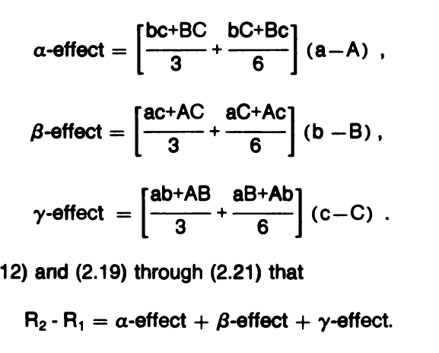
Decomposition – Das Gupta

Slide 36
Decomposition – {DasGuptR}

Slide 37
Rate of being a Green Square
Population 1
Population 2
-Rate = $\frac{3}{15}$ = 0.2
-Rate = $\frac{8}{15}$ = 0.53
$\frac{5}{15}×\frac{3}{5}=\frac{3}{15}=0.2$
$\frac{10}{15}×\frac{8}{10}=\frac{8}{15}=0.53$
A
B
$×$ $=$
+
+
rate of green squares = proportion of squares x proportion of squares that are green

Slide 38
Rate of being Green
Population 1
Population 2
+ +
2 8
3 7
3 1
+ +
2 5
4 3
7 3
8 16
Rate = 8/24 = 0.33
13 11
Rate = 13/24 = 0.54

Slide 39

Weights and Rates: Green Squares
Population 1
Population 2
-Rate = $\frac{3}{15}$ = 0.2
-Rate = $\frac{8}{15}$ = 0.53
Weight: Proportion of population
that is square
Rate: Rate of being green, for squares
$\frac{5}{15}×\frac{3}{5}=\frac{3}{15}=0.2$
$\frac{10}{15}×\frac{8}{10}=\frac{8}{15}=0.53$
$×$ $=$
+
+
rate of green squares = proportion of squares x proportion of squares that are green

Slide 40



Weights and Rates: Green Shapes
Population 1
Population 2
+ +
+ +
( $×$ ) +
( $×$ ) +
( $×$ )
+ +
+ +
+ +
weight
rate
weight
rate
weight
rate

Slide 41
Group Disparity in Y
Different baseline Y
Differential prevalence of X
Differential effects of X

Slide 42
Recovery from Stroke: Hospital A vs Hospital B
Different baseline Y better recovery for patients with zero physiotherapy in HospA compared to patients with zero physiotherapy in HospB
Differential prevalence of X
Higher proportion of patients given physiotherapy in HospA vs HospB
Differential effects of X
Physiotherapy has a better effect on recovery in HospA than it does in HospB
Differential selection into X
In HospA, physio is specifically targeted for those it will help more.
In HospB, physio is given randomly

Slide 43
Disparity in offspring’s income between Parents with High Income vs Parents with Low Income
Different baseline Y offspring of PHI without college degree earn more than offspring of PLI without a degree
Differential prevalence of X
Higher proportion of PHI offspring have college degree compared to PLI offspring
Differential effects of X
College degree results in greater increase in income for PHI offspring than it does for PLI offspring

Slide 44
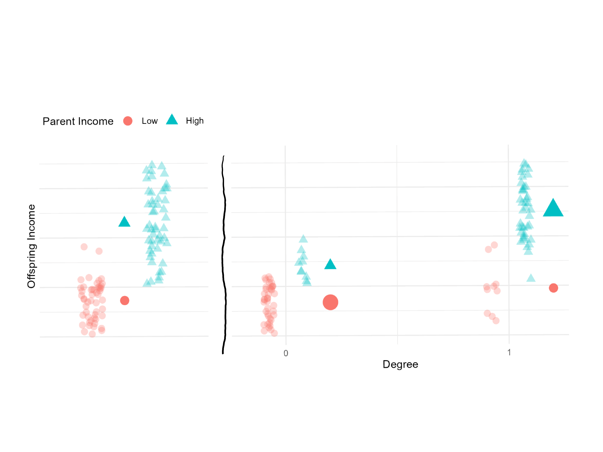

Slide 45
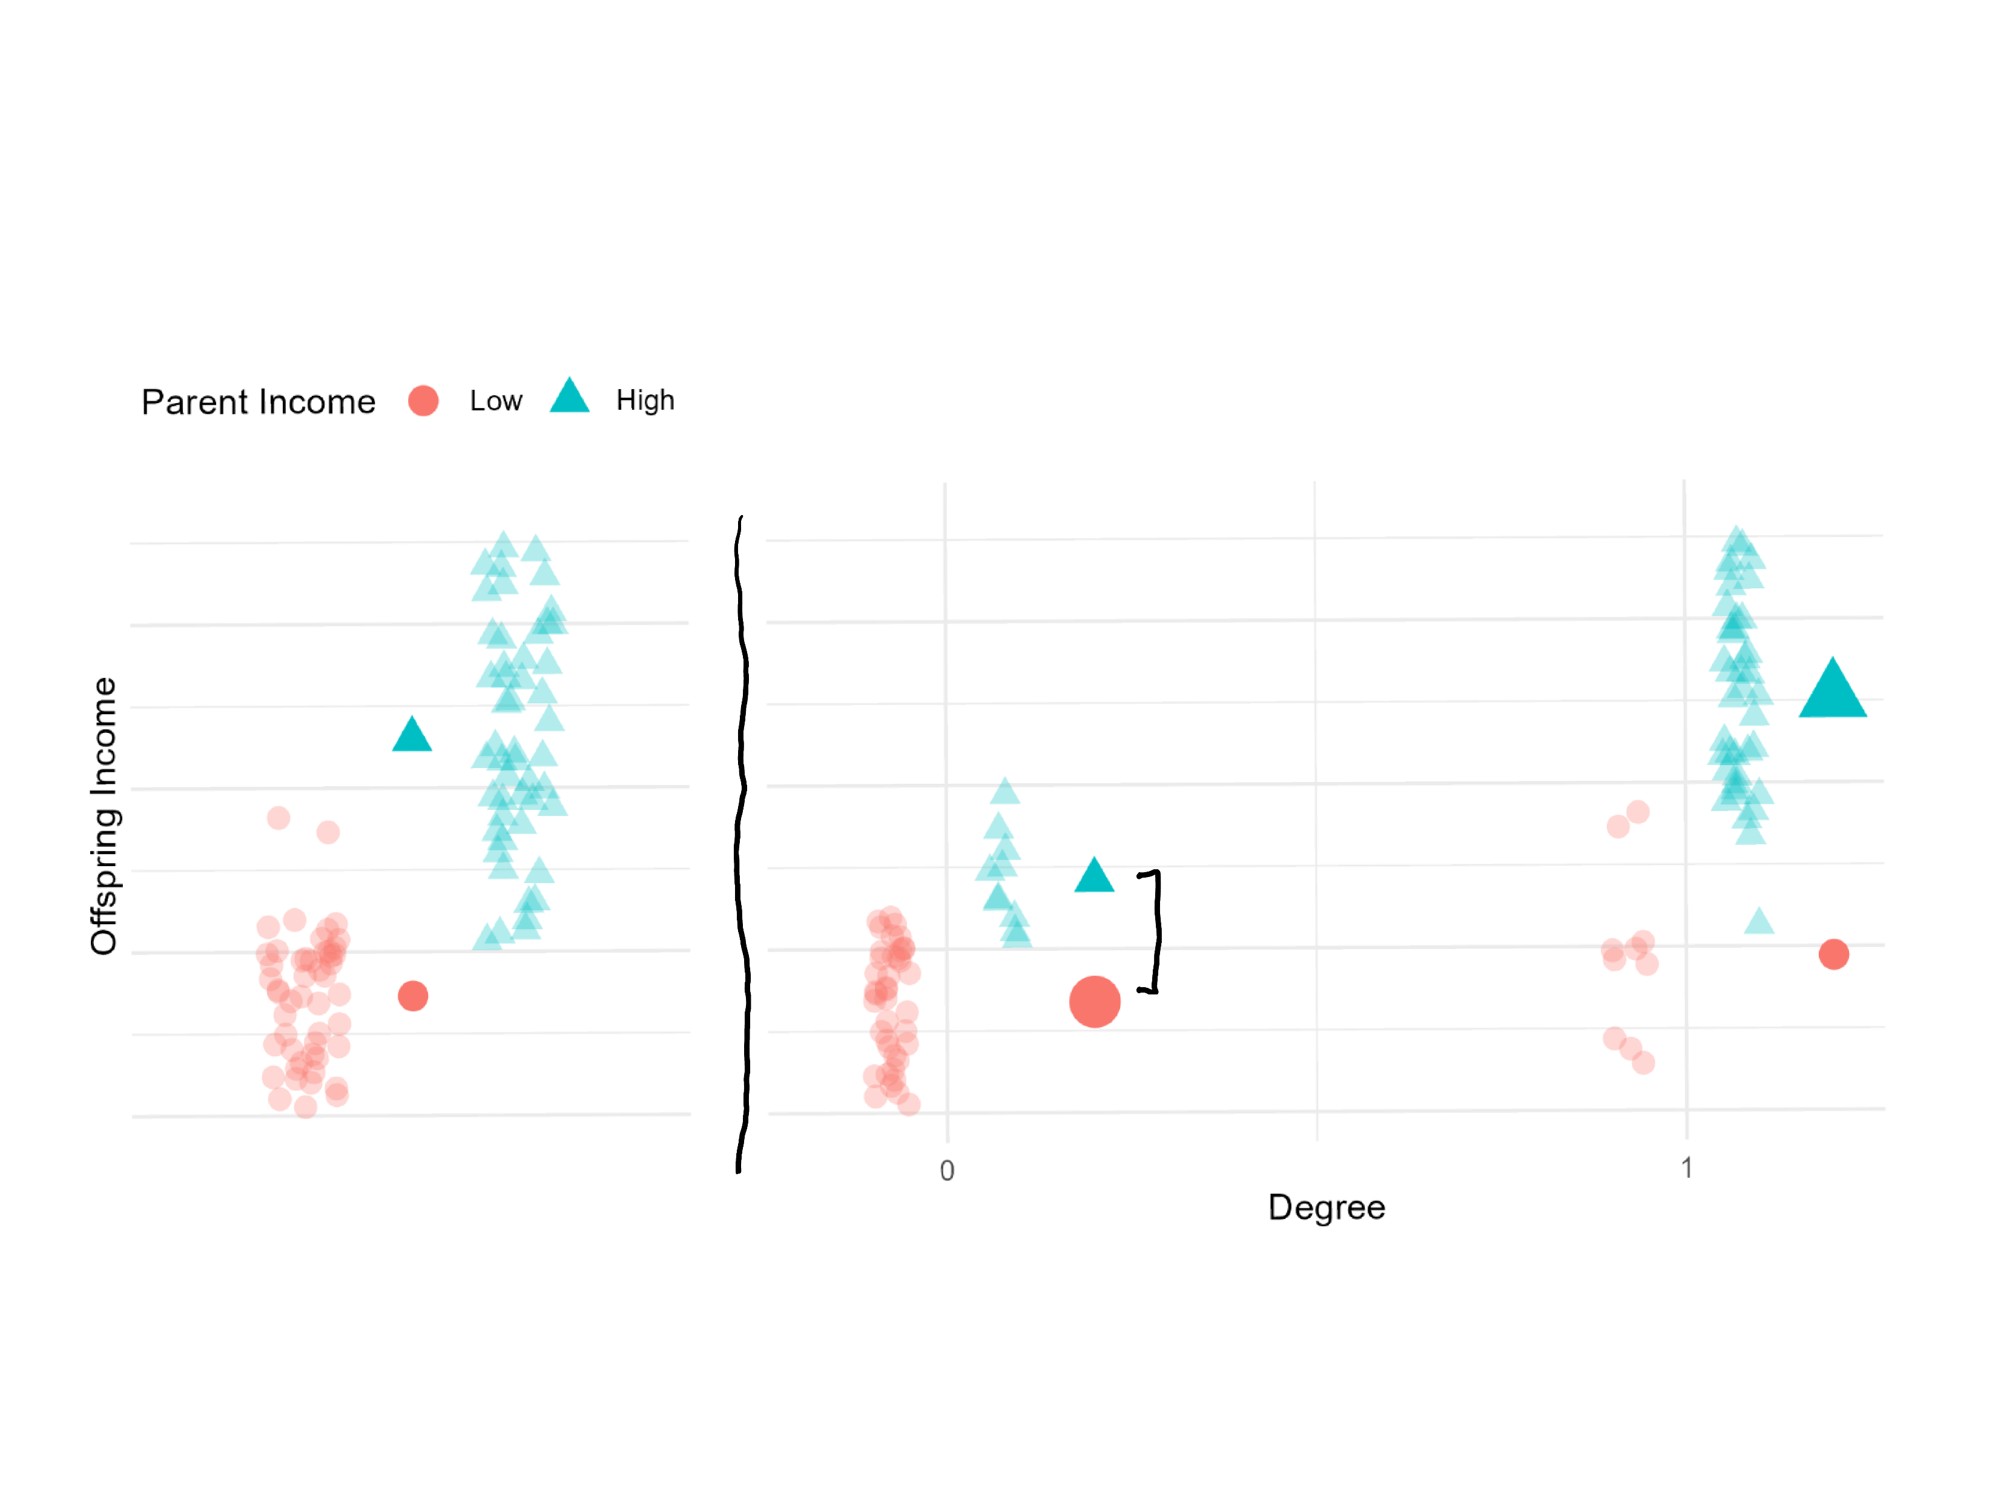

Slide 46
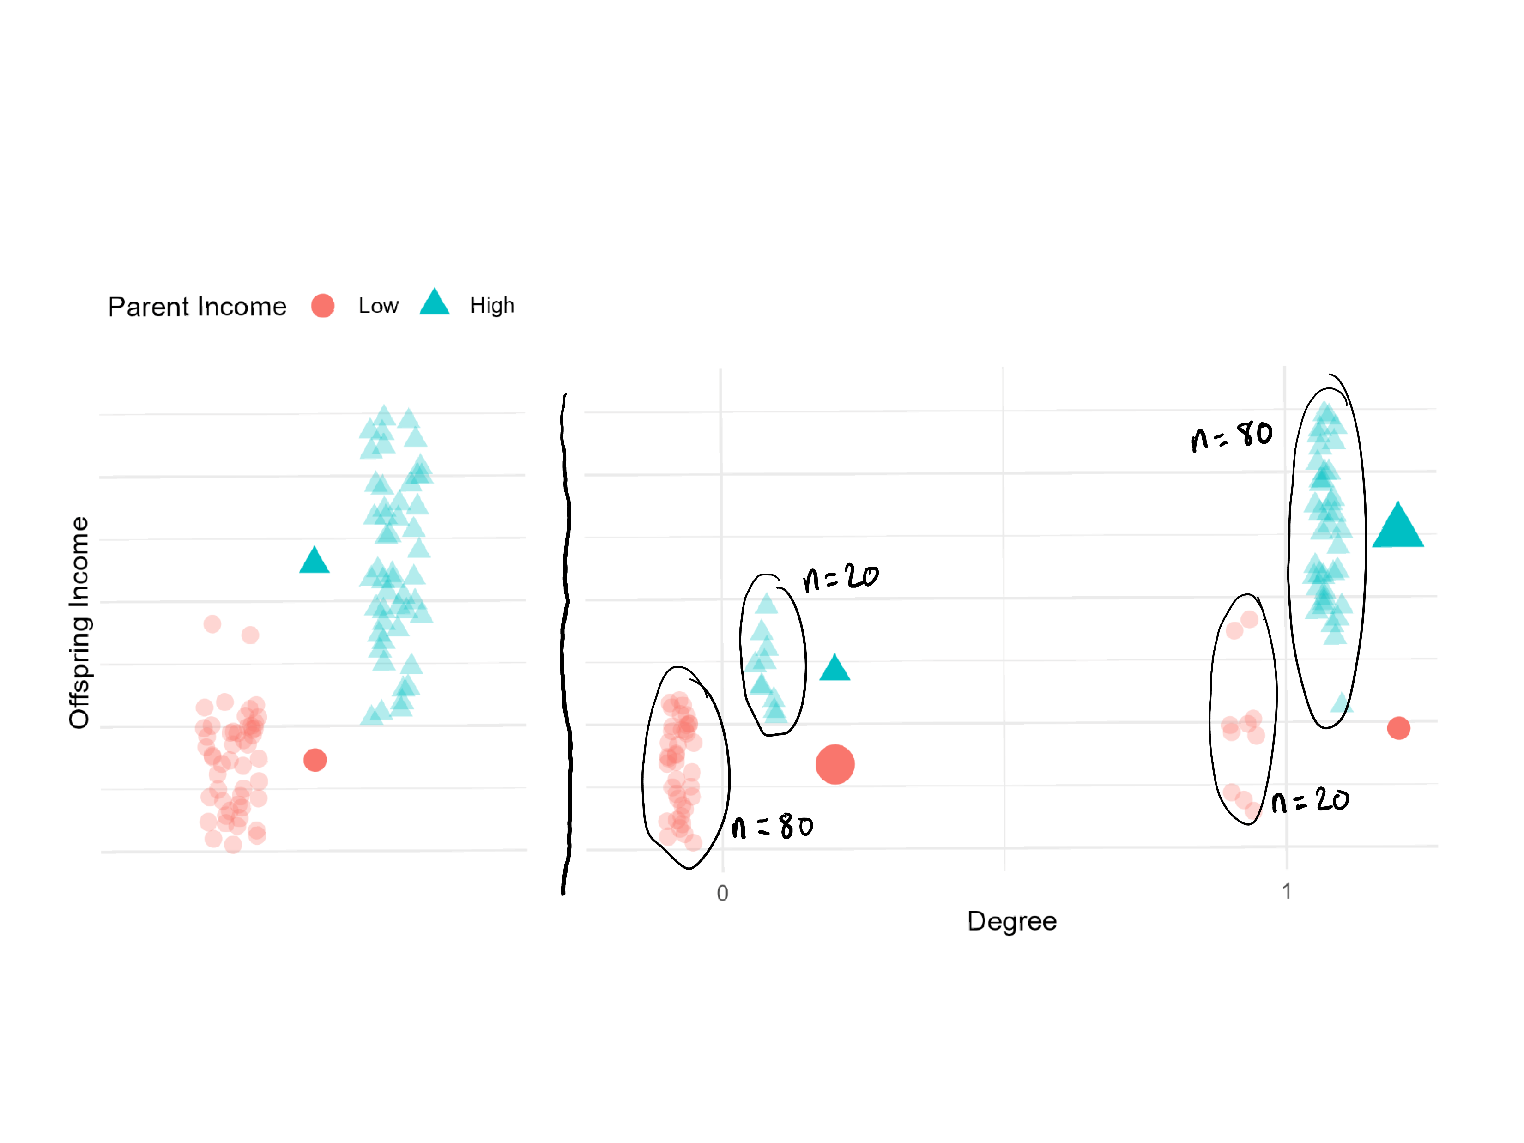

Slide 47
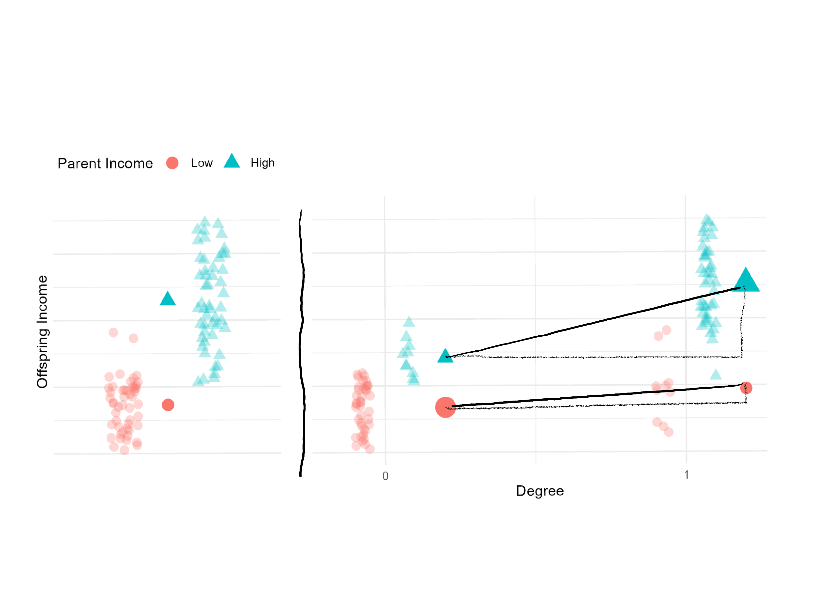

Slide 48
Group Disparity in Y
Different baseline Y
Differential prevalence of X
Differential effects of X
Differential selection into X

Slide 49
Disparity in offspring’s income between Parents with High Income vs Parents with Low Income
Different baseline Y offspring of PHI without college degree earn more than offspring of PLI without a degree
Differential prevalence of X
Higher proportion of PHI offspring have college degree compared to PLI offspring
Differential effects of X
College degree results in greater increase in income for PHI offspring than it does for PLI offspring
Differential selection into X
PHI offspring for whom college will have most benefit are more likely to go to college PLI offspring for whom college will have most benefit are no more likely to go to college

Slide 50
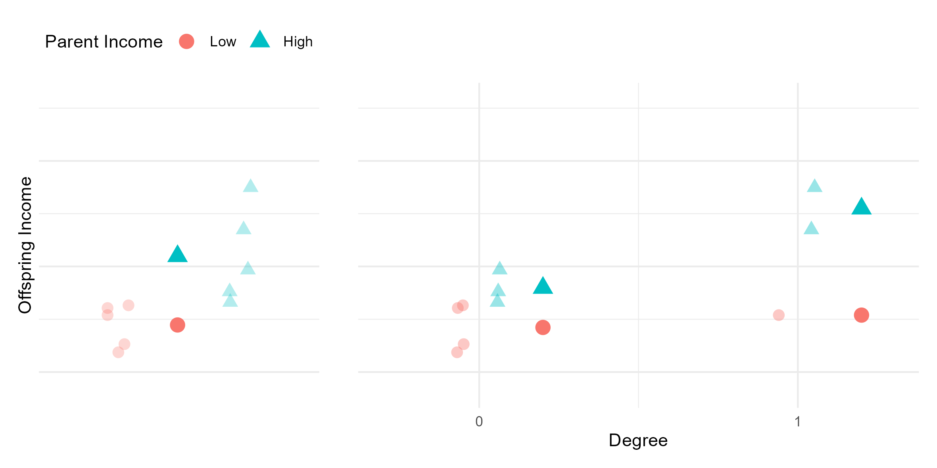

Slide 51
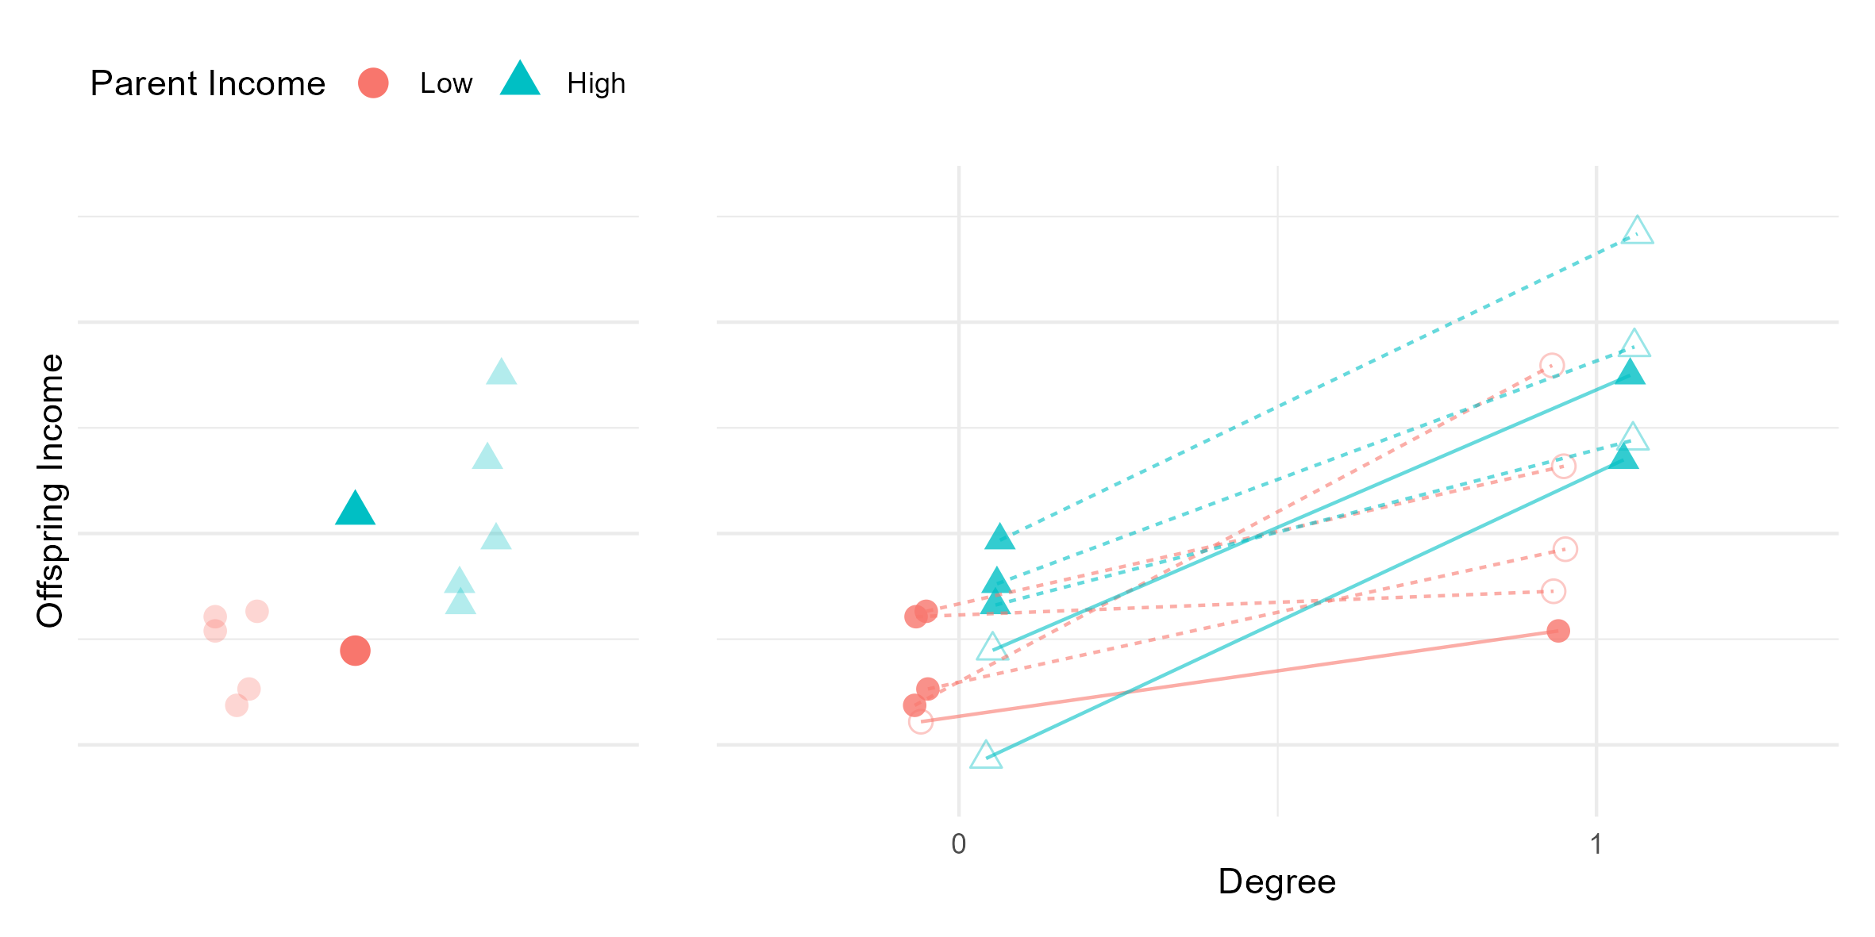

Slide 52
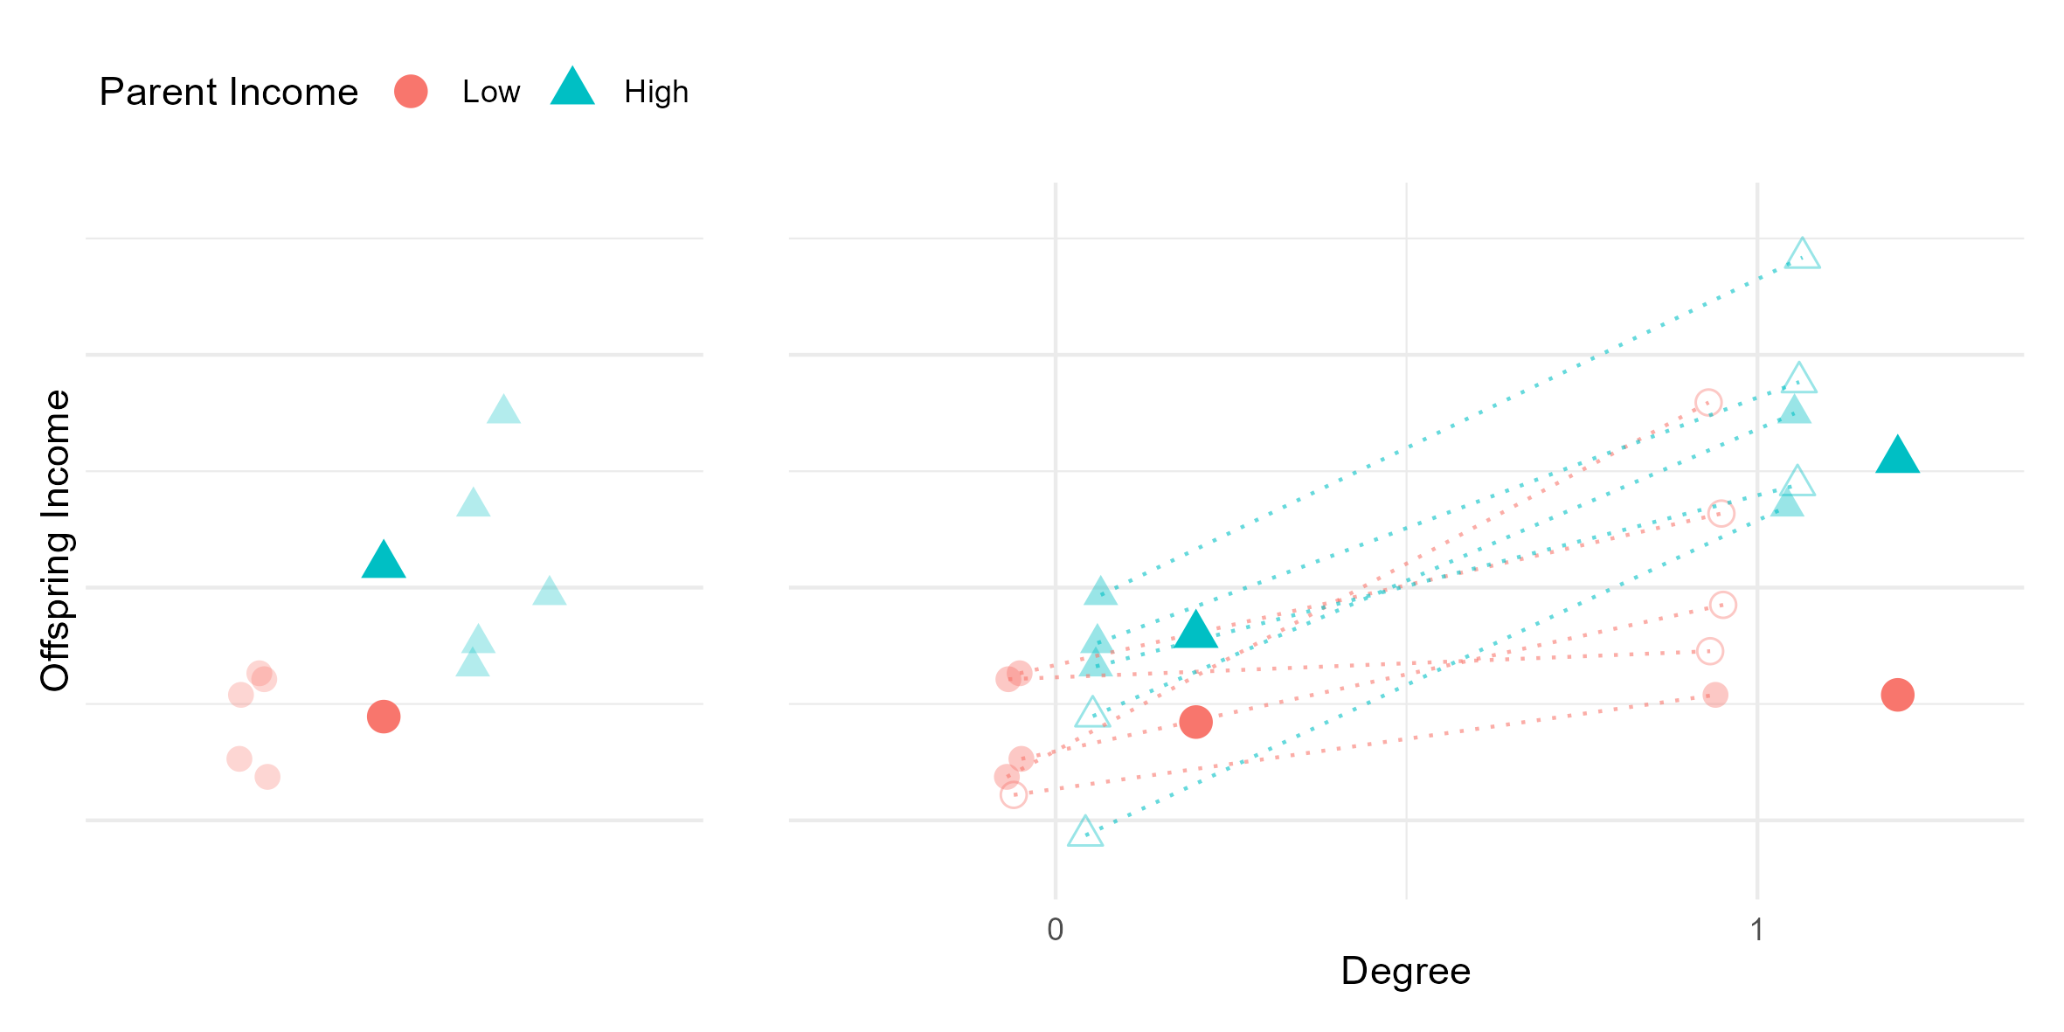

Slide 53
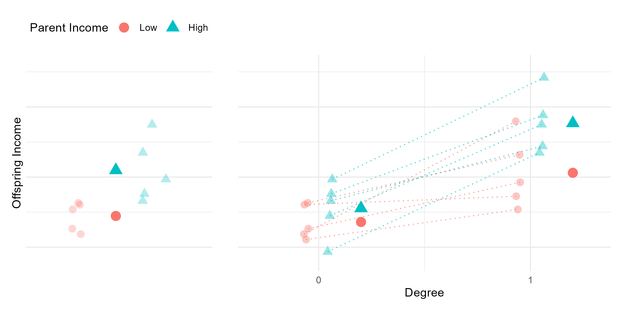

Slide 54
Group Disparity in Y
Different baseline Y
Differential prevalence of X
Differential effects of X
Differential selection into X
Describe X in each group
Estimate effect of X on Y in each group
Estimate propensity for X in each group

Slide 55

2 factor worked example
P1
$\frac{5}{15}×\frac{3}{5}=\frac{3}{15}=0.2$
A-effect
$$\left(A_{2}−A_{1}\right)×\frac{B_{1}+B_{2}}{2}$$
$$+$$
$$\frac{A_{1}+A_{2}}{2}×\left(B_{2}−B_{1}\right)$$
B-effect
P2
$\frac{10}{15}×\frac{8}{10}=\frac{8}{15}=0.53$

Slide 56

2 factor worked example
P1
$\frac{5}{15}×\frac{3}{5}=\frac{3}{15}=0.2$
A-effect
$$\left(A_{2}×\frac{B_{1}+B_{2}}{2}\right)−\left(A_{1}×\frac{B_{1}+B_{2}}{2}\right)$$
$$+$$
$$\left(\frac{A_{1}+A_{2}}{2}×B_{2}\right)−\left(\frac{A_{1}+A_{2}}{2}×B_{1}\right)$$
standardised rate in pop 2 -- standardised rate in pop 1
B-effect
P2
$\frac{10}{15}×\frac{8}{10}=\frac{8}{15}=0.53$

