Slide 1


Two populations, two rates
Population 1
Population 2
-Rate = $\frac{3}{15}$ = 0.2
-Rate = $\frac{8}{15}$ = 0.53

Slide 2



Rates can be split into component parts
Population 1
Population 2
-Rate = $\frac{3}{15}$ = 0.2
-Rate = $\frac{8}{15}$ = 0.53
$\frac{5}{15}×\frac{3}{5}=\frac{3}{15}=0.2$
$\frac{10}{15}×\frac{8}{10}=\frac{8}{15}=0.53$
A
B
$×$ $=$
+
+
rate of green squares = proportion of squares x proportion of squares that are green

Slide 3
Two methods, two questions
Standardisation
What would Rate_{P2} be if… A was the same in P1 and P2?
B was the same in P1 and P2?
Decomposition
How much of Rate_{P2} – Rate_{P1} is because… A is different between P1 and P2?
B is different between P1 and P2?

Slide 4
Two methods, two questions
P1
P2
Rate = rate of green squares = AxB
A = proportion of squares
B = proportion of squares that are green
Standardisation
What would Rate_{P2} be if… A was the same in P1 and P2?
B was the same in P1 and P2?
Decomposition
How much of Rate_{P2} – Rate_{P1} is because… A is different between P1 and P2?
B is different between P1 and P2?

Slide 5
Need to be specific
Standardisation
What would Rate_{P2} be if… A was the same in P1 and P2?
A in P2 was the same as A in P1?
A in P2 was at the average of what it is in P1 and P2?

Slide 6
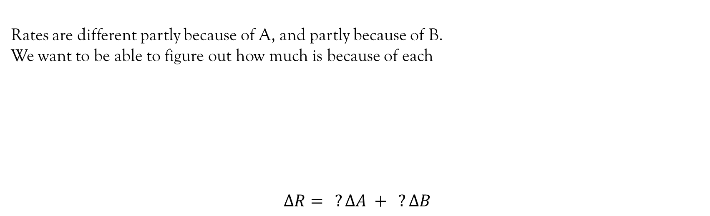
Decomposition
Rates are different partly because of A, and partly because of B.
We want to be able to figure out how much is because of each
$$∆R= ?∆A + ?∆B$$
Rate_{P1} = A_{P1} x B_{P1}
A-effect
B-effect
Rate_{P2} = A_{P2} x B_{P2}

Slide 7
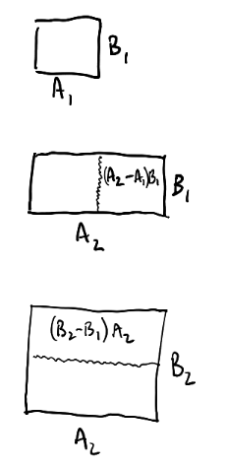


Decomposition – geometrically
Rate_{P1} = A_{P1} x B_{P1}
Rate_{P2} = A_{P2} x B_{P2}

Slide 8
Decomposition – one way to get ∆R
Rate_{P1} = A_{P1} x B_{P1}
Rate_{P2} = A_{P2} x B_{P2}

Slide 9
Decomposition – one way to get ∆R
Rate_{P1} = A_{P1} x B_{P1}
Rate_{P2} = A_{P2} x B_{P2}

Slide 10
Decomposition – another way to get ∆R
Rate_{P1} = A_{P1} x B_{P1}
Rate_{P2} = A_{P2} x B_{P2}

Slide 11
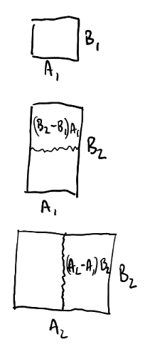
Decomposition – another way to get ∆R
Rate_{P1} = A_{P1} x B_{P1}
Rate_{P2} = A_{P2} x B_{P2}

Slide 12
Decomposition – another way to get ∆R
Rate_{P1} = A_{P1} x B_{P1}
Rate_{P2} = A_{P2} x B_{P2}

Slide 13
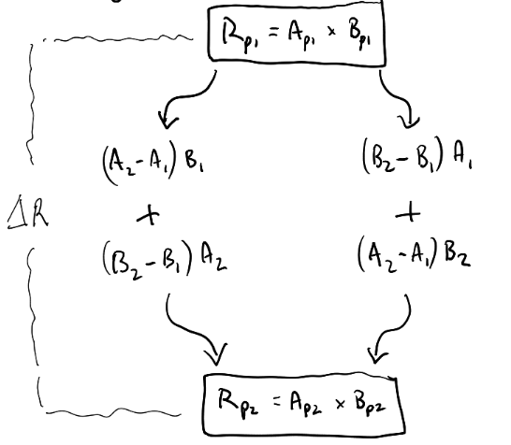
Decomposition – two ways to get ∆R, two sets of answers
Rate_{P1} = A_{P1} x B_{P1}
Two ways to get from Rp1 to Rp2
But the “effect of moving A1 -> A2”
is very different
Rate_{P2} = A_{P2} x B_{P2}

Slide 14
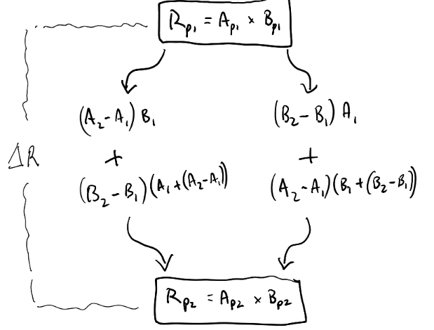
Decomposition – the interaction
Rate_{P1} = A_{P1} x B_{P1}
Substitute in A2 = A1 + (A2-A1)
Rate_{P2} = A_{P2} x B_{P2}

Slide 15
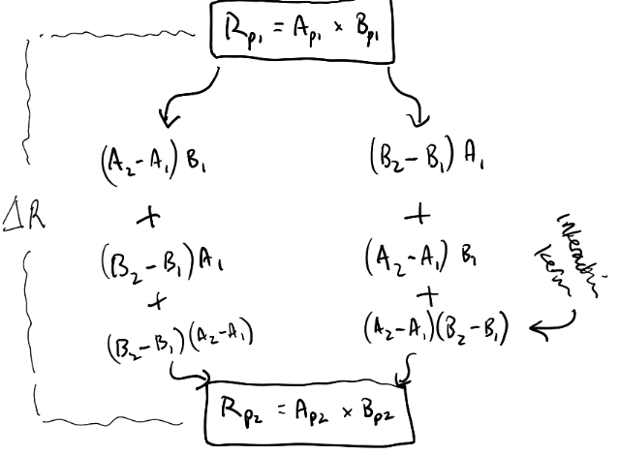
Decomposition – the interaction
Rate_{P1} = A_{P1} x B_{P1}
Interaction term
Rate_{P2} = A_{P2} x B_{P2}

Slide 16
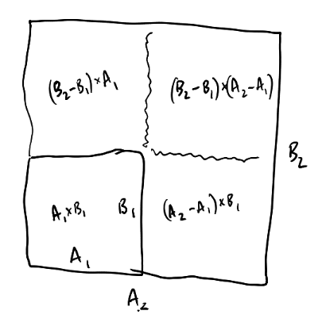
Decomposition – the interaction (geometrically)
Interaction term

Slide 17
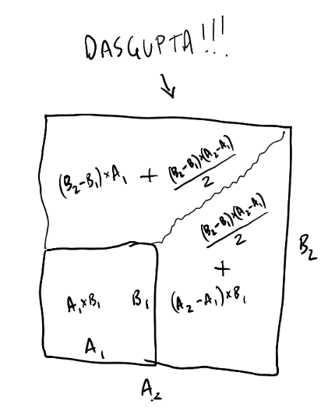
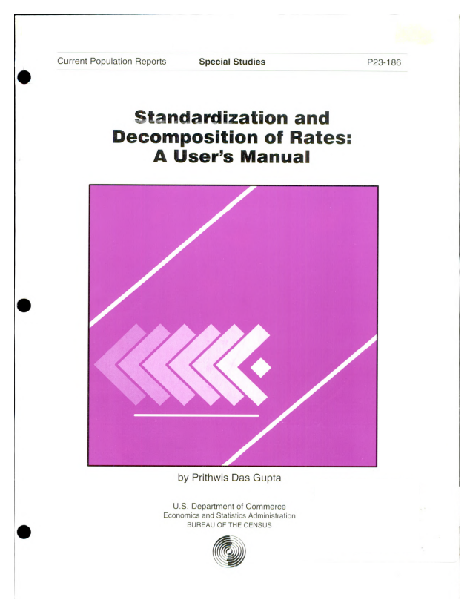
Decomposition – splitting the interaction

Slide 18
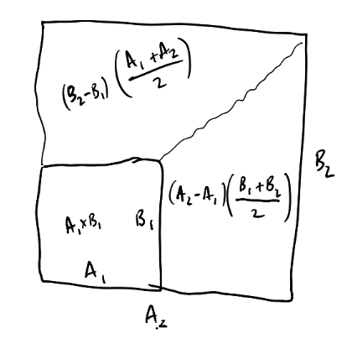
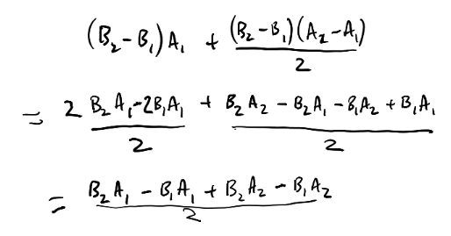
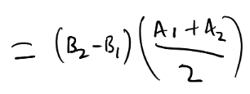
Decomposition – splitting the interaction
(just to show the simplification)

Slide 19
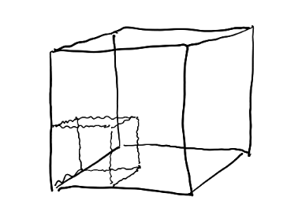
Decomposition – more dimensions..

Slide 20




2 factor worked example
-Rate_{P1} = $\frac{3}{15}$ = 0.2
-Rate_{P2} = $\frac{8}{15}$ = 0.53
Population 1
Population 2
$\frac{5}{15}×\frac{3}{5}=\frac{3}{15}=0.2$
$\frac{10}{15}×\frac{8}{10}=\frac{8}{15}=0.53$

Slide 21

2 factor worked example
-Rate_{P1} = $\frac{3}{15}$ = 0.2
-Rate_{P2} = $\frac{8}{15}$ = 0.53
Population 1
Population 2
$\frac{5}{15}×\frac{3}{5}=\frac{3}{15}=0.2$
$\frac{10}{15}×\frac{8}{10}=\frac{8}{15}=0.53$
Standardisation
What would Rate_{P2} be if… A was the same in P1 and P2? - A in P2 was the same as A in P1? <<<
- A in P2 was at the average of what it is in P1 and P2?
$\frac{5}{15}×\frac{8}{10}=\frac{4}{15}=0.26$
A = proportion of squares
B = proportion of squares that are green

Slide 22
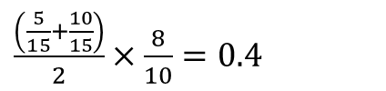
2 factor worked example
-Rate_{P1} = $\frac{3}{15}$ = 0.2
-Rate_{P2} = $\frac{8}{15}$ = 0.53
Population 1
Population 2
$\frac{5}{15}×\frac{3}{5}=\frac{3}{15}=0.2$
$\frac{10}{15}×\frac{8}{10}=\frac{8}{15}=0.53$
Standardisation
What would Rate_{P2} be if… A was the same in P1 and P2? - A in P2 was the same as A in P1?
- A in P2 was at the average of what it is in P1 and P2? <<<
$\frac{\left(\frac{5}{15}+\frac{10}{15}\right)}{2}×\frac{8}{10}=0.4$
A = proportion of squares
B = proportion of squares that are green

Slide 23
2 factor worked example
-Rate_{P1} = $\frac{3}{15}$ = 0.2
-Rate_{P2} = $\frac{8}{15}$ = 0.53
Population 1
Population 2
$\frac{5}{15}×\frac{3}{5}=\frac{3}{15}=0.2$
$\frac{10}{15}×\frac{8}{10}=\frac{8}{15}=0.53$
Decomposition
How much of Rate_{P2} – Rate_{P1} is because… A is different between P1 and P2? B is different between P1 and P2?
A = proportion of squares
B = proportion of squares that are green

Slide 24
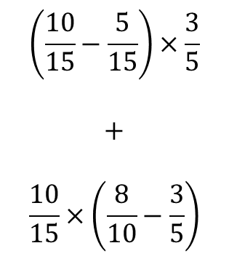


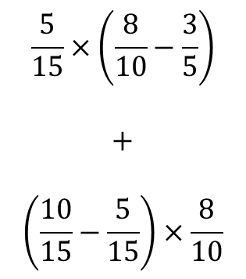
2 factor worked example
P1
$\frac{5}{15}×\frac{3}{5}=\frac{3}{15}=0.2$
$$\left(\frac{10}{15}−\frac{5}{15}\right)×\frac{3}{5}$$
$$+$$
$$\frac{10}{15}×\left(\frac{8}{10}−\frac{3}{5}\right)$$
$$\frac{5}{15}×\left(\frac{8}{10}−\frac{3}{5}\right)$$
$$+$$
$$\left(\frac{10}{15}−\frac{5}{15}\right)×\frac{8}{10}$$
P2
$\frac{10}{15}×\frac{8}{10}=\frac{8}{15}=0.53$

Slide 25
2 factor worked example
P1
$\frac{5}{15}×\frac{3}{5}=\frac{3}{15}=0.2$
A-effect
$$\left(\frac{10}{15}−\frac{5}{15}\right)×\frac{3}{5}$$
$$+$$
$$\frac{10}{15}×\left(\frac{8}{10}−\frac{3}{5}\right)$$
$$\frac{5}{15}×\left(\frac{8}{10}−\frac{3}{5}\right)$$
$$+$$
$$\left(\frac{10}{15}−\frac{5}{15}\right)×\frac{8}{10}$$
A-effect
P2
$\frac{10}{15}×\frac{8}{10}=\frac{8}{15}=0.53$

Slide 26
2 factor worked example
P1
$\frac{5}{15}×\frac{3}{5}=\frac{3}{15}=0.2$
A-effect
B-effect
$$\left(\frac{10}{15}−\frac{5}{15}\right)×\frac{3}{5}$$
$$+$$
$$\frac{10}{15}×\left(\frac{8}{10}−\frac{3}{5}\right)$$
$$\frac{5}{15}×\left(\frac{8}{10}−\frac{3}{5}\right)$$
$$+$$
$$\left(\frac{10}{15}−\frac{5}{15}\right)×\frac{8}{10}$$
B-effect
A-effect
P2
$\frac{10}{15}×\frac{8}{10}=\frac{8}{15}=0.53$

Slide 27



2 factor worked example
P1
$\frac{5}{15}×\frac{3}{5}=\frac{3}{15}=0.2$
A-effect
B-effect
$$0.2$$
$$+$$
$$0.1333$$
$$0.0667$$
$$+$$
$$0.2667$$
$$+0.33$$
B-effect
A-effect
P2
$\frac{10}{15}×\frac{8}{10}=\frac{8}{15}=0.53$

Slide 28

2 factor worked example
P1
$\frac{5}{15}×\frac{3}{5}=\frac{3}{15}=0.2$
A-effect
$$\left(\frac{10}{15}−\frac{5}{15}\right)×\frac{\frac{3}{5}+\frac{8}{10}}{2}$$
$$+$$
$$\frac{\frac{5}{15}+\frac{10}{15}}{2}×\left(\frac{8}{10}−\frac{3}{5}\right)$$
B-effect
P2
$\frac{10}{15}×\frac{8}{10}=\frac{8}{15}=0.53$

Slide 29

2 factor worked example
P1
$\frac{5}{15}×\frac{3}{5}=\frac{3}{15}=0.2$
A-effect
$$0.233$$
$$+$$
$$0.1$$
$$+0.33$$
B-effect
P2
$\frac{10}{15}×\frac{8}{10}=\frac{8}{15}=0.53$

Slide 30
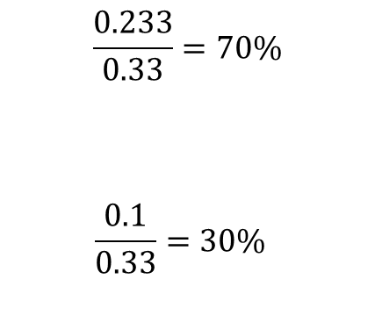
2 factor worked example
P1
$\frac{5}{15}×\frac{3}{5}=\frac{3}{15}=0.2$
A-effect
$$\frac{0.233}{0.33}=70\%$$
$$\frac{0.1}{0.33}=30\%$$
$$0.233$$
$$+$$
$$0.1$$
$$+0.33$$
B-effect
P2
$\frac{10}{15}×\frac{8}{10}=\frac{8}{15}=0.53$

Slide 31



3 factor worked example
-Rate_{P1} = $\frac{3}{15}$ = 0.2
-Rate_{P2} = $\frac{8}{15}$ = 0.53
Population 1
Population 2
$\frac{11}{15}×\frac{4}{11}×\frac{3}{4}=0.2$
$\frac{13}{15}×\frac{10}{13}×\frac{8}{10}=0.53$
A B C
+
$× ×$ $=$
+ + +
+
+
rate of green squares = proportion of coloured shapes x proportion of coloured shapes that are squares x proportion of coloured squares that are green

Slide 32
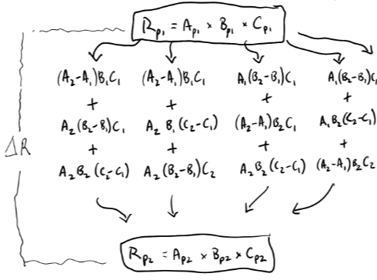
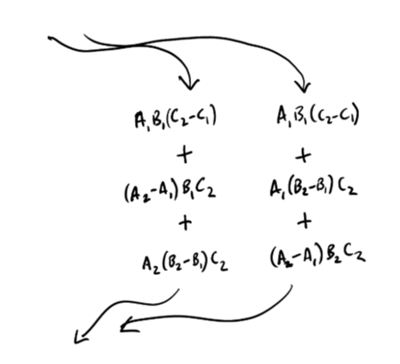
Decomposition – 6 ways to get ∆R, 6 sets of answers
Rate_{P1} = A_{P1} x B_{P1}
… …
… …
… …
Rate_{P2} = A_{P2} x B_{P2}

Slide 33
Decomposition – 6 ways to get ∆R, 6 sets of answers
We end up with pairwise interactions of A*B, A*C, B*C, and the three-way interaction A*B*C.
Note that starting/ending combinations, e.g. A₁C₁ or A₂C₂ arise more frequently than mixed A₁C₂ …
Rate_{P1} = A_{P1} x B_{P1}
… …
… …
… …
Rate_{P2} = A_{P2} x B_{P2}

Slide 34
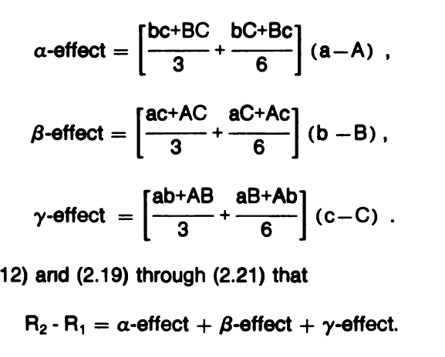
Decomposition – Das Gupta

Slide 35
Decomposition – {DasGuptR}

Slide 36
Population 1
Population 2

Slide 37
Population 1
Population 2
2 8
3 7
3 1
2 5
4 3
7 3

