Slide 1
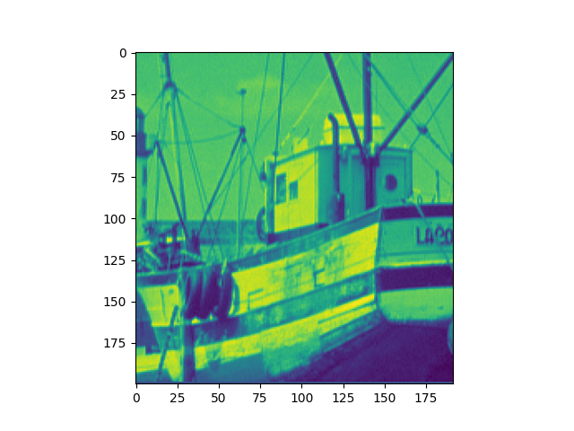
Fishing Boat Original Image

Slide 2
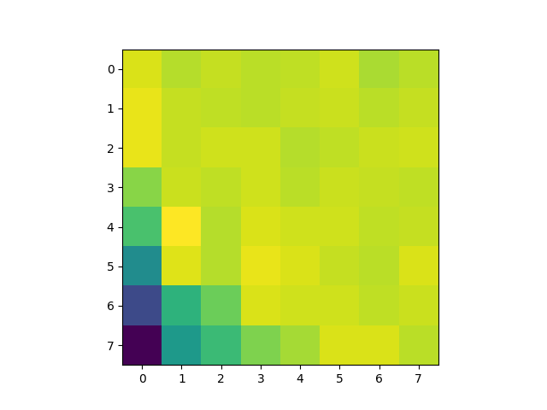
Fishing Boat 8x8, Top Pixel @ (17, 25)

Slide 3
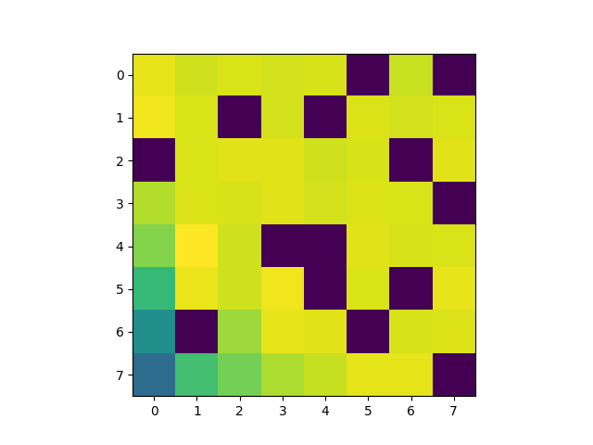
Fishing Boat 8x8, Top Pixel @ (17, 25), S = 50

Slide 4
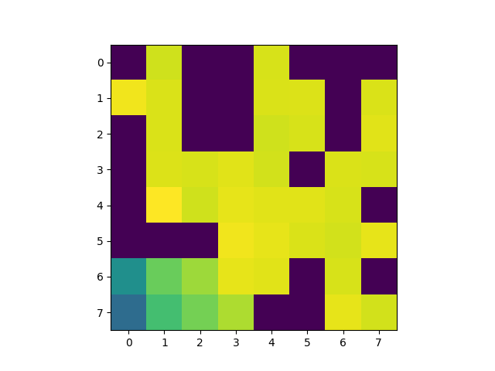
Fishing Boat 8x8, Top Pixel @ (17, 25), S = 40

Slide 5
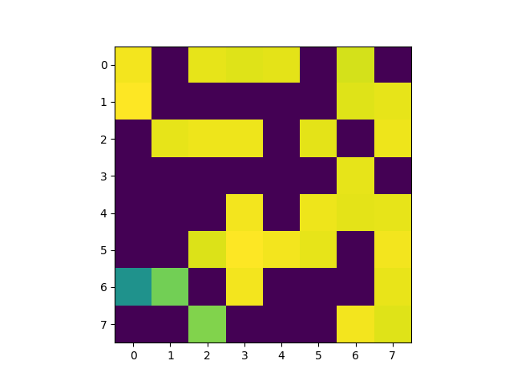
Fishing Boat 8x8, Top Pixel @ (17, 25), S = 30

Slide 6
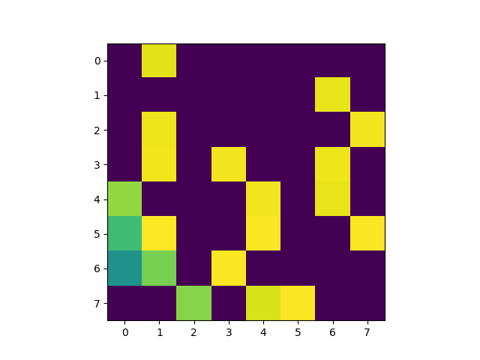
Fishing Boat 8x8, Top Pixel @ (17, 25), S = 20

Slide 7
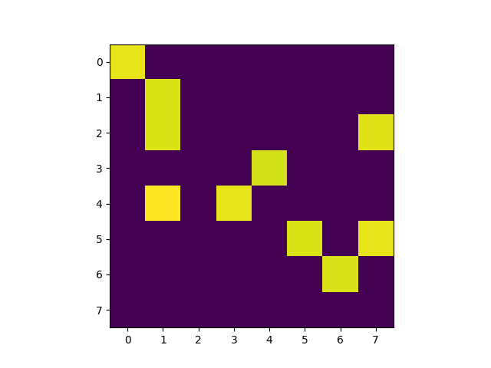
Fishing Boat 8x8, Top Pixel @ (17, 25), S = 10

Slide 8
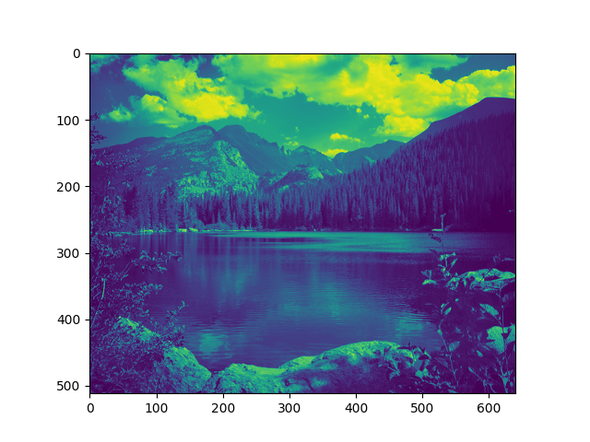
Nature Original Image

Slide 9
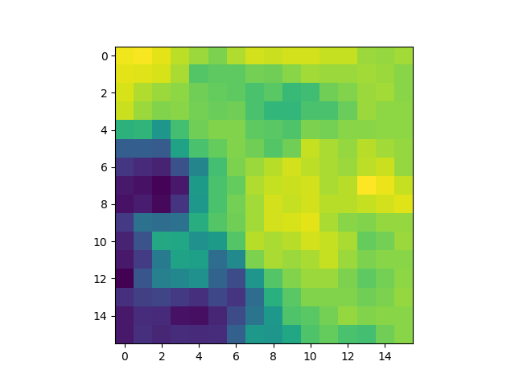
Nature 16x16, Top Pixel @ (17, 193)

Slide 10
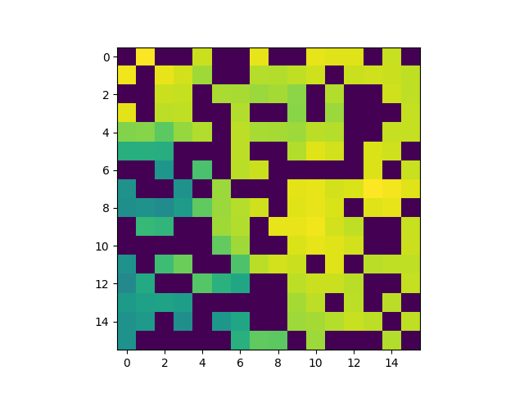
Nature 16x16, Top Pixel @ (17, 193), S = 150

Slide 11
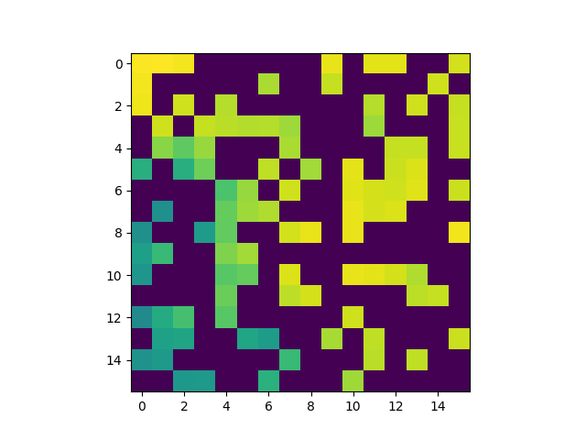
Nature 16x16, Top Pixel @ (17, 193), S = 100

Slide 12
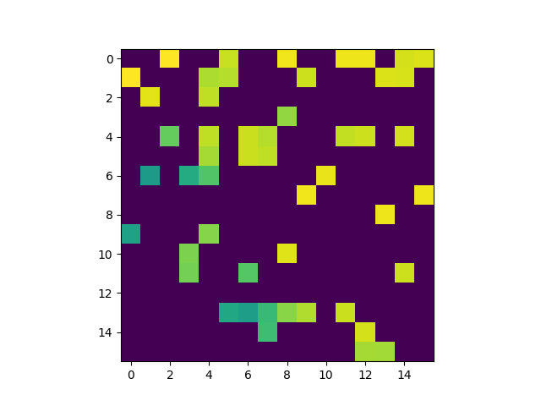
Nature 16x16, Top Pixel @ (17, 193), S = 50

Slide 13
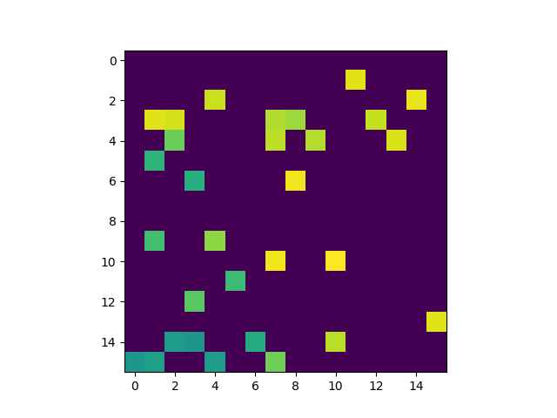
Nature 16x16, Top Pixel @ (17, 193), S = 30

Slide 14
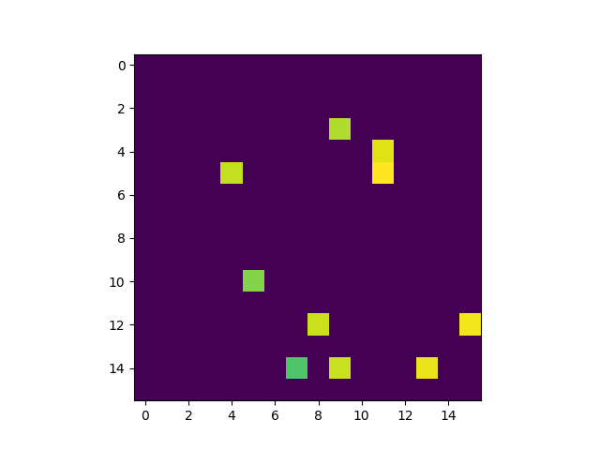
Nature 16x16, Top Pixel @ (17, 193), S = 10

