Slide 1
Video Frame Prediction Using Autoencoding and LSTM
Ben McCamish
Trevor Fiez
You must be in slide master view to replace image.

Slide 2
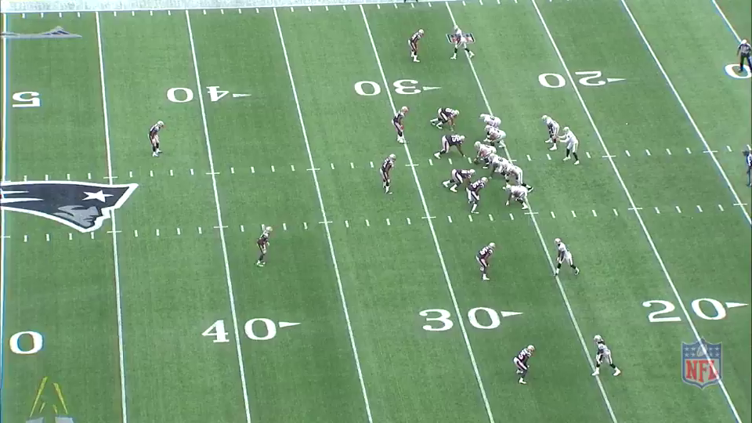


Introduction
American Football Plays
Downsampled
Goal is to predict the final frame in a sequence
Use Autoencoder to reduce feature vector
Use LSTM to train
December 1, 2015

Slide 3


Autoencoder
Goal: Reduce the number of features
Didn’t work as intended, couldn’t reduced number of features
Initially wanted to include in LSTM network
December 1, 2015

Slide 4
Long Short Term Memory
December 1, 2015
What is Long Short Term Memory?
Something here about it
How can it help with our problem?

Slide 5


Long Short Term Memory
Goal: Predict last frame in sequence
Learn from previous frames, goal in training is next frame in sequence
Effective, sort of…
December 1, 2015

Slide 6
Long Short Term Memory
December 1, 2015
What is Long Short Term Memory?
Something here about it
How can it help with our problem?

