Slide 1
Video Frame Prediction Using an Autoencoder and LSTM
Ben McCamish
Trevor Fiez
You must be in slide master view to replace image.

Slide 2
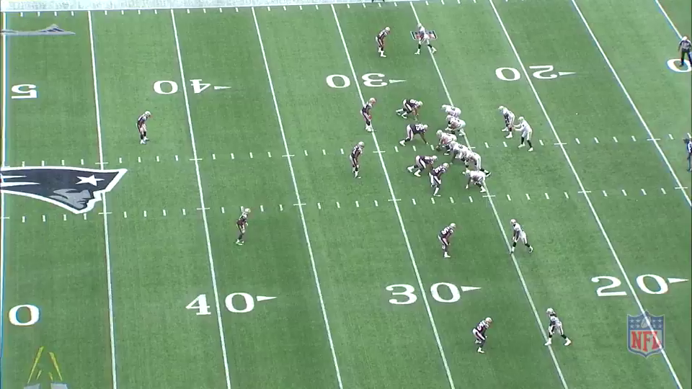


Introduction
American Football Plays
Downsampled
Goal is to predict next frame in a sequence
Use LSTM to train
<number>
December 1, 2015

Slide 3


Autoencoder
Goal: Reduce the number of features
Didn’t work as intended, couldn’t reduced number of features
Initially wanted to include in LSTM network
<number>
December 1, 2015

Slide 4

Long Short Term Memory
LSTM is connected to itself
Holds a state vector to represent history of input and output
<number>
December 1, 2015

Slide 5


Long Short Term Memory
Goal: Predict next frame in sequence
Learn from previous frames, goal in training is next frame in sequence
Effective, sort of…
<number>
December 1, 2015

Slide 6
Issues
More than 40 million learned parameters for only 5 layers
CPU too slow

Slide 7
Questions?

