Slide 1
Why Take AP Art History?

Slide 2
To study

Slide 3
Cave Men
Priests
Sculptors
architects
Goddesses

Slide 4
Impressionism
Cubism
Surrealism
Romanticism
Minimalism

Slide 5
Modernism
Smarty Pantsism

Slide 6
Register for AP Art History and learn about these strange people:

Slide 7
VINCENT
VAN GOGH

Slide 8
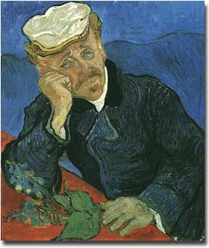

Slide 9
Born: 1853
Died: 1890
Cut off his ear during a fit of depression. Tried to commit suicide by eating paint. Shot himself in the chest. After his death, his sister-in-law collected his art, one piece, the Portrait of Dr. Gachet is auctioned off for $125,000,000.

Slide 10
CARAVAGGIO

Slide 11
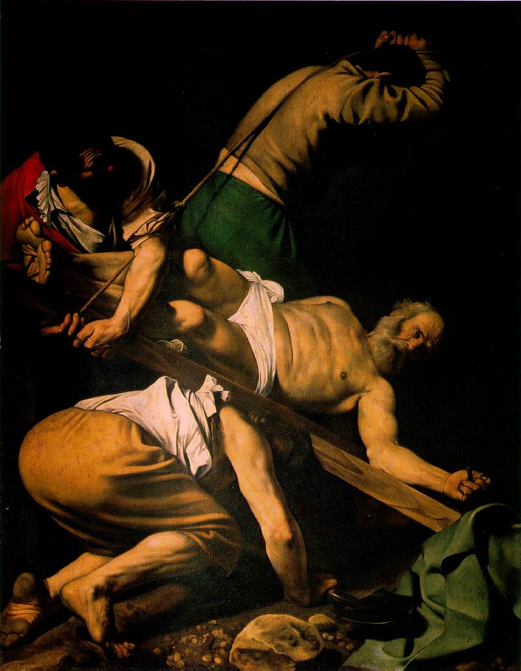

Slide 12
Born:1573
Died:1610
Once murdered a man because he wouldn’t pay a lost wager on a tennis game. Used criminals as models for his religious paintings. Was considered to be one of the most dangerous and controversial artists in history.

Slide 13
ROSSO FIORENTINO

Slide 14
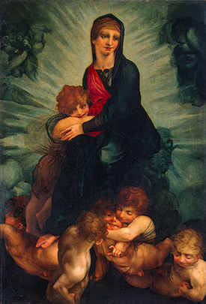

Slide 15
Born:1495
Died:1540
This artist was obsessed with decomposition. He used to dig up corpses so that he could watch them rot. He socialized only with his pet Baboon. A priest claimed that he was possessed by the devil. Fiorentino committed suicide.

Slide 16
PONTORMO

Slide 17
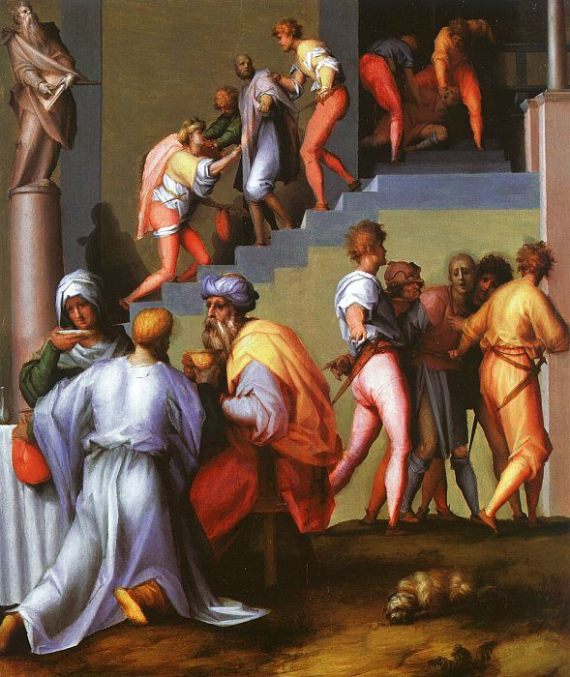

Slide 18
Born:1499
Died:1557
Locked himself in a tower that was only accessible by ladder. He was terrified by death and obsessed with the state of his bowels. He kept a diary that describes his torment and obsession.

Slide 19
TOULOUSE-LAUTREC

Slide 20
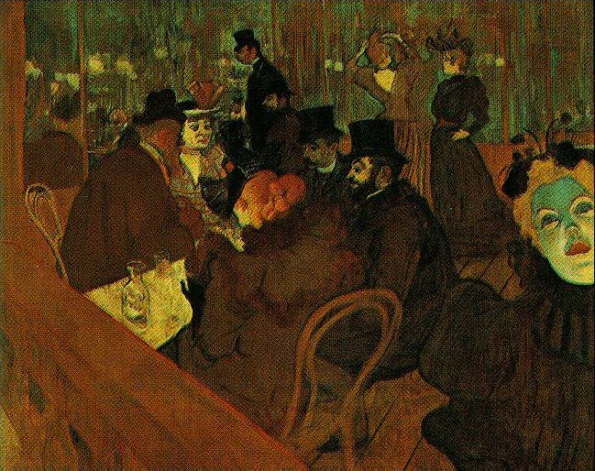

Slide 21
Born: November 24,1864
Died:1901
Popular among the other visitors at the Moulin Rouge. Born with a bone disease that prevented his legs from growing normally, he grew to be a a normal size man, from the waist up. He spent his artistic life inside operas, bars and circuses painting women that he admired, but never gaining their love. He died of alcoholism.

Slide 22
ANDY WARHOL

Slide 23
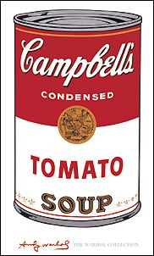

Slide 24
Born:1928
Died:February 22, 1987
The portrait artist of the stars, that hob-nobbed with the rich and famous at Studio 54 was shot in the chest by a crazed fan. His most important quote, “Everyone in their lifetime, will have their 15 minutes of fame.” His most important painting, a Campbell’s Soup Can.

Slide 25
Register for AP Art History and learn about these interesting places:

Slide 26
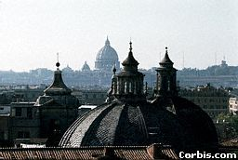

Slide 27
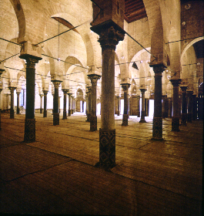

Slide 28
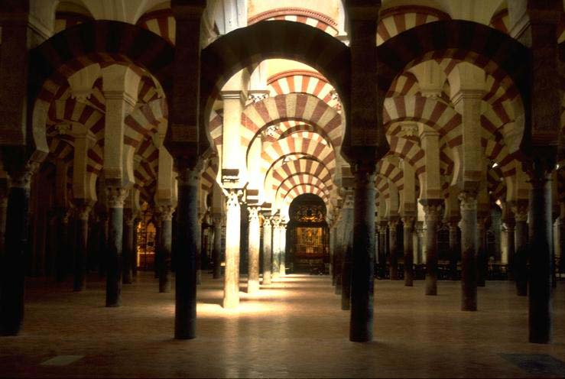

Slide 29
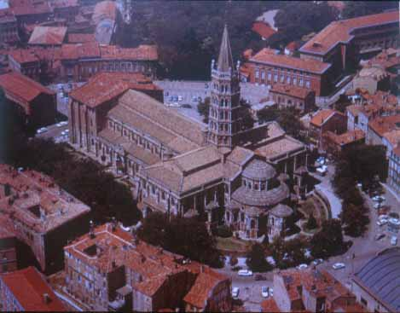

Slide 30
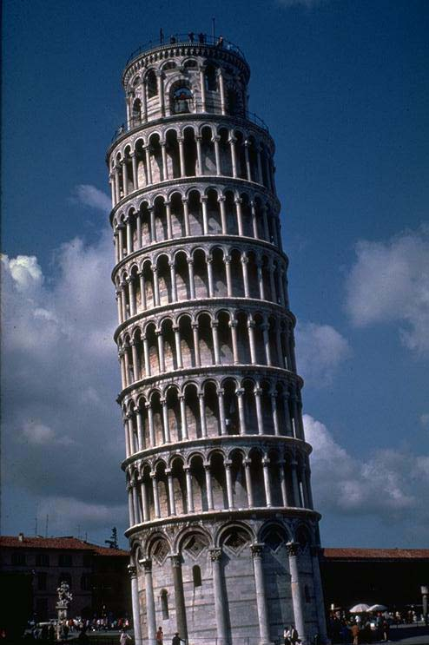

Slide 31
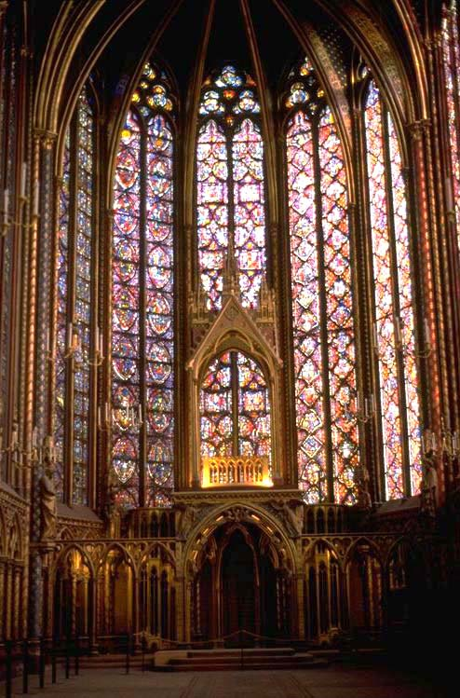

Slide 32
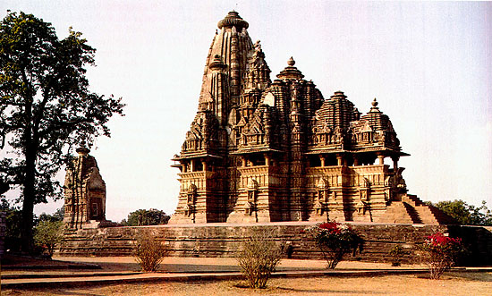

Slide 33
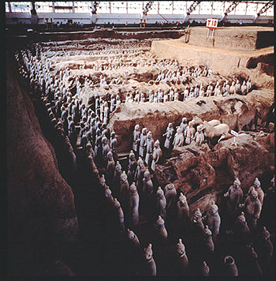

Slide 34
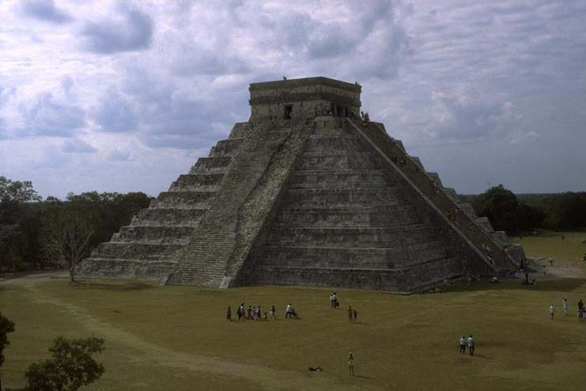

Slide 35
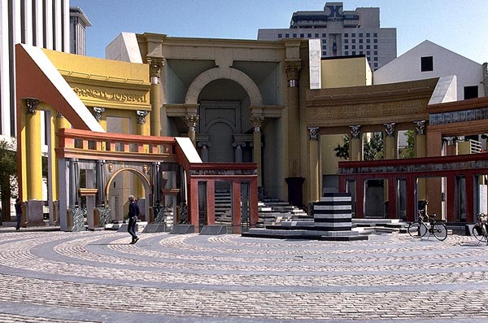

Slide 36
Take AP Art History and be able to discuss and write about these art works intelligently:

Slide 37
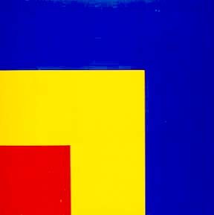

Slide 38
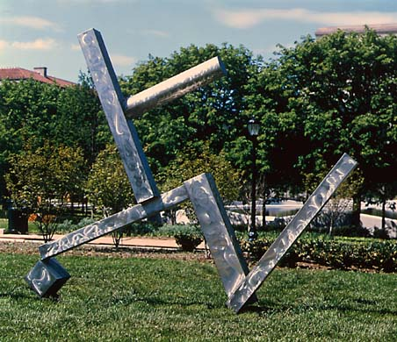

Slide 39
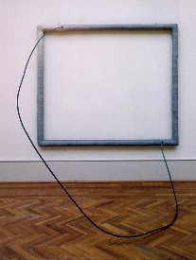

Slide 40
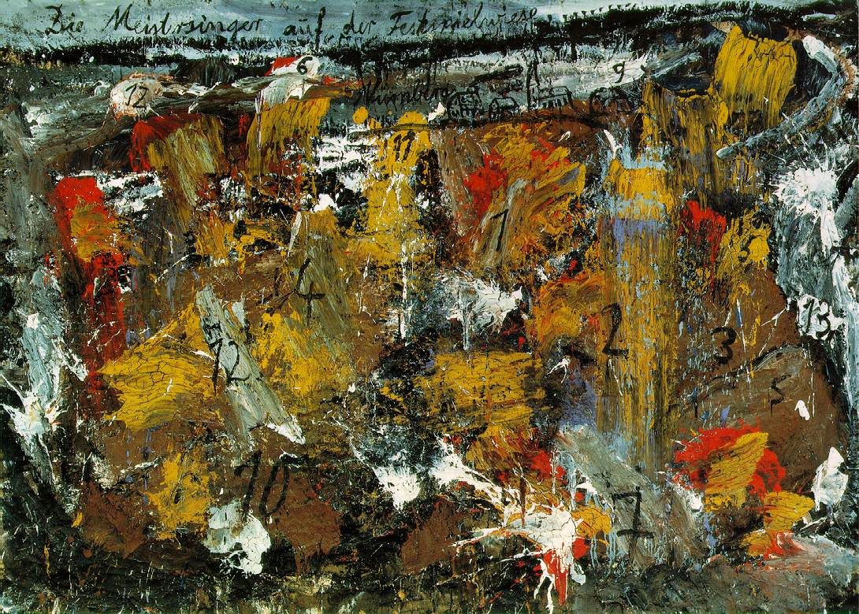

Slide 41
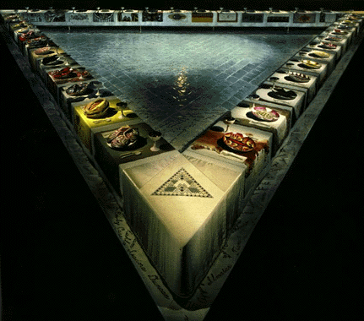

Slide 42
Finally be able to answer the hard questions when playing trivial puirsuit.

Slide 43
Save yourself some money by earning college credit now.

Slide 44
Fulfill your UC/CSU fine arts requiremnt in one year, with no prerequisite.

Slide 45
Take the only history class on campus that covers everything from the dawn of man to modern day.

Slide 46
Last year, 6 out of 8 students passed the AP Art History exam.

Slide 47
....and yes, there are naked people in some of the paintings.

