Slide 1
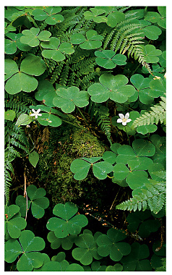
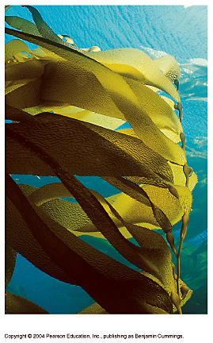
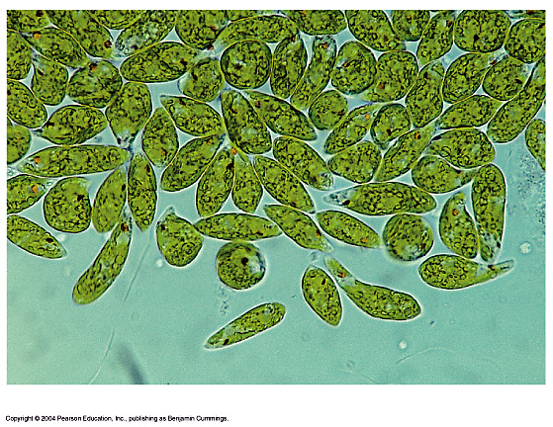
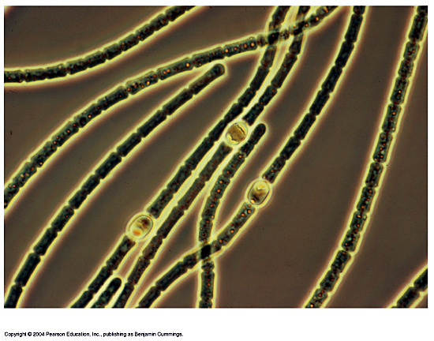
THE BASICS OF PHOTOSYNTHESIS
Almost all plants are photosynthetic autotrophs, as are some bacteria and protists
  Autotrophs generate their own organic matter through photosynthesis
  Sunlight energy is transformed to energy stored in the form of chemical bonds
(c) Euglena
(d) Cyanobacteria
(b) Kelp
(a) Mosses, ferns, and
flowering plants

Slide 2
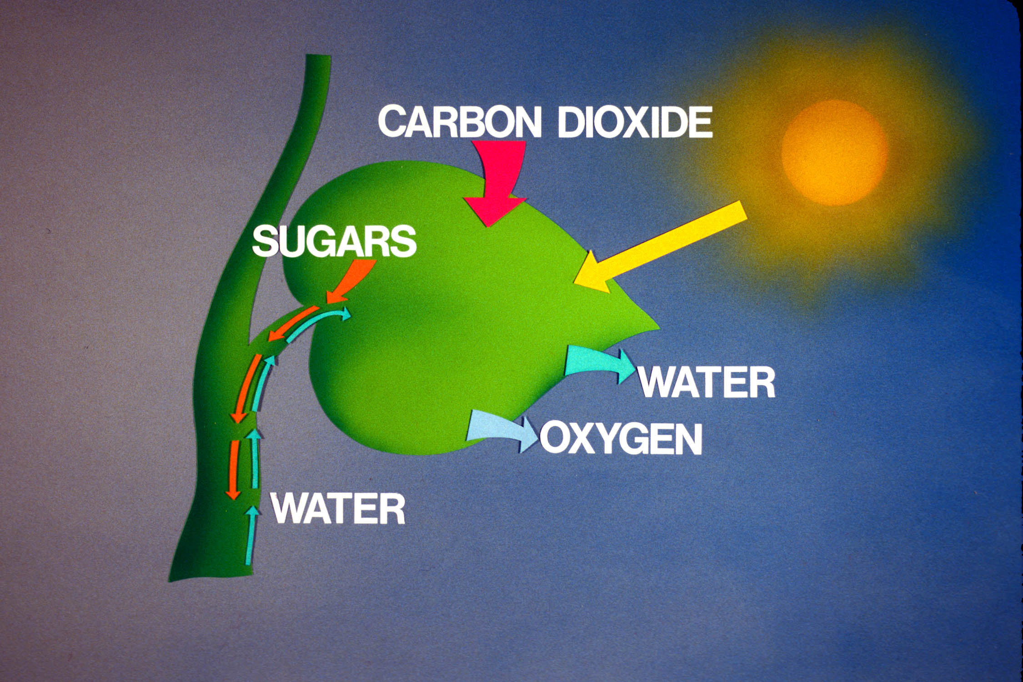
Light Energy Harvested by Plants & Other Photosynthetic Autotrophs
6 CO₂ + 6 H₂O + light energy → C₆H₁₂O₆ + 6 O₂

Slide 3
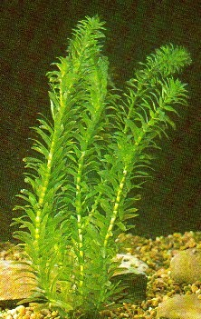
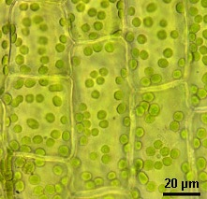
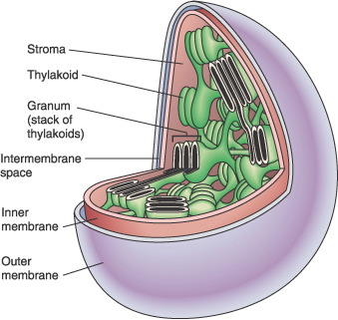
WHY ARE PLANTS GREEN?
Plant Cells have Green Chloroplasts
The thylakoid membrane of the chloroplast is impregnated with photosynthetic pigments (i.e., chlorophylls, carotenoids).

Slide 4
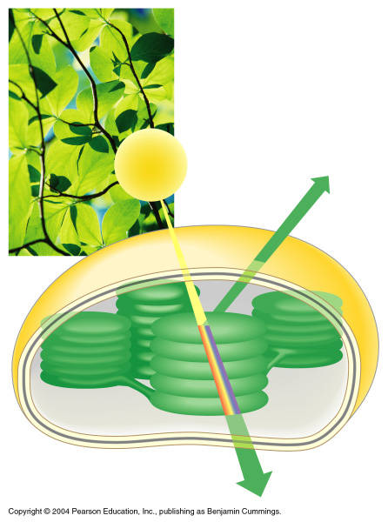
THE COLOR OF LIGHT SEEN IS THE COLOR NOT ABSORBED
Chloroplasts absorb light energy and convert it to chemical energy
Reflected
light
Light
Absorbed
light
Transmitted
light
Chloroplast

Slide 5
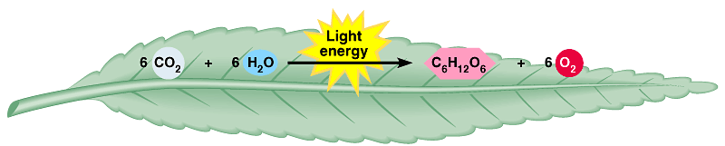
AN OVERVIEW OF PHOTOSYNTHESIS
Photosynthesis is the process by which autotrophic organisms use light energy to make sugar and oxygen gas from carbon dioxide and water
Carbon
dioxide
Water
Glucose
Oxygen
gas
PHOTOSYNTHESIS

Slide 6
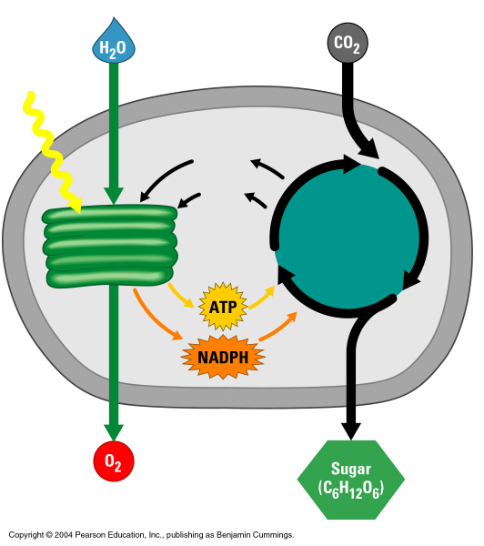
AN OVERVIEW OF PHOTOSYNTHESIS
The light reactions convert solar energy to chemical energy
  Produce ATP & NADPH
Light
Chloroplast
NADP⁺
ADP
+ P
The Calvin cycle makes sugar from carbon dioxide
  ATP generated by the light reactions provides the energy for sugar synthesis
  The NADPH produced by the light reactions provides the electrons for the reduction of carbon dioxide to glucose
Calvin
cycle
Light
reactions

Slide 7
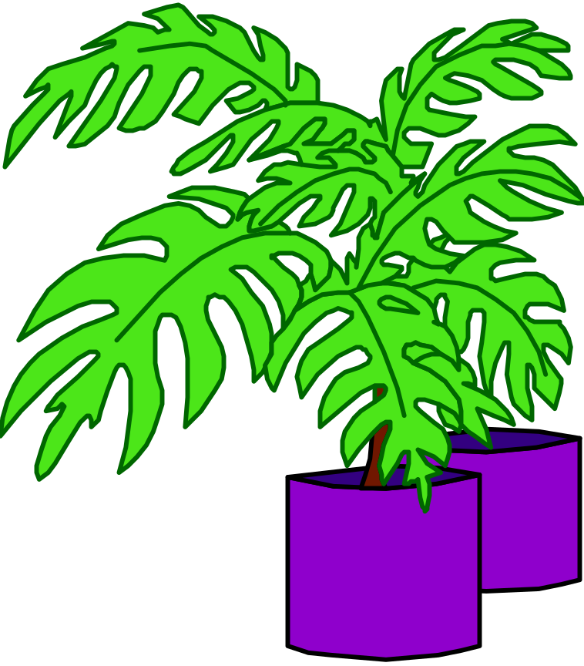
PHOTOSYNTHESIS
Sunlight provides ENERGY
CO2 + H2O produces
Glucose + Oxygen
6CO2 + 6H2O
C6H12O6 + 6O2

Slide 8
Steps of Photosynthesis
Light hits reaction centers of chlorophyll, found in chloroplasts
Chlorophyll vibrates and causes water to break apart.
Oxygen is released into air
Hydrogen remains in chloroplast attached to NADPH
“THE LIGHT REACTION”

Slide 9
Steps of Photosynthesis
The DARK Reactions= Calvin Cycle
CO2 from atmosphere is joined to H from water molecules (NADPH) to form glucose
Glucose can be converted into other molecules with yummy flavors!

Slide 10
Photosynthesis occurs in chloroplasts
In most plants, photosynthesis occurs primarily in the leaves, in the chloroplasts
A chloroplast contains:
  stroma, a fluid
  grana, stacks of thylakoids
The thylakoids contain chlorophyll
  Chlorophyll is the green pigment that captures light for photosynthesis

Slide 11
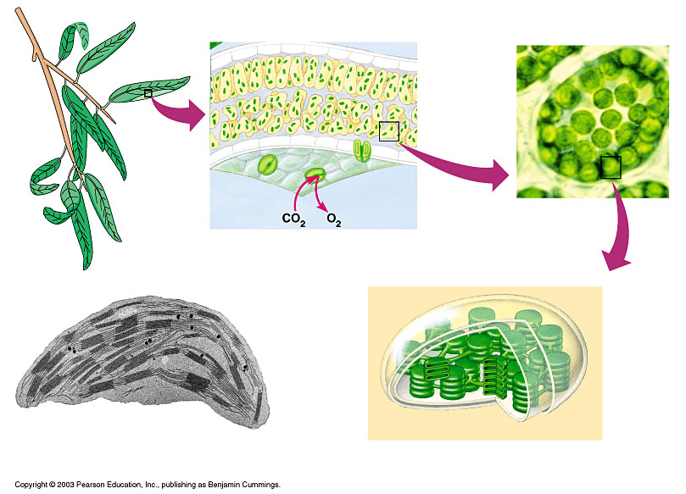
The location and structure of chloroplasts
Chloroplast
LEAF CROSS SECTION
MESOPHYLL CELL
LEAF
Mesophyll
CHLOROPLAST
Intermembrane space
Outer
membrane
Granum
Inner
membrane
Grana
Stroma
Thylakoid
compartment
Stroma
Thylakoid

Slide 12
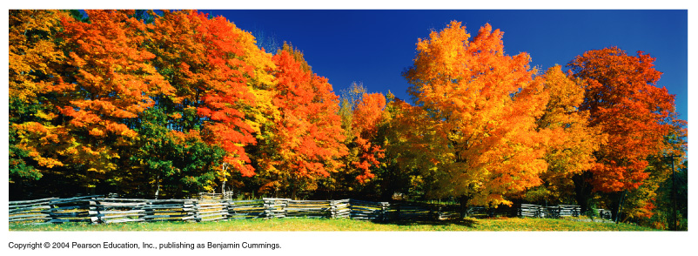
Chloroplast Pigments
Chloroplasts contain several pigments
  Chlorophyll a
  Chlorophyll b
  Carotenoids
  Xanthophyll
Figure 7.7

Slide 13
Summary—Light Dependent Reactions
a. Overall input
light energy, H₂O.
b. Overall output
ATP, NADPH, O₂.

Slide 14
Summary—Light Independent Reactions
a. Overall input
CO₂, ATP, NADPH.
b. Overall output
glucose.

Slide 15
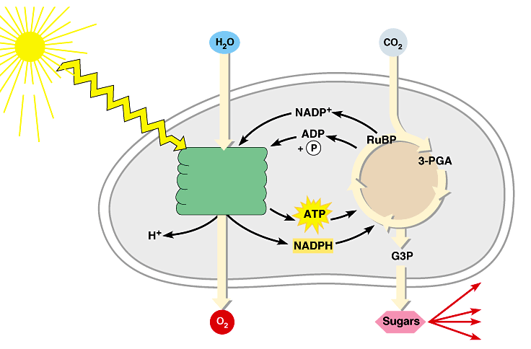
Review: Photosynthesis uses light energy to make food molecules
A summary of the chemical processes of photosynthesis
Chloroplast
Light
Photosystem II
Electron transport chains Photosystem I
CALVIN CYCLE
Stroma
Electrons
Cellular respiration
Cellulose
Starch
LIGHT REACTIONS
CALVIN CYCLE
Other organic compounds

