Slide 1
Gene Set Enrichment Analysis, Chronic Myeloid Leukemia
Ben Mescher, SBMI 5330, Spring 2019

Slide 2
Aims
Overview and Background
Methods and Tools
Results

Slide 3
Aims
Functional enrichment for two sets of RNA microarray data containing a handful of CML phenotypes
Leverage R package GEOquery to retrieve data from GEO repository
Explore the “ExpressionSet” data structure generated by R package Biobase
Leverage R package clusterProfiler for functional enrichment

Slide 4
Overview and Background
Chronic myeloid leukemia (also: Chronic myelogenous leukemia, or CML)
Accounts for 15% of adult leukemias, ~8,000 new cases per year
With Targeted Therapies, annual mortality has improved to 2-3%
https://www.cancernetwork.com/chronic-myeloid-leukemia/chronic-myeloid-leukemia

Slide 5
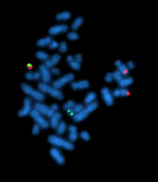
Overview and Background
All cases of CML are positive for the Philadelphia Chromosome (Ph)
Translocation between chromosomes 9 and 22
Ph also observed in Acute Lymphoblastic Leukemia
Discovered in 1959 in Philadelphia by David Hungerford (Fox Chase Cancer Center) and Peter Nowell (University of Pennsylvania School of Medicine)
Image: https://en.wikipedia.org/wiki/Philadelphia_chromosome

Slide 6
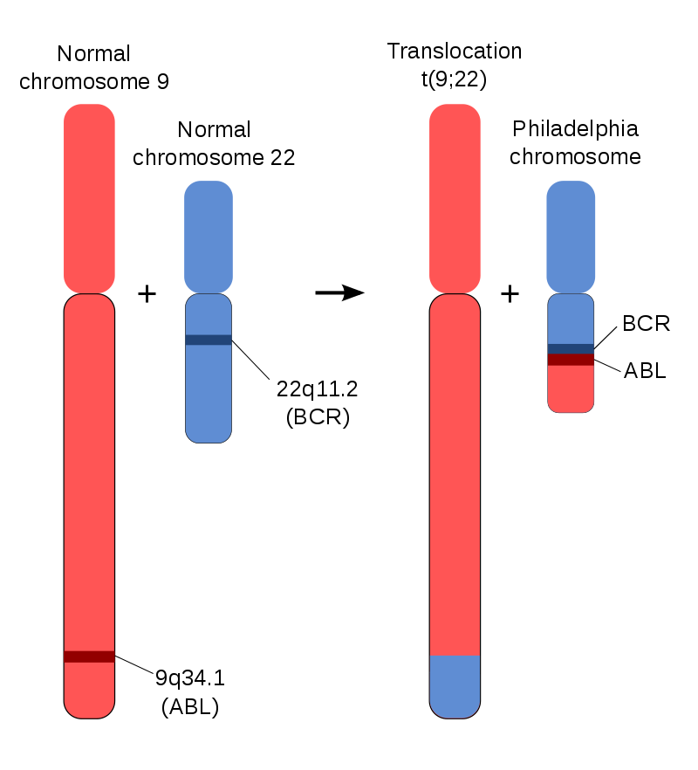
Overview and Background
Ph. Translocation creates the BCR-Abl fusion protein
Abl gene encodes a tyrosine kinase
Fusion BCR-Abl results in impaired DNA binding and unregulated cell division
“BCR-ABL1 stands out among oncogenes, as chronic myelogenous leukaemia (CML) - which is caused by this fusion gene - is with few exceptions strictly dependent on BCR-ABL1 function. Thus, BCR-ABL1 signaling could reveal the minimum assortment of pathways required for transforming a human cell.”
Quote: Kolch, W., & Pitt, A. (2010). Functional proteomics to dissect tyrosine kinase signalling pathways in cancer. Nature Reviews Cancer, 10(9), 618.
Image: https://en.wikipedia.org/wiki/Philadelphia_chromosome

Slide 7
Overview and Background
Since 2001, CML has been treated with tyrosine kinase inhibitors
Imatinib (Gleevec) specifically targets the BCR-Abl protein
“Before the year 2000, when we saw patients with chronic myeloid leukemia, we told them that they had a very bad disease, that their course was fatal, their prognosis was poor with a median survival of maybe three to six years, frontline therapy was allogeneic transplant… and there was no second-line treatment… Today when I see a patient with CML, I tell them that the disease is an indolent leukemia with an excellent prognosis, that they will usually live their functional lifespan provided they take an oral medicine, Gleevec, for the rest of their lives”
Quote: Hagop Kantarjian, as reprinted in Mukherjee, S. The Emperor of All Maladies: A Biography of Cancer. (Simon and Schuster, 2010).

Slide 8
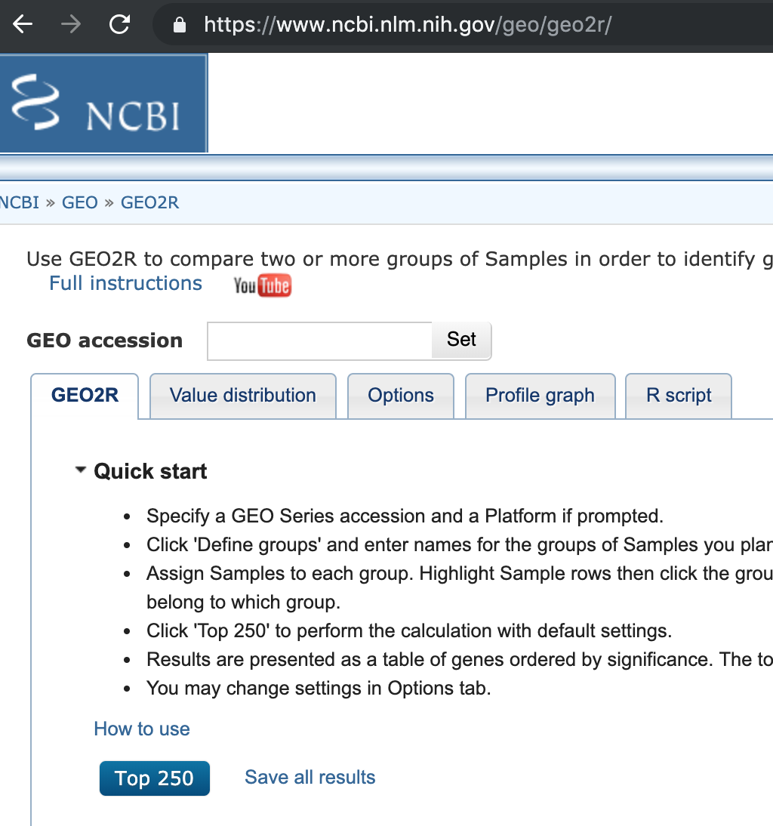
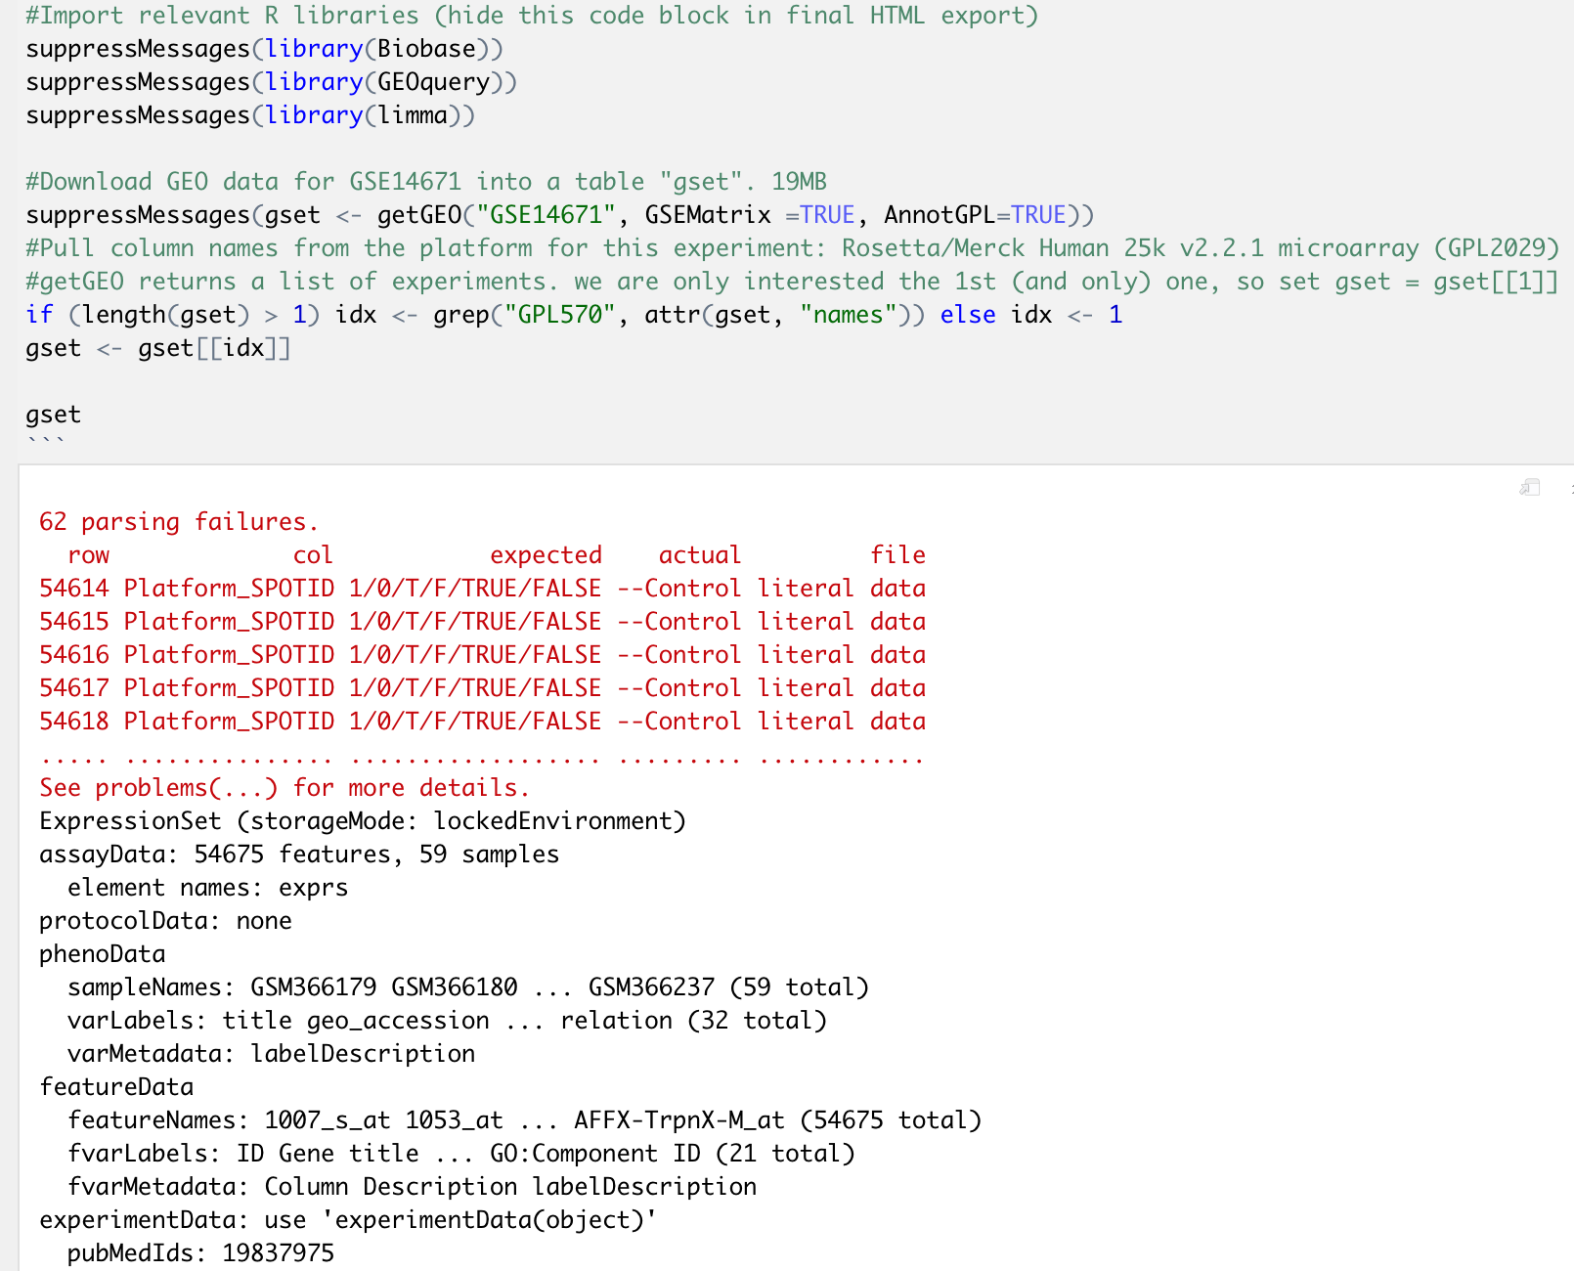
Methods and Tools
Gene Expression Omnibus (GEO) provides starter code in the “GEO2R” tool
Uses R packages “Biobase” and “GEOquery” to retreive datasets

Slide 9
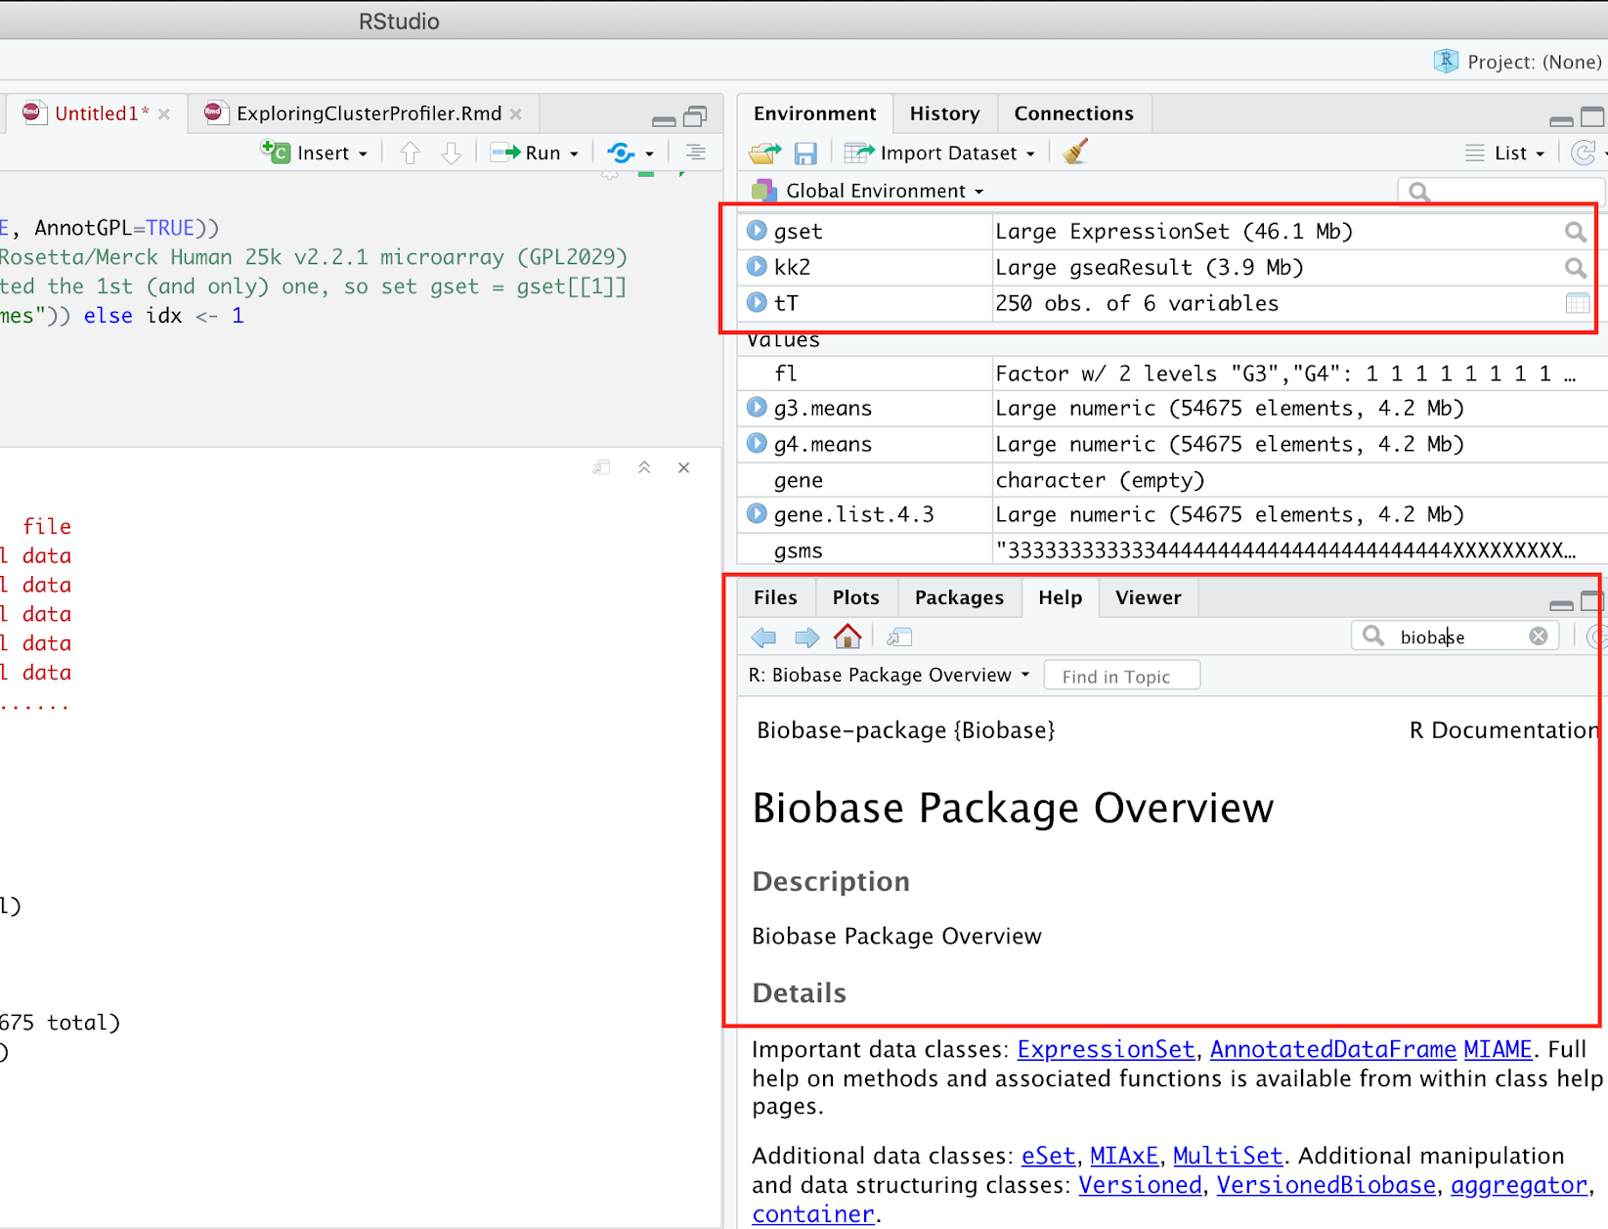
Methods and Tools
R Studio
Write and execute R code, download new packages
Can make “R notebooks”
Mix text, R code, and R output
More readable than just an R script of raw code
Can save notebooks to PDF or HTML format
Useful “Help” pane:
search for documentation on any R package or function
Useful “Environment” pane:
Can dig into any variable to see its structure

Slide 10
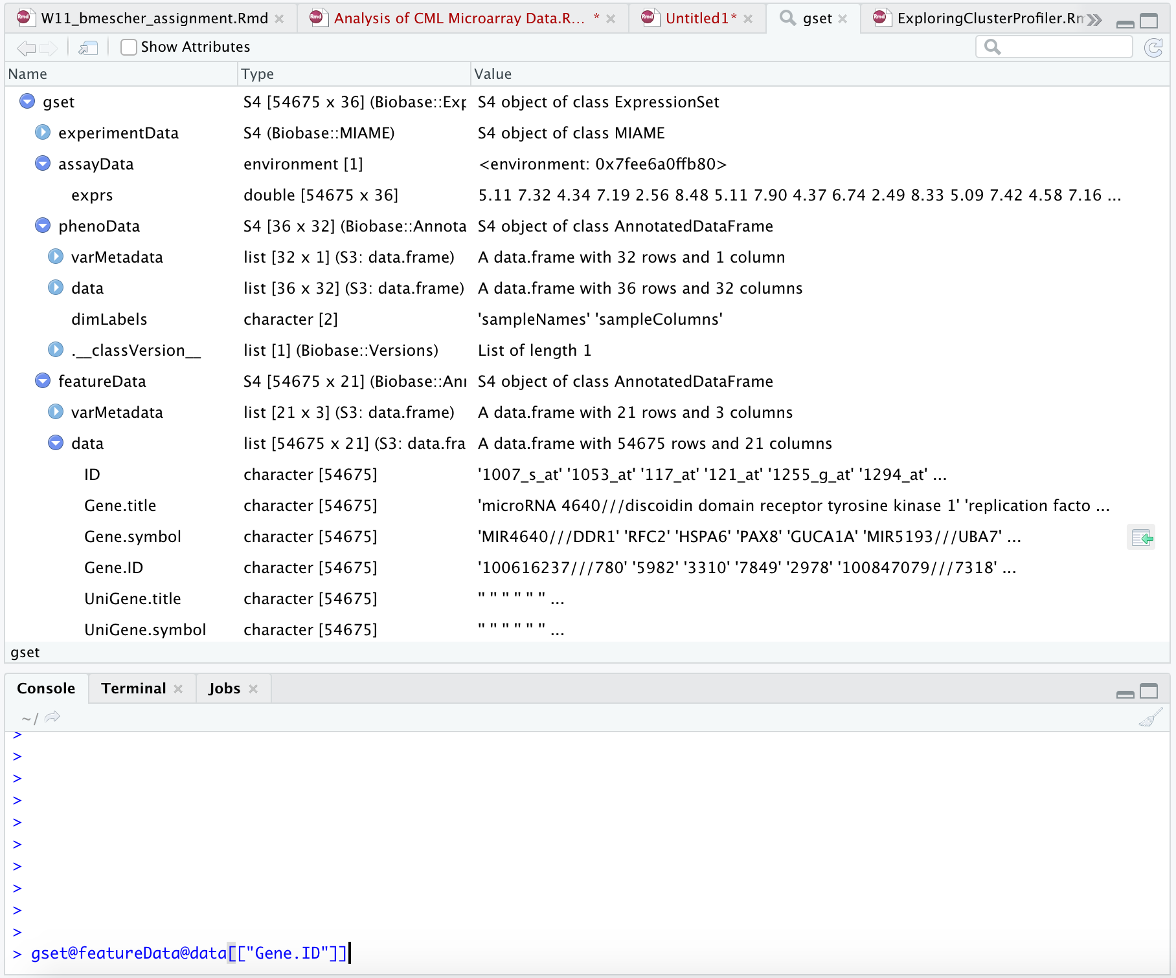

Methods and Tools
R Studio > Environment pane > open gset [Large ExpressionSet created by GEOquery)
GEO2R starter code uses the package GEOquery to download data
A “large expressionset” object is created, which I was not familiar with
R environment pane is a graphical interface for clicking-thru-exploring unfamiliar objects
Shows structure of the object
“assayData” is where numerical expression values are saved
“phenoData” has information on each sample
“featureData” is the list of genes
Click the “ ” and the Console pane will show the syntax for accessing that particular element

Slide 11
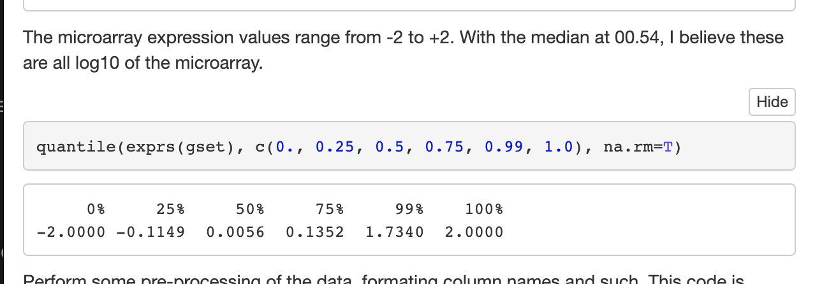
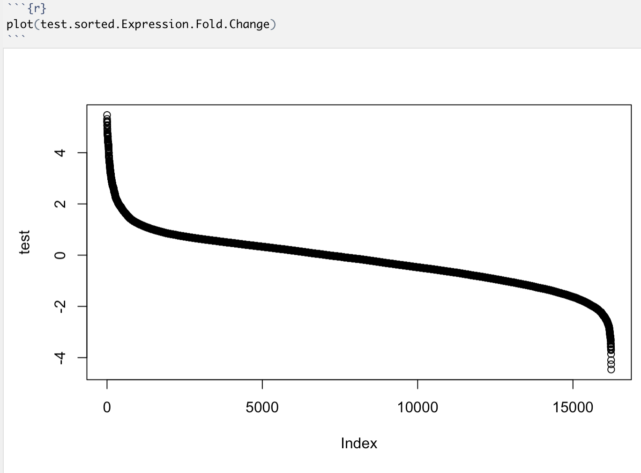
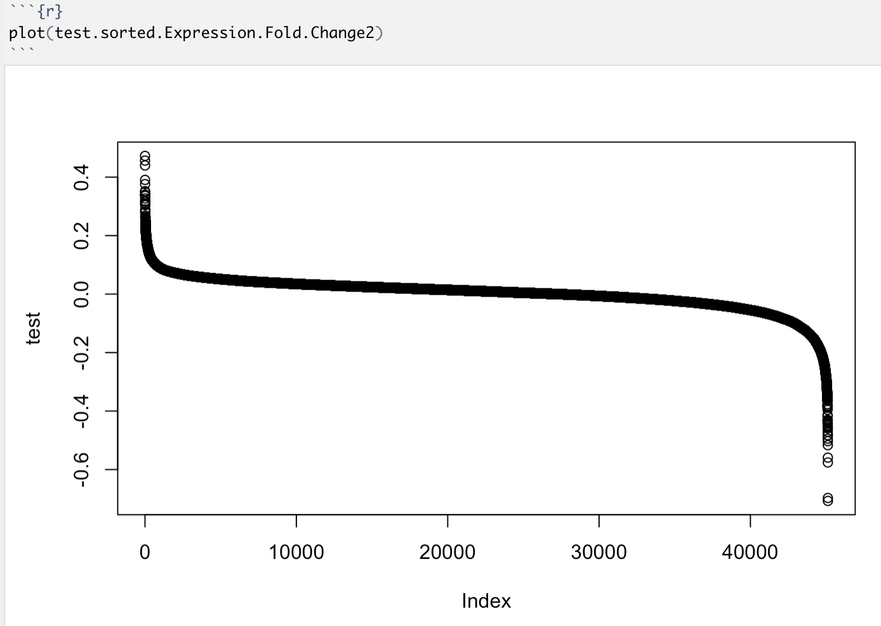
Methods and Tools
Quantile() and Plot() are great checks to see the range of expression values you are working with. GEO datasets are variably transformed and preprocessed.

Slide 12
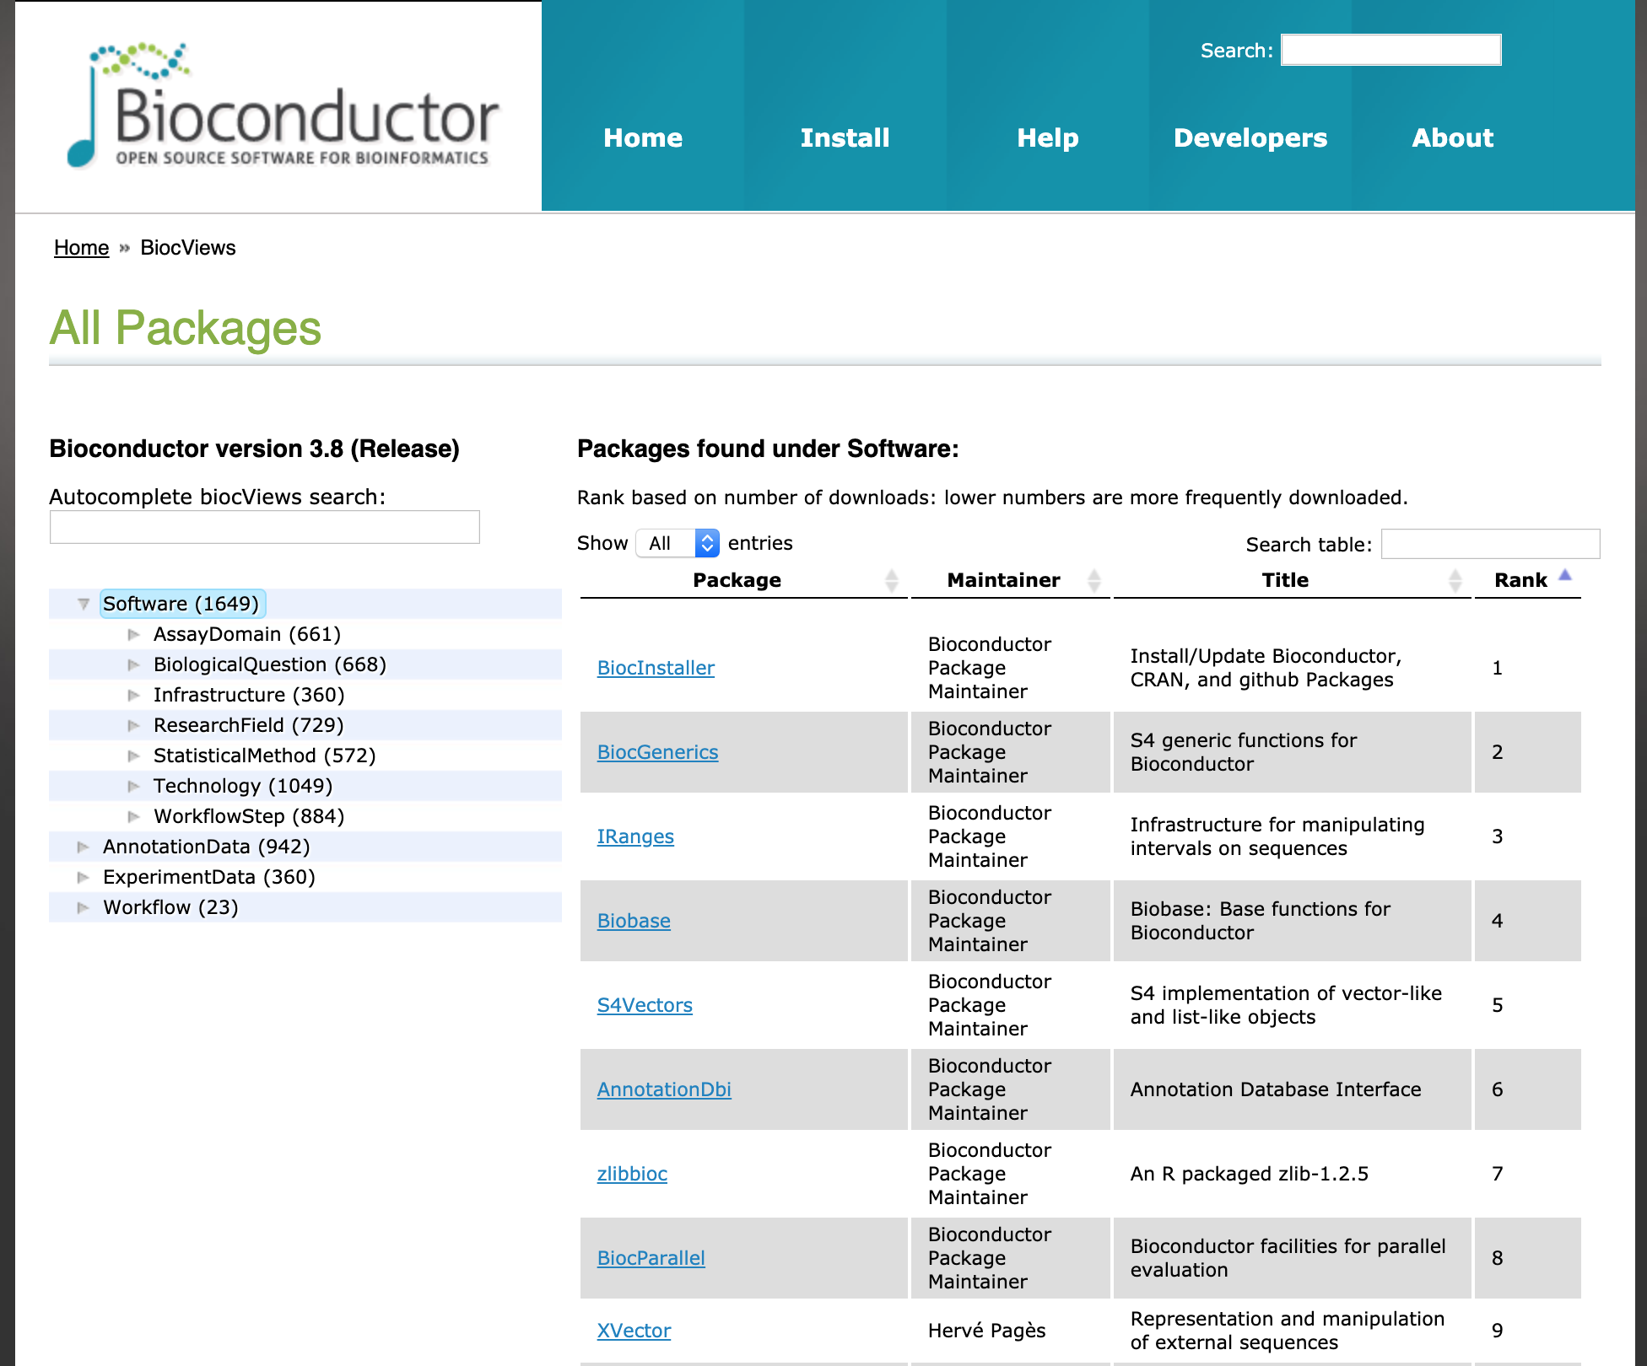
Methods and Tools
Bioconductor is open source R software for analysis of genomic data
The home page also provides a popularity rank of packages, which can be filtered by purpose or topic
Led me to the “clusterProfiler” package for enrichment analysis

Slide 13
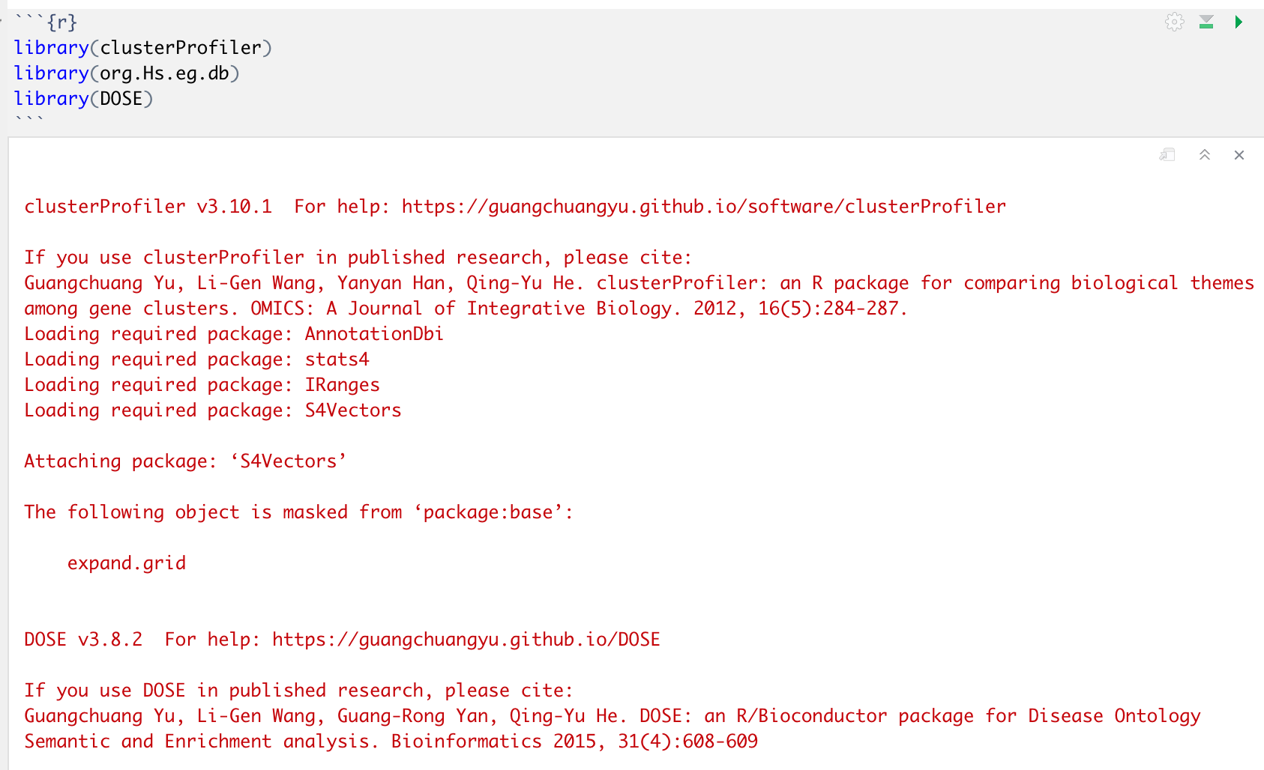
Methods and Tools
Used bioconductor “clusterProfiler” for enrichment analysis

Slide 14
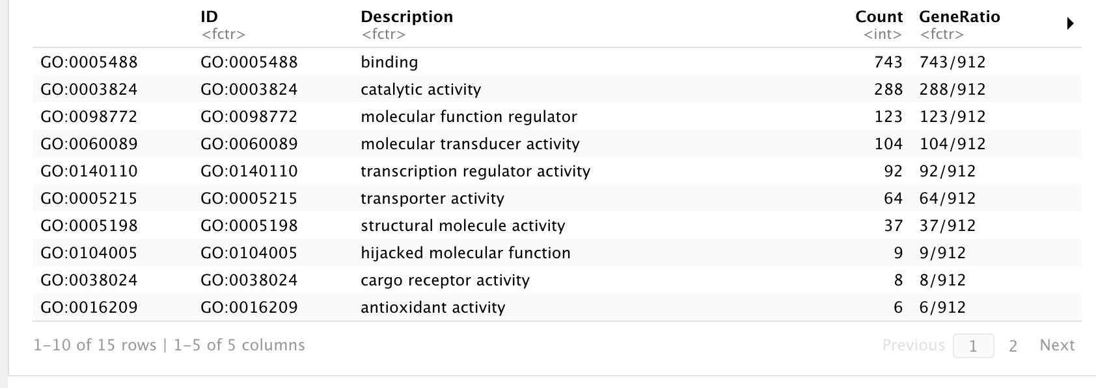
Results
Gene set enrichment analysis, for Chronic Phase CML vs. healthy CD34
GO Molecular Function (level 2):

Slide 15
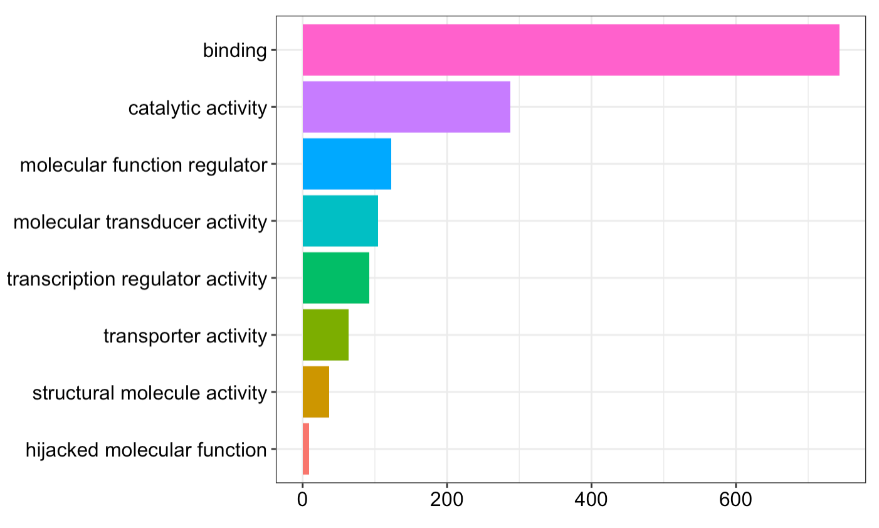

Slide 16
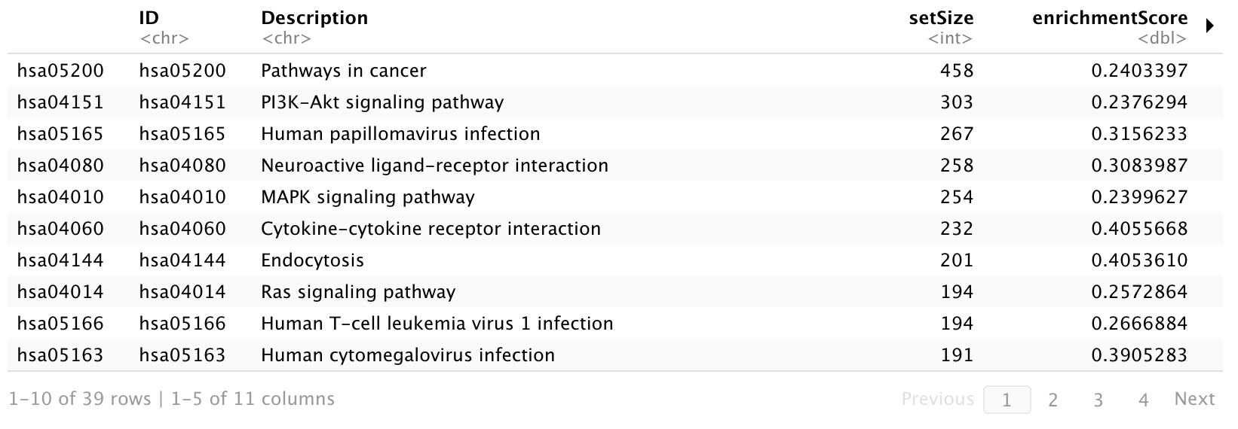
Results
Gene set enrichment analysis, for Chronic Phase CML vs. healthy CD34
Enriched KEGG Pathways:

Slide 17
Links and Citations
Guangchuang Yu, Li-Gen Wang, Yanyan Han, Qing-Yu He. clusterProfiler: an R package for comparing biological themes among gene clusters. OMICS: A Journal of Integrative Biology. 2012, 16(5):284-287.
Original dataset publication: Radich JP, Dai H, Mao M, Oehler V et al. Gene expression changes associated with progression and response in chronic myeloid leukemia. Proc Natl Acad Sci U S A 2006 Feb 21;103(8):2794-9. PMID: 16477019
GEO Repository Link: https://www.ncbi.nlm.nih.gov/geo/query/acc.cgi?acc=GSE4170

