Slide 1
Project 1 – Classification Algorithms
Group 2: Stella Shipman & Benjamin Anderson

Slide 2
Part 1
Preprocessing the Data

Slide 3
Preprocessing the Data
Methodology
Challenges
Results
Used class activity code to read data and build initial preprocessing function
Handled missing values
Binarized income variable
Encoded categorical features
Ensured all columns were numeric
Standardized numerical features
Missing Values:
Represented as '?', making them hard to detect
Resolved by treating them as a separate category (only appeared in categorical columns)
Encoding:
One-hot encoding increased feature count​
Column mismatch between test and validation sets​
Dropped 3 test-only columns to align datasets​
Data Format Issues:
Encountered mismatches between preprocessing output and model input
Fixed by explicitly specifying columns and using .values() for compatibility
Standardized numerical features
Encoded categorical features
Binary target variable
Original index for reference
Data ready to be used in any of our models

Slide 4
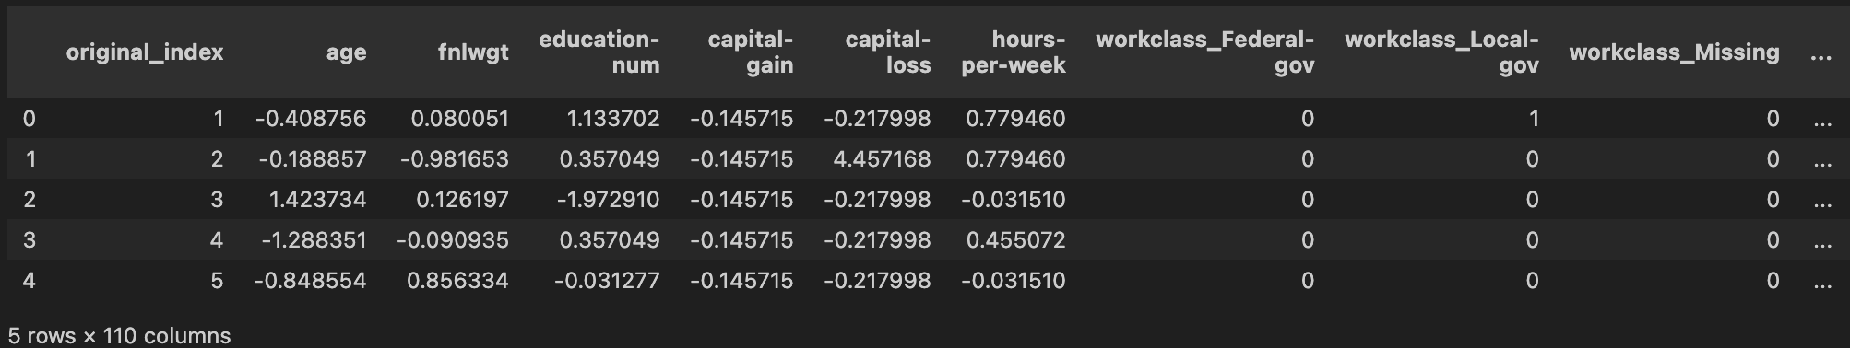
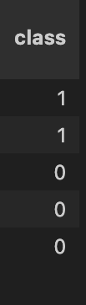
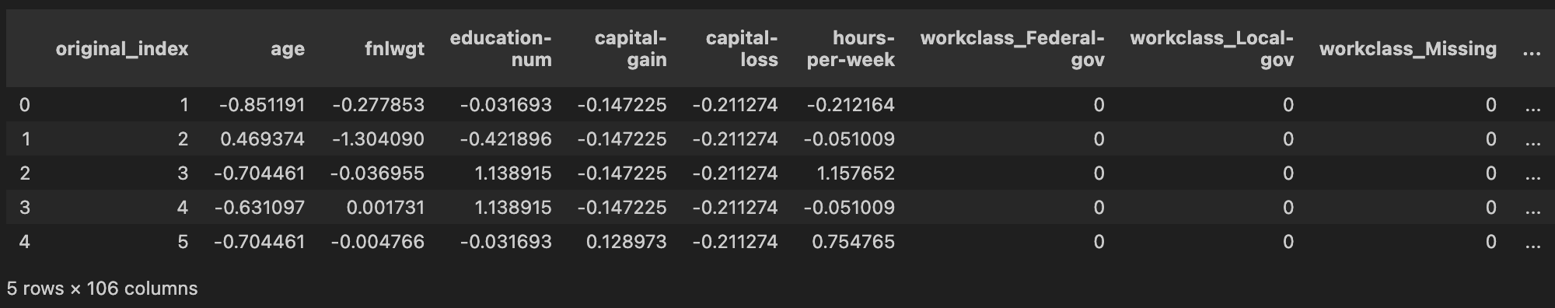
Preprocessing the Data
Test/Train Dataset
Validation Dataset

Slide 5
Part 2
Perceptron & Adaline

Slide 6
Perceptron & Adaline
Methodology
Challenges
Results
Adapted manual implementations from class activities
Used scikit-learn versions to mirror manual loops and compare performance
Tuned hyperparameters of each model for best accuracy
Verified results using cross-validation on scikit-learn models
Adaline Convergence:
Required extremely small learning rates to converge
Traced issue to data formatting; resolved by refining preprocessing and column selection
Hyperparameter Tuning:
Extensive trial and error to find optimal learning rate and iteration combinations
Some scikit-learn models showed high accuracy despite not fully converging
Warnings:
Frequent convergence warnings cluttered output
Tuned eta and max_iter to avoid models that didn’t converge
Manual Perceptron
eta 0.001 and n_iter 25
Accuracy: 82.07%
Manual Adaline
eta 0.0001 and n_iter 10
Accuracy: 84.30%
Sklearn Perceptron
eta 0.01 and max_iter 20
Accuracy: 82.80%
Sklearn Adaline
eta 1e-05 and max_iter 20
Accuracy: 83.55%

Slide 7
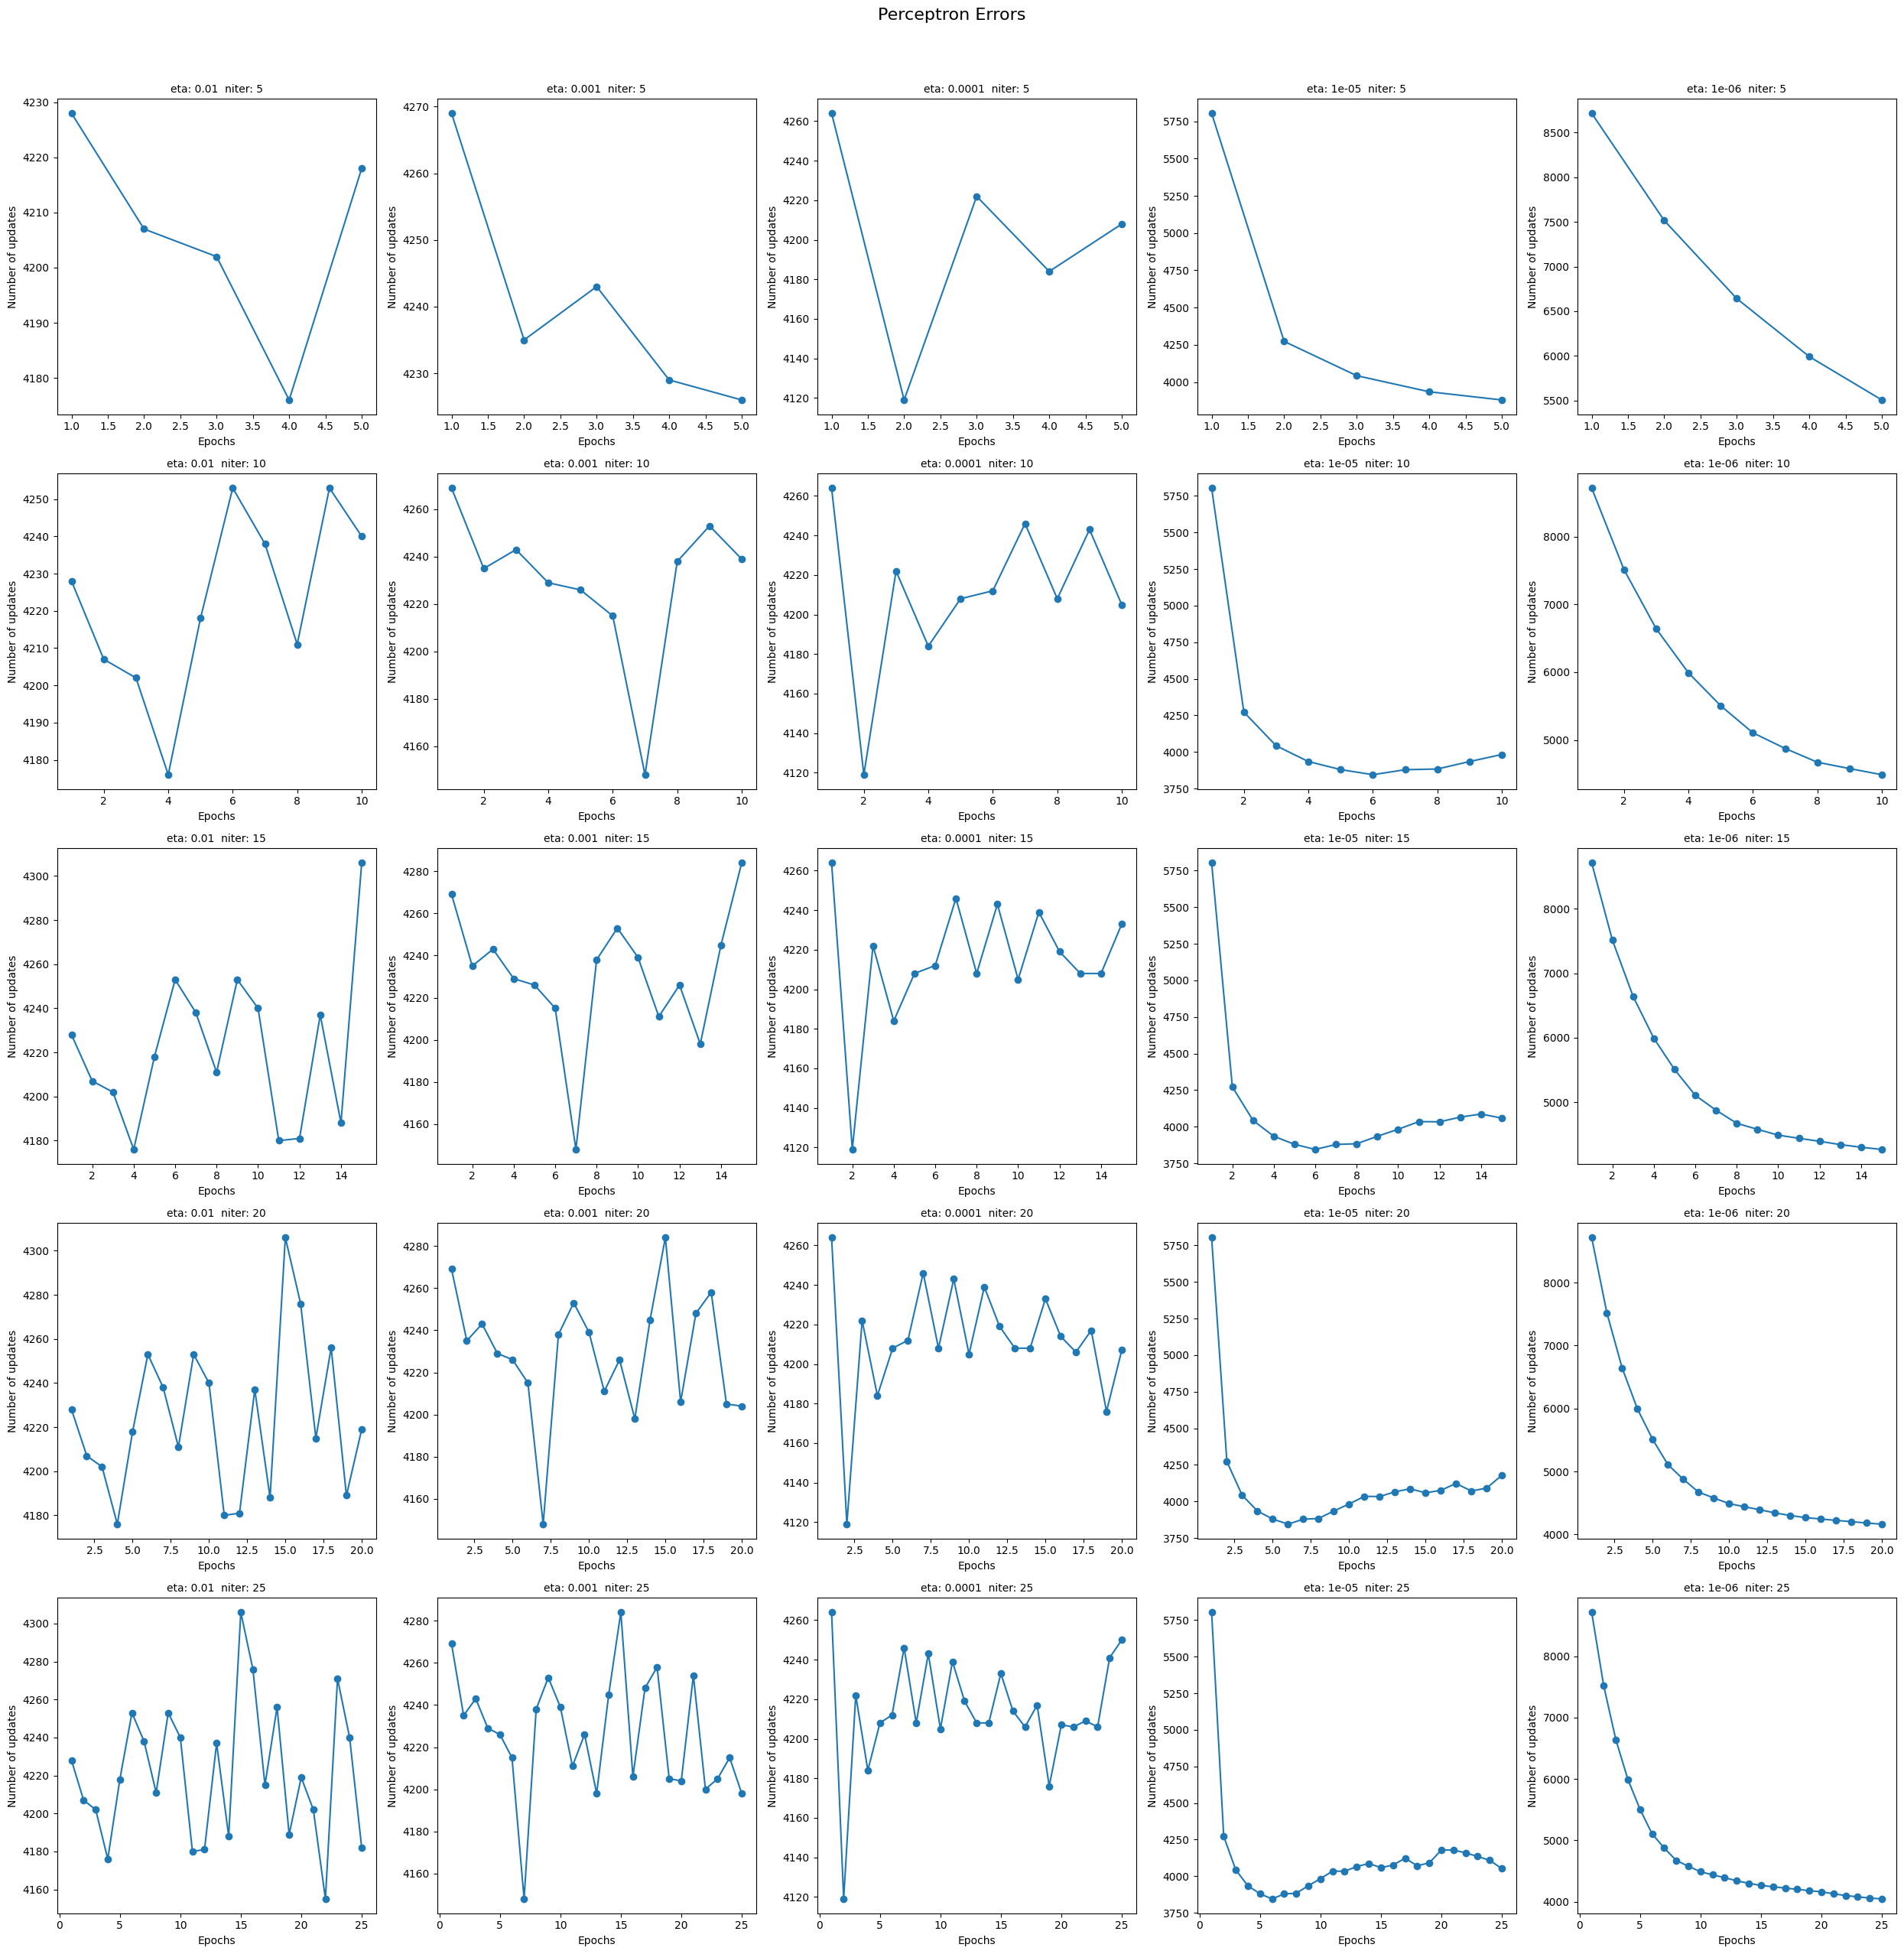
Perceptron (5 / 10 / 15 epochs)

Slide 8
Perceptron (20 / 25 epochs)

Slide 9
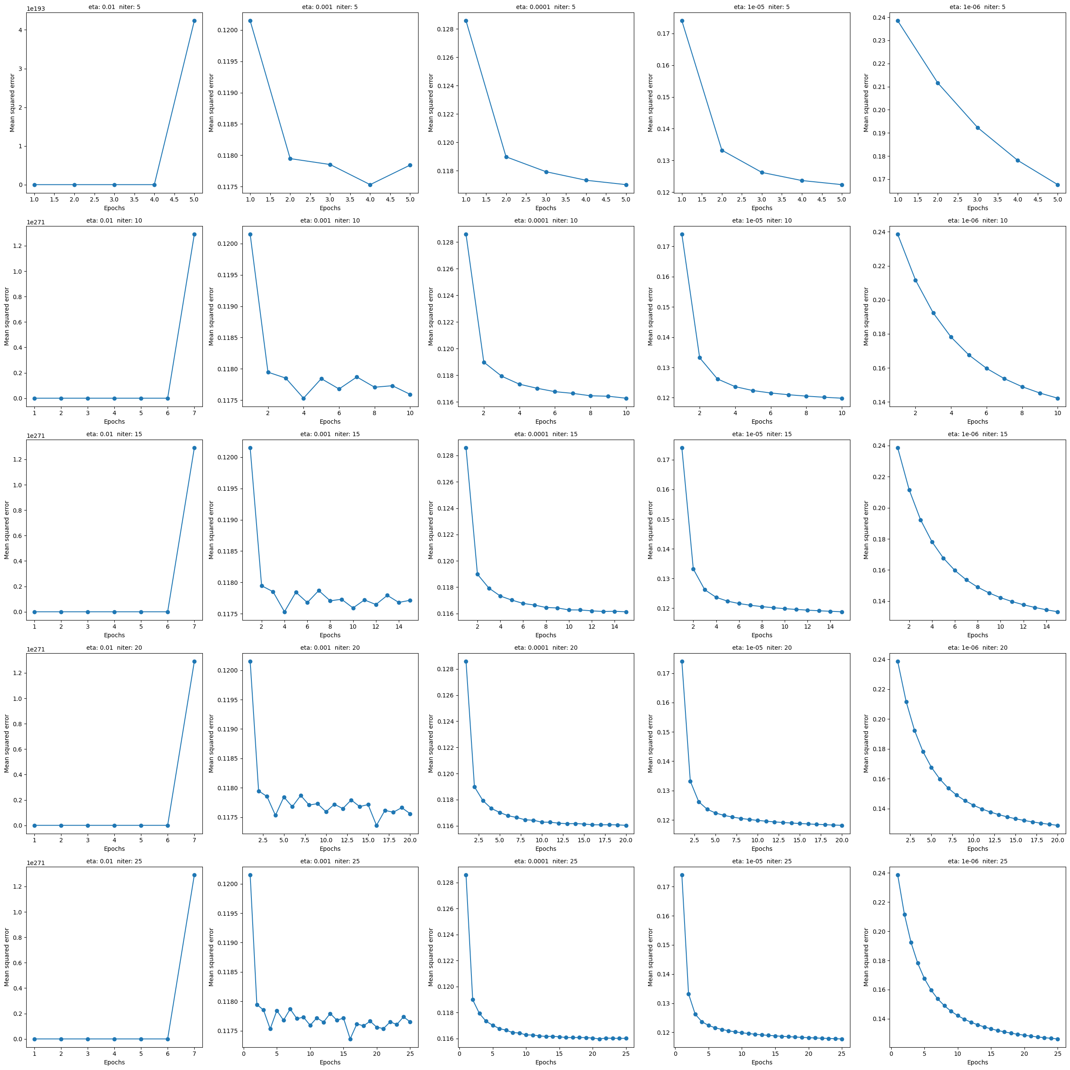
Adaline SGD (5 / 10 / 15 epochs)

Slide 10
Adaline SGD (20 / 25 epochs)

Slide 11
Part 3
Logistic Regression & SVM

Slide 12
Logistic Regression
Methodology
Challenges
Results
L-BFGS solver for convergence optimization
L2 regularization with C parameter tuning
GridSearchCV with 5-fold cross-validation
C values from 0.01 to 100 (logarithmic scale)
Required max_iter=300 for stable convergence
Decision boundary visualization for all numerical feature pairs
Convergence issues requiring increased max_iter to 300
Large parameter search space (20 C values)
Computational time for GridSearchCV (100 total fits)
Linear decision boundary limitations for complex patterns
Best Cross-validation Accuracy: 85.09%
Test Set Accuracy: 84.89%
Optimal Parameters: C = 0.785
Confusion Matrix: 3,693 TN, 311 FP, 476 FN, 730 TP
Precision: 0.70 (class 1), 0.89 (class 0)
Recall: 0.61 (class 1), 0.92 (class 0)

Slide 13
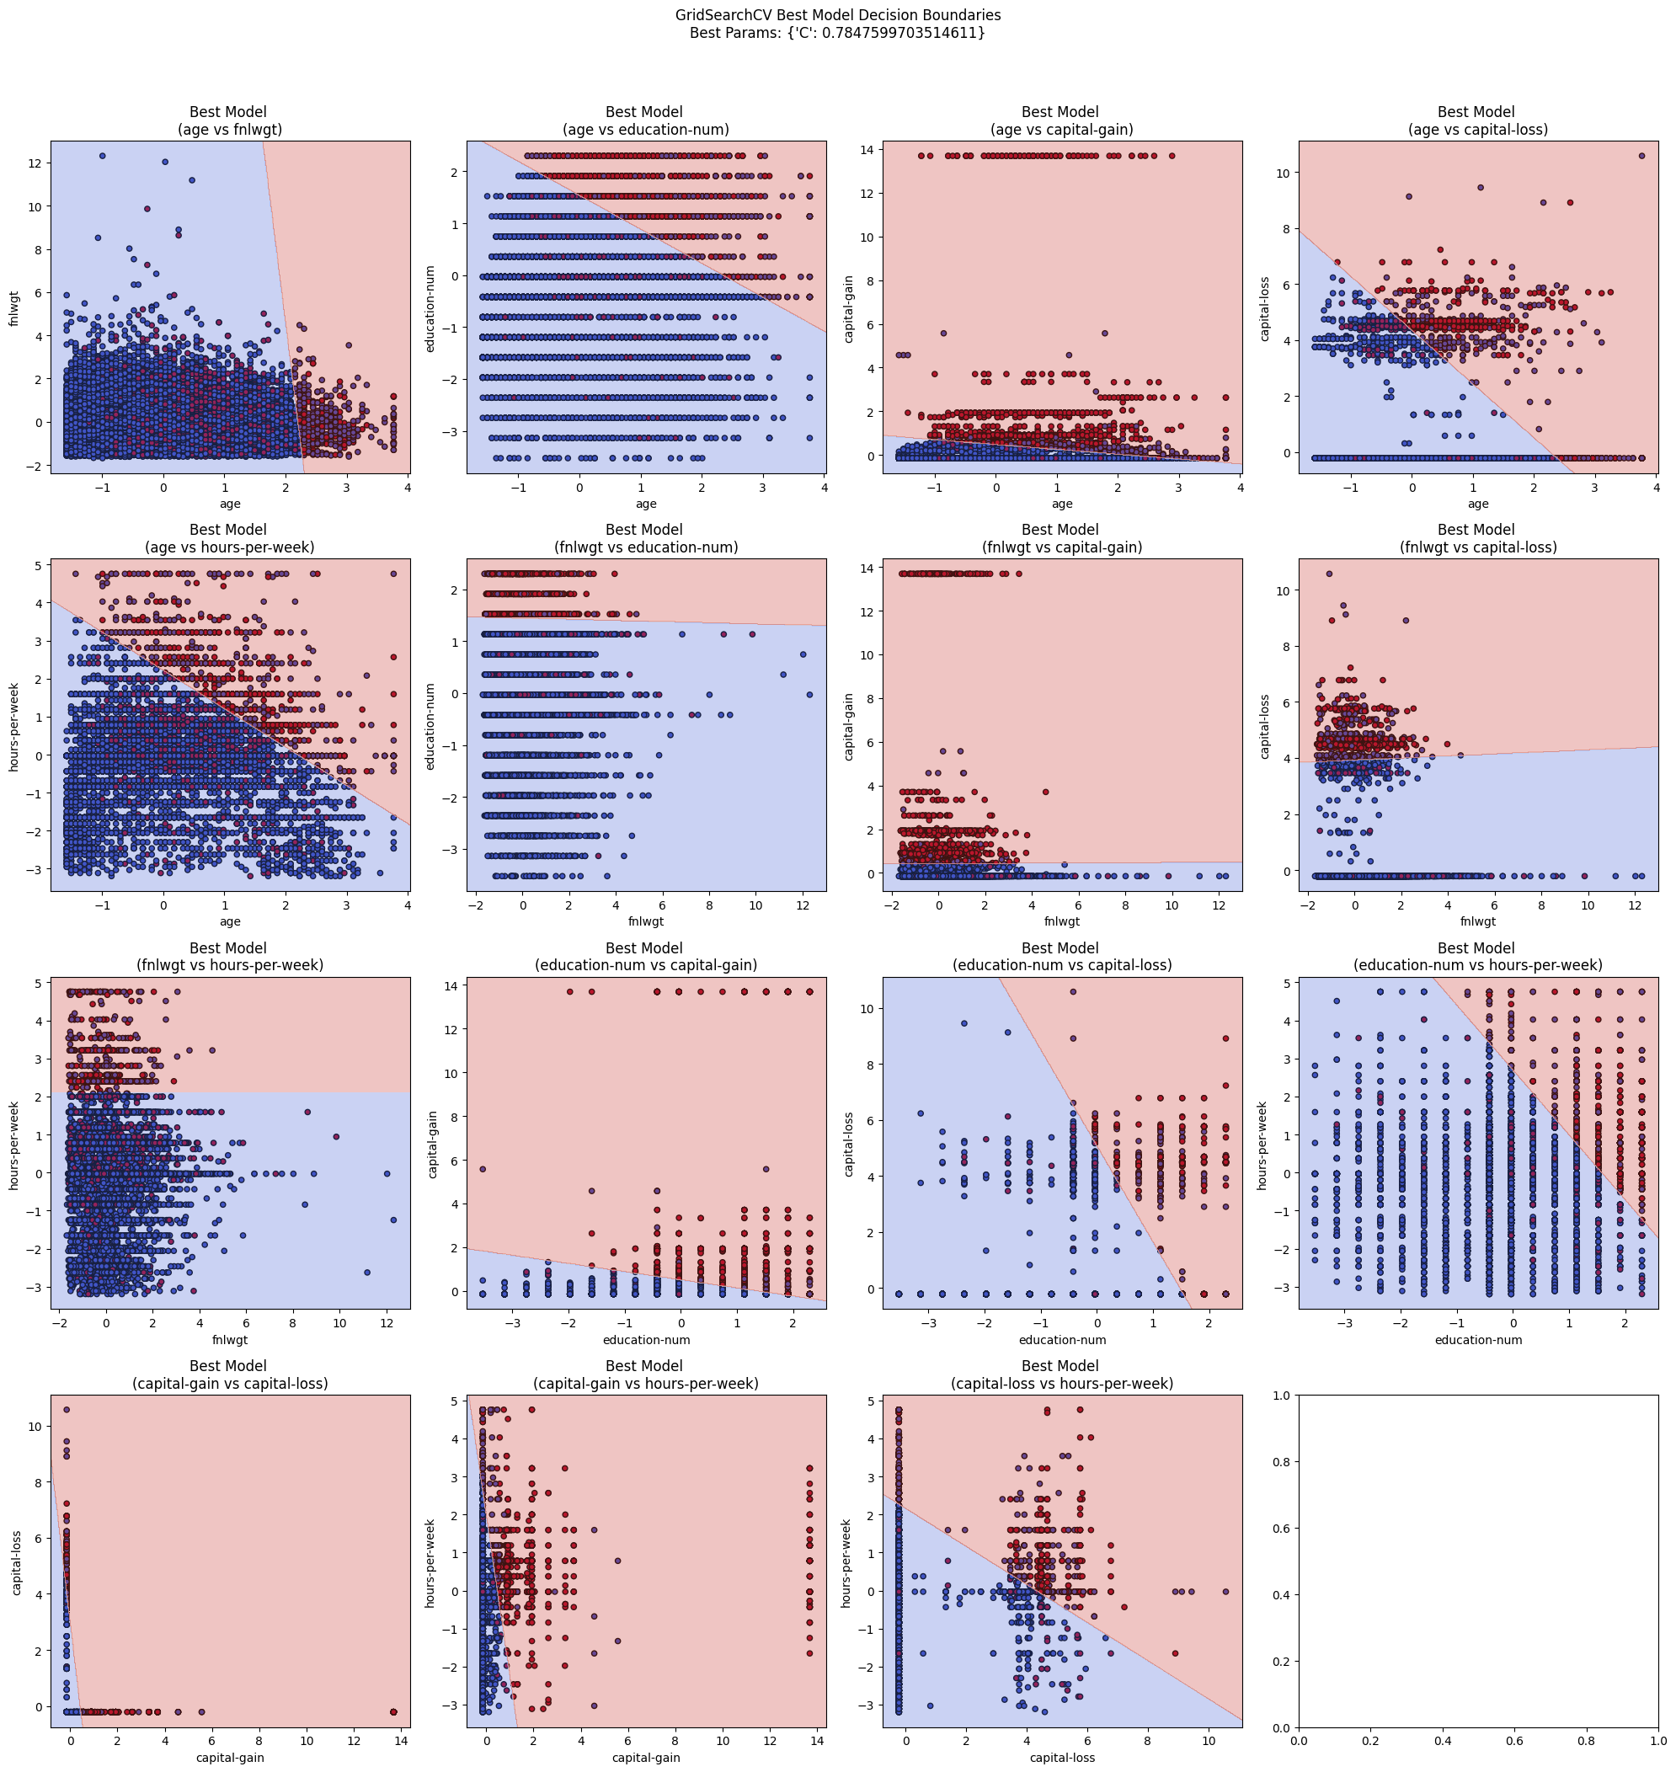
Logistic Regression Decision Boundaries

Slide 14
Support Vector Machine
Methodology
Challenges
Results
Three kernel types tested: Linear, RBF, Polynomial
SVC class with different kernel configurations
Cross-validation for parameter selection (3-fold CV)
C values tested: [0.1, 1, 10]
Gamma values: ['scale', 'auto'] for RBF kernel
Support vector highlighting in decision boundaries
PCA integration with 32 components (95% variance)
Kernel tuning done separately:
Full grid search avoided due to long run times
Each kernel was tuned in its own cross-validation loop
Poly kernel was most computationally expensive:
Especially with gamma='auto', it was excluded due to excessive training time
RBF kernel complexity:
Still computationally intensive, but more manageable than poly in high-dimensional space
High feature dimensionality (>100 features):
Increased training time and impacted kernel performance
Graphing:
Only graphed decision boundaries for two features using 2 kernels due to runtime constraints
Linear Kernel: 85.15% CV accuracy (C=10), 85.00% test accuracy
RBF Kernel: 85.49% CV accuracy (C=1, gamma='scale'), 85.00% test accuracy
Polynomial Kernel: 85.17% CV accuracy (C=1), 85.00% test accuracy
Best Overall: RBF kernel with C=1, gamma='scale'
PCA Integration: 85.25% accuracy with dimensionality reduction
Kernel Ranking: RBF > Polynomial > Linear

Slide 15
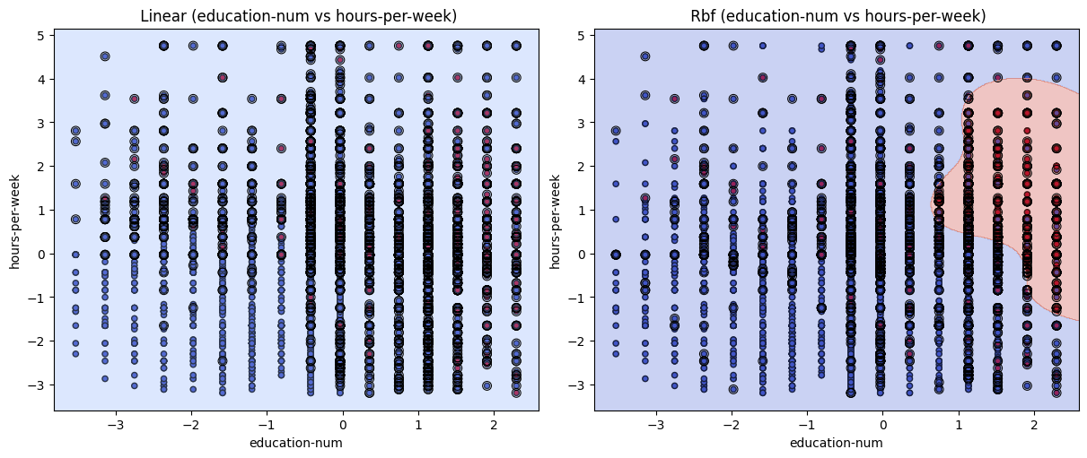
SVM Decision Boundaries

Slide 16
Logistic Regression & SVM
Key Insights
SVM with RBF kernel achieved highest overall performance
The RBF kernel delivered the best cross-validation accuracy of 85.49% and maintained 85.00% test accuracy, outperforming both linear and polynomial kernels.
Non-linear kernels captured complex feature relationships
Both RBF and polynomial kernels significantly outperformed the linear kernel, demonstrating that the underlying data relationships are non-linear.
PCA integration slightly improved SVM performance
Dimensionality reduction from 95 original features to 32 principal components resulted in 85.25% accuracy, which was an improvement. This suggests that while some features contained noise, many patterns were preserved in the reduced dimensional space.
Support vectors highlighted critical decision points
The SVM models identified key data points that define the decision boundaries as seen in the decision boundary plots.

Slide 17
Part 4
Reflection & Questions

Slide 18
Importance of Feature Scaling in Gradient-Based Algorithms
Prevents Uneven Weight Updates:
Without scaling, features with larger ranges produce larger gradients, causing unstable or slow learning
Improves Convergence Speed:
Gradient descent may zigzag or take inefficient paths when features are on different scales, requiring more iterations
Avoids Skewed Model Behavior:
High-magnitude features dominate updates, leading to biased decision boundaries and poor generalization
Preserves Optimization Geometry:
Scaling ensures a smoother loss surface, helping algorithms like Logistic Regression and SVM find better solutions
Essential for Kernel-Based SVMs:
Kernels such as RBF rely on distance metrics, unscaled features distort these, reducing classification accuracy

Slide 19
Batch vs. Stochastic Gradient Descent
Batch Gradient Descent:
Uses the entire training set to compute gradients
One update per epoch
More stable and accurate, but computationally expensive
Slower for large datasets
Stochastic Gradient Descent (SGD):
Uses one training example at a time
Updates weights after each sample
Faster and more memory-efficient
Converges noisily, may oscillate around the minimum

Slide 20
Perceptron & Adaline: Scikit-Learn vs Textbook Implementations
Scikit-learn adds regularization and optimization to construct perceptron and adaline models that are more efficient and robust than our book code.
Scikit-learn has:
Faster convergence: shuffle + adaptive learning rate + tol-based stopping.
Better generalization: built-in regularization.
Numerical stability: vectorized linear algebra vs Python loops.
Scalability: efficient on large, sparse datasets.
Ease of tuning: integrates with GridSearchCV to systematically optimize parameters.

Slide 21
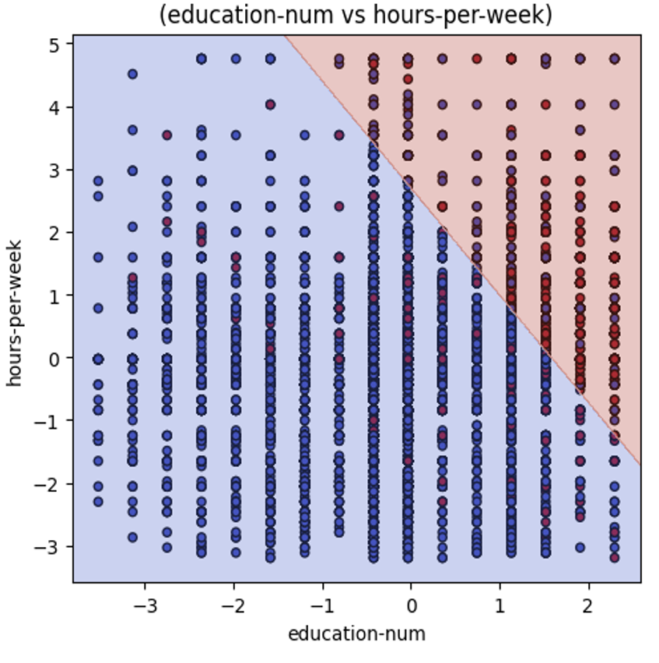
Decision Boundaries: Logistic Regression vs. SVM
Logistic Regression
Shows a clear linear decision boundary
Even when classes overlap, it fits a boundary based on predicted probabilities
Always tries to separate classes as best as possible using a straight line
Linear SVM
No visible boundary, model predicts one class
If the two features don’t allow for linear separation, SVM may fail to find a meaningful dividing line
This is likely why the graph shows only one dominant class region
RBF SVM
Displays a visible, curved decision boundary.
Uses Euclidean distance to measure similarity between points
Can capture complex, non-linear patterns, better suited for overlapping like in this case

Slide 22
Regularization for Overfitting
Overfitting happens when a model learns the training data too closely, so it performs poorly on new, unseen data
Regularization helps by adding a penalty to the model’s complexity during training
This discourages the model from relying too heavily on any one feature or from fitting the data too precisely
Instead of just minimizing the error on the training set, regularization also tries to keep the model simpler and more generalizable
This is done by shrinking the weights of less important features, which reduces the risk of the model being overly tuned to the training data
The result is a model that may not fit the training data perfectly, but is more likely to perform well on new data

Slide 23
Impact of Varying C Values: Logistic Regression & Linear SVC
Impact of varying C values: [0.01, 1.0, 100.0]
Both models show consistent trends as C increases (less regularization):
Recall for the minority class (1) improves from ~0.57 to ~0.60–0.61
Precision for the minority class slightly decreases from ~0.72–0.73 to ~0.70–0.71
Majority class (0) performance remains strong across all settings
precision ~0.88–0.89, recall ~0.92–0.94
Overall accuracy stays stable at ~85%, driven by class imbalance
Trade-off: Increasing C allows the models to better detect minority class instances (higher recall), but at the cost of slightly more false positives (lower precision)
Conclusion: Logistic Regression and Linear SVC behave similarly under varying regularization, with performance gains for the minority class as C increases

Slide 24
Thank you!

