Slide 1
Project 1 – Classification Algorithms
Group 2: Stella Shipman & Benjamin Anderson

Slide 2
Part 1
Preprocessing the Data

Slide 3
Preprocessing the Data
Methodology
Challenges
Results
Used class activity code to read data and build initial preprocessing function
Handled missing values
Binarized income variable
Encoded categorical features
Ensured all columns were numeric
Standardized numerical features
Missing Values:
Represented as '?', making them hard to detect
Resolved by treating them as a separate category (only appeared in categorical columns)
Encoding:
One-hot encoding increased feature count​
Column mismatch between test and validation sets​
Dropped 3 test-only columns to align datasets​
Data Format Issues:
Encountered mismatches between preprocessing output and model input
Fixed by explicitly specifying columns and using .values() for compatibility
Standardized numerical features
Encoded categorical features
Binary target variable
Original index for reference
Data ready to be used in any of our models

Slide 4
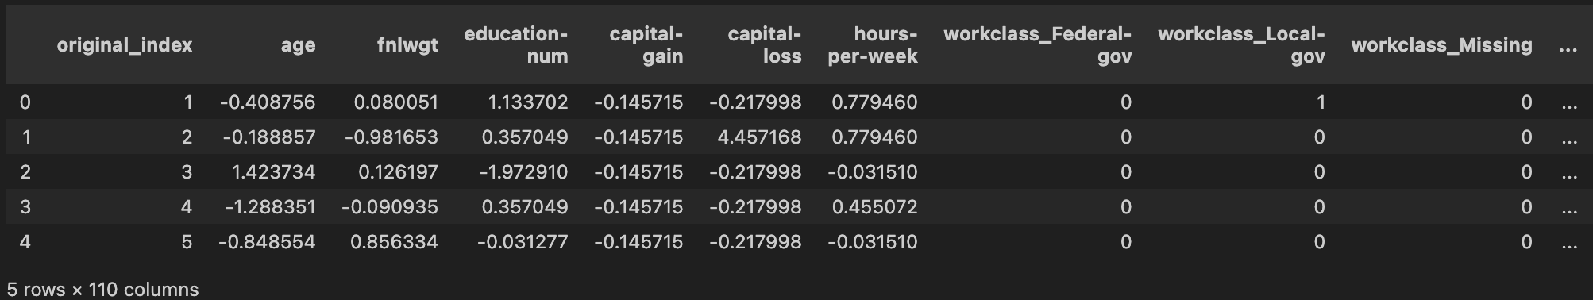
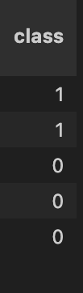
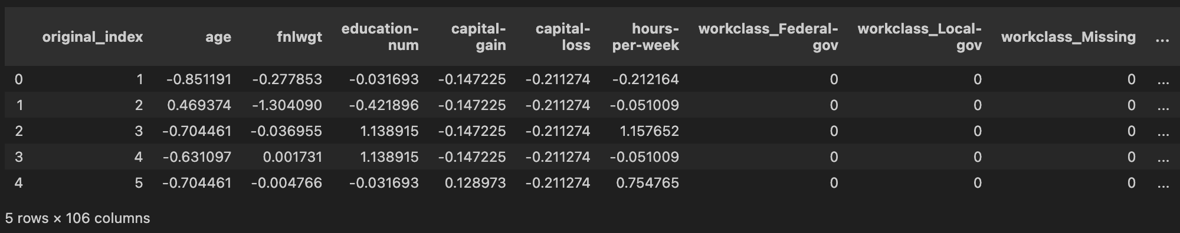
Preprocessing the Data
Test/Train Dataset
Validation Dataset

Slide 5
Part 2
Perceptron & Adaline

Slide 6
Perceptron & Adaline
Methodology
Challenges
Results
Adapted manual implementations from class activities
Used scikit-learn versions to mirror manual loops and compare performance
Tuned hyperparameters of each model for best accuracy
Verified results using cross-validation on scikit-learn models
Adaline Convergence:
Required extremely small learning rates to converge
Traced issue to data formatting; resolved by refining preprocessing and column selection
Hyperparameter Tuning:
Extensive trial and error to find optimal learning rate and iteration combinations
Some scikit-learn models showed high accuracy despite not fully converging
Warnings:
Frequent convergence warnings cluttered output
Tuned eta and max_iter to avoid models that didn’t converge
Manual Perceptron
eta 0.001 and n_iter 25
Accuracy: 82.07%
Manual Adaline
eta 0.0001 and n_iter 10
Accuracy: 84.30%
Sklearn Perceptron
eta 0.01 and max_iter 20
Accuracy: 82.80%
Sklearn Adaline
eta 1e-05 and max_iter 20
Accuracy: 83.55%

Slide 7
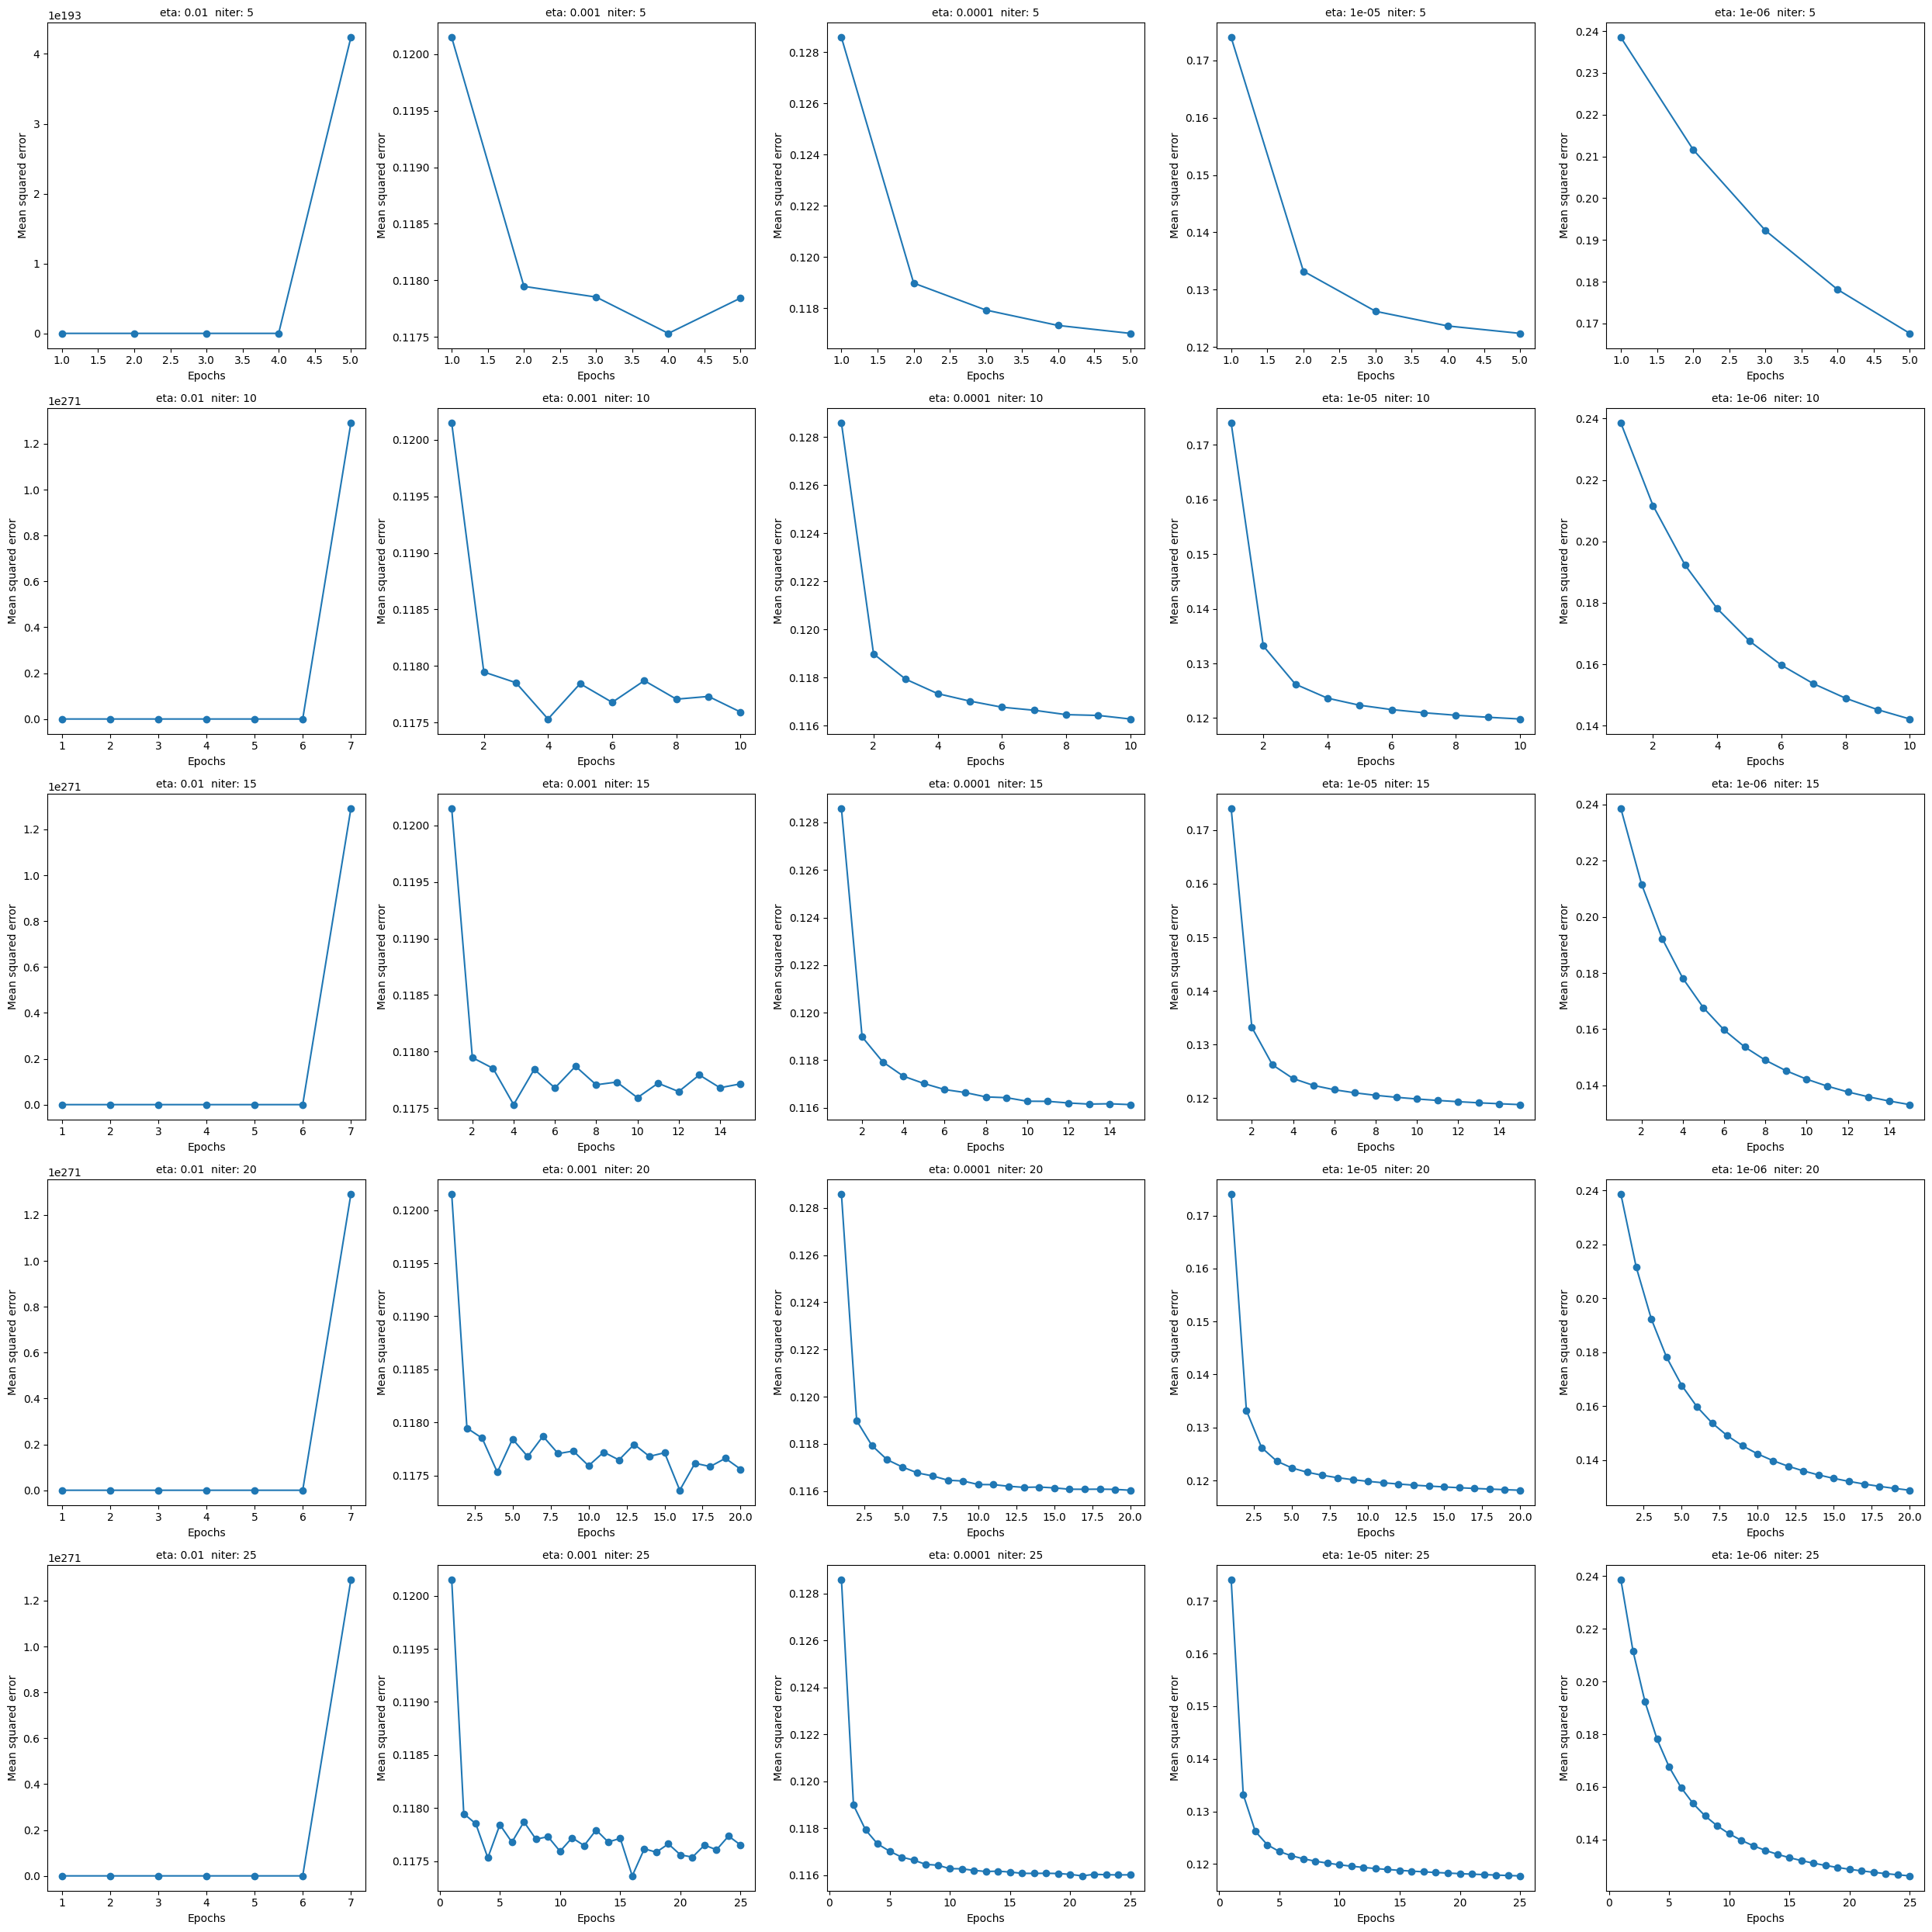
Adaline SGD (5 / 10 / 15 epochs)

Slide 8
Adaline SGD (20 / 25 epochs)

Slide 9
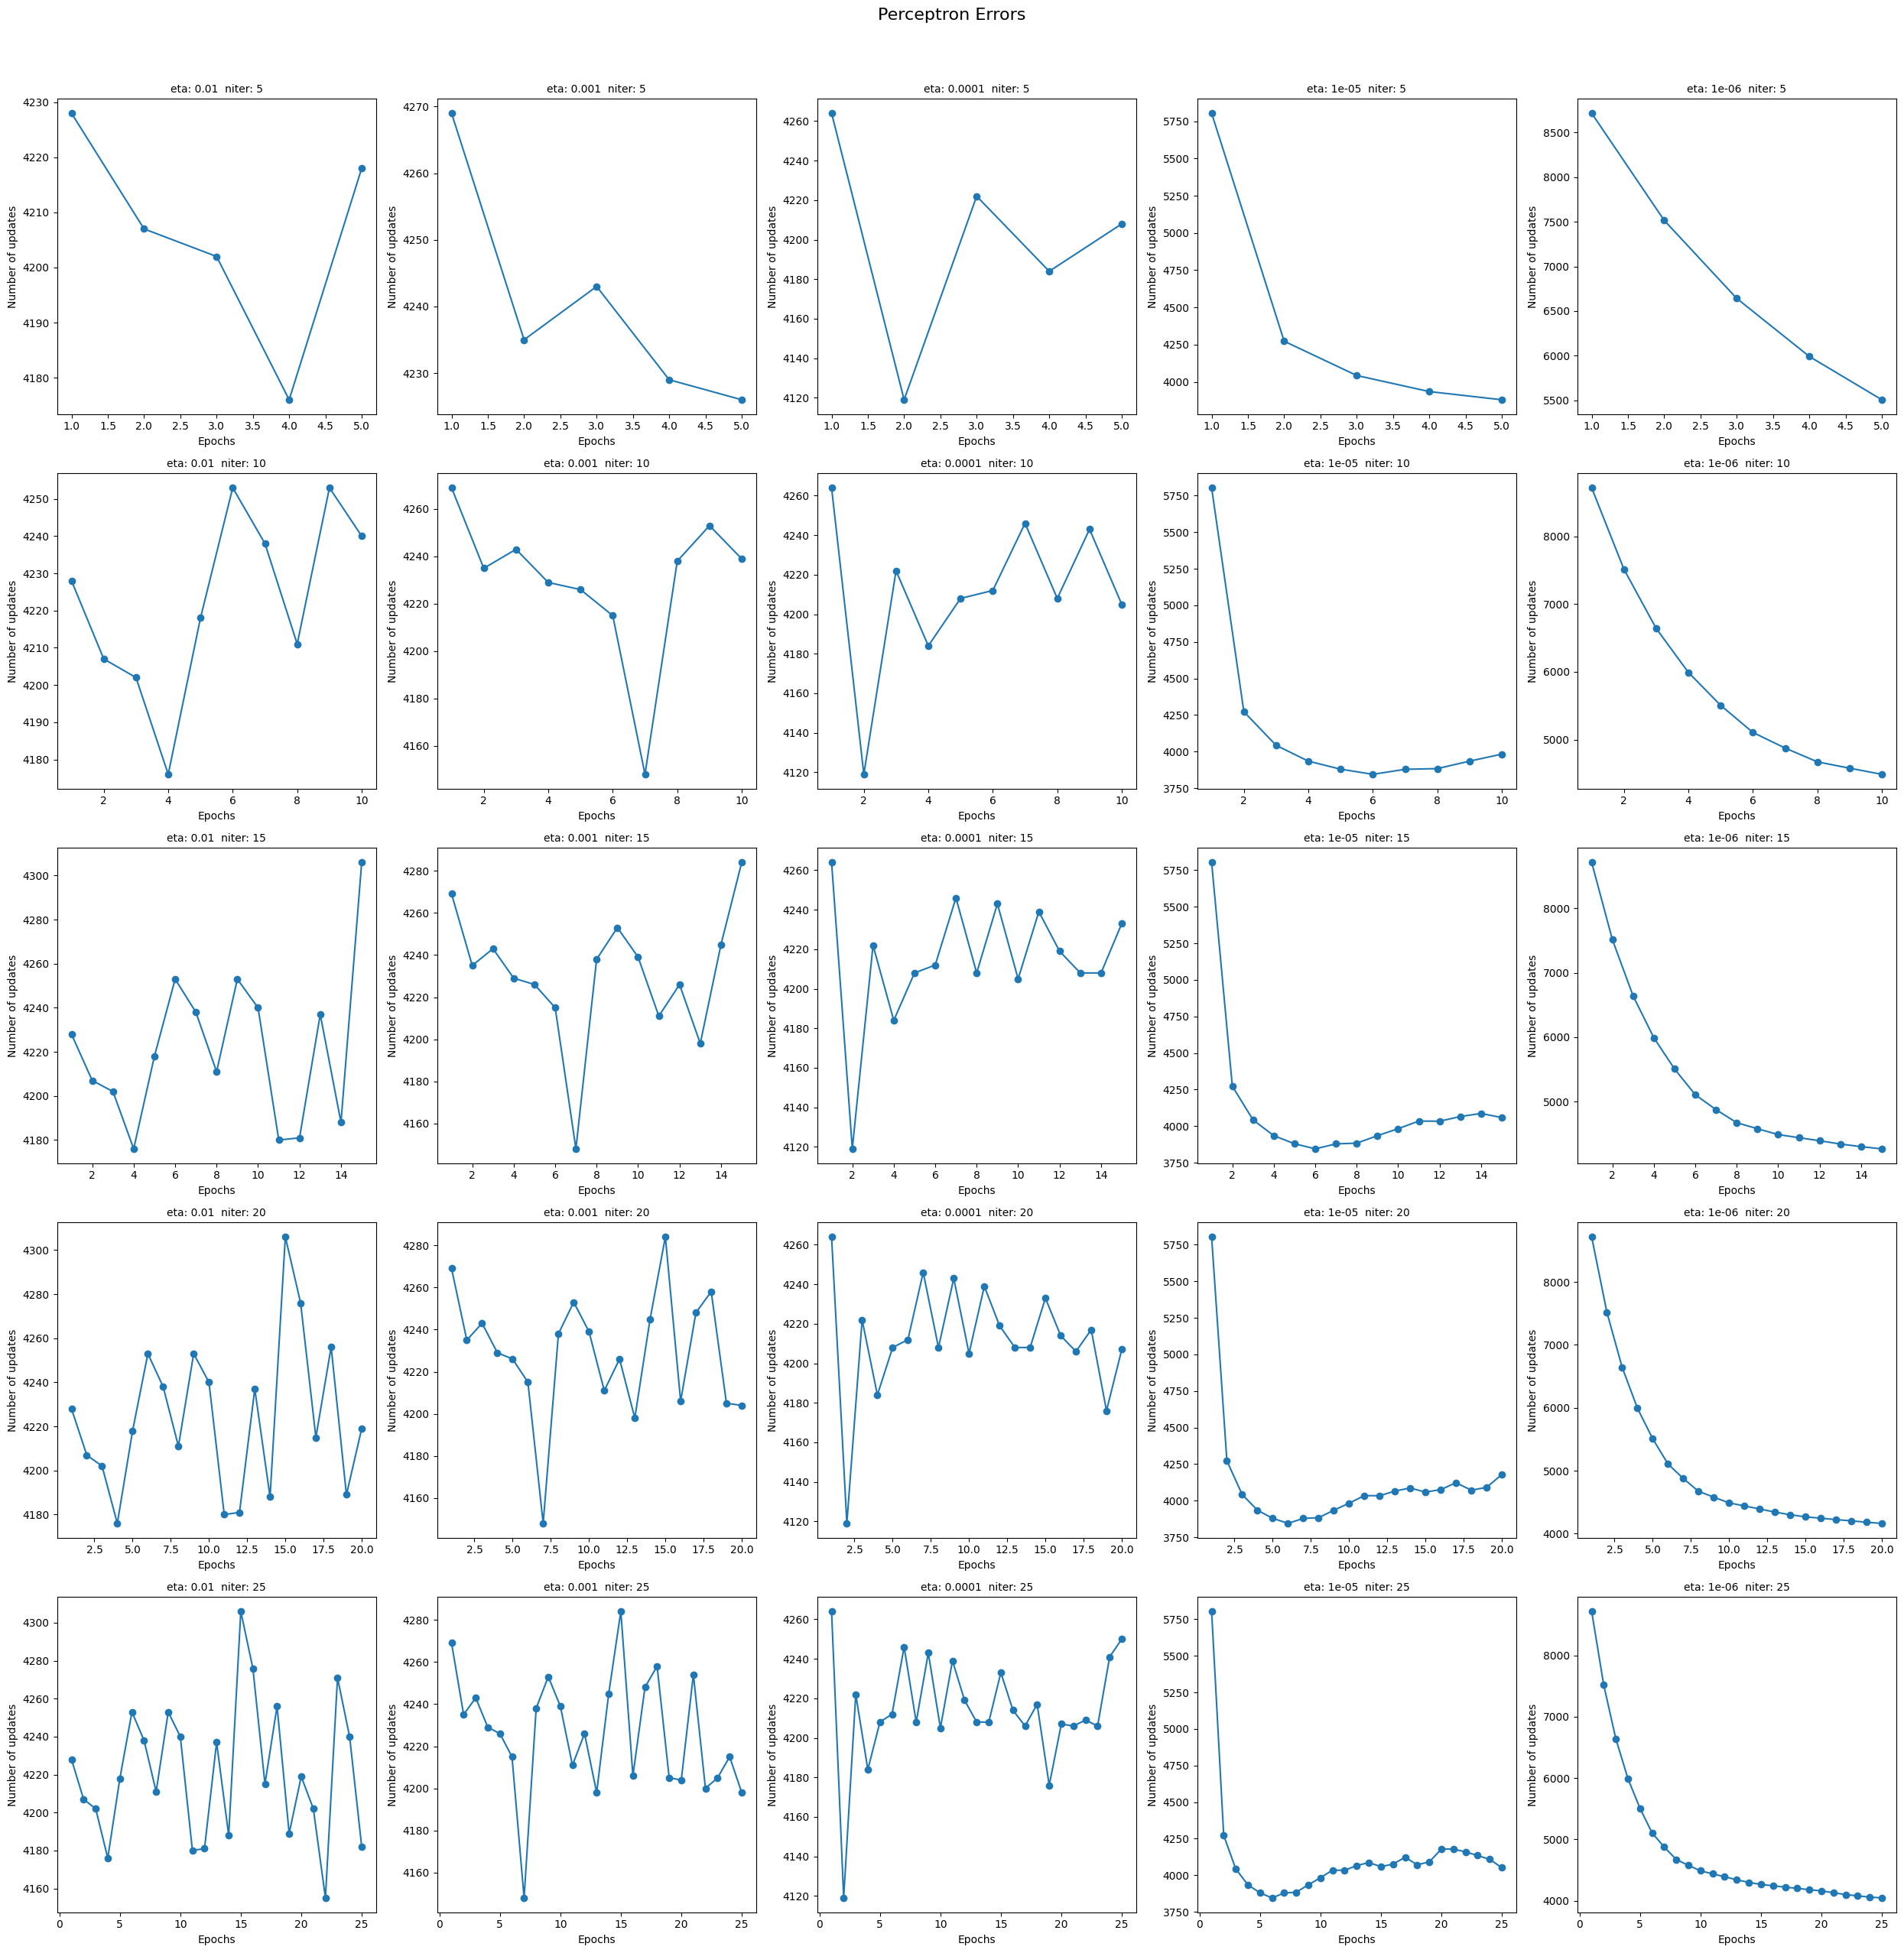
Perceptron (5 / 10 / 15 epochs)

Slide 10
Perceptron (20 / 25 epochs)

Slide 11
Part 3
Logistic Regression & SVM

Slide 12
Logistic Regression
Methodology
Challenges
Results
- L-BFGS solver for convergence optimization
- L2 regularization with C parameter tuning
- GridSearchCV with 5-fold cross-validation
- C values from 0.01 to 100 (logarithmic scale)
- Required max_iter=300 for stable convergence
- Decision boundary visualization for all numerical feature pairs
Convergence issues requiring increased max_iter to 300
Large parameter search space (20 C values)
Computational time for GridSearchCV (100 total fits)
Linear decision boundary limitations for complex patterns
Best Cross-validation Accuracy: 85.09%
Test Set Accuracy: 84.89%
Optimal Parameters: C = 0.785
Confusion Matrix: 3,693 TN, 311 FP, 476 FN, 730 TP
Precision: 0.70 (class 1), 0.89 (class 0)
Recall: 0.61 (class 1), 0.92 (class 0)

Slide 13
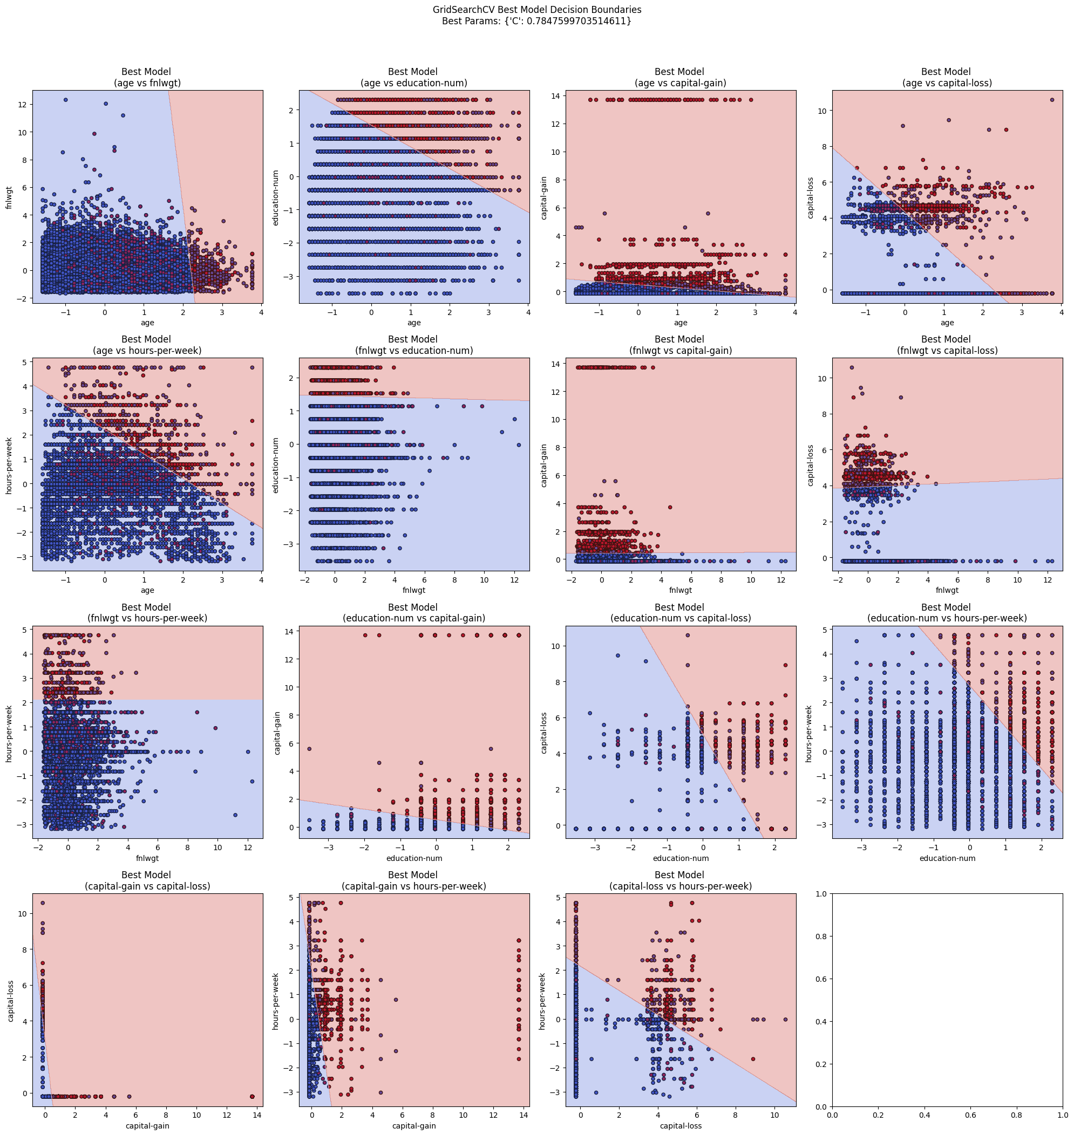
Logistic Regression Decision Boundaries

Slide 14
Support Vector Machine
Methodology
Challenges
Results
Three kernel types tested: Linear, RBF, Polynomial
SVC class with different kernel configurations
Cross-validation for parameter selection (3-fold CV)
C values tested: [0.1, 1, 10]
Gamma values: ['scale', 'auto'] for RBF kernel
Support vector highlighting in decision boundaries
PCA integration with 32 components (95% variance)
Kernel tuning done separately:
Full grid search avoided due to long run times
Each kernel was tuned in its own cross-validation loop
Poly kernel was most computationally expensive:
Especially with gamma='auto', it was excluded due to excessive training time
RBF kernel complexity:
Still computationally intensive, but more manageable than poly in high-dimensional space
High feature dimensionality (>100 features):
Increased training time and impacted kernel performance
Graphing:
Only graphed decision boundaries for two features using 2 kernels due to runtime constraints
Linear Kernel: 85.15% CV accuracy (C=10), 85.00% test accuracy
RBF Kernel: 85.49% CV accuracy (C=1, gamma='scale'), 85.00% test accuracy
Polynomial Kernel: 85.17% CV accuracy (C=1), 85.00% test accuracy
Best Overall: RBF kernel with C=1, gamma='scale'
PCA Integration: 85.25% accuracy with dimensionality reduction
Kernel Ranking: RBF > Polynomial > Linear

Slide 15
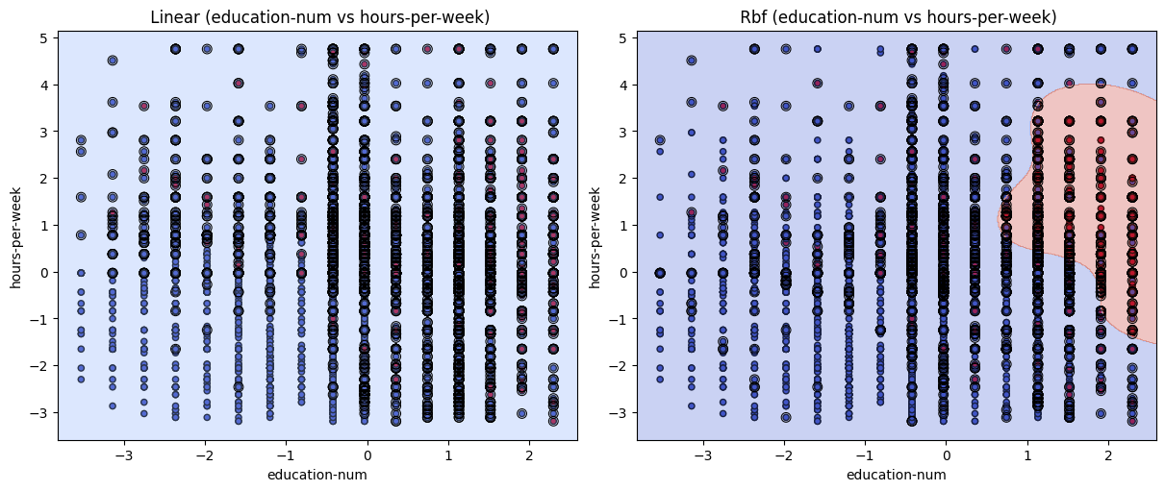
SVM Decision Boundaries

Slide 16
Logistic Regression & SVM
Key Insights
SVM with RBF kernel achieved highest overall performance
The RBF kernel delivered the best cross-validation accuracy of 85.49% and maintained 85.00% test accuracy, outperforming both linear and polynomial kernels.
Non-linear kernels captured complex feature relationships
Both RBF and polynomial kernels significantly outperformed the linear kernel, demonstrating that the underlying data relationships are non-linear.
PCA integration slightly improved SVM performance
Dimensionality reduction from 95 original features to 32 principal components resulted in 85.25% accuracy, which was an improvement. This suggests that while some features contained noise, many patterns were preserved in the reduced dimensional space.
Support vectors highlighted critical decision points
The SVM models identified key data points that define the decision boundaries as seen in the decision boundary plots.

Slide 17
Part 4
Reflection & Questions

Slide 18
Importance of Feature Scaling in Gradient-Based Algorithms
answer

Slide 19
Batch vs. Stochastic Gradient Descent
answer

Slide 20
Perceptron & Adaline: Scikit-Learn vs Textbook Implementations
answer

Slide 21
Decision Boundaries: Logistic Regression vs. SVM
answer

Slide 22
Regularization for Overfitting
answer

Slide 23
Impact of Varying C Values: Logistic Regression & Linear SVC
Impact of varying C values: [0.01, 1.0, 100.0]
Logistic Regression
SVC
Result:
Accuracy was 0.83 for all three C values
Precision, recall, and F1 scores were very consistent
Confusion matrices very consistent
Why C had little impact:
Preprocessing reduced sensitivity to regularization
Model learned a stable decision boundary, not reliant on extreme coefficients
Class imbalance dominated performance, limiting the effect of C on minority class
Result:
Why:

Slide 24
SOURCES?? Idk I don’t think we need to cite
words
website

