Slide 1
Transforming SQL Queries for Database Testing
Calvin Li and Ben Mishkanian
6/6/15

Slide 2
Motivation – DBMS Testing
Random query generation alone can be used to test for crashing bugs, but not functional correctness.
Differential testing can be used to find functional bugs, but it can not be applied directly, since SQL is not fully standardized across implementations.
We need the coverage of random testing and the functional validation of differential testing, without having to translate across SQL dialects.
We focus our tests on SQLite, as it is has not been tested as extensively as other DBMSs.

Slide 3
Hybrid Testing Approach
Generate a set Q of random SQL queries
Fill a database with randomly generated data.
Scan the database to find a set P of invariant predicates (ones that are always true or always false)
For each query in Q, generate a semantically equivalent query by appending a valid invariant in P to the WHERE clause.
Run both the original query and the transformed query on the DB, checking if the output is identical.

Slide 4
Example
Database db1 has table employees, containing columns Name, Income, and Age
Scanning employees, we find out that the largest income is 100000 and the largest age is 50. We may generate the following invariants:
employees.Income <= 100000
employees.Age <= 50
Given the randomly generated query SELECT Name FROM employees WHERE id=3; We generate the transformed query SELECT Name FROM employees WHERE id=3 AND employees.Age <= 50;

Slide 5
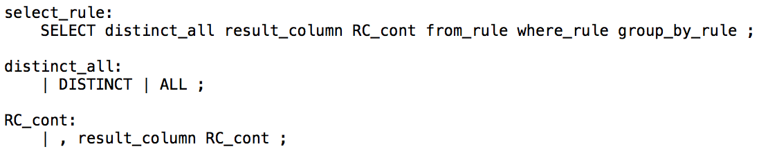
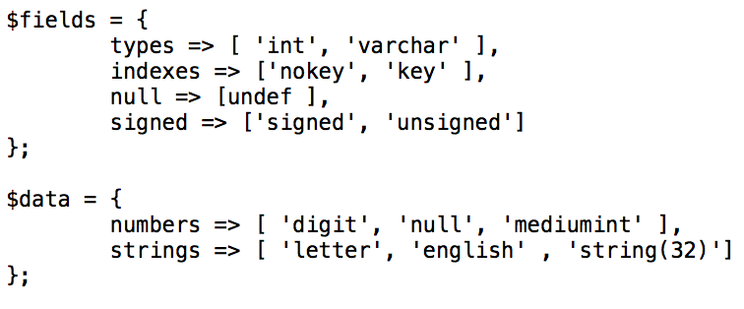
Generating Random Queries and Data
The Random Query Generator tool generates queries based on a grammar file given as input:
It also generates randomized database tables based on a configuration file given as input:
snippet of grammar defining SQLite syntax
snippet of schema configuration

Slide 6
Finding Database Invariants
There are many different ways to find predicates that are always true/false
Possible ideas:
Comparison to the min/max of a column
Checking if a cell in column X is also in a subquery that returns column X
Comparison to the sum of a column

Slide 7
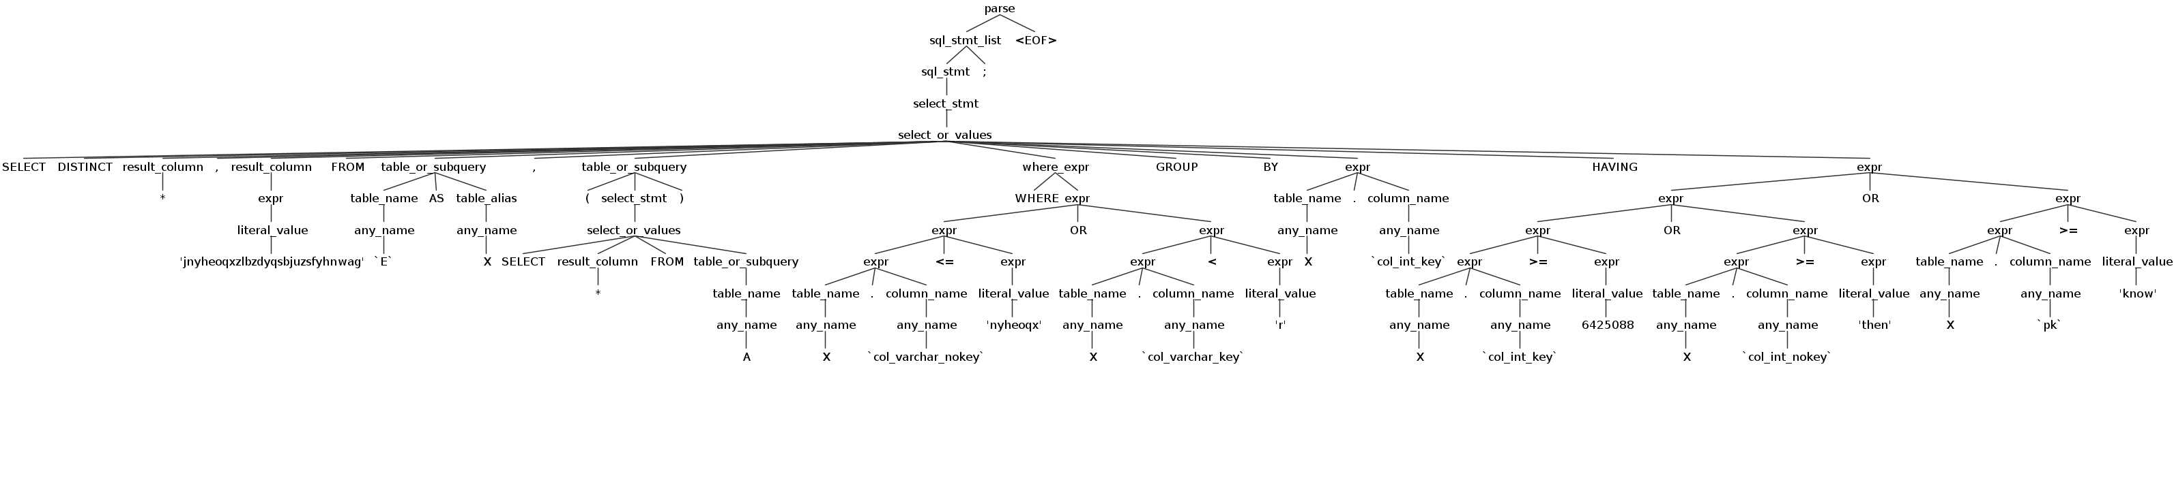
Query Transformation
We use ANTLR, a tool that generates for our SQLite grammar file.
Antlr generates a parse tree, which we can then traverse to both retrieve information about the query and insert additional tokens.
We go to the node that covers the table used in the query, using that to generate an appropriate invariant.
Then we go to the node for where_expr and insert our invariant there.

Slide 8
Evaluation
We ran the program for 2000 queries so far
Record:
original query
transformed query
Comparison
error messages
Transformations are simple for now: 3 true invariants ANDed to the where clause.
Over 400 (~20%) queries produced different outputs.
Further investigation will be needed to determine which queries are the result of bugs in SQLite.

Slide 9
Future Work
Process queries with different outputs
Determine if there is a bug within our scripts
Reduce query to get minimal test case that reveals bug.
See if bug is new
Automate this process as much as possible
Implement more sophisticated ways to transform queries
Mix AND and OR operands
Compare to result of an aggregate subquery
Use a membership condition (also involves subqueries)
Transform JOIN clause in addition to WHERE

Slide 10
The End
Questions?

