Slide 1
Recipezy
Team members: Ben Mitchell, Xiupeng Cui

Slide 2
Why do we want to develop Recipezy?
Recipes being shared over social media has become a big thing, however they are not formatted in a way that are easy to follow. This app aims to allow influencers to share their recipes with followers in an easily accessible way.

Slide 3
Why is Recipezy “Novel”?
Allow influencers to share their recipes with followers in an easily accessible way.
Be able to save or favourite certain recipes, which will allow users to access these easily from their profile page on the app.
Be able to create a weekly shopping list, which users will be able to add ingredients from any recipes that they have saved or are currently viewing.
Be able to create a weekly meal planner and assign recipes to days of the weeks so users are able to keep track of what they are eating in an easy way.
Be able to search through the recipes that are hosted on the app. Filters will be available like search by name, category, dietary restrictions etc.

Slide 4
What other features does it have?
Multiple User Types: These user types are admin, verified user and regular user. The admin user will serve as a way to manage back end functions, such as removing users, recipes and maintaining integrity of the site for the other users. The verified users are able to add recipes which will become available for the regular users. The regular users will be able to follow verified users and access the recipes that are shared.
Rich interface elements: To meet users' demands for recipes, the app provides rich interface elements and features.

Slide 5
Potential Issues
Follow Feature: Have never worked with a system for following users and displaying content based on that so could be a potential issue.
Meal Planner: Have not worked with calendar system so this could prove to be difficult.

Slide 6
Time sheets of development
Task | Planned Completion Date | Actual Completion Date
Proposal | 27/09/2023 | 03/10/2023(change project)
Design | 12/10/2023 | 10/10/2023
Implementation | 29/10/2023 | 31/10/2023
Testing and Documentation | 30/10/2023 | 01/11/2023

Slide 7
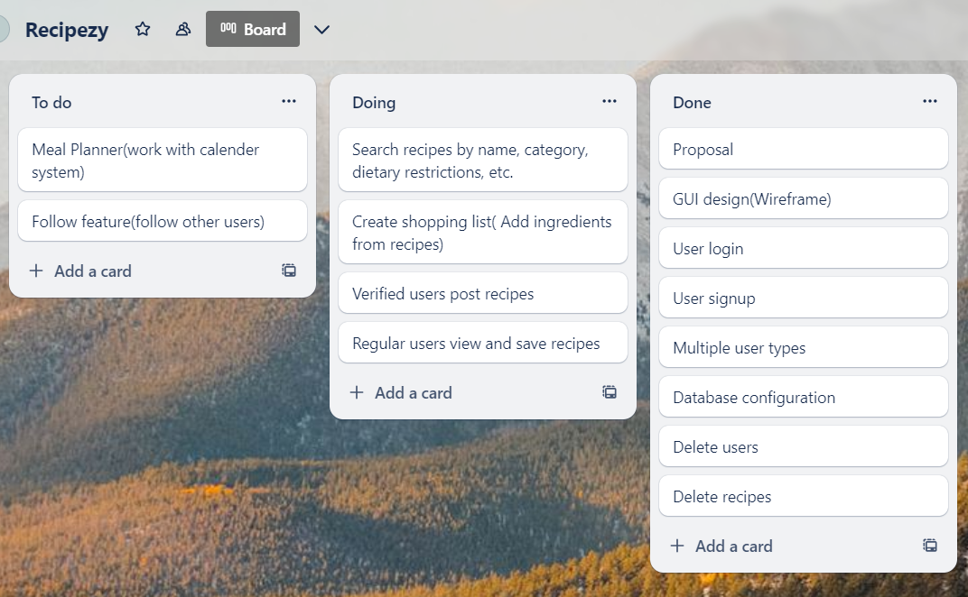
Use of Trello(project management)

Slide 8
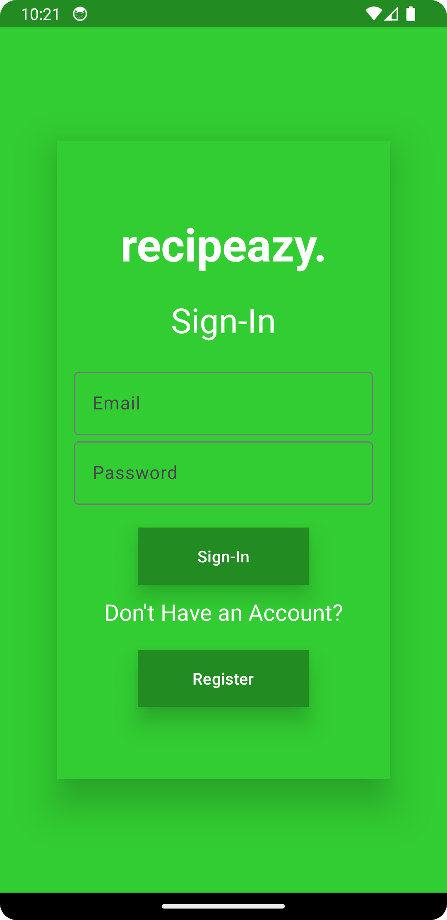

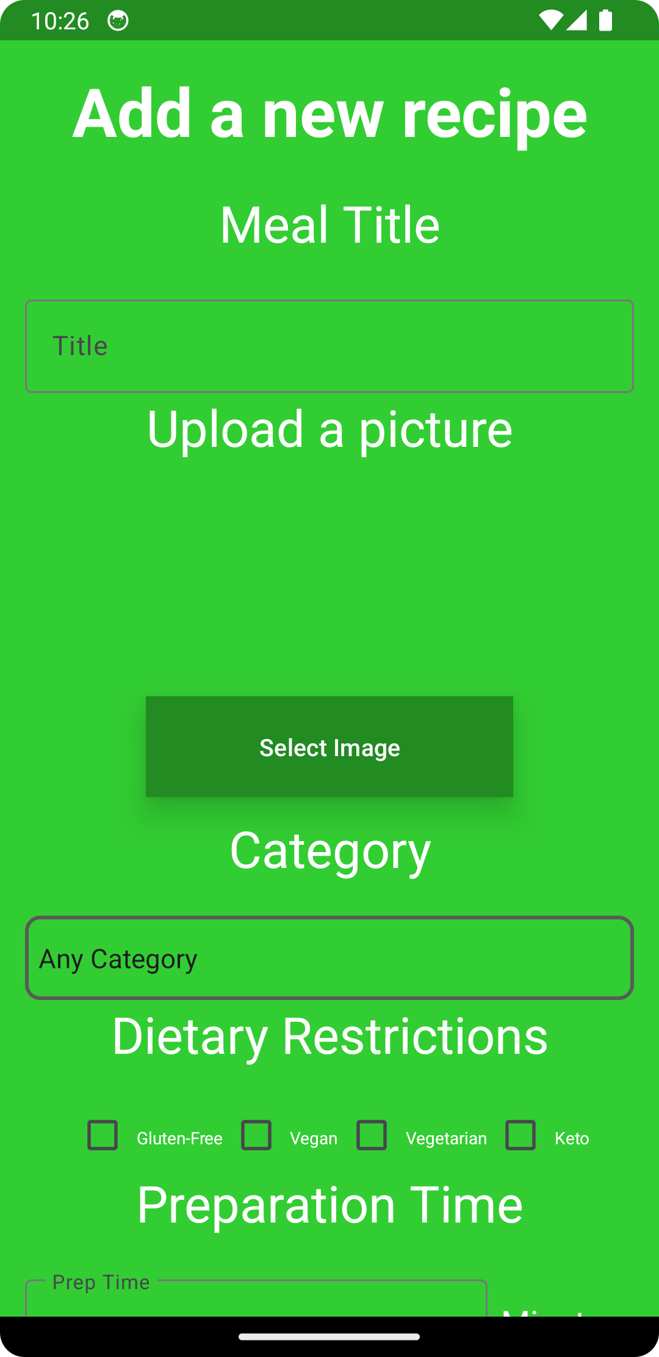
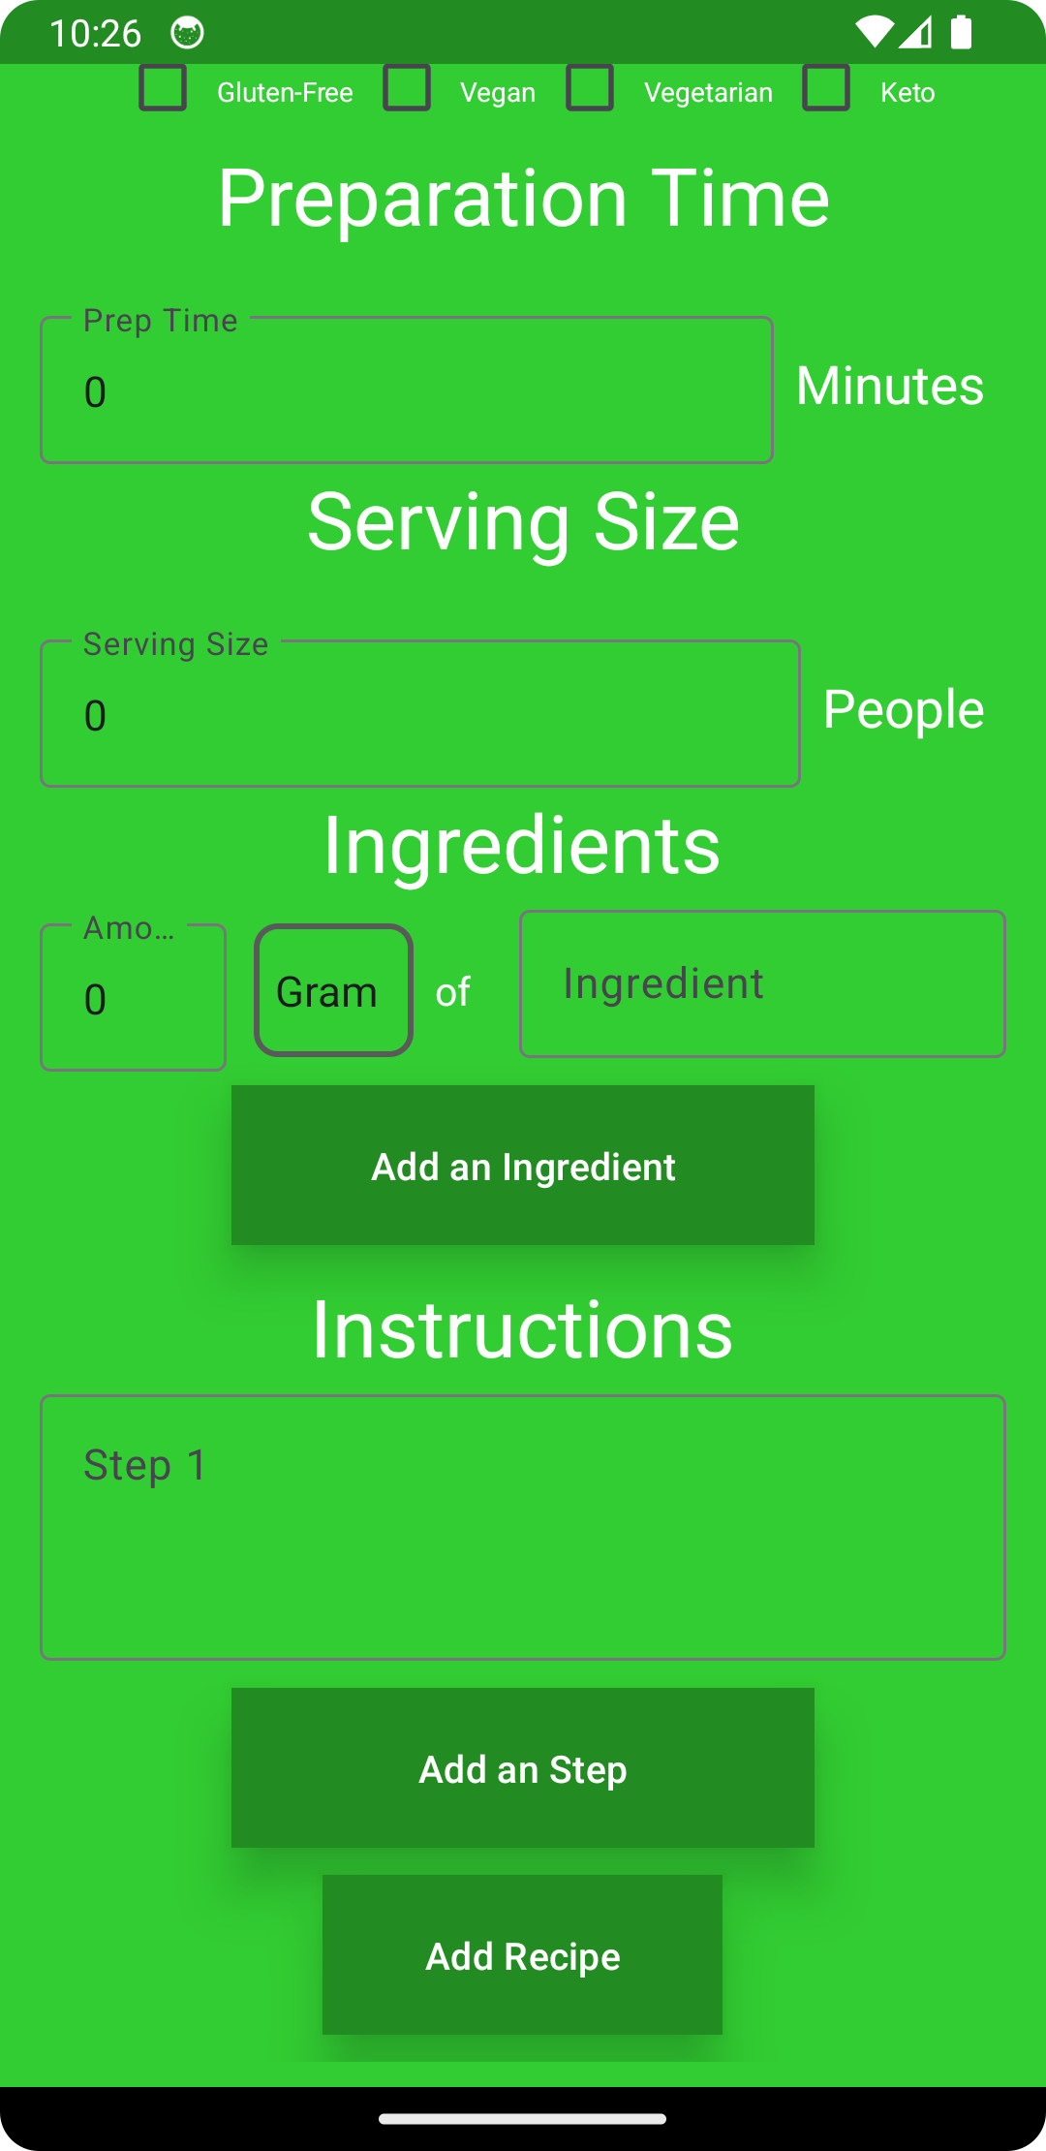
Final software product

Slide 9
Team reflection
In the actual development process, we will encounter more challenges than we initially expected.
Unforeseen difficulties can be obstacles to development, but they also present opportunities to enhance our skills.
Team collaboration and communication are essential for the successful development of a project.

