Slide 1


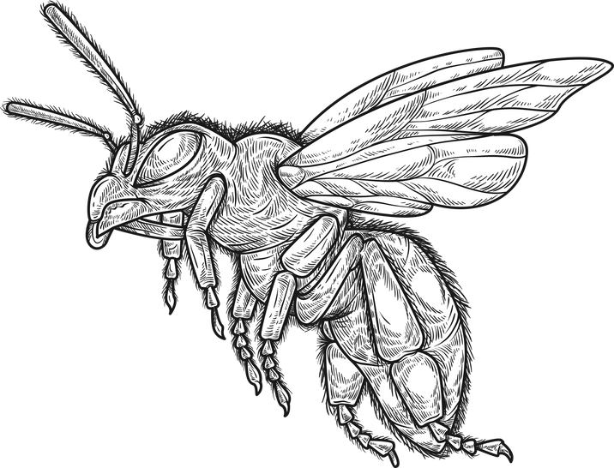
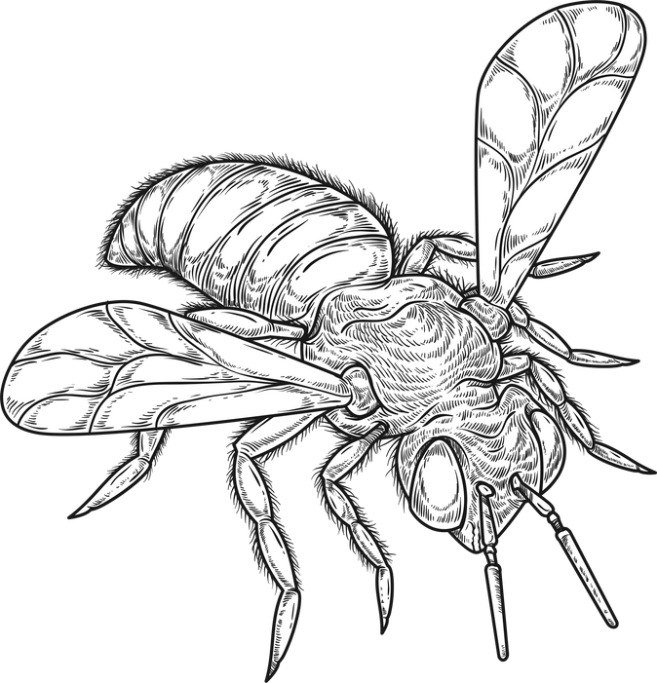


Pollen & Bee Eater Detection

Slide 2

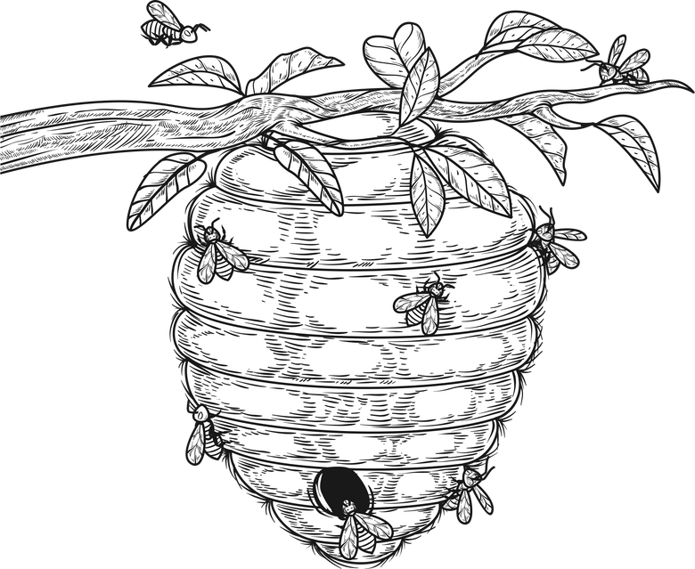

Objectives
Pollen detection
Computer vision
European Bee Eater Detection
Voice recognition

Slide 3
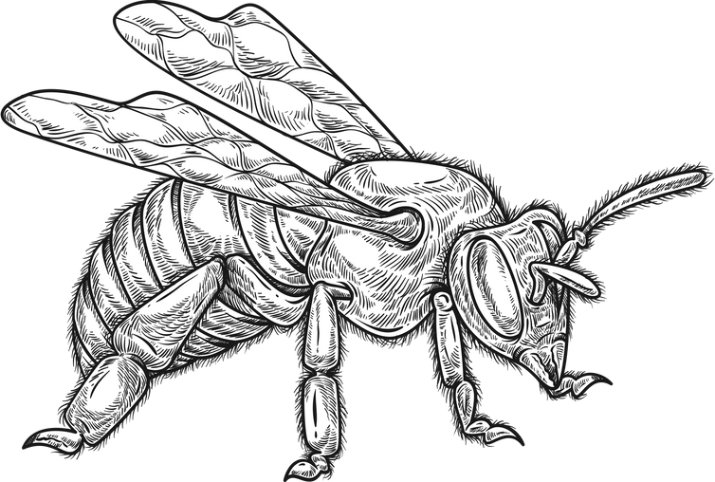
CNN

Slide 4


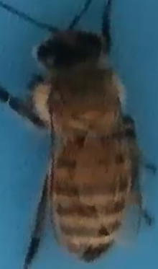
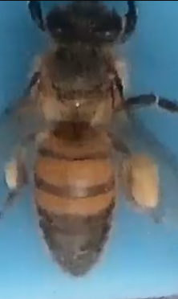


CNN
Data collection
Source
Dataset:
Kaggle
Images + annotation
385 Bees with pollen
387 Bees without pollen
Merge
Dataset
Merging between 2 datasets
Size: 772 images
Balanced Data

Slide 5

CNN
Data Preprocessing
Data split
Train, Validation, Test data
Rotation
Random rotation of the image
Channel shift range
Adjust the desired intensity of yellow
Data
augmentation
Brightness Range
Adjust the brightness within a specified range
Horizontal & vertical flipping
Randomly flip the image vertically and horizontally

Slide 6


CNN
Data Training
1
CNN architecture:
Input shape=(224, 224, 3)
2 convolutional layers
2 Max pooling layers
Global average pooling
Feature extraction
2
Binary classification
Activation function
Two Relu dense layer
Final Sigmoid dense layer
3
Callbacks
Model training in 100 epochs and stops after 5 epochs if the val_loss is not improving

Slide 7


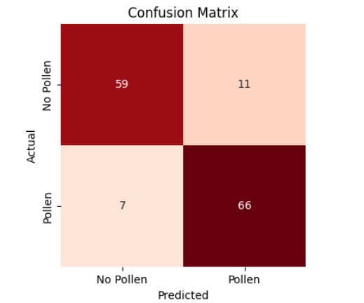
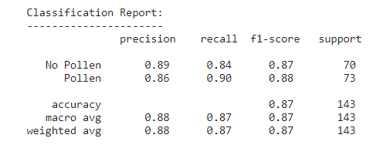
CNN
Data Testing
Accuracy
Classification report
87%
Confusion Matrix

Slide 8
LSTM

Slide 9





LSTM
Data Loading
Research
Most known birds in Tunisia
Dataset
Audios + Annotation
Data Scrapping
Species
xeno-canto
Website dedicated to sharing wildlife sounds from all over the world
4 species
500 Eurasian Hoopoe,
500 European Bee-eater,
500 Sardinian Warbler,
500 Crested Lark
Size
2000 audios
- balanced
Annotation
File_name, path, Duration

Slide 10



LSTM
Data Preprocessing
01
02
03
04
Conversion
Data Splitting
Length Normalization
MFCC
Feature Extraction
Converting MP3 audios into WAV to fit the LSTM requirements
Train
Test
Valid
Trimming or Padding the audios to normalize the length to 20s
Extract relevant features from audio signals

Slide 11
LSTM
Data Training
1
Binary classification
one layer each of Batch Normalization, Dropout, Bidirectional LSTM, and Dense.
European Bee Eater
Not an European Bee Eater
2
Binary classification
3
Fine tuning
We used the preprocessed data to fine tune our Yamnet model

Slide 12
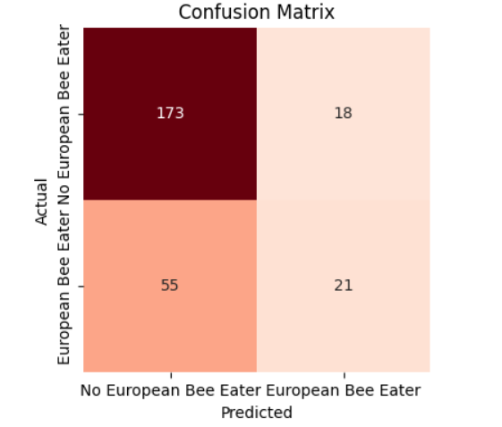
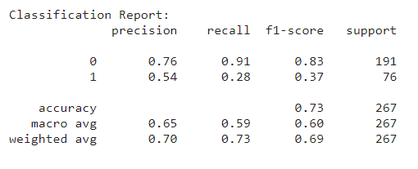
LSTM
Data Testing
Accuracy
Classification report
72,65%
Confusion Matrix

