Slide 1
Visual Object Recognition
Fruits-360 Dataset
By: Melinda Bennett

Slide 2
OBjective
Create a convolutional neural network to correctly identify images of fruits
Apply transfer learning to improve the accuracy of the CNN model
Kaggle: https://www.kaggle.com/moltean/fruits

Slide 3
Dataset properties
Total number of images: 75937
Training set size: 56781 images
Test set size: 19053 images
Number of classes: 111
Image size: 100x100 pixels.
Paper:
Muresan, H., Oltean, M.(2018) Fruit recognition from images using deep learning, Acta Univ. Sapientiae, Informatica Vol. 10, Issue 1, pp. 26-42.

Slide 4
Why Fruits?
Fruits are a common product in stores.
An autonomous robot that can complete complex tasks in stores.
Aisle inspections to correctly identify understocked shelves or out of place products.
Fruits chosen were hard to differentiate
Ex. There are 13 different varieties of apples: Apple Braeburn, Apple Crimson Snow, Apple Golden 1, Apple Golden 2, Apple Golden 3, Apple Granny Smith, Apple Pink Lady, Apple Red 1, Apple Red 2, Apple Red 3, Apple Red Delicious, Apple Red Yellow 1, Apple Red Yellow 2

Slide 5
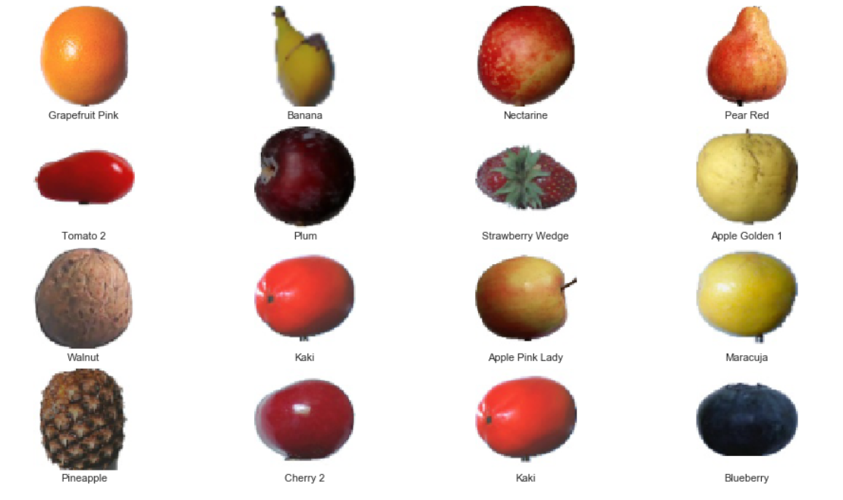
Snapshot of the Data

Slide 6
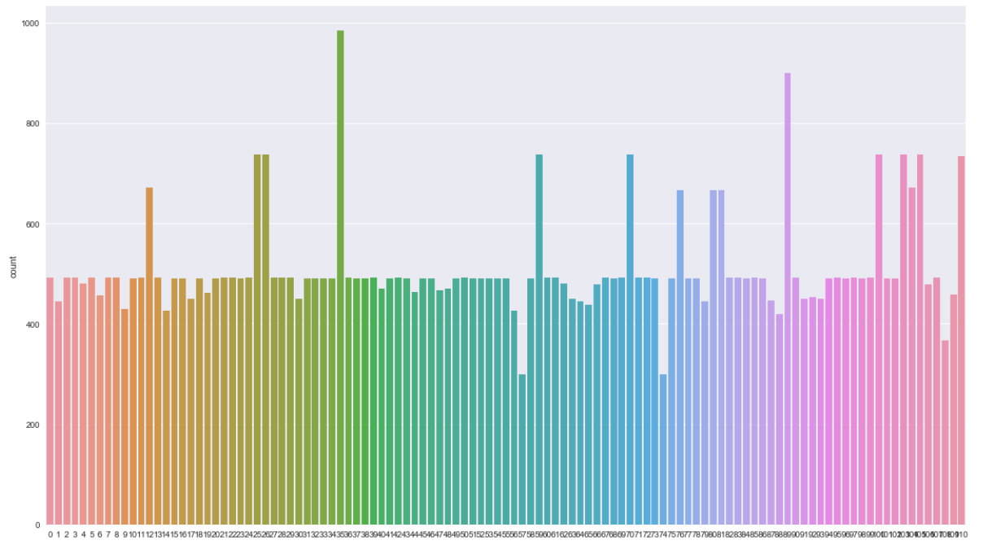
Training Set

Slide 7
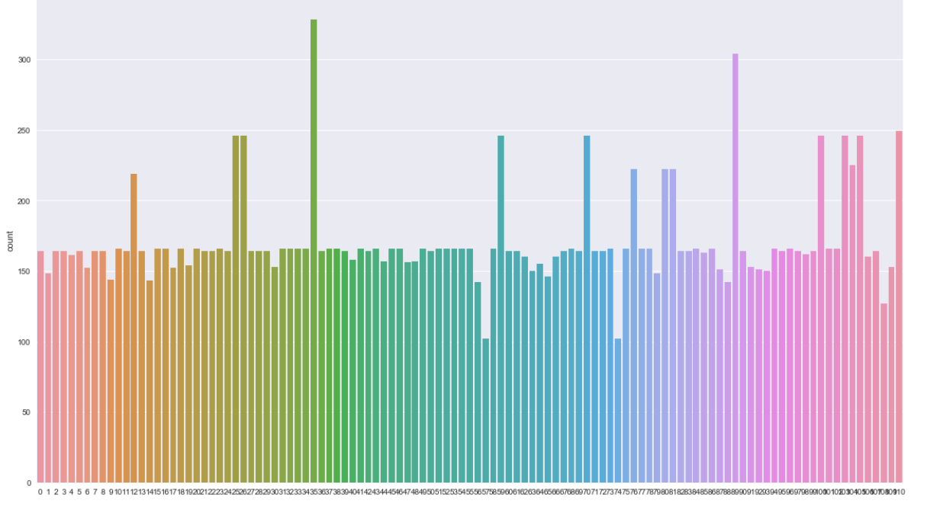
Test Set

Slide 8
CNN Model
Layer Type | Dimensions | Output
Convolutional -1 | 5 x 5 x 4 | 16
Max Pooling - 1 | 2 x 2 -- Stride: 2 | -
Convolutional - 2 | 5 x 5 x 16 | 32
Max Pooling – 2 | 2 x 2 -- Stride: 2 | -
Convolutional - 3 | 5 x 5 x 32 | 64
Max Pooling – 3 | 2 x 2 -- Stride: 2
Convolutional - 4 | 5 x 5 x 64 | 128
Max Pooling - 4 | 2 x 2 -- Stride: 2
Flatten |  | 512
Fully Connected 1 | - | 512
Fully Connected 2 | - | 256
Output | - | 111

Slide 9
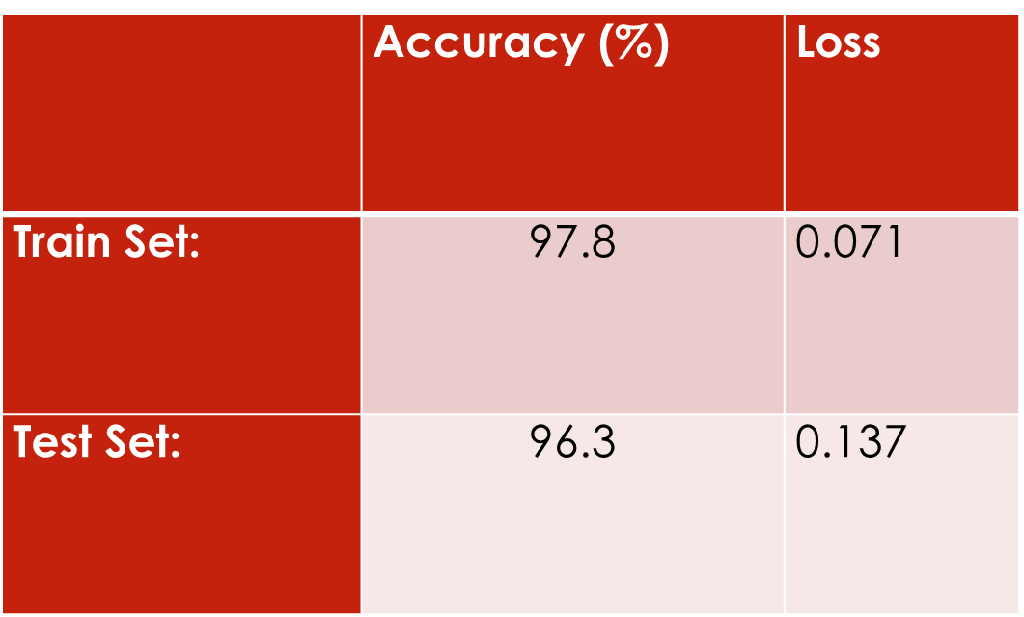
Results

Slide 10
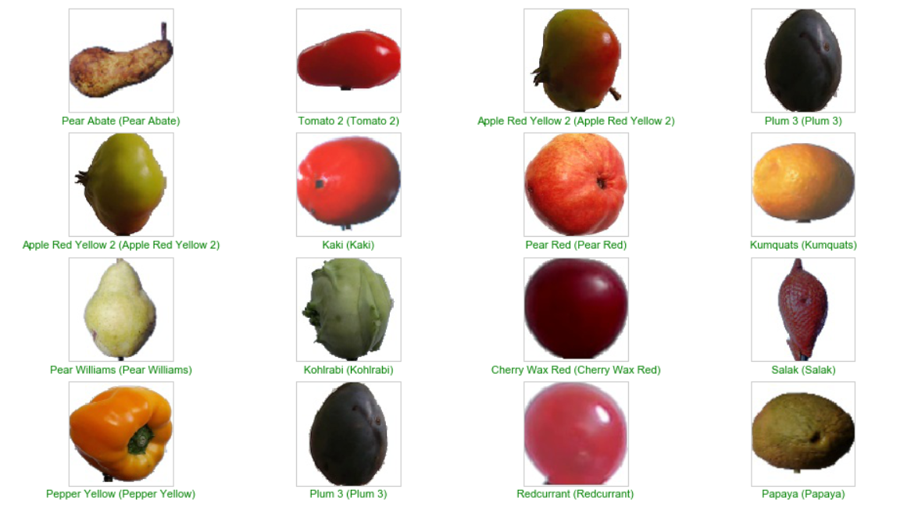

Slide 11
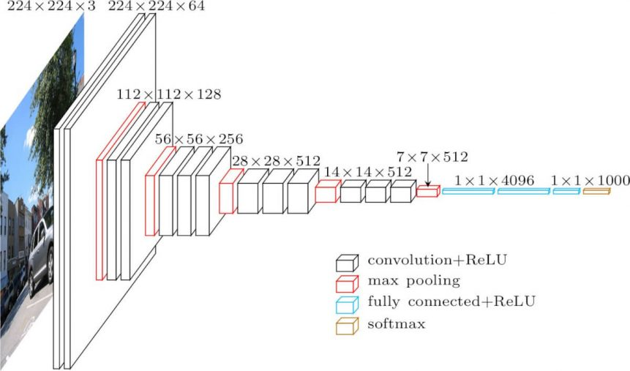
Transfer Learning with VGG16
Retrieved from: https://neurohive.io/en/popular-networks/vgg16/

Slide 12
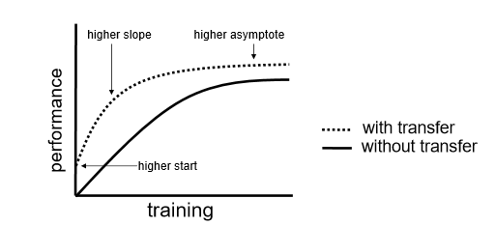
Benefits of Transfer Learning
Retrieved From: http://ftp.cs.wisc.edu/machine-learning/shavlik-group/torrey.handbook09.pdf

Slide 13
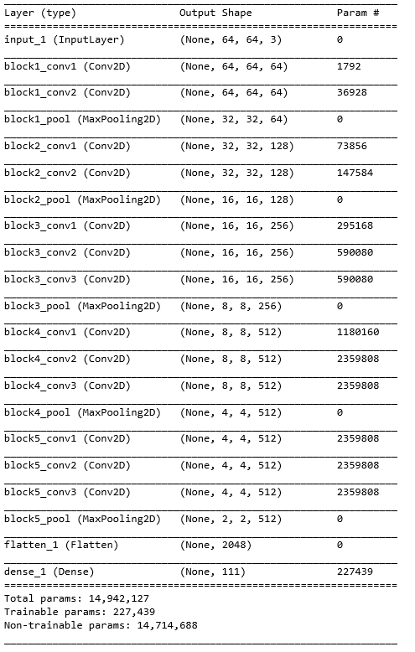
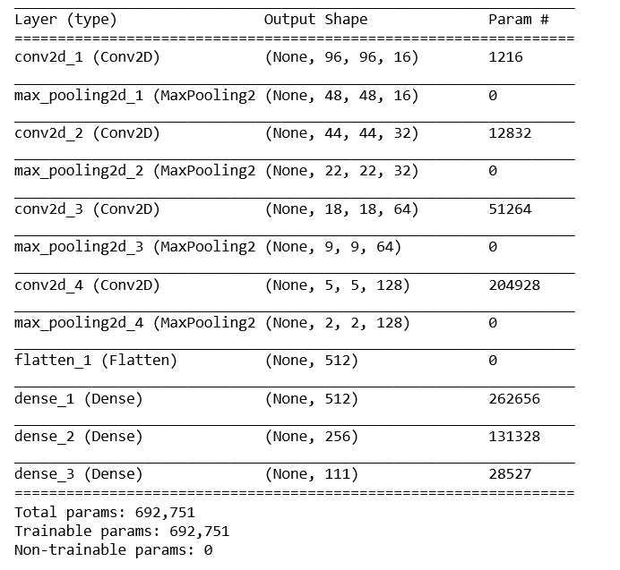
VGG16 Model
CNN Model

Slide 14
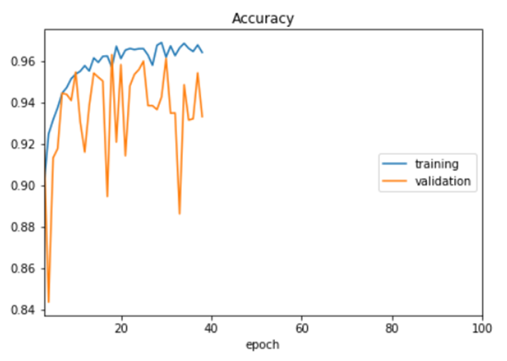
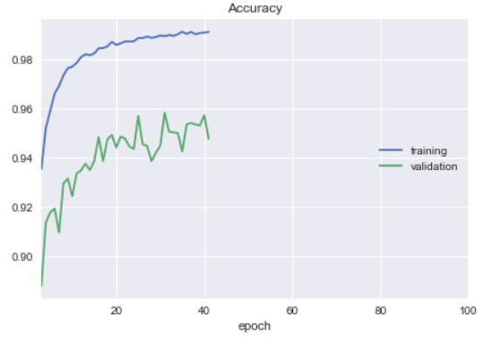
Accuracy Plots
CNN From Scratch
Transfer Learning

Slide 15
Results
CNN From Scratch
Transfer Learning with VGG16
Time to Early Stopping ~ 12 hours
Time to Early Stopping ~ 20 hours
Epochs = 38
Epochs = 41
 | Accuracy (%) | Loss
Train Set: | 97.8 | 0.072
Test Set: | 96.3 | 0.137
 | Accuracy (%) | Loss
Train Set: | 99.1 | 0.033
Test Set: | 95.8 | 0.140

Slide 16

Questions
This Photo by Unknown Author is licensed under CC BY-SA

