Slide 1
Firewall
Bennett Yardley, Casey Borror, Khristian Samuel,

Slide 2
Overview: What’s the Problem?
Firewall
Vulnerabilities
Viruses

Slide 3
Firewall Background
What is a Firewall?
A choke point of control and monitoring
Interconnects networks with differing trust
Imposes restrictions on network services
only authorized traffic is allowed
Auditing and controlling access
can implement alarms for abnormal behavior
Itself immune to penetration
Provides perimeter defence

Slide 4
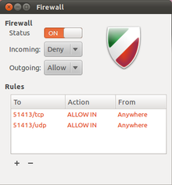
Classification of Firewall
Characterized by protocol level it controls, - Packet filtering - Circuit gateways - Application gateways Combination of above is dynamic packet filter

Slide 5
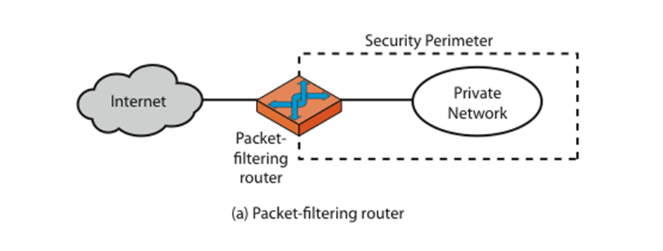
Firewall - Packet Filters

Slide 6
Firewall - Packet Filters
Simplest of components Uses transport-layer information only - IP Source Address, Destination Address - Protocol/Next Header (TCP, UDP, ICMP, etc) - TCP or UDP source & destination ports - TCP Flags (SYN, ACK, FIN, RST, PSH, etc) Examples - DNS uses port 53 - No incoming port 53 packets except known trusted servers
- Entire Subnet

Slide 7
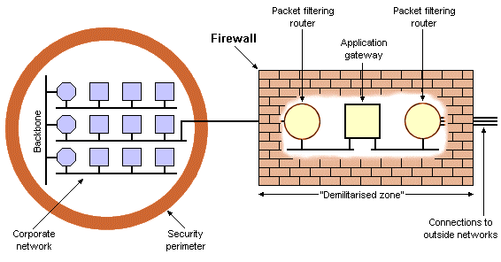
Usage of Packet Filters
Filtering with incoming or outgoing interfaces - E.g., Ingress filtering of spoofed IPs Permits or denies certain services - Requires intimate knowledge of TCP and UDP port utilization on a number
of operating systems

Slide 8

How to Configure a Packet Filter
Start with a security policy
Specify allowable packets in terms of logical expressions on packet fields
General rules - least privilege - All that is not expressly permitted is prohibited - If you do not need it, eliminate it

Slide 9
IPTables Background
•Packet inspection.
The firewall keeps track of each connection passing through it, This is an important feature in the support of active FTP.
•Filtering packets based on a MAC address IPv4 / IPv6
Very important in WLANs and similar environments.
•Filtering packets based the values of the flags in the TCP header
Helpful in preventing attacks using malformed packets and in restricting access.
•Network address translation and Port translation (NAT)
Building DMZ and more flexible NAT environments to increase security.

Slide 10
IPTables Background Continued
•Source and stateful routing and failover functions
Route traffic more efficient and faster than regular IP routers.
•System logging of network activities
Provides the option of adjusting the level of detail of the reporting
•A rate limiting feature
Helps to block some types of denial of service (DoS) attacks.
•Packet manipulation to the bits of the IP header

Slide 11
Starting IPTables
•You can start, stop, and restart iptables after booting by using the commands:
–Starting IPtables
service iptables start
–Stopping IPtables
service iptables stop
–Restarting IPtables
service iptables restart
–Checking IPtables status (rule chains)
service iptables status

Slide 12
Starting IPTables Continued
•To get iptables configured to start at boot, use the chkconfig command:
chkconfig iptables on
•iptables itself is a command which we will see soon.
•To show all current rule chains:
iptables –-list
•To drop all current rule chains:
iptables –-flush

Slide 13
Packet Processing in IPTables
•IPtables is complex for the beginner.
•Three built in tables (queues) for processing:
1. MANGLE: manipulate QoS bits in TCP header
2. FILTER: packet filtering, has three built in chains (your firewall policy rules)
Forward chain: filters packets to servers protected by firewall
Input chain: filters packets destined for the firewall
Output chain: filters packets originating from the firewall
3. NAT: network address translation, has two built in chains
Pre-routing: NAT packets when destination address need changes
Post-routing: NAT packets when source address need changes

Slide 14
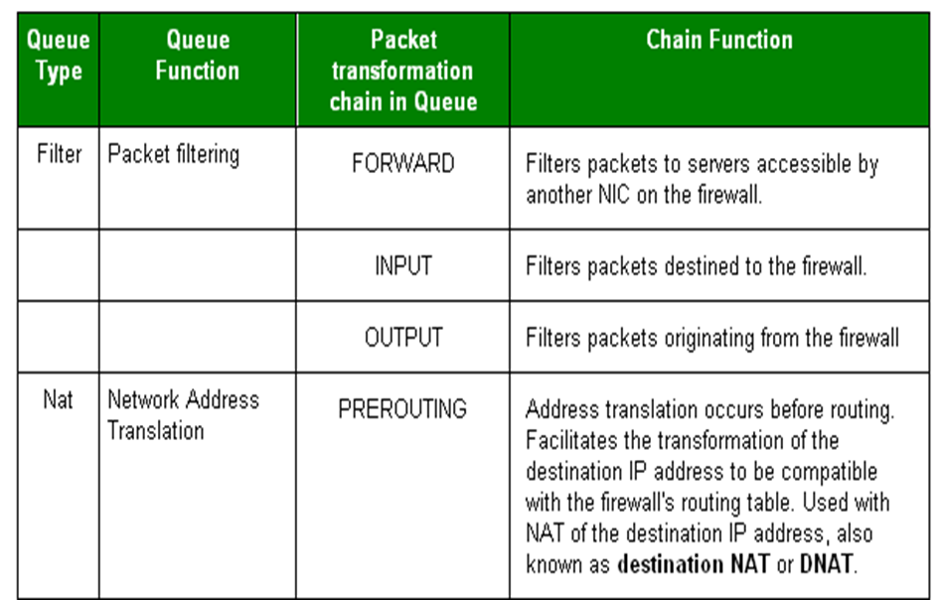
Processing for Packets Routed by the Firewall

Slide 15
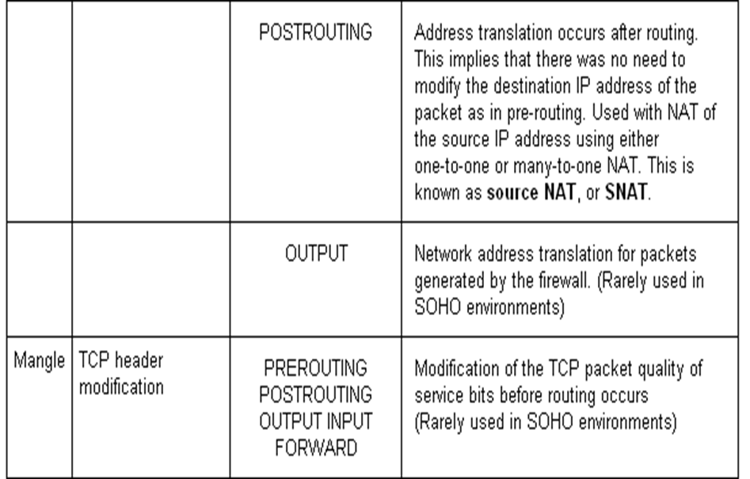
Processing for Packets Routed by the Firewall

Slide 16
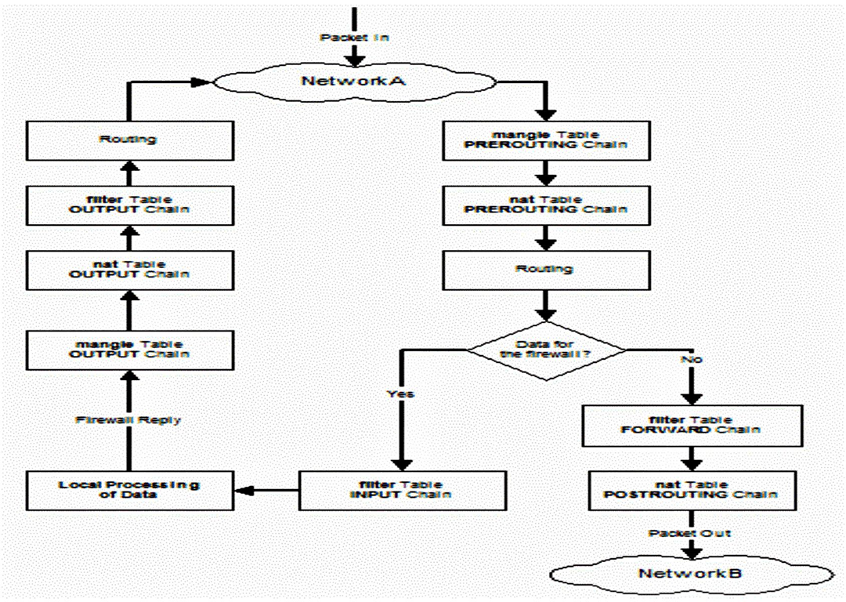

Slide 17
Vulnerabilities Background
Three parts
A system flaw
Access to the flaw
Exploitation of the flaw
Tools and Software are available for patching or attacking vulnerabilities

Slide 18
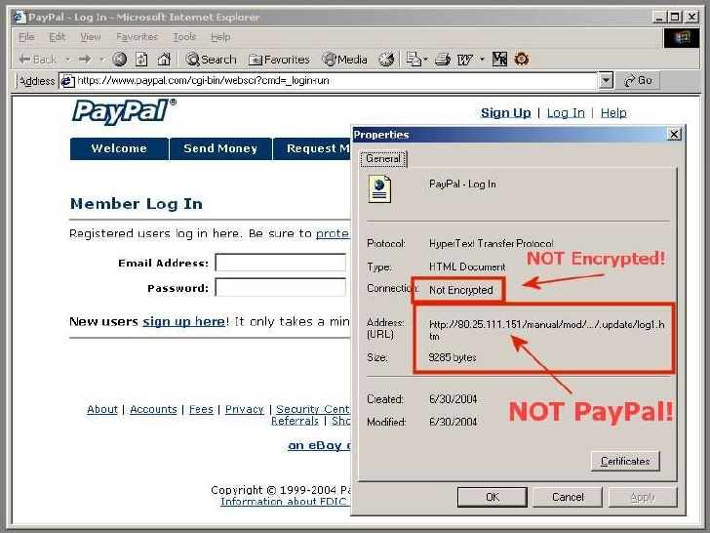
URL Spoofing
One website poses as another
Attacker is able to redirect you to his private IP instead of the intended site
Fixes: Common Sense If it looks strange it's bad Key based exchange between machines Removes the possibility of private IP Addresses

Slide 19
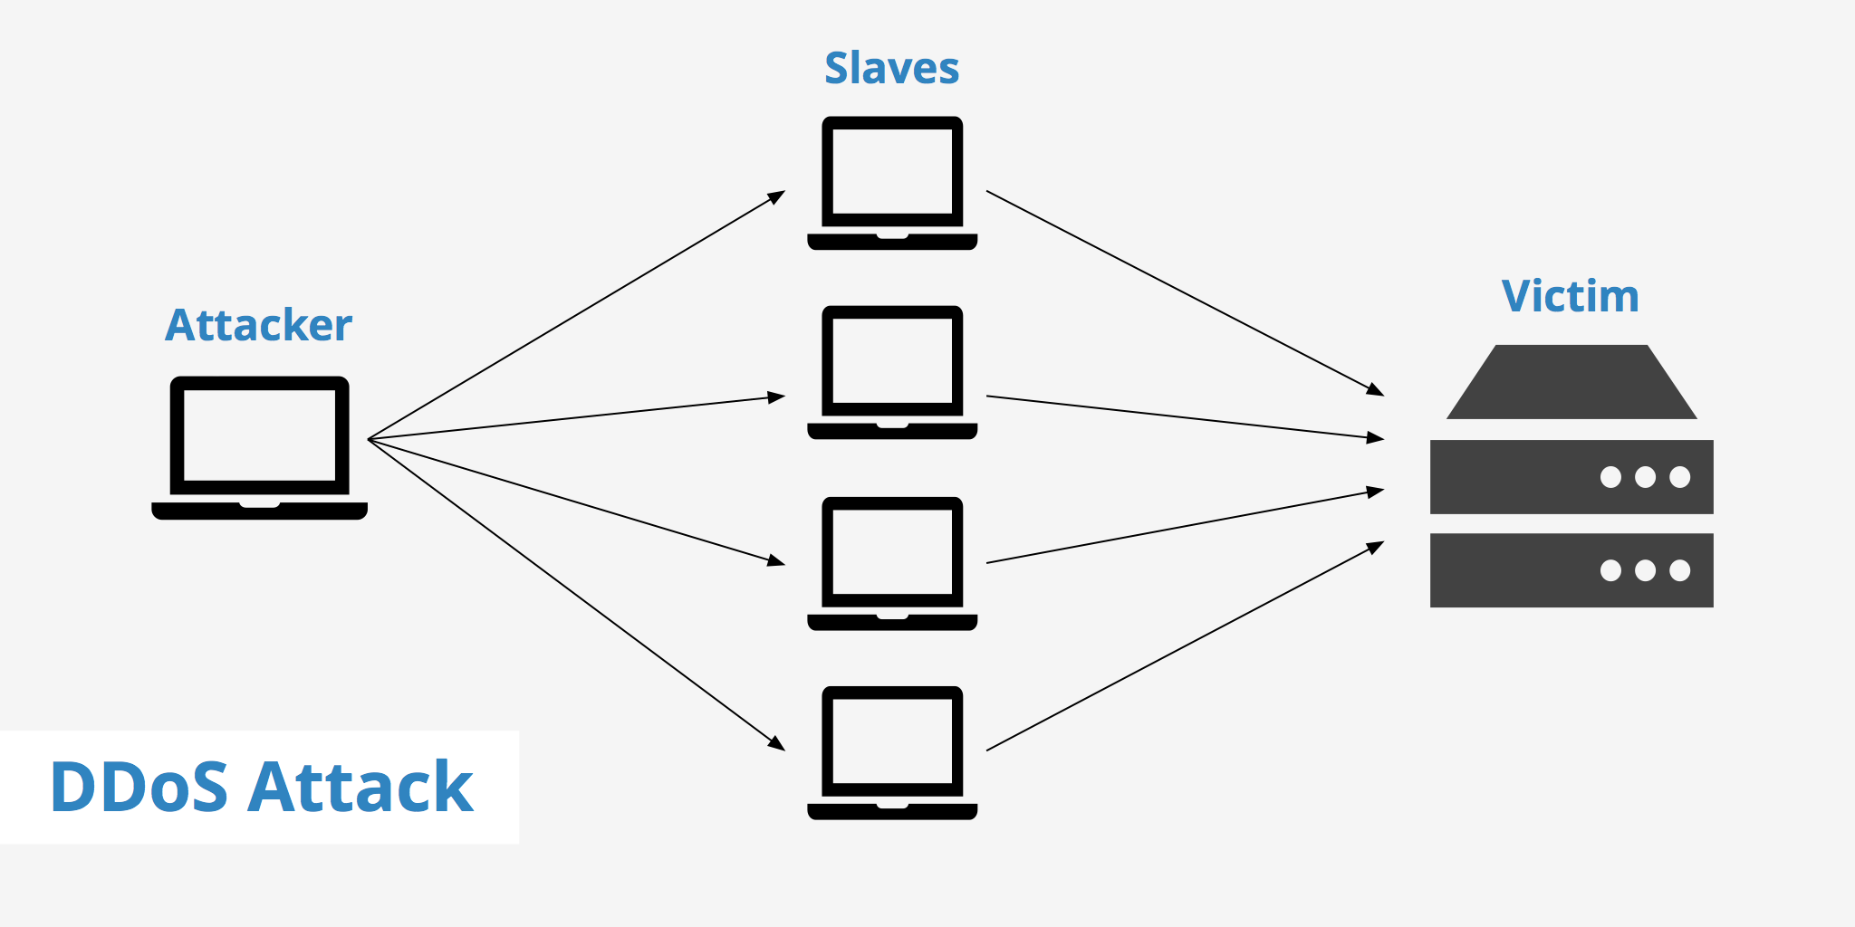
DOS Attack
Flooding a targeted machine with requests to overload it
Attacker uses various techniques to make the server perform tasks repetitively Attacker sends a lot of small tasks Attacker sends a small amount of large tasks
Fixes: Find the source of the traffic and block it Have supplementary servers to take care of additional traffic (how cloudfare works)

Slide 20
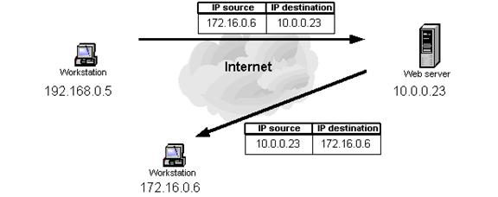
IP Address Spoofing
Creating a false IP address to send a person to another system
Attacker is able to change a packet to make the network think it came from a different IP address
Fixes: Packet filtering Block harmful packets from outside networks

Slide 21
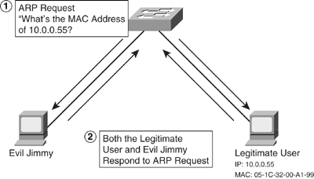
MAC Address Spoofing
Changing a Media Access Control address of a networking interface/device
Offensive: Attacker changes his own MAC address to the same as another on the network in order to make the other systems think he is the real system (ARP Spoofing) Defensive: Attacker changes his own MAC address to hide his identity
Fixes: Determining strength of signal and if it randomly jumps Preventing ARP Spoofing

Slide 22
Vulnerabilities Implementation
Created DOS protection scripts
Look for heavy use of traffic and block it
iptables -A INPUT -p tcp -m connlimit --connlimit-above 60 -j REJECT --reject-with tcp-reset
iptables -A INPUT -p tcp -m conntrack --ctstate NEW -m limit --limit 60/s --limit-burst 20 -j ACCEPT
iptables -A INPUT -p tcp -m conntrack --ctstate NEW -j DROP
Limits at 60 packets per second and if it goes above it drops it
Blocks all invalid/not established traffic
iptables -t mangle -A PREROUTING -m conntrack --ctstate INVALID -j DROP
iptables -A INPUT -m state --state INVALID -j DROP
iptables -A FORWARD -m state --state INVALID -j DROP
iptables -A OUTPUT -m state --state INVALID -j DROP
Blocks ping attempts
iptables -t mangle -A PREROUTING -p icmp -j DROP

Slide 23
Vulnerabilities Implementation PT. 2
Spoofing protection rules (Block spoofed packets coming from a private IP)
iptables -A INPUT -s 10.0.0.0/8 -j DROP
iptables -A INPUT -s 169.254.0.0/16 -j DROP
iptables -A INPUT -s 172.16.0.0/12 -j DROP
iptables -A INPUT -s 127.0.0.0/8 -j DROP
iptables -A INPUT -s 224.0.0.0/4 -j DROP
iptables -A INPUT -d 224.0.0.0/4 -j DROP
iptables -A INPUT -s 240.0.0.0/5 -j DROP
iptables -A INPUT -d 240.0.0.0/5 -j DROP
iptables -A INPUT -s 0.0.0.0/8 -j DROP
iptables -A INPUT -d 0.0.0.0/8 -j DROP
iptables -A INPUT -d 239.255.255.0/24 -j DROP
iptables -A INPUT -d 255.255.255.255 -j DROP
SSH Brute force protection rules (Bennett has an interesting log over 6 days with 110000+ brute force attempts if you want to see)
iptables -A INPUT -p tcp --dport ssh -m conntrack --ctstate NEW -m recent --set
iptables -A INPUT -p tcp --dport ssh -m conntrack --ctstate NEW -m recent --update --seconds 60 --hitcount 10 -j DROP

Slide 24
Vulnerabilities Implementation PT. 3
ARP Spoofing Protection (using ARPTables by blocking all ARP requests that are not from router)
arptables -P INPUT DROP
arp -n
Get the MAC address of router (typically the first) -> MACADDRESS
arptables -A INPUT --source-mac MACADDRESS -j ACCEPT

Slide 25
Virus Scanner Background
Anti-malware software, is computer software used to prevent, detect and remove malicious software. Antivirus software was originally developed to detect and remove computer viruses. Antivirus programs also scan other types of files that can contain viruses. For example, a .zip archive file may contain compressed viruses, or a Word document can contain a malicious macro.

Slide 26
Different Types of Viruses
1. Resident Viruses - A permanent virus that which dwells in the RAM memory. From there it can overcome and interrupt all of the operations executed by the system
2. Multipartite Viruses - Viruses that are distributed through infected media and usually hide in the memory. Gradually, the virus moves to the boot sector of the hard drive and infects executable files on the hard drive
3. Direct Action Viruses - This Virus replicates programs and take action when executed When a specific condition is met, the virus will go into action and infect files in the directory or folder that it is in and in directories that are specified in the AUTOEXEC.BAT file PATH.

Slide 27
Different Types of Viruses pt. 2
4. Overwrite Viruses - Virus of this kind is characterized by the fact that it deletes the information contained in the files that it infects, rendering them partially or totally useless once they have been infected.
5. Boot Virus - A type of virus that affects the boot sector of a floppy or hard disk, a crucial part of a disk, in which information on the disk itself is stored together with a program that makes it possible to boot (start) the computer from the disk.
6. Macro Virus - A virus that infect files that are created using certain applications or programs that contain macros. These mini-programs make it possible to automate series of operations so that they are performed as a single action, thereby saving the user from having to carry them out one by one.

Slide 28
Viruses continued
7. Directory Virus - A virus that changes the paths that indicates location of files By executing a program (file with the extension .EXE or .COM) which has been infected by a virus, you are unknowingly running the virus program, while the original file and program have been previously moved by the virus.
8. Polymorphic Virus - A virus that encrypt or encode themselves in a different way (using different algorithms and encryption keys) every time they infect a system.
9. File Infectors - This type of virus infects programs or executable files (files with an .EXE or .COM extension). When one of these programs is run, directly or indirectly, the virus is activated, producing the damaging effects it is programmed to carry out.

Slide 29
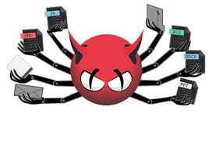
Clamav
Clamav is an open source antivirus engine used in a variety of ways that include: an email scanner, web scanning, and endpoint security. It provides a number of utilities including a command line scanner and an advanced tool for automatic database updates.

Slide 30
What our Virus Scanner is:
Our virus scanner is based on the Linux based virus scanner: Clamav. Clamav allows the user to configure its rules, schedule scans and scan specific directories.
By making a bash script, we have automated the following upon boot:
1. Checks for Version number, an update if needed
2. Updating the virus definitions if needed
3. A scan of all directories and then placing the infected files in its own directory and deleting them if necessary
4. Setting a time for the next scan on the next day

Slide 31
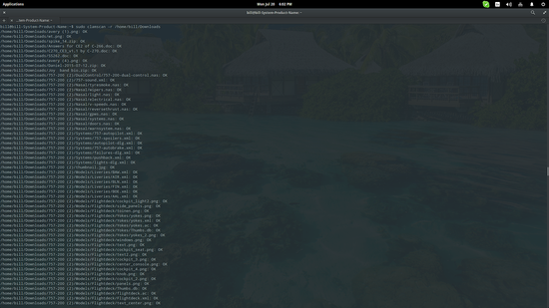
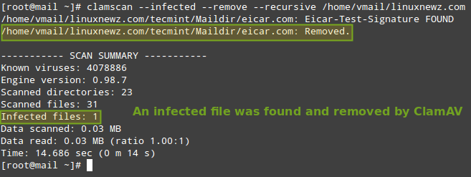
Virus Scanner Implementation

Slide 32
Program Demo

Slide 33
Future Improvements
GUI (Better looking CLI or UI)
Add additional methods for encrypting and verifying network traffic between a computer and the router.
Make it usable across an entire network of computers
Server capabilities for assigning static ips and acting as a host
Add an API to give the end user a better understanding of how to use the program

Slide 34
Thank You!
Questions?
Comments?
Concerns?

