Slide 1
Privacy by Design

Slide 2
Overview
Definitions
Security-Frameworks for Java
Spring Security
Field-Level Security

Slide 3
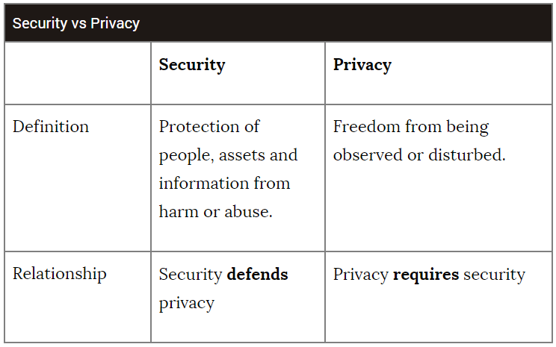
Definitions
“Privacy by design calls for privacy to be taken into account throughout the whole engineering process.”
Authentication: Who are you?
Authorization: What are you allowed to do? (Access Control)

Slide 4
Security-Frameworks (for Java)
JAAS (Java Authentication and Authorization Services)
Apache Shiro: Authentication, Authorization, Cryptography, similar to Spring Security
HDIV: Security Testing and Monitoring
OACC: Fully implemented data store to handle security model
KeyCloak: Identity and Access Management solution, SSO, bole-based authorization, fine-grained authorization with custom policies
Spring Security

Slide 5
Spring Security
De-facto standard for securing Spring-based applications
Powerful and highly customizable
Separation of authentication and authorization

Slide 6
Spring Security - Authentication
Authentication information is bind to threads
Spring does not mind how the Authentication is put in the SecurityContexHolder
Authentication auth = SecurityContextHolder.getContext().getAuthentication()
{
authenticated: true,
authorities: [„ROLE_USER“] //instance of GrantedAuthority
principal:{ //Usually instance of UserDetails
username: „user“
password: „password“
...
}
...
}
Notes:
Rather common to query the Authentication like that
For most applications the principal is an instance of UserDetails. UserDetails is a core interface. UserDetails is like an adapter to your own user database
SimpleGrantedAuthority = String only Authority

Slide 7
Spring Security - Authentication
“Spring Security can participate in many different authentication environments. While we recommend people use Spring Security for authentication and not integrate with existing Container Managed Authentication, it is nevertheless supported - as is integrating with your own proprietary authentication system.”
Interface AuthenticationManager main strategy for authentication
Preconfigured Authentication Managers available
Basic Auth
OpenID
LDAP
OAuth
Notes:
AuthenticationManager delegates to a chain of AuthenticationProvider has one method and returns and Authentication if authentication is successful, Exception if not successful otherwise null.
Default global AuthenticationManager (with just one user) and Basic Auth and secures all Endpoints

Slide 8
Spring Security – Authorization
Web request authorization
Method security

Slide 9
Spring Security – Authorization – Web Security
Used to secure HTTP-endpoints
@Configuration
@EnableWebSecurity
public class WebSecurityConfig extends WebSecurityConfigurerAdapter{
@Override
protected void configure(HttpSecurity http) throws Exception {
http.authorizeRequests().antMatchers("/api/users/**").hasAnyRole("ADMIN")
.and().authorizeRequests().antMatchers(HttpMethod.GET).permitAll()
.and().authorizeRequests().antMatchers(HttpMethod.POST).fullyAuthenticated()
.and().httpBasic();
}
}
Notes:
Different matchers (e.g. Regex-Matcher)
Automatically sends 401 Unauthorized or 403 Forbidden
https://www.baeldung.com/spring-security-expressions

Slide 10
Spring Security – Authorization – Method Security
Used to secure methods
Based on AOP (throws exceptions before/after method invocation)
Mostly used to secure methods on service level (@Service)
public interface UserService {
//@Secured({ "ROLE_USER", "ROLE_ADMIN" }) Alternative Secured
//@RolesAllowed({ "ROLE_USER", "ROLE_ADMIN" }) Alternative JSR-250
@PreAuthorize("hasRole('ROLE_USER') or hasRole('ROLE_ADMIN')") //SEL
User getUserProfile (String username);
}
Notes:
Method Security also works for inner-service method invocation
I suggest using @PreAuthorize (Spring Expression Language)
Throws 403 forbidden

Slide 11
Spring Security – Authorization – Method Security
Use method parameter
Use return value
@PreAuthorize("#username == authentication.principal.username or hasRole('ROLE_ADMIN')")
User getUserProfile (String username);
@postAuthorize("returnObject.username == authentication.principal.username or hasRole('ROLE_ADMIN')")
User getUserProfile (String username);

Slide 12
Spring Security – Authorization – Method Security
Filter parameter
Filter return value
Security Annotation also valid on class-level (will be enforced for all methods)
@PreFilter(value = "filterObject != authentication.principal.username“, filterTarget = "usernames")
List<Users> getUsers (List<String> usernames);
@PostFilter("filterObject.username != authentication.principal.username")
List<User> getUsers (List<String> usernames);

Slide 13
Spring Security – Authorization – Method Security – Custom Permissions
Permission Evaluater
@PreAuthorize("hasPermission(#username, 'SAME_DEPARTMENT')")
User getUserProfile (String username);
@Component
public class CustomPermissionEvaluator implements PermissionEvaluator {
@Override
public boolean hasPermission(Authentication auth, Object targetDomainObject, Object permission) {
if("SAME_DEPARTMENT".equals(permission.toString)){
//do check (i.e. call repository, other service)
}
return false;
}
}

Slide 14
Spring Security – Authorization – Method Security – Custom Permissions
Configuration
@Configuration
@EnableGlobalMethodSecurity(prePostEnabled = true)
public class SecurityMethodConfig extends GlobalMethodSecurityConfiguration {
@Autowired
CustomPermissionEvaluator customPermissionEvaluator;
@Override
protected MethodSecurityExpressionHandler createExpressionHandler() {
DefaultMethodSecurityExpressionHandler handler = new DefaultMethodSecurityExpressionHandler();
handler.setPermissionEvaluator(customPermissionEvaluator);
return handler;
}
}

Slide 15
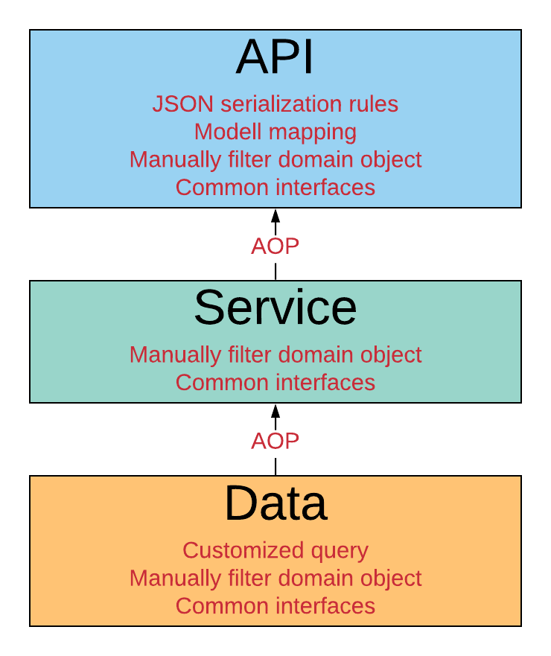
Field-Level Security
When?
Data layer
Service layer
Serializing
How?
Spring Data + Security
JSON View
Jackson Field Security
Custom solutions

Slide 16
Spring Data + Security
You can use all common built-in security expressions in queries
hasRole([role])
isFullyAuthenticated()
hasPermission(Object target, Object permission)
@Repository
public interface MessageRepository extends PagingAndSortingRepository<Message,Long> {
@Query("select m from Message m where m.id = ?#{ principal?.id }")
Page<Message> findInbox(Pageable pageable);
}
Notes:
https://docs.spring.io/spring-security/site/docs/5.1.0.RELEASE/reference/htmlsingle/#data
https://www.baeldung.com/spring-data-security
Sample projects: https://github.com/eugenp/tutorials/tree/master/spring-security-mvc-boot
A good way to create pagination
Case Statements to optionally return null

Slide 17
JSON VIEW
public class User {
@JsonView(View.Anonymous.class)
private String username;
@JsonView(View.Admin.class)
private String password;
}
@JsonView(View.Admin.class)
@RequestMapping(value= "api/users/{id}", method = RequestMethod.GET)
public User getUserById(@PathVariable Long id) {
return userService.getUserProfile(id);
}
Possible to automatically set JsonView based on user Authorities
Notes:
Only role based
Problem to set view programmatically
https://stackoverflow.com/questions/17276081/spring-3-2-filtering-jackson-json-output-based-on-spring-security-role
Too much constraints
Each field (or class) needs to be annotated, but: spring.jackson.mapper.default_view_inclusion=true
Inside collection all objects have the same view
@RequestMapping("/foos")
public MappingJacksonValue getFoo(@AuthenticationPrincipal UserDetails userDetails ) {
MappingJacksonValue value = new MappingJacksonValue( fooService.getAll() );
if( userDetails.isAdminUser() ) {
value.setSerializationView( Views.AdminView.class );
} else {
value.setSerializationView( Views.UserView.class );
}
return value;
}

Slide 18
Jackson Field Security
https://github.com/JahnelGroup/jackson-field-security
@JsonFilter("securityFilter")
public class User {
private Long id;
private String username;
@SecureField( policyClasses = {TestPolicy.class})
private String password;
}
public class TestPolicy{
public boolean permitAccess(SecureField secureField, PropertyWriter writer, Object target, String targetCreatedByUser, String currentPrincipalUser) {
//Perform checks
return false;
}
}
Notes:
Rather immature

Slide 19
Spring Data Rest Projections
Only works for Spring Data Rest Repositories
Excerpts are projections defined as default view
Excerpts only work for collection resources
@Projection(
name = "customBook",
types = { Book.class })
public interface CustomBook {
String getTitle();
}
http://localhost:8080/books/1?projection=customBook
@RepositoryRestResource(excerptProjection = CustomBook.class)
public interface BookRepository extends CrudRepository<Book, Long> {}
Notes:
https://www.baeldung.com/spring-data-rest-projections-excerpts
https://stackoverflow.com/questions/28794145/spring-data-rest-security-based-projection/35399030#35399030

Slide 20
Modelmapper – Data Transfer Object
„DTOs help to hide implementation details of domain objects“
Apply customized mapping rules to hide information based on security polices
Notes:
https://www.baeldung.com/entity-to-and-from-dto-for-a-java-spring-application
https://auth0.com/blog/automatically-mapping-dto-to-entity-on-spring-boot-apis/
Lombok
https://www.javadevjournal.com/spring/data-conversion-spring-rest-api/ → Facade Layer
Modelmapper SpringIntegration http://modelmapper.org/user-manual/spring-integration/

Slide 21
Spring Domain Object Security (ACL)
Access Control List is a list of permissions attached to an object. An ACL specifies which identities are granted which operations on a given object.
4 mandatory database tables
https://www.baeldung.com/spring-security-acl
Notes:
Do not know if able to secure fields
Keep owner of object
Keeps parent of object
Inherited permissions possible
Needs a cache
Base Permissions: Read Write Create Delete Adminstratin
Advanced Permissions possible
AclPermissionEvaluator

Slide 22
Custom Solutions
AOP
Common interface for multiple views
Null values
Customize Getter and Setter
Splitting into multiple resources (high network load)
“Generally speaking we've come to the conclusion that fine grained security constraints inside a resource is creating more trouble than it actually solves. What we basically recommend is custom resources and security rules applied to them.”

Slide 23
Next work packages?
Requirements
Authentication (OAuth)
Inter-service communication
View other security frameworks
Field Level Security
Implement sample applications
Security testing

