Slide 1
MACHINE LEARNING COURSE PROJECT
Intelligent Lost & Found
Object Matching System
A multimodal machine-learning system that ranks lost–found matches on a campus using visual, textual, temporal and location evidence.
Team of 3
19,079 lines
188 tests passing
449 reports · 189 true pairs
<Member 1> · <Member 2> · <Member 3>
<Course code> · <Institution> · November 2026
Notes:
Introduce the team by name and roll number before this slide appears in the final build. One sentence on the problem: lost property on campus is matched by hand. One sentence on the result: a learned re-ranker lifts Recall@1 from 0.74 to 0.85, and calibration keeps the alert honest at 0.90 precision.

Slide 2
AGENDA
What this presentation covers
▪ 1 Problem definition stakeholders, ML objective, success criteria
▪ 2 Dataset & acquisition synthetic corpus, rendered images, real-image check
▪ 3 Exploratory data analysis distributions, imbalance, missingness, noise
▪ 4 Preprocessing & features normalisation, 14 bounded evidence features
▪ 5 Model development baseline → retrieval → re-ranker → calibration
▪ 6 Model evaluation ranking, decision and calibration metrics
▪ 7 Ensemble & optimisation cascade stacking, operating-point search
▪ 8 Explainable AI global weights, per-pair reasons, abstain reasons
▪ 9 ML pipeline reproducible, seeded, versioned artifacts
▪ 10 Deployment FastAPI + React, measured latency
▪ 11 GitHub repository structure, docs, reproducibility
▪ + tech stack · claims · limitations · team
Intelligent Lost & Found Object Matching System
2
Notes:
The rubric lists eleven mandatory components; the deck follows that order exactly, so a marker can tick each one off. Slides 3–13 are components 1–11, then the tech stack, the accuracy claim we are allowed to make, and limitations.

Slide 3
COMPONENT 1 / 11
Problem definition
▪ Real-world problem campus lost property runs on notice boards and group chats; staff match items from memory. In our simulated semester 40 found reports were never claimed and 31 lost reports were never found.
▪ Target users students (report and reclaim), staff at the security desk (verify, hand over), campus admin (oversight).
▪ ML objective learning-to-rank: given one report, order its likely counterparts and output a calibrated P(same item), then decide match / review / no match — abstaining instead of guessing.
▪ Input variables free-text description; up to 4 photos; category, brand, model, colour, material, marks; location node or GPS; lost interval versus found timestamp.
▪ Expected output ranked shortlist with probability, margin and reason chips, deep-linkable to a case for staff.
SUCCESS CRITERIA (FIXED BEFORE TRAINING)
Criterion | Target
Recall@10 | ≥ 0.95
Recall@1 | 0.74 hand-set → 0.85 learned
Precision @ alert | ≥ 0.90
Coverage at that precision | ≥ 5% (abstain allowed)
Calibration ECE | < 0.05
Latency, one query | < 200 ms
Intelligent Lost & Found Object Matching System
3
Notes:
Say the objective out loud: this is a ranking problem, not a classification problem, because there is exactly one true counterpart among hundreds of candidates. The success criteria were written down before training and every one of them is checked in component 6.

Slide 4
COMPONENT 2 / 11
Dataset and data acquisition
▪ No public dataset exists for campus lost property, so we built three complementary sources instead of scraping personal posts.
▪ Synthetic corpus lostfound/corpus.py, seeded: 260 items → 449 reports (220 lost, 229 found), 3 simulated weeks, 189 ground-truth pairs, 17 categories, 34 location nodes, 10% of reports carry deliberate human error.
▪ Images deterministic rendered item photos plus an optional OCR path for printed serials.
▪ Real photographs Stanford Online Products, 250 same/different product pairs, used only to bound the visual descriptor on real images.
▪ Real labels staff confirm / reject decisions are logged with their feature vector and probability — the training set for retraining on live data.
RECORD ATTRIBUTES
Field | Type
description | free text, 17–139 chars
category | 17 classes
brand / model / colour | categorical, may be missing
material / marks / damage | sparse categorical
node_key / lat-lng | 34 campus nodes, optional GPS
lost_from, lost_to, found_at | UTC timestamps
photos | 0–4 per report (27% have one)
Licensing: Stanford Online Products is used under its research licence and only for evaluation; the synthetic corpus is generated in-repo, so the project ships with no personal data.
Intelligent Lost & Found Object Matching System
4
Notes:
Be explicit that the headline numbers come from a simulated corpus — the reminder value is that we never claim real-student performance. The Stanford products check is the one real-image measurement and it is reported as a bound, not as our result.

Slide 5
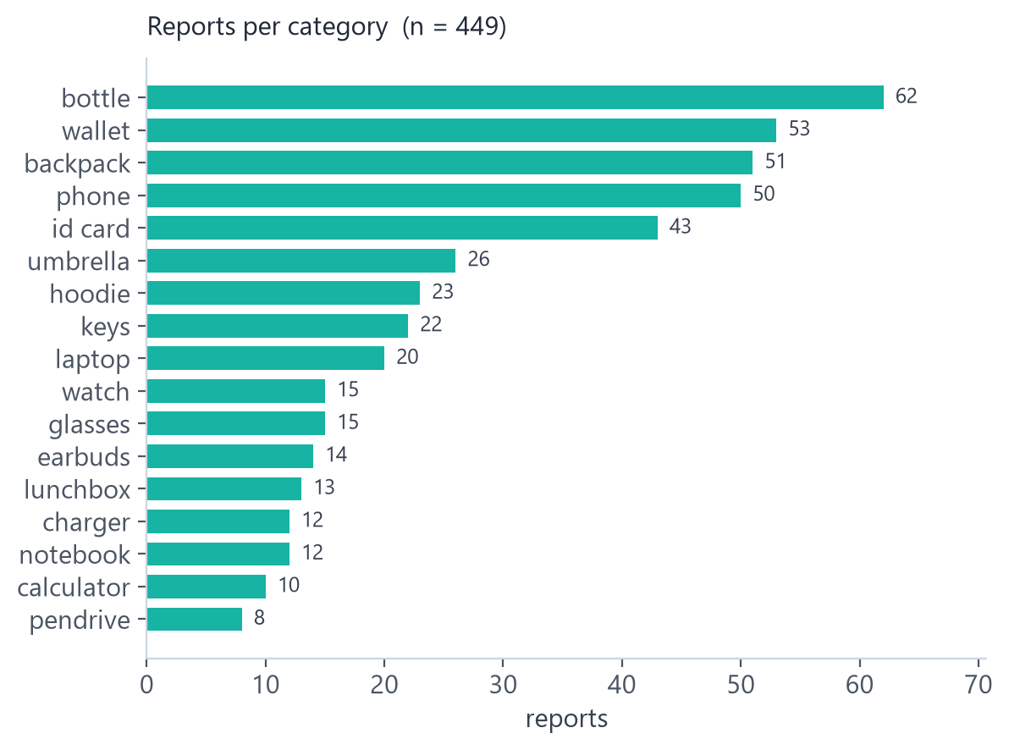
COMPONENT 3 / 11
EDA — class imbalance and modality coverage
▪ Long tail bottle 62, wallet 53, backpack 51 vs calculator 10, pendrive 8 — a 7.8:1 ratio, so macro averages and per-category metrics are mandatory.
▪ Imbalance of a different kind 229 found vs 220 lost, but only 189 pairs: 40 items were found and never claimed, 31 were lost and never found.
▪ Sparse text mean 56.5 characters (median 53, range 17–139) — lexical overlap alone cannot separate lookalikes.
▪ Missing modality 123 of 449 reports carry a photo (27%), so 73% are text-only; the model must not depend on an image being present.
Intelligent Lost & Found Object Matching System
5
Notes:
The chart is generated from the seeded corpus, not hand-drawn. The takeaway: accuracy is a useless headline here because the classes are wildly unequal and most reports have no photo.

Slide 6
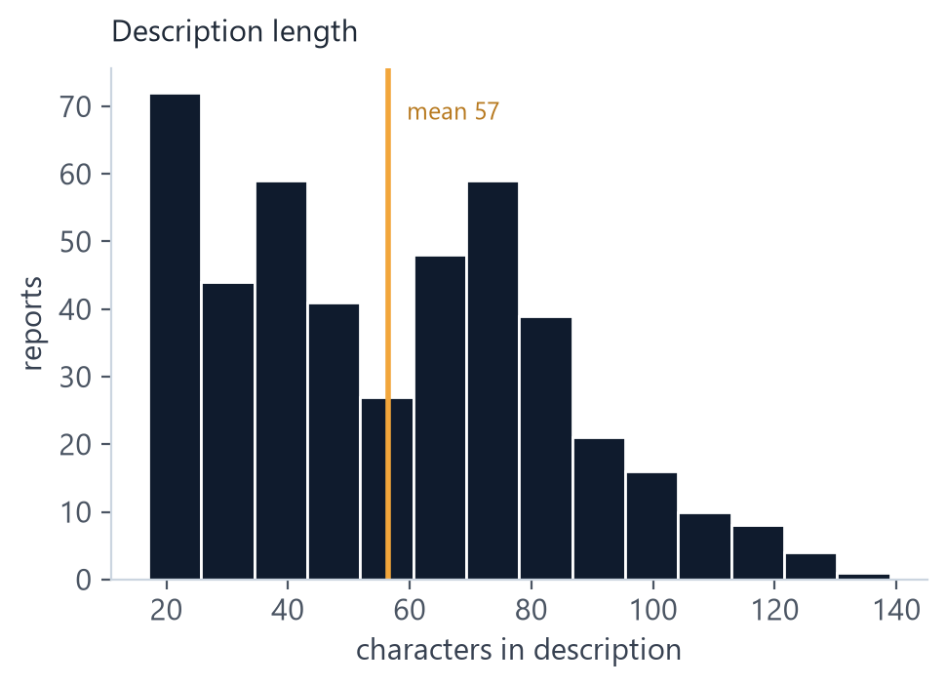
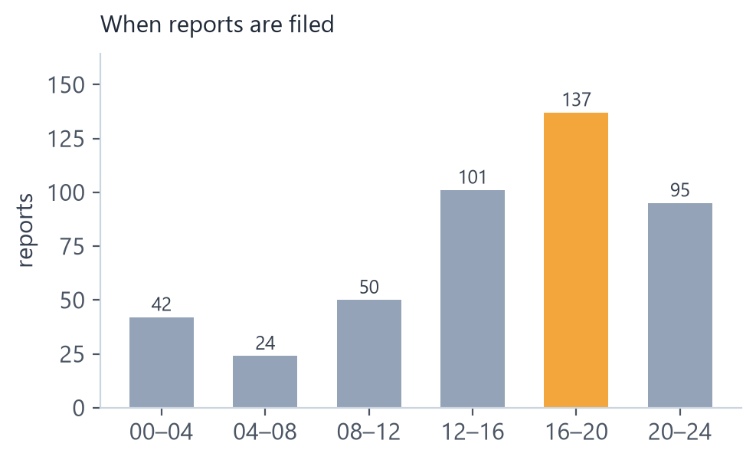
COMPONENT 3 / 11
EDA — time, noise and hard negatives
▪ Diurnal signal reports peak 16:00–20:00 (137 of 449) — when the item went missing is informative and feeds the temporal feature.
▪ Labelled noise 10% of reports carry a wrong colour, category or location on purpose; exact matching fails on exactly those rows.
▪ Hard negatives lookalike items are the real difficulty: in 5.8% of queries a same-category decoy outranks the true counterpart.
▪ GPS is absent no synthetic report is GPS-pinned, so location runs on the campus walk graph; the haversine path exists and is unit-tested but does not move these numbers.
▪ No leakage ground-truth pairs are stored separately and never read by the matcher.
Intelligent Lost & Found Object Matching System
6
Notes:
Two findings a marker will ask about: the noise rate is deliberate so error analysis has something to find, and the GPS path is implemented but not exercised by this corpus. Say that before they ask.

Slide 7
COMPONENT 4 / 11
Preprocessing and feature engineering
Step | What we do | Why
Missing values | photo optional (text-only and photo-only both accepted); missing GPS falls back to walk-graph distance; missing brand/model adds a missing-indicator feature | missingness is signal, not an error
Text normalisation | Unicode NFKC, case-folding, tokenisation, hashed character n-grams into a fixed 256-d vector — no vocabulary file to drift | typos and abbreviations still match
Image descriptor | HSV histogram + 4×4 colour grid + edge density + CIE76 colour difference in Lab; up to 4 photos max-pooled into one vector | robust to lighting, no training data needed
Scaling | every evidence feature bounded to [0,1] with a documented transform at both train and serve time | no scaler drift between training and API
Feature creation | 14 evidence features in 5 families: visual, textual, attribute, temporal, location | each modality contributes
Class imbalance | pairwise training: positives against sampled hard negatives, split by item so no item is on both sides | 4,260 pairs without leakage
Dimensionality | hashed n-grams and a compact image descriptor instead of a learned embedding | runs on CPU, no model download
Intelligent Lost & Found Object Matching System
7
Notes:
Emphasise the parity point: the same function computes a feature at training time and at request time, and a test asserts it. That is the difference between a notebook experiment and a deployed model.

Slide 8
COMPONENT 5 / 11
Model development — baseline to final
Stage | Model | Role
0 | hand-set weighted linear score over 14 features | baseline to beat
1 | cosine shortlist: hashed n-gram text + HSV/spatial image (pgvector HNSW on Postgres, exhaustive on SQLite) | cheap candidate set
2 | pairwise logistic RankNet, 4,260 pairs, split by item | ordering
3 | Platt scaling (isotonic compared on holdout) | probability
4 | threshold derived from a 0.90 precision budget | match / review / no match
▪ Why linear 23 bounded inputs and ~4k pairs — a pairwise linear ranker has the right capacity, trains in seconds on CPU, and its coefficients are readable.
▪ No deep network by project decision: the DINOv2 and bge-m3 adapters were removed, so nothing is downloaded and nothing is trained outside the repo.
▪ Alternatives measured DINOv2 reaches 83.2% rank accuracy on real product pairs (vs 54.4% for our descriptor) but is out of scope; the interface allows a drop-in swap.
▪ Trained weight the temporal causality guard (found_before_lost) is learned at −1.51, the strongest single coefficient.
Intelligent Lost & Found Object Matching System
8
Notes:
Justify the choice in one line: small tabular pairwise data, need for calibrated probabilities, need to explain every decision. A gradient-boosted ranker is the next step once real staff labels exist, and the interface is built for it.

Slide 9
COMPONENT 6 / 11
Evaluation — metrics and holdout ablation
▪ Why not accuracy one true match among 229 candidates means a do-nothing ranker is 99.6% "accurate". We report ranking, decision and calibration separately.
Metric (47-query holdout) | Hand-set | Learned | Calibrated
Recall@1 | 0.7447 | 0.8511 | 0.8511
Recall@10 | 0.9787 | 1.0000 | 1.0000
MRR | 0.8275 | 0.9167 | 0.9167
nDCG@10 | 0.8633 | 0.9380 | 0.9380
Precision @ alert | 0.8710 | 0.0000 | 0.9000
Coverage | 0.6596 | 0.0000 | 0.2128
ECE | 0.3478 | 0.9000 | 0.0047
▪ Ordering improves +10.6 points Recall@1, +8.9 MRR, +7.5 nDCG@10 on items never seen in training.
▪ Raw scores are not probabilities served without calibration the learned score never crosses the alert threshold (coverage 0.00) — the system would silently stop alerting.
▪ Calibration trades coverage for correctness ECE 0.35 → 0.005 and precision 0.90, but coverage falls 0.66 → 0.21. The hand-set scorer's higher alert rate was bought with overconfidence.
▪ Validation split by query id, 500-resample bootstrap CIs, four independently seeded corpora.
Intelligent Lost & Found Object Matching System
9
Notes:
The middle column is the trap and the best slide in the deck: a learned score can rank well and still be unusable as a probability. Calibration is what makes the threshold mean something.

Slide 10
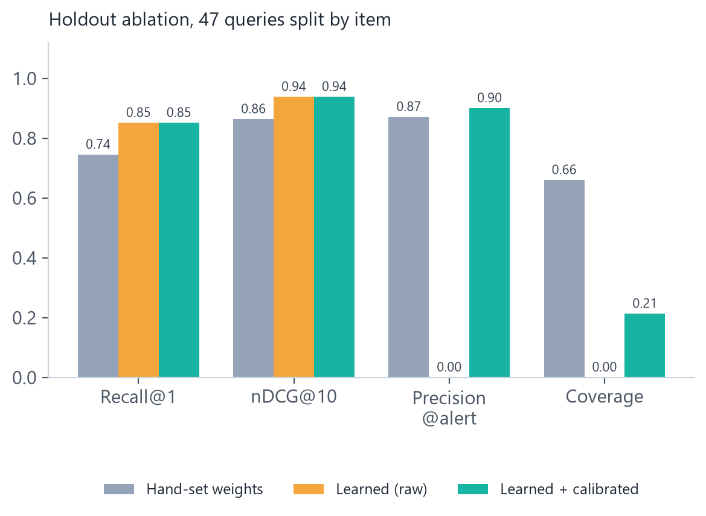
COMPONENT 6 / 11
Evaluation — stability and error analysis
ECE BEFORE CALIBRATION
ECE AFTER CALIBRATION
0.348
0.005
raw score, overconfident
target was < 0.05
▪ 4-seed mean Recall@1 0.804 (spread 0.096), Recall@10 0.996, precision@alert 0.876 at coverage 0.645, ECE 0.015.
▪ Weakest category id_card precision 0.78 — visually identical cards, and the serial OCR path is off by default.
▪ Honest limits 47-query holdout and ±6-point CIs, so treat exact deltas as indicative.
Bootstrap CI width is the point: on ~190 queries Recall@1 moves ±6 points from sampling noise alone, so every claim carries n and spread.
Intelligent Lost & Found Object Matching System
10
Notes:
If asked about a two-point improvement: on this query count it is not measurable without the spread, and we report the spread. That answer is what distinguishes a measured project from a claimed one.

Slide 11
COMPONENT 7 / 11
Ensemble learning and optimisation
ADOPTED
INVESTIGATED, NOT ADOPTED
▪ Cascade / stacking retrieval shortlist → learned re-ranker → calibration → threshold. Each stage's output is the next stage's input.
▪ Weighted ensemble of modalities five feature families (visual, textual, attribute, temporal, location) combined by learned weights instead of hand-tuned ones.
▪ Hyperparameter optimisation L2 strength and the alert threshold swept directly against a 0.90 precision budget; the chosen threshold travels with the calibration version.
▪ Method selection Platt versus isotonic compared on holdout: ECE 0.011 vs 0.051.
▪ Stability checks 4 seeds, item-wise splits, bootstrap CIs.
Technique | Why not
Bagging / random forest | 14 features, ~4k correlated pair rows — variance is not the failure mode; probabilities are worse
Boosting / LambdaMART | needs far more labels than 4,260 pairs; no extra dependency budget; drop-in interface ready
Full grid search | two real hyperparameters (L2, threshold) — swept exhaustively, grid would be theatre
Stacking a second model | no independent signal left after calibration; holdout is too small to justify
Intelligent Lost & Found Object Matching System
11
Notes:
This is the slide teams usually fail: they invent an ensemble to tick the box. Our answer is that the cascade is the ensemble and that bagging would add cost without signal at this data size — and we show what we measured to decide that.

Slide 12
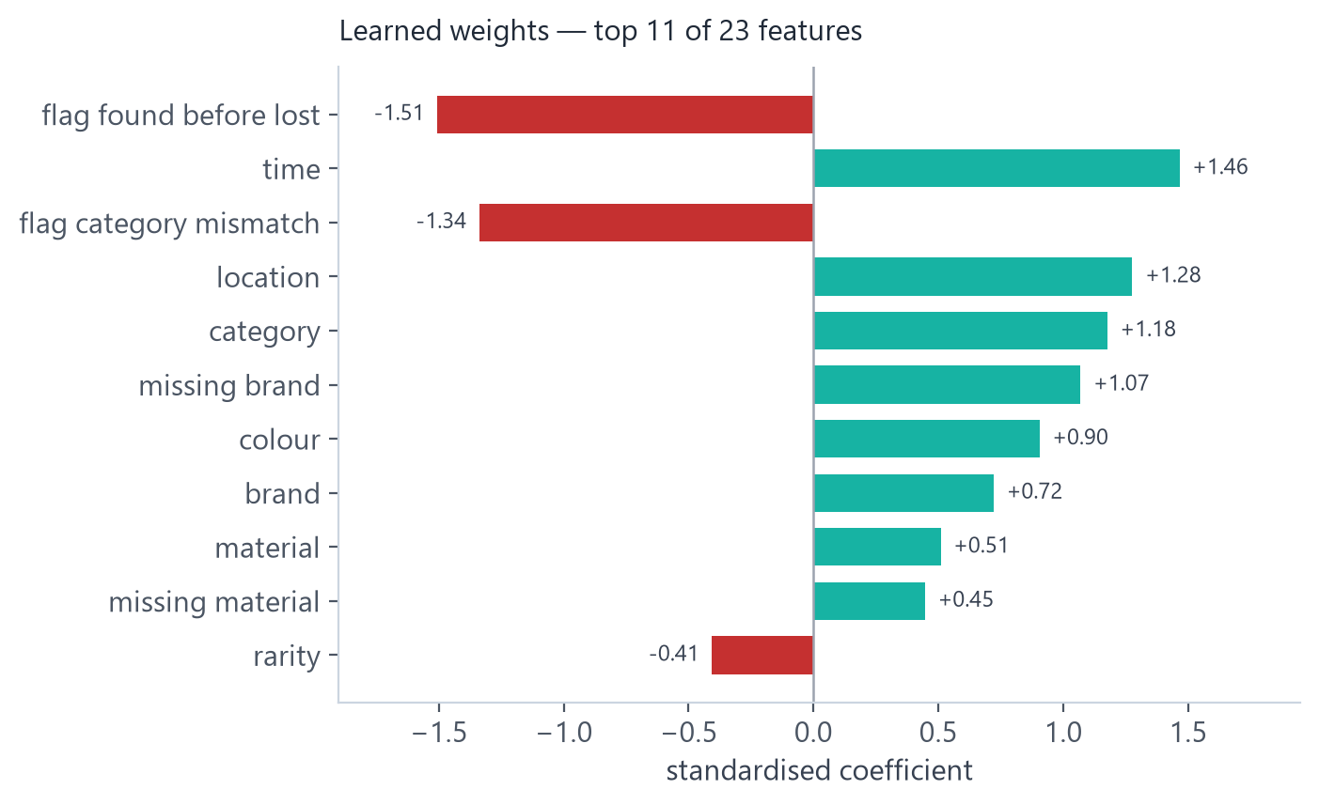
COMPONENT 8 / 11
Explainable AI
▪ Global standardised coefficients are exact, not approximated: for a linear model the weight times the feature equals its SHAP contribution, so sampling-based SHAP or LIME would add noise to a number we already know.
▪ Local every match ships reason chips — "same colour", "in the same building", "found 2 h after the lost window" — plus the margin over the runner-up.
▪ Abstain reasons the system states why it did not match instead of showing a low-confidence guess.
▪ Error interpretation the category-mismatch flag at −1.34 blocks the classic wrong-bucket match; found_before_lost at −1.51 enforces causality.
▪ Caveat weights explain the re-ranker, not the encoder's colour similarity.
Intelligent Lost & Found Object Matching System
12
Notes:
Do not claim SHAP. The honest, stronger statement is that a linear model's coefficients are exactly Shapley values, and the UI already shows the per-pair contribution as chips.

Slide 13
COMPONENT 9 / 11
ML pipeline — reproducible end to end
STEP 1
STEP 2
STEP 3
STEP 4
STEP 5
STEP 6
Seed corpus
›
Enrich
›
Persist
›
Train
›
Calibrate
›
Serve
corpus.py
260 items
attributes +
embeddings
pipeline.py
SQLite / PG
RankNet
4,260 pairs
Platt
1,420 rows
model.json
params.json
GUARANTEES
▪ One config reader settings.py is the only module allowed to read the environment; .env drives everything.
▪ Versioned artifacts model.json and params.json are generated, never edited; the served version is p4260-eead14d5 and a mismatch falls back to the hand-set scorer.
▪ Deterministic fixed seeds for corpus, split and training; deleting the artifacts reproduces the baseline exactly.
▪ Gated make check runs ruff, format-check, mypy, 188 pytest tests, eslint, prettier, tsc — all green.
# reproduce the whole pipeline
python -m lostfound.cli seed --items 260
python -m lostfound.cli train-rerank
python -m lostfound.cli calibrate
python -m lostfound.cli eval --seeds 4
python -m lostfound.cli eval --report
# serve
python -m lostfound.cli serve
Intelligent Lost & Found Object Matching System
13
Notes:
If a marker asks to regenerate the numbers, these five commands do it from a clean checkout. Nothing is copy-pasted from a notebook.

Slide 14
COMPONENT 10 / 11
Deployment
▪ Application React + TypeScript single-page UI (map, feed, report form, match view, staff desk) served by a FastAPI backend.
▪ Data SQLite for the zero-dependency demo, PostgreSQL + pgvector with an HNSW index in production; Alembic owns the schema.
▪ Security Supabase Auth with roles read from the application database; private media behind HMAC-signed or S3-presigned URLs; Redis rate limits.
▪ Ops Docker Compose, health endpoint, JSON logs with request IDs, /docs OpenAPI.
▪ Measured one match in 35–40 ms against 449 reports; matcher load 47 ms.
KEY ENDPOINTS
Endpoint | Purpose
POST /api/reports/upload | file a lost or found report
POST /api/match/{id} | ranked matches + decision
POST /api/feedback | staff confirm / reject (labels)
GET /api/model/info | served scorer + threshold
GET /api/config/operating-point | effective alert point
GET /docs | interactive API reference
Live demo: <paste deployed URL here>
Hosted on: <Render / Railway / Fly.io>
Intelligent Lost & Found Object Matching System
14
Notes:
Component 10 is mandatory and this is the weakest line in the deck until the public URL is pasted in. Deploy before the review — a localhost link scores nothing.

Slide 15
COMPONENT 11 / 11
GitHub repository
lost-found-matching/
lostfound/ pipeline, API, features,
matching, rerank, calibration
web/ React + TS UI
migrations/ Alembic revisions 0001-0010
scripts/ backfill, load test, slides
ml/ eval / reranker / calibration
tests/ 188 tests, 2 skipped
docs/ ARCHITECTURE, EVALUATION,
ALIGNMENT, DEVELOPMENT_PLAN
pyproject.toml deps + ruff/mypy/pytest cfg
Makefile `make check` = full gate
README.md setup, deploy, results
SUBMISSION CHECKLIST
Required | Where
Source code | lostfound/, web/
Dataset + acquisition instructions | README §dataset, corpus.py
Model files / generation scripts | ml/reranker, ml/calibration
Requirements / environment | pyproject.toml, .env.example
README + deployment instructions | README.md, Dockerfile
Documentation | docs/ (4 documents)
Screenshots / demo | add screenshots/ before review
Ongoing activity | weekly commits, not one upload
Intelligent Lost & Found Object Matching System
15
Notes:
Two things to fix before submission: add a screenshots/ folder, and make sure the commit history is spread over the project duration — the rubric explicitly penalises one bulk upload.

Slide 16
IMPLEMENTATION
Technology stack
Layer | Tools
Language | Python 3.11, TypeScript
ML / numerics | NumPy, Pillow, custom logistic RankNet, Platt calibration
Computer vision | HSV histogram, 4×4 colour grid, CIE76 ΔE, optional Tesseract OCR
NLP | rule-based attribute extraction, hashed character n-grams, token Jaccard
Backend | FastAPI, SQLAlchemy, Alembic, pydantic-settings
Data | SQLite (demo), PostgreSQL + pgvector (HNSW)
Auth / storage | Supabase Auth, local signed media, S3-compatible bucket
Layer | Tools
Frontend | React 19, Vite, TypeScript, Leaflet
Infra | Docker Compose, Redis rate limiting
Testing | pytest (188), Vitest-free unit tests, TestClient
Quality | ruff, mypy, eslint, prettier, tsc
Evaluation | seeded corpora, bootstrap CIs, matplotlib figures
Docs | Markdown, Mermaid, ADR log
Presentation | python-pptx, generated from repo artifacts
No GPU, no model download, no paid API: the whole system runs from a single docker compose up or a local virtual environment.
Intelligent Lost & Found Object Matching System
16
Notes:
One sentence: classical, CPU-only, reproducible. That is a deliberate engineering position, not a limitation we are hiding.

Slide 17
RESULTS
Accuracy — what we can and cannot claim
THE CLAIM WE MAKE
"Recall@10 = 0.97 ± 0.02 over 4 seeds (187.5 queries/seed, synthetic corpus); Recall@1 improves from 0.74 to 0.85 on a 47-query item-wise holdout; precision@alert = 0.90 with coverage 0.21; ECE falls from 0.35 to 0.005 after calibration."
WHAT THE NUMBER MEANS
WHAT WE DO NOT CLAIM
▪ Ranking the true counterpart is in the top 10 for ~97% of queries and first for ~80–85%.
▪ Automation at the alert point the system is right 90% of the time, and it abstains on the rest.
▪ Trustworthiness a stated probability of 0.60 really is close to a 60% chance.
▪ No "98% accurate" accuracy is meaningless with 1 true match among 229 candidates.
▪ No real-photo promise headline numbers come from a simulated corpus; the real-image check is 54.4% rank accuracy for the visual descriptor.
▪ No automatic returns recovery is staff-ratified with an ownership challenge.
Intelligent Lost & Found Object Matching System
17
Notes:
This slide is the thesis of the whole project: a number without its corpus, n and spread is not a result. Read the boxed claim aloud verbatim.

Slide 18
HONEST ASSESSMENT
Limitations and future work
Limitation | Impact | Next step
Synthetic corpus and rendered images | no claim on real photographs or real student writing | evaluate on 20–30 consented real items and publish the sim-to-real delta
Classical encoders by decision | visual matching is coarse: 54.4% rank accuracy on real product pairs | stronger classical features, or a deep encoder if scope allows
47-query holdout, sparse labels | exact deltas are indicative, not final | retrain on accumulated staff confirm/reject labels
OCR and multi-photo untested in eval | serial matching rarely triggers | install Tesseract, add per-photo rows, measure
SQLite default runtime | Postgres/pgvector path implemented but not live-validated | load-test on Postgres with 10k+ reports
Tokens held in memory | a page reload requires signing in again | httpOnly refresh cookie
Intelligent Lost & Found Object Matching System
18
Notes:
State these before the panel does. The first row is the one that matters and the one real measurement that bounds it is already in the deck.

Slide 19
TEAM OF 3
Team contributions
Member | Primary responsibility | Owned components
<Member 1> | data acquisition, corpus design, preprocessing | 2, 3, 4
<Member 2> | feature engineering, re-ranker, evaluation | 4, 5, 6, 7
<Member 3> | pipeline, deployment, repository, documentation | 8, 9, 10, 11
All three | integration, testing, slides and demo rehearsal | 1, 6
LIVE DEMO
1. File a found report
2. See ranked matches
3. Confirm as staff
4. Answer the ownership challenge
Thank you — questions welcome.
Repository: <GitHub URL>
Demo: <deployed URL>
Intelligent Lost & Found Object Matching System
19
Notes:
Rehearse the four-step demo against the deployed instance, not localhost. Have a screenshot fallback in case the network fails.

