Slide 1
WeTeach
Capstone Project

Slide 2

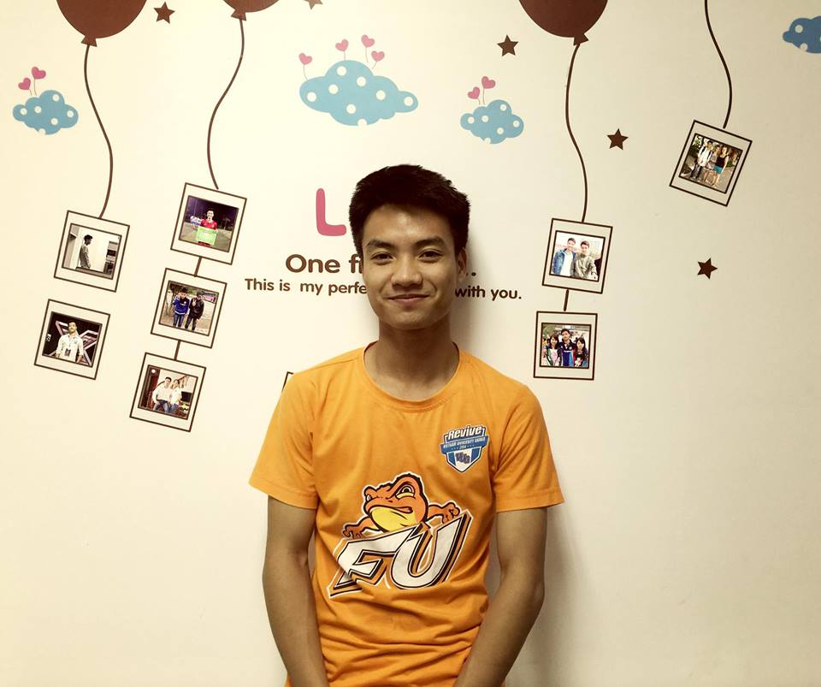
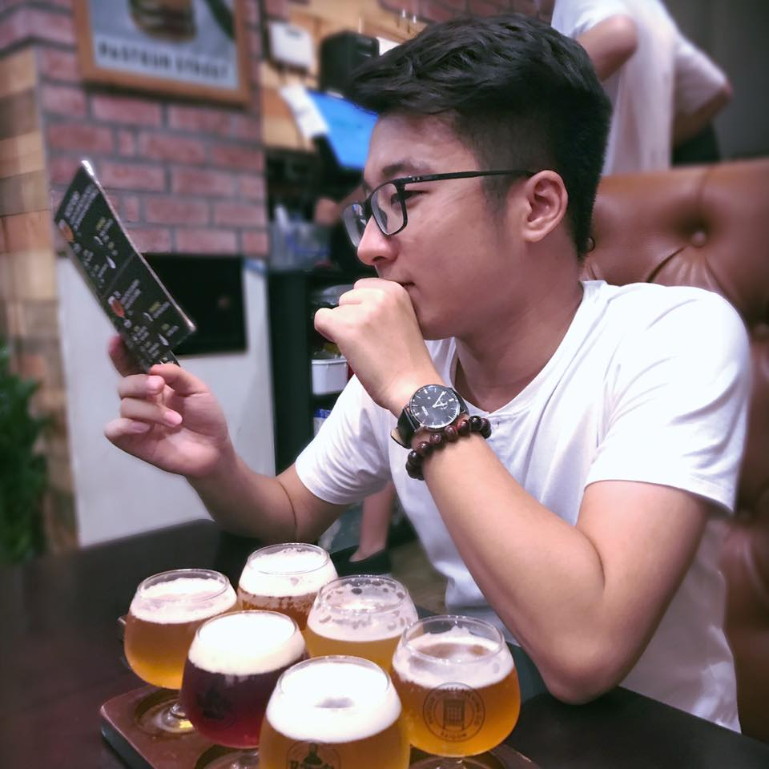
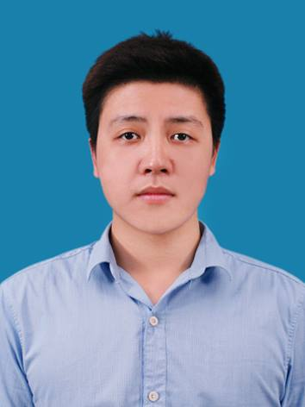
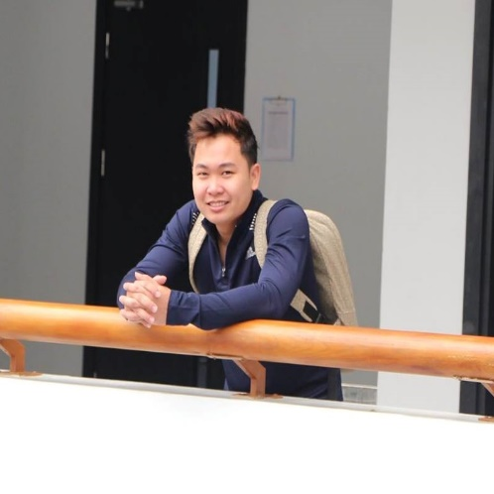
Supervisor:
Mr. Dao Trong Duy
Chu Van Toan
Tran Nhat Truong
Nguyen Viet Nam
Nguyen Thinh Cuong

Slide 3


Slide 4
AGENDA
01
Introduction
02
Project Management
03
Software Requirement
04
Software Detail Design
05
Software Testing
06
Conclusion
07
Demo
08
Q&A
Notes:
© Copyright Showeet.com

Slide 5
AGENDA
01
Introduction
02
Project Management
03
Software Requirement
04
Software Detail Design
05
Software Testing
06
Conclusion
07
Demo
08
Q&A
Notes:
© Copyright Showeet.com

Slide 6


Introduction
Nowadays the internet has become part and parcel of our life in today’s modern world.
Education websites have grown along with the development of the internet.
Most of those website are online study website.
Is self study for everyone?

Slide 7
Introduction
Create an educational website that is a bridge to connect Trainers, who look for student, and Learners, who look for courses.
Our goals are:
help learners find a best course that have a excellent trainer, reasonable price, suitable for them and most important, the course have to have high quality content.
help trainers introduce their course to learners and provide each course’s statistic to help them increase their course quality.

Slide 8
Introduction
Existing/Similar System
Advantages:
Most courses are self-paced.
Udemy have a wide range of 45,000 course portfolio.
On any given subject, there are courses from multiple authors so you can choose the best one.
Udemy provides lifetime access to all its courses.
Many courses are offered free of cost.
Disadvantages:
Lack of communicate between trainer and learner.
Language barrier
Self-paced is not for everyone.
Trainer have to make video.
Trainer have to pay a small amount of courses’ fee for website.

Slide 9

Introduction
Existing/Similar System
Advantages:
Most courses are self-paced.
Easy to pay (COD, ATM…)
Edumall provides lifetime access to all its courses.
Many courses are offered free of cost.
Disadvantages:
Lack of communicate between trainer and learner.
The target users are Vietnamese only.
Self-paced is not for everyone.
Trainer have to make video.
Trainer have to pay a small amount of courses’ fee for website.

Slide 10
AGENDA
01
Introduction
02
Project Management
03
Software Requirement
04
Software Detail Design
05
Software Testing
06
Lesson Learned
07
Demo
08
Q&A
Notes:
© Copyright Showeet.com

Slide 11
Project Management
Dao Trong Duy
Supervisor
Nguyen Viet Nam
Project Manager
Tran Nhat Truong
SRS Leader
Chu Van Toan
Technical Leader
Nguyen Thinh Cuong
Test Leader
Nguyen Thinh Cuong
SRS Member
Nguyen Viet Nam
Technical Member
Tran Nhat Truong
Test Member
Nguyen Thinh Cuong
Technical Member
Project Organization

Slide 12
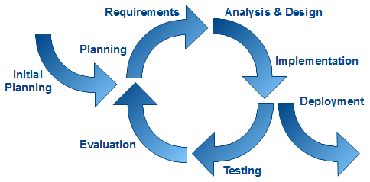
Project Management
Software Model

Slide 13
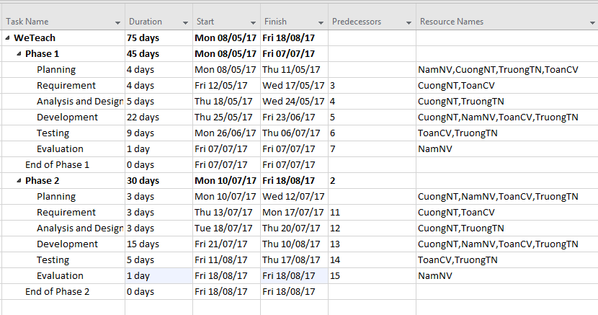
Project Management
Schedule

Slide 14
Project Management
Risk Management
Risk Code | Risk | Avoidance Plan | Contingency Plan | Impact
R01 | Team member is not pulling their weight. | Create friendly but professional environment. Listen and give everybody the chance to speak out their ideas. | Talk to them directly. Talk about this issues with the team to work it out. | High
R02 | Team member lack of knowledge and skill. | Provide training classes for team members. | Project Manager have responsibility to monitor and support team members whenever they need. | Medium
R03 | Team member have conflict. | Organize team building to create a cohesive group. | Bring up the issue with the team and together find the solution. | High
R04 | Deliver the website later than expected. | Project Manager have responsibility to make sure everything is on track. | Work overtime if necessary. | High
R05 | Data lost | Always backup data using SVN or Google Docs. Each team member also should keep data file in their own computer. | Try to restore as much data as possible. | High
R06 | Requirement changing too much. | The team and customer together agree on the requirement. The team have responsibility to give customer advise. | Carefully review the requirement to decide if it’s necessary to be change. Work overtime if necessary. | Medium

Slide 15




Project Management
Communication Management
Communication:
Time:
6h/days
5 days/week

Slide 16
AGENDA
01
Introduction
02
Project Management
03
Software Requirement
04
Software Detail Design
05
Software Testing
06
Conclusion
07
Demo
08
Q&A
Notes:
© Copyright Showeet.com

Slide 17
Software Requirement
WeTeach
Administrator
Learner
Guest
Trainer
WeTeach’s Actors

Slide 18
Software Requirement
Business Rules
No. | Business Rules Name | Business Rules Description
1 | Rate Course | Registered users can only rate one time.
2 | Rate Trainer | Registered users can only rate one time.
3 | Approve Trainer | After sign up, trainer have to approved by administrator to be able to create new course
4 | Approve Course | After create new course, new course will have to wait for administrator to approve to be able to appear in course list.

Slide 19
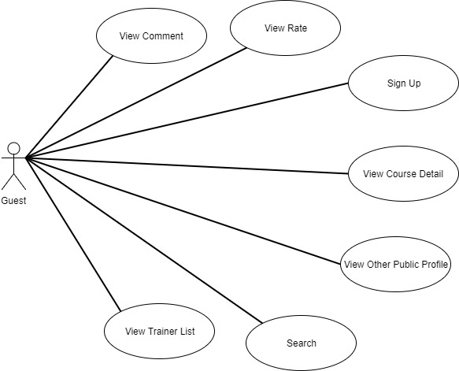
Software Requirement
Guest Use Case

Slide 20
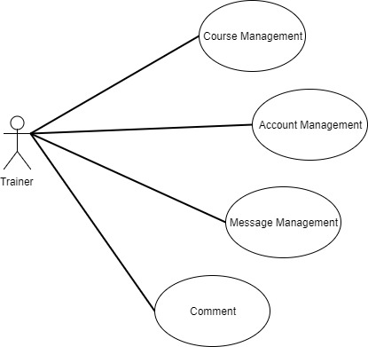
Software Requirement
Trainer Use Case

Slide 21
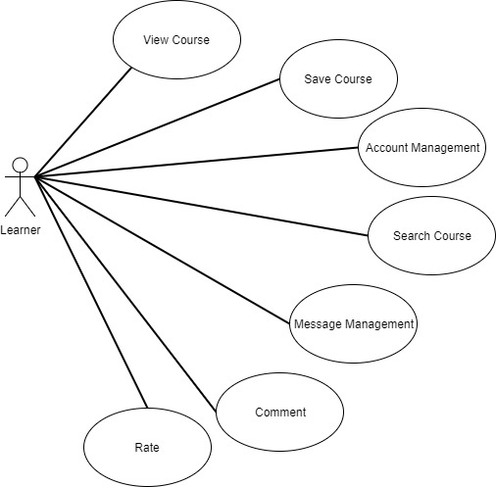
Software Requirement
Learner Use Case

Slide 22
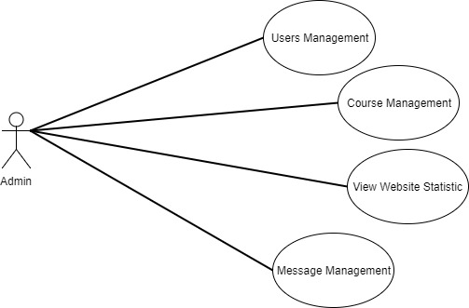
Software Requirement
Admin Use Case

Slide 23
Requirement Changes
Validate create new course: Course’s image dimension, upload video.
Website’s language.
Trainer rate.

Slide 24
AGENDA
01
Introduction
02
Project Management
03
Software Requirement
04
Software Detail Design
05
Software Testing
06
Conclusion
07
Demo
08
Q&A
Notes:
© Copyright Showeet.com

Slide 25








Development Tool

Slide 26
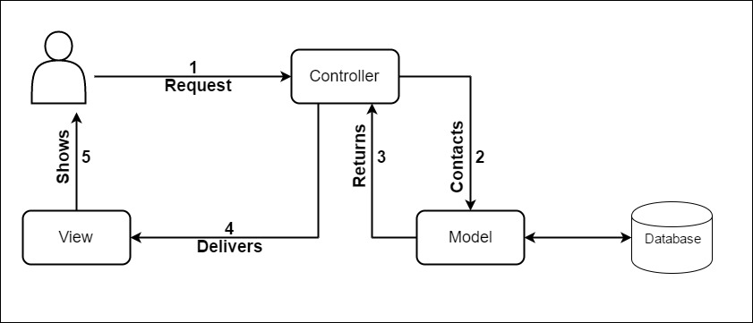
Software Detail Design
Model – View - Control

Slide 27
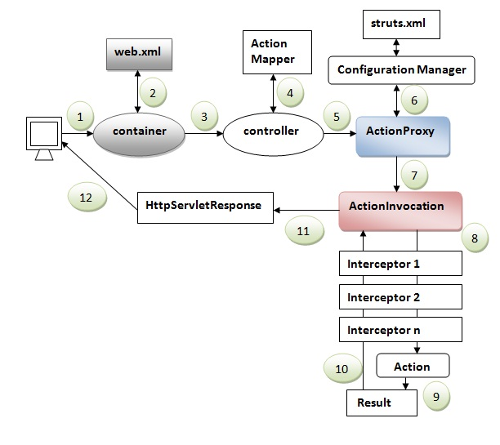
Software Detail Design
Struts2

Slide 28
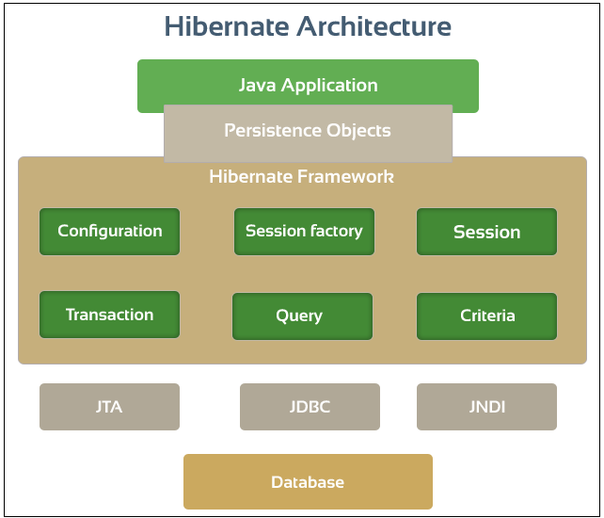
Software Detail Design
Hibernate

Slide 29
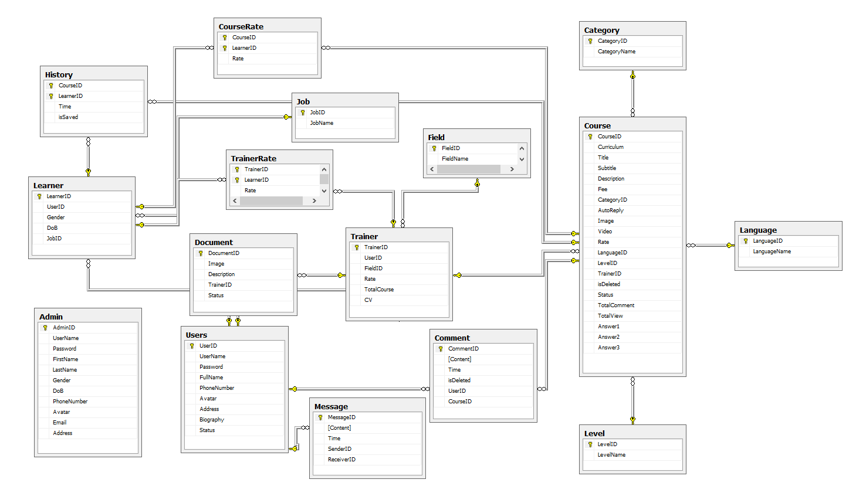
Software Detail Design
Database Design

Slide 30
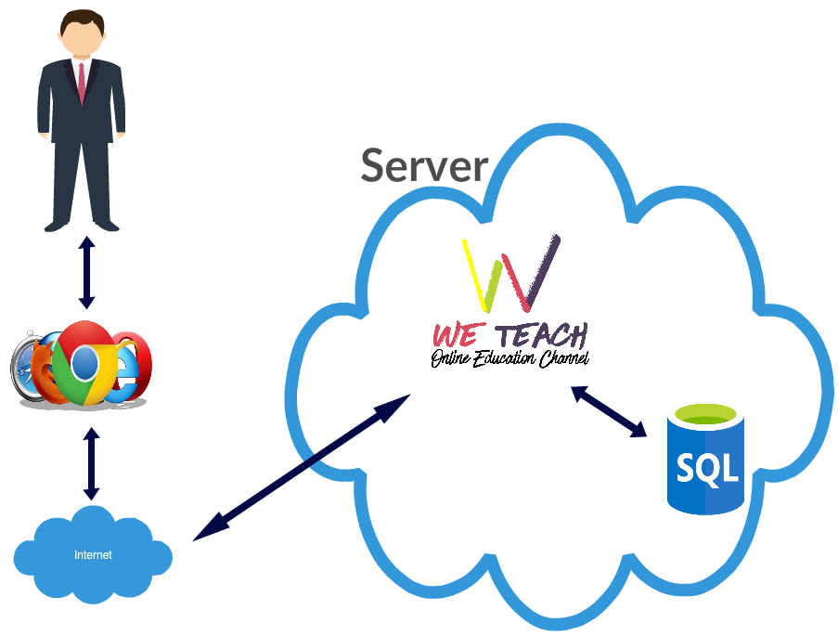
Software Detail Design
System Architecture

Slide 31
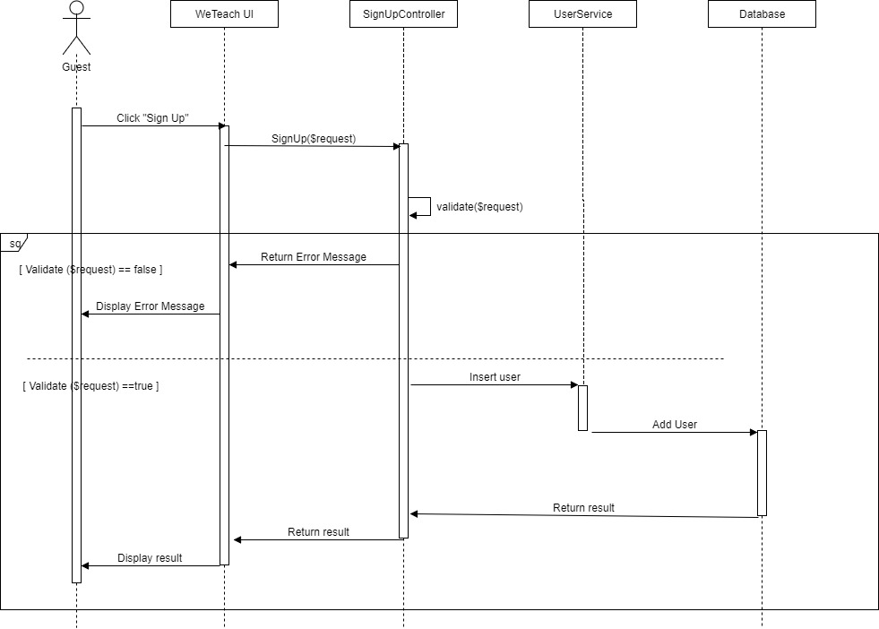
Software Detail Design
Sequence Diagram
Sign up

Slide 32
AGENDA
01
Introduction
02
Project Management
03
Software Requirement
04
Software Detail Design
05
Software Testing
06
Conclusion
07
Demo
08
Q&A
Notes:
© Copyright Showeet.com

Slide 33
Software Testing
Test Schedule
Test Schedule | Start Date | End Date
Phase 1: Main features | 26/06/2017 | 06/07/2017
Functional Testing | 26/06/2017 | 30/06/2017
User Interface Testing | 01/07/2017 | 06/07/2017
Phase 2: Other features and optimization | 11/08/2017 | 17/08/2017
User Interface Testing | 11/08/2017 | 12/08/2017
Functional Testing | 13/08/2017 | 14/08/2017
Regression Tests | 14/08/2017 | 17/08/2017

Slide 34
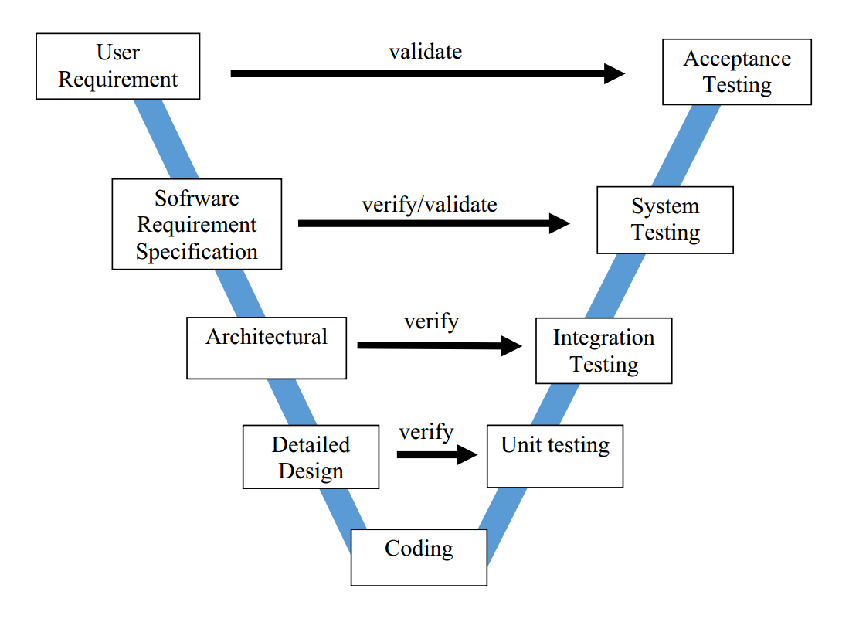
Software Testing
Test Model

Slide 35
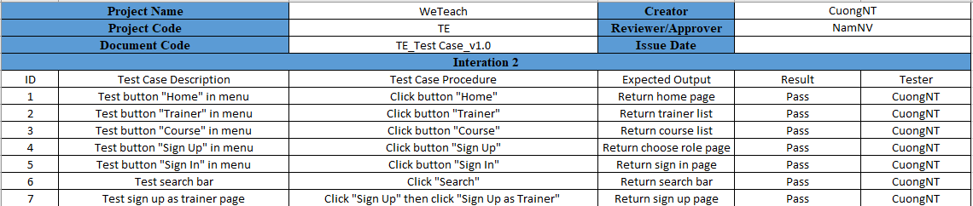
Software Testing
Sample of Test Case

Slide 36
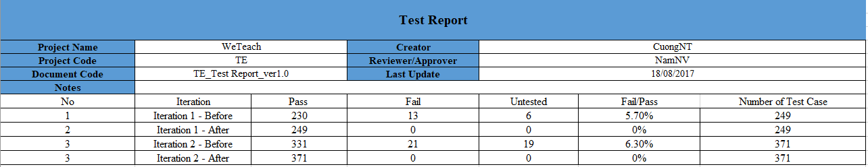
Software Testing
Test Report

Slide 37
AGENDA
01
Introduction
02
Project Management
03
Software Requirement
04
Software Detail Design
05
Software Testing
06
Conclusion
07
Demo
08
Q&A
Notes:
© Copyright Showeet.com

Slide 38

Conclusion

Slide 39
AGENDA
01
Introduction
02
Project Management
03
Software Requirement
04
Software Detail Design
05
Software Testing
06
Conclusion
07
Demo
08
Q&A
Notes:
© Copyright Showeet.com

Slide 40


Slide 41


Slide 42


