Slide 1
Software Requirement
Business Rules
No. | Business Rules Name | Business Rules Description
1 | Rate Course | Registered users can only rate one time.
2 | Rate Trainer | Registered users can only rate one time.
3 | Approve Trainer | After sign up, trainer have to approved by administrator to be able to create new course
4 | Approve Course | After create new course, new course will have to wait for administrator to approve to be able to appear in course list.

Slide 2
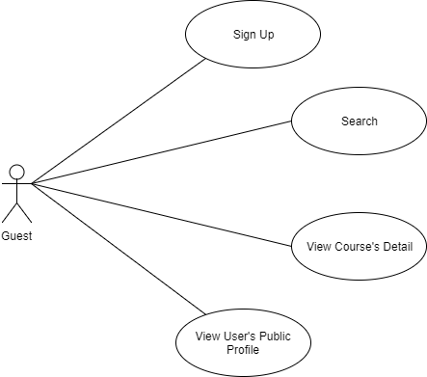
Software Requirement
Guest Use Case

Slide 3
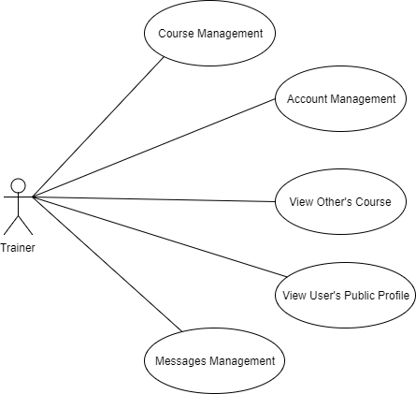
Software Requirement
Trainer Use Case

Slide 4
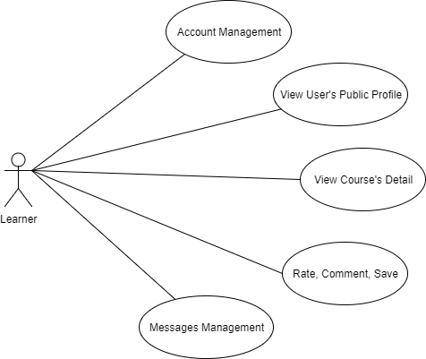
Software Requirement
Learner Use Case

Slide 5
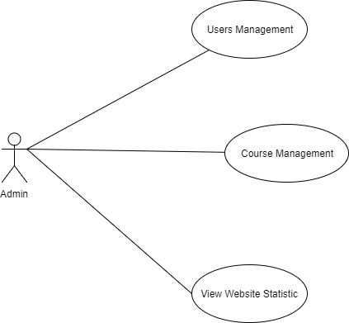
Software Requirement
Admin Use Case

