Slide 1
计组分享
信智竞 姜锐
2024.6.14

Slide 2
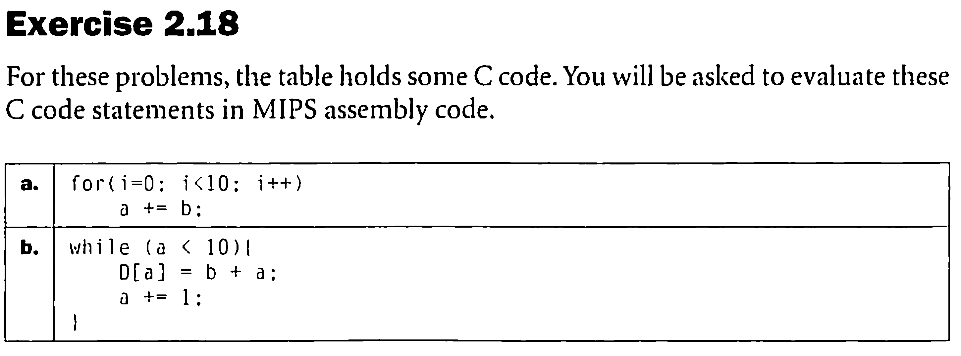
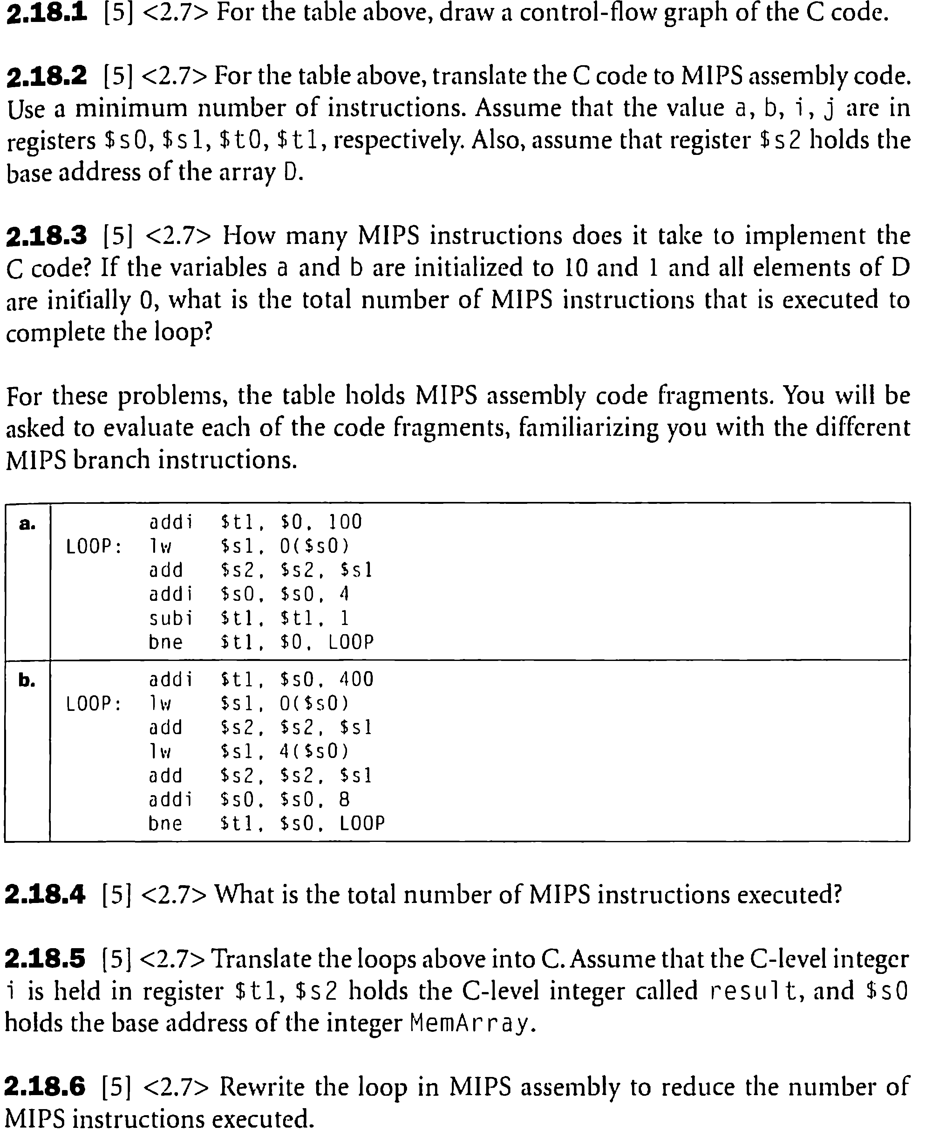

Slide 3
1
浮点数表示 IEEE 754
浮点数运算
2
浮点数加减法
3
浮点数乘除法

Slide 4
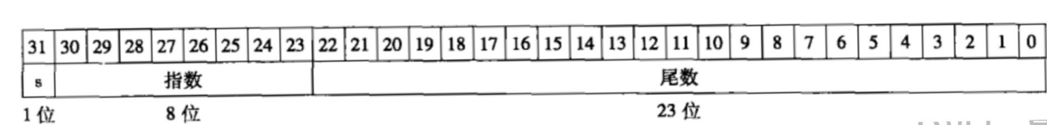
IEEE 754规定，单精度浮点数大小为32位
其中最高1位是符号位(sign)，随后8位是指数域(exponent)
剩下的位全部用来表示尾数(fraction)
偏阶？ 0-255 -> 1-254 -> -126-127
表示范围？
为了表示范围更大、精度更高的浮点数，IEEE 754提供了双精度浮点数标准,共64位
其中最高1位是符号位，随后11位是指数域，剩下的位全部用来表示尾数
偏阶？
表示范围？

Slide 5
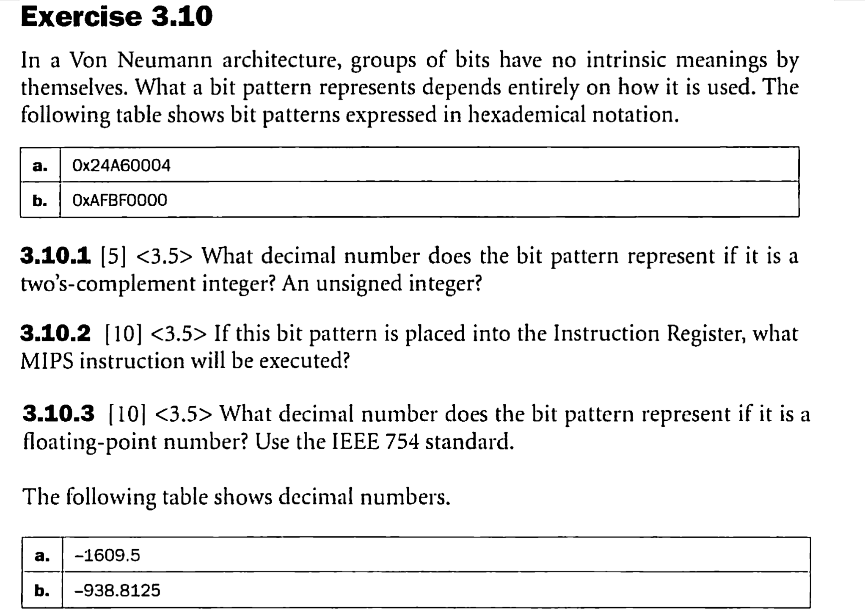
0.5 - 0.4375
0.5 * 0.4375

Slide 6
1
数据通路
单周期处理器
2
关键路径问题
3
控制信号问题

Slide 7
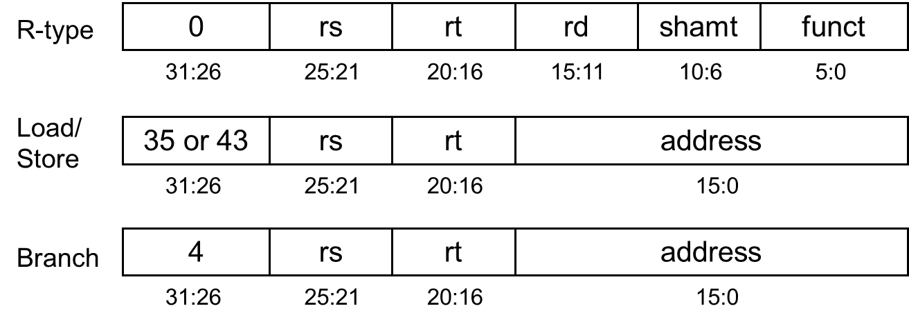
Instructions
R-Type: add, sub, and, or, slt
Memory: lw, sw
Branch: beq, j
Jump
2
address
31:26
25:0
Notes:
R-格式的指令执行涉及的数据通路
需要从寄存器堆中读取两个值，运算后写入到指定的寄存器中

Slide 8
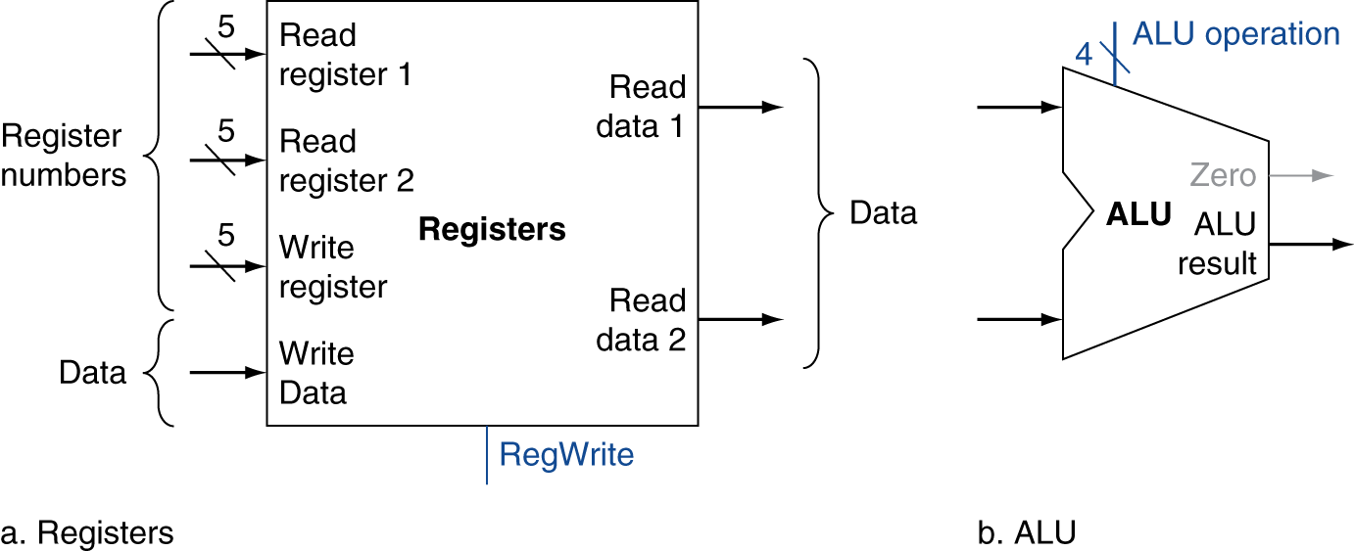
R-Format Instructions
Read two register operands
Perform arithmetic/logical operation
Write register result
Notes:
R-格式的指令执行涉及的数据通路
需要从寄存器堆中读取两个值，运算后写入到指定的寄存器中

Slide 9
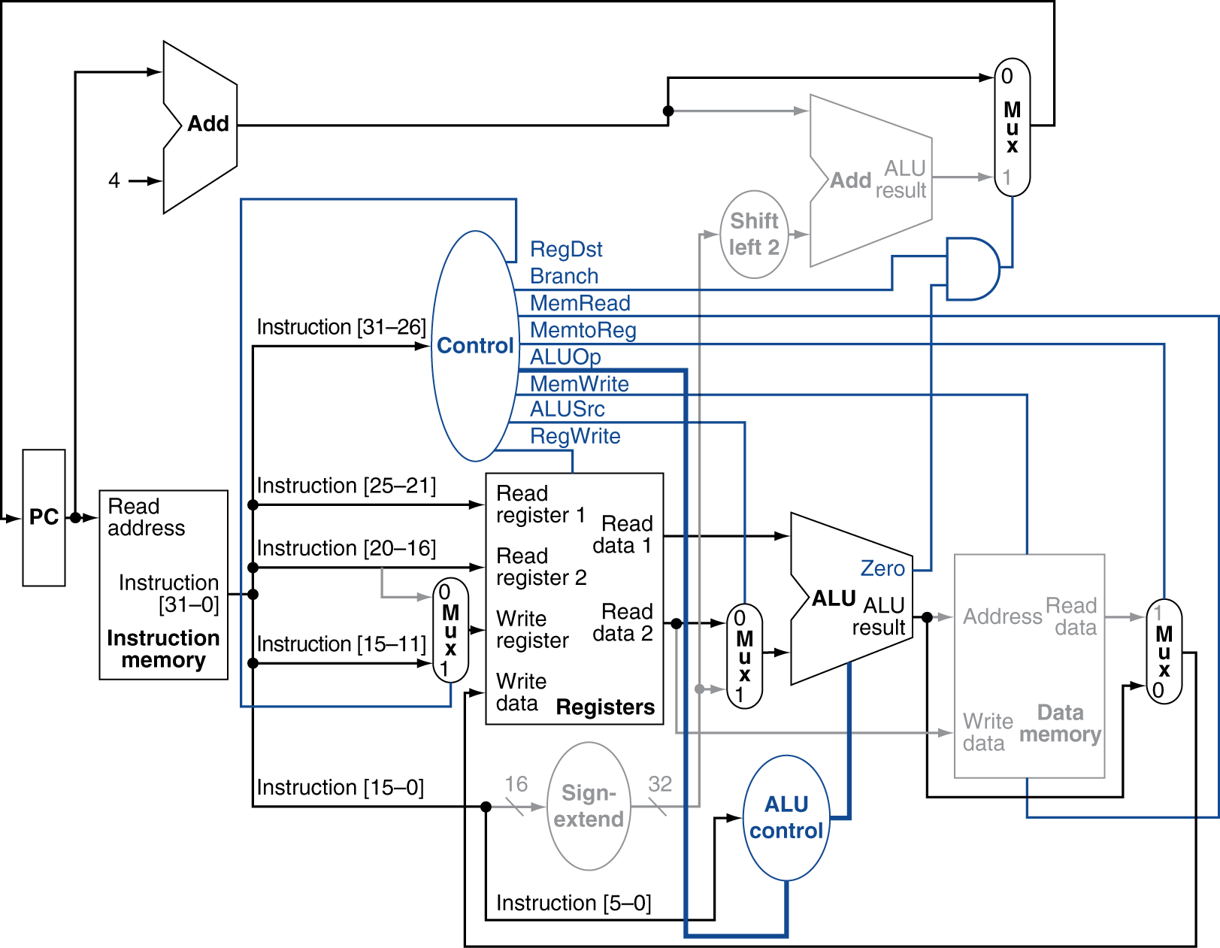
R-Type Instruction
add rd, rs, rt
Notes:
有了基本的数据通路之后，需要测试这些数据通路是否正确。我们将分别测试3类指令是否能够在该数据通路上正确地被执行。
下面我们浅色部分的部件为不使用的部件。

Slide 10
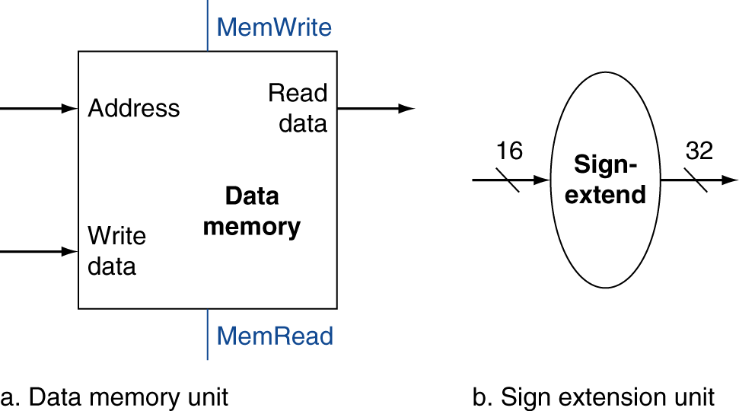
Load/Store Instructions
Read register operands
Calculate address using 16-bit offset
  Use ALU, but sign-extend offset
Load: Read memory and update register
Store: Write register value to memory
Notes:
读取数据指令，执行时涉及的数据通路
读取寄存器操作数
与 16位的立即数运算的偏移地址运算读写的内存的地址

Slide 11
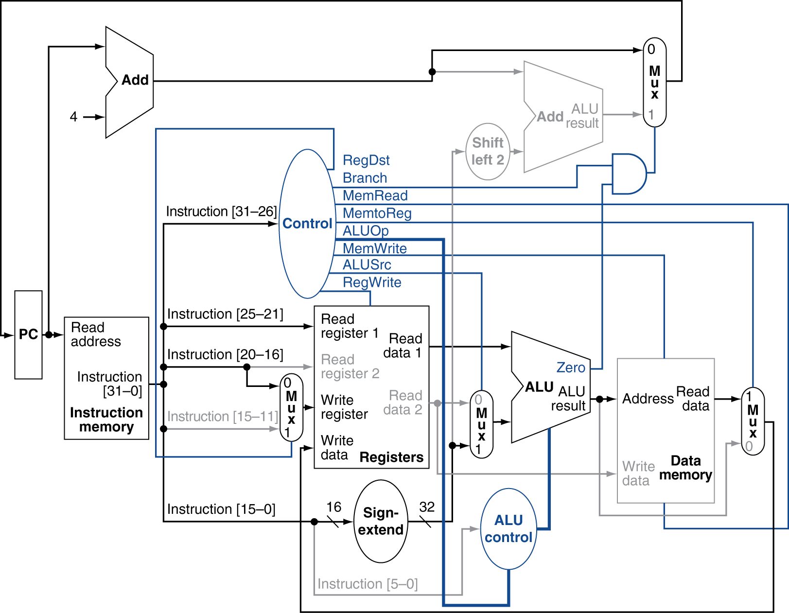
Load Instruction
lw rt, offset(rs)
Notes:
对于Load指令或者Store指令
浅色部分的部件为不使用的部件。

Slide 12
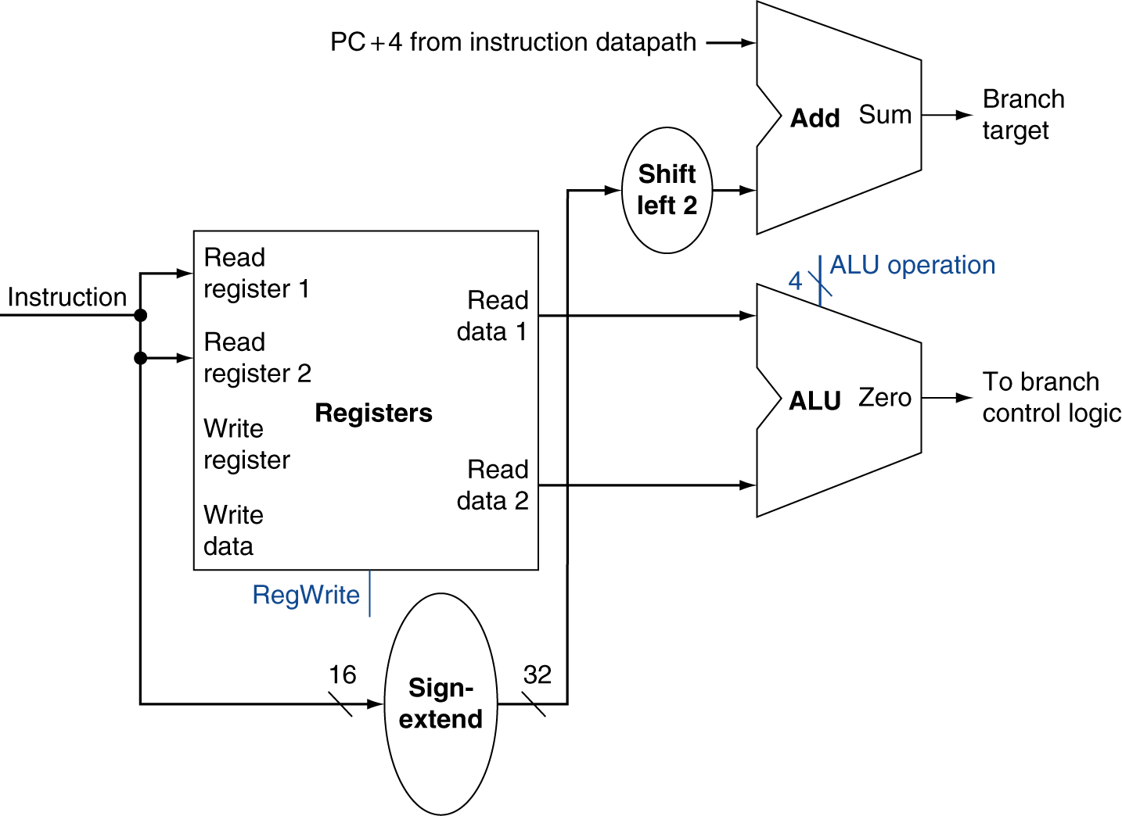
Branch Instructions
Read register operands
Compare operands
  Use ALU, subtract and check Zero output
Calculate target address
  Sign-extend displacement
  Shift left 2 places (word displacement)
  Add to PC + 4
    Already calculated by instruction fetch
Notes:
分支指令：
读取寄存器操作数
比较运算
计算目标地址

Slide 13
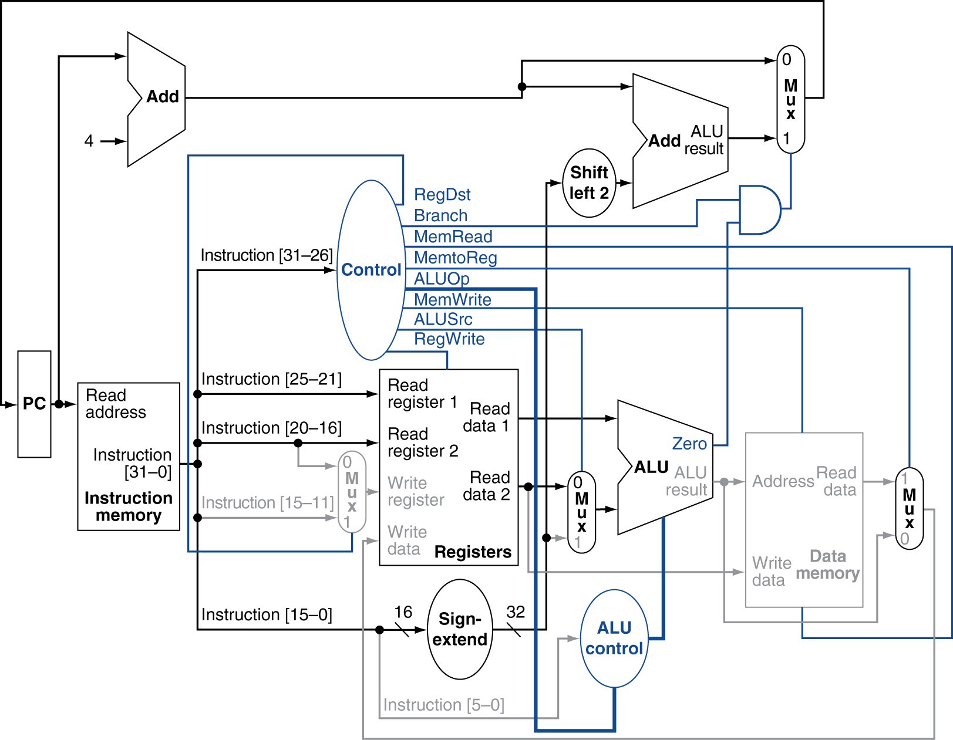
Branch-on-Equal Instruction
beq rs, rt
Notes:
对于Branch指令
浅色部分的部件为不使用的部件。

Slide 14
Implementing Jumps
Jump
2
address
31:26
25:0
Jump uses word address
Update PC with concatenation of
  Top 4 bits of old PC
  26-bit jump address
  00
Need an extra control signal decoded from opcode

Slide 15
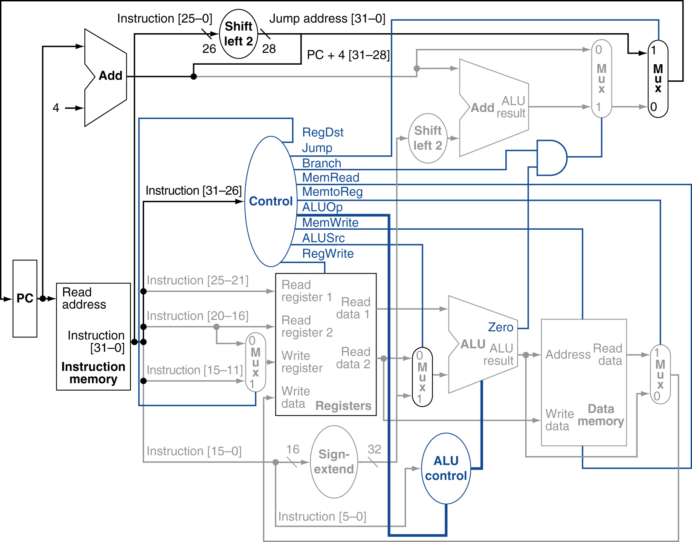
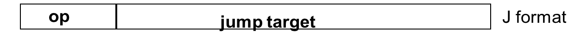
Datapath With Jumps Added
Notes:
浅色部分的部件为不使用的部件。

Slide 16

Critical Path-Load
lw rt, offset(rs)
I-MEM + Regs + MUX + ALU + D-MEM + MUX + Regs
T(ADD) < T(I-MEM)
T(SIG-Extend) < T(Regs)

Slide 17
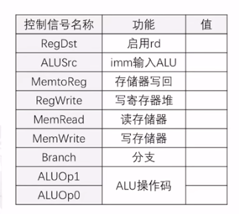
Control Signals-Load
lw rt, offset(rs)
R型指令 aluop = 10 根据func确定
Lw,sw aluop = 00
Beq aluop = 01
0
1
1
1
1
0
0
0
0

Slide 18
Critical Path-Branch
beq rs, rt，label
I-MEM + Regs + MUX + ALU + MUX
T(Shift-Left2) + T(ADD) < T(MUX) + T(ALU)
Notes:
对于Branch指令
浅色部分的部件为不使用的部件。

Slide 19
Control Signals-Branch
beq rs, rt，label
R型指令 aluop = 10 根据func确定
Lw,sw aluop = 00
Beq aluop = 01
x
0
0
0
0
0
1
0
1
Notes:
对于Branch指令
浅色部分的部件为不使用的部件。

Slide 20
Control Signals
Instruction | RegWrite | RegDst | AluSrc | Branch | MemWrite | MemtoReg | ALUOp_{1:0} | Jump
R-type | 1 | 1 | 0 | 0 | 0 | 0 | 10 | 0
lw | 1 | 0 | 1 | 0 | 0 | 1 | 00 | 0
sw | 0 | X | 1 | 0 | 1 | X | 00 | 0
beq | 0 | X | 0 | 1 | 0 | X | 01 | 0
j | 0 | X | X | X | 0 | X | XX | 1

Slide 21
1
数据通路
流水线处理器
2
冲突问题

Slide 22
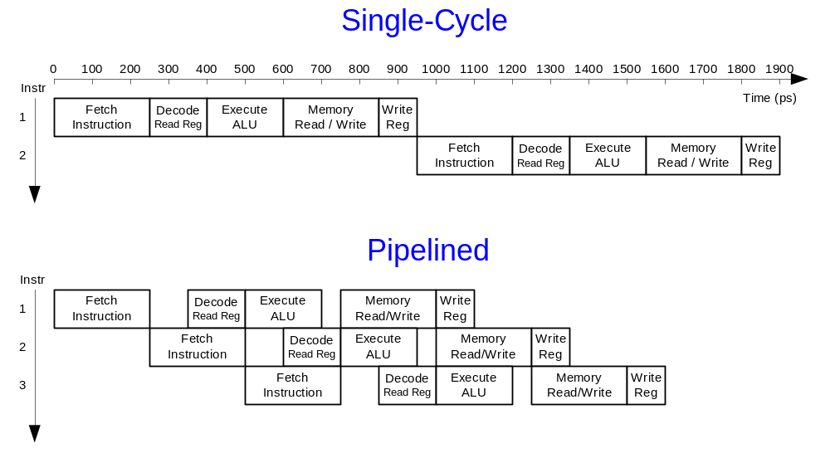
Single-Cycle vs. Pipelined

Slide 23
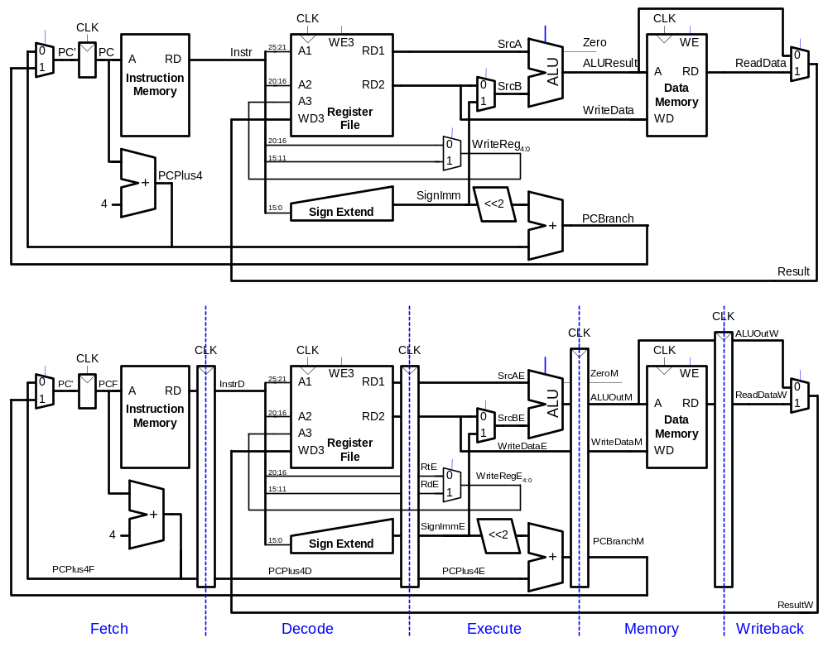
Single-Cycle & Pipelined Datapath

Slide 24
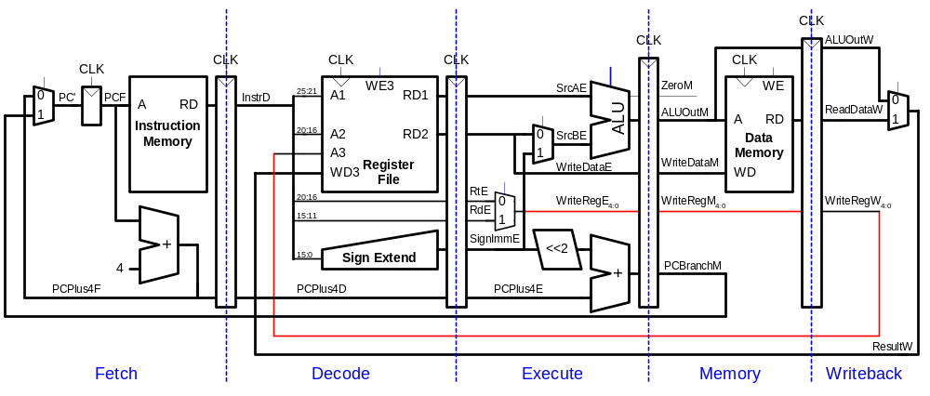
Corrected Pipelined Datapath
WriteReg must arrive at same time as Result

Slide 25
Pipeline Hazards
When an instruction depends on result from instruction that hasn’t completed
Types:
  Data hazard: register value not yet written back to register file (Read after Write)
  Control hazard: next instruction not decided yet (caused by branches)

Slide 26
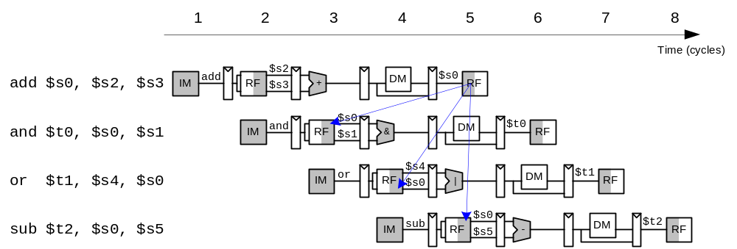
Data Hazard – R Type Write

Slide 27
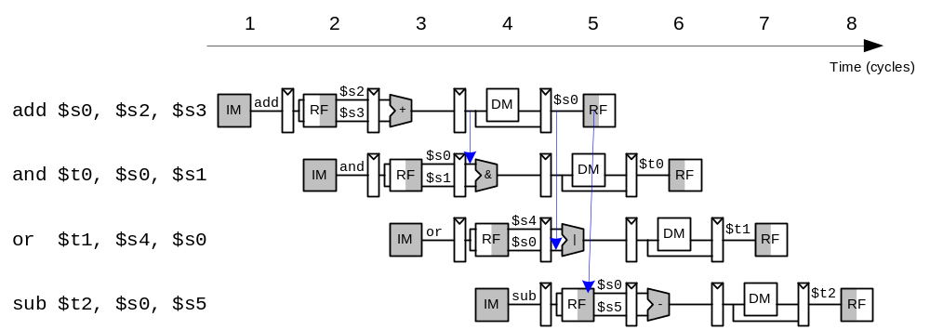
Data Forwarding (Bypassing)

Slide 28
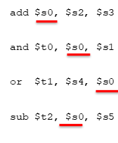
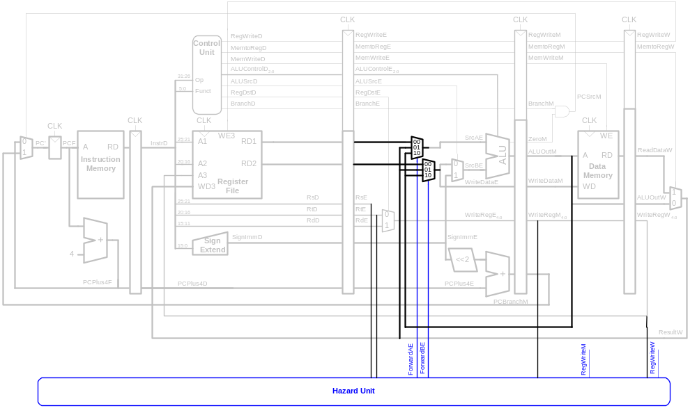
Data Forwarding

Slide 29
Data Forwarding
Forward to Execute stage from either:
  Memory stage or
  Writeback stage
Forwarding logic for ForwardAE:
if((rsE != 0) AND (rsE == WriteRegM) AND RegWriteM)
then ForwardAE = 10
else if ((rsE != 0) AND (rsE == WriteRegW) AND RegWriteW)
then ForwardAE = 01
else ForwardAE = 00
Forwarding logic for ForwardBE same, but replace rsE with rtE

Slide 30
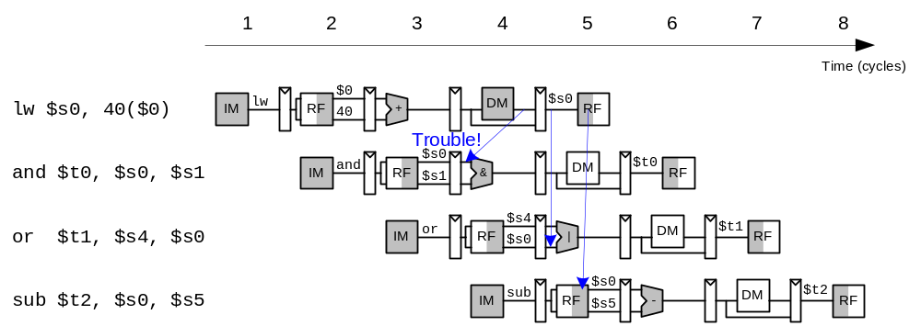
Data Hazard – Load Write

Slide 31
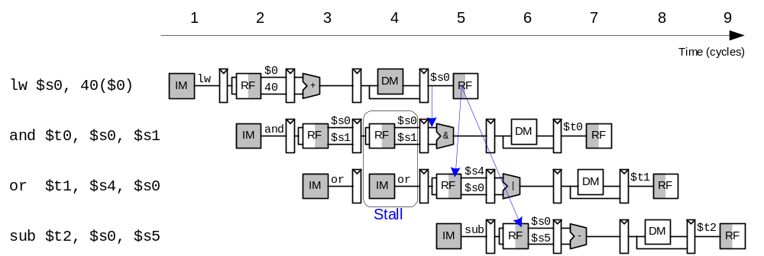
Stalling – Load Write

Slide 32
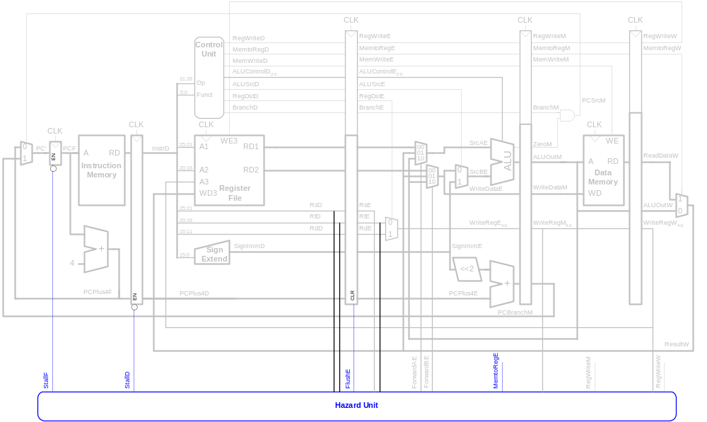
Stalling Hardware

Slide 33
Stalling Logic
lwstall =
((rsD==rtE) OR (rtD==rtE)) AND MemtoRegE
StallF = StallD = FlushE = lwstall

Slide 34
Control Hazards
beq:
  branch not determined until 4th stage of pipeline
  Instructions after branch fetched before branch occurs
  These instructions must be flushed if branch happens
Branch misprediction penalty
  number of instruction flushed when branch is taken
  May be reduced by determining branch earlier

Slide 35
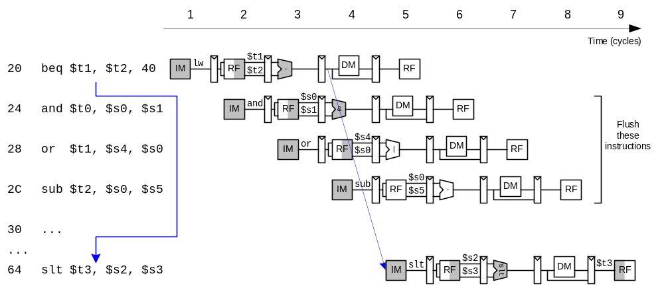
Control Hazards

Slide 36
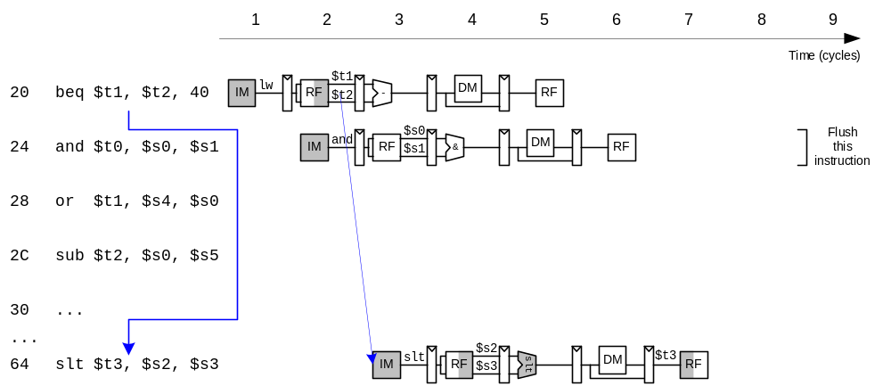
Early Branch Resolution

Slide 37
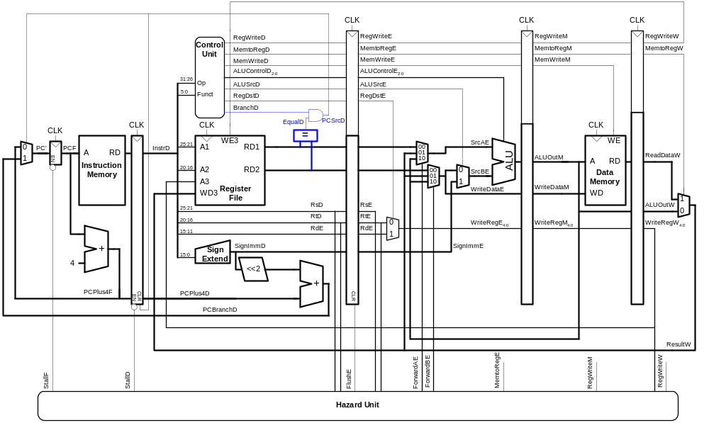
Early Branch Resolution
Introduced another data hazard in Decode stage

Slide 38
Stalling – R Type Write
add t0, s1, s2
beq t0, t1

Slide 39
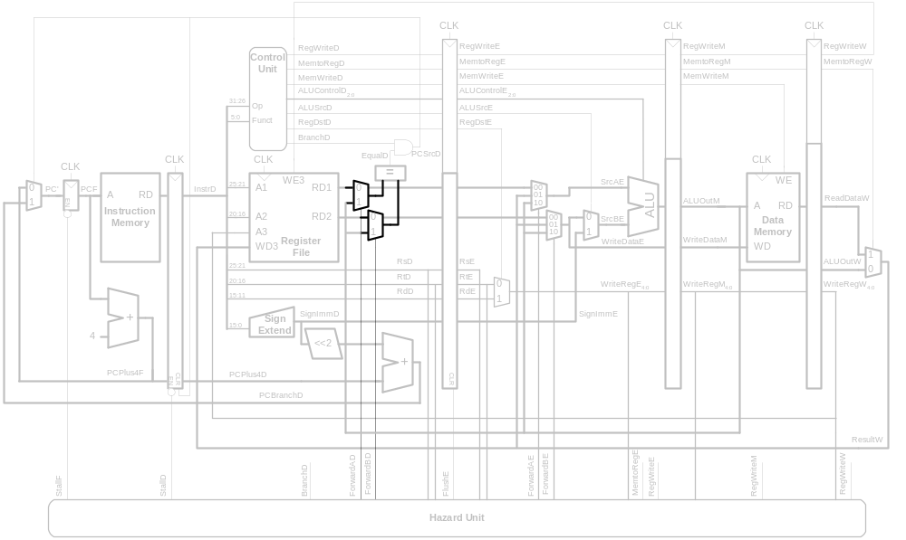
Data Hazard – R Type Write
add t0, s1, s2
nop
beq t0, t1

Slide 40
Stalling – Load Write
lw t1, offset(s3)
beq t0, t1
lw t1, offset(s3)
nop
nop
beq t0, t1

Slide 41
Control Forwarding & Stalling Logic
Forwarding logic:
ForwardAD = (rsD !=0) AND (rsD == WriteRegM) AND RegWriteM
ForwardBD = (rtD !=0) AND (rtD == WriteRegM) AND RegWriteM
Stalling logic:
branchstall = BranchD AND RegWriteE AND
(WriteRegE == rsD OR WriteRegE == rtD)
OR
BranchD AND MemtoRegM AND
(WriteRegM == rsD OR WriteRegM == rtD)
StallF = StallD = FlushE = lwstall OR branchstall

Slide 42
