Slide 1
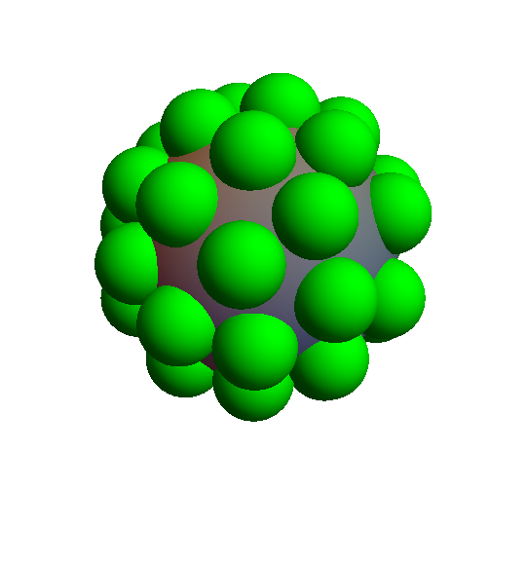
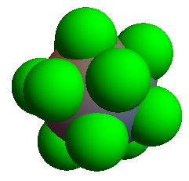
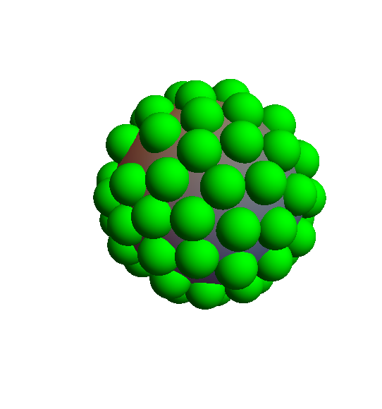
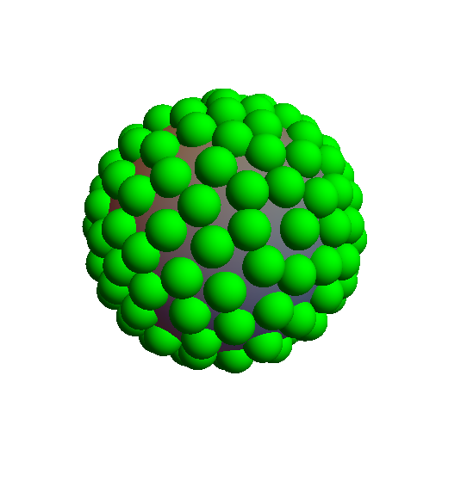
Sphere Packing
Ben Nissan and Tom Magerlein

Slide 2
Algorithm
Randomly distribute points on a sphere.
Try to shift each one a little bit in a random direction along the sphere.
Check how many moves were accepted and exit if none of them were (i.e., a full pack).
Expand all of their radii slightly.
Repeat until 3) is satisfied.

Slide 3
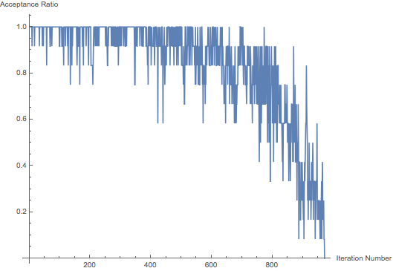
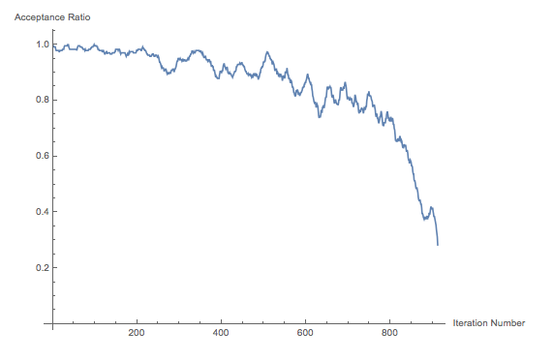
One Run, Standard Algorithm

Slide 4
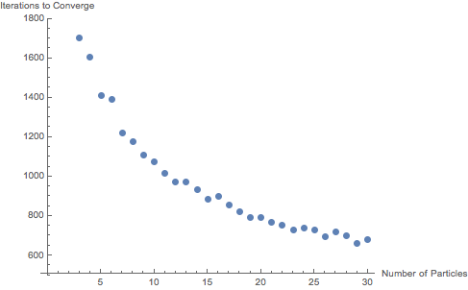
Testing Multiple Particles

Slide 5
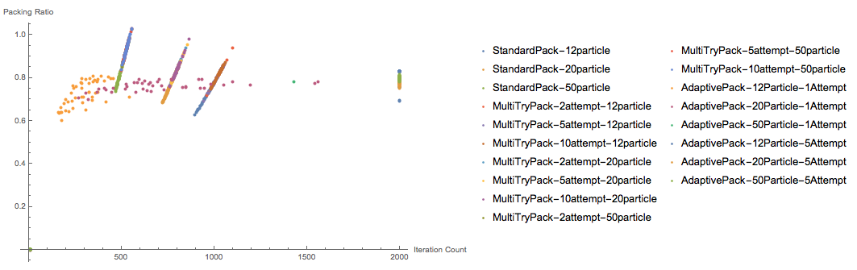
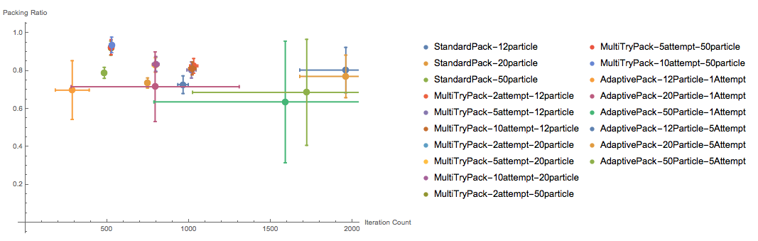
Multiple Approaches—Packing Ratio vs. Iterations

Slide 6
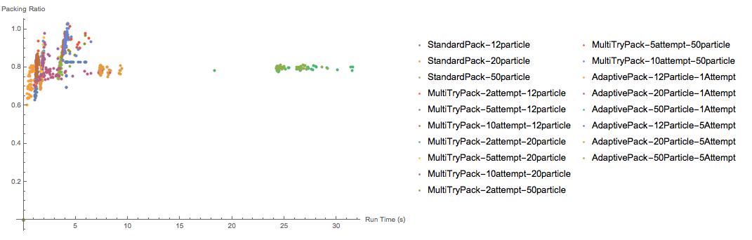
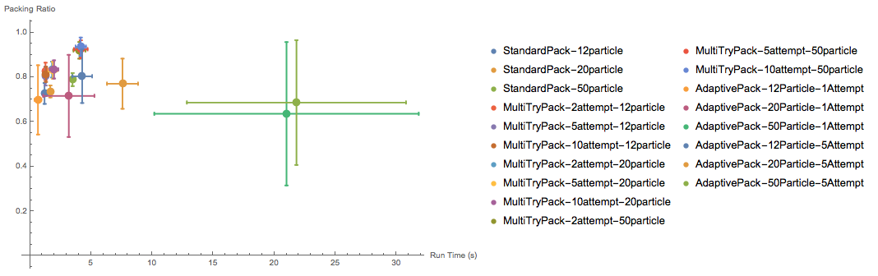
Multiple Approaches—Packing Ratio vs. Run Time

Slide 7
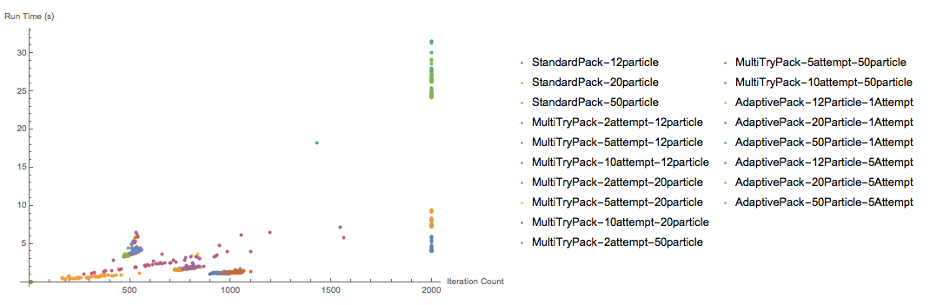
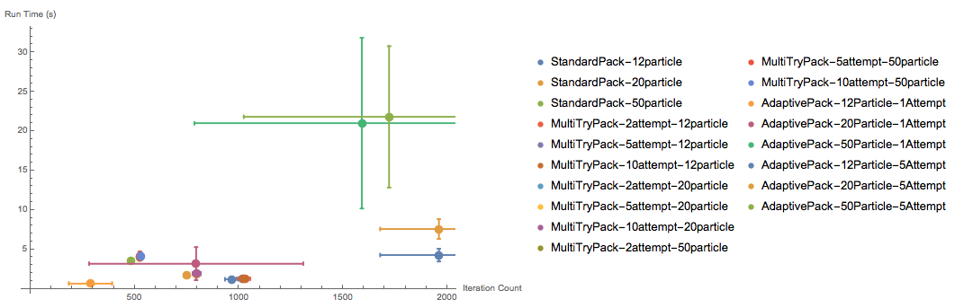
Multiple Approaches—Run Time vs. Iterations

