Slide 1
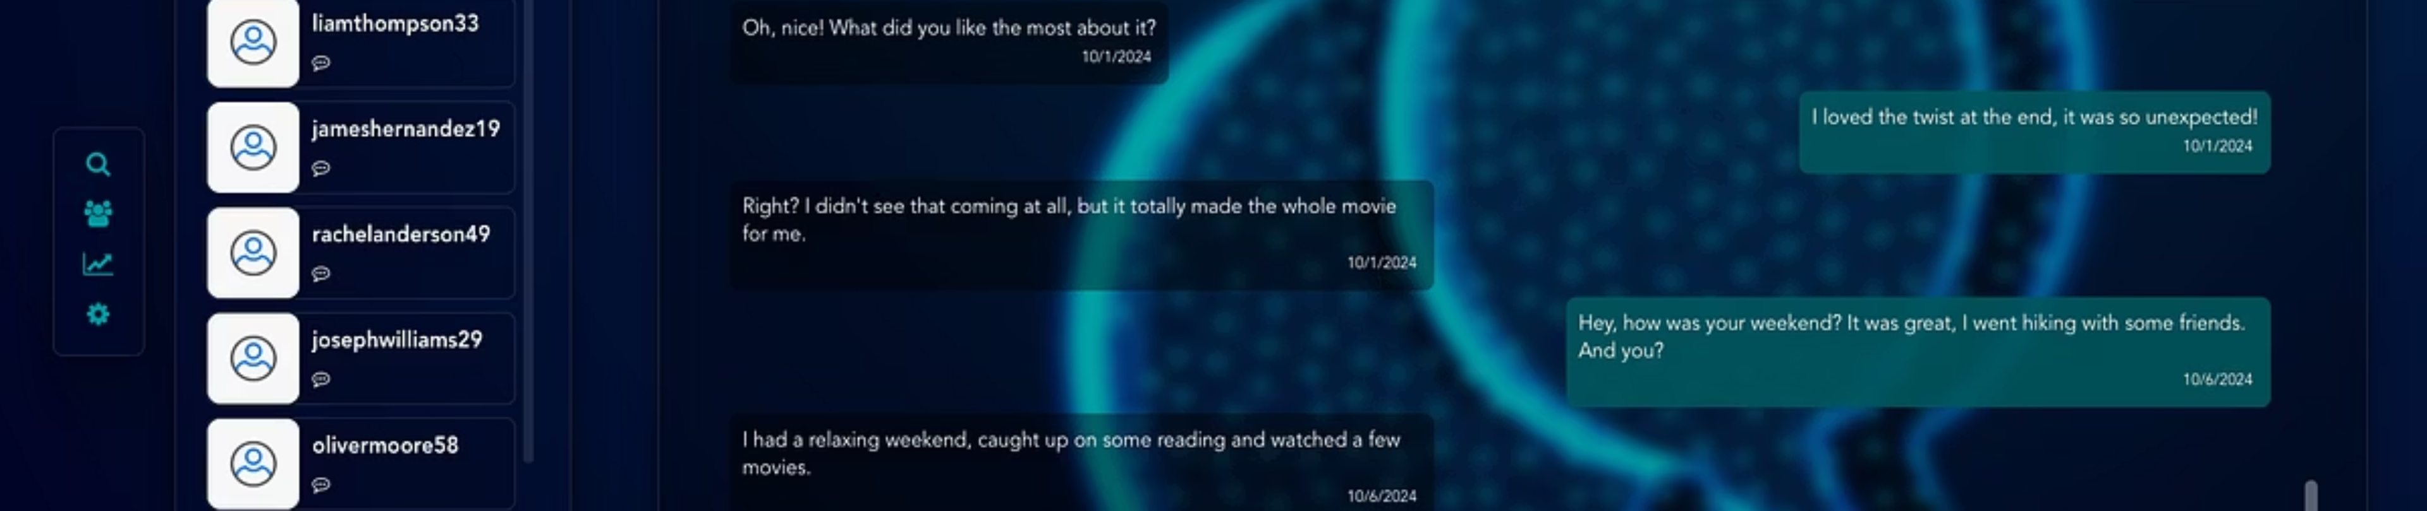
Web Chat Application
Presented by: Miuta Beniamin
Git rep : github.com/bennixm/chatapp

Slide 2
Introduction
Overview
Key Features
Web-based chat application for user communication.
Login, Register
Find people
Friendship System
Real-Time Messaging

Slide 3
System Overview
Login & Register
1
Users create accounts or log in.
2
Search User Page
Search for others by name.
Friend Request System
3
Send requests, receive notifications.
4
Friendship
Accepted requests form friendships.
Chat Page
5
Real-time messaging using WebSockets.

Slide 4
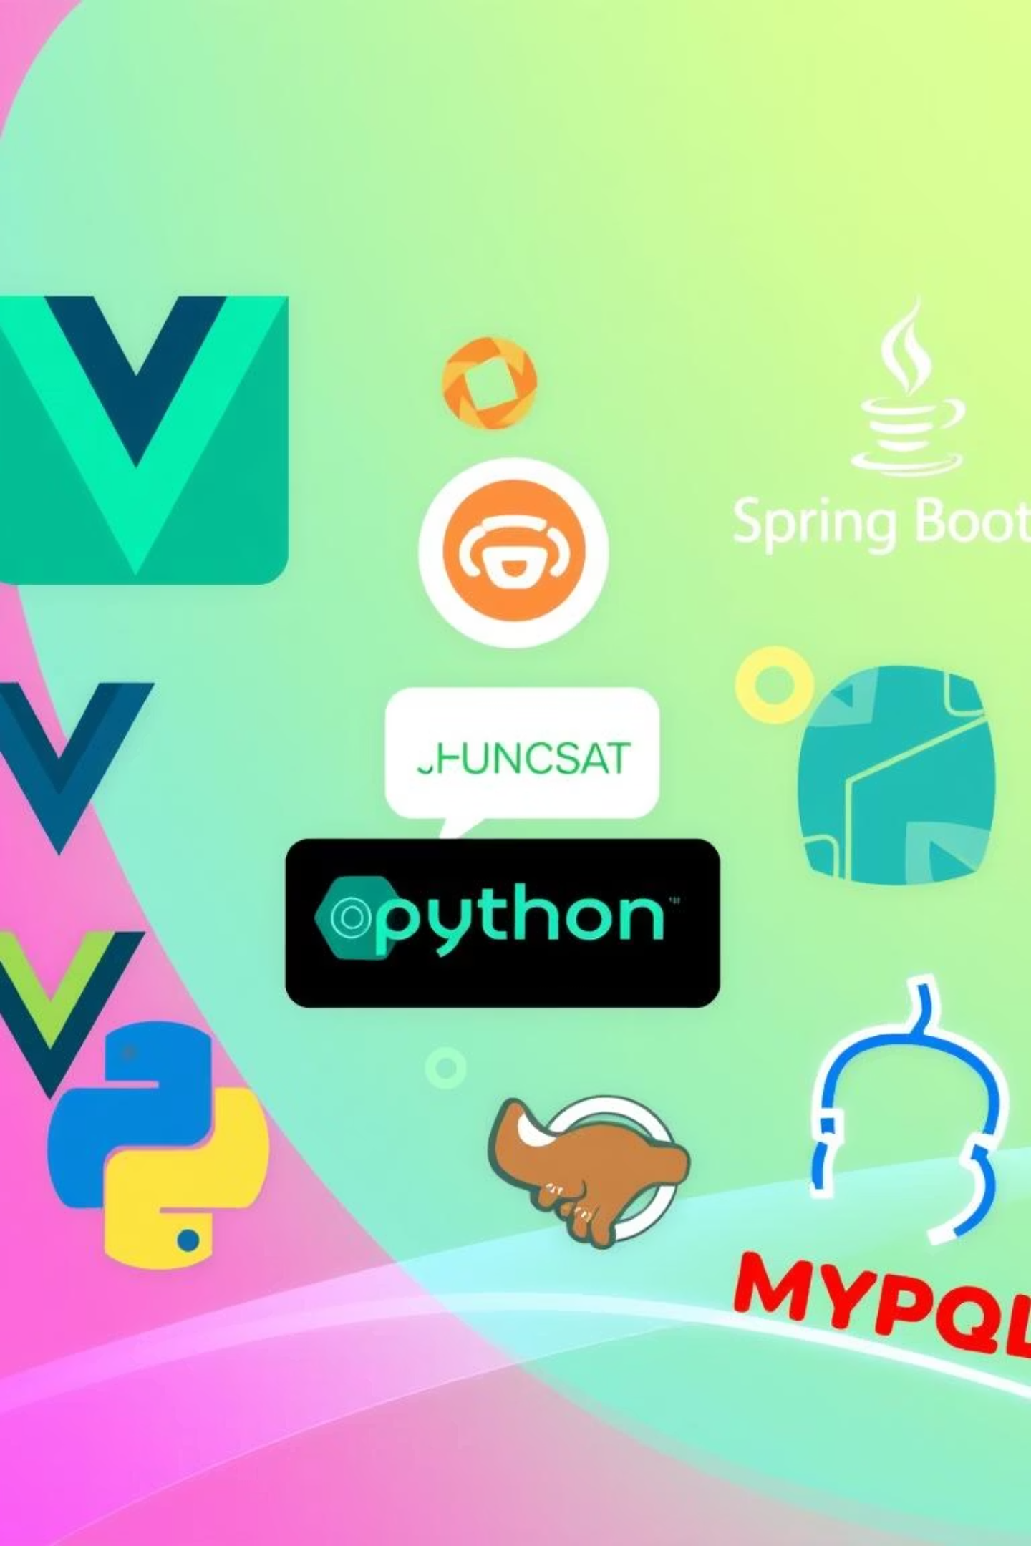
Technologies Used
Vue.js
Frontend framework for user interface.
Java Spring Boot
Backend API for user authentication and logic.
MySQL
Database for data storage and persistence.

Slide 5
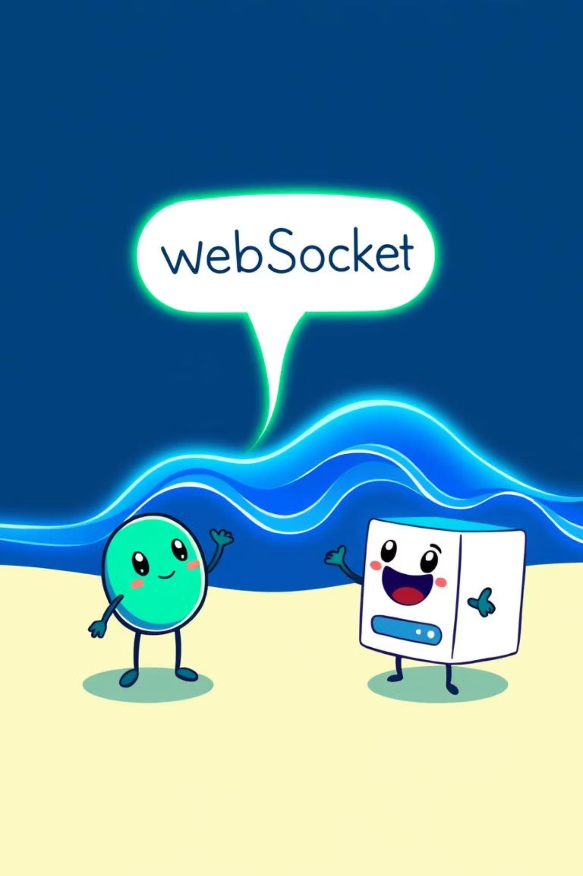
Real-Time Messaging
1
WebSockets
Real-time communication between client and server.
2
Instant Messaging
Messages sent instantly without page reload.
3
Chat History
Stored in MySQL for persistence.

Slide 6
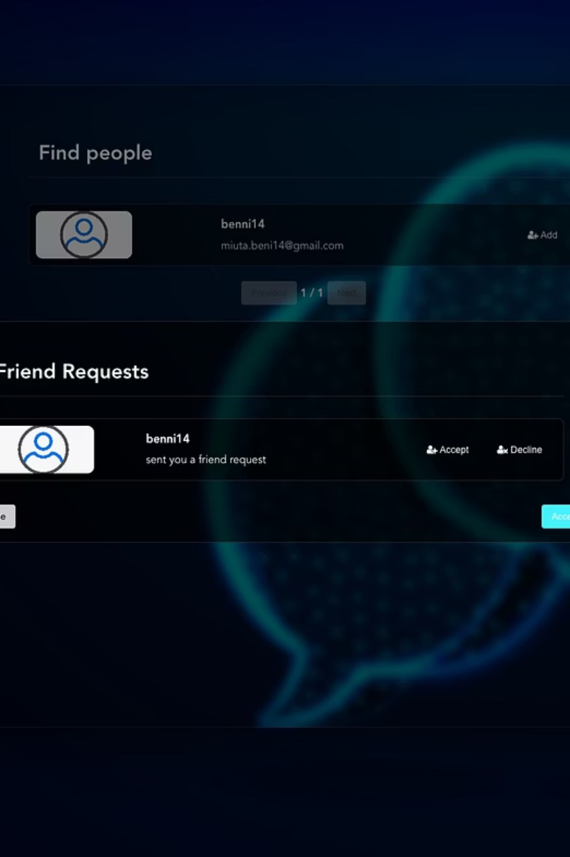



Notification System
Friend Request Notification
Notification List
Accept/Reject
Clicking the bell opens the list of requests.
Users can accept or reject requests directly.
Users are notified when they receive a friend request.

Slide 7
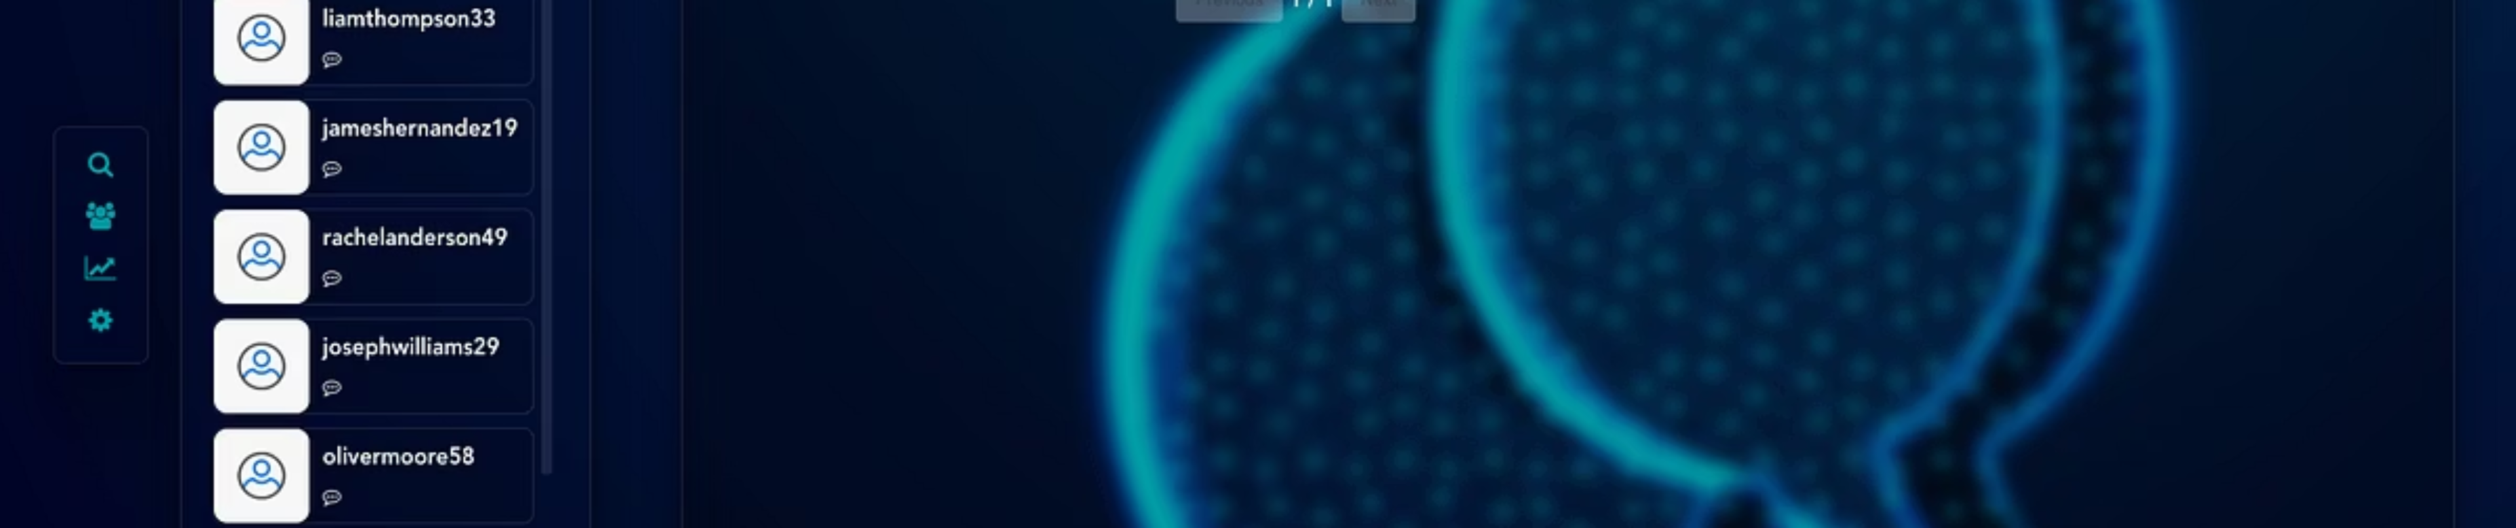




Friendship Management
Accept Request
Friendship Display
Chat Access
Unique Chats
Users are added as friends.
Friendships are displayed in the navbar.
Clicking on a friend opens the chat page.
Each chat is unique for instant messaging.

Slide 8


Functions
Register
Login
Friendship system
Find people
Using JWT token
Friend request popup
Search for user - page
Real time messages
Send messages in real time

Slide 9
Improvements in V2
Added secured Login using JWT Token ( in HTTP Only Cookie ) + route guards on token
Better XSS security
Restructured the error handling in frontend
Data Validation: Implemented more robust data validation on user inputs.

