Slide 1
k-Nearest Neighbors

Slide 2

When do we use KNN algorithm?
KNN can be used for both classification and regression predictive problems.
However, it is more widely used in classification problems in the industry.
To evaluate any technique we generally look at 3 important aspects:
1. Ease to interpret output
2. Calculation time
3. Predictive Power

Slide 3
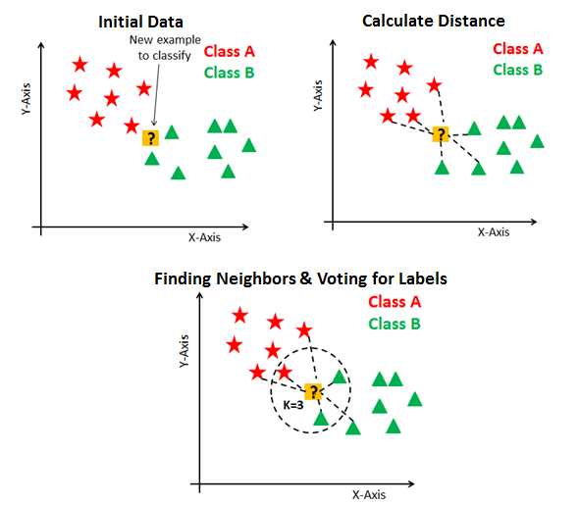
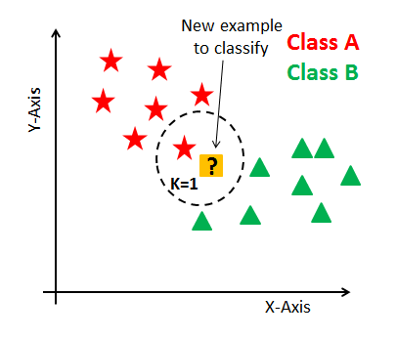

Slide 4
What is K? K represents the number of training data points lying in proximity to the test data point which we are going to use to find the class.
1. Load the training and test data 2. Choose the value of K 3. For each point in test data: - find the Euclidean distance to all training data points - store the Euclidean distances in a list and sort it - choose the first k points - assign a class to the test point based on the majority of classes present in the chosen points 4. End

Slide 5
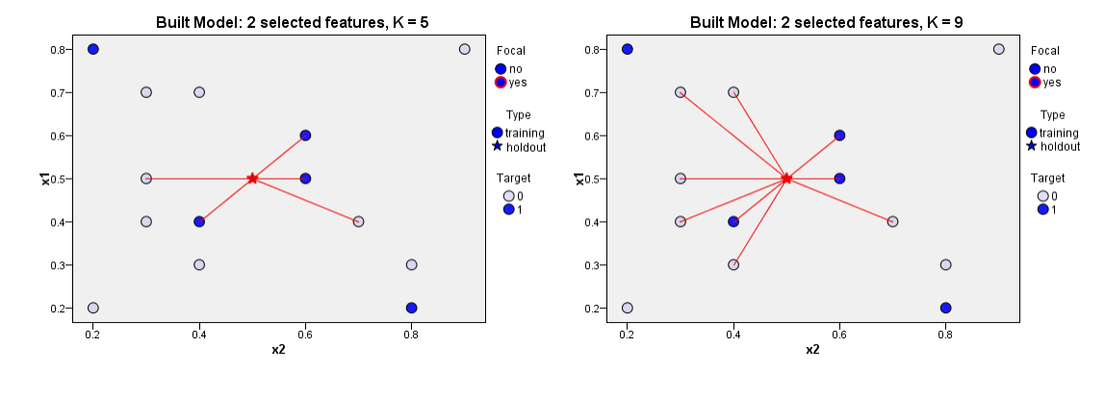

Slide 6
Pros and Cons of KNN
In this section we'll present some of the pros and cons of using the KNN algorithm.
Pros
It is extremely easy to implement
As said earlier, it is lazy learning algorithm and therefore requires no training prior to making real time predictions. This makes the KNN algorithm much faster than other algorithms that require training e.g SVM, linear regression, etc.
Since the algorithm requires no training before making predictions, new data can be added seamlessly.
There are only two parameters required to implement KNN i.e. the value of K and the distance function (e.g. Euclidean or Manhattan etc.)
Cons
The KNN algorithm doesn't work well with high dimensional data because with large number of dimensions, it becomes difficult for the algorithm to calculate distance in each dimension.
The KNN algorithm has a high prediction cost for large datasets. This is because in large datasets the cost of calculating distance between new point and each existing point becomes higher.
Finally, the KNN algorithm doesn't work well with categorical features since it is difficult to find the distance between dimensions with categorical features.

Slide 7
d = sqrt(q1-p1)2 + (q2-p2)2

