Slide 1

Demanded Abstract Interpretation
Benno Stein
Thesis Defense
University of Colorado Boulder
March 30, 2022

Slide 2




Static Analysis Workflow
Is this program okay?*
Land changes, deploy to production, etc.
*i.e. is it safe with respect to some program analysis?

Slide 3


Static Analysis Workflow
Is this program okay?
How about this one?
...
This is slow and frustrating, since each iteration can take minutes to hours.
Land changes, deploy to production, etc.

Slide 4

Interactive Static Analysis Workflow
Is this program okay?
Did my edits fix those alarms?
Alarms:
- Possible issue foo at location x
- Possible issue bar at location y
User needs this to be:
- correct with respect to underlying batch analyzer
- fast enough for interactive use as they make edits and issue queries – on the order of seconds
/
Land changes, deploy to production, etc.
Analysis designer needs this to be:
- plug-and-play with no need for ad hoc incremental or demand-driven reasoning
- general w.r.t. abstract domains and analyses

Slide 5


Batch Analysis
Over-
approximate
Facts
Program

Slide 6
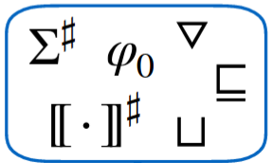
Abstract Interpretation
Pros:
- Expressivity of abstract domains
- Robust metatheory: soundness,
termination, etc.
- Modularity w.r.t abstractions and
fixed-point solver engines
Cons:
- Whole-program fixed points are
expensive to compute
- Black-box: invariant map only holds
meaning once fixed point is reached
Abstract domain, transfer functions, join, widen, etc.
Worklist-based fixed point solver
Control-flow graph(s)
Invariant Map
Over-
approximate
Facts
Program

Slide 7
Existing Approaches
Intraprocedural Analysis and Unrolling
Demanded Summarization
Conclusions & Future Work
Benno Stein
Thesis Defense
University of Colorado Boulder
March 30, 2022

Slide 8
Existing Approaches
 | Infinite-height abstract domains with widening | Incremental | Demand-Driven
Classic Abstract Interpretation
Demand-Driven Dataflow Analysis
Incremental Dataflow Analysis
Datalog-based Analysis
Demanded Abstract Interpretation (this talk!)

Slide 9
Demand-Driven Analysis
Over-
approximate
Facts
Program
query
result
???

Slide 10
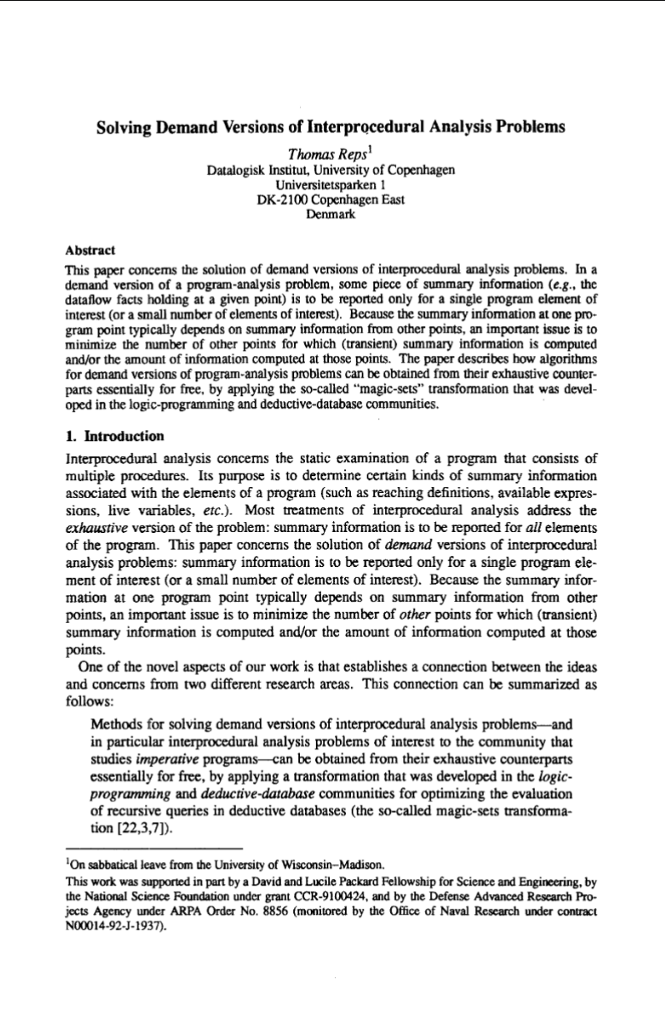
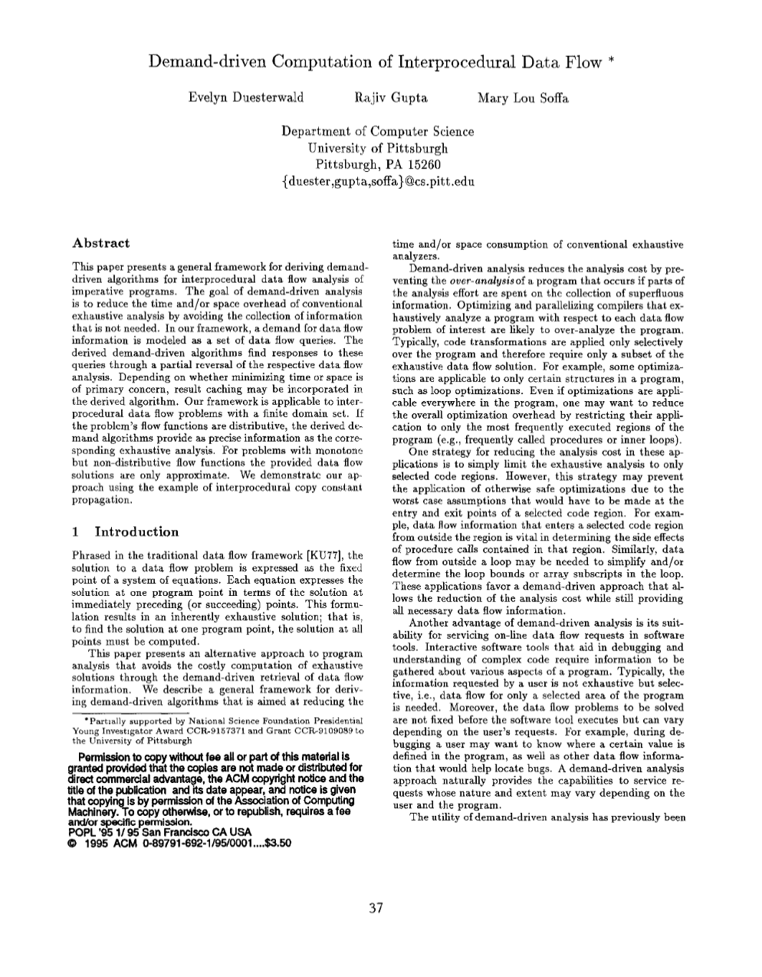
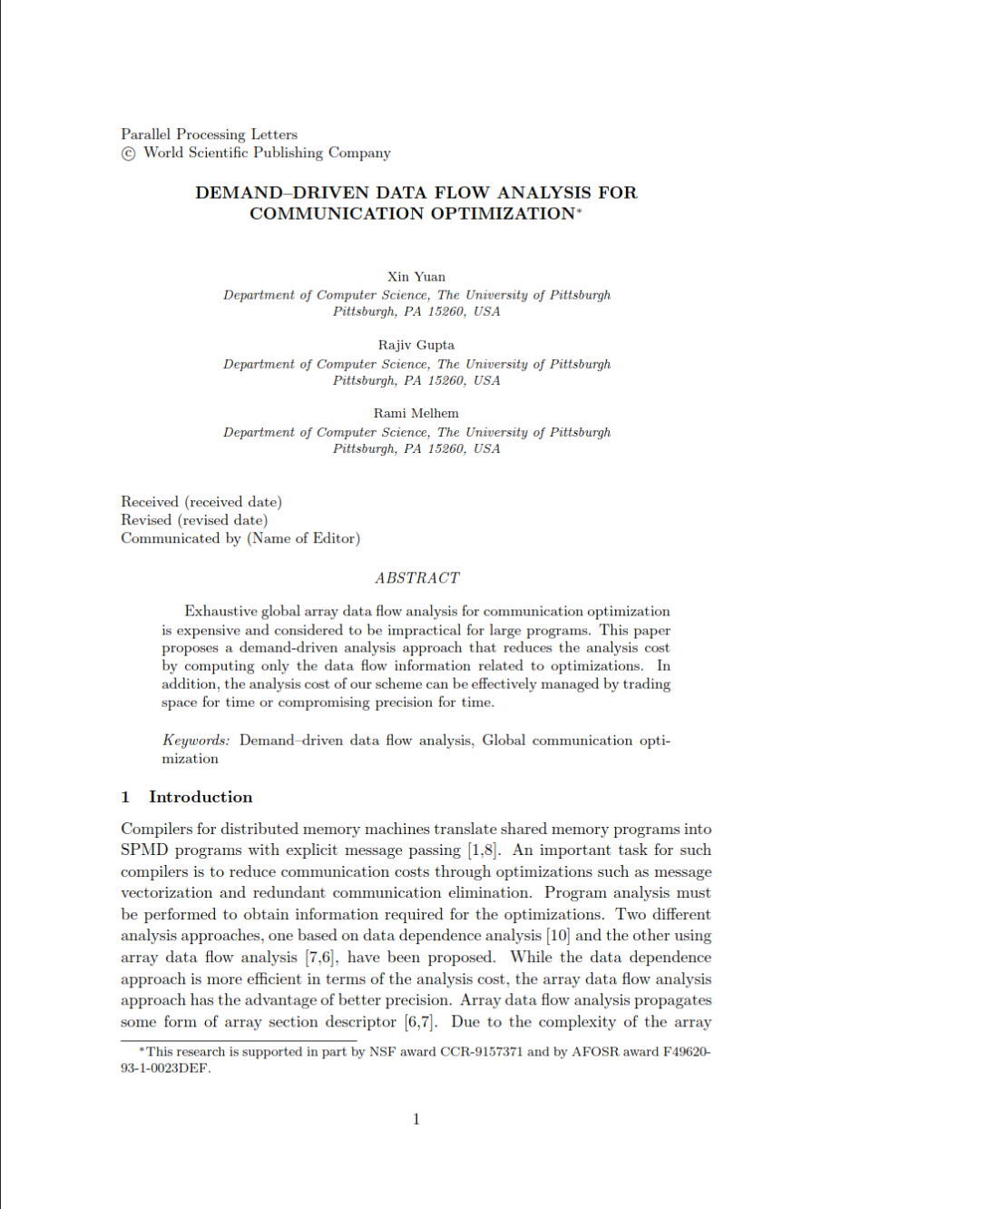
Demand-Driven Analysis
Over-
approximate
Facts
Program
Analysis responds to demand queries for specific results, rather than computing exhaustive global results
query
result
???
Existing work focuses on finite data flow analysis problems only.
It’s still expensive to handle queries that depend on most of the program.

Slide 11
Existing Approaches
 | Infinite-height abstract domains with widening | Incremental | Demand-Driven
Classic Abstract Interpretation
Demand-Driven Dataflow Analysis
Incremental Dataflow Analysis
Datalog-based Analysis
Demanded Abstract Interpretation (this talk!)

Slide 12
Incremental Analysis
Over-
approximate
Facts
Program
Δ
???
(new)
Program
(new) Over-
approximate
Facts

Slide 13
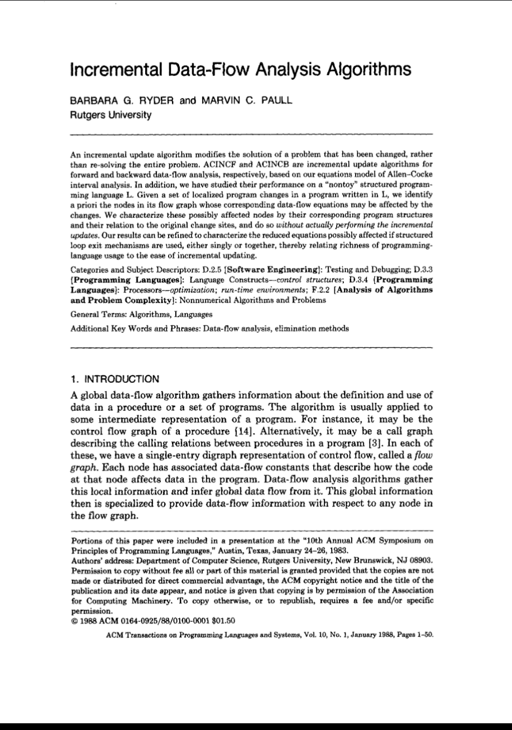
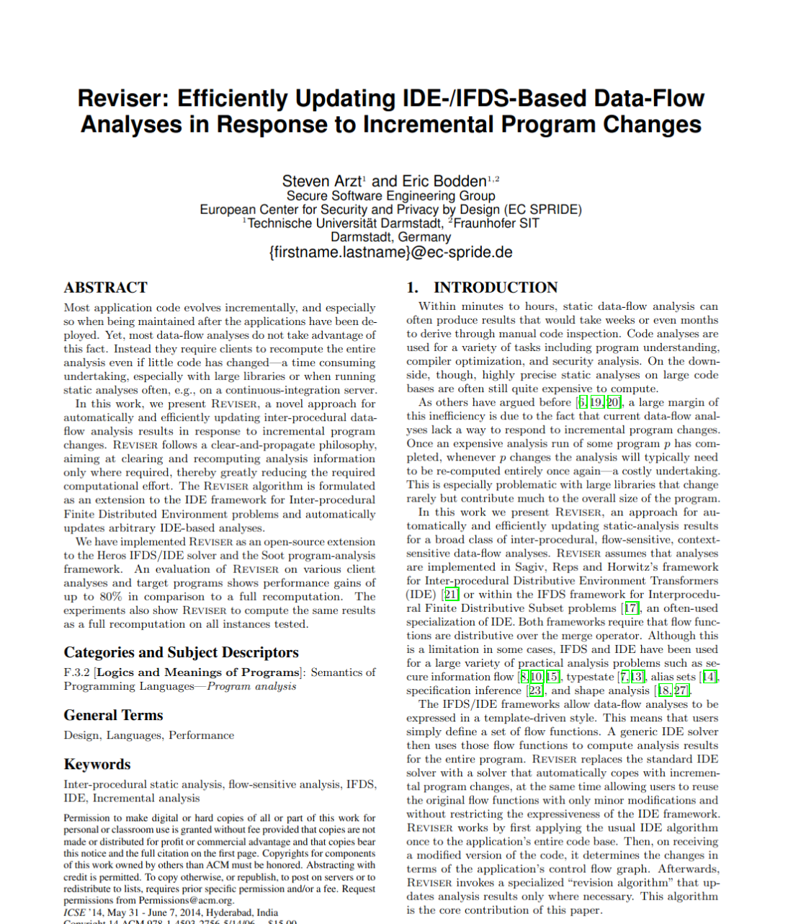
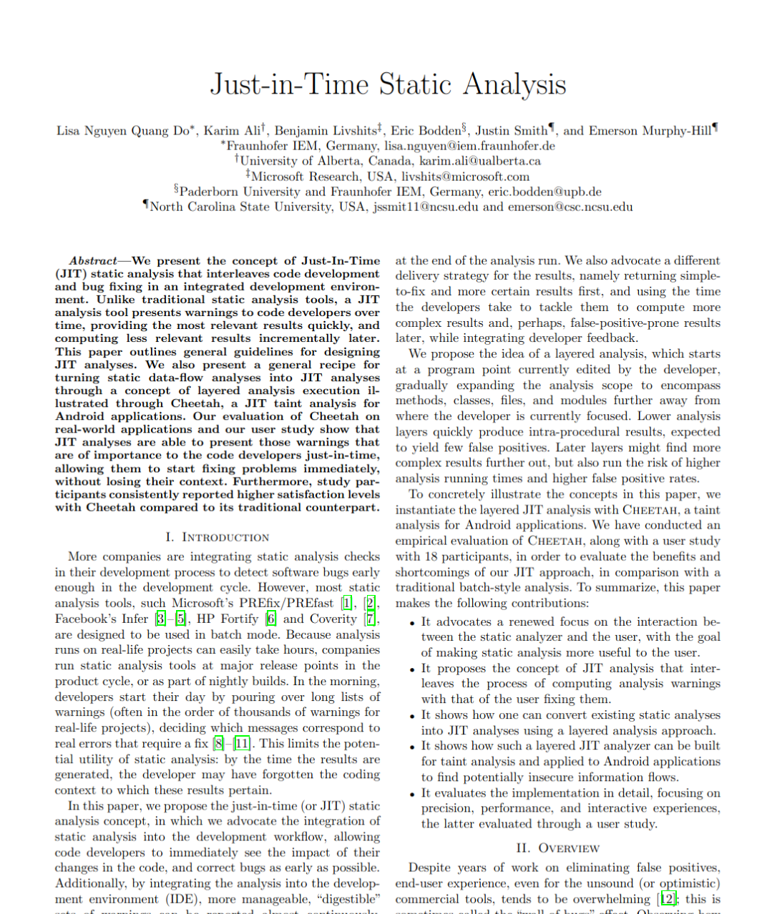
Incremental Analysis
Over-
approximate
Facts
Program
As the program is edited, the analysis responds and recomputes affected results on the fly
Δ
???
(new)
Program
(new) Over-
approximate
Facts
Existing work focuses on finite data flow analysis problems only.
It’s still expensive to handle edits that affect most of the program.

Slide 14
Existing Approaches
 | Infinite-height abstract domains with widening | Incremental | Demand-Driven
Classic Abstract Interpretation
Demand-Driven Dataflow Analysis
Incremental Dataflow Analysis
Datalog-based Analysis
Demanded Abstract Interpretation (this talk!)

Slide 15
Existing Approaches
 | Infinite-height abstract domains with widening | Incremental | Demand-Driven
Classic Abstract Interpretation
Demand-Driven Dataflow Analysis
Incremental Dataflow Analysis
Datalog-based Analysis, Attribute Grammars
Demanded Abstract Interpretation (this talk!)

Slide 16
Existing Approaches
 | Infinite-height abstract domains with widening | Incremental | Demand-Driven
Classic Abstract Interpretation
Demand-Driven Dataflow Analysis
Incremental Dataflow Analysis
Datalog-based Analysis, Attribute Grammars
Demanded Abstract Interpretation (this talk!)
Why does this matter?
Many important analyses require infinite height lattices! Intervals,
octagons, shape analysis, etc.
Why is this hard?
Incremental and demand-driven analysis are fundamentally dependency graph problems; infinite domains yield unbounded graphs

Slide 17
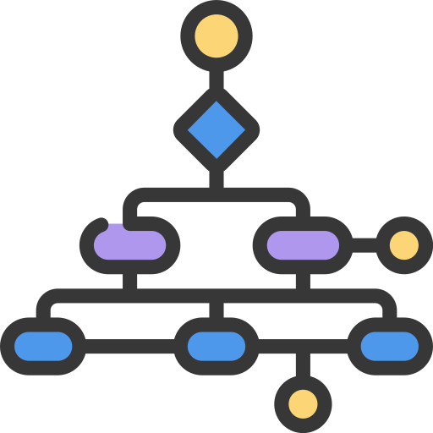
Programs as Graphs
imperative programs:
control-flow graphs:
l
x := e
l’
l’
x := e
p1 ; p2
if (e) {p1} else {p2}
while (e) {p}
...
l
p1
l’
p2
l’’
assume e
l1
p1
l
l’
assume !e
l2
p2
assume e
l
l’
p
assume !e
⇔
structured imperative control flow reducible control flow graphs

Slide 18
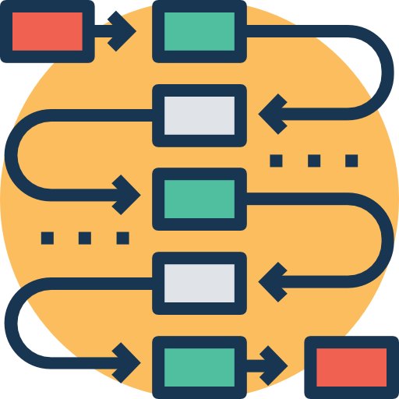
Dependency Graphs
Analysis traverses graph, computing facts at each location
Over-
approximate
Facts
analysis computation itself is a graph: facts depend on program syntax and on other intermediate facts
key idea: we can reify that graph, and use it to perform analysis incrementally & on-demand
two (related) issues:
dependency cycles (induced by cyclic control flow), and
unbounded dependencies (induced by infinite-height analysis domains)

Slide 19
Procedure Calls
intraprocedural analysis: programs P = control-flow graphs L, E, l0 
=
loops (i.e. cycles within one procedure CFG)
interprocedural analysis: programs P = collections of control-flow graphs
(finite maps from procedure labels ρ to CFGs L, E )
main
foo
bar
=
...
recursion (i.e. cycles in the procedure call graph)

Slide 20
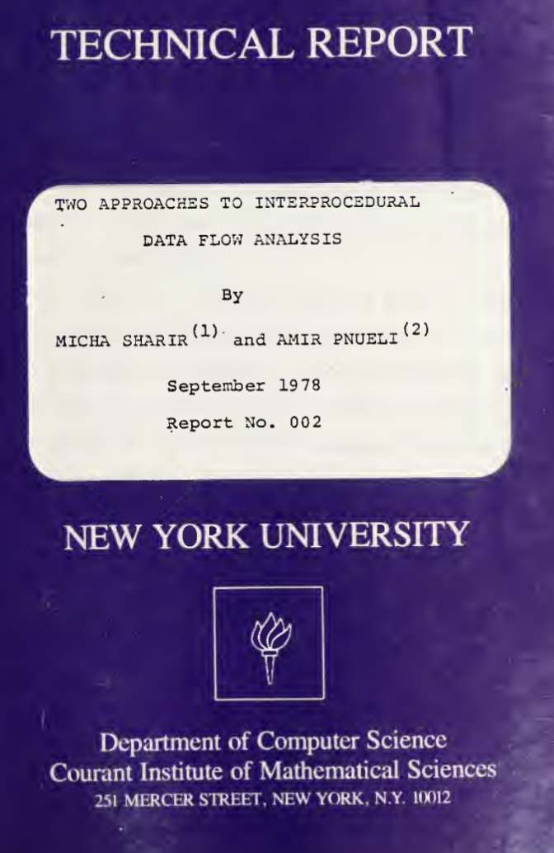
Interprocedural (Batch) Analysis
???
main
foo
Over-
approximate
Facts
bar
a useful analysis needs to somehow distinguish “different” calls to the same procedure
Two Approaches to Interprocedural Data Flow
Analysis. Micha Sharir and Amir Pnueli, 1978.

Slide 21
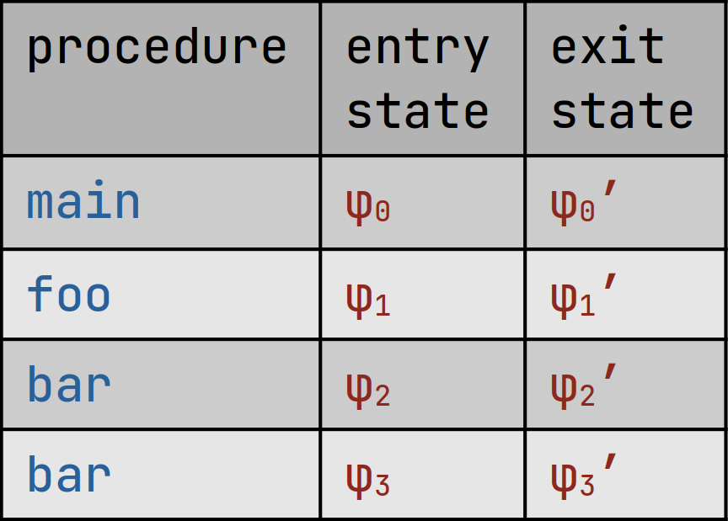
Interprocedural (Batch) Analysis
call strings approach:
analyze each procedure separately
for each (abstract) calling context
e.g.
main calls foo and bar
foo calls bar
functional approach:
analyze each procedure separately for each (abstract) entry state
main
empty call stack
bar
called from main
main
entry state
φ0
bar
entry state
φ2
main
a.k.a. tabulation, as it builds a table of (partial) summaries
propagate data flow through the context-sensitive interprocedural flow graph
compute and compose procedure summaries to derive semantics of progressively larger program parts
operational approach
foo
bar
denotational approach
foo
called from main
bar
called from foo
foo
entry state
φ1
bar
entry state φ3
both work for batch analysis and are common in practice, but there are some nuanced implications for demanded analysis
Two Approaches to Interprocedural Data Flow Analysis. Micha Sharir and Amir Pnueli, 1978.

Slide 22
Existing Approaches
Intraprocedural Analysis and Unrolling
Demanded Summarization
Conclusions & Future Work
Benno Stein
Thesis Defense
University of Colorado Boulder
March 30, 2022

Slide 23
Intraprocedural Demanded Analysis
Demand-driven queries
“What is the abstract state at this
program location?”
???
Incremental program edits
Add, edit, or delete statements
(initial)
CFG
From-scratch consistent results
Query results are identical to batch
analysis on current program version

Slide 24
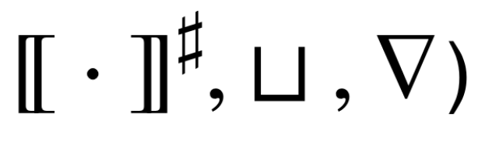
Demanded Abstract Interpretation Graphs
A DAIG reifies the dependency structure of an intraprocedural abstract interpretation computation
Reference cell vertices …
… contain program syntax and intermediate analysis results
… are uniquely named and potentially empty
Computation edges …
… acyclically connect reference cells
… are labelled by analysis semantic functions (e.g.
???
Demand-driven queries
Incremental program edits
From-scratch consistent results
Demanded Abstract Interpretation. Stein, Chang, and Sridharan. PLDI ‘21.

Slide 25
Demanded Abstract Interpretation Graphs
A DAIG reifies the dependency structure of an intraprocedural abstract interpretation computation
A DAIG reifies the dependency structure of an intraprocedural abstract interpretation computation
cyclic and unbounded fixed point computation in infinite-height domains
Reference cell vertices …
… contain program syntax and intermediate analysis results
… are uniquely named and potentially empty
Computation edges …
… acyclically connect reference cells
… are labelled by analysis semantic functions (e.g.
demanded unrolling of fixed point computations
acyclic and finite dependency structure, supporting incremental and demand-driven evaluation
???
Demand-driven queries
Incremental program edits
From-scratch consistent results

Slide 26
Programs to DAIGs
Program
DAIG

Slide 27
Programs to DAIGs (by example)
Program CFG
DAIG
l
?
l·l’
s
l
s
l’
l’
?
unique names identify values for reuse across different program versions and demand queries

Slide 28
Programs to DAIGs (by example)
Program CFG
DAIG
fix
l
l¹
l*
l⁰
violates acyclicity!
?
l
?
?
Δ
Δ
s
s’
analyze
l-to-l’-to-l
loop
l’

Slide 29
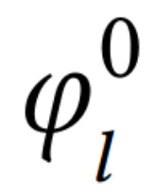
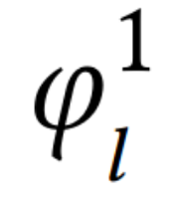
Fixed points without cycles
demand-driven query:
What is the fixed point abstract state at l?
fix
l⁰
l¹
l*
?
?
?
?
Δ
analyze
l-to-l’-to-l
loop
if two consecutive abstract states at l are equal, that’s the fixed point: write it to l* and return
compute transitive dependencies normally

Slide 30
Fixed points without cycles
demand-driven query:
What is the fixed point abstract state at l?
fix
l⁰
l¹
l*
l²
?
?
Δ
Δ
analyze
l-to-l’-to-l
loop
analyze
l-to-l’-to-l
loop
widening’s “ascending chains converge” property ensures that unrolling is finite
if two consecutive abstract states at l are not equal, unroll the DAIG and continue analysis

Slide 31
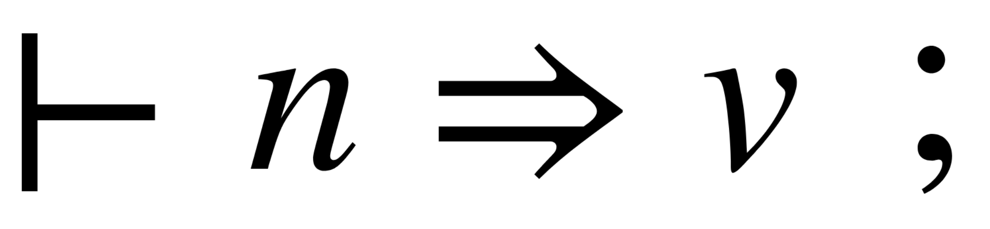

DAIG Semantics
,
demand-driven query evaluation is an operational semantics over DAIGs
,
recall: a DAIG is a reified state of some
abstract interpretation computation
incremental change propagation is another operational semantics over DAIGs
*we’re eliding some details here, of course

Slide 32
DAIG Analysis Termination
query termination: analysis in DAIGs always converges
,
for any query against a valid initial DAIG...
...there exists a corresponding result v and final DAIG

Slide 33
DAIG From-Scratch Consistency
from-scratch consistency: analysis in DAIGs produces the exact same results as the underlying batch analysis would
,
for any valid initial DAIG...
...if n names an invariant at some location l...
...then v is equal to [[ l ]]♯*, the fixed point result that batch analysis computes at l
i.e. there is no loss of precision due to incremental/demand-driven mechanisms!
analysis soundness is a direct corollary of from-scratch consistency

Slide 34
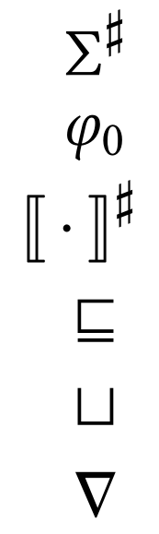
Domain Expressivity
DAIG analysis framework
~2500 lines of OCaml code
parametric in a statement language and abstract domain
No ad hoc reasoning about incrementality or demand is required!
Domain implementor gets incrementality and demand “for free”.
module type Domain = sig
type t
val init : t
val interpret : stmt → t → t
val implies : t → t → bool
val join : t → t → t
val widen : t → t → t
(* elided: hash, equal, etc. *)
end
abstract states
initial abstract state
transfer function
We’ve implemented interval, octagon, and shape analyses
partial order
join
widen

Slide 35
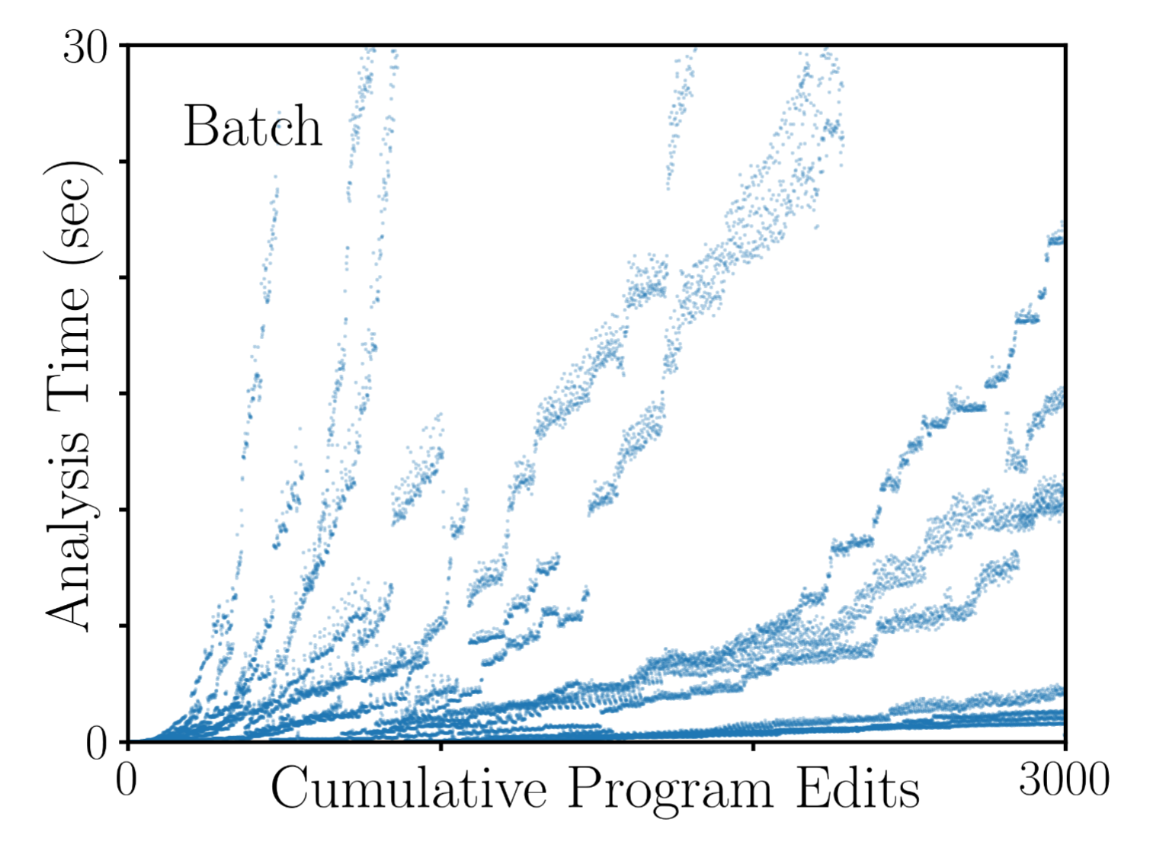
Scalability & Responsiveness
synthetic benchmarks: randomly-generated program edits and demand queries
analysis is in octagon domain
y-axis ≈ analysis cost
x-axis ≈ program size

Slide 36
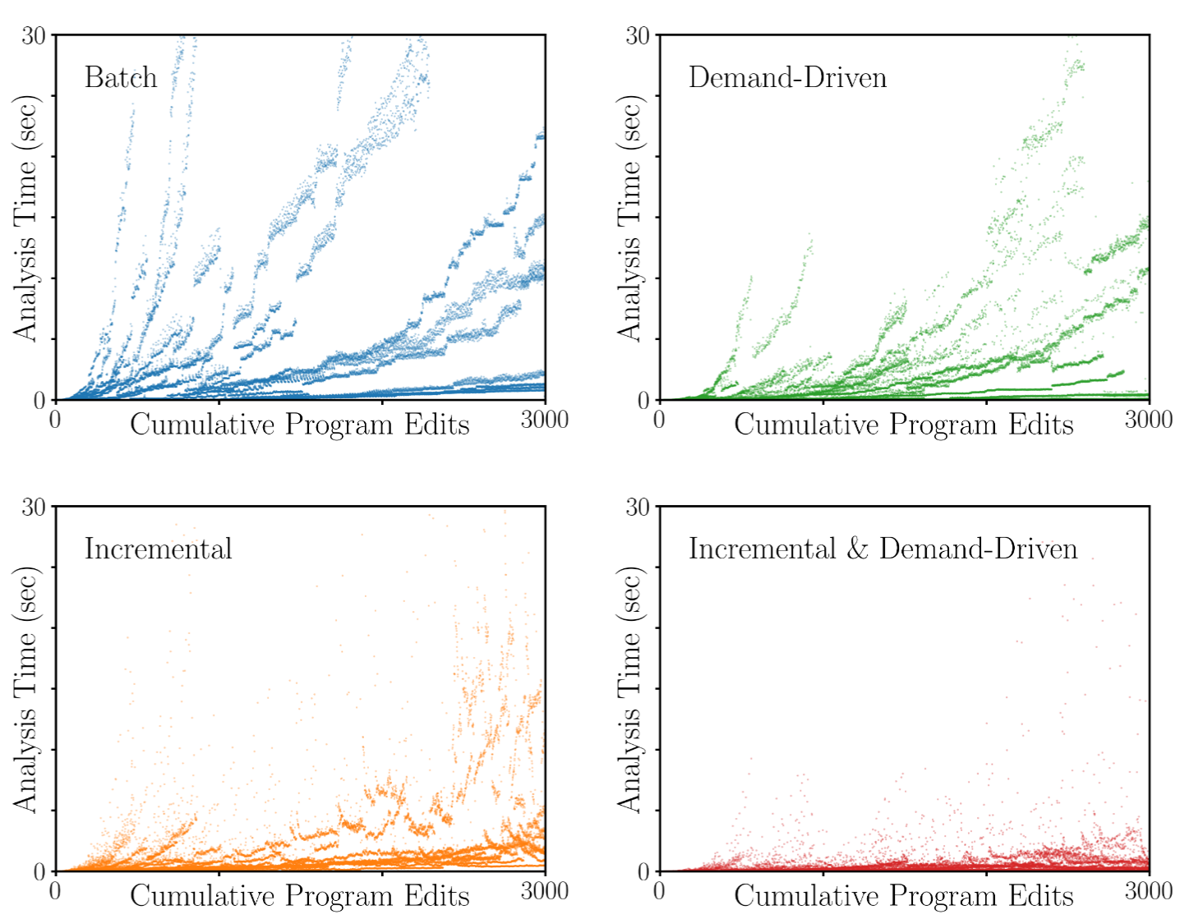
Scalability & Responsiveness

Slide 37
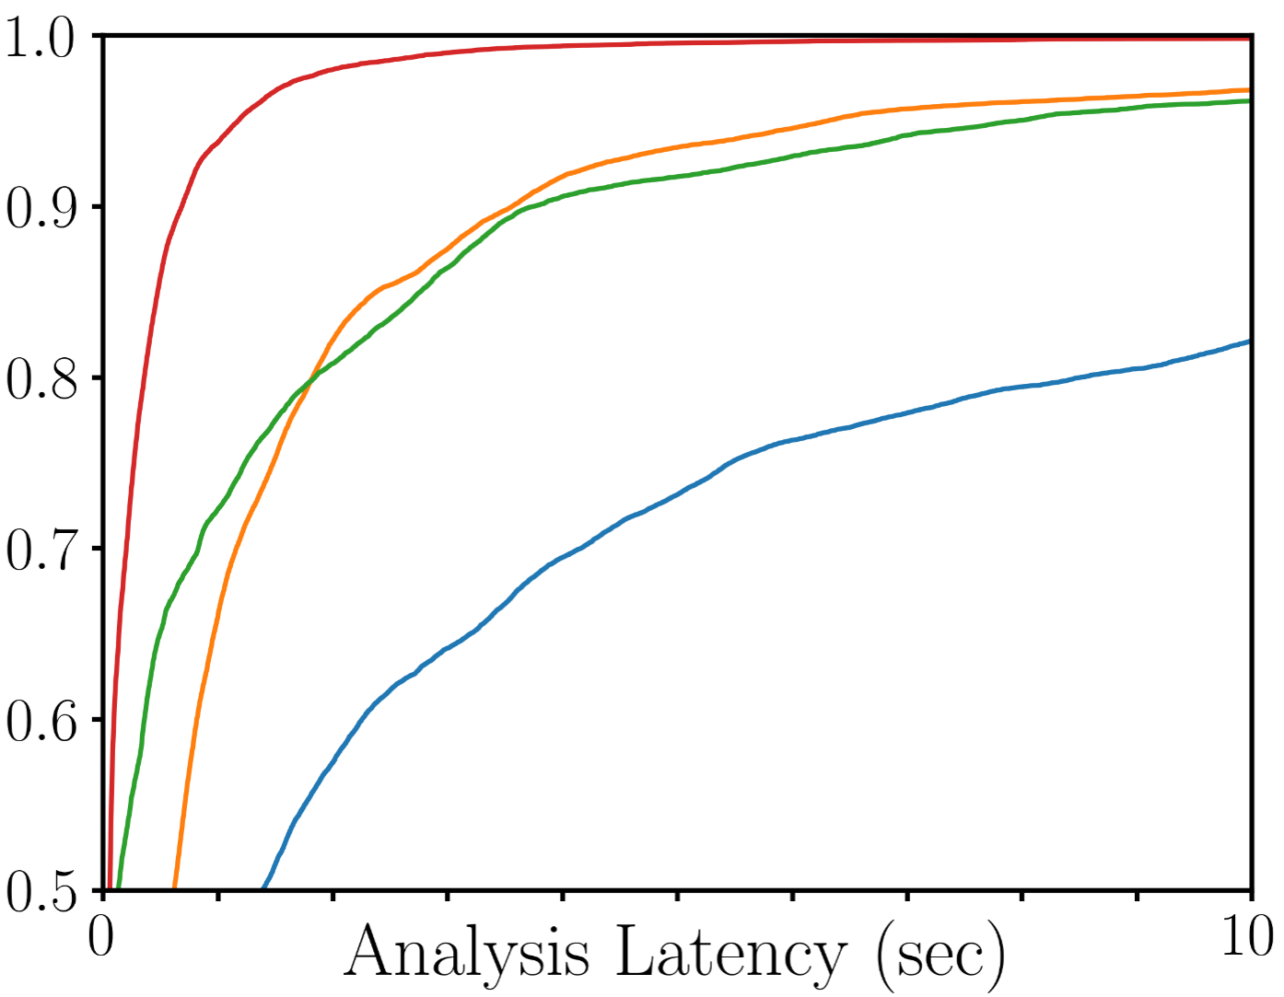
Scalability & Responsiveness
combination of incrementality and demand consistently obtains faster results than either technique alone: p95 of ~1 second
Fraction of Analysis Runs Completed
Incr. & D.-D.
Incremental
Demand-Driven
Batch

Slide 38
Existing Approaches
Intraprocedural Analysis and Unrolling
Demanded Summarization
Conclusions & Future Work
Benno Stein
Thesis Defense
University of Colorado Boulder
March 30, 2022

Slide 39
Demanded Interprocedural Analysis
Demand-driven queries
“What is the abstract state at this
program location?”
main
???
Incremental program edits
Add, edit, or delete statements
foo
bar
From-scratch consistent results
Query results are identical to batch
analysis on current program version

Slide 40
Demanded Interprocedural Analysis
Demand-driven queries
“What is the abstract state at this
program location?”
main
???
Incremental program edits
Add, edit, or delete statements
Add, edit, or delete procedures
foo
bar
From-scratch consistent results
Query results are identical to batch
tabulation on current program version

Slide 41
A naïve approach: one big DAIG
naïve approach: combine all of the CFGs into an interprocedural flow graph and build a single DAIG structure, using the operational approach
main
Combined DAIG
foo
CFG → DAIG
bar

Slide 42
A naïve approach: one big DAIG
naïve approach: combine all of the CFGs into an interprocedural flow graph and build a single DAIG structure, using the operational approach
main
e.g. main calls foo calls bar
Combined DAIG
foo
call foo
foo
bar
call bar
CFG → DAIG
main
return
bar
return
two main issues:
- cycles in the call graph (i.e. recursion) break DAIG acyclicity
- overly conservative dirtying: all callees and callers of
an edited procedure are invalidated

Slide 43
Demanded Summarization Graphs
our approach: use a DAIG to compute each summary in a tabulation algorithm, following the denotational approach
main
main
foo
foo
bar
bar
...

Slide 44
Demanded Summarization Graphs
Demand-driven queries
“What is the abstract state at this
program location?”
main
???
Incremental program edits
Add, edit, or delete statements
Add, edit, or delete procedures
foo
bar
From-scratch consistent results
Query results are identical to batch
tabulation on current program version

Slide 45
Demanded Summarization Graphs
A DSG reifies the dependency structure of an interprocedural abstract interpretation computation
DAIG vertices …
… handle intraprocedural analysis computation
summarization edges …
… record summary applications as interprocedural dependencies
Demand-driven queries
Incremental program edits
From-scratch consistent results
Interactive Abstract Interpretation with Demanded Summarization.
Stein, Flores, Chang, and Sridharan. Under submission.

Slide 46
Encoding procedure calls in DAIGs
we know how to build a DAIG for a single procedure (mostly...)
main DAIG
main CFG
l
?
l
procedure labels ρ (e.g. main, foo, bar) can label DAIG edges now
call foo
foo
l’
l’
?

Slide 47
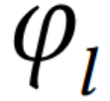
Compositionality
DAIG evaluation gets “stuck”: the abstract state at l’ depends on foo analysis results
foo DAIG
main DAIG
construct (or reuse) a DAIG for the callee
lentry
fully-solved DAIG is effectively a Hoare-style procedure summary
{φ} foo {φ’}
l
foo
l’
,
apply it as a procedure summary
?
lexit
,
?
query its exit state
may require more summaries of transitive callees!
i.e. l’ in main depends on the summary of foo with procedure-entry state φ

Slide 48
Compositionality
foo DAIG
main DAIG
lentry
l
DSG records summary dependency
foo
l’
,
?
lexit
,
i.e. dirty l’ if foo summary is dirtied
?
very fine-grained! return-site state in caller depends on summary of callee

Slide 49
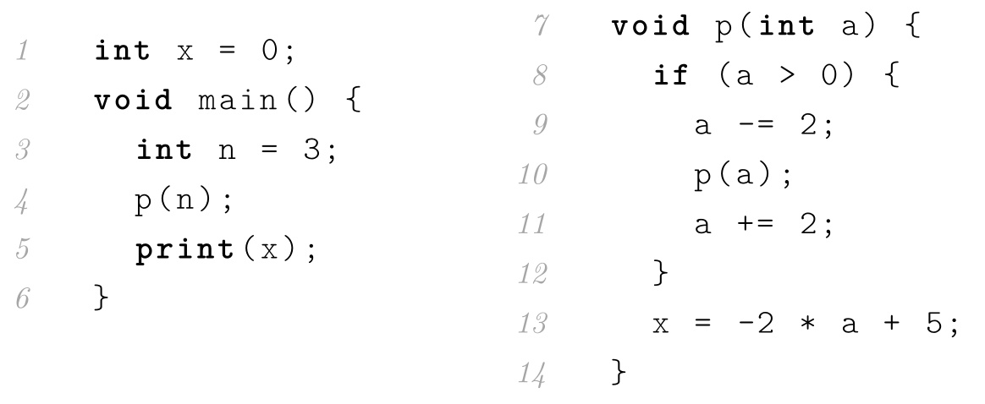
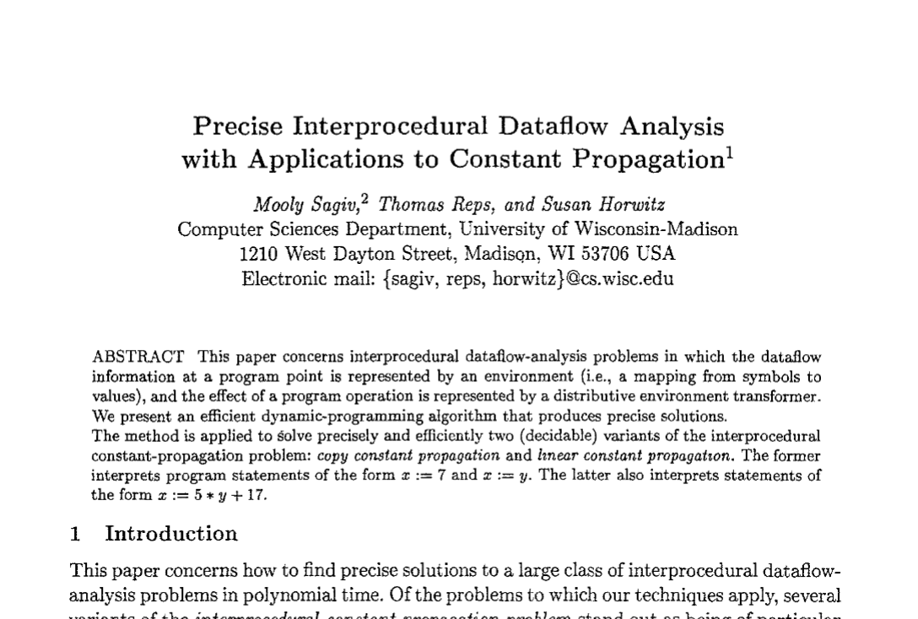
An interprocedural example

Slide 50
Recursion
recall: demanded unrolling only works for reducible control-flow graphs
fix
l
l⁰
l¹
l²
?
l*
?
Δ
Δ
s
s’
analyze
l-to-l’-to-l
loop
analyze
l-to-l’-to-l
loop
therefore, it only applies to
tail-recursive procedures
(with exactly one recursive call)
l’
fun search(key, bst) {
if ( key == t.key )
return t.val;
else if ( key < t.key )
return search(t.left);
else
return search(t.right);
}
control-flow cycle introduced by recursive call
Real programs have richer structure, e.g.:

Slide 51
Recursion by example
p @ { x ↦ [0,0];
a ↦ [3,3] }
p @ { x ↦ [0,0];
a ↦ (-∞,3] }
main @ {x ↦ [0,0]}
Δ
{x ↦ [0,0]}
int n = 3;
{x ↦ [0,0]; n ↦ [3,3]}
p(n);
???
print(x);
???
{x ↦ [0,0]; a ↦ [3,3]}
if (a > 0) {
{x ↦ [0,0]; a ↦ [3,3]}
a -= 2;
{x ↦ [0,0]; a ↦ [1,1]}
p(a); ???
a += 2; ???
} ???
x = -2 * a + 5;
???
{x ↦ [0,0]; a ↦ (-∞,3]}
if (a > 0) {
{x ↦ [0,0]; a ↦ [0,3]}
a -= 2;
{x ↦ [0,0]; a ↦ [-1,1]}
p(a); ???
a += 2; ???
} ???
x = -2 * a + 5;
???
self-referential summary query!
compute a fixed point in place
Notes:
By the same intuition as we used for intraprocedural analysis: we know there is a sound/terminating algorithm, so we should be able to dynamically extend our dependencies and rely on widening to ensure termination

Slide 52
Recursion by example
{x ↦ [0,0]; a ↦ (-∞,3]}
if (a > 0) {
{x ↦ [0,0]; a ↦ [0,3]}
a -= 2;
{x ↦ [0,0]; a ↦ [-2,1]}
p(a);
???
a += 2;
???
} ???
x = -2 * a + 5;
???
{x ↦ [0,0]; a ↦ (-∞,3]}
if (a > 0) {
{x ↦ [0,0]; a ↦ [0,3]}
a -= 2;
{x ↦ [0,0]; a ↦ [-2,1]}
p(a);
⊥
a += 2;
⊥
} {x ↦ [0,0]; a ↦ (-∞,0]}
x = -2 * a + 5;
{x ↦ [5,∞); a ↦ (-∞,0]}
{x ↦ [0,0]; a ↦ (-∞,3]}
if (a > 0) {
{x ↦ [0,0]; a ↦ [0,3]}
a -= 2;
{x ↦ [0,0]; a ↦ [-2,1]}
p(a);
{x ↦ [5,∞); a ↦ [-2,1]}
a += 2;
{x ↦ [5,∞); a ↦ [0,3]}
} {x ↦ [0,∞]; a ↦ (-∞,3]}
x = -2 * a + 5;
{x ↦ [-1,∞); a ↦ (-∞,3]}
{x ↦ [0,0]; a ↦ (-∞,3]}
if (a > 0) {
{x ↦ [0,0]; a ↦ [0,3]}
a -= 2;
{x ↦ [0,0]; a ↦ [-2,1]}
p(a);
{x ↦ [-1,∞); a ↦ [-2,1]}
a += 2;
{x ↦ [-1,∞); a ↦ [0,3]}
} {x ↦ [-1,∞]; a ↦ (-∞,3]}
x = -2 * a + 5;
{x ↦ [-1,∞); a ↦ (-∞,3]}
Δ
Δ
Notes:
By the same intuition as we used for intraprocedural analysis: we know there is a sound/terminating algorithm, so we should be able to dynamically extend our dependencies and rely on widening to ensure termination

Slide 53
Recursion by example
p @ { x ↦ [0,0];
a ↦ [3,3] }
p @ { x ↦ [0,0];
a ↦ (-∞,3] }
main @ {x ↦ [0,0]}
{x ↦ [0,0]}
int n = 3;
{x ↦ [0,0]; n ↦ [3,3]}
p(n);
???
print(x);
???
{x ↦ [0,0]; a ↦ [3,3]}
if (a > 0) {
{x ↦ [0,0]; a ↦ [3,3]}
a -= 2;
{x ↦ [0,0]; a ↦ [1,1]}
p(a); ???
a += 2; ???
} ???
x = -2 * a + 5;
???
{x ↦ [0,0]; a ↦ (-∞,3]}
if (a > 0) {
{x ↦ [0,0]; a ↦ [0,3]}
a -= 2;
{x ↦ [0,0]; a ↦ [-2,1]}
p(a);
{x ↦ [-1,∞); a ↦ [-2,1]}
a += 2;
{x ↦ [-1,∞); a ↦ [0,3]}
} {x ↦ [-1,∞]; a ↦ (-∞,3]}
x = -2 * a + 5;
{x ↦ [-1,∞);
a ↦ (-∞,3]}
Notes:
By the same intuition as we used for intraprocedural analysis: we know there is a sound/terminating algorithm, so we should be able to dynamically extend our dependencies and rely on widening to ensure termination

Slide 54
Recursion by example
p @ { x ↦ [0,0];
a ↦ [3,3] }
p @ { x ↦ [0,0];
a ↦ (-∞,3] }
main @ {x ↦ [0,0]}
{x ↦ [0,0]}
int n = 3;
{x ↦ [0,0]; n ↦ [3,3]}
p(n);
???
print(x);
???
{x ↦ [0,0]; a ↦ [3,3]}
if (a > 0) {
{x ↦ [0,0]; a ↦ [3,3]}
a -= 2;
{x ↦ [0,0]; a ↦ [1,1]}
p(a);
{x ↦ [-1,∞);a ↦ [1,1]}
a += 2;
???
} ???
x = -2 * a + 5;
???
{x ↦ [0,0]; a ↦ (-∞,3]}
if (a > 0) {
{x ↦ [0,0]; a ↦ [0,3]}
a -= 2;
{x ↦ [0,0]; a ↦ [-2,1]}
p(a);
{x ↦ [-1,∞); a ↦ [-2,1]}
a += 2;
{x ↦ [-1,∞); a ↦ [0,3]}
} {x ↦ [-1,∞]; a ↦ (-∞,3]}
x = -2 * a + 5;
{x ↦ [-1,∞);
a ↦ (-∞,3]}
Notes:
By the same intuition as we used for intraprocedural analysis: we know there is a sound/terminating algorithm, so we should be able to dynamically extend our dependencies and rely on widening to ensure termination

Slide 55
Recursion by example
p @ { x ↦ [0,0];
a ↦ [3,3] }
p @ { x ↦ [0,0];
a ↦ (-∞,3] }
main @ {x ↦ [0,0]}
{x ↦ [0,0]}
int n = 3;
{x ↦ [0,0]; n ↦ [3,3]}
p(n);
???
print(x);
???
{x ↦ [0,0]; a ↦ [3,3]}
if (a > 0) {
{x ↦ [0,0]; a ↦ [3,3]}
a -= 2;
{x ↦ [0,0]; a ↦ [1,1]}
p(a);
{x ↦ [-1,∞);a ↦ [1,1]}
a += 2;
{x ↦ [-1,∞);a ↦ [3,3]}
} {x ↦ [-1,∞);a ↦ [3,3]}
x = -2 * a + 5;
{x ↦ [-1,-1];
a ↦ [3,3]}
{x ↦ [0,0]; a ↦ (-∞,3]}
if (a > 0) {
{x ↦ [0,0]; a ↦ [0,3]}
a -= 2;
{x ↦ [0,0]; a ↦ [-2,1]}
p(a);
{x ↦ [-1,∞); a ↦ [-2,1]}
a += 2;
{x ↦ [-1,∞); a ↦ [0,3]}
} {x ↦ [-1,∞]; a ↦ (-∞,3]}
x = -2 * a + 5;
{x ↦ [-1,∞);
a ↦ (-∞,3]}
Notes:
By the same intuition as we used for intraprocedural analysis: we know there is a sound/terminating algorithm, so we should be able to dynamically extend our dependencies and rely on widening to ensure termination

Slide 56
Recursion by example
p @ { x ↦ [0,0];
a ↦ [3,3] }
p @ { x ↦ [0,0];
a ↦ (-∞,3] }
main @ {x ↦ [0,0]}
{x ↦ [0,0]}
int n = 3;
{x ↦ [0,0]; n ↦ [3,3]}
p(n);
{x ↦ [-1,-1]; n ↦ [3,3]}
print(x);
???
{x ↦ [0,0]; a ↦ [3,3]}
if (a > 0) {
{x ↦ [0,0]; a ↦ [3,3]}
a -= 2;
{x ↦ [0,0]; a ↦ [1,1]}
p(a);
{x ↦ [-1,∞);a ↦ [1,1]}
a += 2;
{x ↦ [-1,∞);a ↦ [3,3]}
} {x ↦ [-1,∞);a ↦ [3,3]}
x = -2 * a + 5;
{x ↦ [-1,-1];
a ↦ [3,3]}
{x ↦ [0,0]; a ↦ (-∞,3]}
if (a > 0) {
{x ↦ [0,0]; a ↦ [0,3]}
a -= 2;
{x ↦ [0,0]; a ↦ [-2,1]}
p(a);
{x ↦ [-1,∞); a ↦ [-2,1]}
a += 2;
{x ↦ [-1,∞); a ↦ [0,3]}
} {x ↦ [-1,∞]; a ↦ (-∞,3]}
x = -2 * a + 5;
{x ↦ [-1,∞);
a ↦ (-∞,3]}
Notes:
By the same intuition as we used for intraprocedural analysis: we know there is a sound/terminating algorithm, so we should be able to dynamically extend our dependencies and rely on widening to ensure termination

Slide 57
Recursion by example
p @ { x ↦ [0,0];
a ↦ [3,3] }
p @ { x ↦ [0,0];
a ↦ (-∞,3] }
main @ {x ↦ [0,0]}
{x ↦ [0,0]}
int n = 3;
{x ↦ [0,0]; n ↦ [3,3]}
p(n);
{x ↦ [-1,-1]; n ↦ [3,3]}
print(x);
{x ↦ [-1,-1];
n ↦ [3,3]}
{x ↦ [0,0]; a ↦ [3,3]}
if (a > 0) {
{x ↦ [0,0]; a ↦ [3,3]}
a -= 2;
{x ↦ [0,0]; a ↦ [1,1]}
p(a);
{x ↦ [-1,∞);a ↦ [1,1]}
a += 2;
{x ↦ [-1,∞);a ↦ [3,3]}
} {x ↦ [-1,∞);a ↦ [3,3]}
x = -2 * a + 5;
{x ↦ [-1,-1];
a ↦ [3,3]}
{x ↦ [0,0]; a ↦ (-∞,3]}
if (a > 0) {
{x ↦ [0,0]; a ↦ [0,3]}
a -= 2;
{x ↦ [0,0]; a ↦ [-2,1]}
p(a);
{x ↦ [-1,∞); a ↦ [-2,1]}
a += 2;
{x ↦ [-1,∞); a ↦ [0,3]}
} {x ↦ [-1,∞]; a ↦ (-∞,3]}
x = -2 * a + 5;
{x ↦ [-1,∞);
a ↦ (-∞,3]}
Notes:
By the same intuition as we used for intraprocedural analysis: we know there is a sound/terminating algorithm, so we should be able to dynamically extend our dependencies and rely on widening to ensure termination

Slide 58
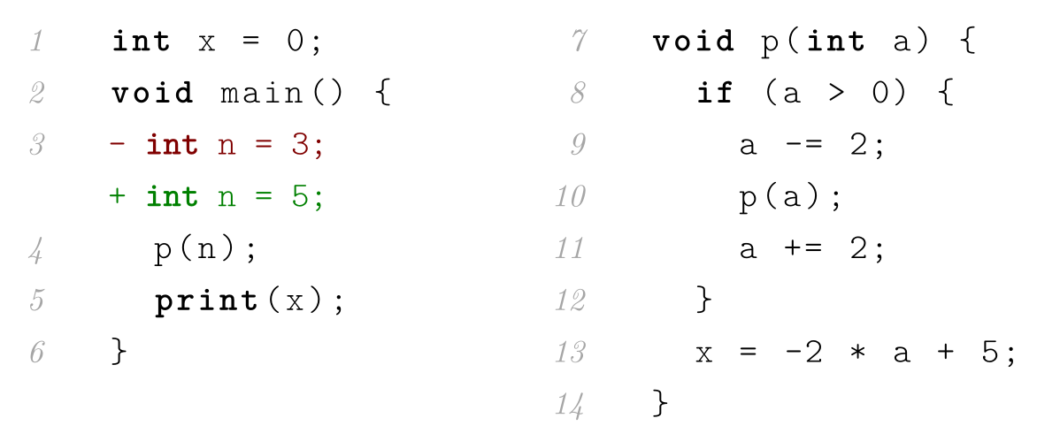
Incremental Edits in DSGs
p @ { x ↦ [0,0];
a ↦ [3,3] }
p @ { x ↦ [0,0];
a ↦ (-∞,3] }
main @ {x ↦ [0,0]}
{x ↦ [0,0]}
int n = 3;
{x ↦ [0,0]; n ↦ [3,3]}
p(n);
{x ↦ [-1,-1]; n ↦ [3,3]}
print(x);
{x ↦ [-1,-1];
n ↦ [3,3]}
{x ↦ [0,0]; a ↦ [3,3]}
if (a > 0) {
{x ↦ [0,0]; a ↦ [3,3]}
a -= 2;
{x ↦ [0,0]; a ↦ [1,1]}
p(a);
{x ↦ [-1,∞);a ↦ [1,1]}
a += 2;
{x ↦ [-1,∞);a ↦ [3,3]}
} {x ↦ [-1,∞);a ↦ [3,3]}
x = -2 * a + 5;
{x ↦ [-1,-1];
a ↦ [3,3]}
{x ↦ [0,0]; a ↦ (-∞,3]}
if (a > 0) {
{x ↦ [0,0]; a ↦ [0,3]}
a -= 2;
{x ↦ [0,0]; a ↦ [-2,1]}
p(a);
{x ↦ [-1,∞); a ↦ [-2,1]}
a += 2;
{x ↦ [-1,∞); a ↦ [0,3]}
} {x ↦ [-1,∞]; a ↦ (-∞,3]}
x = -2 * a + 5;
{x ↦ [-1,∞);
a ↦ (-∞,3]}
int n = 3; int n = 5;
callee summaries are unaffected, since they are denotational not operational
Notes:
By the same intuition as we used for intraprocedural analysis: we know there is a sound/terminating algorithm, so we should be able to dynamically extend our dependencies and rely on widening to ensure termination

Slide 59




DSG Operational Semantics
demand-driven analysis is govern by three mutually-inductive rules: abstract value queries...
incremental edit/dirtying semantics:
… procedure summary queries ...
writing s to n in this DSG...
… yields this updated DSG.
a query at l under entry state φ ...
… yields φ’ and updated DSG
… then we can get unstuck and produce this updated DSG
computing a fixed point in the (ρ,φ) DAIG ...
if we’re stuck at n in the (ρ,φ) DAIG ...
… with a query for the (ρ’,φ’) DAIG ...
… and in-place fixed points.
we have proofs of:
termination of queries and edits,
from-scratch consistency wrt tabulation,
and soundness of analysis results
… yields this updated DSG.
*we’re eliding some details here, of course

Slide 60


Implementation & Evaluation
Can we apply demanded analysis to real-world programs?
integrate with tree-sitter incremental parsers
- incrementality is baked in: not just the
solver engine but also frontend and IR
10 BugSwarm program pairs,
averaging ~45k LOC, ~5k procedures
tabulation in an interval domain:
batch: ~48k states computed (on avg.)
demand-driven: 15.1%
incremental: 3.2%
d-d & incremental: 0.1%
implement DSG structure and algorithms
- ~4k lines of OCaml on top of DAIG framework
- same domain expressivity as described earlier,
but with call/return semantics added
analyze program pairs from BugSwarm dataset
- open-source Java programs mined from GitHub
- real bug fixes: each pair consists of a buggy “fail”
version and a fixed “pass” version
Notes:
By the same intuition as we used for intraprocedural analysis: we know there is a sound/terminating algorithm, so we should be able to dynamically extend our dependencies and rely on widening to ensure termination

Slide 61
Existing Approaches
Intraprocedural Analysis and Unrolling
Demanded Summarization
Conclusions & Future Work
Benno Stein
Thesis Defense
University of Colorado Boulder
March 30, 2022

Slide 62
Practical Considerations
none of which are true in practice!
We’ve made some simplifying assumptions to this point
- unlimited memory to cache/memoize analysis results
cache invalidation and “condensing” DAIGs to two-state summaries in DSGs
- analysis interactions take place over one continous session
persisting summaries across sessions and sending them between multiple clients
- maximum precision is always required. (w.r.t. batch analysis)
weakening summaries to trade precision for reuse
see the thesis for details!
Notes:
By the same intuition as we used for intraprocedural analysis: we know there is a sound/terminating algorithm, so we should be able to dynamically extend our dependencies and rely on widening to ensure termination

Slide 63
Future Directions
customizability of the underlying abstract interpretation
- more diverse widening strategies
- analysis direction / exploration algorithms
- sparse analysis
integrations, tooling, and user studies
- IDE integrations and/or better CLI tools
- evaluate developer workflows and analysis interactions
Notes:
By the same intuition as we used for intraprocedural analysis: we know there is a sound/terminating algorithm, so we should be able to dynamically extend our dependencies and rely on widening to ensure termination

Slide 64
Thank you!
… to everyone who helped along the way
(far too many to list)
… to you for being here
… for your questions?
Benno Stein
Thesis Defense
University of Colorado Boulder
March 30, 2022
icons and clip-art credit to Freepik / flaticon.com

Slide 65



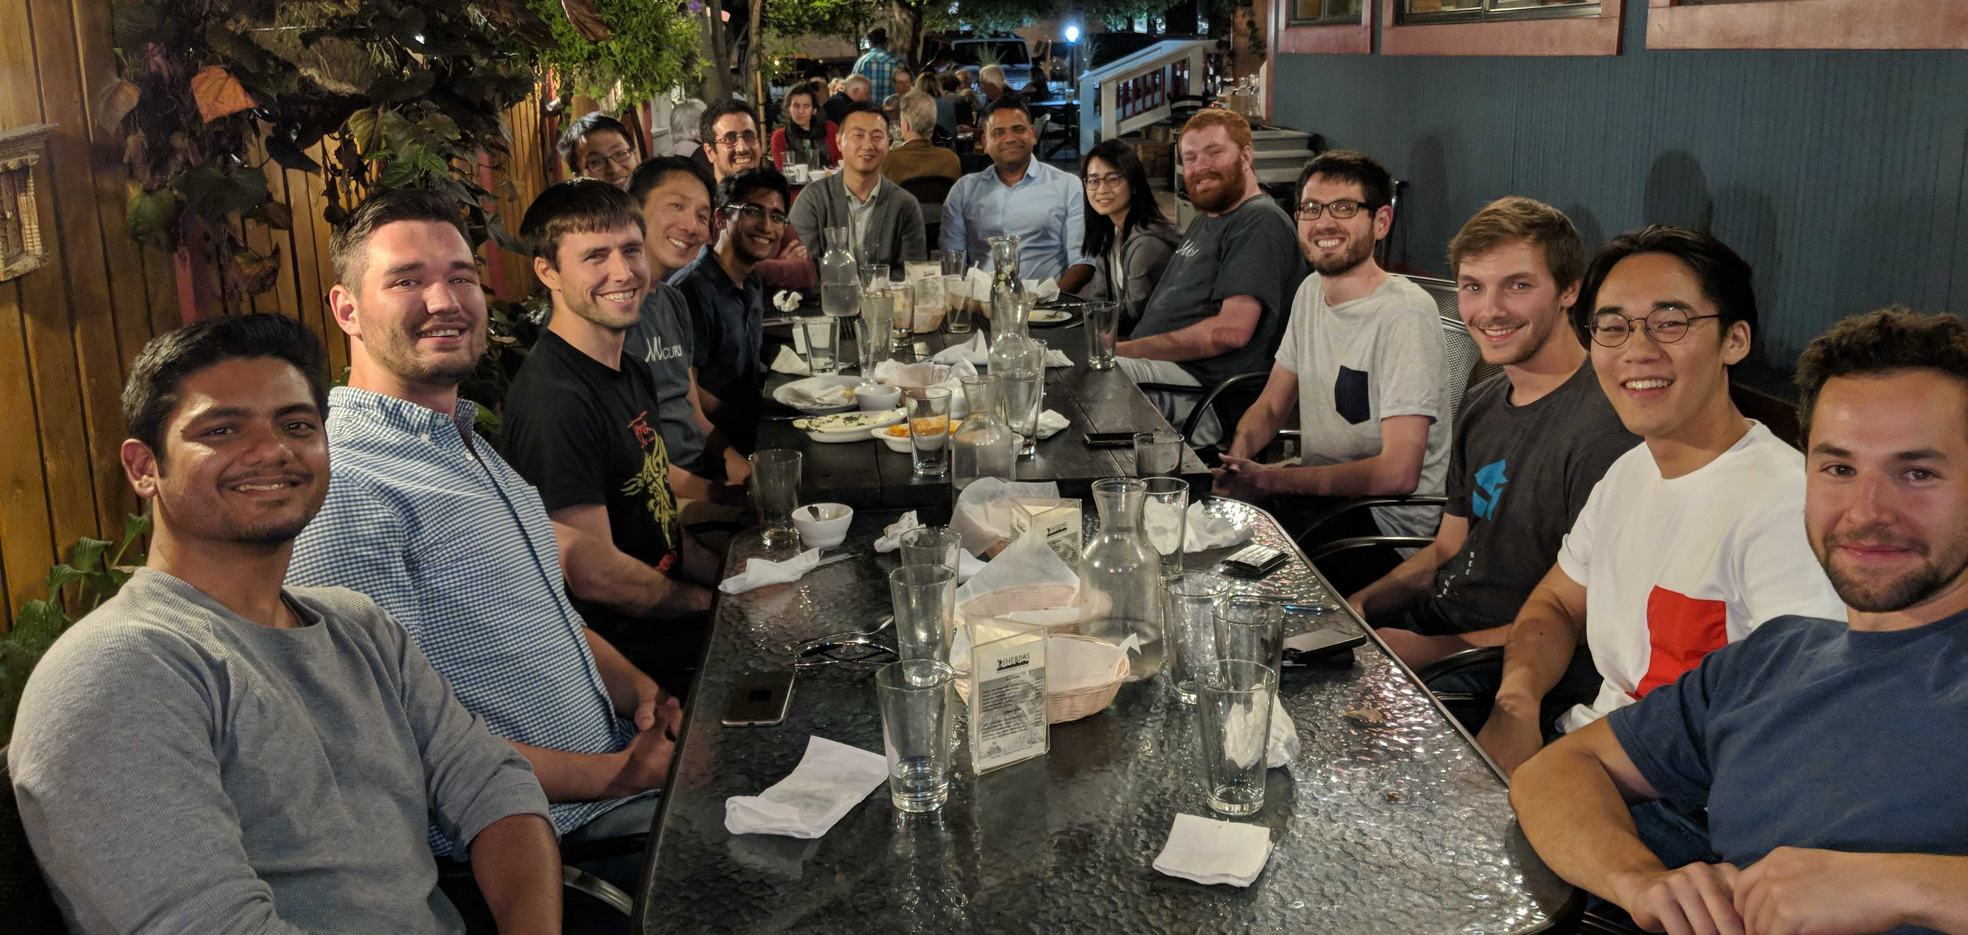



Thank you!
… to everyone who helped along the way especially:
- Evan
- Manu
- Matthew
- CUPLV labmates past and present
- Mom, Dad
- Nat, Elena
- Lucie
… to you for being here
… for your questions?
Benno Stein
Thesis Defense
University of Colorado Boulder
March 30, 2022

Slide 66
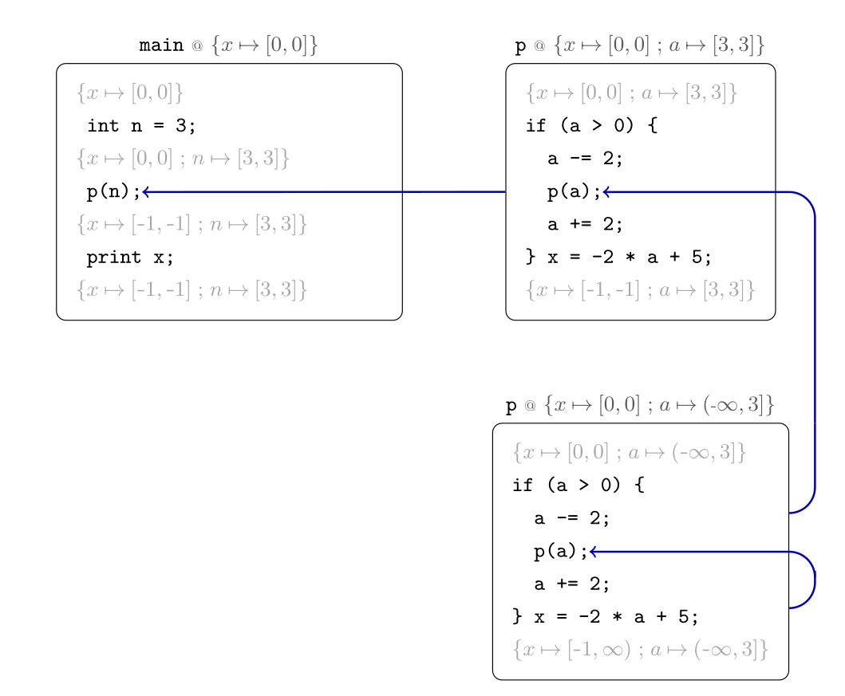
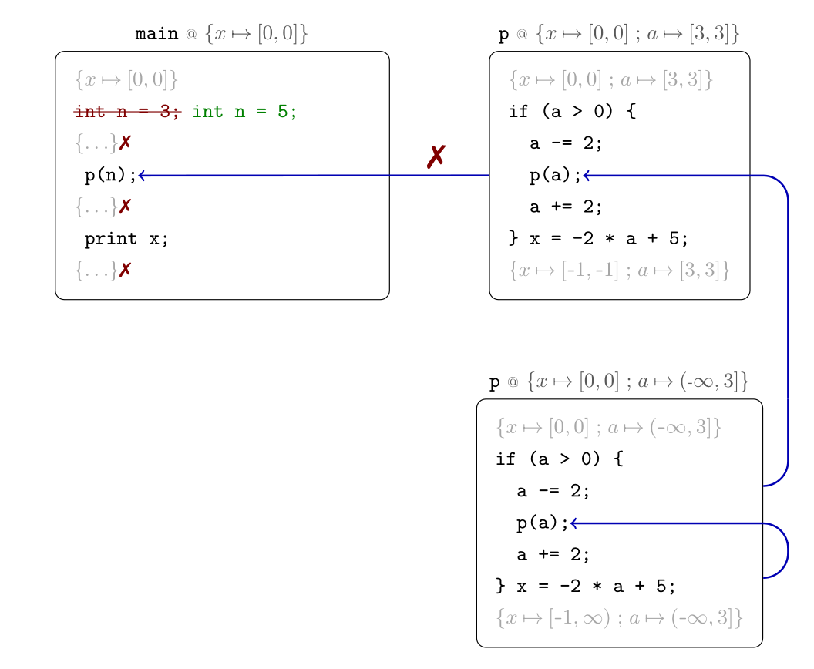
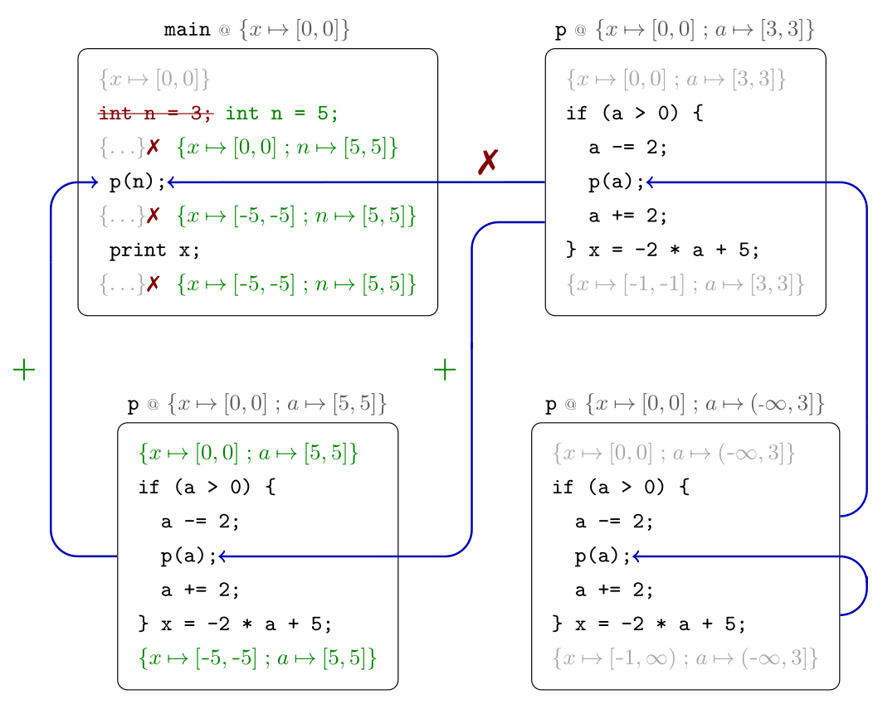
Compositionality
Callees of edited procedure are unaffected!
No new fixed point computation is needed – previously computed summaries of p can be applied
Notes:
By the same intuition as we used for intraprocedural analysis: we know there is a sound/terminating algorithm, so we should be able to dynamically extend our dependencies and rely on widening to ensure termination

Slide 67
An interprocedural example

Slide 68
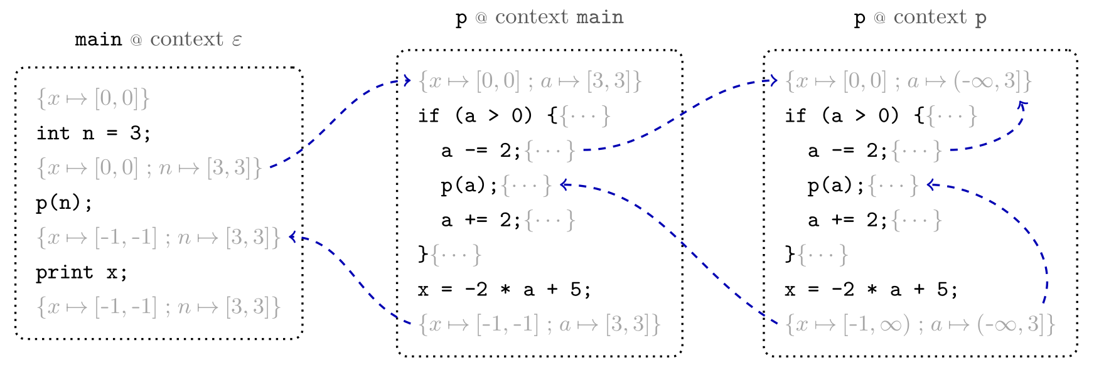
An interprocedural example
operational approach:
analyze each procedure separately for each (abstract) calling context
blue arrows denote semantic dependencies, though they coincide here with data flow

Slide 69
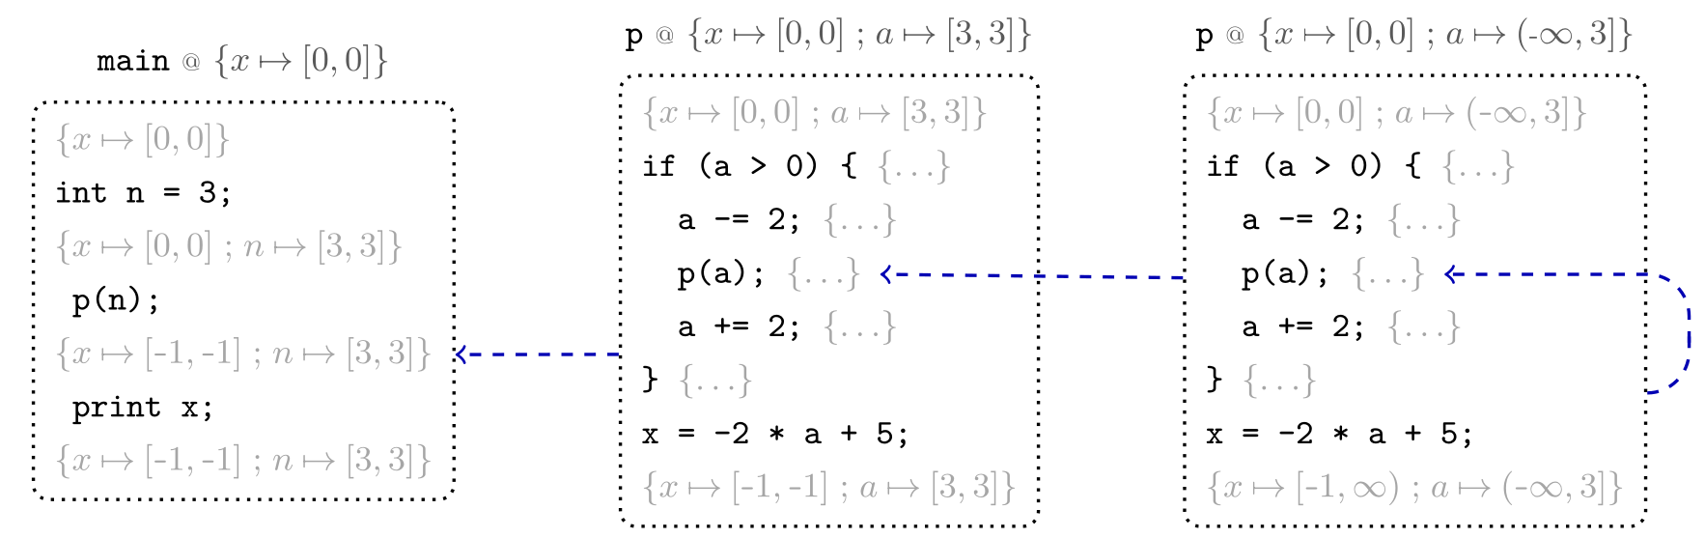
An interprocedural example
denotational approach:
analyze each procedure separately for each (abstract) entry state
both approaches work well for batch analysis of this example!

Slide 70
An interprocedural example

Slide 71
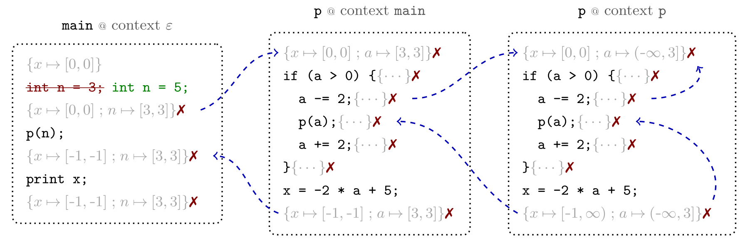
An interprocedural example
operational approach:
all states marked by an X may be affected by the edit – sound incremental dirtying must follow call and return edges

Slide 72
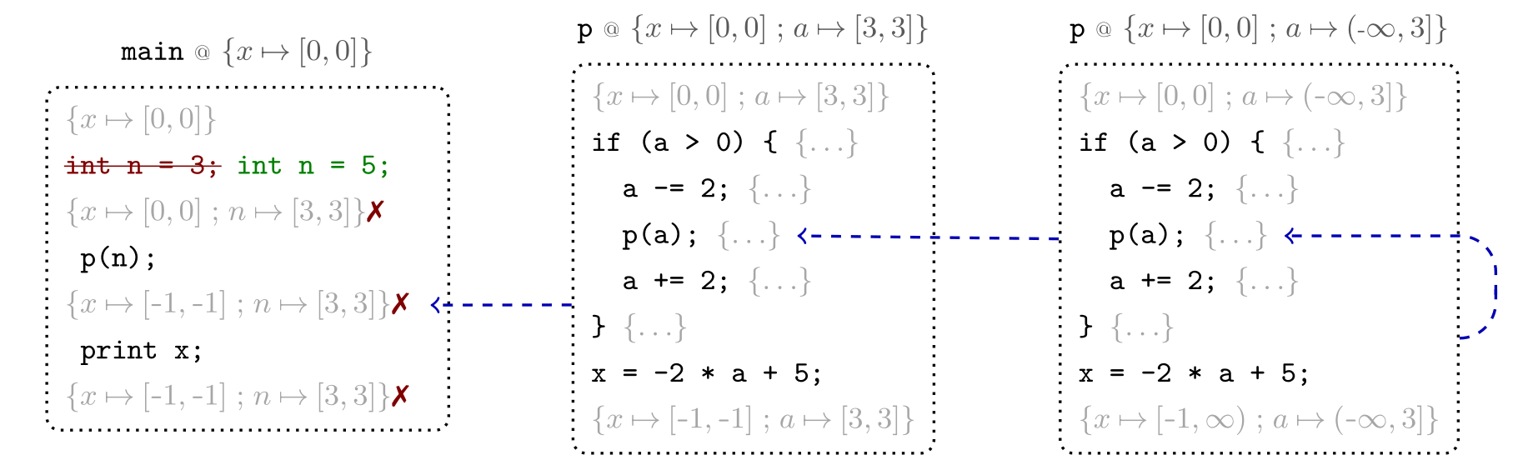
An interprocedural example
denotational approach:
all states marked by an X may be affected by the edit – sound incremental dirtying only needs to follow return edges

Slide 73
Interprocedural (Batch) Analysis
call strings approach:
analyze each procedure separately for each (abstract) calling context
main
ε
bar
main
bar
bar
we generalize from “call strings” and say operational approach to include related context-sensitivity techniques
foo
main
key feature: data flow is propagated operationally through the interprocedural flow graph, and different instances of a procedure are distinguished by an abstraction of the context
foo
bar
Two Approaches to Interprocedural Data Flow
Analysis. Micha Sharir and Amir Pnueli, 1978.

Slide 74
Interprocedural (Batch) Analysis
functional approach:
analyze each procedure separately for each (abstract) entry state
this algorithm is a.k.a. tabulation, as it builds a table of
(partial) procedure summaries
main
φ0
bar
φ2
bar
φ4
procedure | entry state | exit state
main | φ0 | φ0’
foo | φ1 | φ1’
bar | φ2 | φ2’
foo | φ3 | φ3’
bar | φ4 | φ4’
foo | φ5 | φ5’
foo
foo
we generalize from “functional” and say denotational approach to include related summary-based techniques
φ1
φ3
foo
φ5
key feature: input/output procedure summaries are computed and composed to derive semantics of progressively larger program parts
Two Approaches to Interprocedural Data Flow
Analysis. Micha Sharir and Amir Pnueli, 1978.

Slide 75
Domain Expressivity
Interval Analysis
- abstract values [x,y] model numbers { i | x ≤ i ≤ y}
- used to verify array accesses in-bounds in a JS data structure library
Shape Analysis
- separation logic formulae over linked-list-segment primitive lseg(x,y)
- used to verify memory-safety of linked-list append, reverse, etc.
Octagon Analysis
- invariants of the form ±x±y≤c
- built with APRON – optimized open-source numerical domains written in C

Slide 76
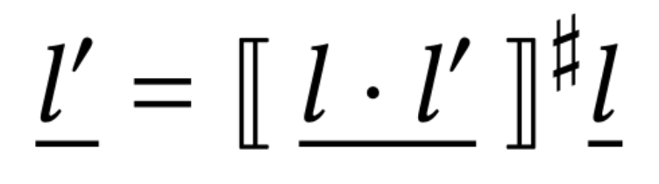
Demand-Driven Abstract Interpretation
demand-driven query:
What is the abstract state at l’?
l
?
l·l’
s
l
s
l’
?
Internal
query
for l·l’
l’

Slide 77
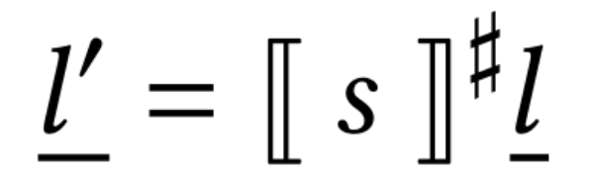
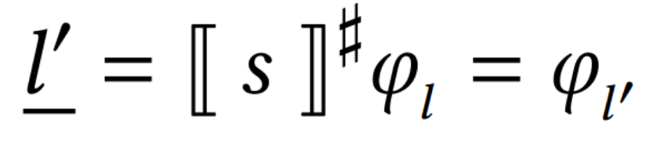
Demand-Driven Abstract Interpretation
recursively compute transitive dependencies
demand-driven query:
What is the abstract state at l’?
l
?
l·l’
s
l
s
l’
?
Internal
query
for l
l’

Slide 78
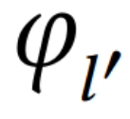
Demand-Driven Abstract Interpretation
demand-driven query:
What is the abstract state at l’?
l
?
l·l’
s
l
s
l’
?
l’

Slide 79
Incremental Abstract Interpretation
incremental edit:
modify statement s to s’
i.e. write s’ to l·l’
l
l·l’
s
s’
l
l
eagerly dirty
forwards-reachable analysis results
s
s’
l’
?
l’
l’
...recursively
Subsequent queries only need to recompute affected results!

Slide 80
DAIG Semantics
,
,
if the initial DAIG before a query/edit is a valid analysis state...
...then so is the final DAIG, after the query/edit.

