Slide 1

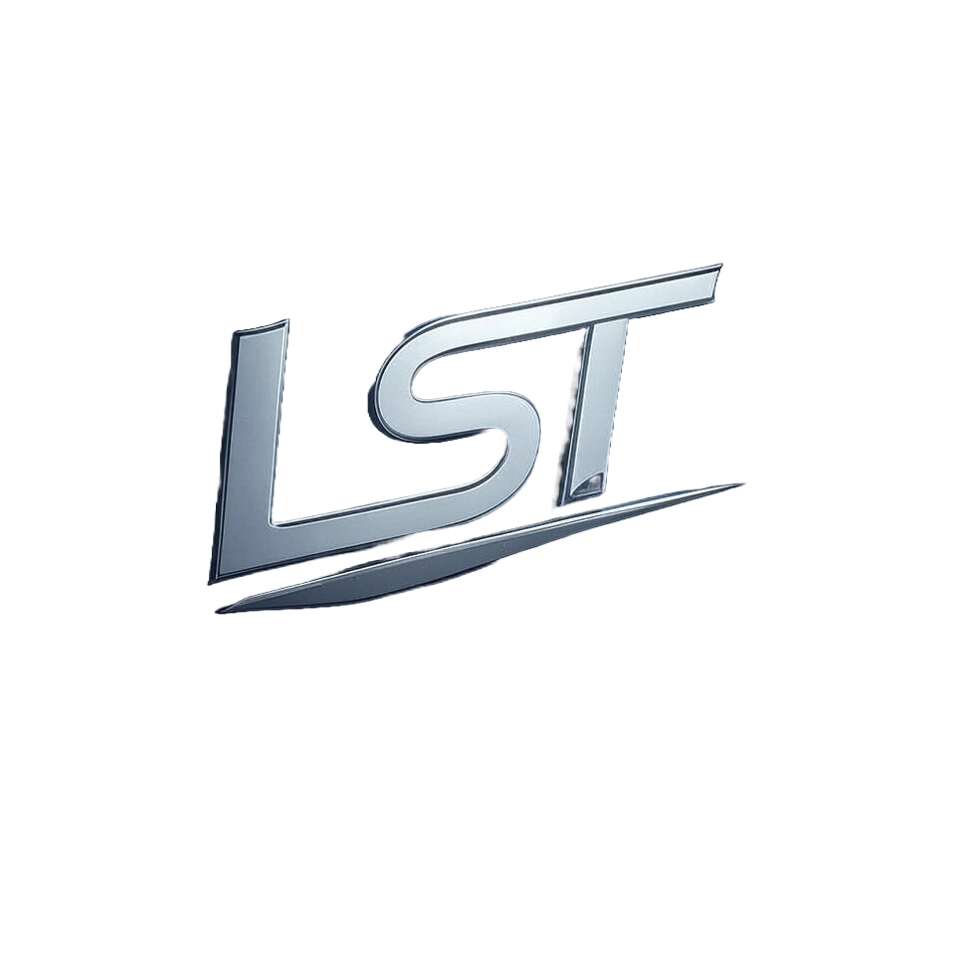
Cosmos Due Diligence Report

Slide 2
Table of Contents
4. Team and Governance

Slide 3
4. Team and Governance

Slide 4
How are governance proposals submitted, voted on, and executed?
In Cosmos' governance ecosystem: **Proposal Submission and Discussion:** Proposals are submitted by validators or delegates (token holders who delegate their voting power). These proposals undergo an initial review phase where they can be discussed across various platforms like forums, social media channels dedicated to Cosmos discussions. **Voting Process on the Cosmos Hub:** - **Validators' Voting Power:** Validators hold governance tokens and have a vested interest in maintaining network security. Their votes are weighted by their bonded stake. - **Delegation Mechanism (DPC):** Delegates can vote for other validators, allowing token holders to influence decisions indirectly through trusted delegates. Proposals posted on the Cosmos Hub undergo multiple voting rounds: 1. Initial Proposal Round: Validators cast preliminary votes after reviewing discussions and proposals in advance channels like forums or social media. 2. (Continued on next slide...)

Slide 5
(Continued) How are governance proposals submitted, voted on, and executed?
Subsequent Rounds (if needed): Additional discussion periods may occur before finalizing a proposal for execution, allowing further refinement based upon community feedback. **Execution of Proposals:** - **Quorum Thresholds & Execution Criteria:** - A successful governance change requires meeting predefined quorum thresholds to ensure broad consensus. - If the threshold is met after sufficient voting rounds and discussions (typically involving multiple stages), a proposal can be executed immediately. This immediate execution ensures that changes are applied swiftly once they have garnered enough support. **Types of Proposals:** 1. **Single Action Proposal Contracts (SAPCs):** Used for straightforward, one-time modifications to the protocol. 2. (Continued on next slide...)

Slide 6
(Continued) How are governance proposals submitted, voted on, and executed?
**Delegating Proposal Contracts (DPCs):** Enable more complex governance logic and continuous utilization by delegators without restrictions on their voting power or delegation rights across different layers. The Maker platform's internal variables can be modified through these proposals: - SAPCs: Directly modify a single variable at once, applying the change immediately upon execution. - DPCs: Allow for ongoing adjustments to multiple governance parameters over time and provide flexibility in how changes are implemented within defined constraints (e.g., magnitude restrictions). In summary: Cosmos' decentralized governance process involves proposal submission by validators or delegates followed by community discussion. Proposals undergo a voting mechanism on the Cosmos Hub, with weighted votes based on bonded stakes of participating validators/donors. Multiple rounds may be required for thorough deliberation and consensus-building before execution if quorum thresholds are met. Proposals can either modify internal governance variables directly (SAPCs) or allow complex adjustments over time through DPCs without restrictions in delegation rights across layers, ensuring a flexible yet secure approach to decentralized decision-making within the Cosmos ecosystem.

