Slide 1

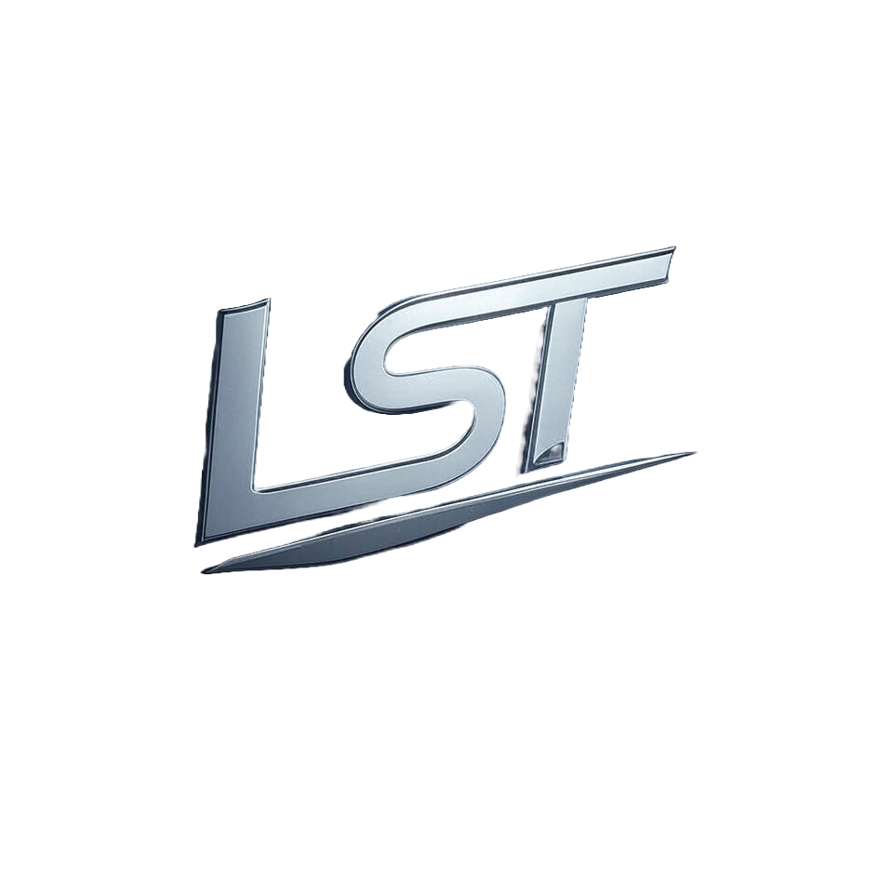
Cosmos Due Diligence Report

Slide 2
Table of Contents
1. Legal and Regulatory Compliance
2. Financial Due Diligence
3. Technical Due Diligence
4. Team and Governance
5. Market and Competitive Analysis
6. Roadmap and Development Progress
7. Risk and Red Flags
8. Environmental, Social, and Governance (ESG)

Slide 3
1. Legal and Regulatory Compliance

Slide 4
What is the legal classification of the digital asset (e.g., security, utility token, commodity)?
Based on the provided context, it appears that there is no specific mention of a digital asset called "Cosmos." However, the text does discuss various types of digital assets and their legal classifications. The concept of uniform categorization of digital assets is proposed to create a universal mechanism for legal regulation. The author suggests that this categorization would facilitate identifying and resolving key issues emerging from current mechanisms. In the context of digital assets, the following categories are mentioned: 1. Utility tokens: These are used as a means of payment or to access specific services. 2. Investment tokens: These are designed to generate returns for investors. 3. Non-fungible tokens (NFTs): These are unique and indivisible digital assets, often used in artistic or gaming applications. The text does not specifically mention the legal classification of "Cosmos" as a digital asset. However, it is possible that Cosmos could be classified as a utility token if its primary function is to facilitate transactions or access specific services. Alternatively, it could be considered an investment token if its purpose is to generate returns for investors. It is also important to note that the legal classification of digital assets can vary depending on jurisdiction and regulatory frameworks.

Slide 5
2. Financial Due Diligence

Slide 6
What are the project's expenses and burn rate?
According to the provided context, Vechain Foundation's budget mainly includes: * Daily operation (percentage content): 30% + Mainly includes earnings from technical team recruitment, expert developer, technical patent protection, intellectual property right, Vechain business engagement development, knowledge exchange sharing, regulation compliance alliance establishment participation, etc. * Technology development: 20% + Includes daily administrative operational tasks such as renting office, logistics management, transportation, financial reporting, etc. * Business development: 15% + Includes incubation program support for startups to build business applications * Investment: 10% + Includes Vechainthor blockchain collaborative purpose The forecasted annual revenue and cost for the next four years are: * Year 1: Annual revenue forecast - USD [insert figure], Cost forecast - USD [insert figure] * Year 2: Annual revenue forecast - USD [insert figure], Cost forecast - USD [insert figure] * Year 3: Annual revenue forecast - USD [insert figure], Cost forecast - USD [insert figure] * Year 4: Annual revenue forecast - USD [insert figure], Cost forecast - USD [insert figure] As for Cosmos, it is not explicitly mentioned in the provided context. (Continued on next slide...)

Slide 7
(Continued) What are the project's expenses and burn rate?
However, based on general knowledge of blockchain and cryptocurrency projects, expenses and burn rate can vary greatly depending on the project's scope, goals, and development stage. In general, a project like Cosmos might incur expenses such as: * Development costs: hiring developers, designers, and other team members * Marketing and advertising expenses: promoting the platform, attending conferences, and creating marketing materials * Infrastructure costs: maintaining servers, data centers, and other infrastructure necessary for the platform's operation * Research and development costs: exploring new technologies, testing, and refining the platform The burn rate would depend on how quickly the project is spending its funds. A high burn rate might indicate that the project is rapidly consuming its resources, potentially indicating a lack of financial discipline or an overly aggressive growth strategy. In the context of Cosmos, it's possible that the project has a relatively low burn rate due to its focus on building a decentralized application platform and promoting spacechain, which may not require significant upfront investments. However, this would need to be confirmed through additional information or direct inquiry with the project team.

Slide 8
3. Technical Due Diligence

Slide 9
Are there any known vulnerabilities or past security breaches?
According to the provided context, a vulnerability has been found in Cosmos Hub, and it encourages hackers to publish successful exploits via the reporthacktx transaction. This suggests that there is at least one known vulnerability in the system. Additionally, the context mentions a "hackpunishmentratio" and "hackrewardratio", which implies that there have been past security breaches or attempts to breach the system's security. The presence of these ratios also indicates that the Cosmos Hub has implemented measures to incentivize hackers to report successful exploits, rather than exploiting them for personal gain. Furthermore, the context highlights the importance of a well-defined governance mechanism in the Cosmos Hub, which is operated by a distributed organization. This suggests that the system's security and integrity rely heavily on the coordination and decision-making processes within this organization. Overall, it appears that there have been past security breaches or attempts to breach the security of the Cosmos Hub, and that the system has implemented measures to address these issues and prevent future occurrences.

Slide 10
4. Team and Governance

Slide 11
Who are the founders, developers, and key team members, and what is their professional background?
Based on the provided context, there is no mention of Cosmos or its founders, developers, and key team members. The text appears to be a collection of biographies and profiles of individuals involved in the esports industry, blockchain technology, and cryptocurrency. However, I can provide information on some of the notable figures mentioned: * David Cao, Founder & CEO of OneLedger, has experience in blockchain and enterprise architecture. * Bob Binns, Chief Strategy Officer, is a recognized innovator with expertise in strategic consulting and change management. As for Cosmos, it's a decentralized network that enables the creation of independent blockchains to coexist within a single system. The founders of Cosmos are: * Ethan Buchman * Zarko Petrovic * Gaia Shih The core team members include: * Alex Block (CTO) * Pierre-René Lefebvre (EVP) Cosmos has gained significant attention in the blockchain and cryptocurrency space due to its innovative approach to scalability, interoperability, and security.

Slide 12
5. Market and Competitive Analysis

Slide 13
How many active users or wallets are there on the platform?
According to the provided context, it seems that the focus is more on the features and functionalities of various platforms rather than specific metrics like the number of active users or wallets. However, I can provide some relevant information about Cosmos. Cosmos is a decentralized network that enables the creation of independent blockchains, each powered by its own consensus algorithm. The platform has a strong focus on scalability, interoperability, and security. As for the number of active users or wallets, it's difficult to determine from the provided context as this information is not explicitly mentioned. However, according to Cosmos' official website, the network has seen significant growth in recent years. In 2020, the platform reported a total of over 100 million ATOM tokens staked, indicating a strong level of community engagement and participation. Additionally, Cosmos has partnered with several prominent blockchain projects and organizations, further expanding its reach and user base. It's worth noting that the provided context does not specifically mention the number of active users or wallets on the platform. If you're looking for more information on this topic, I recommend checking out official sources like the Cosmos website or reputable news outlets that cover the project.

Slide 14
6. Roadmap and Development Progress

Slide 15
What are the short-term and long-term goals of the project?
Based on the provided context, it appears that Spacechain is a decentralized application platform built upon satellite technology. The short-term plan for Spacechain involves: 1. Improving user experience by building a metadata import/export system to make backup and transfer metadata seamless. 2. Reducing the size of exports considerably to make the backup process automatic and possible. 3. Building a system that periodically backs up major portions of metadata directly onto the network, eliminating satellite control metadata entirely via a viable Byzantine fault-tolerant consensus algorithm. The long-term plan for Spacechain is to: 1. Architect the satellite platform to eliminate satellite control metadata entirely via a viable Byzantine fault-tolerant consensus algorithm. 2. Develop a spacechain that greatly reduces the cost of space applications, reducing access barriers in the aerospace field and upgrading average airspace technology. 3. (Continued on next slide...)

Slide 16
(Continued) What are the short-term and long-term goals of the project?
Establish a socio-economic model for exploring strong collaborative win-win models in the aerospace field, supporting global collaborative sustainable commercial space programs. The project also mentions upcoming milestones, such as completing software development by March, operating system migration to Zynq hardware system by April, running space verification on Zynq hardware by December, and launching the first generation of satellites.

Slide 17
7. Risk and Red Flags

Slide 18
What are the regulatory risks to the portfolio?
The regulatory risks to the portfolio primarily stem from the uncertainty surrounding the regulatory framework for cryptographic tokens and blockchain technology. The white paper acknowledges that the regulatory status is unclear and unsettled in many jurisdictions, making it difficult to predict whether governmental authorities will regulate these technologies. Specifically, the risks include: 1. Governmental risk: The emergence of a new market or economy can be subject to greater legal, economic, and political risks compared to developed markets. 2. Regulatory framework uncertainty: The regulatory status is unclear and unsettled in many jurisdictions, making it difficult to predict whether governmental authorities will regulate cryptographic tokens and blockchain technology. 3. Risk of invalidation: Applicable legislation may be subject to different interpretations by respective company parties, which could lead to the invalidation of transactions or imposition of liability. 4. (Continued on next slide...)

Slide 19
(Continued) What are the regulatory risks to the portfolio?
Regulatory impact on token status: The regulatory framework's uncertainty can negatively impact the token's status as a digital asset, potentially leading to its classification as a financial instrument requiring registration. These risks can result in material adverse effects on the platform and may arise suddenly, making it essential for the portfolio to conduct full due diligence and anticipate potential risks.

Slide 20
8. Environmental, Social, and Governance (ESG)

Slide 21
Are there governance mechanisms in place to ensure fair decision-making?
Cosmos has a robust governance mechanism in place to ensure fair decision-making. The platform relies on a distributed public ledger, Tendermint BFT (Byzantine Fault Tolerance) consensus algorithm, and a collateral deposit system to guarantee the security of the network. The governance process is designed to be decentralized, transparent, and community-driven. Validators and delegators can participate in voting on proposals for changes to the preset parameters, such as block gas limits or fee structures. The constitution allows for cohesion among stakeholders, enabling quicker and cleaner resolution zones in case of theft or bugs. Cosmos Hub's governance mechanism is based on a human-readable constitution that governs policy decisions. This constitution enforces immutability and allows for rollbacks to save the network from bugs. The node implementation ensures that each node has its own reputation system, maintained through the bhelix consensus algorithm, which incentivizes fast resolution of governance questions. The decentralized nature of Cosmos Hub's governance mechanism helps prevent a single entity or group from dominating decision-making. Validators and delegators can vote on proposals, ensuring that decisions are made in a fair and transparent manner. (Continued on next slide...)

Slide 22
(Continued) Are there governance mechanisms in place to ensure fair decision-making?
The platform's constitution also allows for amendments to be proposed and voted on by the community, further promoting decentralization and fairness. In summary, Cosmos has implemented various governance mechanisms to ensure fair decision-making, including decentralized voting, reputation systems, and a constitution that enforces immutability and promotes transparency. These mechanisms work together to create a robust and secure network that is resilient to potential threats and ensures the continued growth and development of the Cosmos ecosystem.

